Slide 1
Hypermarket and Low-Priced Competition Event Study Analysis
Cummings, Mahoney, Posthumus
Monday, January 13

Slide 2
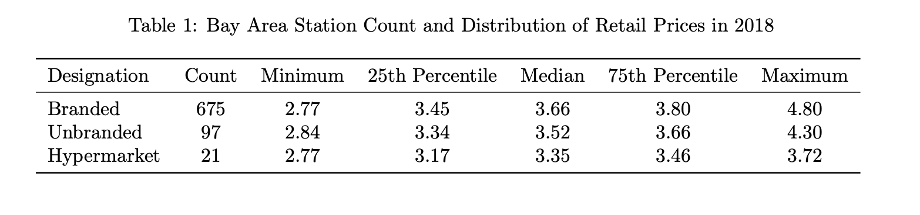
Project Motivation
Background: How do gas stations compete on price? Do they?
Research Question: What happens to nearby stations when a low-priced competitor enters a market?
Data: CDTFA-provided OPIS daily, gas station-level data on retail prices

Slide 3
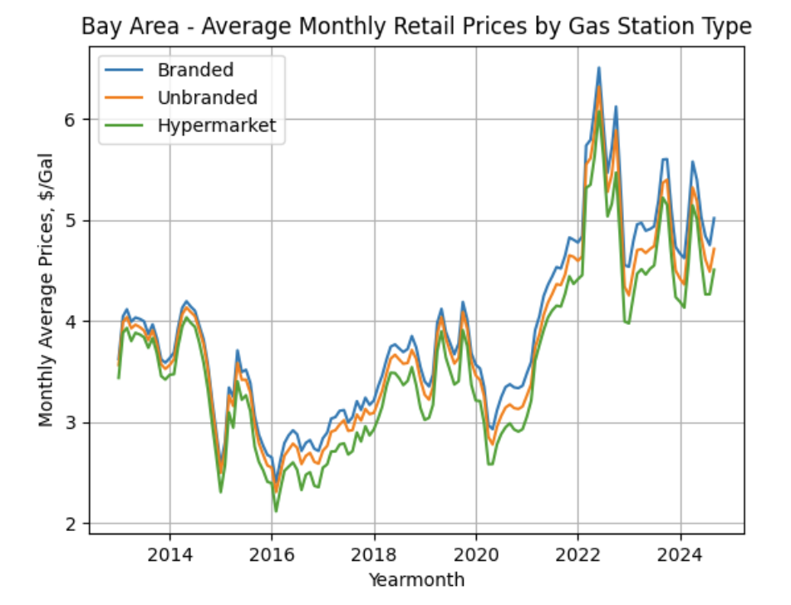
Price Heterogeneity by Gas Station Type

Slide 4
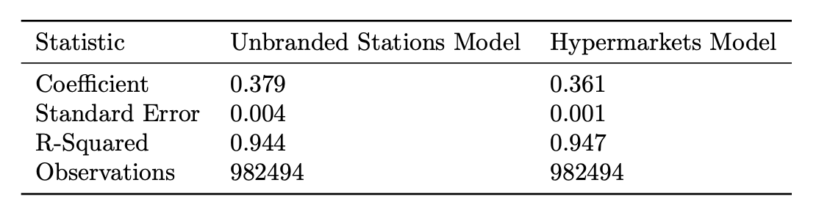
Cross Sectional Approach to Understanding Competition

Slide 5
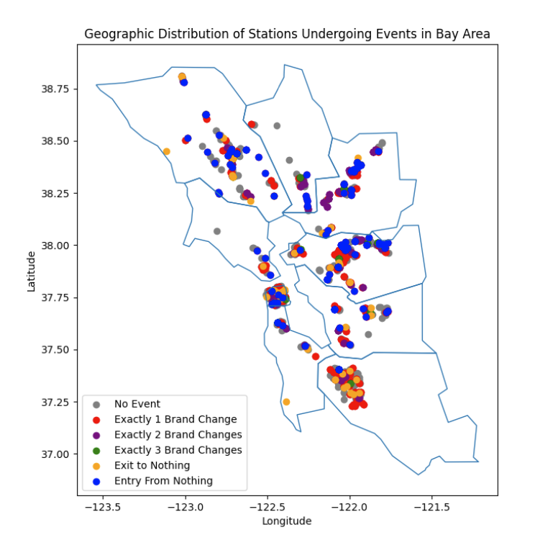
Classification of Events
We’re interested in 3 types of events:
Brand Change
A gas station ‘remains’ in a physical location, while its brand changes
Entry From Nothing
A gas station opens at a physical location at which there was no station previously
Exit to Nothing
A gas station closes, and no station replaces it at its physical location

Slide 6
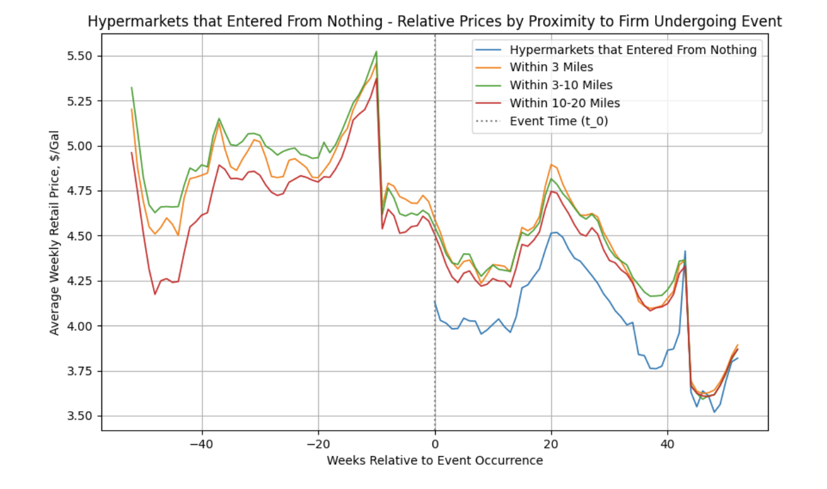
Dynamics Around Entries From Nothing

Slide 7
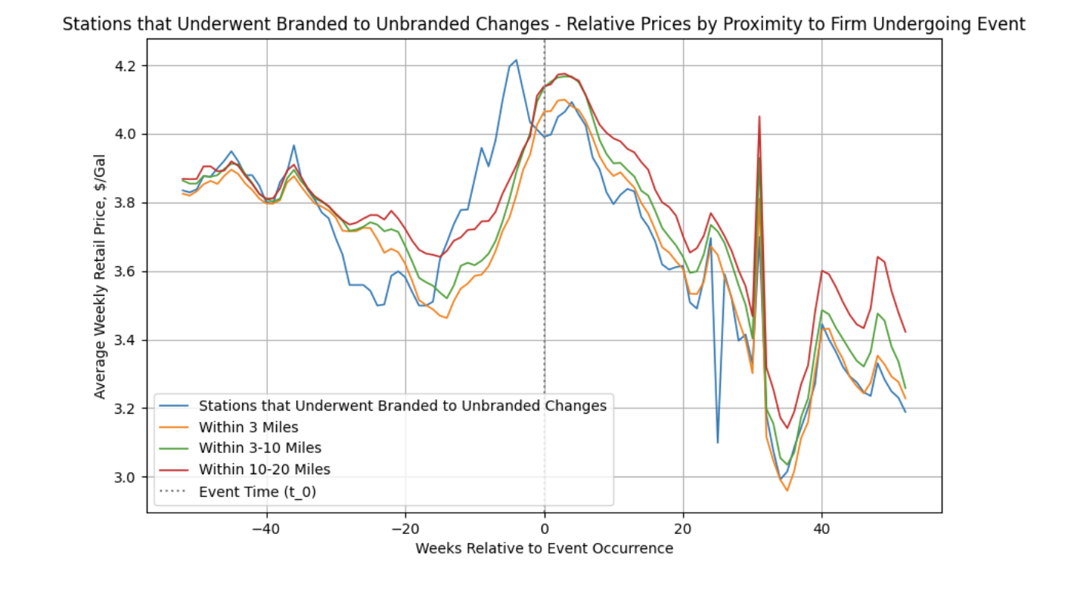
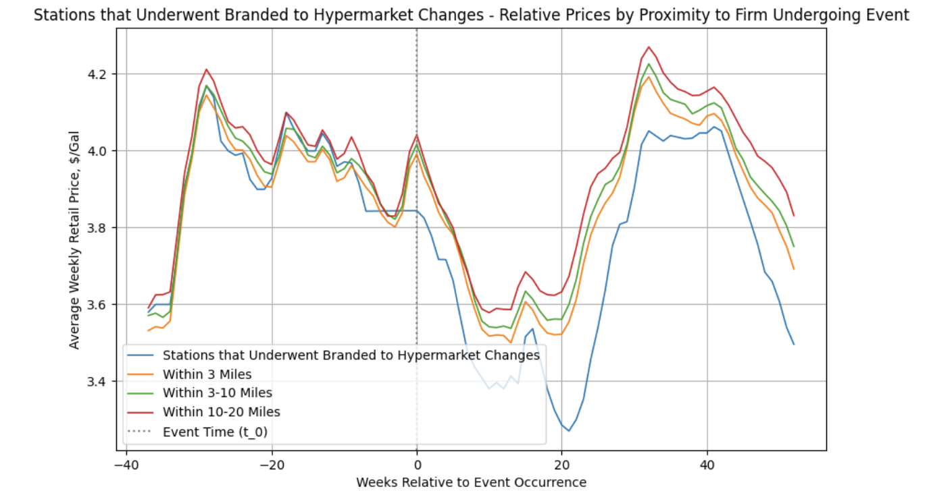
Dynamics Around Brand Changes

Slide 8
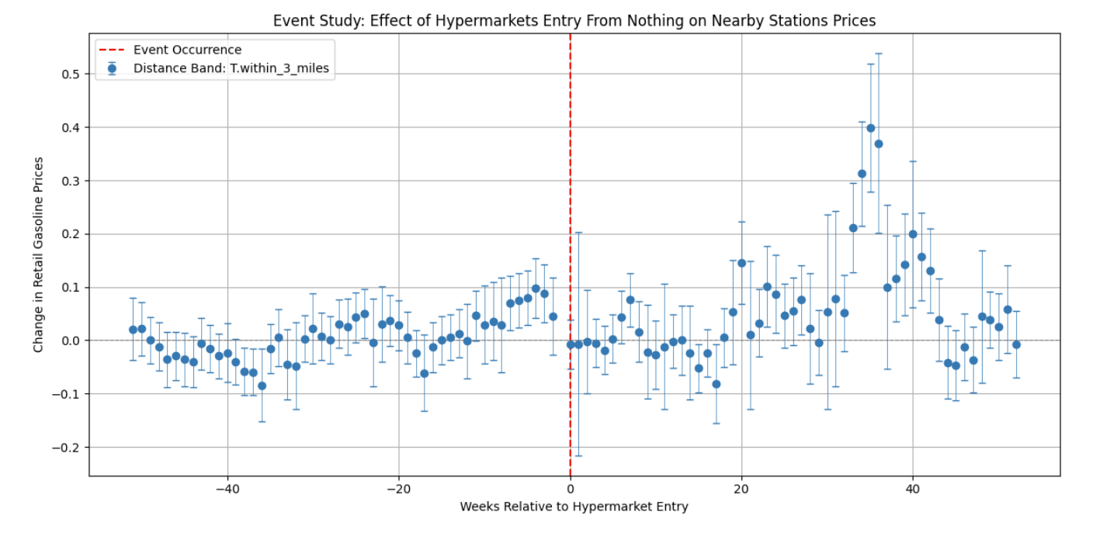
Event Study Analysis – Hypermarket Entry From Nothing

Slide 9
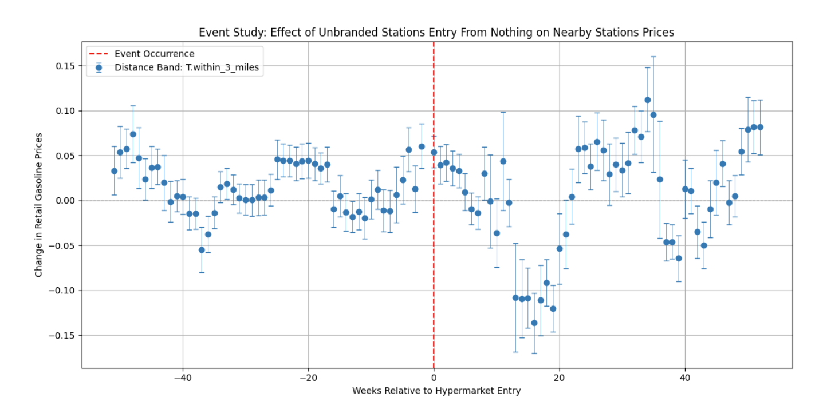
Event Study Analysis – Unbranded Entry From Nothing

Slide 10
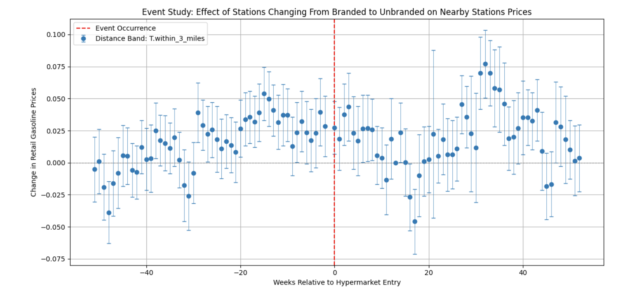
Event Study Analysis – Branded to Unbranded Brand Change

Slide 11
Implication and Next Steps
It doesn’t appear the entry of ‘low-priced competitors’ has any effect on nearby stations’ retail prices in the year after entry.
This suggests consumers’ cross-gas station type elasticity is quite low and there are significant preferences for branded, non-hypermarket gasoline.
Our next project will examine this elasticity to understand consumers’ patterns of consumption and preferences across different types of brands.

Slide 12
Appendix Materials

