Slide 1
OPIS Hypermarket Event Study Dataset Updates
Cummings, Mahoney, Posthumus
December 10, 2024

Slide 2
Agenda
Understanding OPIS Retail Data
Different Types of Events
Constructing Event Study Data
Summary Statistics By Event
Price Dynamics Around Events

Slide 3
Understanding OPIS Retail Data – Station Identifiers
Basic features of the Data:
Frequency: Daily
Geographic Coverage: Statewide (only CA)
Granularity: Individual gas station-level
Gas stations are identified by:
Coordinates (latitude/longitude)
Address (+ City, ZIP Code, and MSA)
Store Brand
Corporate Brand
Gas Brand
Product

Slide 4
Understanding OPIS Retail Data - Variables
OPIS has data on the following variables, w/summary stats included:
Variable | Minimum | 25th %tile | 50th | 75th | Maximum
Retail Price | 1.499 | 3.709 | 3.599 | 4.099 | 23.379
Tax | 0.015 | 0.63 | 0.703 | 0.796 | 1.107
Wholesale Price | 0.604 | 1.963 | 2.45 | 2.961 | 5.571
Margin | -2.362 | 0.286 | 0.436 | 0.626 | 20.395
Net | 0 | 2.402 | 2.895 | 3.376 | 22.257

Slide 5
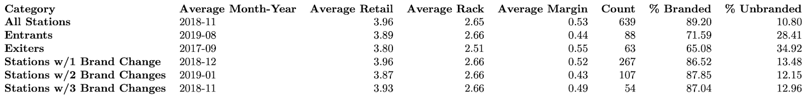
Different Types of Events
There are 3 types of events that can occur:
Entry from nothing
New station opens where there wasn’t one before
Exit to nothing
Station ceases to exist, no station replaces it at same location
Ownership/brand change
Station’s location remains constant, while store brand changes

Slide 6
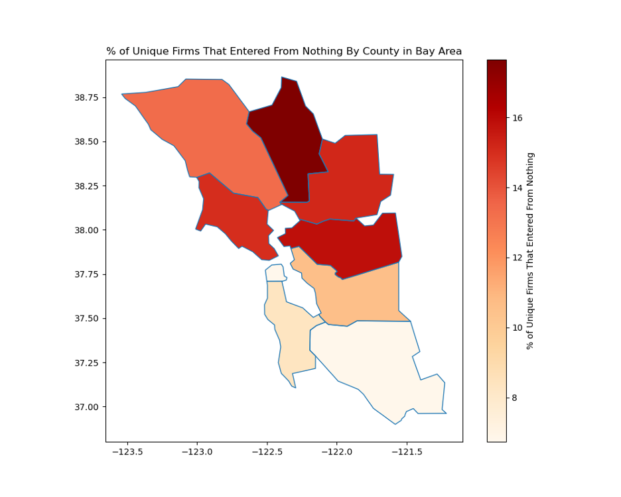
Relative Frequency of Events - Enter From Nothing

Slide 7
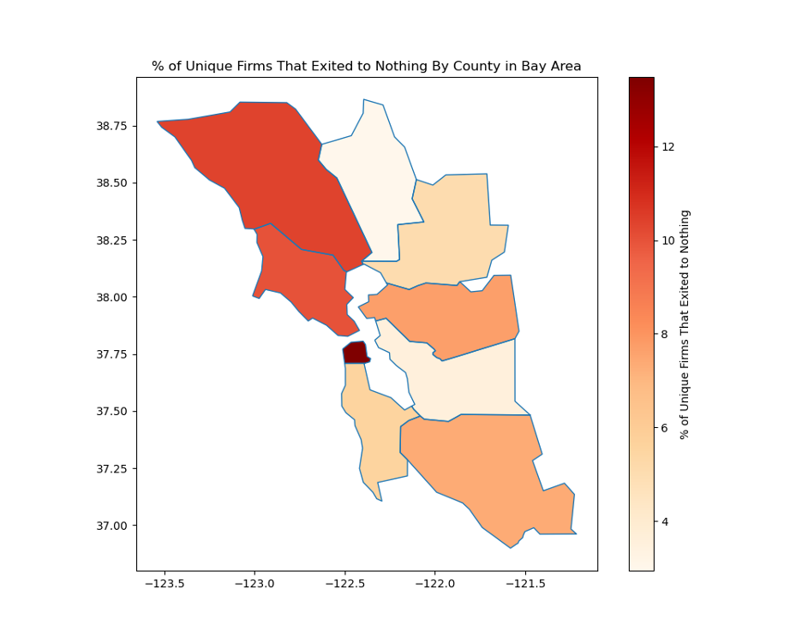
Relative Frequency of Events – Exit To Nothing

Slide 8
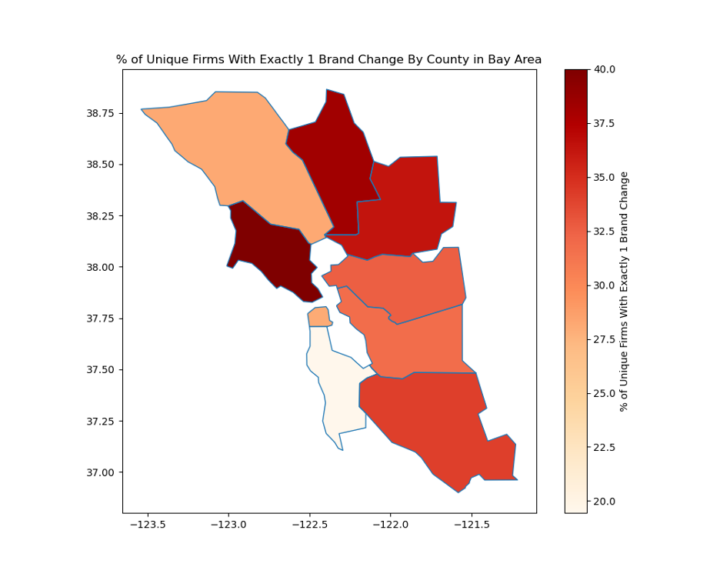
Relative Frequency of Events – Brand Changes

Slide 9


Dataset Creation
Central challenge: identifying stations within different geographical ‘donuts’ of firms undergoing event

Slide 10
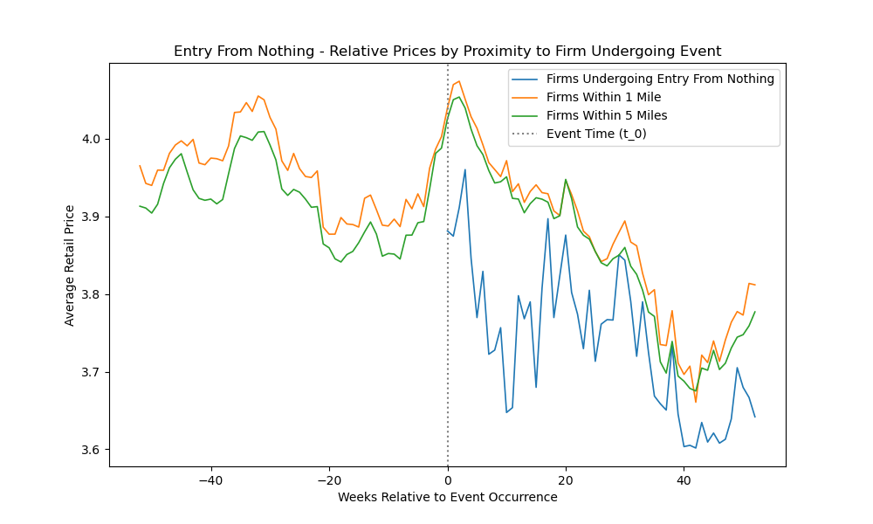
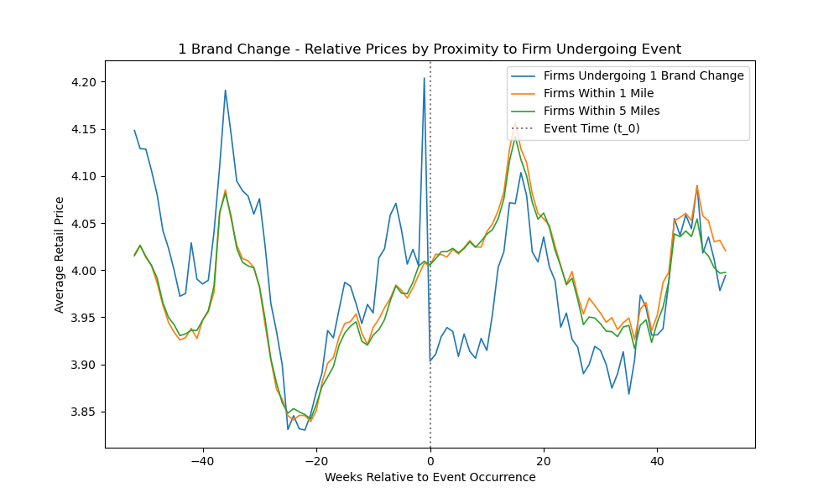
Price Dynamics Around Events

Slide 11
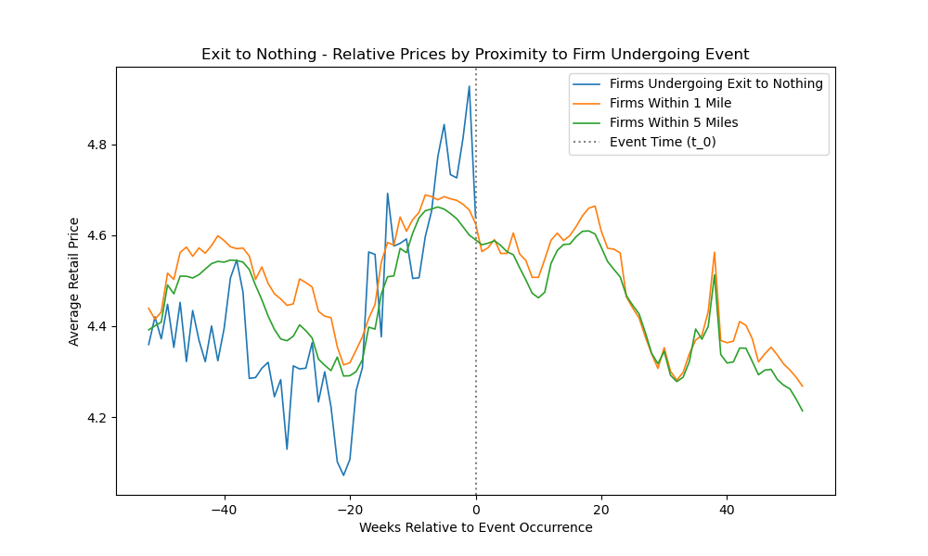
Price Dynamics Around Events

Slide 12
Price Dynamics Around Events

Slide 13
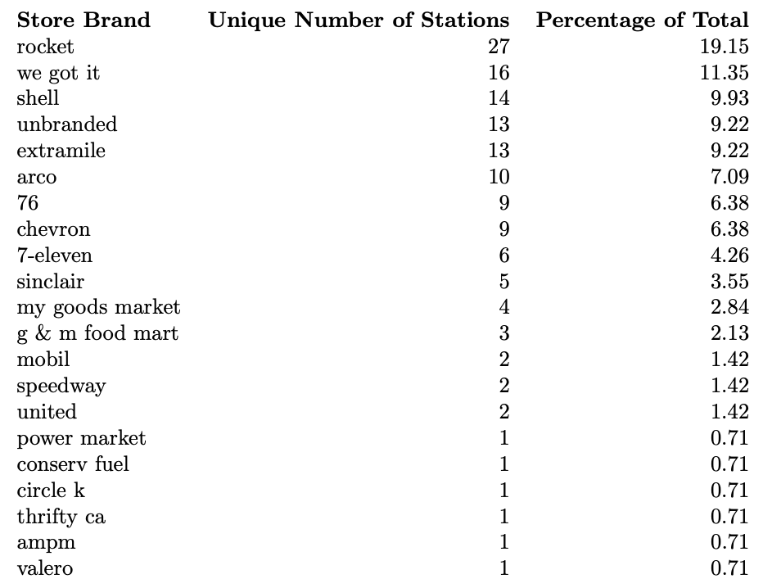
Understanding Brand Changes

Slide 14
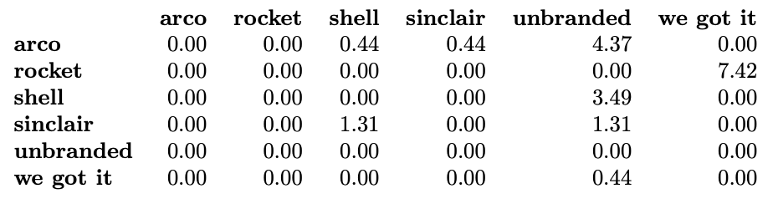
Transition Matrix

Slide 15
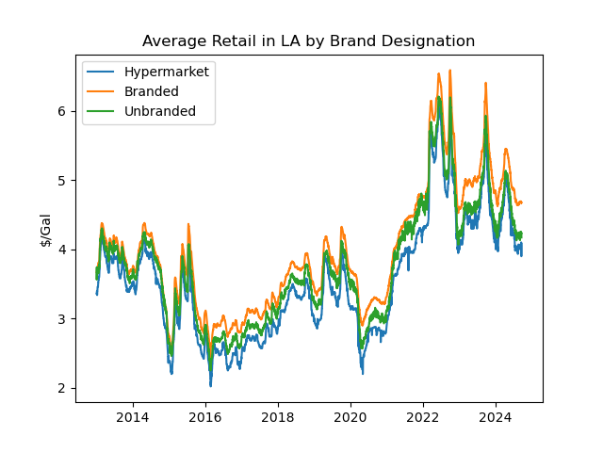
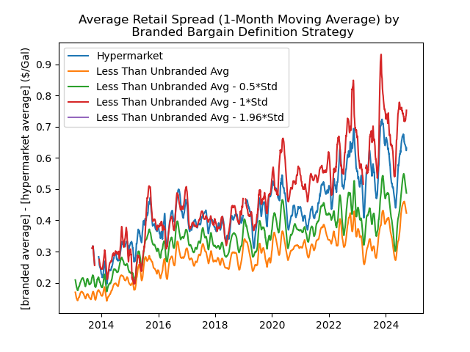
Defining Hypermarkets
Costco (2 stations)
Food 4 Less (1 station)
Ralphs / Kroger (1 station)

