Slide 1
Introduction to UIMA
Dr. Judith Eckle-Kohler, Richard Eckart de Castilho, Roland Kluge, Dr. Torsten Zesch

Slide 2
Part 1: UIMA

Slide 3
UIMA – Unstructured Information Management Architecture
Major goal:
transform unstructured information to structured information
… in order to discover knowledge that is relevant to an end user
Component-based architecture for analysis of unstructured content like text, video, audio
How it works: think of UIMA components as machines in an assembly line

Slide 4
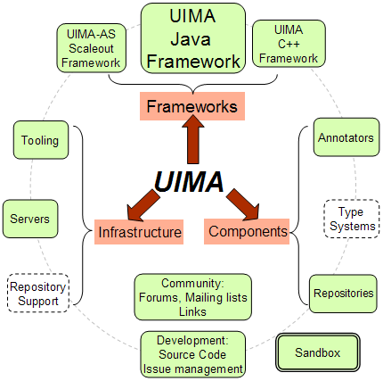


A Short History of UIMA
Unstructured Information Management Architecture
Originally developed at IBM – today an Apache project
Used in commercial as well as educational contexts
LanguageWare, Watson (IBM)
uimaFIT (TU Darmstadt, University of Colorado)
DKPro Core (!) (TU Darmstadt)
many more...
Java and C++ implementations

Slide 5
Learning to read is difficult for computers …
$�Ⱶ�‡⃗⃝⏏%Ⱶ $%$�ᐆ﬩ ⃗⃝ᐆ↕ ⧫ᐆ%¥ ﬩↕%б↕ -- $ᐆ⠼∇бᐆ ↕⧫ᐆ⁆ #%‡ ↕%Ⱶ⁂ ᐆ⁑ᐆ‡ $ᐆ⠼∇бᐆ ↕⧫ᐆ⁆ #%‡ $%$$Ⱶᐆ % ﬩�‡⃗⃝Ⱶᐆ ⁍∇б¥, $%$�ᐆ﬩ �‡ $�Ⱶ�‡⃗⃝⏏%Ⱶ ⧫∇⏏﬩ᐆ⧫∇Ⱶ¥﬩ =%⁆ ⃗⃝ᐆ↕ % ⧫ᐆ%¥ ﬩↕%б↕ �‡ Ⱶ�⠼ᐆ, %##∇б¥�‡⃗⃝ ↕∇ % ↕ᐆ%= ∇⠼ ﬩#�ᐆ‡↕�﬩↕﬩ �‡ �↕%Ⱶ⁆. б%↕⧫ᐆб ↕⧫%‡ #∇‡⠼⏏﬩�‡⃗⃝ $%$�ᐆ﬩, ⧫ᐆ%б�‡⃗⃝ =∇бᐆ ↕⧫%‡ ∇‡ᐆ Ⱶ%‡⃗⃝⏏%⃗⃝ᐆ ⃗⃝�⁑ᐆ﬩ ‡ᐆ⁍$∇б‡﬩ % =ᐆ‡↕%Ⱶ $∇∇﬩↕, %##∇б¥�‡⃗⃝ ↕∇ ↕⧫ᐆ ‡ᐆ⁍ ﬩↕⏏¥⁆, ⁍⧫�#⧫ ↕ᐆ﬩↕ᐆ¥ ﬩ᐆ⁑ᐆ‡-=∇‡↕⧫-∇Ⱶ¥ �‡⠼%‡↕﬩ "�‡ =%‡⁆ ᐆ⏏б∇∘ᐆ%‡ #∇⏏‡↕б�ᐆ﬩, ∘%бᐆ‡↕﬩ %бᐆ ⁍%б⁆ ∇⠼ ⃗⃝�⁑�‡⃗⃝ % $�Ⱶ�‡⃗⃝⏏%Ⱶ ᐆ¥⏏#%↕�∇‡ ↕∇ ↕⧫ᐆ�б ⁂�¥﬩ %‡¥ ↕б⁆ ↕∇ ﬩∘ᐆ%⁂ ∇‡Ⱶ⁆ ∇‡ᐆ Ⱶ%‡⃗⃝⏏%⃗⃝ᐆ," ﬩%�¥ ﬩↕⏏¥⁆ %⏏↕⧫∇б ↗%#⁋⏏ᐆ﬩ =ᐆ⧫Ⱶᐆб ∇⠼ ↕⧫ᐆ Ⱶ%‡⃗⃝⏏%⃗⃝ᐆ, #∇⃗⃝‡�↕�∇‡, %‡¥ ¥ᐆ⁑ᐆⱵ∇∘=ᐆ‡↕ Ⱶ%$ %↕ ↕⧫ᐆ �‡↕ᐆб‡%↕�∇‡%Ⱶ ﬩#⧫∇∇Ⱶ ⠼∇б %¥⁑%‡#ᐆ¥ ﬩↕⏏¥�ᐆ﬩ �‡ ↕б�ᐆ﬩↕ᐆ, �↕%Ⱶ⁆. "↕⧫ᐆ⁆ %бᐆ %⠼б%�¥ [↕⧫ᐆ�б #⧫�Ⱶ¥бᐆ‡] =�⃗⃝⧫↕ ﬩⏏⠼⠼ᐆб ⁍⧫ᐆ‡ ↕⧫ᐆ⁆ ⃗⃝ᐆ↕ ↕∇ ﬩#⧫∇∇Ⱶ %‡¥ ﬩∇ ∇‡," =ᐆ⧫Ⱶᐆб ﬩%�¥. "$ᐆ#%⏏﬩ᐆ ∇⠼ ∇⏏б бᐆ﬩⏏Ⱶ↕﬩, � ¥∇⏏$↕ ↕⧫%↕ ⁑ᐆб⁆ =⏏#⧫.“
Unstructured text

Slide 6
Analysis Levels in Text Processing
unstructured
Segmentation
Morphology
Syntax
Semantics
structured

Slide 7
UIMA Pipeline Example
Collection Reader
Segmentation
CAS
Analysis Engine 1
Morphology
CAS
Syntax
…
Semantics
Analysis Engine n
CAS
CAS Consumer

Slide 8
UIMA Example Pipeline for Text Processing
Collection Reader
CAS
Segmentation
Segmenter
Morphology
CAS
POS Tagger
Syntax
CAS
Semantics
Named Entity Rec.
CAS
CAS Consumer
Notes:
There can be more than one CAS Consumer, even intermixed with AEs

Slide 9
UIMA Concepts I
Pipeline Stages/Components:
Collection Reader: start of pipeline, abstraction of input files
Analysis Engine: performs analysis (tokenization, segmentation, etc.)
CAS Consumer: e.g. for writing out results (XML, text, console)

Slide 10
UIMA Concepts II
Data Structures
Common Analysis System (CAS): „data transfer object“
Type System: representation of annotations, contracted interface between components
Indexes: accessing annotations
Views: e.g. raw HTML view, cleaned text view
Subject-of-Analysis (SofA): e.g., document text of the current view

Slide 11
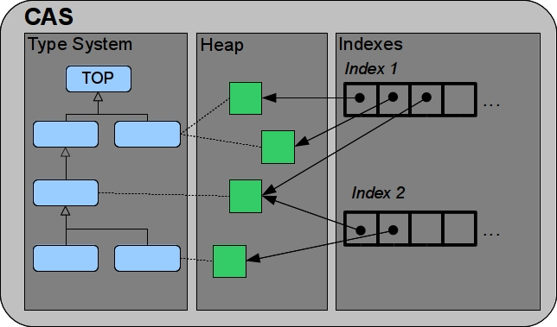
Common Analysis System (CAS)
High-density data structure, functions like an in-memory database
Provides access to
primary data (document/artifact under consideration)
secondary data (meta-data/annotations)

Slide 12
Type System
A UIMA type system specifies the type of data that can be manipulated by annotator components.
UIMA provides an “object-oriented” type system
A type system defines two kinds of objects:
Types (Type -> class)
Features (Feature -> class member, Feature Structure -> instance)
Notes:
A feature defines a field or slot within a type
Each CAS type specifies a single supertype and a list of features that may be associated with that type
A type inherits all of the features from ist supertype
A feature is a name/value pair where the value can be one of UIMA‘s built in primitive types or a reference to another UIMA object

Slide 13
Type System
Single inheritance
Sub-type polymorphism
Primitive types: integer, float, boolean, String
Built-in complex types: arrays, lists, Annotation
Type system is part of communication contract between components
Notes:
A feature defines a field or slot within a type
Each CAS type specifies a single supertype and a list of features that may be associated with that type
A type inherits all of the features from ist supertype
A feature is a name/value pair where the value can be one of UIMA‘s built in primitive types or a reference to another UIMA object
Type priorities: not used in DKPro-Core
They can be defined for annotation types that have the same span

Slide 14
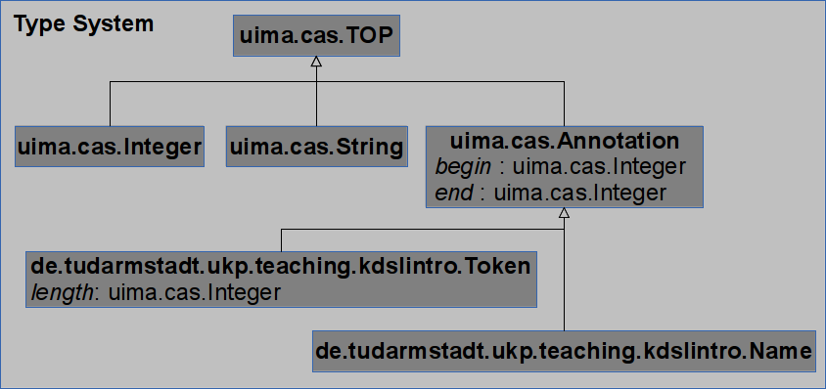
Example Type System

Slide 15
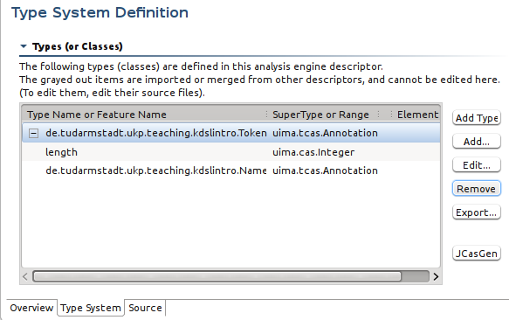
Type System Editor (Eclipse)
File: src/main/resources/desc/types/TypeSystem.xml
Java package name of generated classes
JCasGen generates Java classes from XML
Notes:
CDE = Component Descriptor Editor

Slide 16
Java + CAS = JCas
JCas maps CAS types into the Java type system
JCasGen generates Java classes from the XML type system descriptor
Token.java – feature structure wrapper with getters and setters
Token_type.java – type wrapper (cf. Java ‘Class’ class)
Do not edit these automatically generated Java classes manually!
JCas wrappers cannot be used stand-alone
XML type system descriptors still needed to initialize the underlying CAS
Java Code Example:
JCas jCas = …;
Token token = new Token(jCas); // new allocates memory in the CAS!
token.addToIndexes(); // never forget this!

Slide 17
Indexes
Recap: feature structures (FS) are stored on the heap
Components cannot directly access FS, but only via indexes
Feature structures only accessible when added to an index
Feature structures can only be removed from index, never from CAS
Properties of an index (excerpt):
Type to be indexed (index implicitly contains all sub-types)
Kind: bag, set, sorted (see next slide)
Example: Built-in Annotation index
Type: Annotation
Kind: sorted, begin (standard), end (reverse)
Notes:
17

Slide 18
Figure: Indexes
Bag
Set
Sorted
(0,2 v = “Hi”)
(7,10 v = “Tom”)
(3,6 v = “old”)
(7,10 v = “Tim”)
(0,2 v = “Ho”)
(3,6 v = “red”)
(0,2 v = “Hi”)
(7,10 v = “Tom”)
(3,6 v = “old”)
(0,2 v = “Hi”)
(0,2 v = “Ho”)
(3,6 v = “old”)
(3,6 v = “red”)
(7,10 v = “Tim”)
(7,10 v = “Tom”)
duplicates allowed
unordered
no keys
no duplicates
unordered
keys only test equality
duplicates allowed
ordered

Slide 19
Indexes – all you need to know
normally nobody needs to define indexes
indexes are the only way for UIMA annotators to access annotations in the CAS
it is necessary to generate these indexes, they are not provided automatically within UIMA

Slide 20
Views and SofAs – Conceptual
CAS represents the analysis of a single artifact (a document)
Each view contains a copy of the artifact,
referred to as the Subject of Analysis (SofA) – the primary data associated with a view (as returned by getDocumentText()),
and a set of indexes, the FSIndexRepository, that UIMA annotators use to access data in the CAS
Usual setting: View is one representation of the artifact, e.g.
Translation scenario: original text, translated text
Transformation scenario: original text, transformed text
Multi-modal scenario: video frames, close-captions

Slide 21
Figure: Views and SofAs
View
“_InitialView”
Base
CAS
SofA FS
“_InitialView”
Logical
Physical
SofA unaware component receives default view in process (CAS)
when calling getDocumentText()
View
“Text”
Base
CAS
SofA FS
“Text”
Logical
Physical
View
“HTML”
SofA FS
“HTML”
SofA aware component receives base CAS in process(CAS)
needs to call getView(viewName)

Slide 22
Views and SofAs – Use Cases
CAS represents the analysis of a single artifact (a document)
This is true in most applications
But: Views can also be used to compare different artifacts (mostly pairs)
this requires a customized reader that reads in several artifacts into a single CAS,
and then stores each artifact in a separate view.

Slide 23
Part 2: uimaFIT

Slide 24

uimaFIT
„add-on“ for UIMA simplifying typical development tasks
for instance:
consistency with XML descriptor files
component configuration
(shared) resource management
CAS/JCas access
Component base classes
@ConfigurationParameter annotation
Factories
http://code.google.com/p/uimafit/
Notes:
Apache uimaFIT 2.0.0 to be released soon, backwards compatibility plugin

Slide 25
Steps of Implementing a Collection Reader
subclass the uimaFIT component JCasCollectionReader_ImplBase
Methods to be implemented:
void getNext(JCas): store next document in the given output parameter
boolean hasNext()
Progress[] getProgress(): returns progress information
common implementation: new Progress[]{new ProgressImpl(remaining, total, Progress.ENTITIES)}
void close(): free resources
Optional:
void initialize(UimaContext): may be used for opening files etc.

Slide 26
Steps of Implementing an Annotator
subclass the uimaFIT component JCasAnnotator_ImplBase
void process(JCas) performs the actual analysis
Optional:
void initialize(UimaContext): may be used for opening files etc.
always call super.initialize(context);
public class NameAnnotator
extends JCasAnnotator_ImplBase
{
@Override
public void process(JCas aJCas)
throws AnalysisEngineProcessException {}
}

Slide 27
Steps of Implementing a CAS Consumer I
uimaFIT does not distinguish between CAS Consumer and Annotation Engine (as UIMA does):
Both are initialized almost identically in uimaFIT
See implementation of JCasConsumer_ImplBase and JCasAnnotator_ImplBase
The only difference between the initialization of a CAS Consumer and an Analysis Engine in uimaFIT is the ability of multi-threading
multi-threading is allowed for Analysis Engines by default, but it is not allowed for CAS Consumers
Notes:
uimaFIT kann nicht mit den "echten" UIMA Consumern umgehen (es gibt das als Interface in UIMA).
http://code.google.com/p/uimafit/source/browse/trunk/uimaFIT/src/main/java/org/uimafit/component/JCasConsumer_ImplBase.java?r=801#35

Slide 28
Steps of Implementing a CAS Consumer II
subclass the uimaFIT component JCasConsumer_ImplBase
void process(JCas) extracts data from the CAS
Optional:
void initialize(UimaContext): may be used for opening files etc.
always call super.initialize(context);
void collectionProcessComplete(): is called when all CASes have been processed
public class AnnotationFrequencyConsumer
extends JCasConsumer_ImplBase
{
@Override
public void process(JCas aJCas)
throws AnalysisEngineProcessException{}
}

Slide 29
Create and Configure Your Component - @ConfigurationParameter
uimaFIT provides us with a powerful annotation-based configuration mechanism
declare property as field (any primitive + classes with String-only constructor, Locale, Pattern, …)
add annotation @ConfigurationParameter
Attributes (excerpt):
name: referred to when configuring the component
mandatory: fail if missing/null
defaultValue: string
public static final String PARAM_DICTIONARY_FILE =
"dictionaryFile";
@ConfigurationParameter(name = PARAM_DICTIONARY_FILE,
mandatory = true)
private File dictionaryFile;

Slide 30
Create and Configure Your Component: @ConfigurationParameter – Best Practices
Best Practice: use the field name as value of the string constant
Example:
public static final String PARAM_DICTIONARY_FILE = "dictionaryFile";
private File dictionaryFile;
public static final String PARAM_DICTIONARY_FILE =
"dictionaryFile";
@ConfigurationParameter(name = PARAM_DICTIONARY_FILE,
mandatory = true)
private File dictionaryFile;

Slide 31
Create and Configure Your Component: @ConfigurationParameter – Best Practices
Best Practice: attributes mandatory, default
If possible, set the default value, even if mandatory=true
Why: components are not able to handle a null value
In the example, it is not possible to set a default value, as a meaningful value can only be set by a user
public static final String PARAM_DICTIONARY_FILE =
"dictionaryFile";
@ConfigurationParameter(name = PARAM_DICTIONARY_FILE,
mandatory = true)
private File dictionaryFile;

Slide 32
Create and Configure Your Component II
uimaFIT instantiates the components for you!
AnalysisEngineFactory.createPrimitiveDescription
for analysis engines and CAS consumers
CollectionReaderFactory.createDescription
for collection readers
CollectionReaderDescription reader = createDescription(
TextReader.class,
TextReader.PARAM_PATH, "src/test/resources/txt",
TextReader.PARAM_PATTERNS, new String[] {"[+]*.txt"},
TextReader.PARAM_LANGUAGE, "de");
AnalysisEngineDescription segmenter =
createPrimitiveDescription(BreakIteratorSegmenter.class);
AnalysisEngineDescription consumer =
createPrimitiveDescription(FrequencyConsumer.class);
SimplePipeline.runPipeline(reader, segmenter, consumer);

Slide 33
Using and Exploring Annotations
The utility class org.uimafit.util.JCasUtil provides convenient access to the annotations.
selectCovered is the preferred way to retrieve annotations from the CAS
int i = 0;
for(Sentence sentence : JCasUtil.select(jCas, Sentence.class))
{
System.out.println("Tokens of sentence " + (i++) + ":");
for(Token token :
JCasUtil.selectCovered(jCas, Token.class, sentence))
{
System.out.println(token.getCoveredText());
}
}

Slide 34
Manually Creating JCas Instances
JCas jCas = JCasFactory.createJCas();
jCas.setDocumentText("some text");
jCas.setDocumentLanguage("en"); // IMPORTANT!
AnalysisEngineDescription tokenizer =
createPrimitiveDescription(MyTokenizer.class);
runPipeline(jCas, tokenizer);
for(Token token : JCasUtil.select(jCas, Token.class)){
System.out.println(token.getCoveredText());
}

Slide 35
uimaFIT Best Practices – descriptions
If available, use the Factory methods of uimaFIT to create component descriptions, e.g., CollectionReaderFactory.createDescription
Why: a reader created this way can be used multiple times in different pipelines (see example pipeline in de.tudarmstadt.kdsl.teaching.dkprocore.intro)

Slide 36
uimaFIT Best Practices – CollectionReader
Always set the parameter PARAM_LANGUAGE, this is required by many Analysis Engines
Always set the parameters PARAM_PATH and PARAM_PATTERNS in combination
PARAM_PATTERNS is specified by ANT-style patterns, i.e., you have to set a pattern that specifies the files to be included, see http://ant.apache.org/manual/dirtasks.html#patterns
Good to know: CollectionReader instances can also process compressed files (zip format)

Slide 37
Type System Auto-Discovery
uimaFIT needs to know the XML type system descriptor's location at runtime, see http://code.google.com/p/uimafit/wiki/TypeDescriptorDetection
Either
create file src/resources/META-INF/types.txt
add path to your XML file in the following manner:
classpath*:desc/types/*.xml
(uimaFIT will take into account any XML file in desc/types)
Or
add VM option to Launch Configuration:
-Dorg.apache.uima.fit.type.import_pattern=classpath*:desc/types/*.xml
For more information see Chapter 7 of the uimaFit Guide at http://code.google.com/p/uimafit

Slide 38
Can you answer these questions?
What is UIMA?
What is uimaFIT?
What is the benefit of using uimaFIT component descriptions?
What is the basic structure of UIMA-based projects?
What is an Annotation?
How do you create a new annotation type?
How do you add annotations to a JCas?
Why do you need to call addToIndexes()?
When do you need different views of an artifact?
How to implement a Collection Reader? (Annotator, CAS Consumer)

Slide 39
Exercises (I)
Take a look at uimaFIT’s JCasUtil
UIMA Basics
Explore the project
Pipeline, CR, AE, Consumer
Typesystem Descriptor:
src/test/resources/desc/types/TypeSystem.xml
src/test/resources/META-INF/org.uimafit/types.txt
Micro-corpus
src/test/resources/txt
(optional) explore the structure of the multimodule project
pom.xml
aggregator's pom.xml

Slide 40
Exercises (II)
UIMA Exploring
Objective: Write your own pipeline and analyze the results
Get the uimaexploring.exercise project
Write your own NameAnnotator which looks up each token in a name list (src/main/resources/dictionaries/names.txt)
read in dictionary in initialize(UimaContext) method
Write a NamePrintConsumer which nicely prints out your name annotations; output how many name annotations you have assigned (for each document/all documents in total)
Hint: collectionProcessComplete() may be helpful
Serialize your CASes to XML and use the GUI tools to examine their contents

Slide 41
References
T. Götz, O. Suhre, 2004: Design and implementation of the UIMA Common Analysis System, IBM Systems Journal Vol 43 #3, p. 476-489
http://uima.apache.org/doc-uima-why.html
http://uimafit.googlecode.com/svn/tags/uimafit-parent-1.4.0/apidocs/index.html

