Slide 1

Municipal Complaint
Management System
DBMS Mini Hackathon
Student Details
Academic Details
Name: __Darsh Raval______________
Enrollment No.: _92610116001
Class / Division: _3EG1____________
Subject: Database Management System
Faculty: _Prof. Megha Dabas_________
College / University: _Marwadi University_
HTML • CSS • JavaScript • Python • SQLite
1

Slide 2
2. Problem Statement
Why a municipal complaint database is needed
Existing Problem
Proposed System
Municipalities receive complaints about garbage, water,
roads, street lights and drainage.
Manual handling makes it difficult to organize complaints,
assign the correct department, follow status changes and
preserve resolution history.
A centralized system stores citizen, category, location,
department, status, history and resolution data in a
structured database.
The system provides separate User and Admin dashboards
and does not require login or registration.
2

Slide 3
3. Requirements / Business Rules
Functional Requirements
Business Rules
• Submit a municipal complaint
• View and track complaints using phone number / complaint ID
• Assign complaints to departments
• Update status and priority
• Add resolution details
• View complaint history
• Manage categories, departments and locations
• Show dashboard statistics
1. Every complaint has a citizen.
2. Every complaint has a category and location.
3. A complaint can be assigned to a department.
4. Status follows the complaint workflow.
5. Every status change is stored in complaint_history.
6. A complaint can have one resolution record.
7. IDs are unique.
8. Foreign keys maintain valid relationships.
3

Slide 4
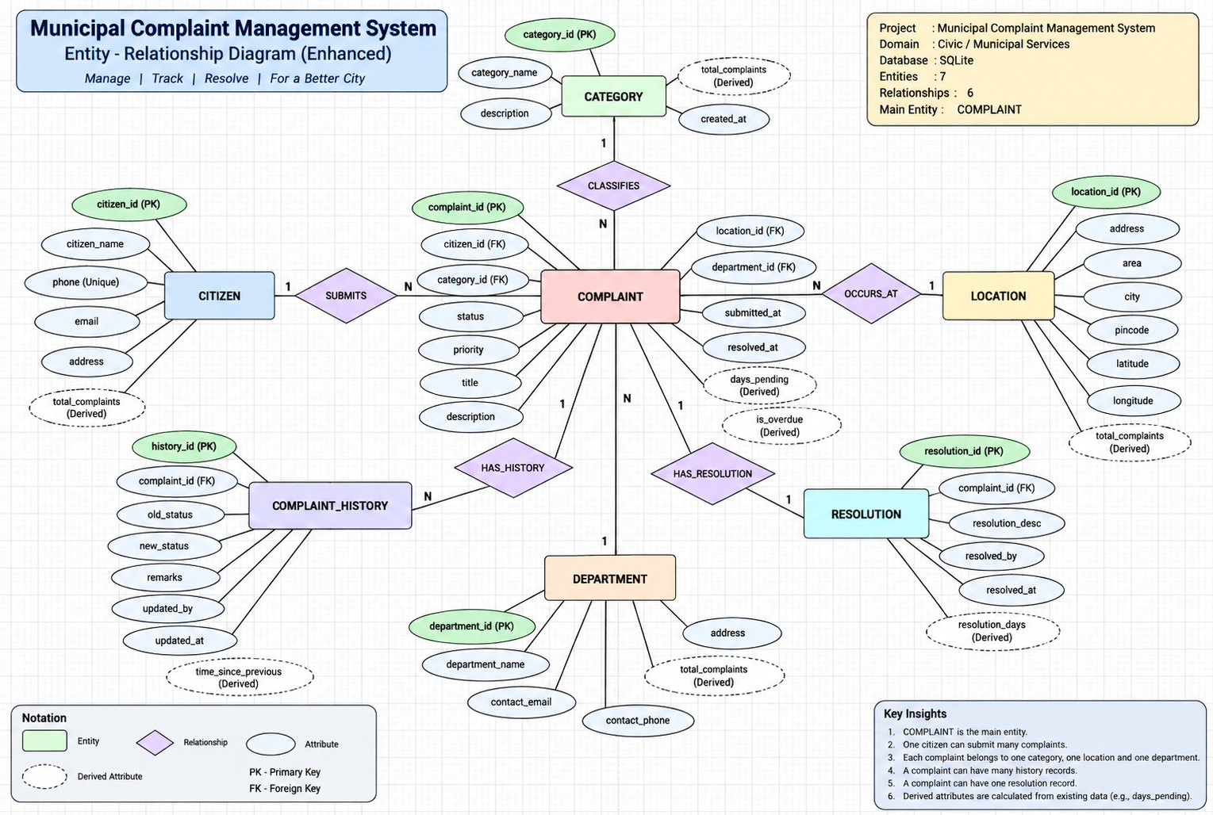
4. ER Diagram
Chen notation with entities, attributes, relationships, cardinality and derived attributes
4

Slide 5
5. Three-Level Architecture
External, conceptual and internal database levels
External Level
User Dashboard + Admin Dashboard
User-facing views and operations.
Conceptual Level
Entities + Relationships + Constraints
ER model, cardinality, PK/FK and business rules.
Internal Level
SQLite tables + indexes + storage
Actual implementation in municipal_complaints.db.
5

Slide 6
6. Relational Schema / Database Tables
Seven relations produced from the ER model
citizens
categories
citizen_id PK | citizen_name | phone
category_id PK | category_name | description
locations
departments
location_id PK | address | area | city | pincode
department_id PK | department_name | contact_email | contact_phone
complaints
complaint_history
complaint_id PK | citizen_id FK | category_id FK | location_id FK | department_id FK |
title | description | priority | status | submitted_at | resolved_at
history_id PK | complaint_id FK | old_status | new_status | remarks | updated_by |
updated_at
resolutions
resolution_id PK | complaint_id FK UNIQUE | resolution_description | resolved_by |
resolved_at
6

Slide 7
7. SQL Queries & Outputs
Examples of retrieval and reporting from the implemented database
Query — JOIN Complaint Details
Sample Output
SELECT c.complaint_id, ci.citizen_name,
cat.category_name, d.department_name, c.status
FROM complaints c
JOIN citizens ci ON c.citizen_id = ci.citizen_id
JOIN categories cat ON c.category_id = cat.category_id
LEFT JOIN departments d ON c.department_id = d.department_id;
ID
Citizen
Category
Status
1
Rahul
Garbage
IN_PROGRESS
2
Priya
Road
ASSIGNED
3
Amit
Street Light
RESOLVED
Aggregate Query
Output
SELECT status, COUNT(*) AS total
FROM complaints
GROUP BY status;
One row per complaint status with its count. This result can be used for dashboard
statistics.
History Query
SELECT * FROM complaint_history WHERE complaint_id = 1 ORDER BY updated_at;
7

Slide 8
8. AI Usage Declaration
Statement of assistance and student responsibility
Declaration
AI tools were used as an assistance resource during the project.
Used for:
• Brainstorming and refining project structure
• Explaining DBMS concepts and SQL syntax
• Drafting presentation wording and improving clarity
• Assisting with code and diagram ideas
Student responsibility:
• Final project scope and requirements were selected by the students.
• Database design, implementation, testing and demonstration were reviewed by the students.
• Students remain responsible for understanding and explaining the submitted work.
8

Slide 9
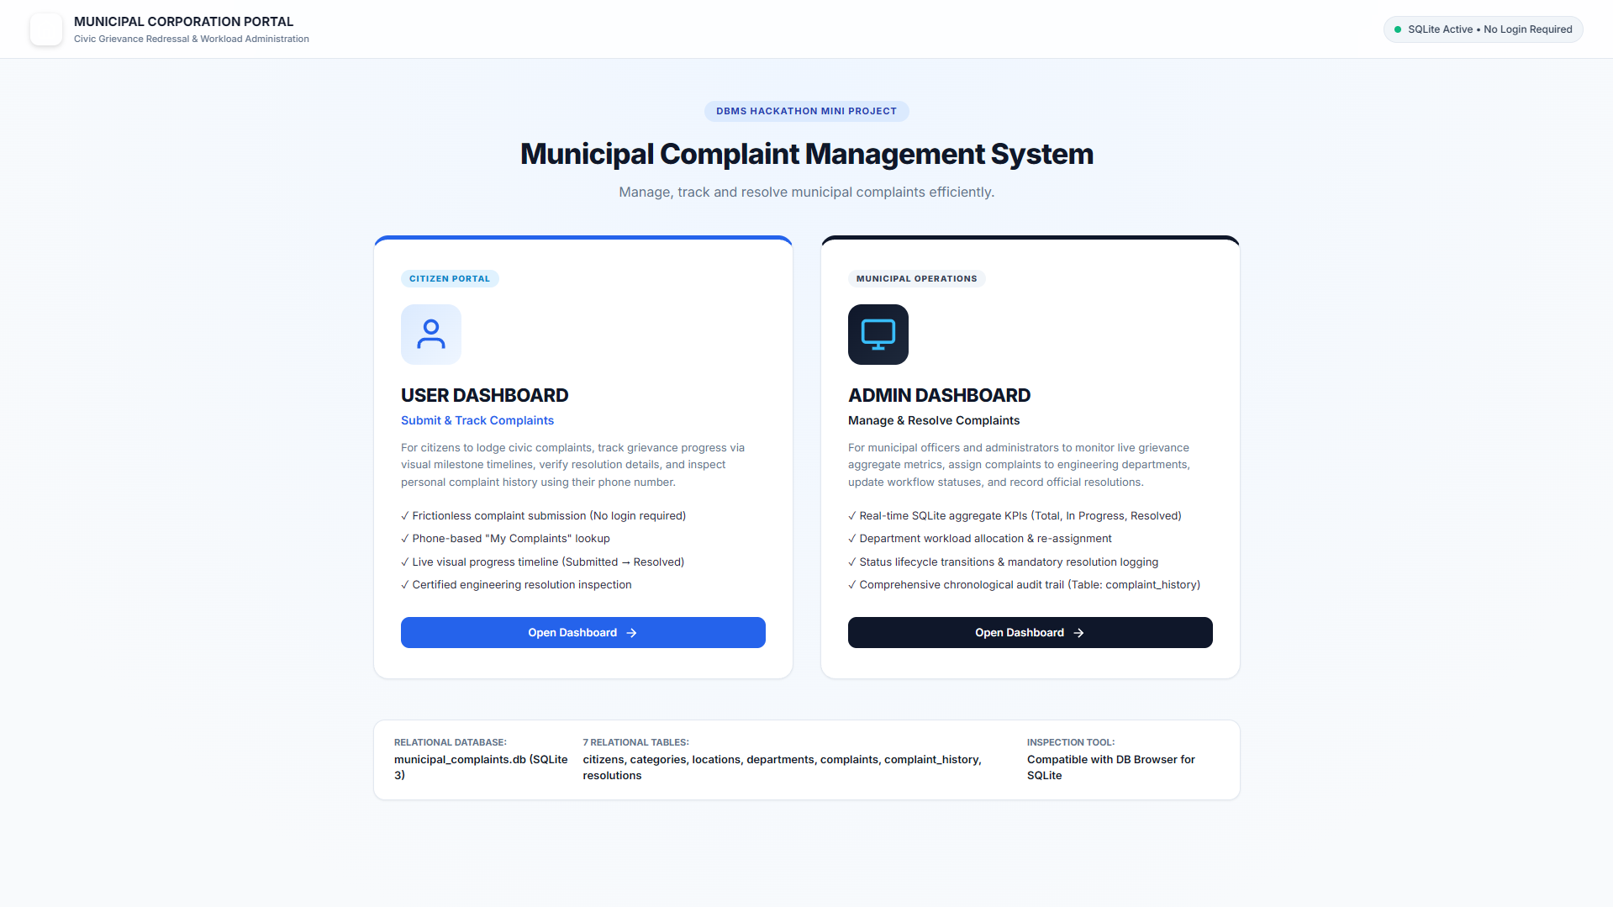
9. Live Demo Plan
9

Slide 10
User Dashboard
10

Slide 11
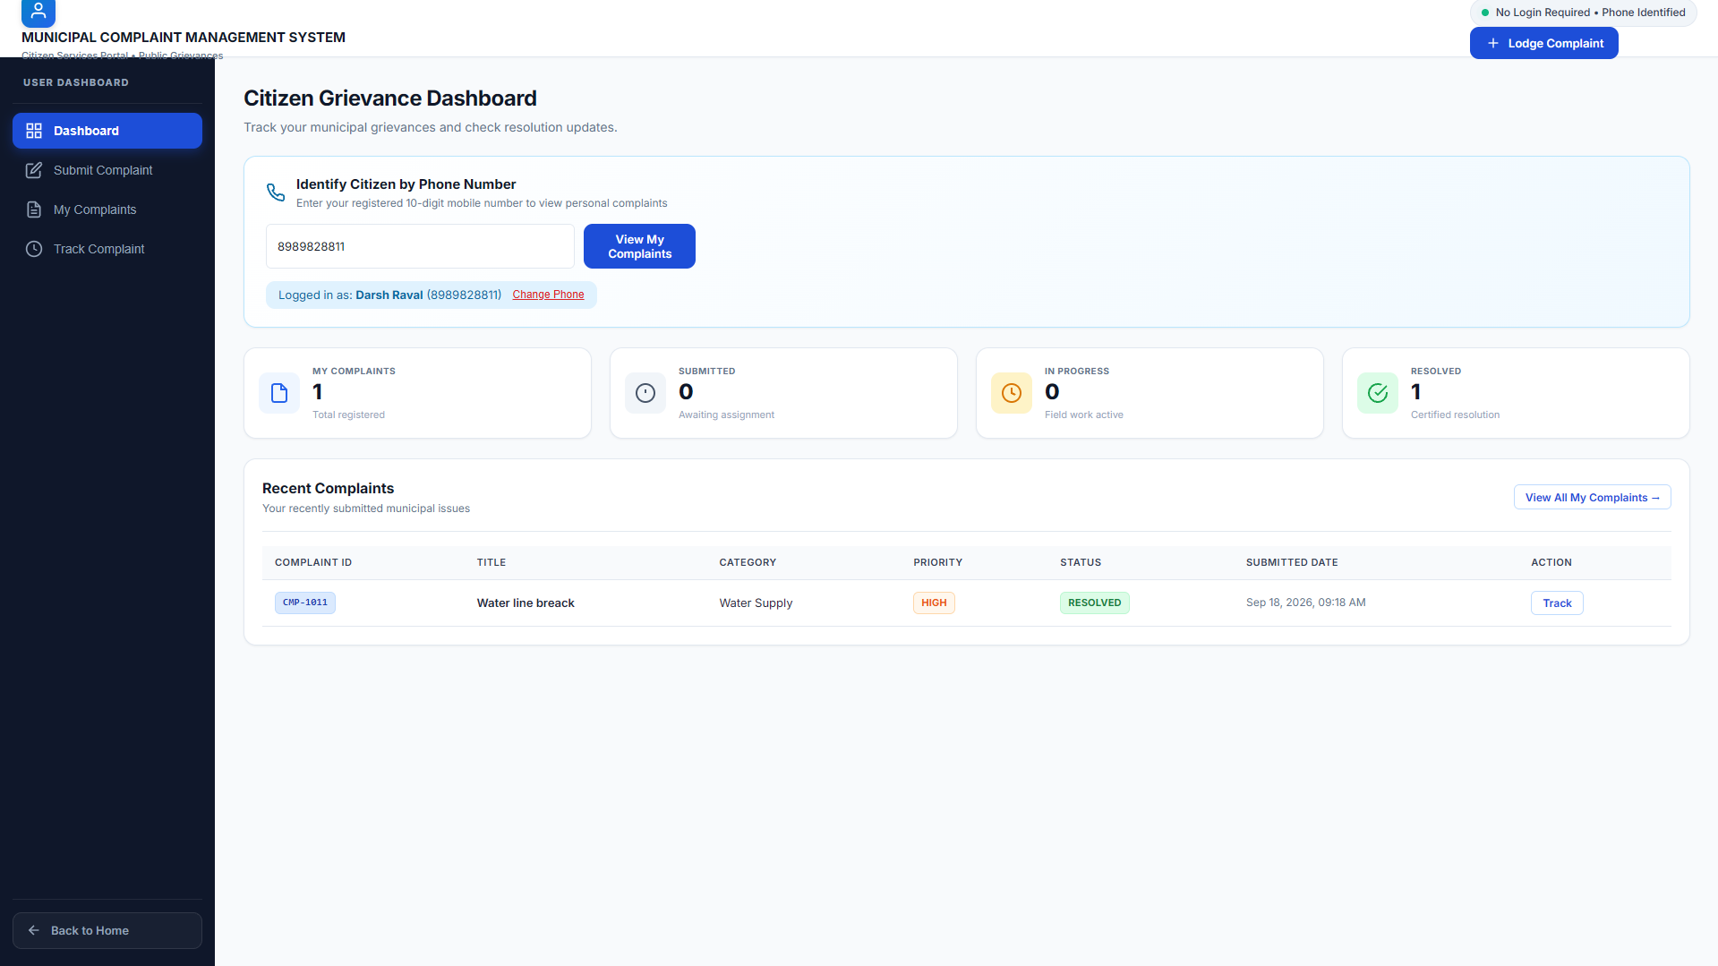
11

Slide 12
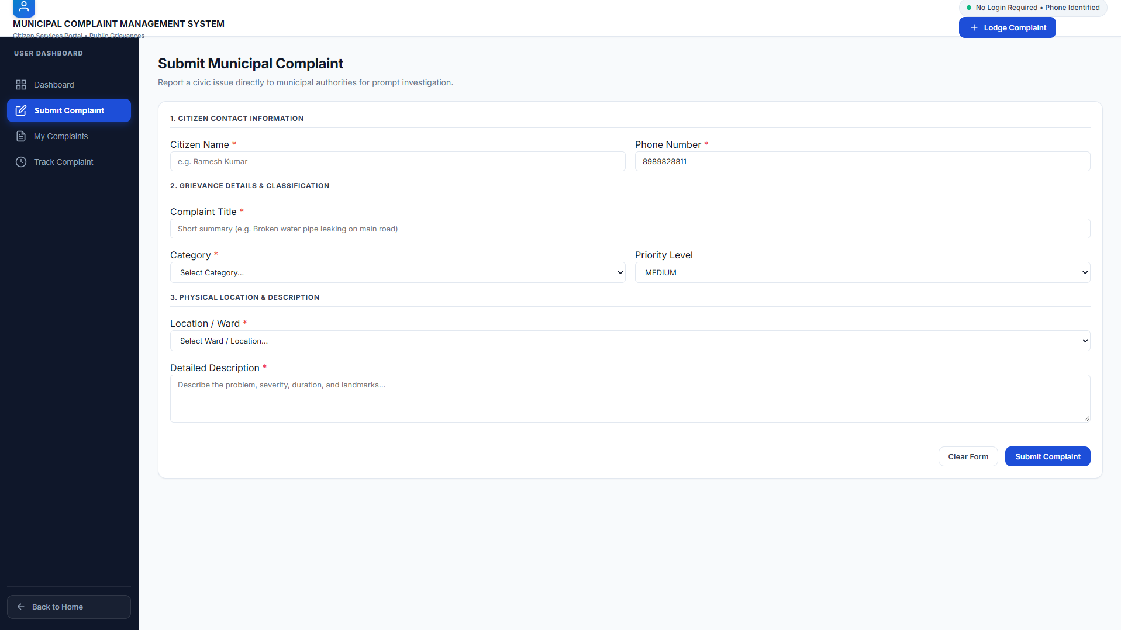
Live Demo Plan
13
12

Slide 13
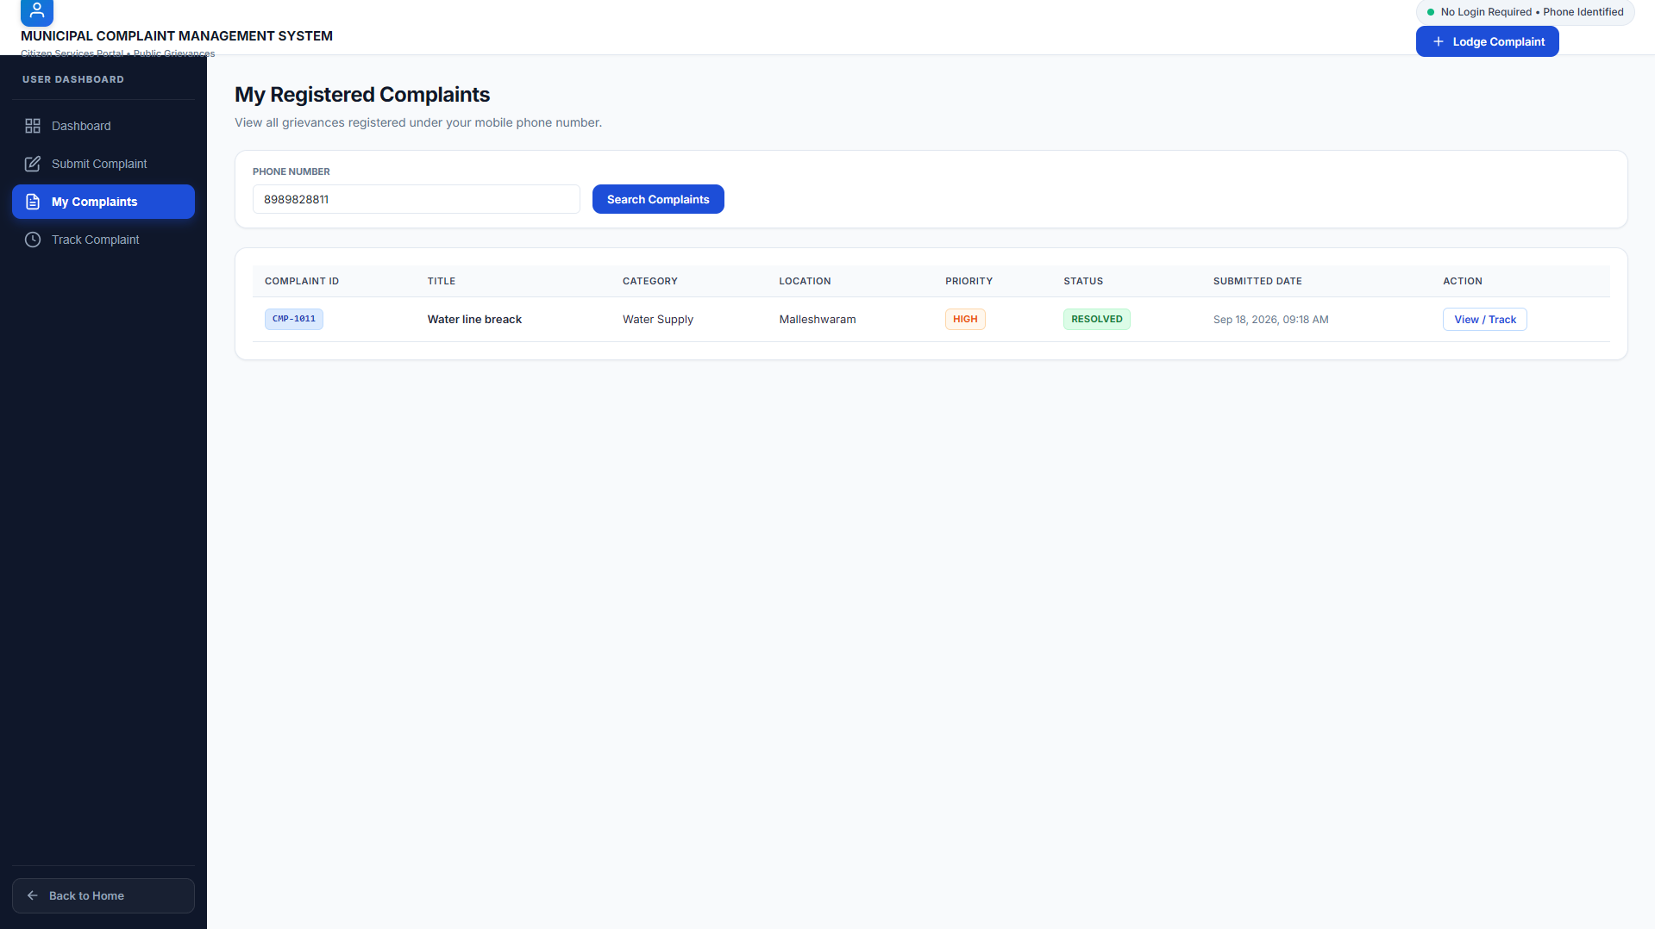
Live Demo Plan
13
13

Slide 14
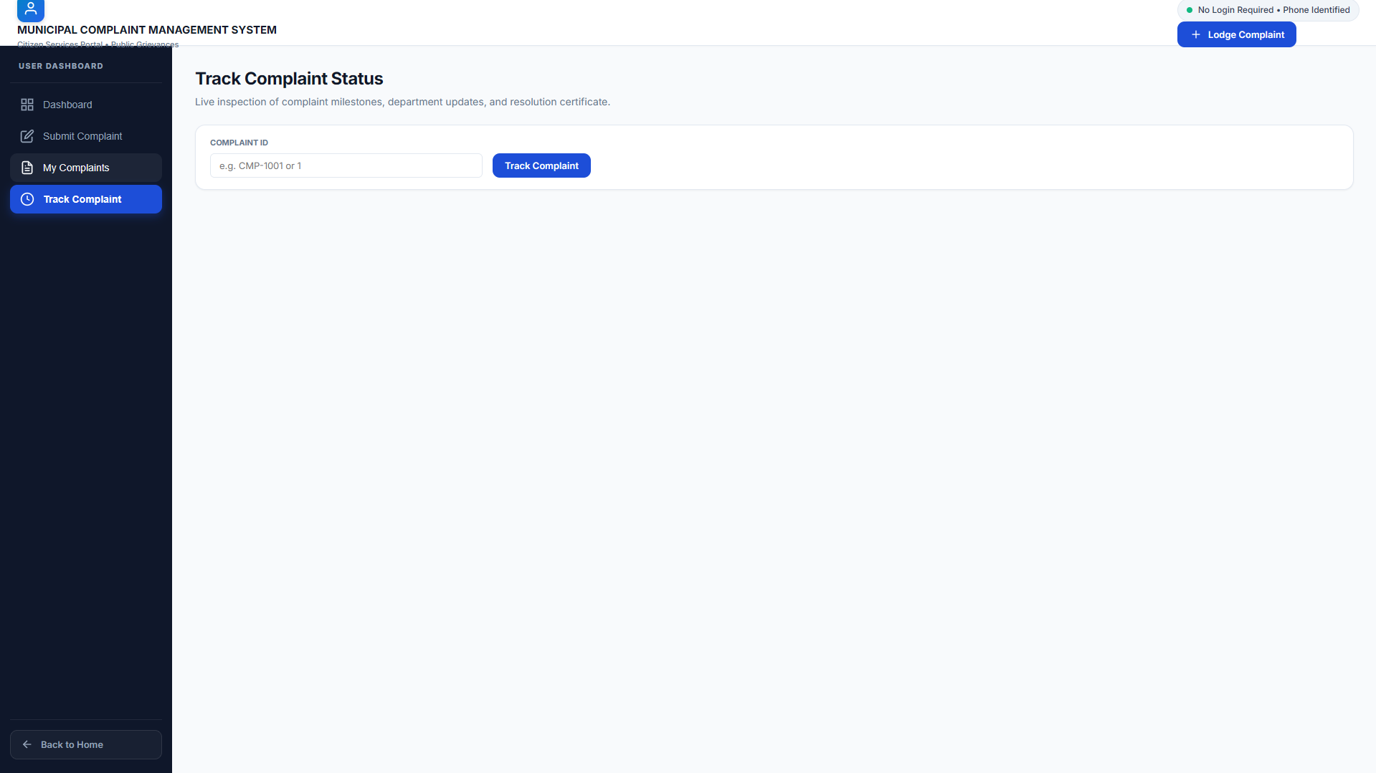
Live Demo Plan
13
14

Slide 15
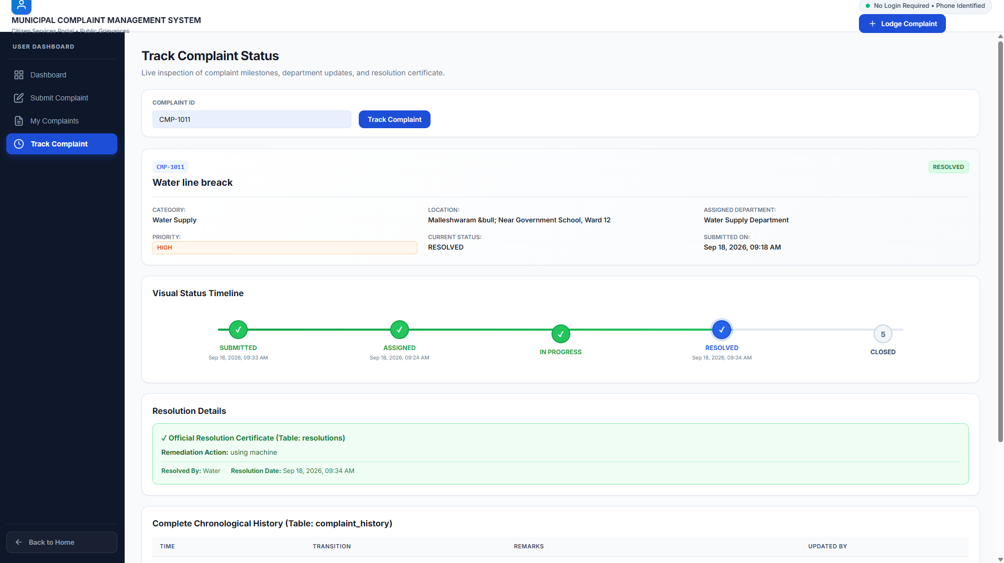
Live Demo Plan
13
15

Slide 16
Admin Dashboard
16

Slide 17
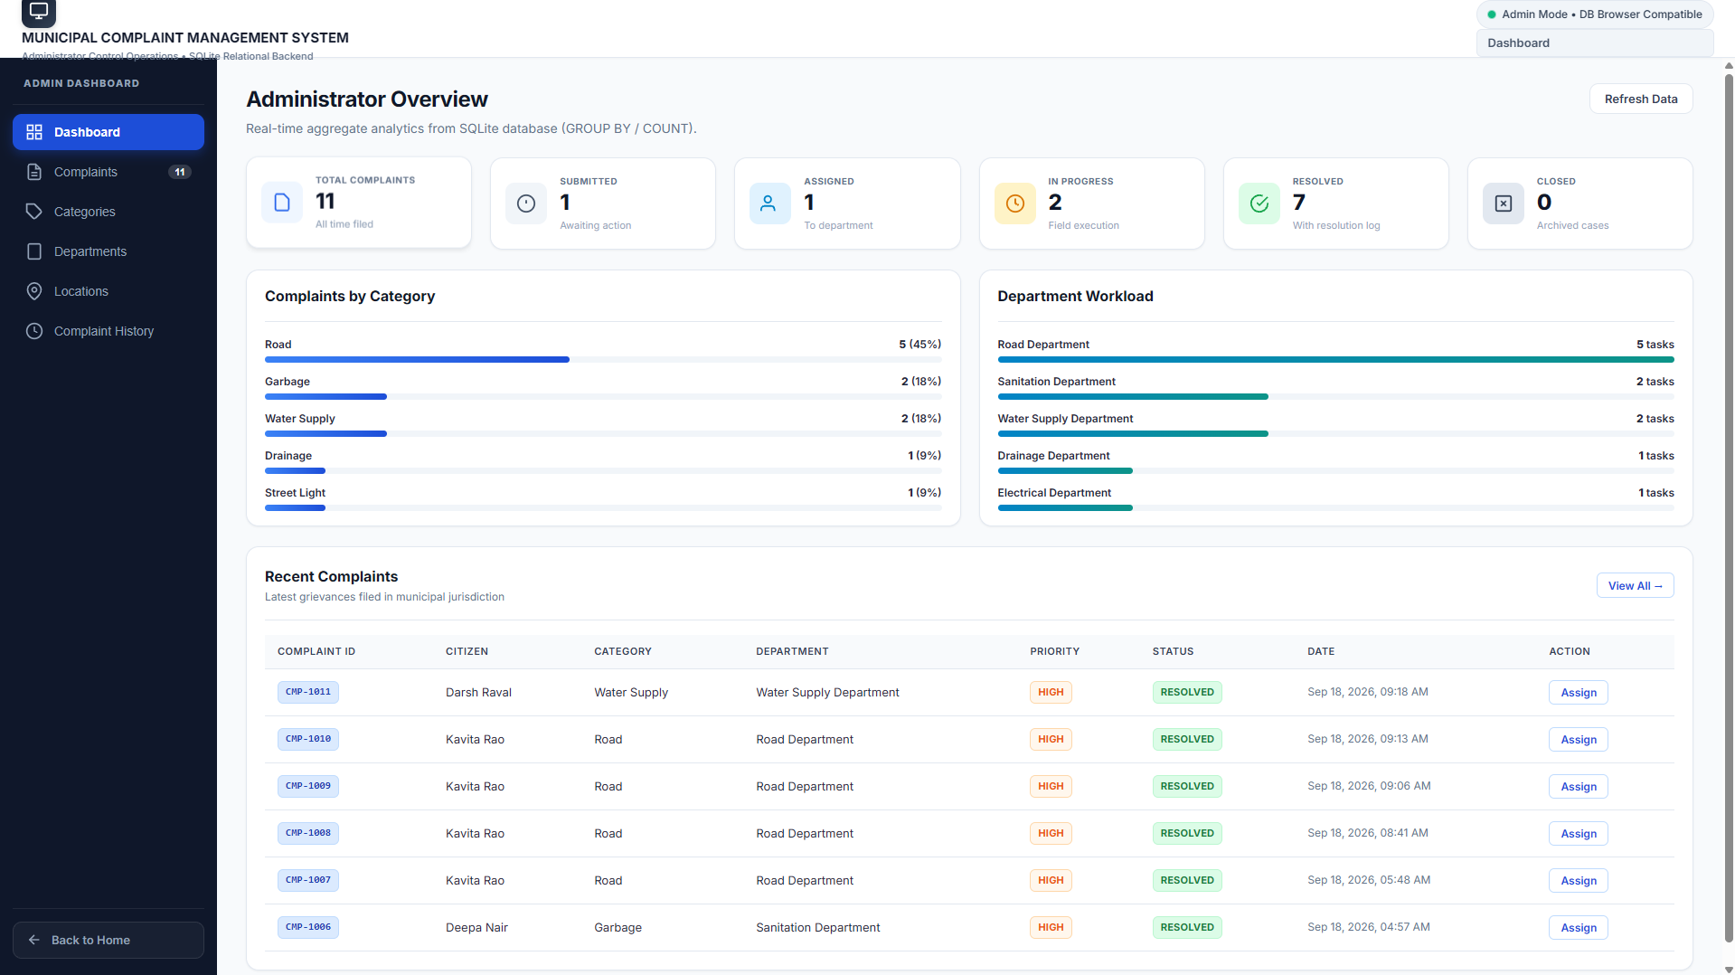
Live Demo Plan
13
17

Slide 18
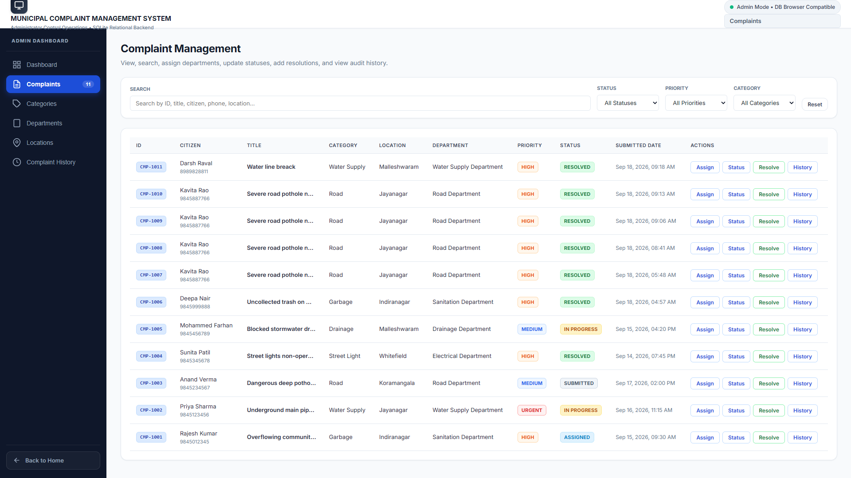
Live Demo Plan
13
18

Slide 19
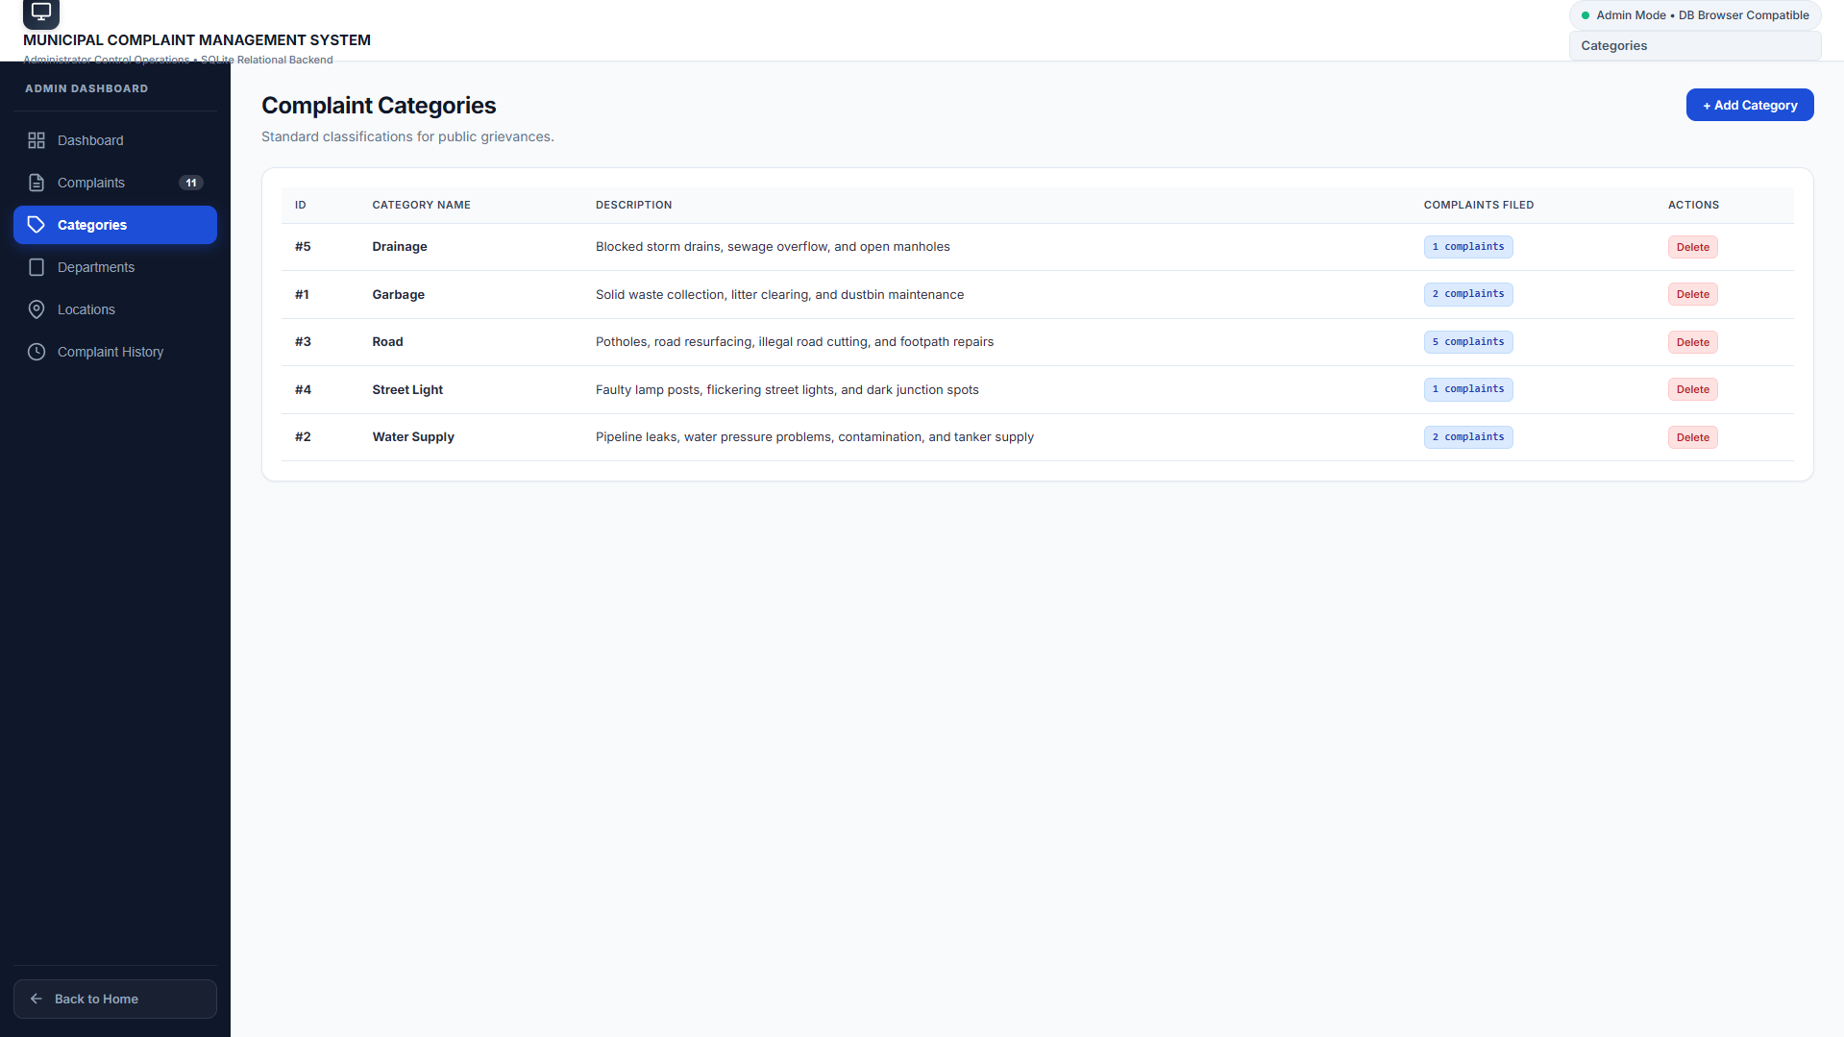
Live Demo Plan
13
19

Slide 20
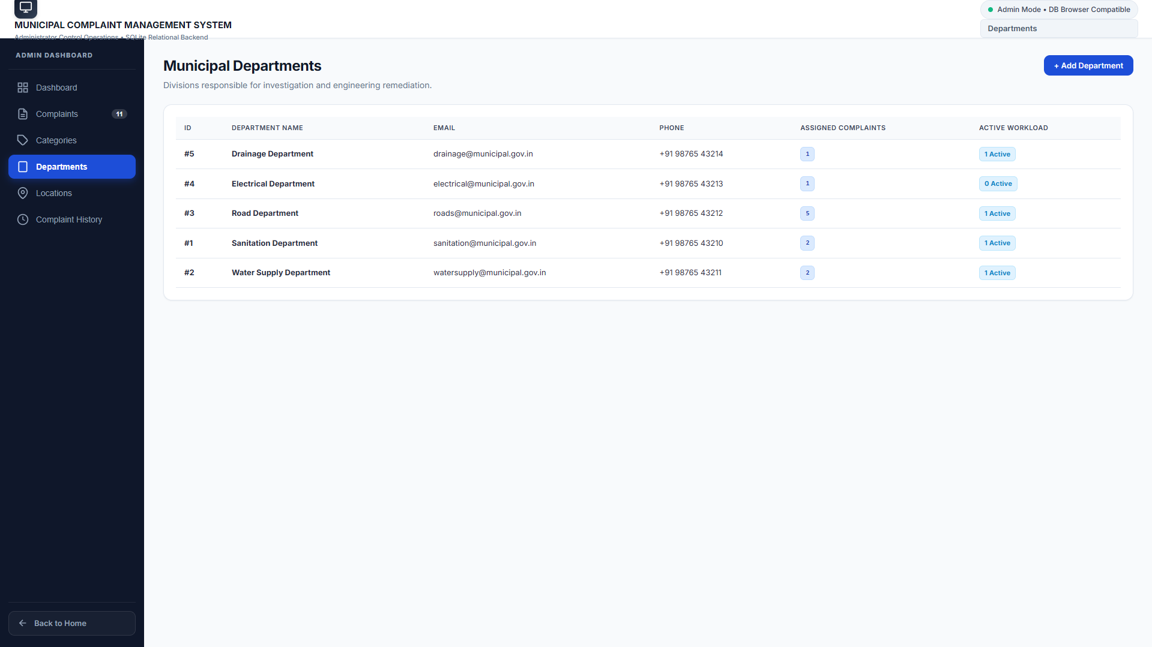
Live Demo Plan
13
20

Slide 21
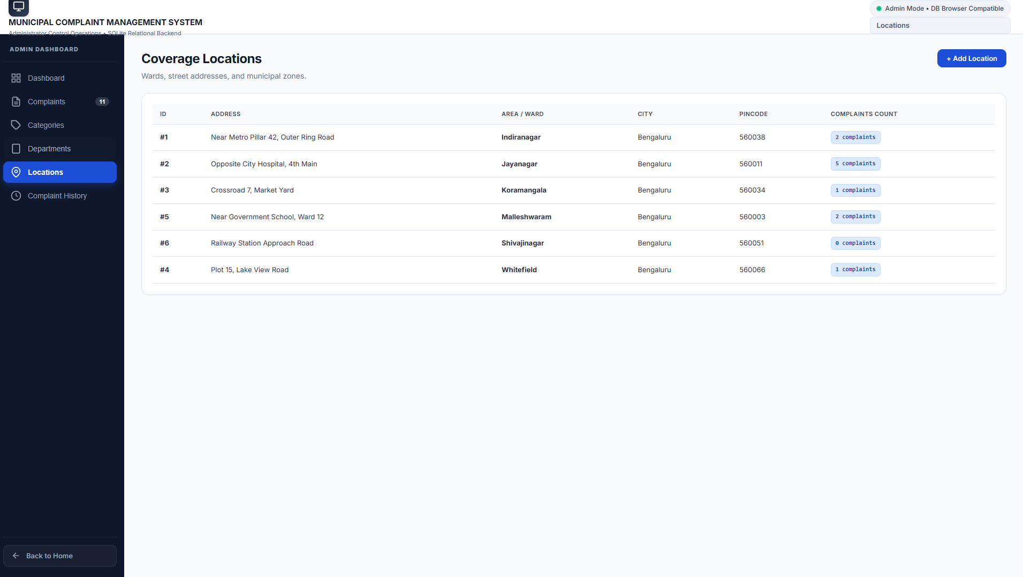
21

Slide 22
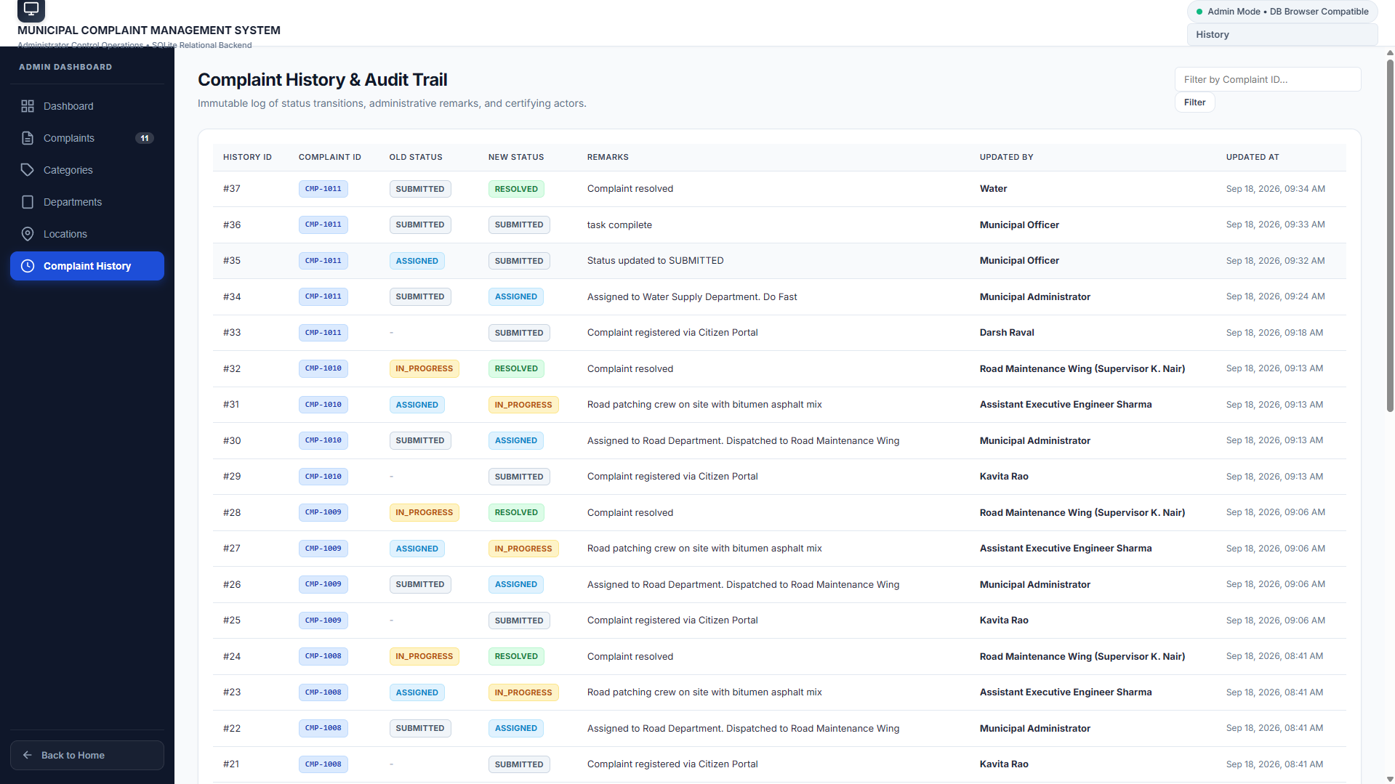
22

Slide 23
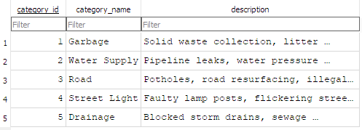
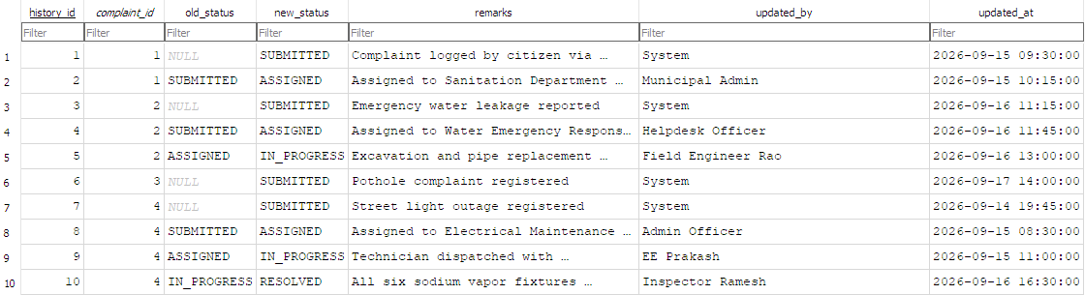
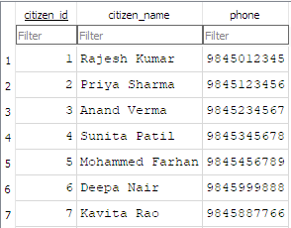
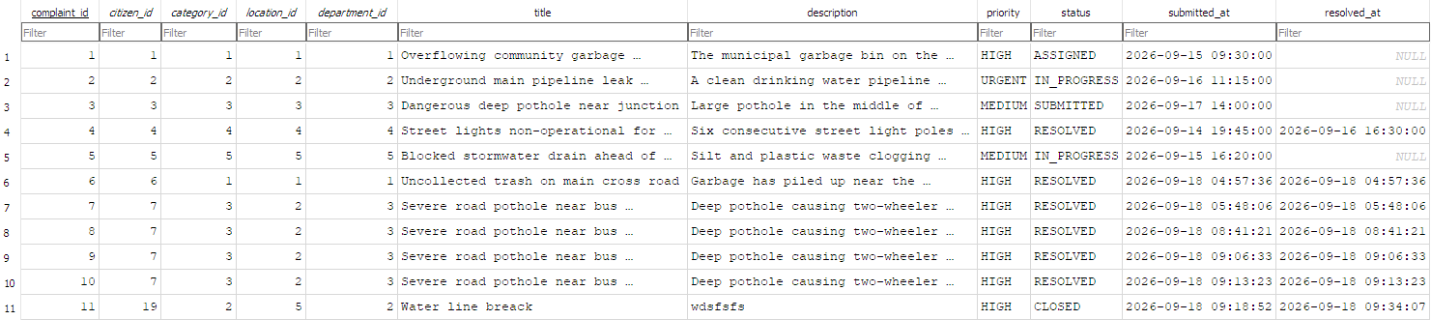
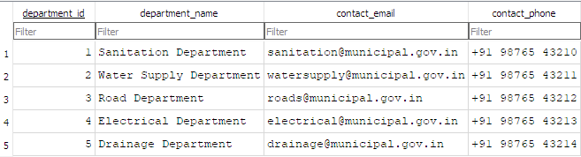
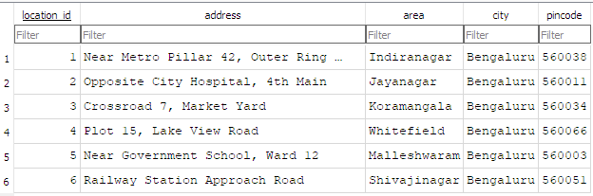
10. Live Demo Plan
23

Slide 24
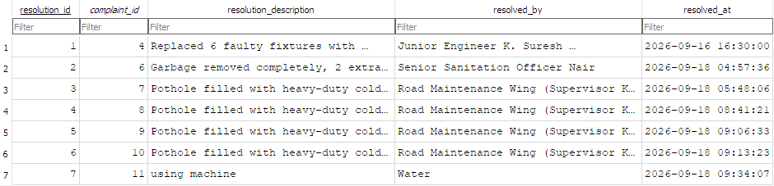
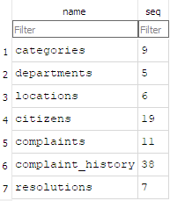
24

Slide 25
10. Conclusion
• The project models a real municipal complaint workflow as a structured DBMS.
• The ER model defines the relationships; the relational schema converts them into SQLite tables.
• SQL queries support retrieval, reporting and complaint-history tracking.
• User and Admin dashboards connect the database to practical operations.
• The result is a traceable workflow from complaint submission to resolution.
Thank You
25

