Slide 1
Cross-Database Mammographic Image Analysis through Unsupervised Domain Adaptation
Deepak Kumar¹, Chetan Kumar¹, Ming Shao²
¹Department of Data Science, University of Massachusetts, Dartmouth
²Department of Computer and Information Sciences, University of Massachusetts, Dartmouth

Slide 2

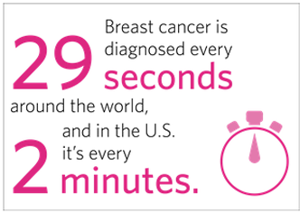
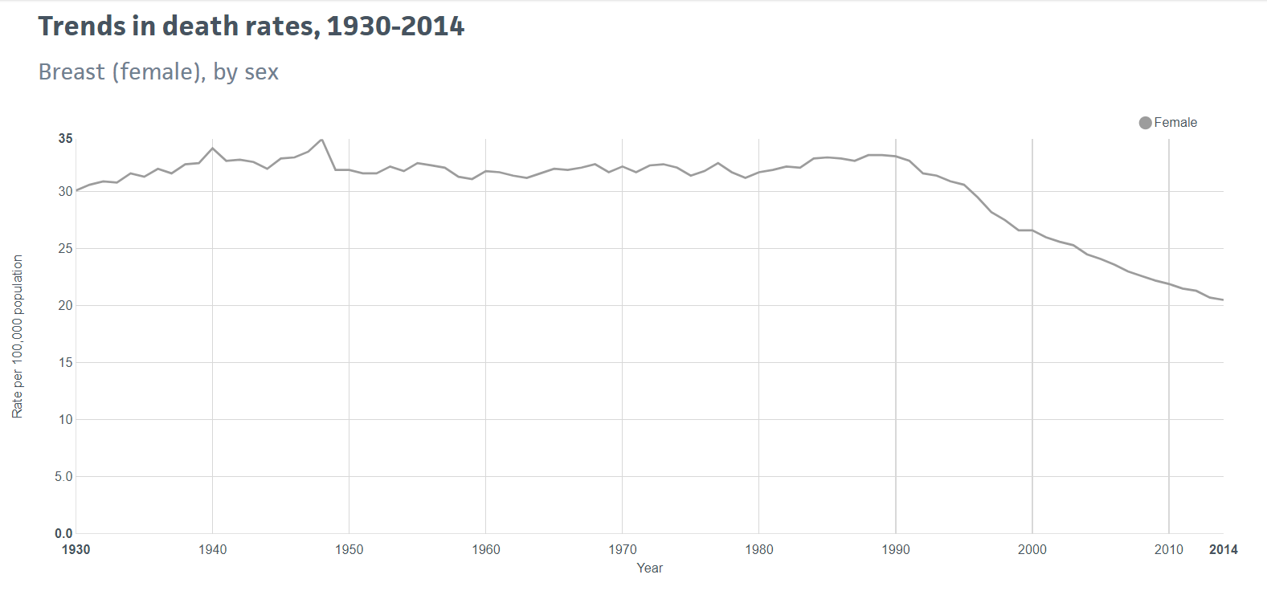
Background

Slide 3
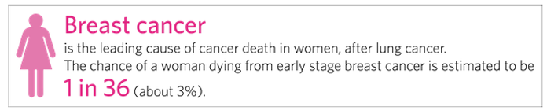
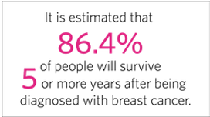
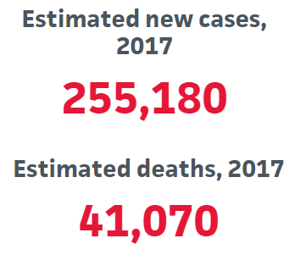
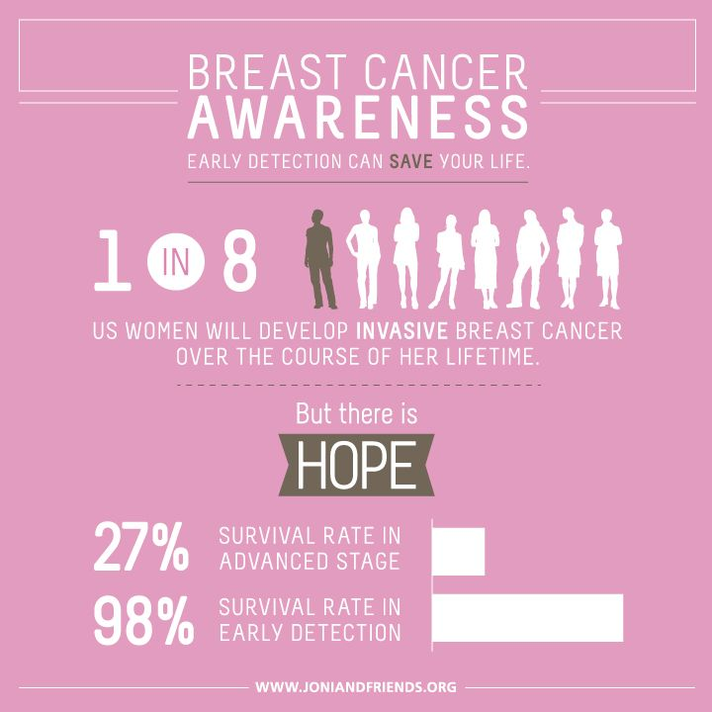
Background

Slide 4
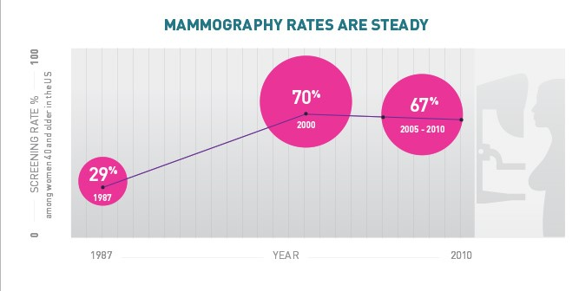
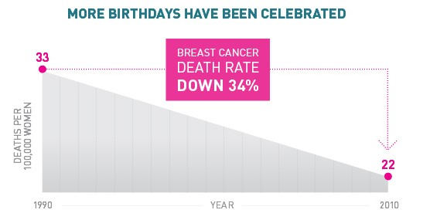
Background
Notes:
Ever year 200,000 thousand women diagnosed with breast cancer.
This info graphics illustrates finding from breast cancer facts and figures taken in 2013-2014.
That shows the percentage of women at age of 40 or older had a mammograms and it stabilized to 67% since past 2 years.
Due to improvements in screening and latest technologies this infographics shows the decline in death rates.

Slide 5
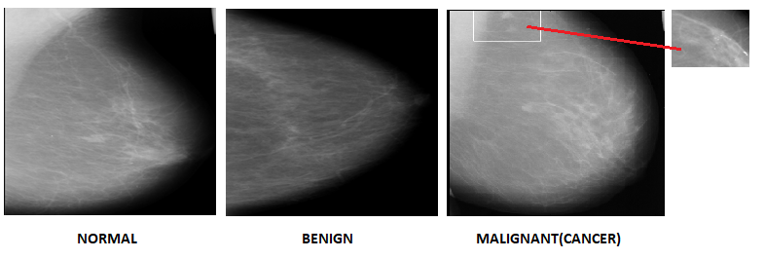
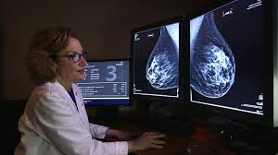
Background
Diagnostics by Professions

Slide 6
Background
Diagnostics by Professions
Notes:
Though there are various imaging techniques, Mammograms is considered the gold standard for breast cancer detection
In this diagram we are showing different mammograms with benign and malignant labels.
CAD have caught attention to automate the process of medical image classification.
CAD rely on pre-segmented portion of mammograms knows as ROI
TO get ROI radiologist expertise are required which are sometimes error prune and time consuming
So in our study we are focused on using whole mammograms without any ROI annotations.

Slide 7
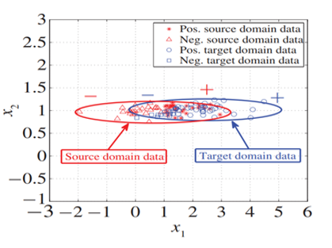
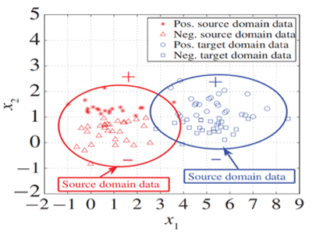
Unsupervised Domain Adaptation
Traditional machine learning methods assume training and test data are distributed similarly
But sometimes we may have few training data
Borrowing training data elsewhere is risky
Transfer learning ensures the “borrowed” data (source) having similar distribution as the tests (target)
Different scenarios
Source with labels
Source without labels
Labeled source
Unlabeled target
Ours
Same task
Domain Adaptation
Unsupervised Transfer Learning
Multi-Task Learning
Self-Taught
Learning
Different tasks
Unsupervised Domain Adaptation for Mammographic Image Analysis
Notes:
Unfortunately training a deep model requires a large volume of labeled data, which can be time consuming and expensive to acquire.
Borrowing the training data elsewhere is risky, but labeled data from a different and related data is if available and with the help of transfer learning labeled data is source domain can be used develop a machine learning model for target domain
There are four different scenarios in transfer learning.
We are working on unsupervised domain adaptation. Where we have labeled source data, but unlabeled target data,

Slide 8
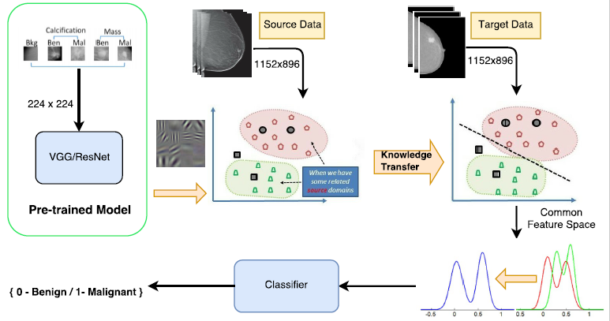
Framework
Notes:
Our research studies follows this given frame work
Fro visual descriptors from mammograms we used “Shen Li ” End to Pre-trained model from source and target domains
Explored different transfer learning methods to get source and target in common subspace
For classification we used svm to classifiy target mammograms with benign and malignant labels.

Slide 9
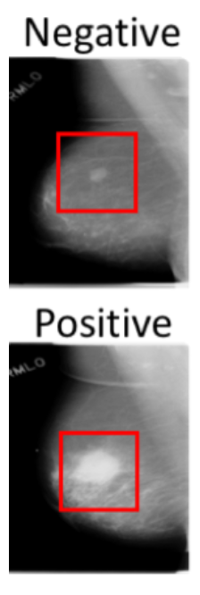
Basic Descriptors
Powerful CNN features
Shen Li, “End to End training algorithm for whole-image breast cancer diagnosis based on mammograms”
Without ROI annotations
Three different convolutional networks are used
First trained on the patch classifier
Changing the learning rate by “freezing and unfreezing the layers”
Fixed the mammogram patch image size to 224 x 224
Whole mammogram image size 1152 x 896
Notes:
In E2L model a patch classifier is trained using 16- layers VGGNet or 50- layer resnet.
To remove the annotation constraint the author was more focused on the top layer structure to fit the high level conceptual modeling.
E2l Includes two parts. Training a patch classifier , training a whole image classifier on top of patch classifier.
Both model trained on pre-trained model on Imagenet database.

Slide 10
Domain Adaptation Methods
TCA (Transfer Component Analysis)
Learn the common space for both domains
Projecting into the common subspace
BDA (Balance Distribution Adaptation)
Balance the marginal and conditional distribution.
Marginal distribution is dominant: datasets are very different
Conditional distribution is important: datasets are similar
Data imbalance – adjusting the weight of each class
Notes:
TCA tries to learn common subspace for both source and target domains and project the both source and target in common subspace by reproducing the hibert kernel using the maximum mean discrepancy.
BDA propose to balance the marginal and conditional distribution.
Marginal distribution is more dominatant when datasets are very different.
Conditional distribution is more important when datasets are more similar.
BDA also handles the imbalance data.

Slide 11
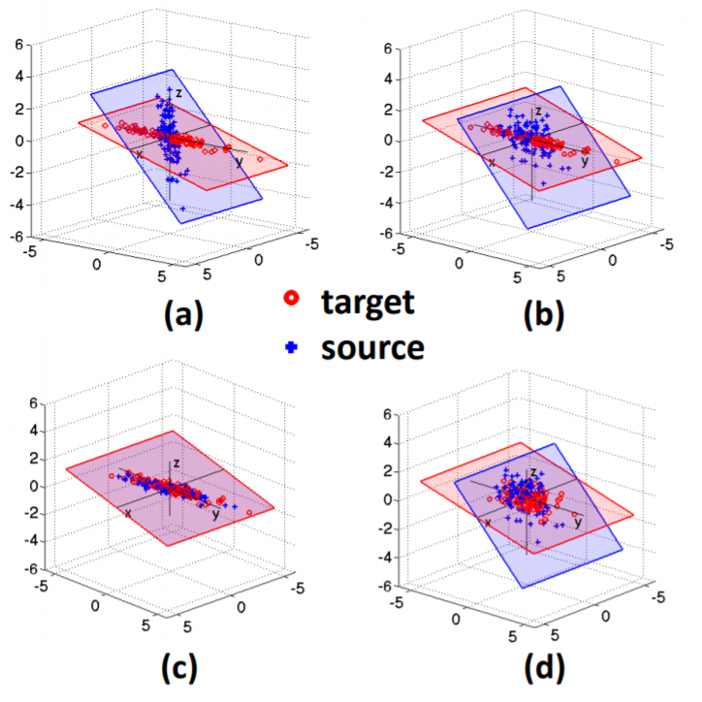
Domain Adaptation Methods
CoRAL (Correlation Alignment)
CoRAL works on Unsupervised Domain Adaptation
Map the source domain distribution by recoloring the whitened features with second order statistics of target domain
Notes:
Coral works on unsupervised domain adaptation
It maps source domain distribution by re-colring whitened features with second order statistics of target domain
Covariance statistics is computed for target domain and then re-coloring linear transformation is performed.

Slide 12
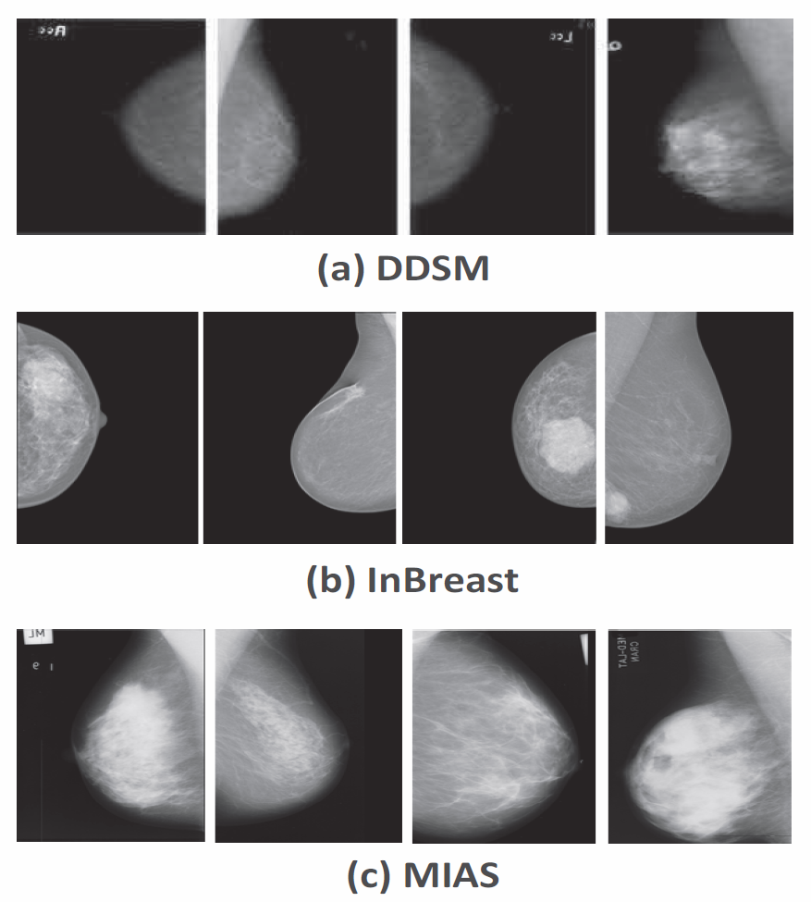
Three publicly available datasets
CBIS-DDSM[5]
3103 scanned mammograms
Contain Benign and Malignant images
InBreast [6]
Full field digital images contain different color profiles
Contain 410 mammograms from 115 patients
Mammograms was labeled in Benign and Malignant based on BI-RAIDS reading
MIAS [7]
Contain 322 mammograms
MIAS images are the scanned copies of films
Only 109 images are with Benign and Malignant views.
Notes:
The Inbreast dataset contain full field digital iamges as opposed to digitized iamges

Slide 13
Preprocessing and Feature Extraction
CBIS-DDSM already contain patches
MIAS dataset contain ROI annotations
Patches are cropped out based on ROI
Feature extraction from patches
On CBIS-DDSM and MIAS datasets
Patches are resized to 224 x 224
Feature extraction from whole images
Whole images are fixed to 1152 x 896
We feed both patches or whole images to pre-trained deep learning models for visual descriptors
Notes:
These images were converted to PNG format.

Slide 14
Classifier and Evaluation Metrics
SVM
Binary Classifier with Linear Kernel
Cost value = 1
Training-testing split
CBIS-DDSM dataset is used as training
Inbreast and MIAS dataset is used as testing
ROC
Visualize the performance of binary classifier
Plot of True Positive rate on y-axis and false Positive rate on x-axis
AUC
AUC is the area under the ROC curve.
Useful when classes are unbalanced.
Different Dimensionality
Produce a compact low-dimensional encoding
Simplify, reduce, and clean the data
Notes:
Data dimensionality reduction: Produce a compact low-dimensional encoding of a given high-dimensional data set.
Preprocessing for supervised learning: Simplify, reduce, and clean the data for subsequent supervised training.

Slide 15
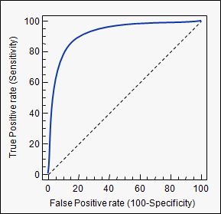
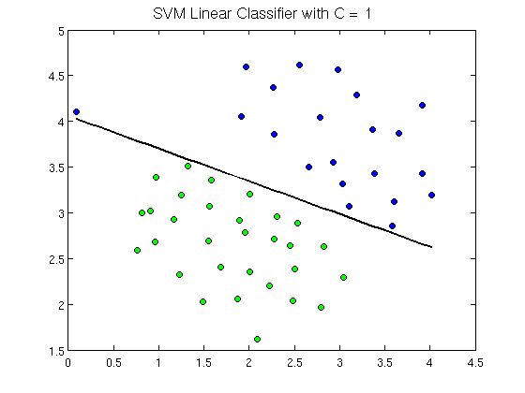
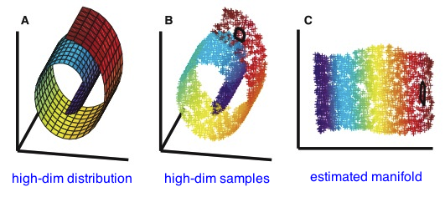
Classifier and Evaluation Metrics
AUC
Notes:
For the evaluation we used the ROC curve to compute AUC. The ROC shows the relation between true positive rate and false positive rate.
The AUC is also useful for imbalance classes.
Data dimensionality reduction: Produce a compact low-dimensional encoding of a given high-dimensional data set.
Preprocessing for supervised learning: Simplify, reduce, and clean the data for subsequent supervised training.

Slide 16
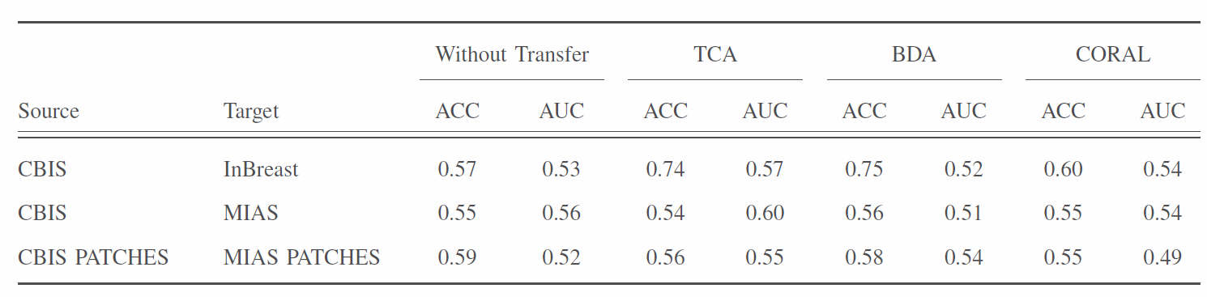
Experimental Results

Slide 17
RESULTS
Notes:
In this section I am showing the results that we obtained using different methods.

Slide 18
Results
Source | Target | Without Transfer |  | TCA |  | BDA |  | CORAL
 |  | ACC | AUC | ACC | AUC | ACC | AUC | ACC | AUC
CBIS | InBreast | 0.57 | 0.53 | 0.74 | 0.57 | 0.76 | 0.52 | 0.6 | 0.54
CBIS | MIAS | 0.55 | 0.56 | 0.54 | 0.6 | 0.56 | 0.51 | 0.55 | 0.54
CBIS Patches | MIAS Patches | 0.59 | 0.52 | 0.56 | 0.55 | 0.58 | 0.54 | 0.55 | 0.49
Accuracy and AUC using Different methods
Notes:
Here we used the CBIS-DDSM data set whole images and patches as a source dataset, while Inbreast and MIAS as target dataset.
First we didn’t used any method we used normal classification by training on source dataset and testing on target data set.
Then we explored the performance using different transfer learning methods.

Slide 19
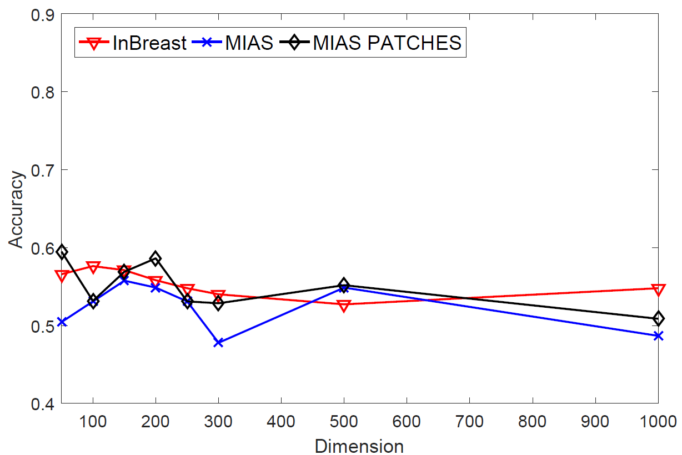
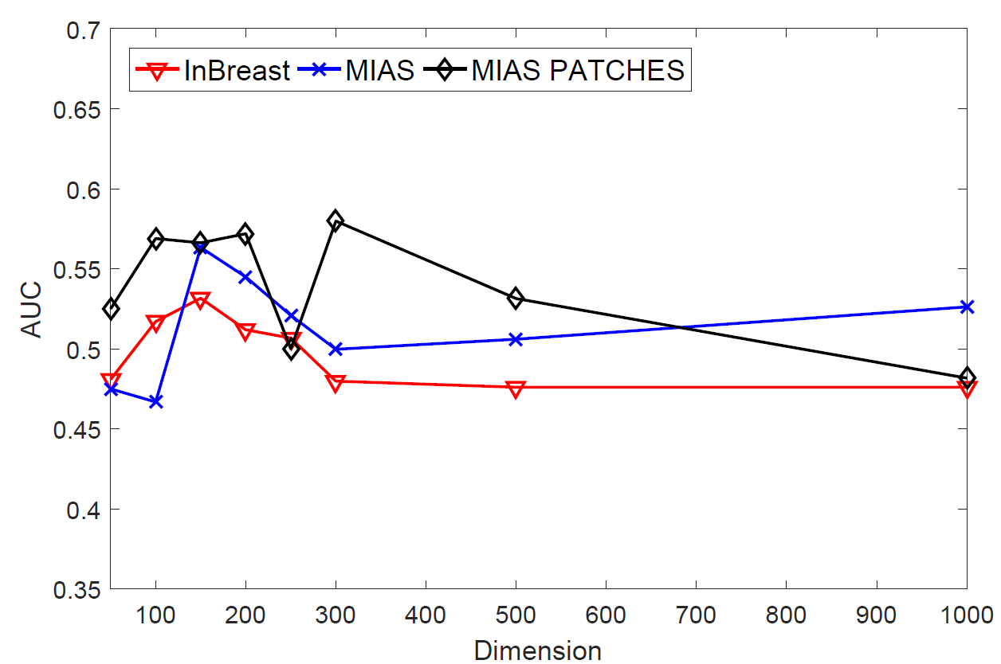
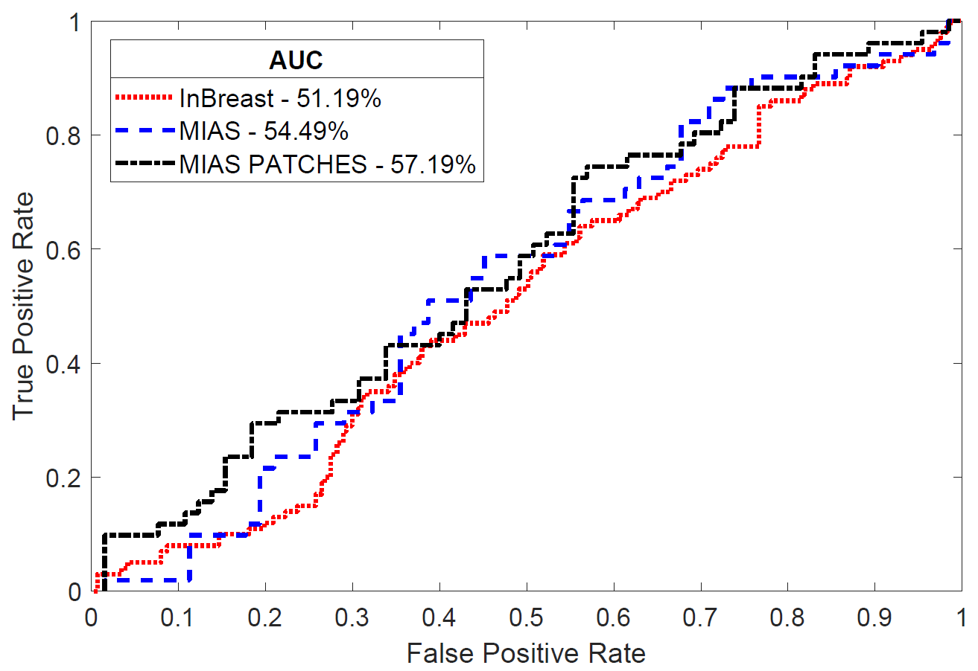
Results (Without Transfer Learning)
Source | Target | Method
CBIS | InBreast , MIAS , MIAS Patches | Without Transfer Learning
Notes:
As most of the methods are using the dimensionality reduction techniques so we explored over model by giving particular no on dimesnion to check whether performance makes any difference to performance of model

Slide 20
Results (Without Transfer Learning)
Source | CBIS, CBIS Patches
Target | InBreast, MIAS, MIAS Patches
Method | Without Transfer Learning
Notes:
As most of the methods are using the dimensionality reduction techniques so we explored over model by giving particular no on dimesnion to check whether performance makes any difference to performance of model

Slide 21
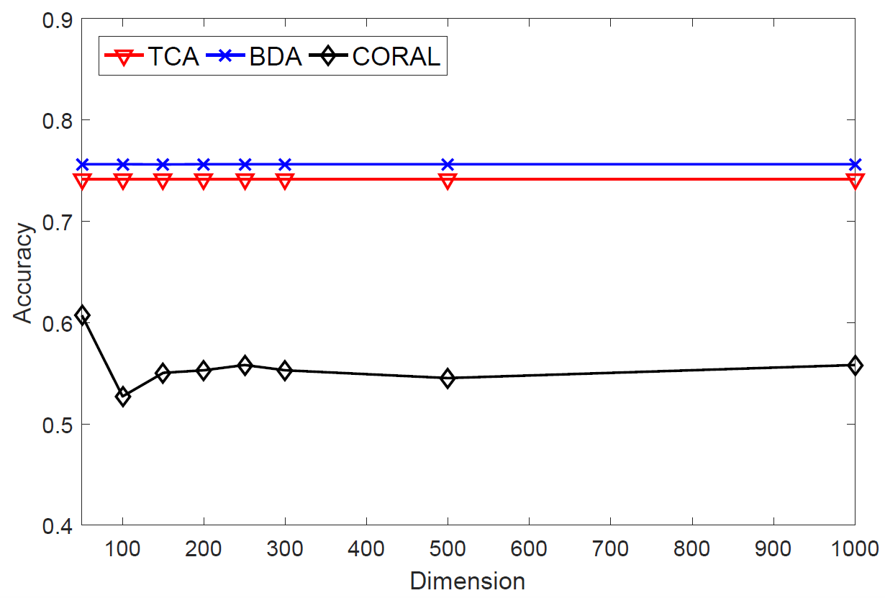
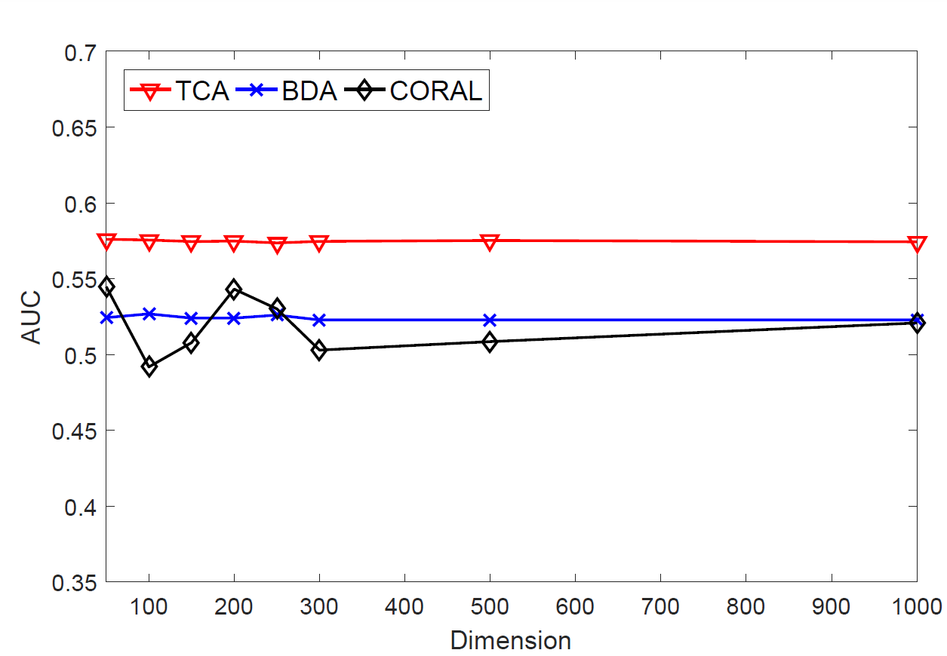
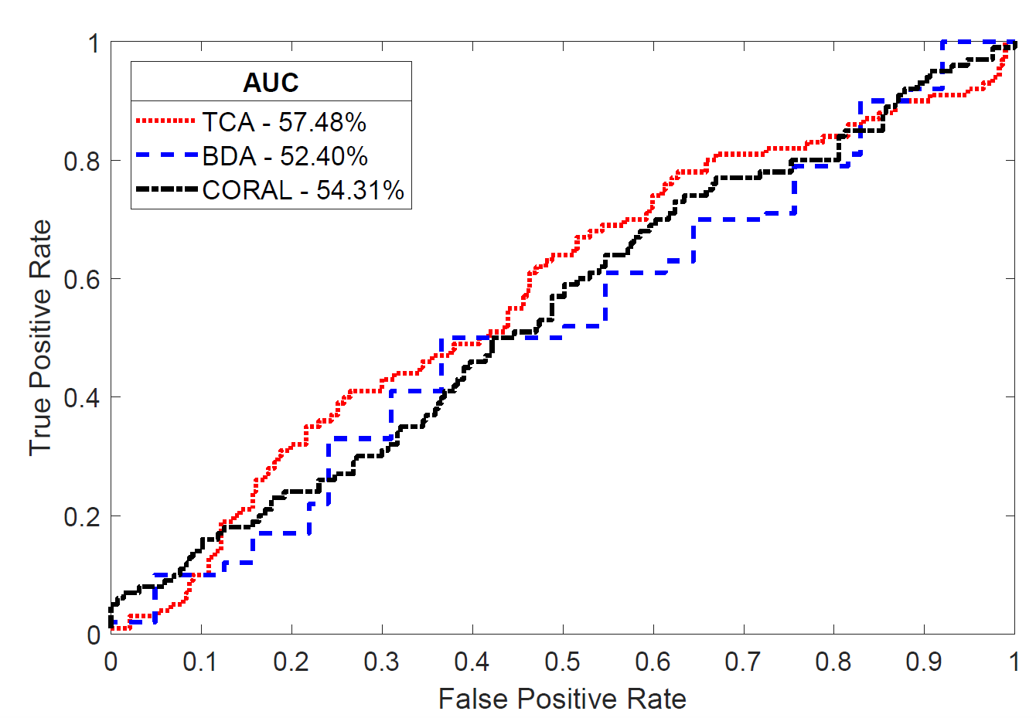
Results
Source | Target | Method
CBIS | InBreast | TCA ,BDA , CORAL

Slide 22
Results
Source | CBIS
Target | InBreast
Method | TCA, BDA, CoRAL

Slide 23
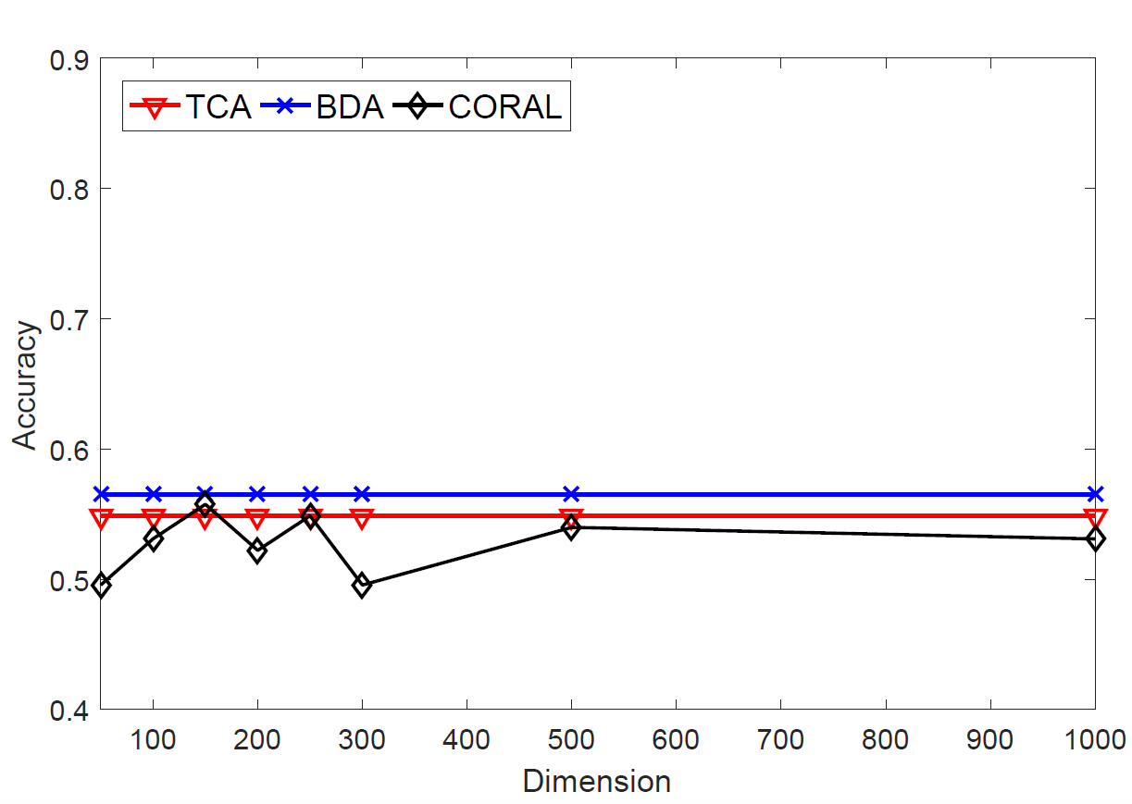
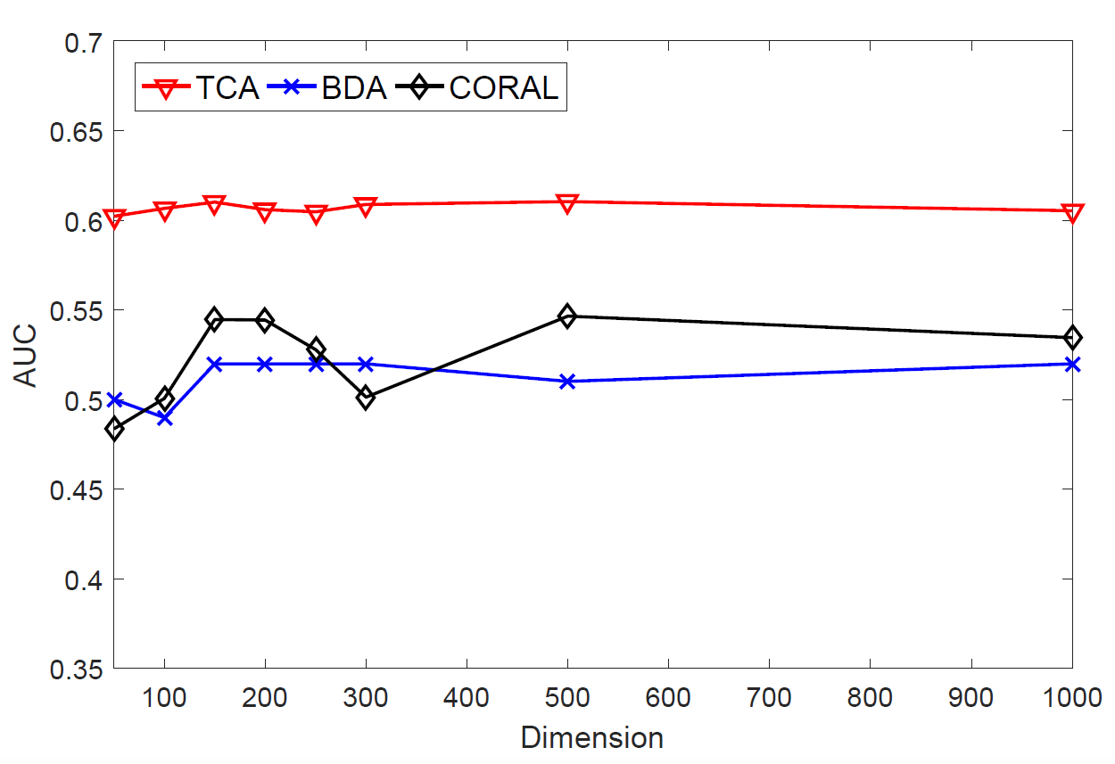
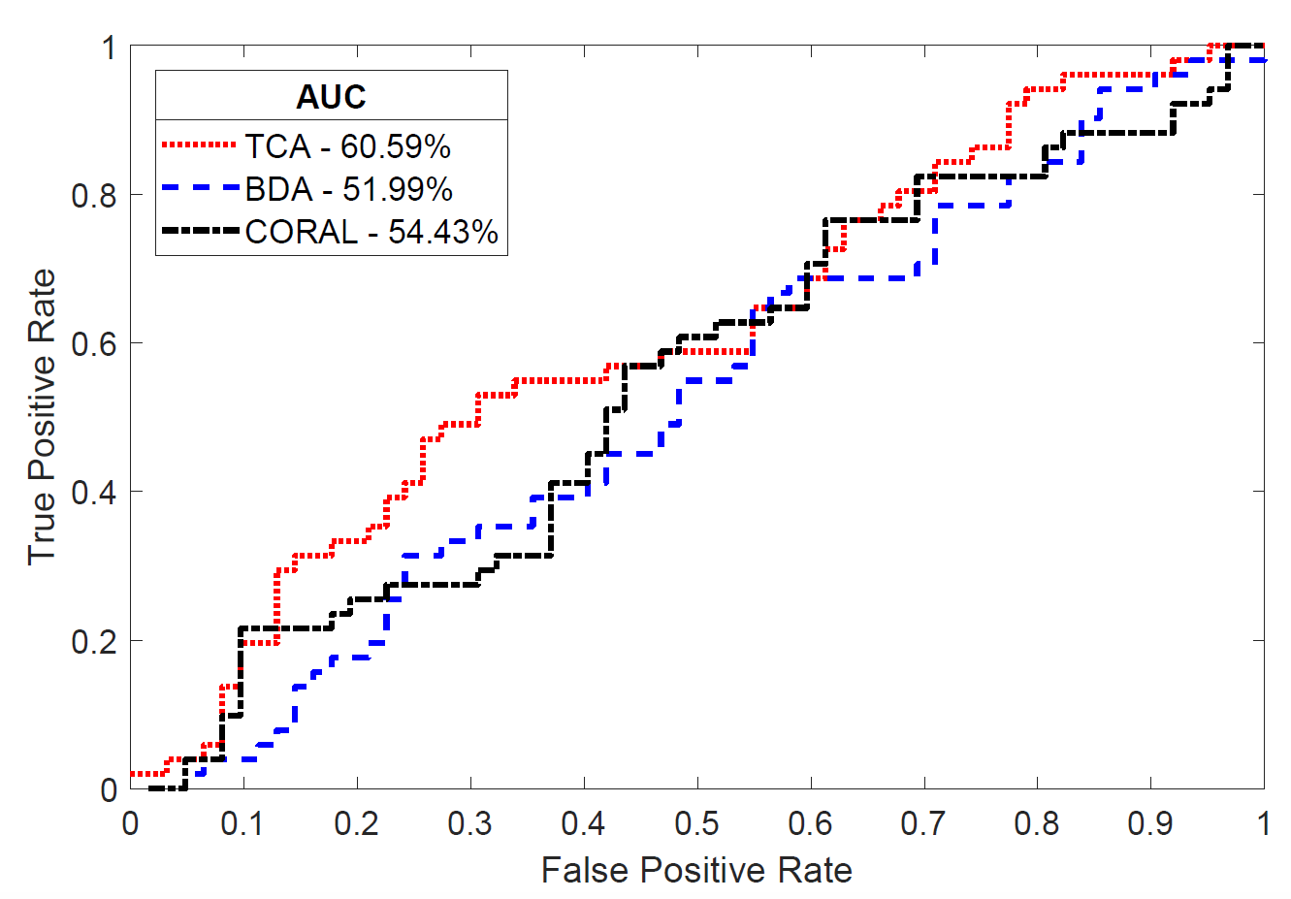
Results
Source | Target | Method
CBIS | MIAS | TCA , BDA , CORAL

Slide 24
Results
Source | CBIS
Target | MIAS
Method | TCA, BDA, CoRAL

Slide 25
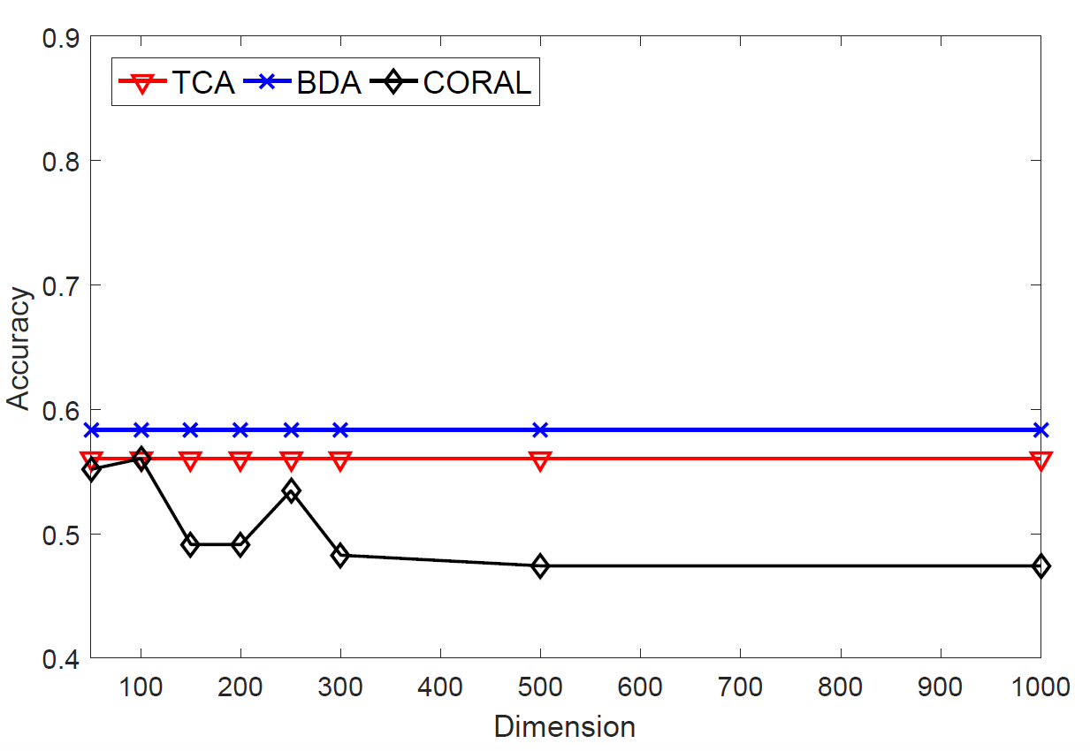
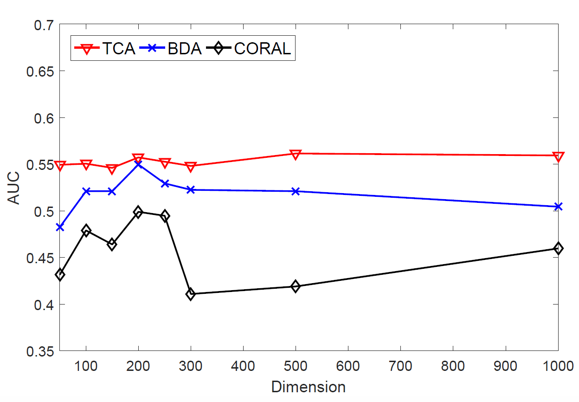
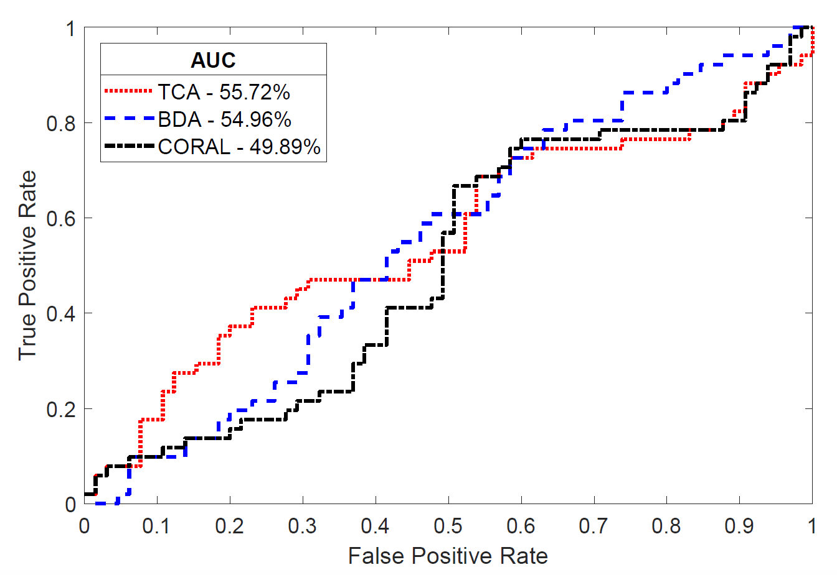
Results
Source | Target | Method
CBIS | MIAS Patches | TCA , BDA , CORAL

Slide 26
Results
Source | CBIS Patches
Target | MIAS Patches
Method | TCA, BDA, CoRAL

Slide 27
Conclusion
Performed Unsupervised Domain Adaptation
Source Dataset Labeled Mammograms
Target Dataset Unlabeled Mammograms
Explored Transfer Learning Methods
TCA
BDA
CoRAL
Notes:
So Our study more focused on mammograms without ROI annotation and we performed unsupervised domain adaptation. We took Labeled mammograms dataset as a source dataset and assumed that Target dataset does not contain any labels. And then explored different transfer learned model.
So the extensive experimental results show that transfer learning works well compared to the model without knowledge transfer.

Slide 28
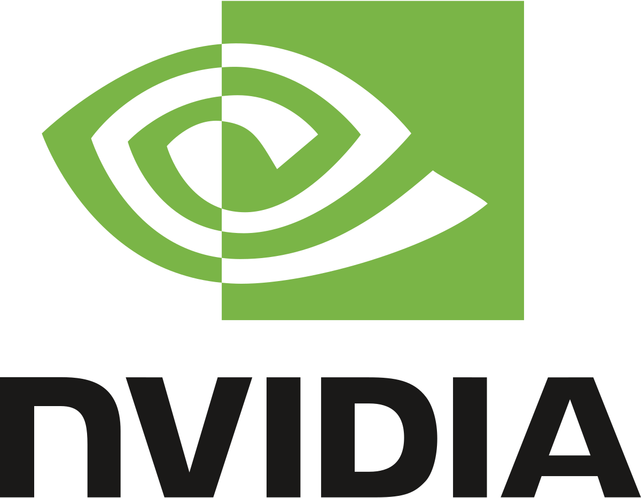
Acknowledgement
We gratefully acknowledge the support of NVIDIA Corporation with the donation of the Titan X Pascal GPU used for this research.

Slide 29
References
L. Shen, “End-to-end training for whole image breast cancer diagnosis using an all convolutional design,” arXiv preprint arXiv:1708.09427, 2017
S. J. Pan, I. W. Tsang, J. T. Kwok, and Q. Yang, “Domain adaptation via transfer component analysis,” IEEE Transactions on Neural Networks, vol. 22, no. 2, pp. 199–210, 2011.
B. Sun, J. Feng, and K. Saenko, “Return of frustratingly easy domain adaptation.” in AAAI, vol. 6, no. 7, 2016, p. 8.
J. Wang, Y. Chen, S. Hao, W. Feng, and Z. Shen, “Balance distribution adaption for transfer learning,” 2017.
R. S. Lee, F. Gimenez, A. Hoogi, and D. Rubin, “Curated breast imaging subset of ddsm,” The Cancer Imaging Archive,2016.
I. C. Moreira, I. Amaral, I. Domingues, A. Cardoso, M. J. Cardoso, and J. S. Cardoso, “Inbreast: toward a full-field digital mammographic database,” Academic radiology, vol. 19, no. 2, pp. 236–248, 2012.
J. Suckling, J. Parker, D. Dance, S. Astley, I. Hutt, C. Boggis, I. Ricketts, E. Stamatakis, N. Cerneaz, S. Kok et al., “The mammographic image analysis society digital mammogram database,” in Exerpta Medica. International Congress Series, vol. 1069, 1994, pp. 375–378

