Slide 1
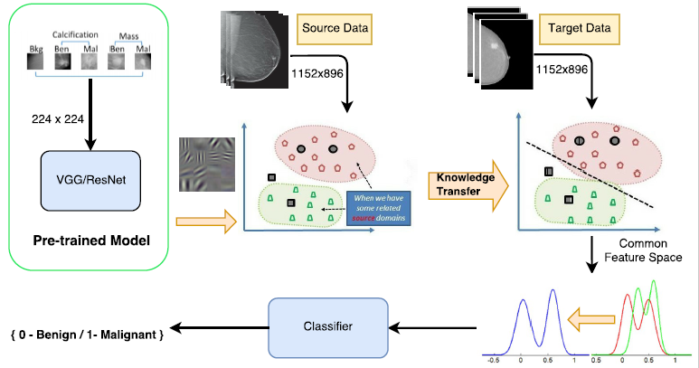
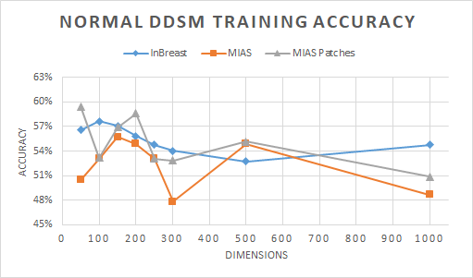
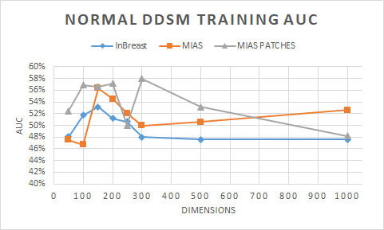
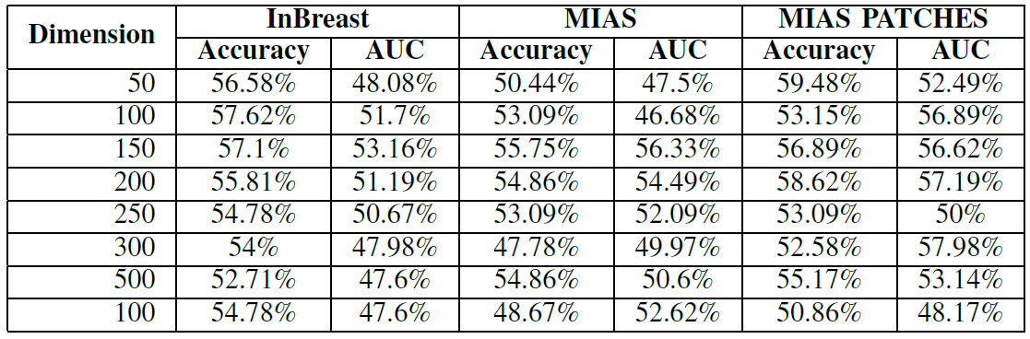
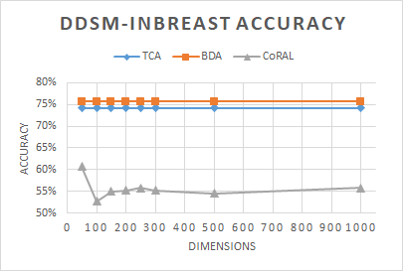
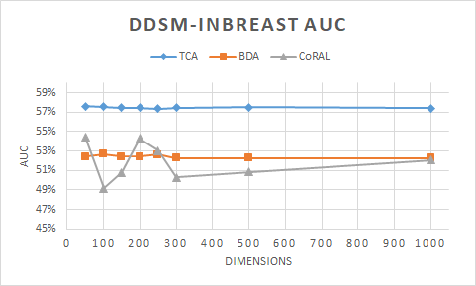
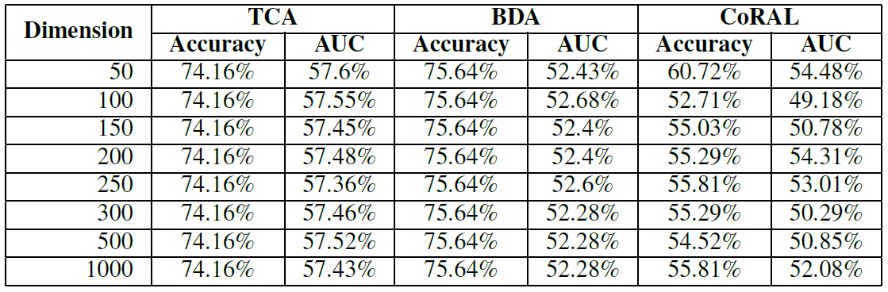
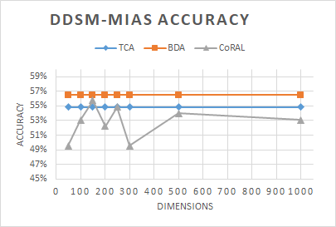
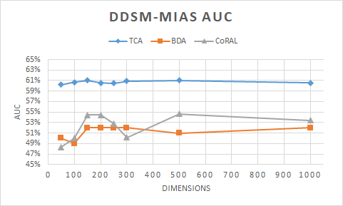
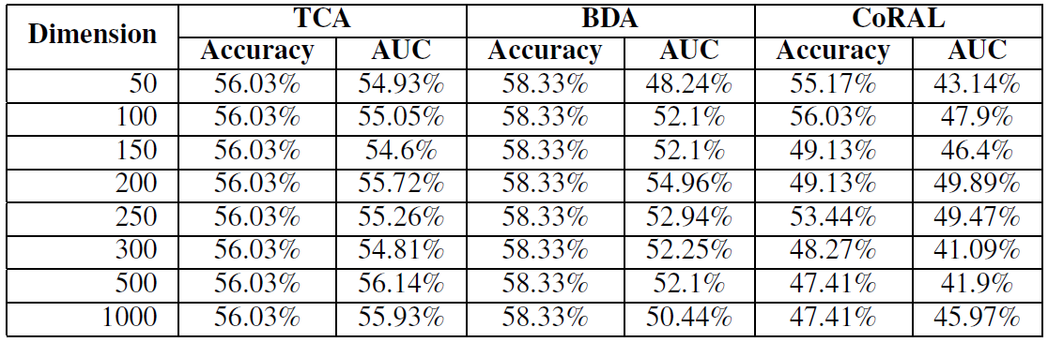
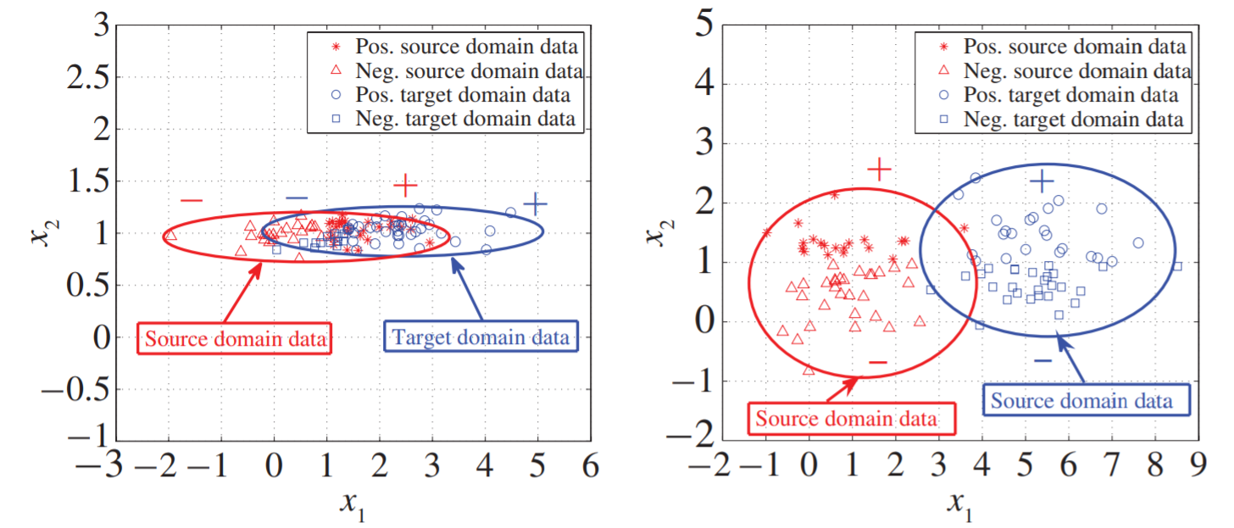
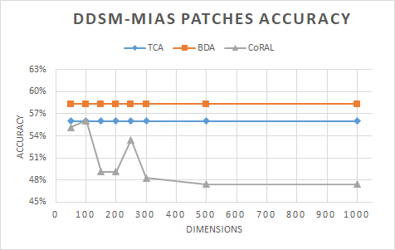
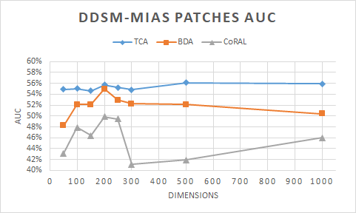
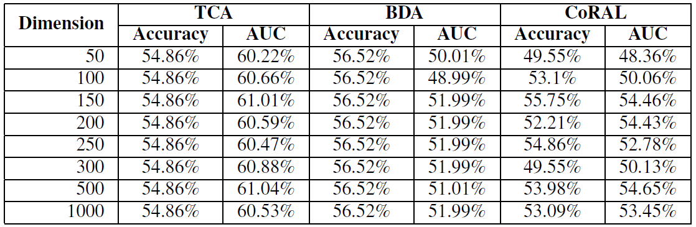
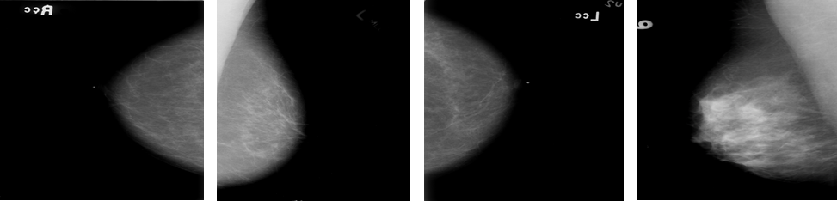
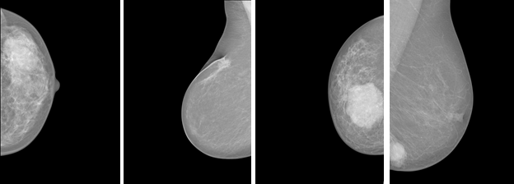
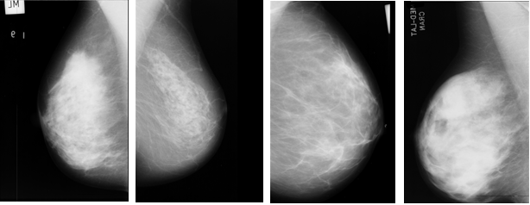
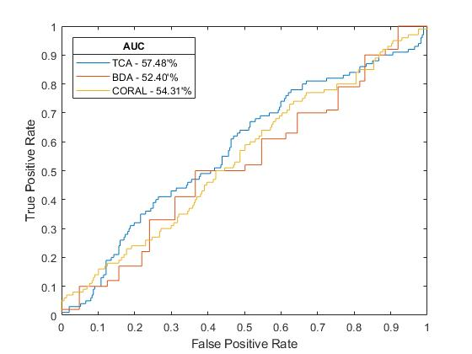
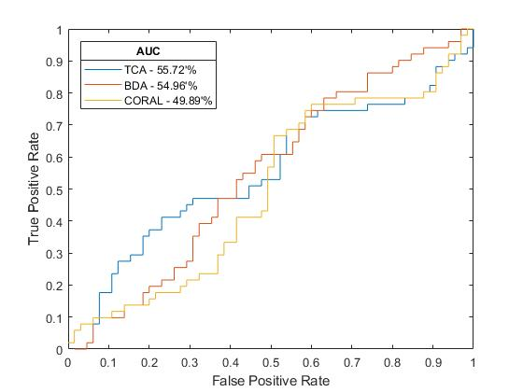
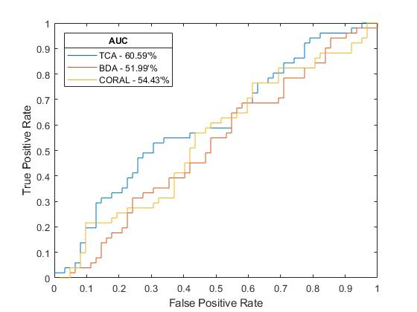
Cross-Database Mammographic Image Analysis through Unsupervised Domain Adaptation
Deepak Kumar$1$, Chetan Kumar¹, Ming Shao²
¹Department of Data Science, University of Massachusetts , Dartmouth
²Department of Computer and Information Sciences, University of Massachusetts, Dartmouth
Introduction
Methodology
MIAS
Dataset contains 322 MLO view mammograms
MIAS images are scanned copies of films
Only 109 images are labeled
Breast Cancer is common health issue
1.7 million cases were found and total 14.71% deaths occurred world wide
Mammography is the best option available to diagnose breast cancer at early stage
Radiologists expertise are required for interpolation of mammograms
Computer Assisted Diagnosis (CAD) have caught the attention to automate the process of medical image classification
CAD completely rely on the pre segmented portion of mammograms know as Region of Interest (ROI)
These system rely on the assumption that training and future data has the same feature space and follows the same distribution
It is expensive to acquire the sufficient new labeled data to rebuild the model
Pre-trained End-to-End training models are used for feature extraction from publicly available databases
CBIS-DDSM
InBreast
MIAS
Data has been transformed into same feature space using the following transfer learning methods:
TCA (Transfer Component Analysis)
BDA (Balance Distribution Adaption)
CoRAL (Correlation Alignment)
End-to-End training algorithm for whole-image breast cancer diagnosis is based on mammograms without the need of the ROI annotations.
In End-to-End three different convolutional network are used but first they trained on the patch classifier by changing the learning rate by freezing and unfreezing the layers.
They fixed the mammogram patch image size to 224 x 224 and whole image size 1152 x 896.
Domain Adaption
TCA (Transfer Component Analysis)
Learn the common Components
Reduce the differences between source and target distribution by projecting on common subspace
BDA (Balance Distribution Adaption)
Balance the marginal and conditional distribution adaption
For different data Marginal distribution is important
For similar data Conditional distribution is important
Handles the data class imbalanced by adjusting each class weight
CoRAL (Correlation Alignment)
CoRAL works on unsupervised domain adaption
Map source domain distribution by recoloring the whitened features with second order statistics of target domain
Experimental Results
Three publicly available dataset are used
CBIS-DDSM
3103 scanned mammograms
Data contain Benign and Malignant images
Dataset contains Cranial Cardo (CC) and Media later oblique (MLO) views
InBreast
Full field digital images contain different color profiles
The dataset contains 410 mammograms from 115 patients including Cranial Cardo (CC) and Media Later Oblique (MLO) views
Data contains BI-RAIDS readings
Sample was divided in Benign and Malignant based on BI-RAIDS reading
Datasets
DDSM- INBREAST
DDSM- MIAS
DDSM- MIAS PATCHES
CBIS- DDSM
InBreast
MIAS
Transfer Learning
References
Traditional machine learning methods learn models based on:
Pre collected label data to predict new data
New data should be in same distributed space
It is difficult to get rich labeled data
Transfer learning facilitates
Different distribution for training and future data
Transfer learning can be promising
Characteristics of different sub domain are mapped into wide common domain
L. Shen, “End-to-end training for whole image breast cancer diagnosis using an all convolutional design,” arXiv preprint arXiv:1708.09427, 2017
S. J. Pan, I. W. Tsang, J. T. Kwok, and Q. Yang, “Domain adaptation via transfer component analysis,” IEEE Transactions on Neural Networks, vol. 22, no. 2, pp. 199–210, 2011.
B. Sun, J. Feng, and K. Saenko, “Return of frustratingly easy domain adaptation.” in AAAI, vol. 6, no. 7, 2016, p. 8.
J. Wang, Y. Chen, S. Hao, W. Feng, and Z. Shen, “Balance distribution adaption for transfer learning,” 2017.

