Slide 1
Cross-Database Mammographic Image Analysis through Unsupervised Domain Adaptation
Deepak Kumar, Chetan Kumar, Ming Shao

Slide 2
Introduction
Breast Cancer is common health issue
1.7 million cases were found and total 14.71% deaths occurred world wide
Mammography is the best option available Diagnose breast cancer at early stages
Radiologists expertise are required for interpolation of mammograms
Computer assisted diagnosis (CAD) have caught the attention to automate the process of medical image classification.
CAD completely rely on the pre segmented potion of mammograms know as Region of Interest (ROI).
These system rely on the assumption that training and future data has the same feature space and follows the same distributions.
It is expensive to acquire the sufficient new labeled data for Rebuilding the model

Slide 3
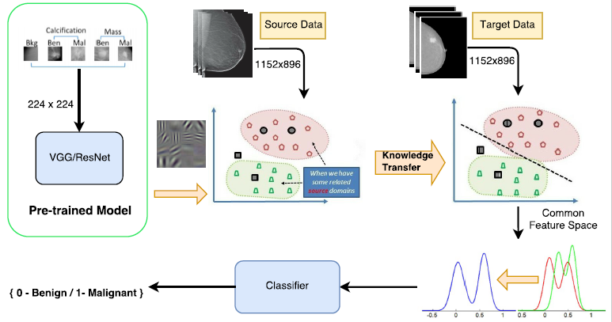
Introduction
End to End training pretrained model [1] are used for feature extraction from publicly available database
CBIS-DDSM
InBreast
MIAS
To Transform the data in same feature space following transfer learning methods are used
TCA (Transfer Component Analysis) [2]
BDA (Balance Distribution Adaption) [4]
CoRAL (Correlation Alignment) [3]

Slide 4
Transfer Learning
Traditional machine learning methods learns models
pre collected label data to predict new data
New data should in same distributed space
Transfer learning facilitates
different distribution or domain for training and future data
source data and target data is in different domain
It very difficult to get rich labeled data
Transfer learning can be promising
characteristics of different sub domain lie in wide common domain
Different scenarios for source and target data
Homogenous Feature and label space but domain is different
Feature space is same but label space is heterogenous
Feature and label space are different for both.

Slide 5
Methodology
End to End training algorithm for whole-image breast cancer diagnosis based on mammograms without the need of the ROI annotations.
In End to End three different convolutional network are used but first they trained on the patch classifier by changing the learning rate by freezing and unfreezing the layers.
They fixed the mammogram patch image size to 224 x 224 and whole image size 1152 x 896.
Domain Adaption
TCA (Transfer Component Analysis)
Learn the common Component
Reduce the differences in source and target distribution by projecting on common subspace

Slide 6
Methodology
Domain Adaption
BDA (Balance Distribution Adaption)
Balance the marginal and conditional distribution adaption
Marginal distribution is dominant
Dataset are very different
Conditional distribution is important
Datasets are more similar
Handles the data with class imbalance by adjusting the each class weight.
CoRAL (Correlation Alignment)
CoRAL works on unsupervised domain adaption
Map Source domain distribution by recoloring the whitened features with second order statistics of target domain

Slide 7
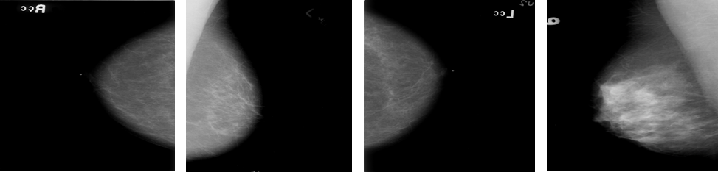
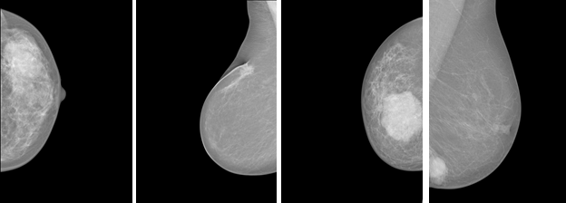
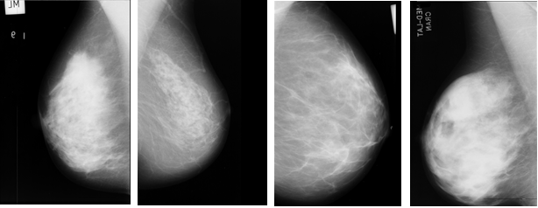
Datasets
Three publicly available dataset are used
CBIS-DDSM[5]
3103 scanned mammograms images
Data contain Benign and Malignant images
Dataset contains Cranial Cardo (CC) and Media later oblique (MLO) views
InBreast [6]
Full Field digital images contain different color profiles
The dataset contains 410 mammograms from 115 patients including Cranial Cardo (CC) and Media later oblique (MLO) views
Data contain BI-RAIDS readings
Sample was divided in Benign and Malignant based on BI-RAIDS reading
MIAS [7]
Dataset contains 322 MLO mammogram view images
MIAS images are the scanned copies of films
Only 109 images are with Benign and Malignant views.
Notes:
The Inbreast dataset contain full field digital iamges as opposed to digitized iamges

Slide 8
Preprocessing and feature Extraction
These images were converted to PNG format.
The CBIS-DDSM already contain patches
MIAS dataset contain ROI annotations
Based on ROI annotations we cropped the whole images
Feature Extraction From patches
CBIS-DDSM and MIAS dataset are used for patches
End to End Resnet50 pretrained model is used for feature extraction
The patches input fixed to 224 x 224
Feature Extraction From whole images
CBIS-DDSM, InBreast and MIAS dataset are used for patches
End to End [] Resnet50 + two [512 x 512 x 1024] *2 residual block pretrained model is used for feature extraction
The patches input fixed to 1152 x 896

Slide 9
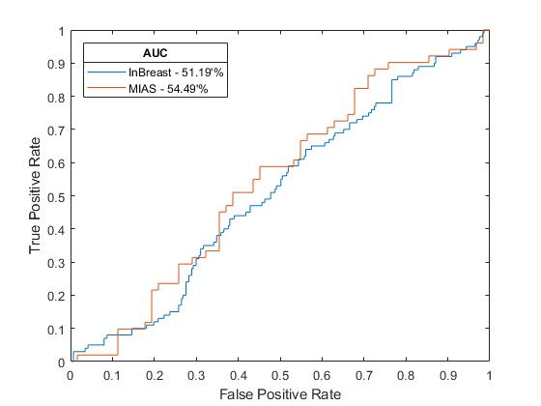
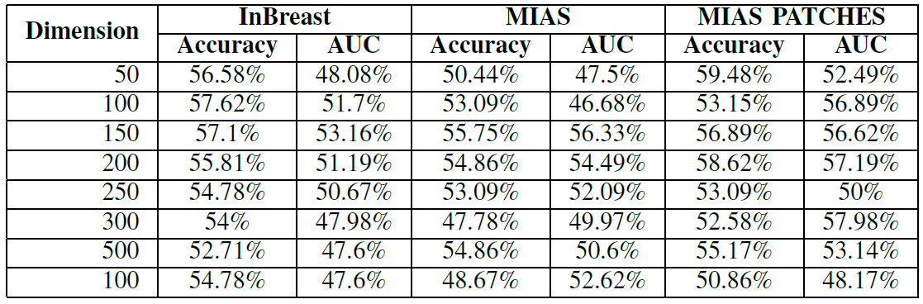
Experimental Results
Whole Images ROC CURVE
The Inbreast and MIAS datasets are unbalanced datasets
Training is done on CBIS-DDSM datasets
InBreast and MIAS datasets are used for testing
Normal Testing
Before training the all three data dimension were reduced between 50-100
LibSvm was used to train the data
Linear Kernel
Cost = 1
Accuracy
InBreast – 57.62%
MIAS – 55.75%
MIAS Patches – 59.48%
AUC
InBreast – 53.16%
MIAS – 56.33%
MIAS Patches – 57.98%

Slide 10
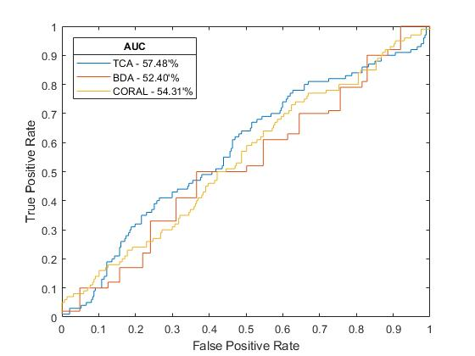
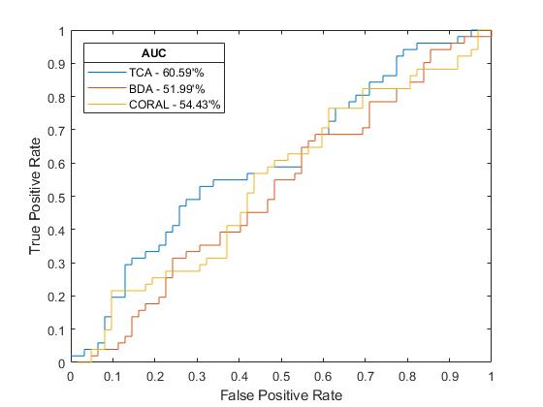
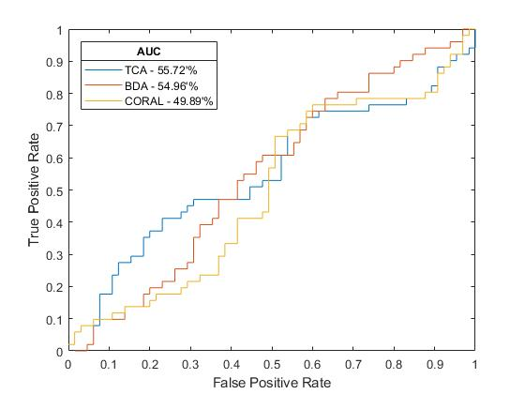
Experimental Results
DDSM-INBREAST ROC Curve
We exploring different domain adaption methods
Compare the results
Without domain adaption
With domain adaption
Performance evaluation is done using three state-of-art-methods
TCA (Transfer Component Analysis)
BDA (Balance Distribution Adaption)
CoRAL (Correlation Alignment )
TCA and BDA acting as dimensionality reduction
Data dimension was reduced before passing data to CoRAL
The lambda and gamma value is set 1 for TCA and BDA with 10 iteration
BDA has extra parameter mu and the value is set to 0.2
BDA is using the KNN while the TCA and CoRAL data was trained using Libsvm
Linear Kernel is used for all three methods.
DDSM-MIAS ROC Curve
DDSM-MIAS Patches ROC Curve

Slide 11
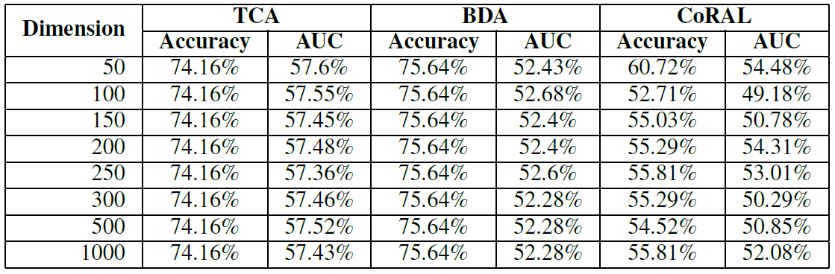
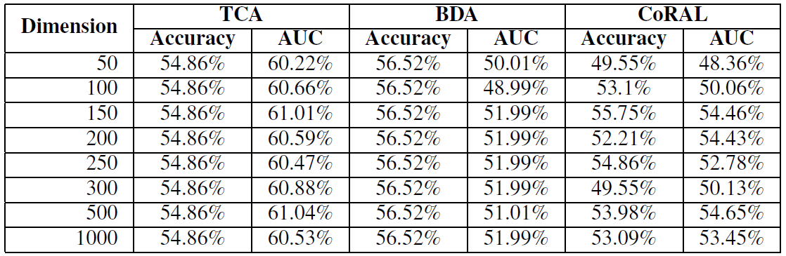
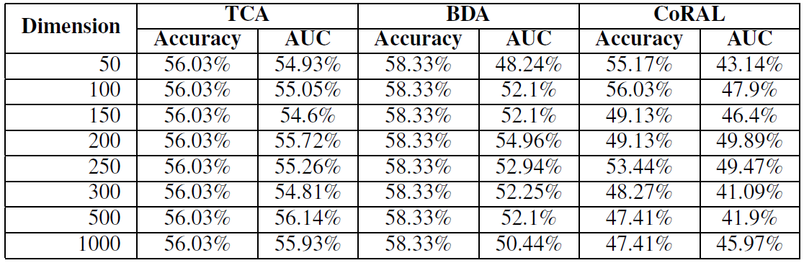
Experimental Results
DDSM- InBreast
DDSM- MIAS
DDSM- MIAS Patches

Slide 12
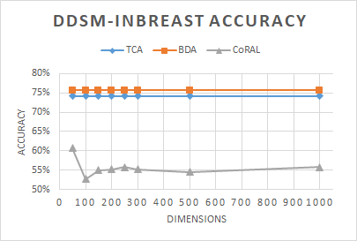
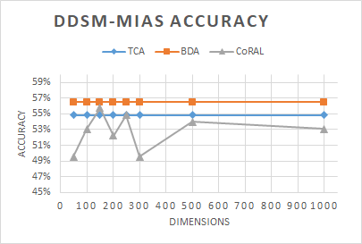
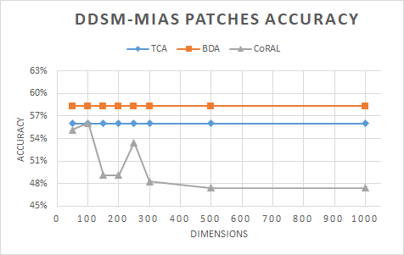
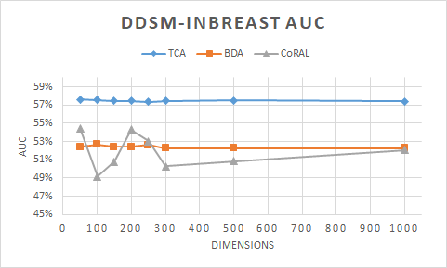
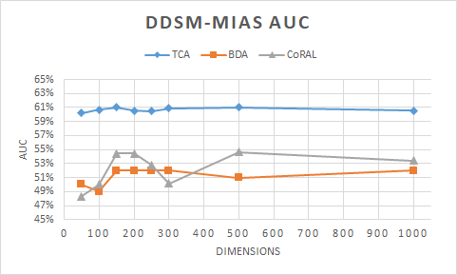
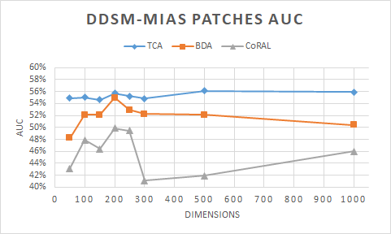
Experimental Results

Slide 13
References
L. Shen, “End-to-end training for whole image breast cancer diagnosis using an all convolutional design,” arXiv preprint arXiv:1708.09427, 2017
S. J. Pan, I. W. Tsang, J. T. Kwok, and Q. Yang, “Domain adaptation via transfer component analysis,” IEEE Transactions on Neural Networks, vol. 22, no. 2, pp. 199–210, 2011.
B. Sun, J. Feng, and K. Saenko, “Return of frustratingly easy domain adaptation.” in AAAI, vol. 6, no. 7, 2016, p. 8.
J. Wang, Y. Chen, S. Hao, W. Feng, and Z. Shen, “Balance distribution adaption for transfer learning,” 2017.
R. S. Lee, F. Gimenez, A. Hoogi, and D. Rubin, “Curated breast imaging subset of ddsm,” The Cancer Imaging Archive,2016.
I. C. Moreira, I. Amaral, I. Domingues, A. Cardoso, M. J. Cardoso, and J. S. Cardoso, “Inbreast: toward a full-field digital mammographic database,” Academic radiology, vol. 19, no. 2, pp. 236–248, 2012.
J. Suckling, J. Parker, D. Dance, S. Astley, I. Hutt, C. Boggis, I. Ricketts, E. Stamatakis, N. Cerneaz, S. Kok et al., “The mammographic image analysis society digital mammogram database,” in Exerpta Medica. International Congress Series, vol. 1069, 1994, pp. 375–378

