Slide 1
Text Mining and Processing using Jupyter Notebook on Stampede
Abhishek, Chetan & Deepak
Prof. Scott Field

Slide 2
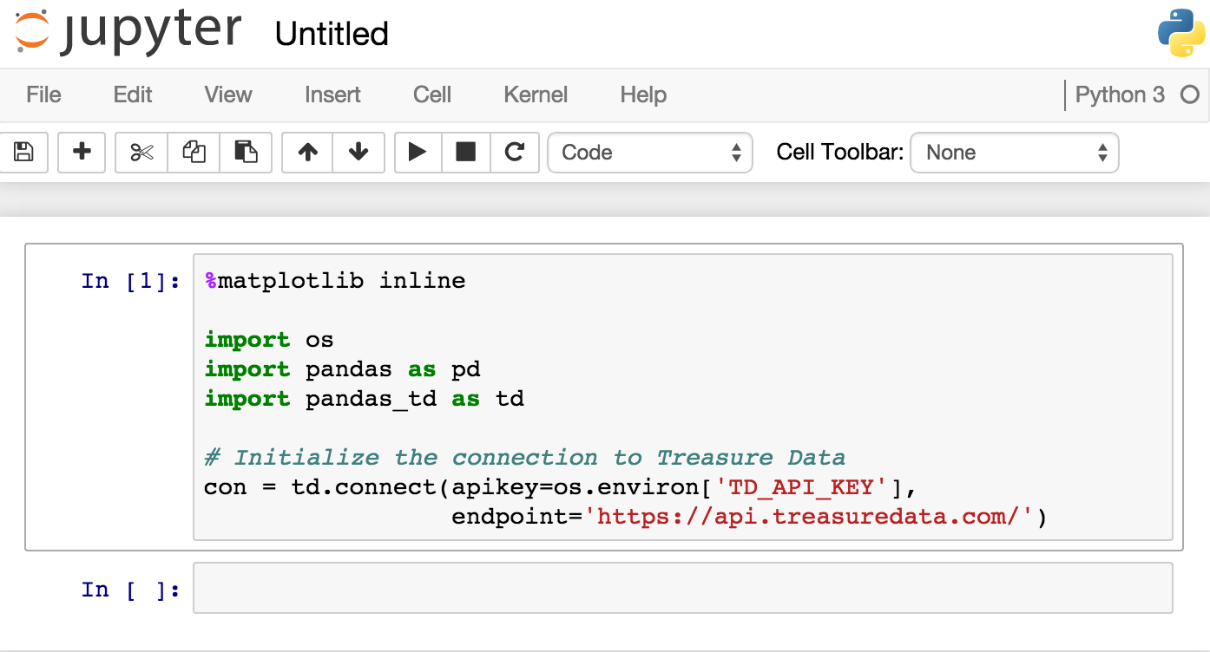
Jupyter Notebook
Sample Interface of Jupyter Notebook
Notes:
The Jupyter Notebook is a web application that allows you to create and share documents that contain live code, equations, visualizations and explanatory text. Uses include: data cleaning and transformation, numerical simulation, statistical modeling, machine learning and much more.

Slide 3
Why use Jupyter Notebook?
Language of choice
Share notebooks
Interactive widgets
Big data integration
How are we making use of Jupyter notebook?
Installed on Stampede
Remote Access
Big Data Analysis
Notes:
Language of choice
The Notebook has support for over 40 programming languages, including those popular in Data Science such as Python, R, Julia and Scala.
Share notebooks
Notebooks can be shared with others using email, Dropbox, GitHub and the Jupyter Notebook Viewer.
Interactive widgets
Code can produce rich output such as images, videos, LaTeX, and JavaScript. Interactive widgets can be used to manipulate and visualize data in realtime.
Big data integration
Leverage big data tools, such as Apache Spark, from Python, R and Scala. Explore that same data with pandas, scikit-learn, ggplot2, dplyr, etc.
Use of Jupyter notebook?
We have installed Jupyter notebook on stampede and set the port for remote access via our local machine (local host) for performing big data analysis (text mining) and the reason to use this to do large data analysis

Slide 4
How to setup Jupyter Notebook on Stampede?
Install Anaconda
Steps can be found below
https://github.com/jupyterhub/jupyterhub/wiki/Installation-of-Jupyterhub-on-remote-server
Setup remote Jupyter server on stampede (specify login1)
>>> ssh YOURNAME@login1.stampede.tacc.utexas.edu
(YOURNAME refers to TACC user name)
>>> ipython notebook --no-browser --port=7000
In local machine create ssh tunnel
>>> ssh -N -f -L localhost:8888:localhost:7000 YOURNAME@login1.stampede.tacc.utexas.edu
In browser: http://localhost:8888

Slide 5
Text Mining
We will be performing text analysis to extract information like
Extract structured data from unstructured text
Identifying the entities and relationship describing the text
We are using Python NLTK package for Text Mining

Slide 6
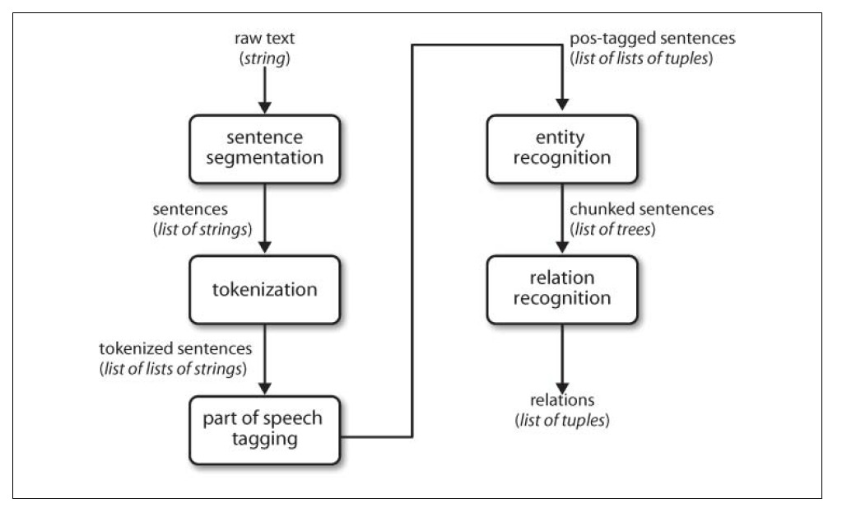
Text Mining Steps

Slide 7
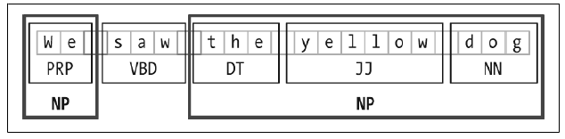
Entity Recognition
Technique used for entity recognition is chunking
Segments and labels the multi token sequence
Goal of the Entity Recognition is identify the mention of named Entities
Broke down into two sub tasks
Identify the boundaries of Named Entities
Identifying its type
Part of Speech Tags:
PRP : Pronoun, Personal
VBD : Verb, Past Tense
DT: determiner
JJ : adjective or numeral, ordinal
NN: noun, common, singular or mass

Slide 8
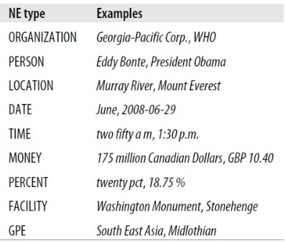
Relation Extraction
Entities identified into text
Extract relation between them
One Way approach this task is
Look for the triples of the form of (X , α, Y)
X and Y are the entities with type
“α” is the string of words
Intervenes between them

Slide 9
Analysis of Text
http://localhost:8888/notebooks/DSC520%20ppt.ipynb

Slide 10
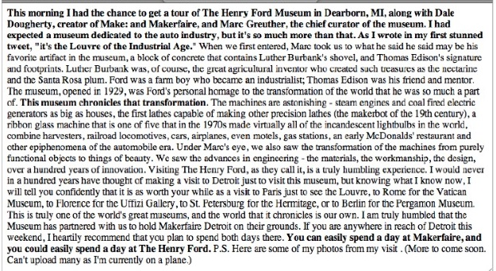
Document Summarization

Slide 11
References
Natural Language Processing with python by “Steven bird”
Python 3 Text Processing with NLTK Cookbook by Jacob perkins
Mining the Social Web by Matthew Russell

Slide 12
Thank you

