Slide 1




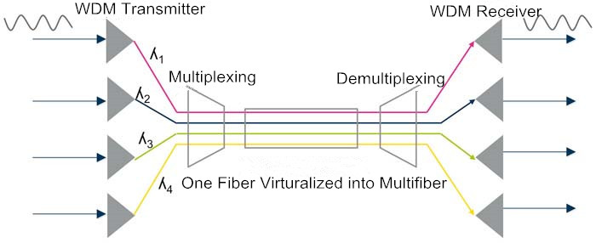


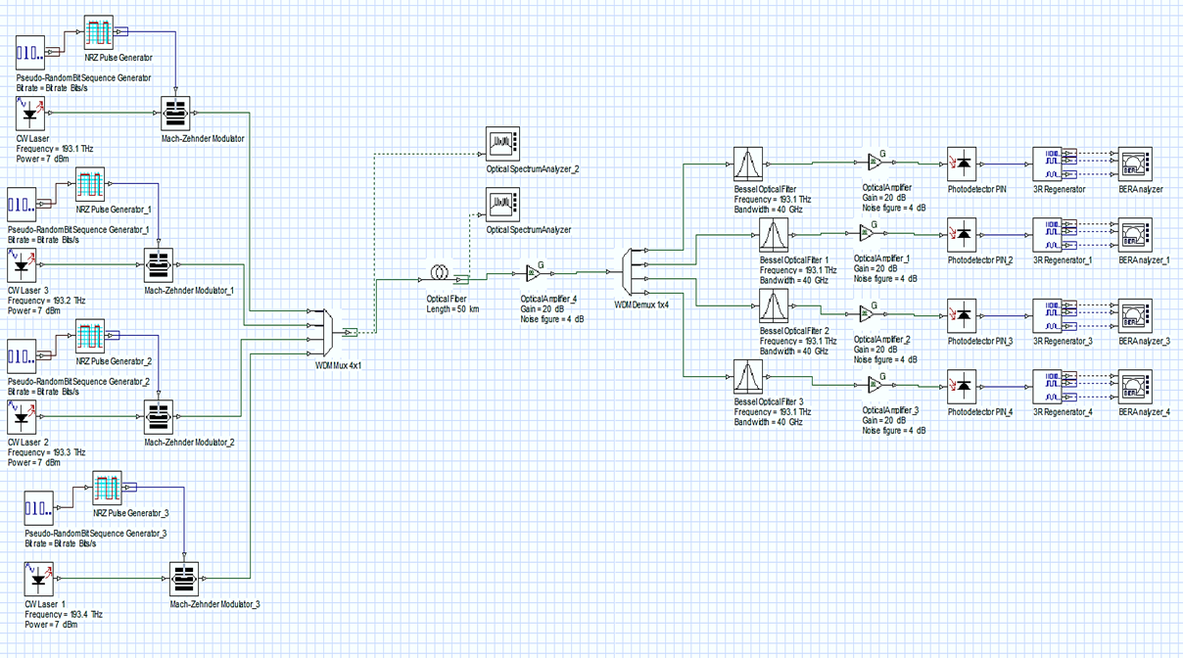
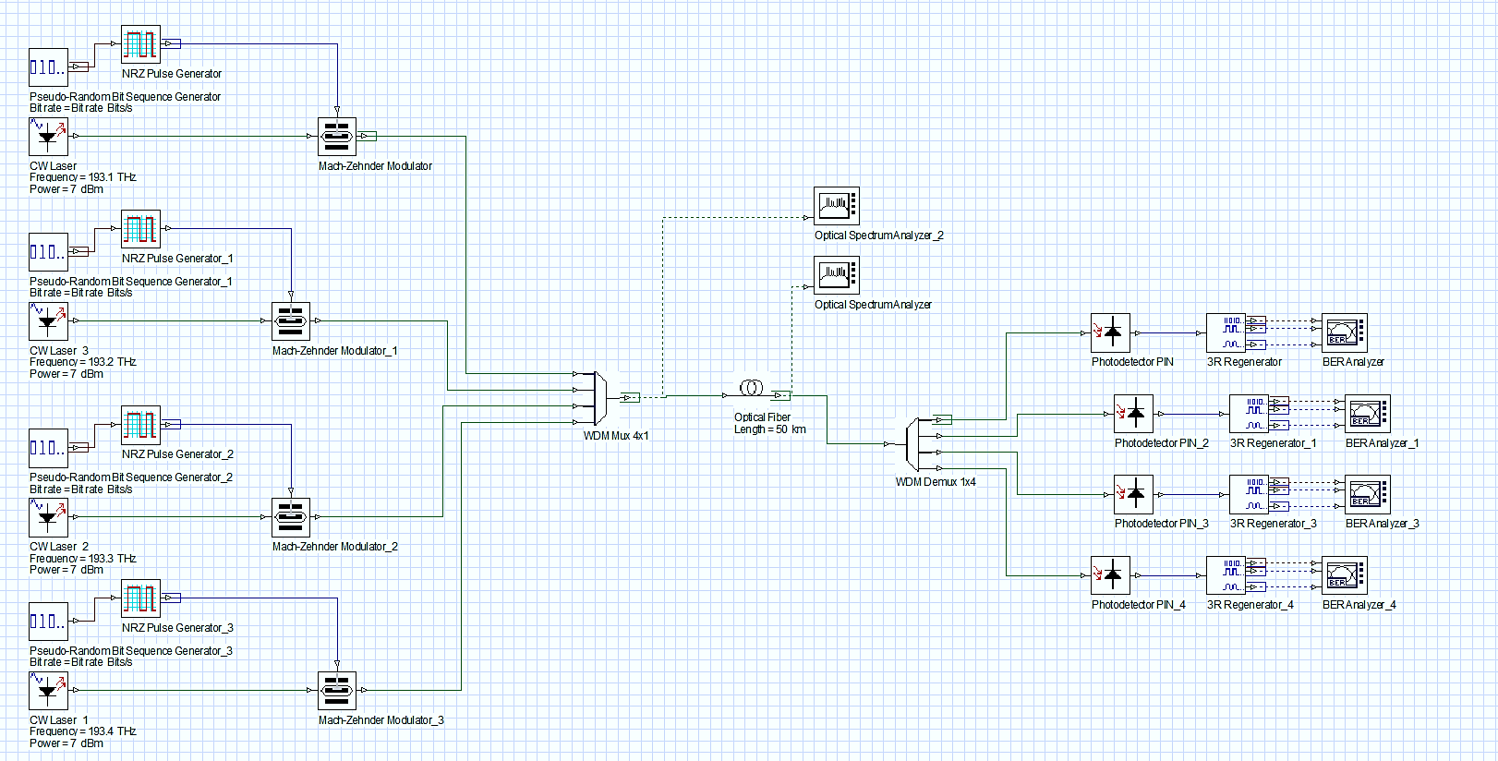
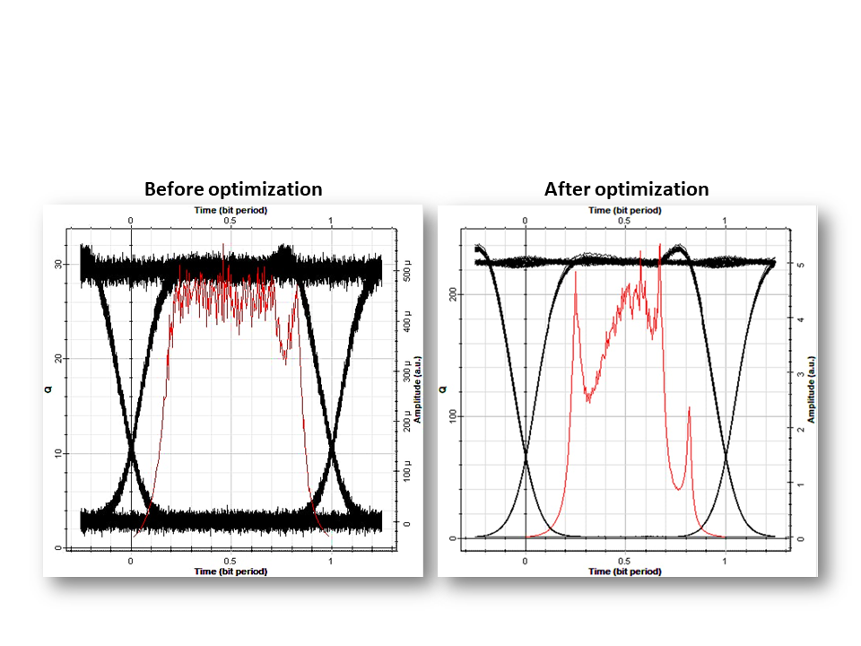
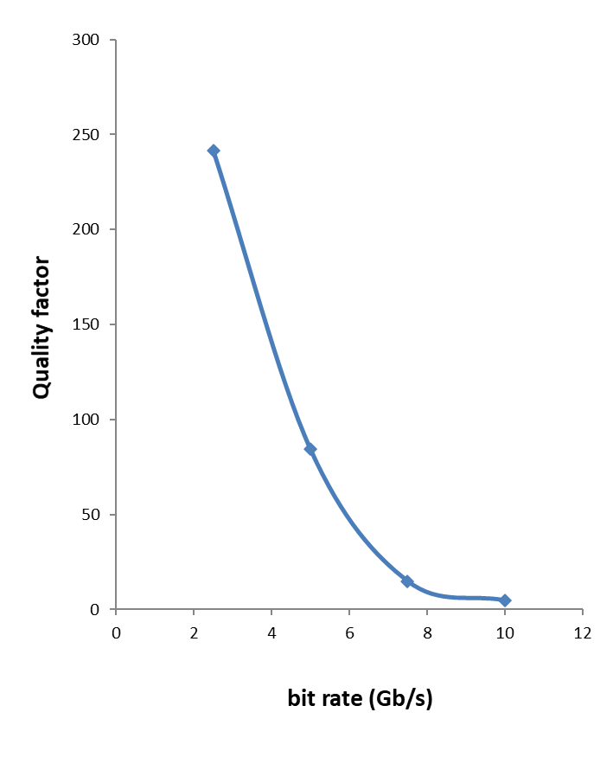
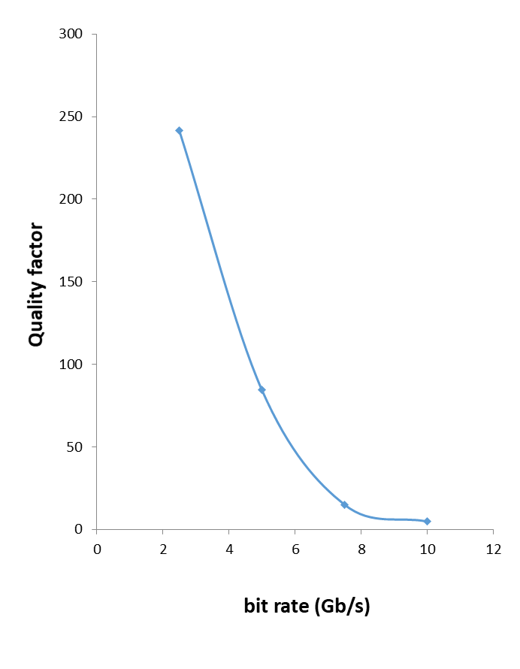
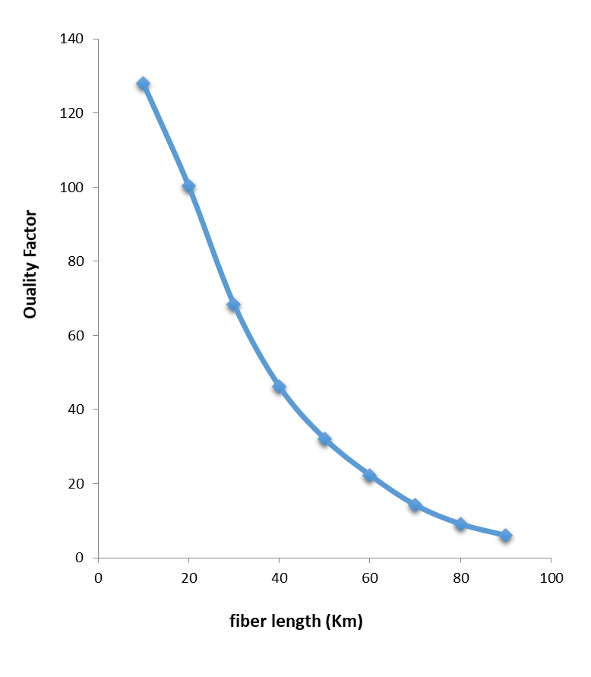
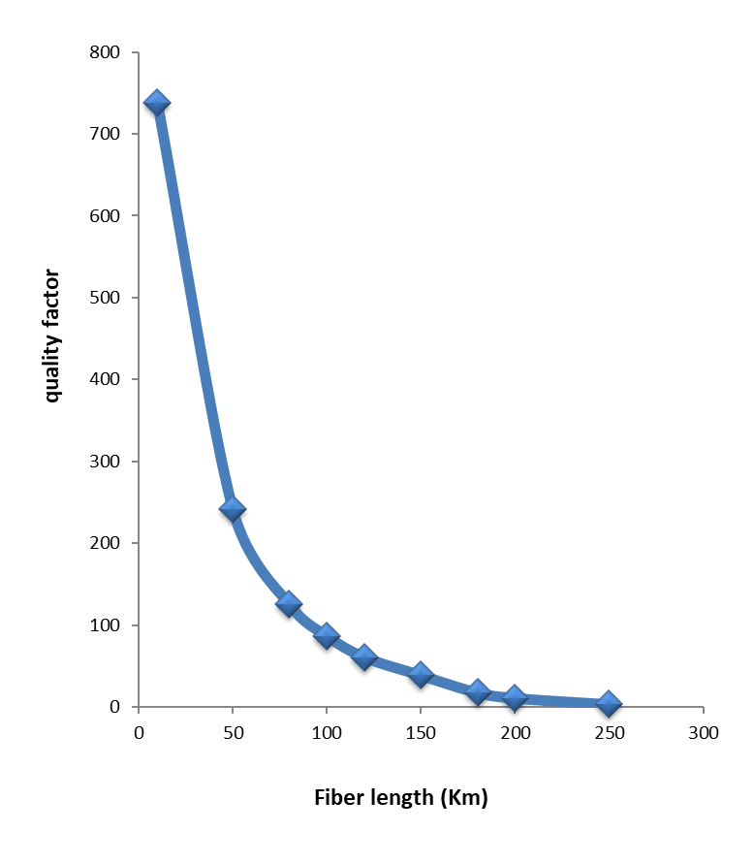
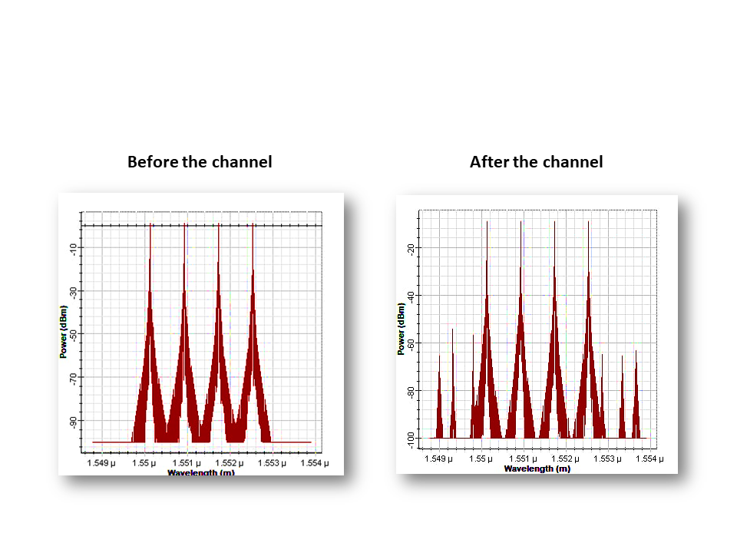
Design and Performance optimization of WDM light wave system using NRZ modulation format
Graduation Projects Festival
Research and Development Office
| Fadhel A.feddal | Qassim Y.Qassim | Abdulkareem K.Ali |
University of Technology
BACKGROUND
METHODS
OBJECTIVES
Flow of Work
work discusses data transmission using (WDM) for four optical channels separated with 100GHz frequency spacing in a 2.5Gb/s optical transmission system.
(NRZ) data inputs with laser signal are modulated with (MZM) before being multiplexed.
The four channels are multiplexed and sent through a (SMF) with 50km.
An optimization system was developed by addition of an optical gain amplifier and an optical filter at the receiver.
Results are compared to both systems.
Wavelength-division multiplexing
WDM is a multiplexing technique to combine optical signals. The advantage of WDM is to exploit the full capacity by allowing multiple beams of light at different frequencies to be transmitted on the same fiber-optic cable.
system design and configuration
RESULTS
CONCLUSIONS
the Quality factor with bit rate using NRZ after optimization at power7 dBm
the Quality factor with bit rate using NRZ after optimization at power7 dBm
the quality factor against fiber length for the
the eye diagram for the system before and after optimization at 50km fiber length
Conclusions
Results show that the transmission distance has been increases significantly after optimization where the fiber length has been maximized by100%.
The bit rate for the system has been increased from (2.5 to10)Gb/s
The overall performance has been enhanced where better quality factors are achieved.
WDM system before optimization
WDM system after optimization
the output spectrum of NRZ format for the 4-signals WDM before and after the channel
ACKNOWLEDGMENTS
The master of optics: Al-Hasan bin Al-Haytham.
The master of mathematics: Muhammad ibn Musa al-Khwarizmi.
The master of electronics and communications: Nikola Tesla.

