Slide 1





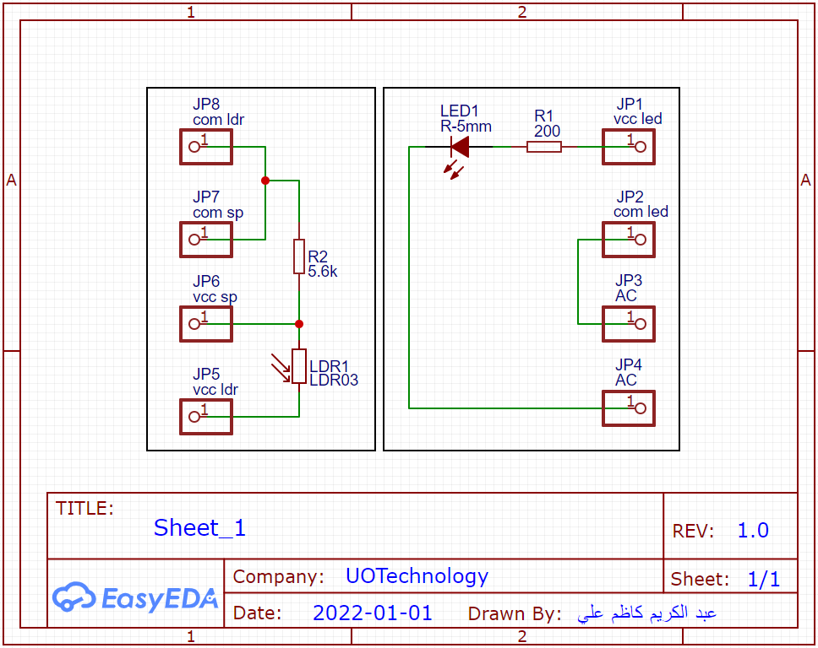
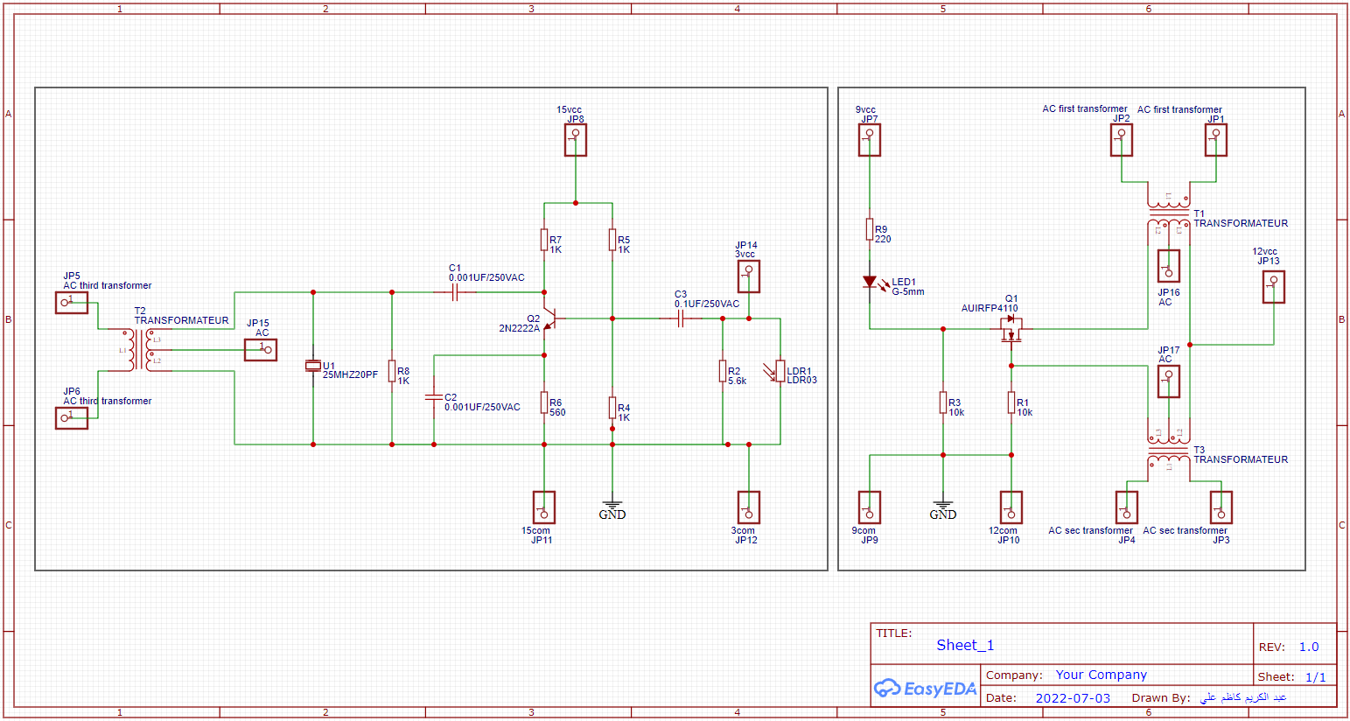
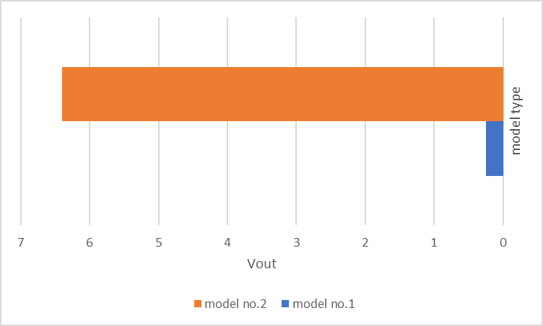
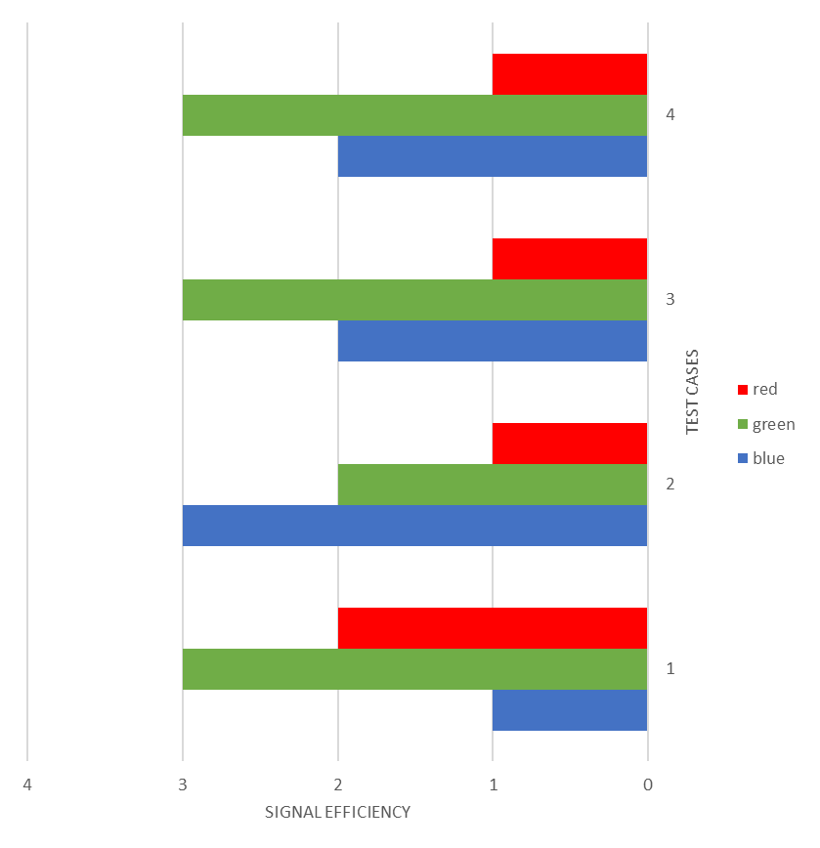
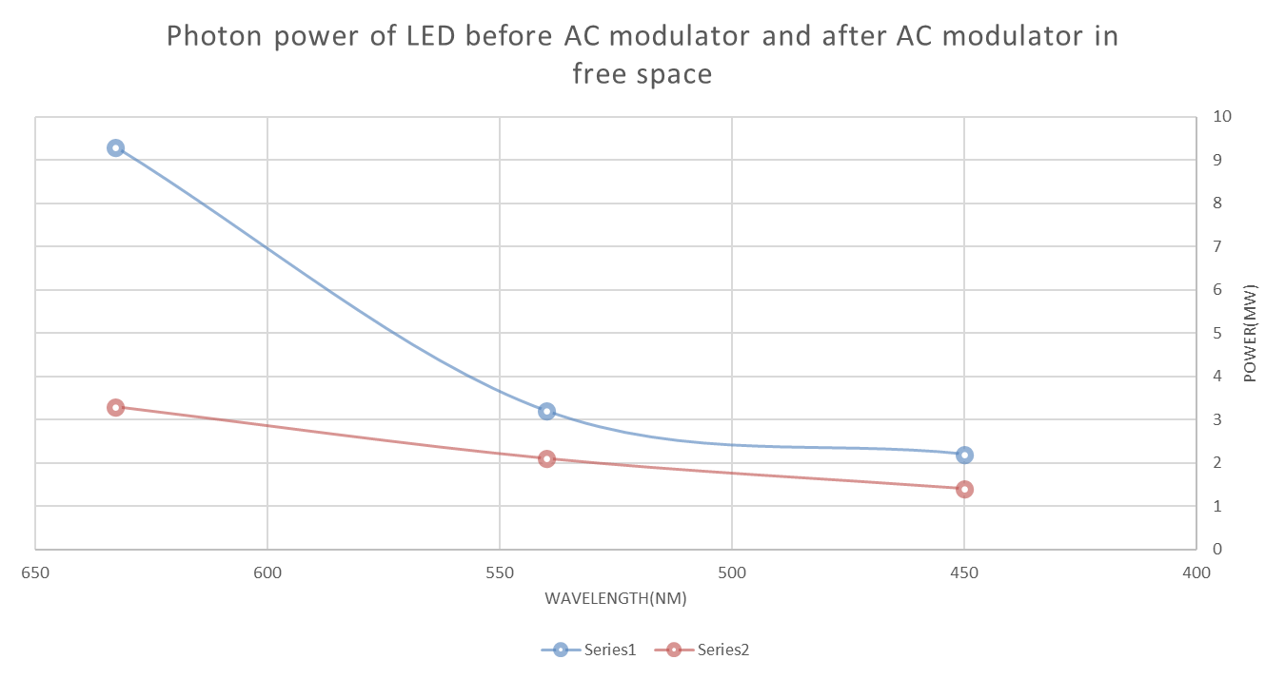
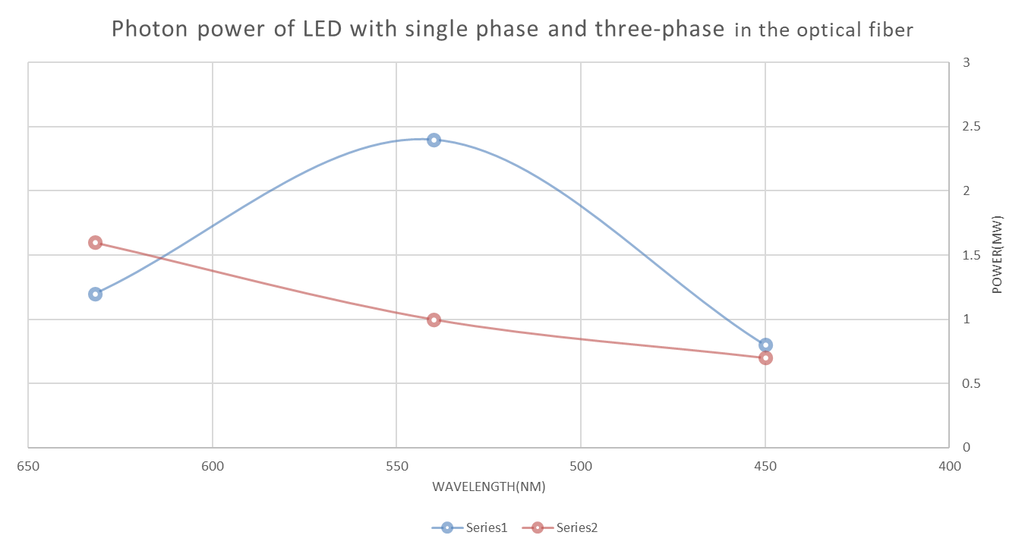
Design a system to transfer alternating current in optical fiber using a light-emitting diode
شعار القسم
هنا
| Fadhel A.feddal | Abdulkareem K.Ali | Qassim Y.Qassim |
University of Technology
Introduction
CONCLUSIONS
SYSTEM DESIGN
Laser power transmission and LiFi
In order to find a new way to transmit the electric current, the li-fi system is used, and instead of entering the data into the system, an alternating electric current is entered so that the electric current is included with the optical wave using the LED.
Conclusions
The difficulties of this project is to maintain perfect alignment between the LEDs and the plastic optical fiber.
Further, more signal loss is found due to waste of signal power due to coupling loss.
a number of advantages were concluded which they are: low cost design, simple circuit implementation, and suitable controlling of the circuit.
model No.1
model No.2
RESULTS
output voltage without crane transformer
Where this table represents the value of the output voltage in the first design (before the improvement) and the second design (after the improvement).
Signal efficiency in all wavelength
Where this table represents the efficiency of the wavelengths in each method in which the alternating electric current was transmitted.
ACKNOWLEDGMENTS
The master of optics: Al-Hasan bin Al-Haytham.
The master of mathematics: Muhammad ibn Musa al-Khwarizmi.
The master of electronics and communications: Nikola Tesla.

