Slide 1
Transformer models
Deep learning

Slide 2
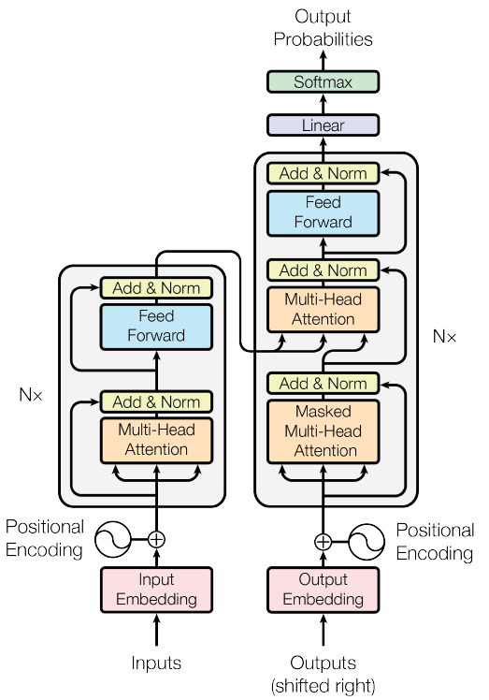
Transformer for machine translation

Slide 3
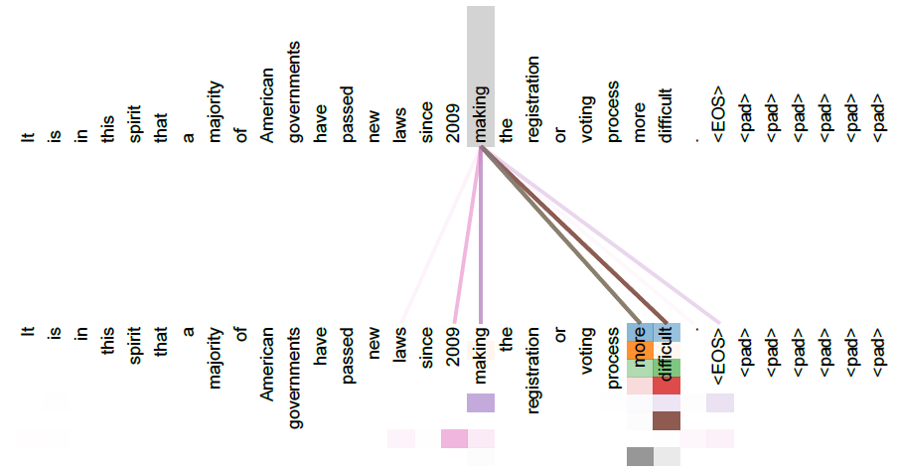
Attention visualization

Slide 4
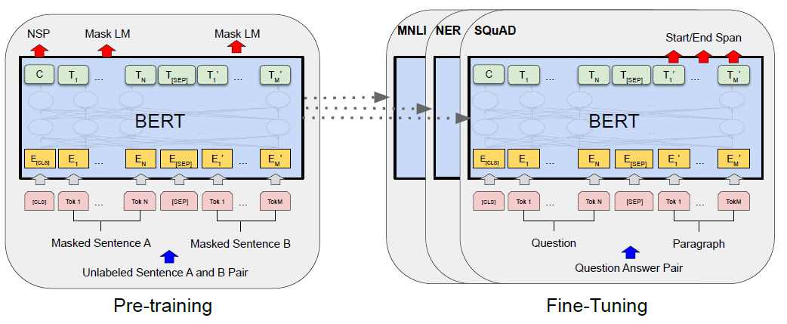
BERT
Using only Transformer encoder
Language Model Masked pretraining
Next Sentence Prediction for training CLS embedding
Fine-tuning for downstream tasks

Slide 5
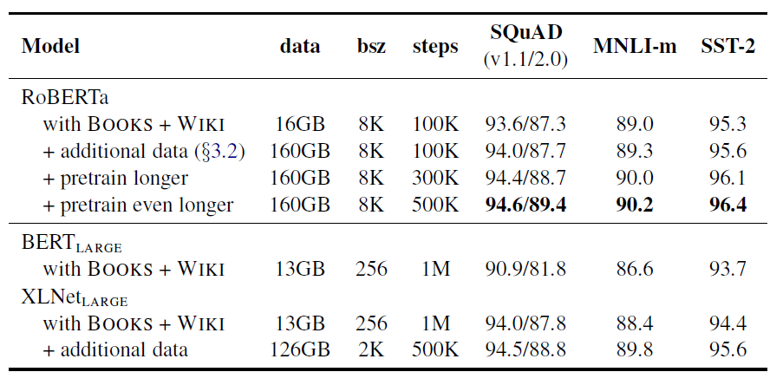
RoBERTa

Slide 6

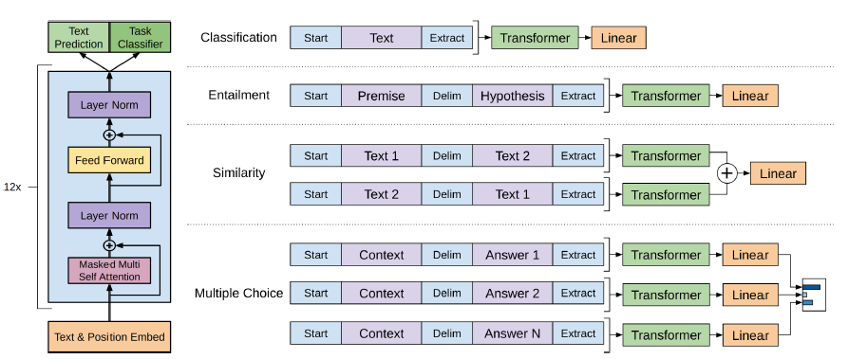
GPT-1
Using only Transformer decoder
Unsupervised pretraining using next token prediction
Fine-tuning for supervised tasks
Observation: fine-tuning requires only few epochs

Slide 7
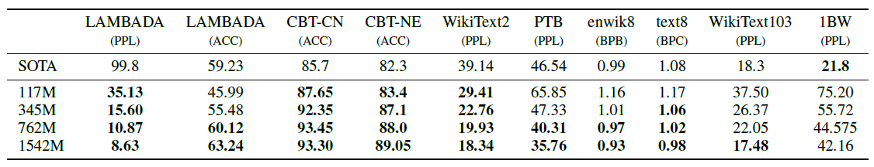
GPT-2
Increased sizes of model and dataset
Fully unsupervised training
Shows not that bad zero-shot performance

Slide 8
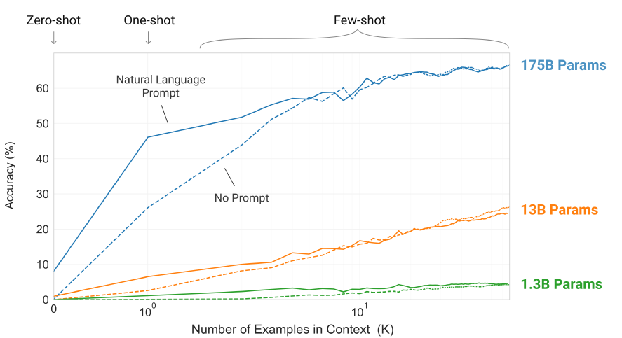
GPT-3
Significantly increased sizes of model and dataset
Fully unsupervised training
Shows much better zero-shot performance

Slide 9
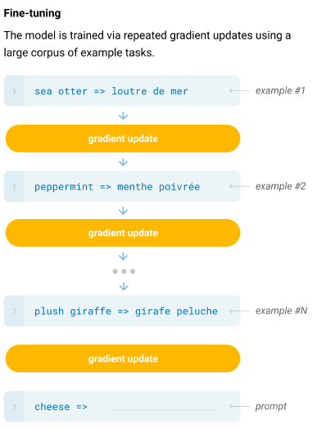
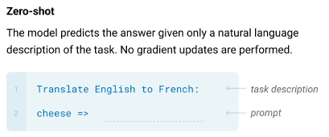
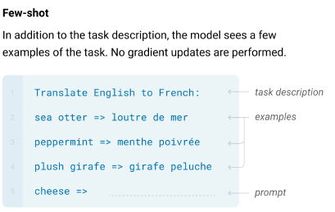
GPT-3

Slide 10
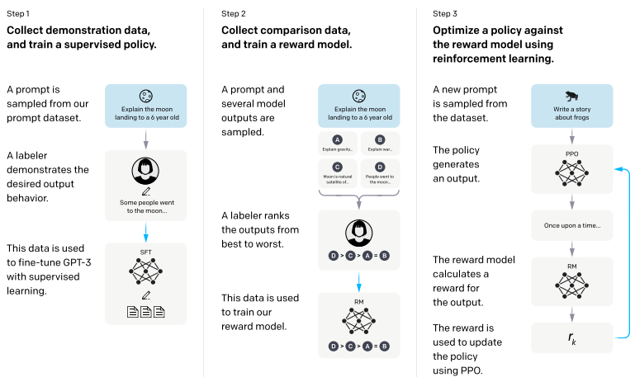
InstructGPT
Finetuning of GPT-3 with assessors help

Slide 11
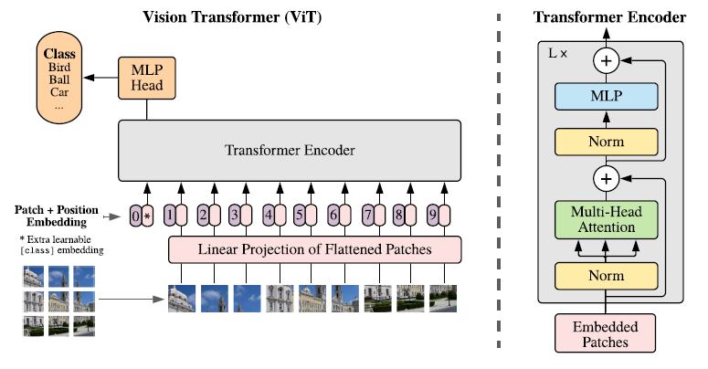
Vision Transformer
Using similar unsupervised pretraining mechanism for images

