Slide 1
Convolutional neural networks

Slide 2
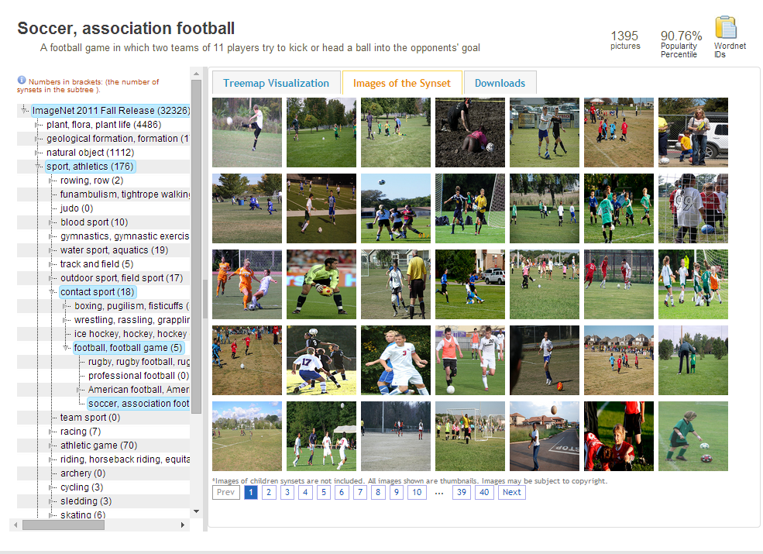
ImageNet (image-net.org)
14,197,122 images 21841 categories

Slide 3
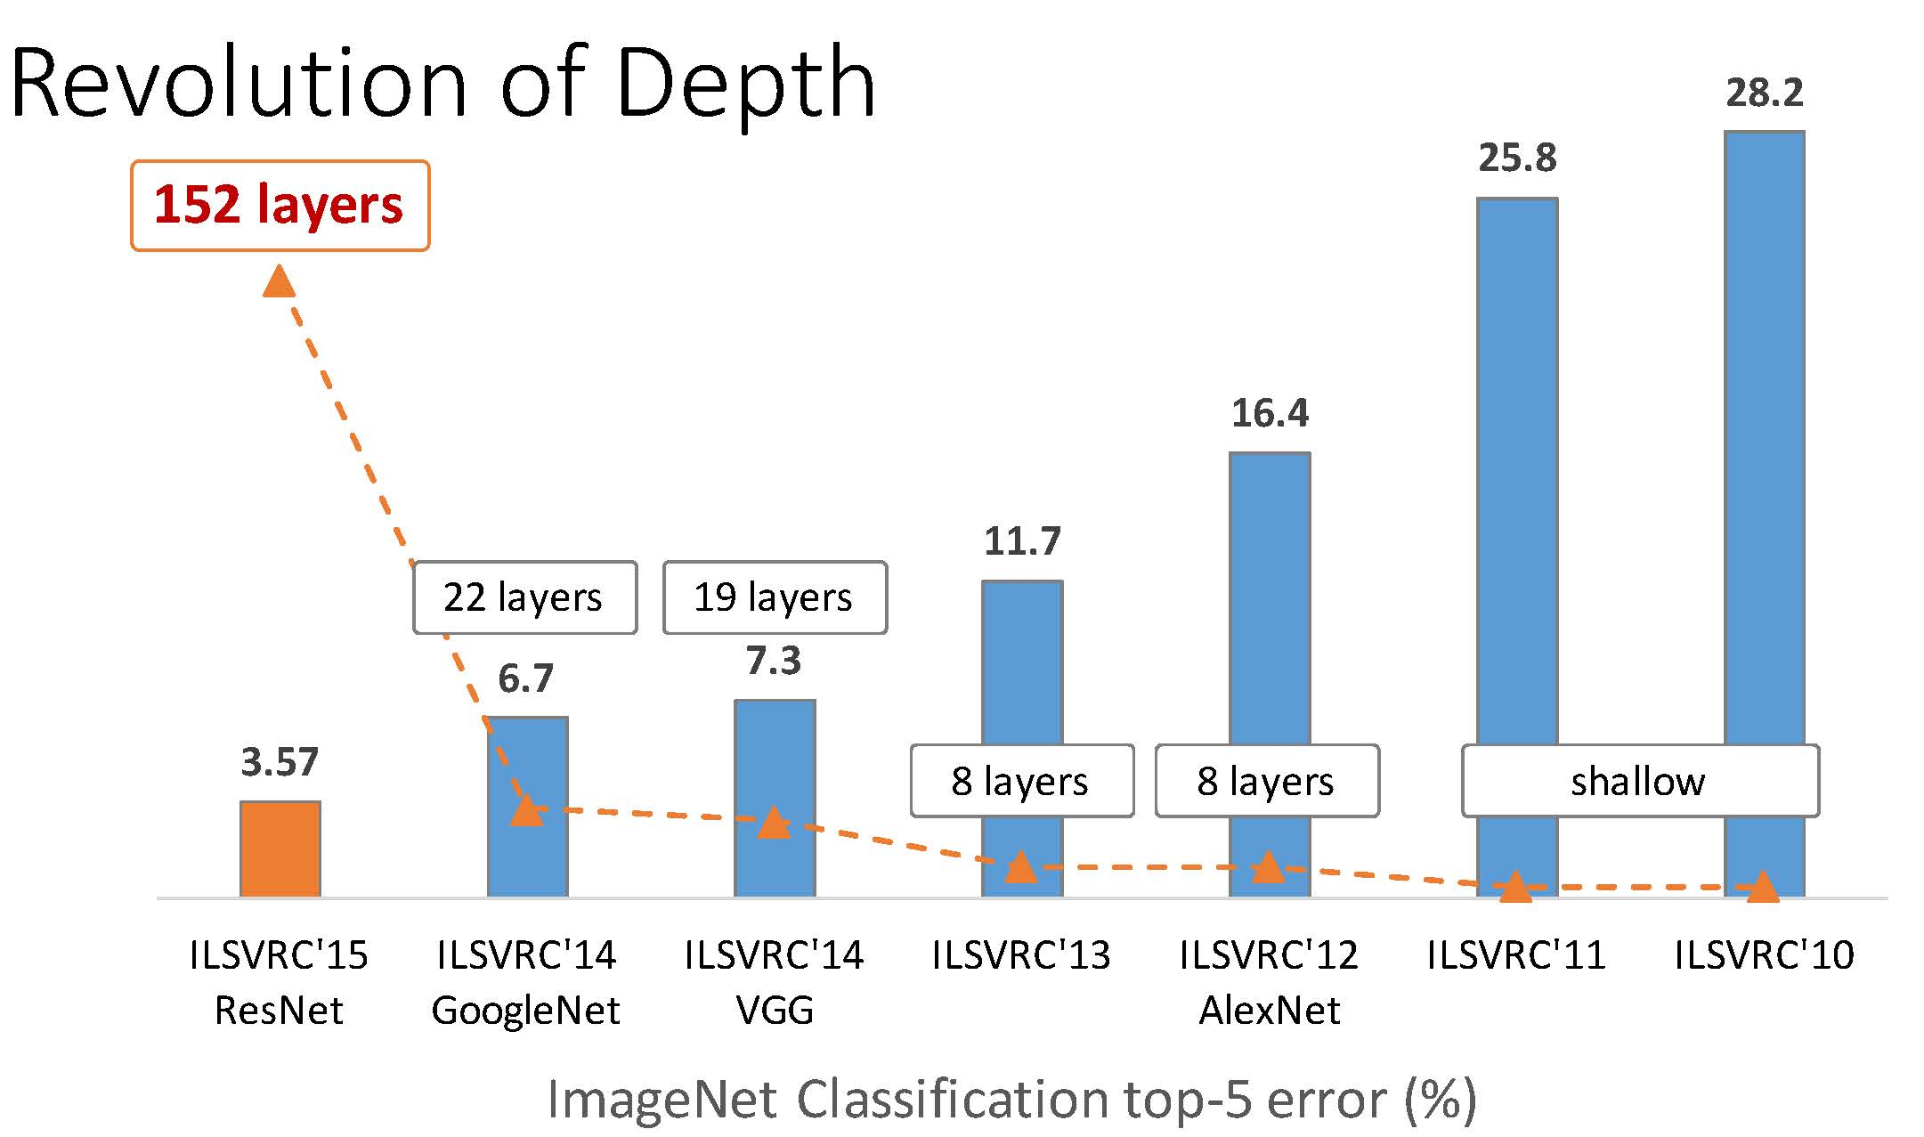

Slide 4
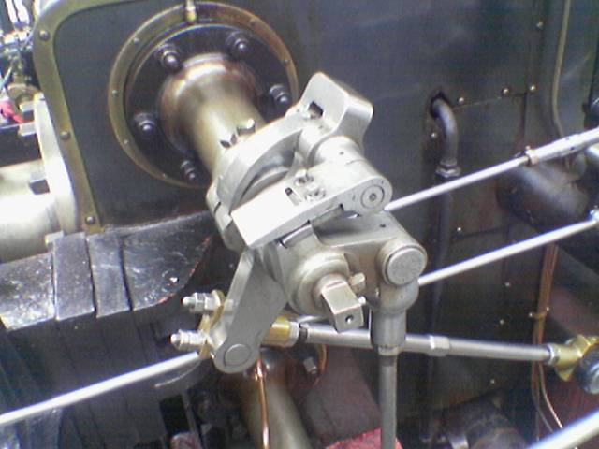
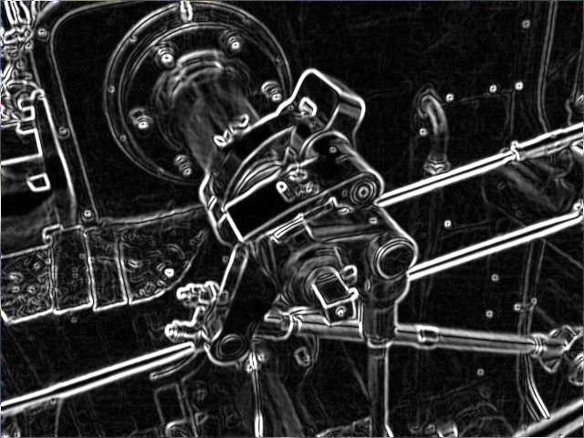
Sobel filter
Initial image
Image after the filter application

Slide 5
LeNet network [LeCun et al., 1998]
Operations in the network:
Convolution with kernel
Non-linearity
Pooling
Fully-connected networks

Slide 6
Convolution visualization
No padding, no stride
No padding,
stride = 2
No padding, no stride, dilation = 2
Zero padding, no stride

Slide 7
Convolution visualization
Convolution transposed
No padding, no stride
Convolution transposed
No padding, stride = 2

Slide 8
Pooling operation

Slide 9
AlexNet network (2012)
Max pooling
ReLu nonlinearity
Fully connected layers
More data and bigger model (60M params)
+ Data augmentation (flips and random samples)
+ Dropout regularization
+ GPUs (50x speed up)
+ 1 week of training on 2 GPUs

Slide 10
Data augmentation

Slide 11
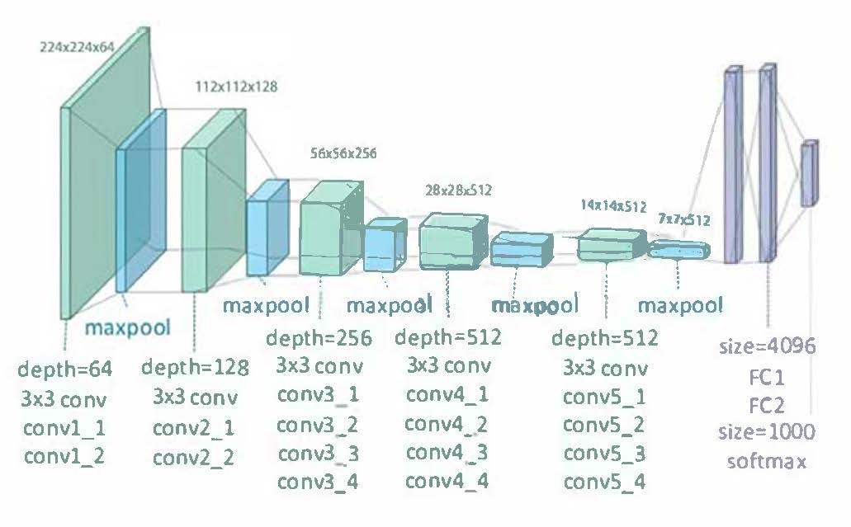
VGG network (2014)
Cascade of 3x3 convs instead of big convs
140M parameters (AlexNet has 60M)
More balanced computations
Can’t be trained from scratch (gradient vanishes)
Several training stages for different depths
Training on 4 Titan Black GPUs for 2-3 weeks

Slide 12
ResNet network (2015)

Slide 13
ResNet network (2015)
Just adding layers doesn’t work

Slide 14
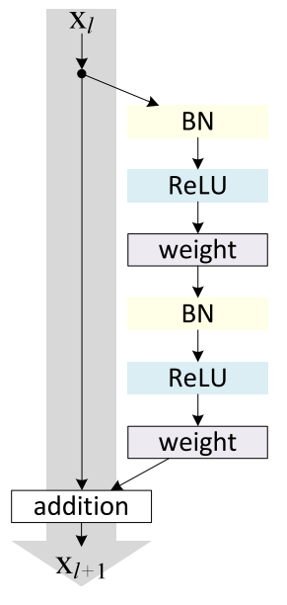
ResNet network (2015)
• The main idea – residual block = adding identity connection
• Allows better propagate gradients inside

Slide 15
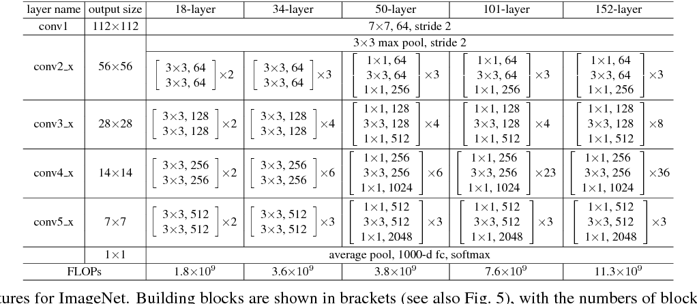
ResNet network (2015)

Slide 16
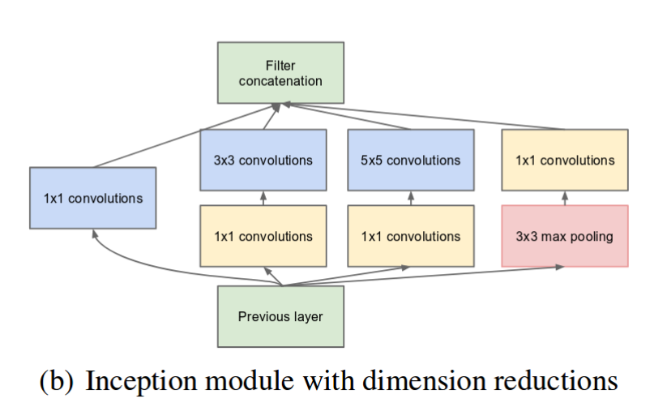
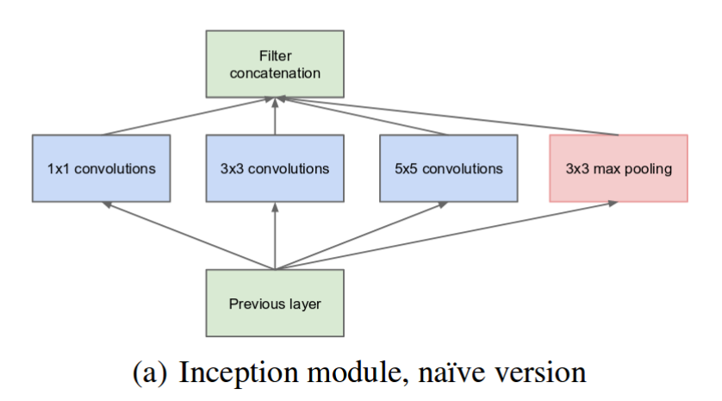
Inception network (2014-2016)

Slide 17
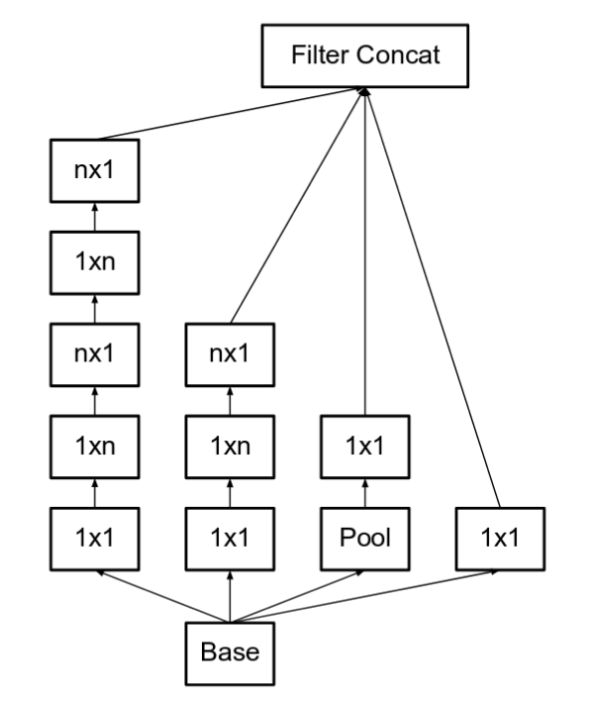
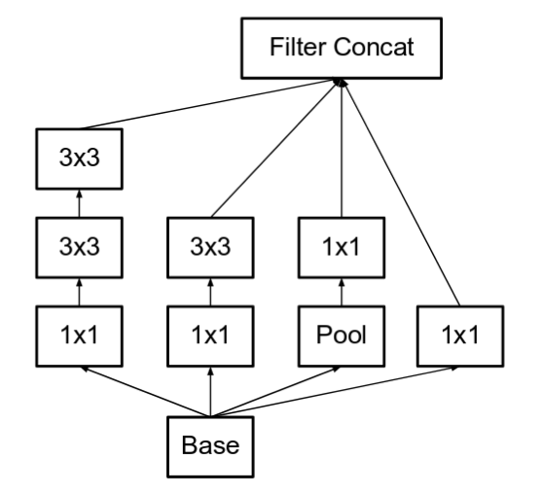
Inception network (2014-2016)

Slide 18
Transfer learning in CNN [Oquab et al., 2014]

Slide 19
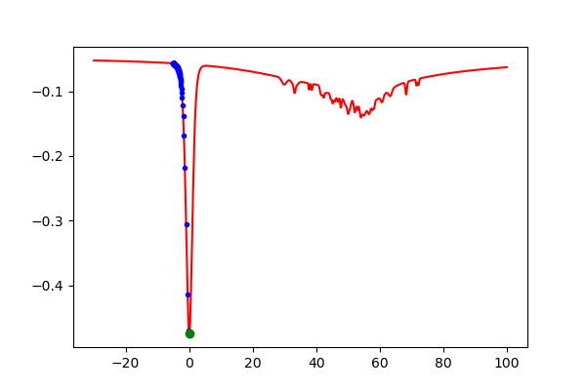
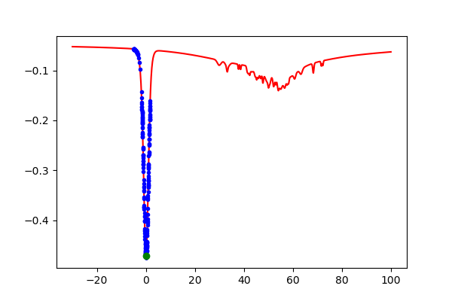
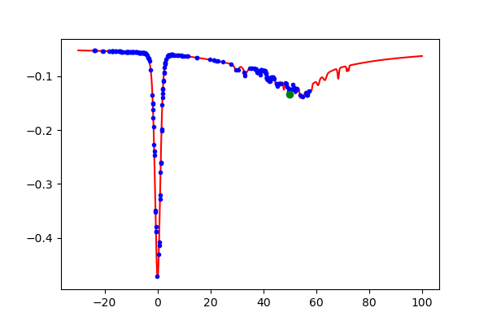
Optimization with SGD
Full GD with proper step size
SGD with little noise
SGD with larger noise

