Slide 1
NN models for audio processing
Deep learning

Slide 2
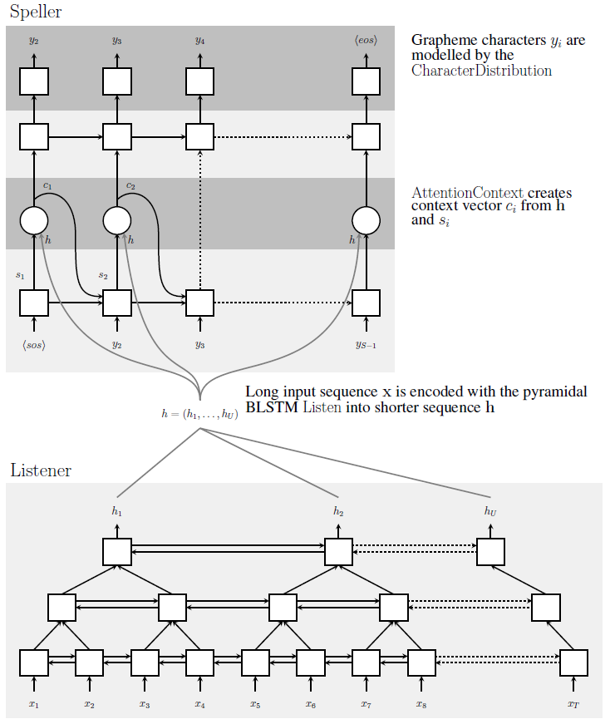
Listen, Attend and Spell (LAS)
Automatic Speech Recognition problem: Audio -> Spectrogram -> Text
Architecture: Encoder-Decoder model with attention
Output: graphemes
Inference: Beam search + separate language model

Slide 3
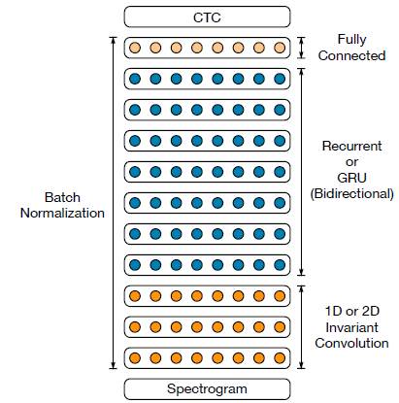
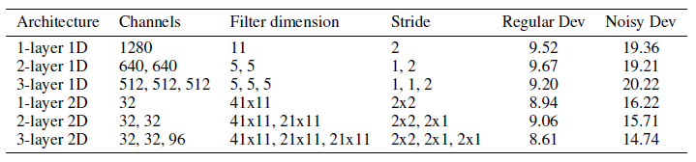
Deep Speech 2
Automatic Speech Recognition problem: Audio -> Spectrogram -> Text
Architecture: Encoder only model + CTC loss
Encoder uses 1) convolutional layers (1d or 2d), RNN layers and FC layers
Output: graphemes

Slide 4
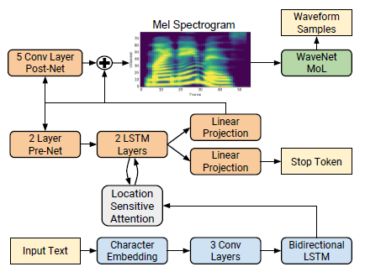
Tacotron 2
Text-to-Speech problem: Text -> Spectrogram -> Audio
Spectrogram to Audio is solved by separate WaveNet vocoder
Architecture: Encoder-Decoder with attention

Slide 5
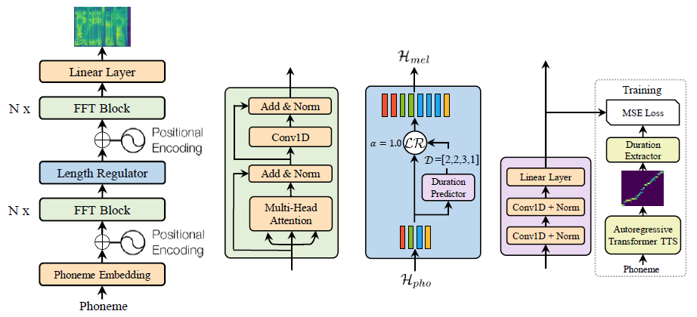
Fast Speech
Phoneme-to-Spectrogram prediction problem
Architecture: encoder only with special length regulator block
Duration Prediction: attention weights from separately trained Encoder-Attention-Decoder TTS

Slide 6
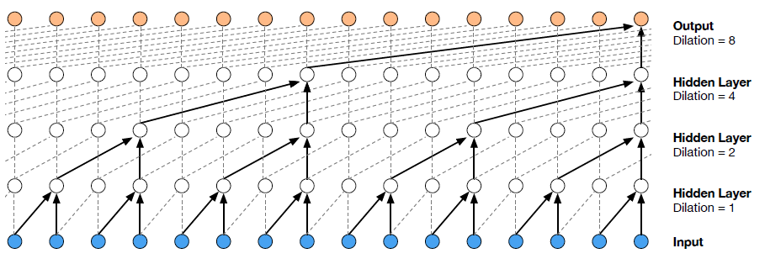
WaveNet vocoder
Problem: Spectrogram -> Audio prediction
Audio part: autoregressive next audio element prediction generative model
Architecture: a stack of dilated convolutions for large receptive field
For conditional generation (condition = spectrogram) each layer compute:

Slide 7
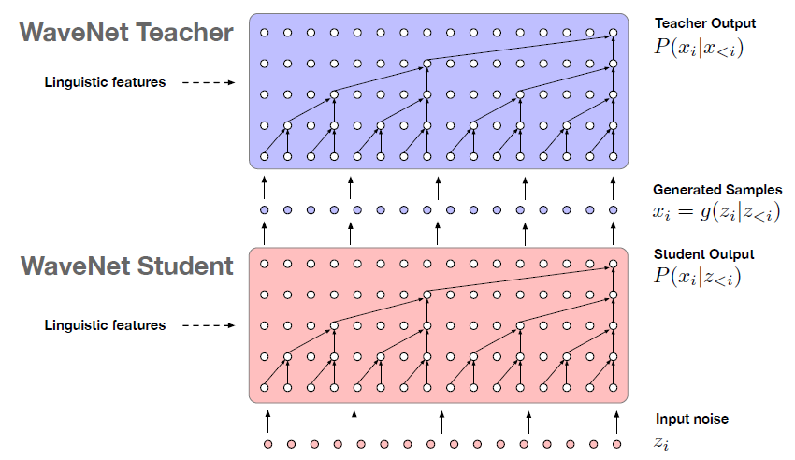
Parallel WaveNet vocoder
Use idea of Inverse Autoregressive Flow for distillation of WaveNet

Slide 8
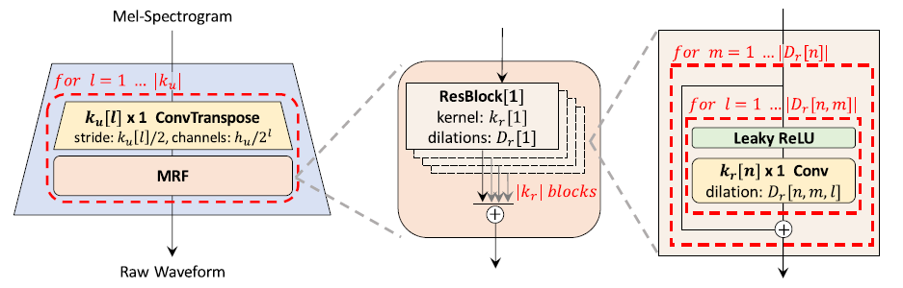
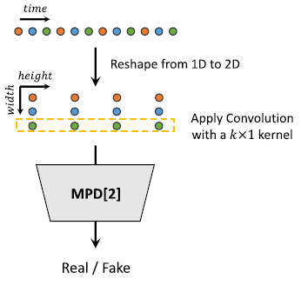
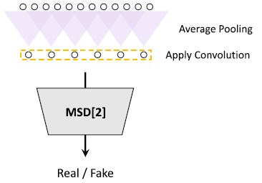
HiFi-GAN
Solve spectrogram-to-audio problem using GAN style generative model
Generator: predict audio using spectrogram using convolutional decoder (as input no noise is given)
Discriminator: predict true/fake classes for given audio

Slide 9
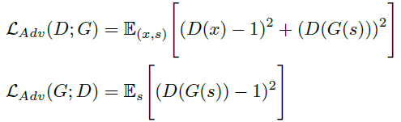



HiFi-GAN
Generator and discriminator losses are formulated as MSE
Mel-spectrogram loss: phi(x) – spectrogram of true waveform, phi(G(s)) – spectrogram of generated audio
Feature-matching loss: measure similarity between generated audio and true waveform using intermediate feature maps of discriminator

