Slide 1
Semantic image segmentation

Slide 2
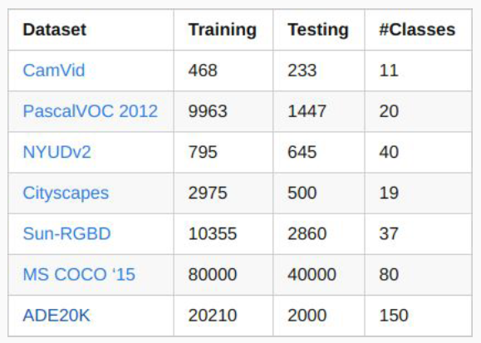
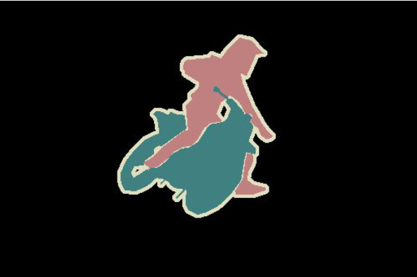
Semantic image segmentation

Slide 3
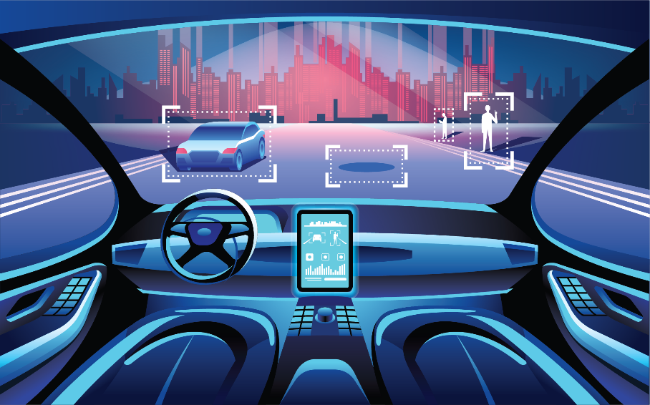
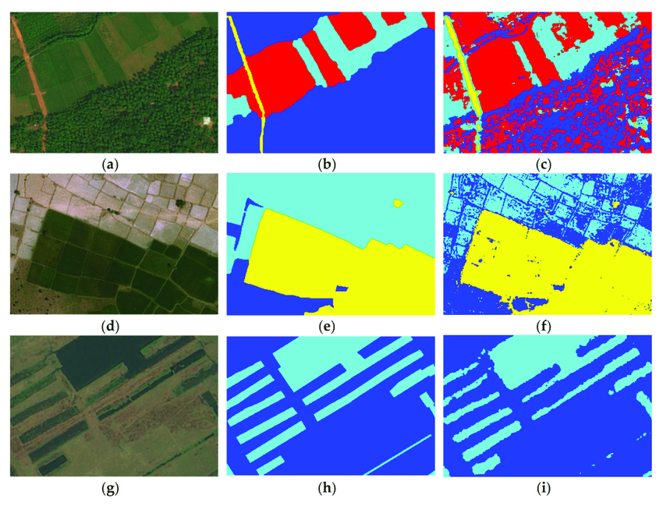
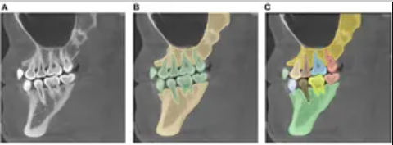
Semantic image segmentation

Slide 4
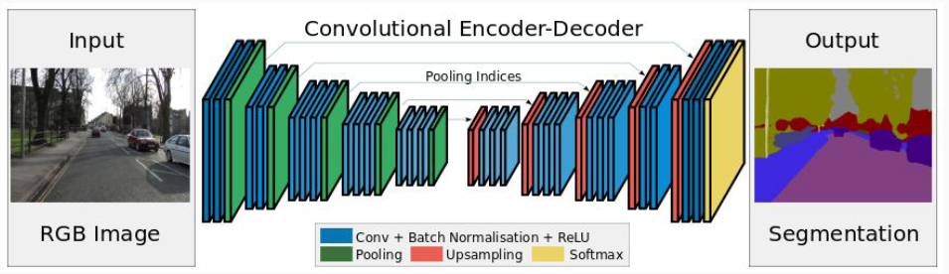
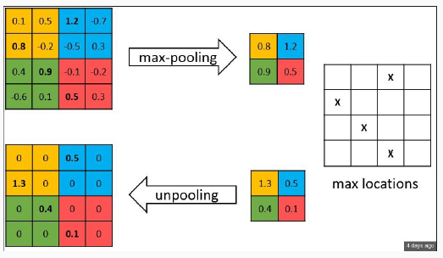
SegNet (2015)

Slide 5
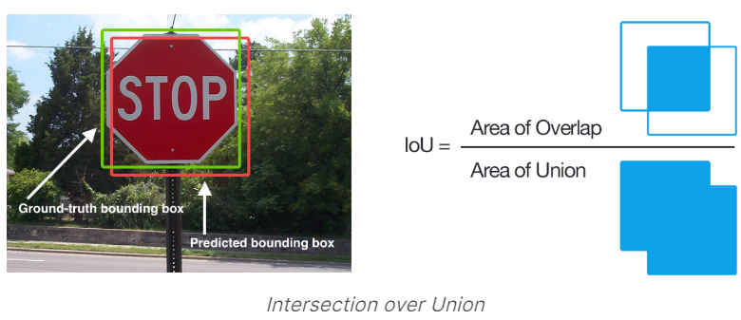

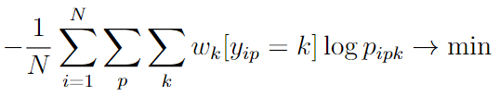

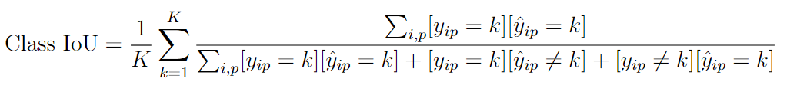
Measuring performance for semantic segmentation
Problem: separate segments may be very imbalanced in size
Training:
Testing:

Slide 6
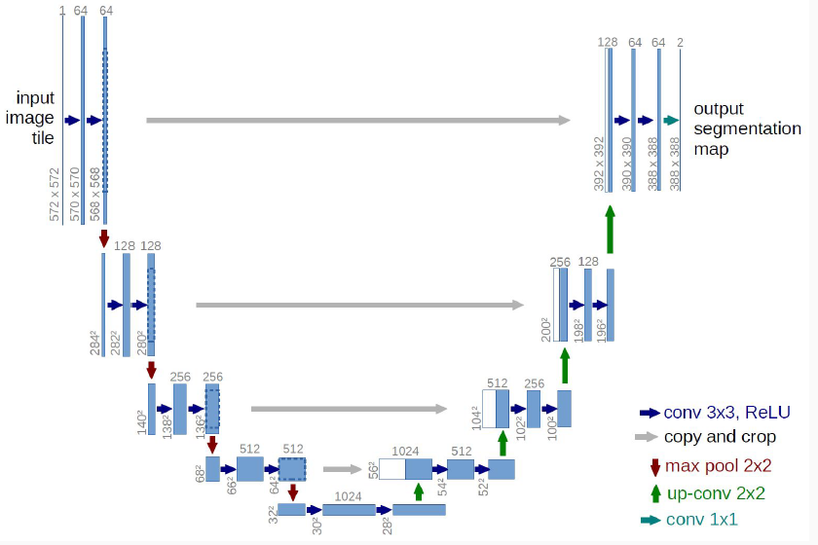
U-net (2015)

Slide 7
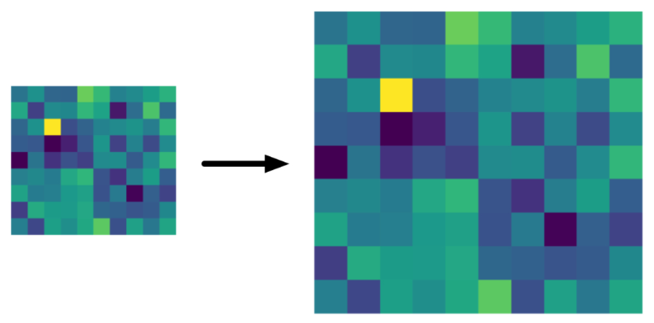
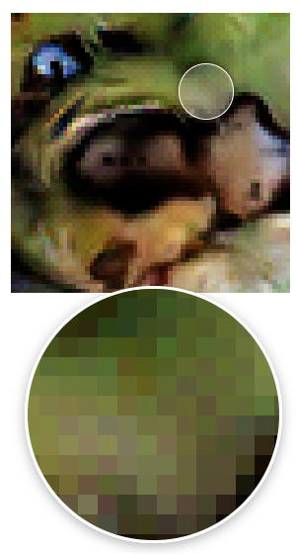
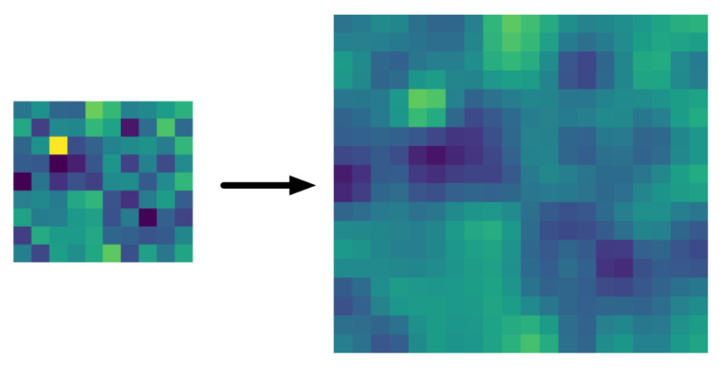
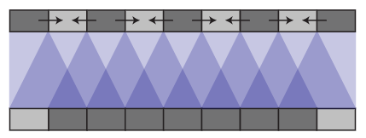
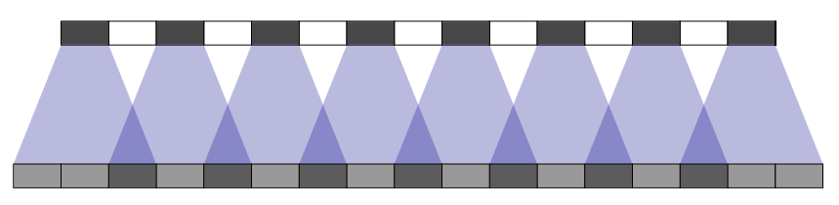
Different up-scale transforms
Nearest Neighbors upscaling:
No parameters, fast to compute
Too blocky result
Bilinear interpolation:
No parameters, fast to compute, can both upscale and downscale the result
Usually shows good results
Transposed convolutions:
has learnable parameters
may slow to compute
may lead sometimes to checkerboard patterns
An article about checkerboard effect

Slide 8
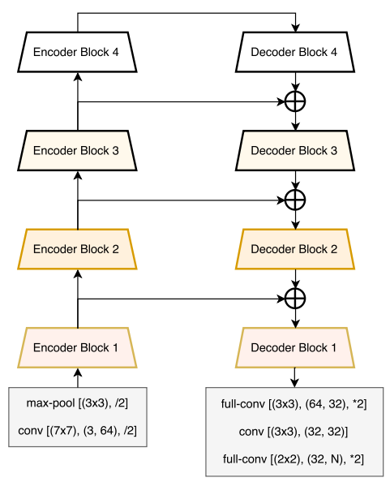
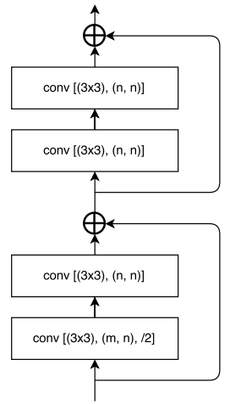
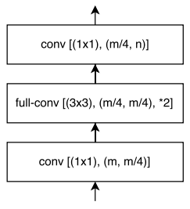
LinkNet (2017)
Decoder block
Encoder block

Slide 9
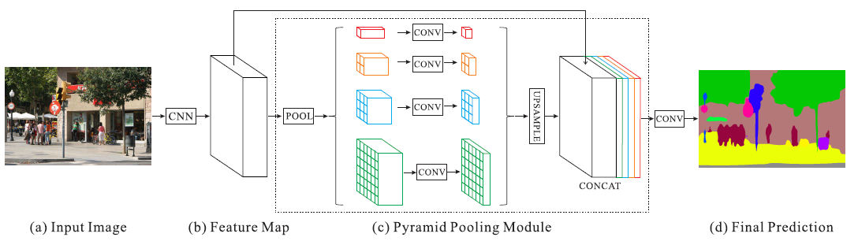
PSPNet (2016)

Slide 10
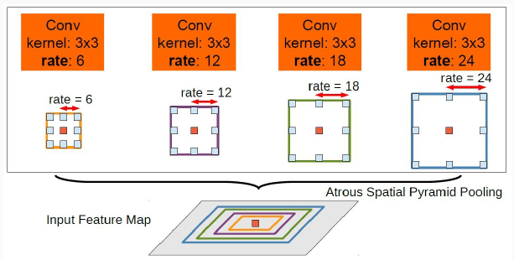
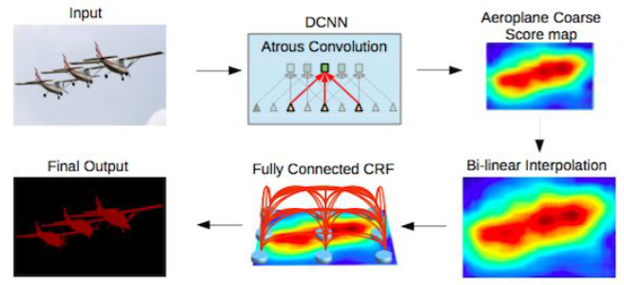
DeepLab v1, v2, …

Slide 11
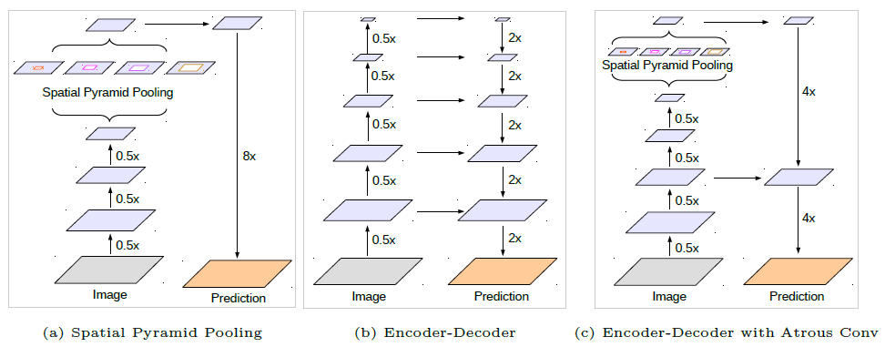
DeepLab v3+

Slide 12
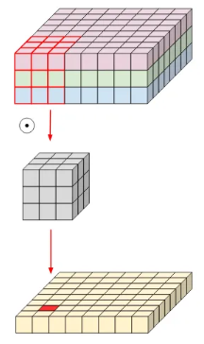
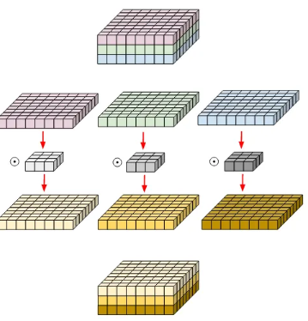
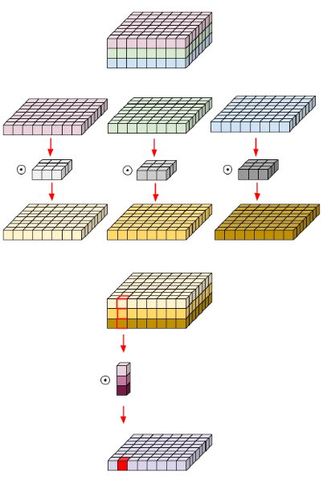
Depth-wise separable convolution
Normal convolution
Depth-wise convolution
Depth-wise separable convolution
No. of params for 3 output channels: 3*(3*3*3)
No. of params: 3*3*3
No. of params for 3 output channels: 3*3*3 + 3*(3*1)

Slide 13
Image segmentation
Main architectural ideas:
Encoder-decoder structure with connections on different resolution levels
Spatial pyramid pooling or Atrous spatial pyramid pooling for analyzing images on different scales and better consider global context
Depth-wise separable convolutions for a smaller number of parameters and faster computations

Slide 14
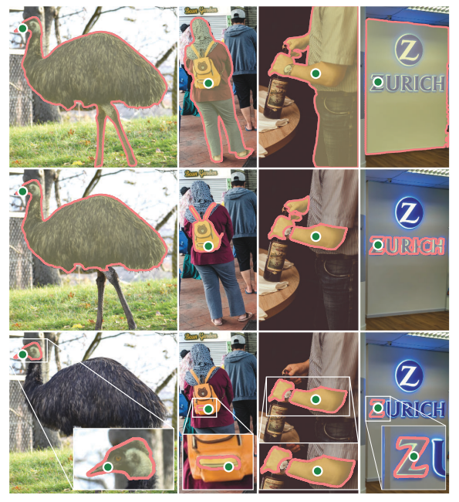
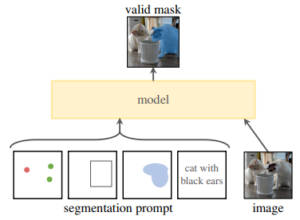
Segment Anything Model for interactive segmentation (SAM, 2023)

Slide 15
Object detection on images

Slide 16
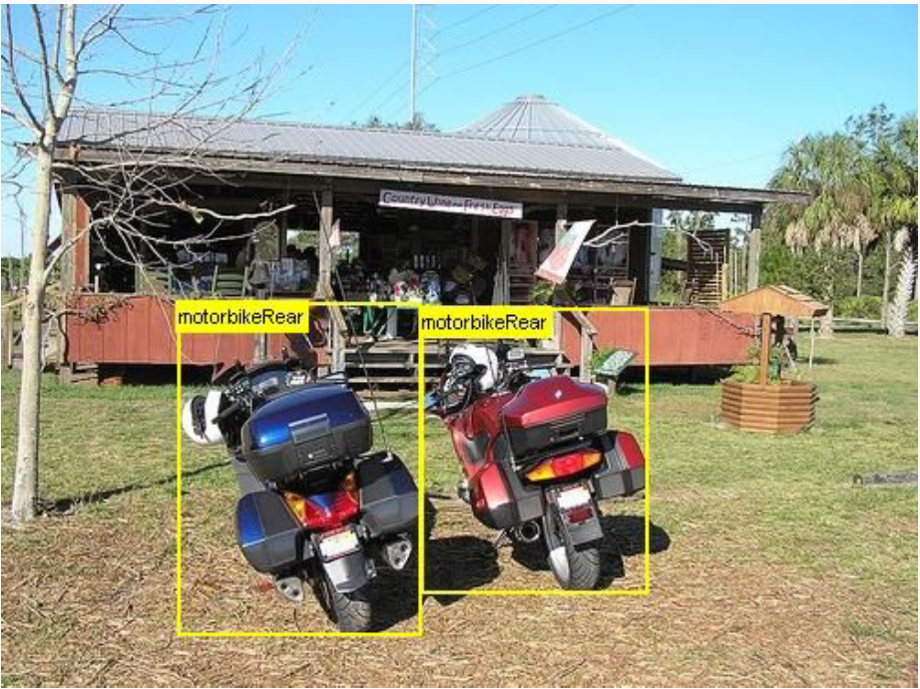
Object detection

Slide 17
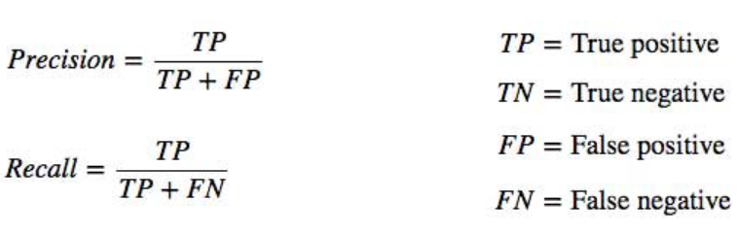
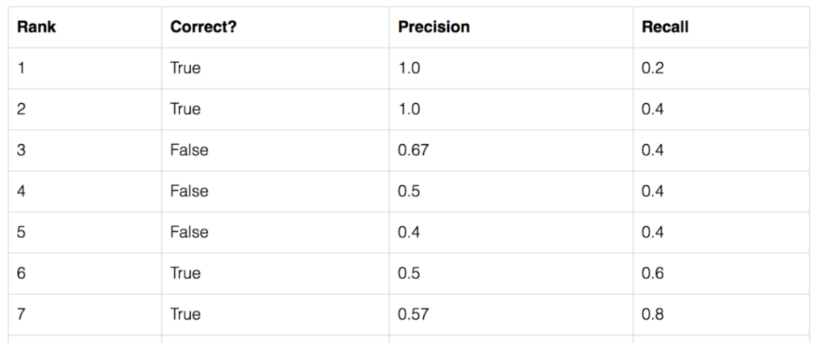
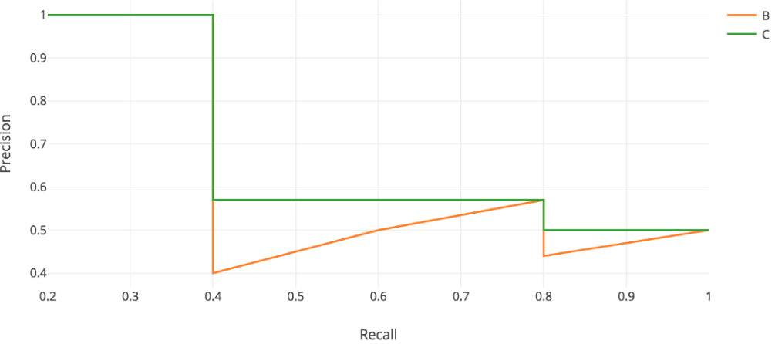
Detection quality measure mAP

Slide 18
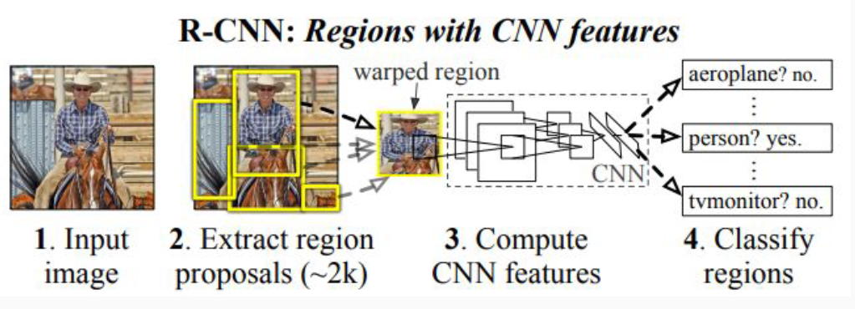
R-CNN (2013)

Slide 19
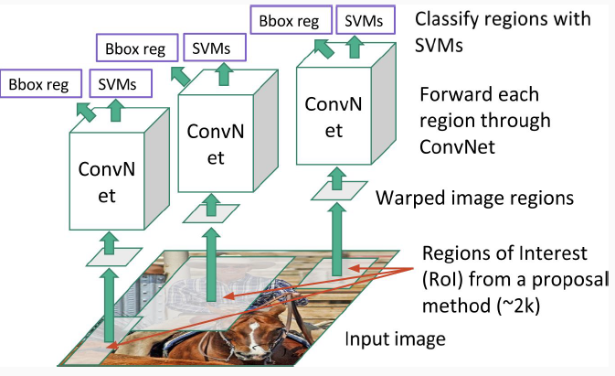
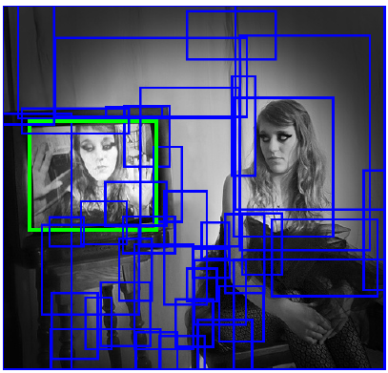
R-CNN (2013)
Training:
1) Generation of region proposals using Selective Search
2) Training classifiers and regressors

Slide 20
R-CNN (2013)
Inference:
Generate region proposals
For each region find class probabilities and regression correction coefficients
For each class make greedy non-maximum suppression

Slide 21
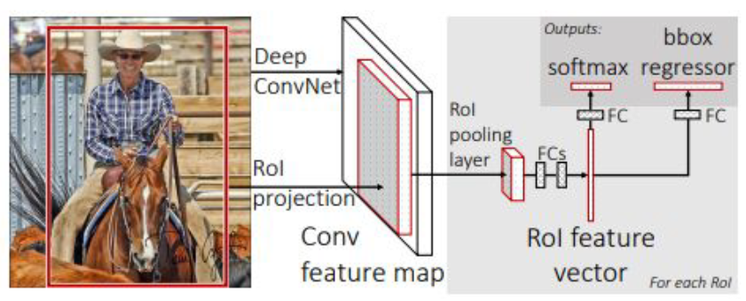
Fast R-CNN (2015)
Main idea: CNN is applied for each image only once
Training in one stage

Slide 22
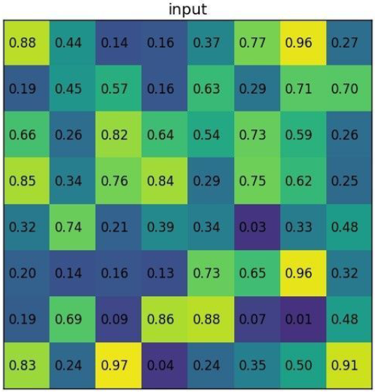
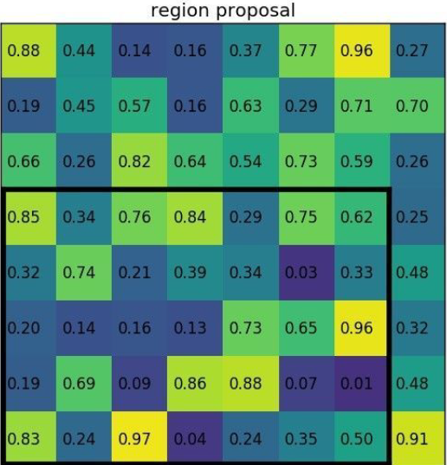
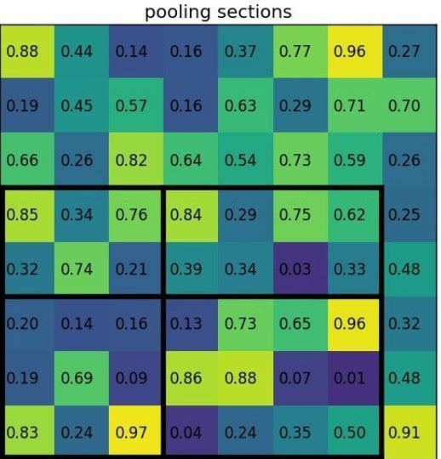
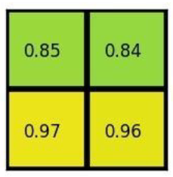
Fast R-CNN (2015)
Finding fixed-sized vector for each RoI

Slide 23
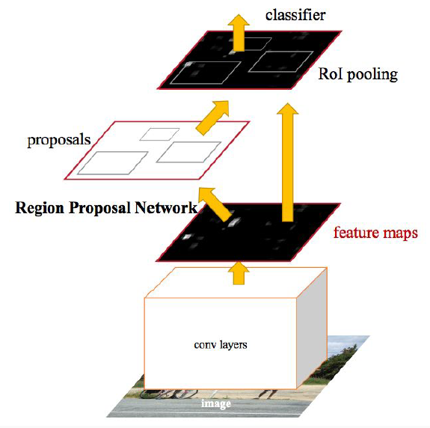
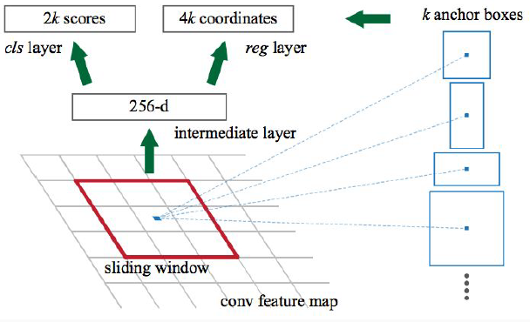
Faster R-CNN (2015)

Slide 24
Faster R-CNN (2015)
RPN training:
Find all anchors
Skip/truncate anchors intersecting image boundaries
Determine positive and negative anchors using IoU with true bounding boxes
Train object presence classifier and bbox regressor
RPN testing:
Predict regions
Apply greedy non-maximum suppression
Select top 2000/300 by object presence probability

Slide 25
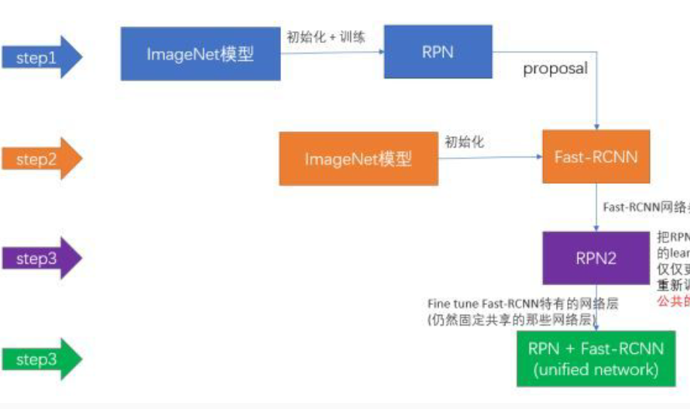
Faster R-CNN (2015)

Slide 26
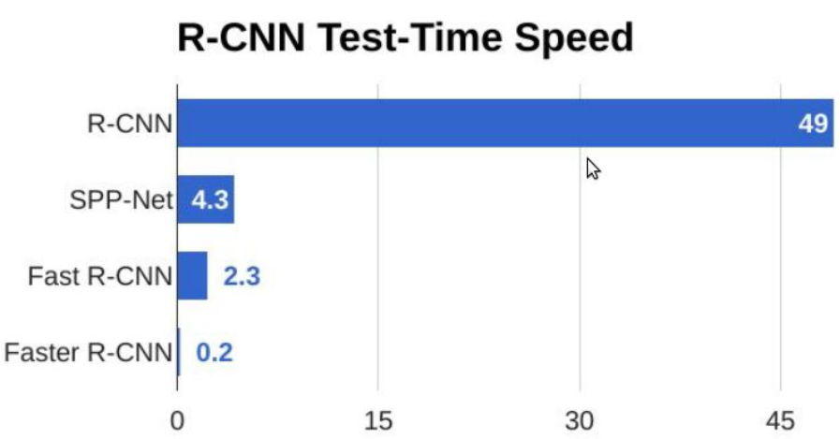
Test time speed for R-CNN family

Slide 27
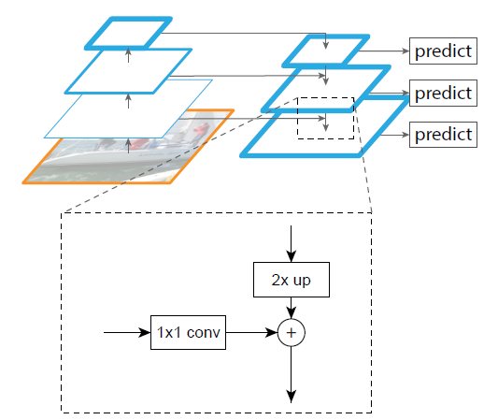
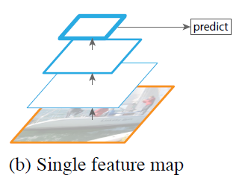
Adding Feature Pyramid Network (FPN) to Faster R-CNN

Slide 28
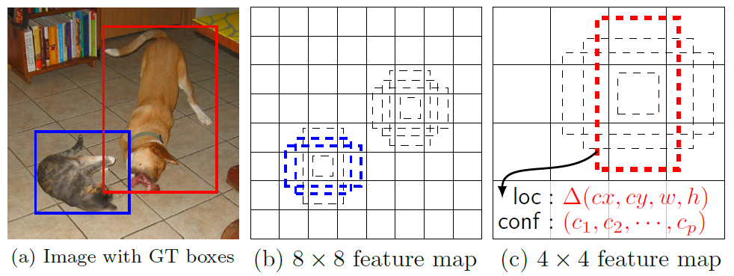
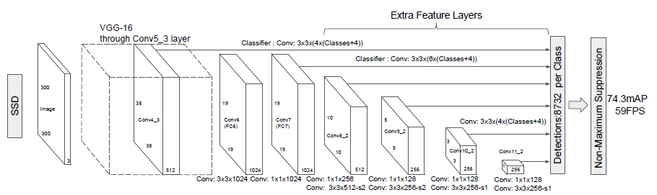
SSD (2016)
One stage object detection

Slide 29
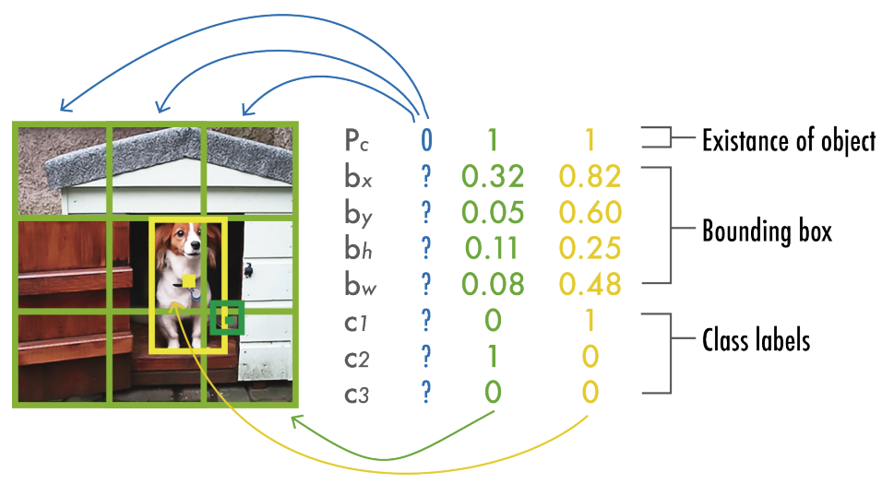
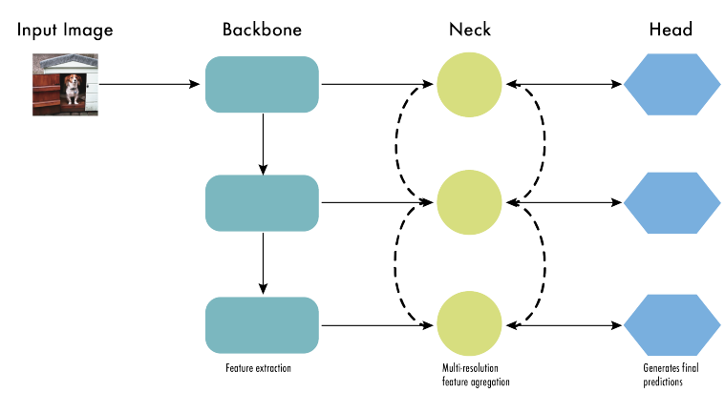
YOLO family (v1, v2, …, v12, …)

Slide 30


RetinaNet (2017)
Focal loss

Slide 31

Instance segmentation

Slide 32


Mask R-CNN

Slide 33
Image style transfer

Slide 34

Image style transfer
Inputs: content image, style image
Output: stylized image

Slide 35
Optimization-based ST (Gatys et al., 2015)
Consider convolutional neural network (VGG)
Content is reconstructed from activations on different layers
Style is reconstructed from correlation of its activations on different layers

Slide 36

Optimization-based ST

Slide 37


Optimization-based ST

Slide 38

Optimization-based ST

Slide 39

Transformation-based ST (Johnson et al., 2016)

Slide 40

Transformation-based ST

