Slide 1
NN models for audio: Automatic Speech Recognition (ASR) and Text-To-Speech (TTS)
Deep learning

Slide 2
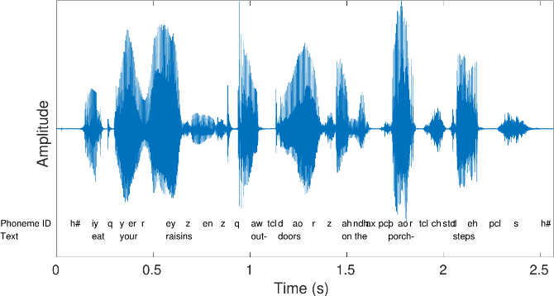
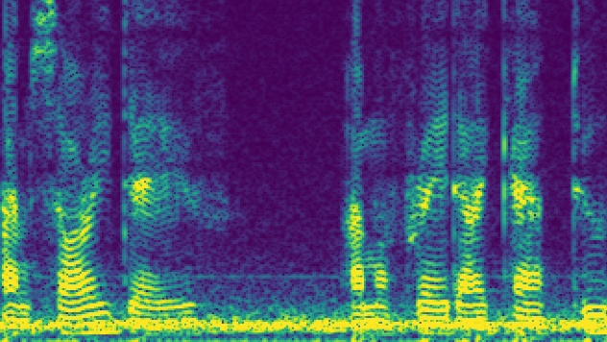
ASR pipeline
Hello, …
NN
Audio waveform
Log-Mel-Spectrogram
Output text
Some typical values:
Audio waveform sampling rate: 16kHz -> 16000 points per second
Spectrogram hop length: 10 ms -> spectrogram x scale 100 frames per second
Spectrogram window size: 25 ms
Number of Mel filters: 80 -> spectrogram y scale 80 values

Slide 3
ASR architectures
LAS: encoder-decoder model with attention
DeepSpeech: encoder-only model with CTC loss
RNN-Transducer: encoder-decoder model with monotonic alignment, suitable for streaming ASR

Slide 4
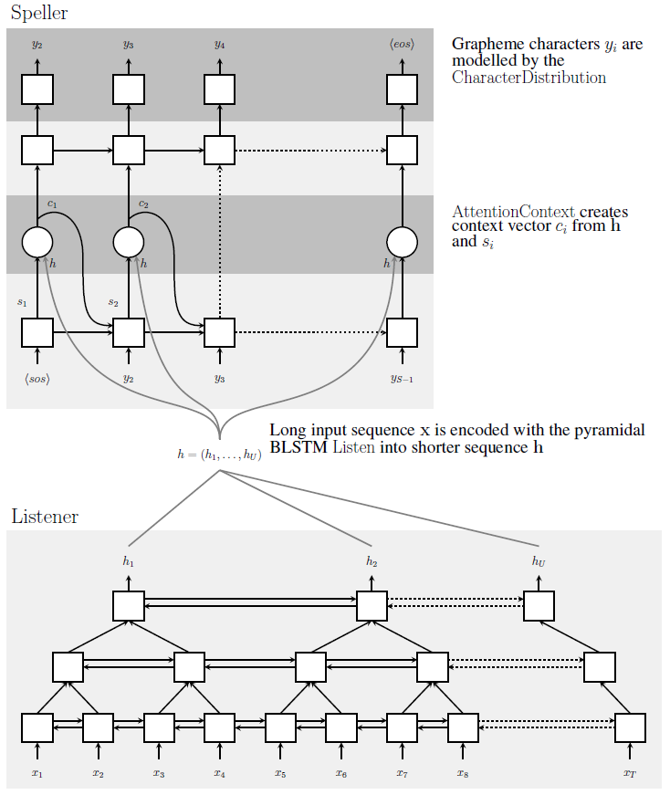
Listen, Attend and Spell (LAS, 2015)
Architecture: Encoder-Decoder model with attention
Encoder: pyramid bidirectional LSTM
Decoder: autoregressive LSTM
Inference: Beam search
Pros: good quality, ability to use separately pretrained encoder for audio (Conformer-like) and decoder for text (GPT-like)
Cons: very slow on inference

Slide 5
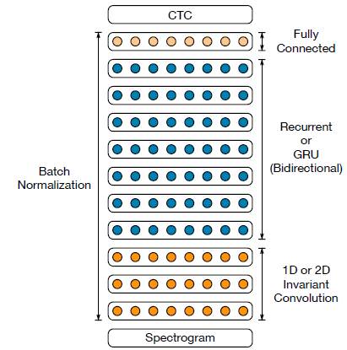
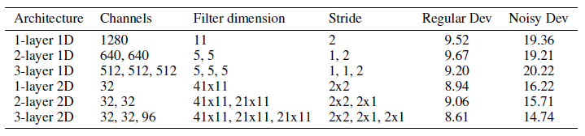
Deep Speech 2 (2016)
Architecture: Encoder only model + CTC loss
Encoder uses 1) convolutional layers (1d or 2d), 2) RNN layers and 3) FC layers
Inference: beam search + separate language model (non-autoregressive word n-gram model like KenLM)
Pros: fast inference
Cons: requires separate language model, can’t use pretrained text decoder

Slide 6
Using language models on inference
Example: I’ll write it right now
Words “write”, “right”, “rite” have almost identical pronunciation
DeepSpeech: each output token is generated independently from each other => without separate language model can output “I’ll right it right now”
LAS: decoder is autoregressive, next token is generated conditioned on previously generated token => can show good performance without additional language model

Slide 7
RNN Transducer (RNN-T, 2012)
Transducer – the best from two worlds (LAS and DeepSpeech): fast inference, can use pretrained models, suitable for streaming ASR
In ASR alignment between input audio and output text is monotonic
Audio Encoder: biLSTM or Conformer, for audio $x_{1},…, x_{T}$ outputs hidden vectors $h_{1},…,h_{T}$
Text decoder (prediction network): autoregressive LSTM or GPT, for text $y_{1},…, y_{U}$ outputs hidden vectors $g_{1},…, g_{U}$
Joiner network: small MLP, for each pair $\left(h_{t}, g_{u}\right)$ outputs probabilities $p(y|h_{t}, g_{u})$ for all text tokens and additional blank symbol $∅$

Slide 8
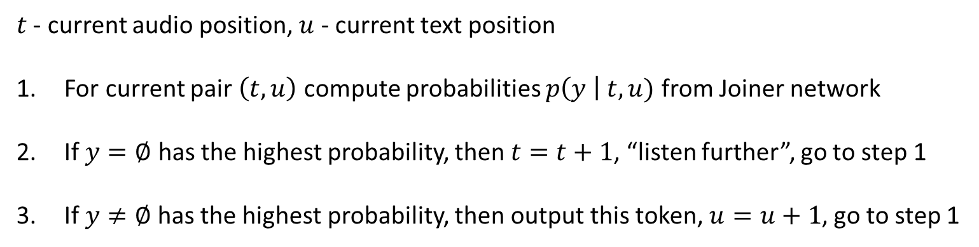
RNN-T Inference
$t$ - current audio position, $u$ - current text position
For current pair $\left(t, u\right)$ compute probabilities $p\left(y \right| t, u)$ from Joiner network
If $y=∅$ has the highest probability, then $t=t+1$, “listen further”, go to step 1
If $y≠∅$has the highest probability, then output this token, $u=u+1$, go to step 1

Slide 9
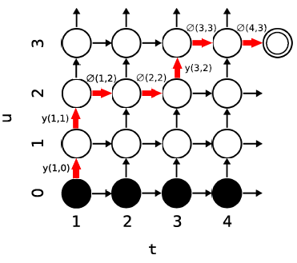
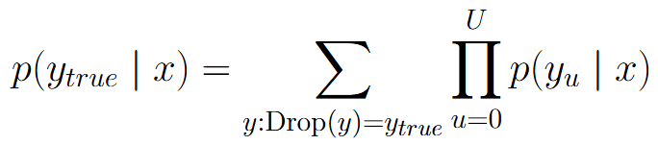
RNN-T Training
Consider Drop operation: drop all empty symbols
Loss function for RNN-T is determined by probability:
Efficient computation of this probability using Dynamic Programming:

Slide 10
RNN-T properties
For ASR streaming let’s process audio in chunks 300-500 ms
Prediction network is autoregressive => doesn’t need a separate language model on inference
Can use pretrained models for both audio encoder and text decoder

Slide 11
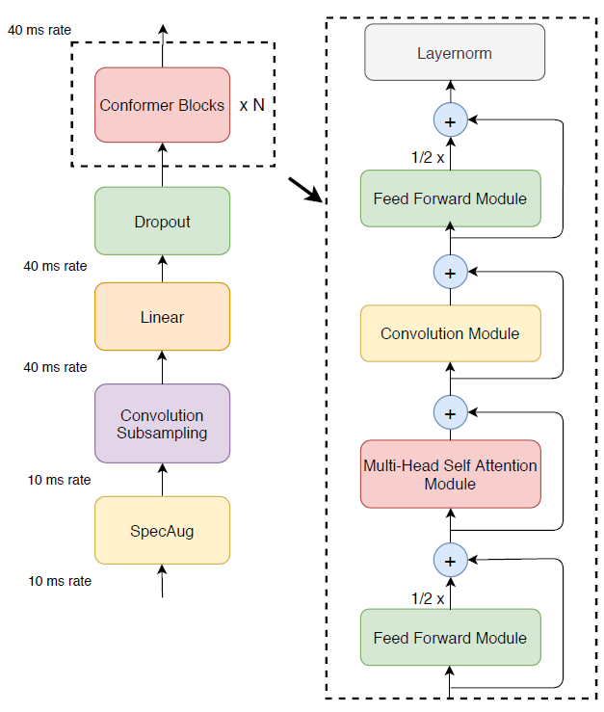
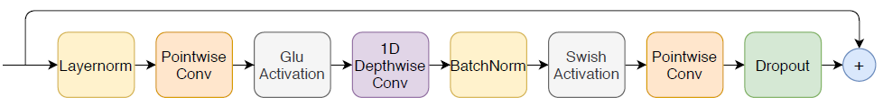
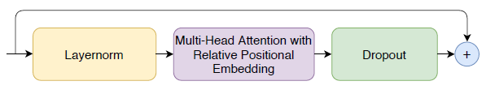
Conformer (CONvolution + transFORMER)
General architecture:
Convolutional block:
Self-attention block with Relative Positional Embedding:

Slide 12
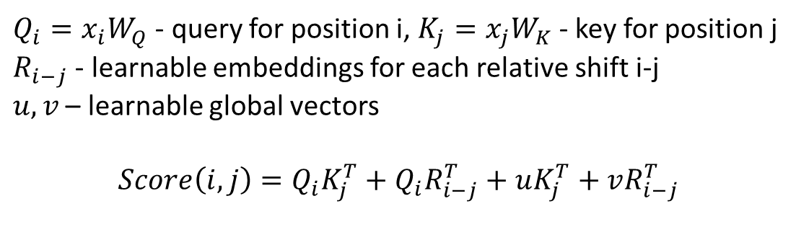
Relative Positional Embedding
$Q_{i}=x_{i}W_{Q}$ - query for position i, $K_{j}=x_{j}W_{K}$ - key for position j
$R_{i−j}$ - learnable embeddings for each relative shift i-j
$u, v$ – learnable global vectors
$$Score\left(i,j\right)=Q_{i}K_{j}^{T}+Q_{i}R_{i−j}^{T}+uK_{j}^{T}+vR_{i−j}^{T}$$

Slide 13
Text Normalization
Text normalization: transformation of written text to pronounced text
Example of input text: Hi, Dr. Smith! We've seen the report from NASA... it's about $19.99, or 20% off the usual price. I saw it on the news at 3:00 PM. The FBI might investigate, y'know? [laughter]
Example of normalized text: hi doctor smith we have seen the report from nasa it is about nineteen dollars and ninety nine cents or twenty percent off the usual price i saw it on the news at three p m the f b i might investigate you know
Elements of normalization: only lower case letters, no punctuation, numbers are pronounced, abbreviations are pronounced, special signs like $, % are pronounced, etc.
Inverse normalization operation is also needed

Slide 14
Text tokenization
Three options:
Separate letters: a, b, c, … + blank, unknown; leads to very long text sequences
Phonemes: hello → [h, ə, l, oʊ]; logical from linguistics point of view, requires non-trivial Grapheme-To-Phoneme (G2P) and inversed Phoneme-To-Grapheme models
The same letters may correspond to different pronunciation: tough, through, though
The same pronunciation may correspond to different words: write, right, rite, wright
Text tokens: BPE, WordPiece, etc.; modern mostly used approach, also needed in case of pretrained text models

Slide 15
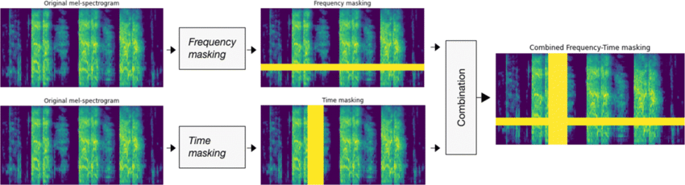
Audio augmentation
SpecAugment: Frequency and Time masking applied to spectrograms
Noise Injection: adding different noise to initial audio in time domain
Acoustic Simulation: adding filters of time domain audio in order to imitate big lecture hall, small bathroom, etc.
Time and Pitch distortion: accelerate and slow down audio signal, shifting pitch (F0)

Slide 16
TTS pipeline
NN: Acoustic model
NN: Vocoder
Input text
Spectrogram
Audio waveform
Acoustic model: requires audio transcript in training => small datasets
Vocoder: can train on all possible audios => huge datasets

Slide 17
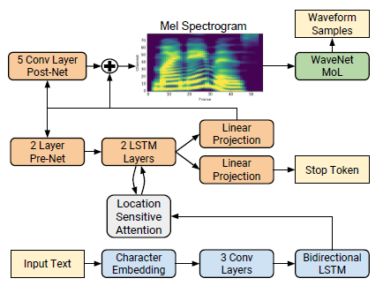



Tacotron 2 (2016)
Architecture: Encoder-Decoder with attention
Local sensitive attention: use attention weight from previous steps
Use separate head for predicting stop token

Slide 18
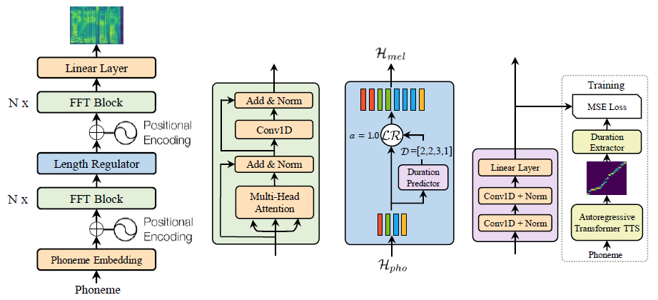
Fast Speech
Phoneme-to-Spectrogram prediction problem
Architecture: encoder-only with special length regulator block
Duration Prediction: attention weights from separately trained Encoder-Attention-Decoder TTS

Slide 19
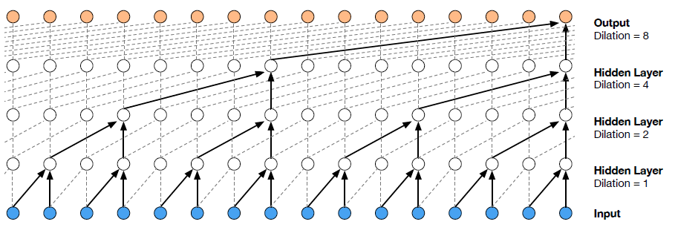
WaveNet vocoder
Problem: Spectrogram -> Audio waveform
Audio part: autoregressive next audio element prediction generative model
Architecture: a stack of dilated convolutions for large receptive field
For conditional generation (condition = spectrogram) each spectrogram is upsampled using conv decoder and then each layer compute:

Slide 20
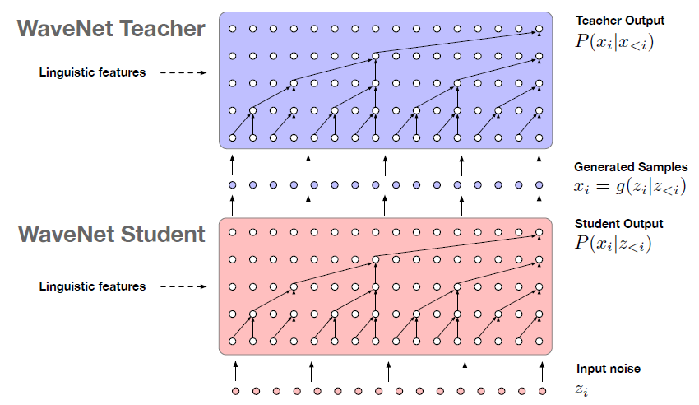
Parallel WaveNet vocoder
Use idea of Inverse Autoregressive Flow for distillation of WaveNet

Slide 21
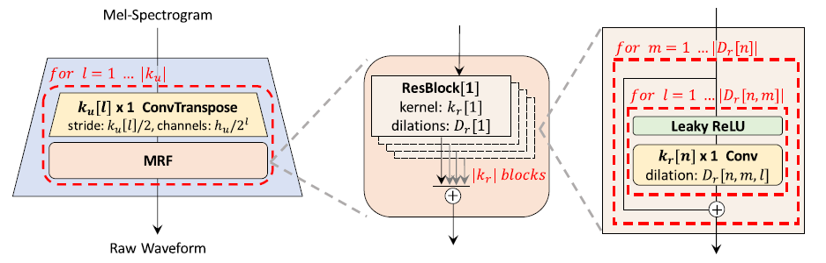
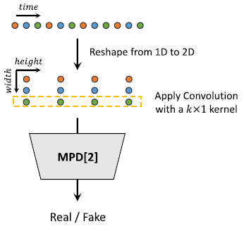
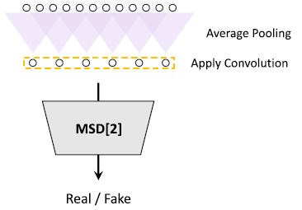
HiFi-GAN
Solve spectrogram-to-audio problem using GAN style generative model
Generator: predict audio using spectrogram using convolutional decoder (as input no noise is given)
Discriminator: predict true/fake classes for given audio
Multi-scale Discriminator
Multi-period Discriminator

Slide 22

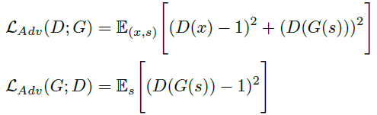


HiFi-GAN
Generator and discriminator losses are formulated as MSE
Mel-spectrogram loss: phi(x) – spectrogram of true waveform, phi(G(s)) – spectrogram of generated audio
Feature-matching loss: measure similarity between generated audio and true waveform using intermediate feature maps of discriminator

