Slide 1
Generative Adversarial Networks
Deep learning

Slide 2
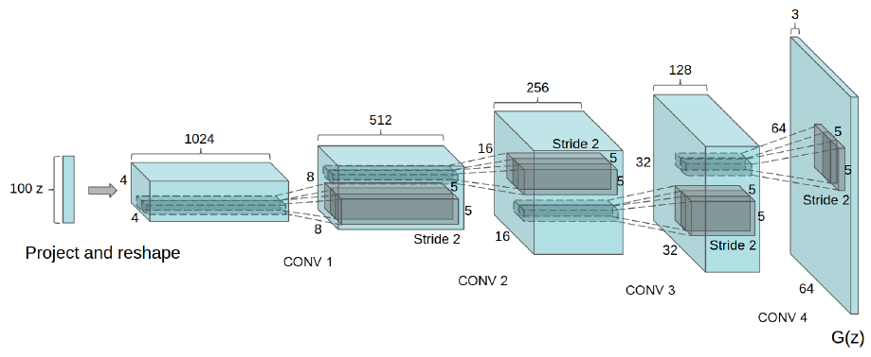
Deep Convolutional GAN (DCGAN, 2015)
Generator: convolutional decoder
Discriminator: convolutional encoder
Some elements:
Non-saturated loss for generator -E_z d(g(z))
Label smoothing for discriminator
Strided convolutions instead of pooling
Batch normalization
Relu in G, LeakyRelu in D
Different learning rates for optimization for D and G parameters

Slide 3
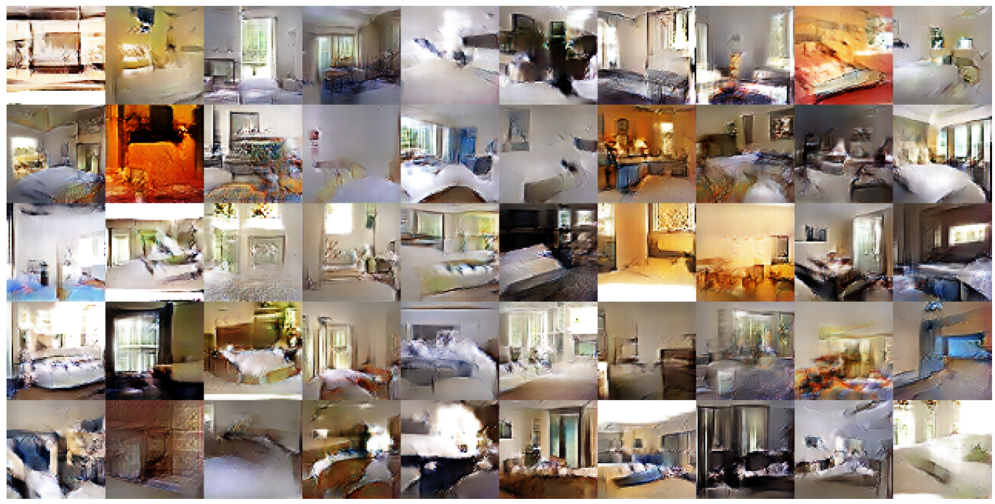
DCGAN
The quality of generated images is far from ideal

Slide 4
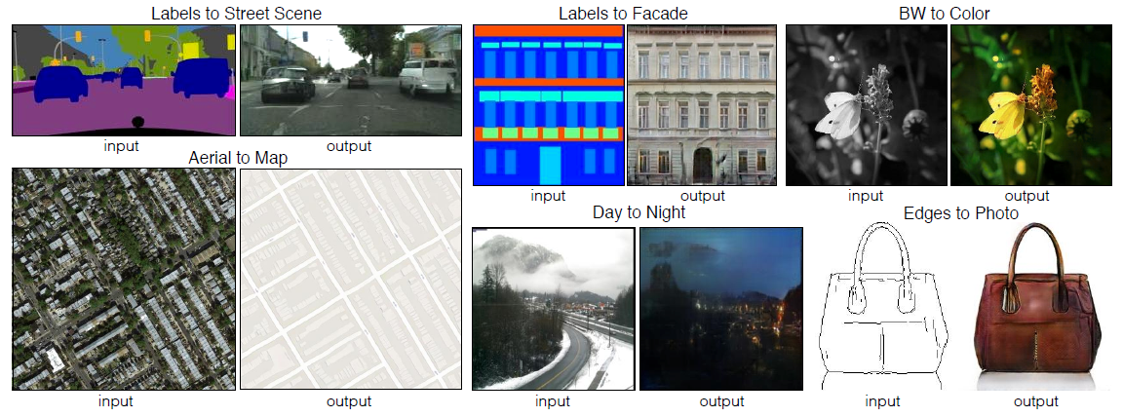
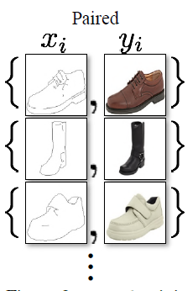
Pix2Pix (2016)
Image to image generation, requires as the dataset a collection of parallel pairs

Slide 5
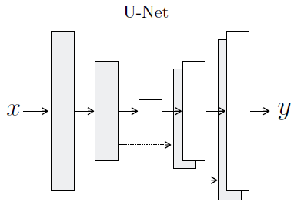
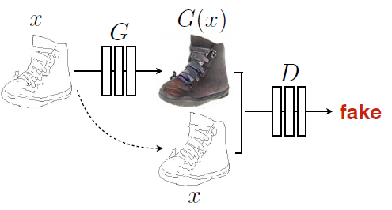
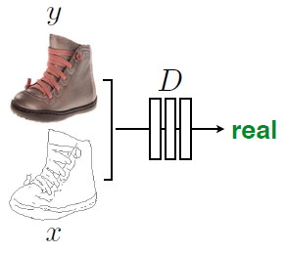
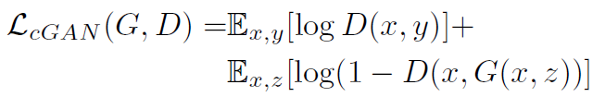

Pix2Pix
Generator:
Discriminator:
Loss function:
Regularizer:

Slide 6
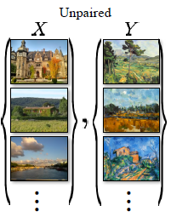
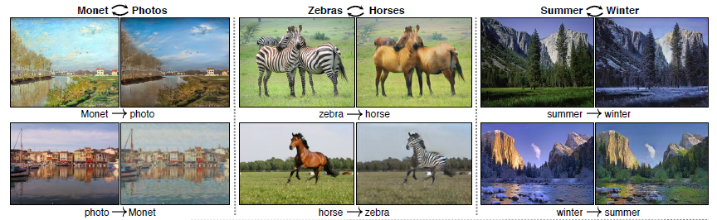
CycleGAN (2017)
Image to image generation, it is enough to have in the dataset separate images from each domain

Slide 7
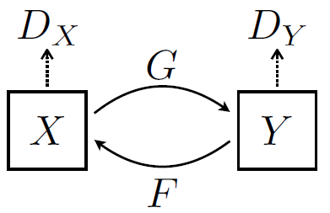


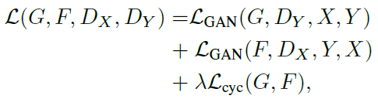
CycleGAN
G: transformation from domain X to domain Y
F: transformation from domain Y to domain X
GAN loss:
Consistency loss:
Full loss:

Slide 8
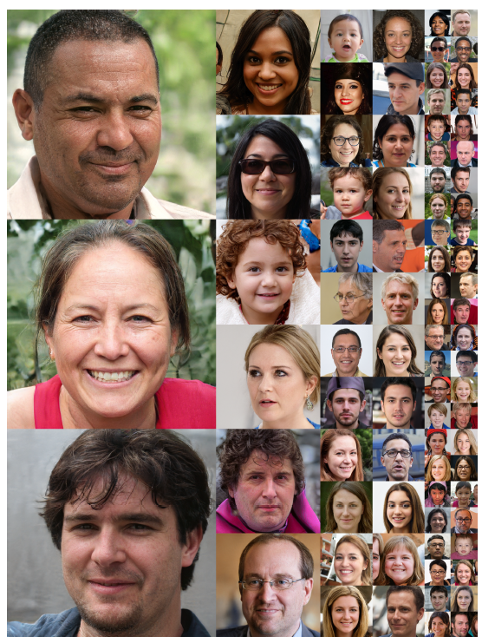
StyleGAN (2018)
High-resolution high-quality image generation

Slide 9
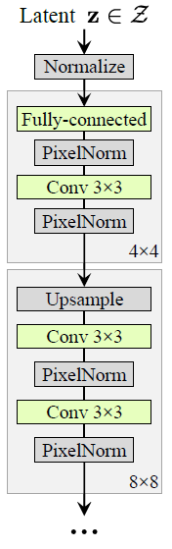
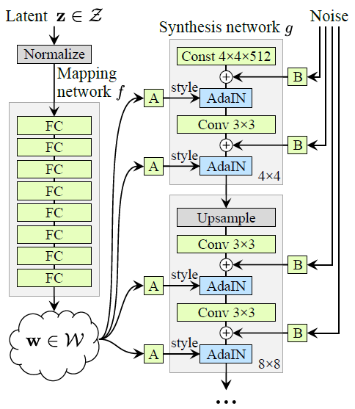

StyleGAN
Classic generator:
Style-based generator:
Adaptive Instance Normalization:
Subtract existing style
Add new style

Slide 10
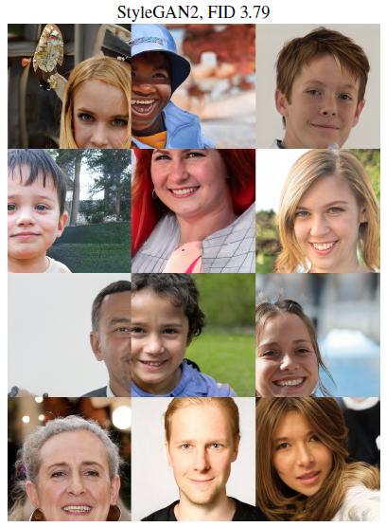
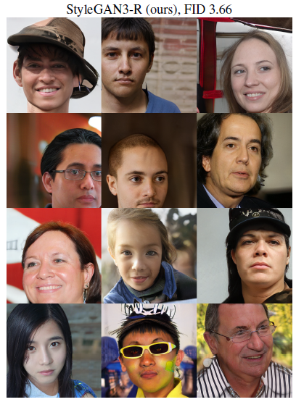
StyleGAN2 (2019), StyleGAN3 (2021)
Even better generation properties

