Slide 1
Transformer models
Deep learning

Slide 2
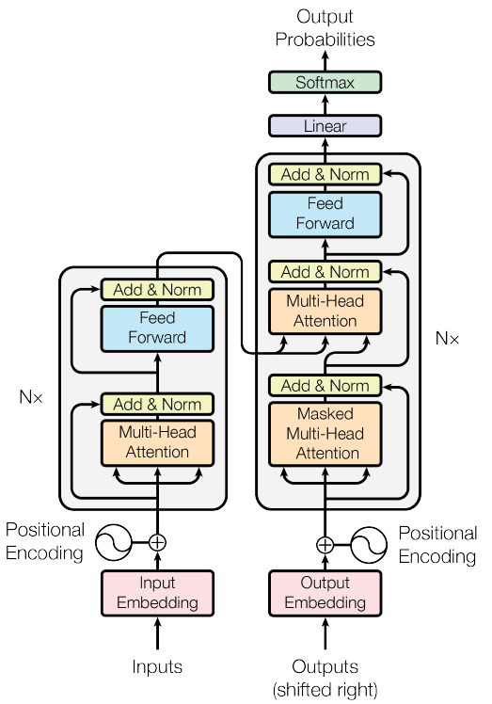
Transformer for machine translation

Slide 3
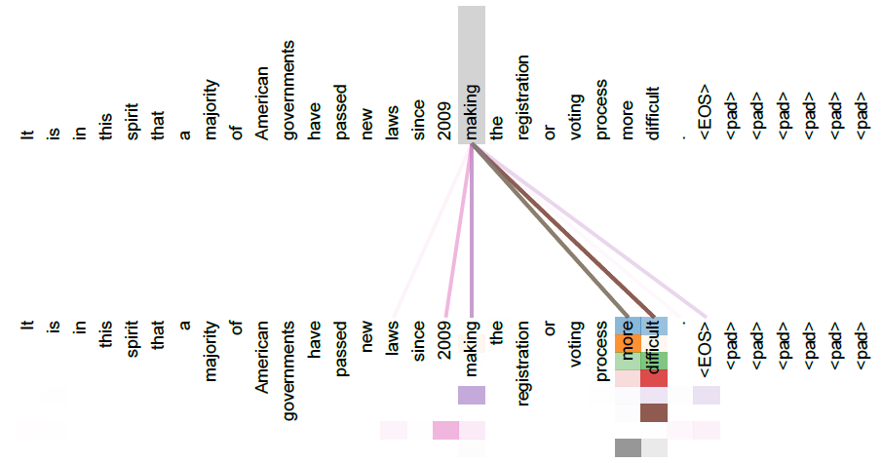
Attention visualization

Slide 4
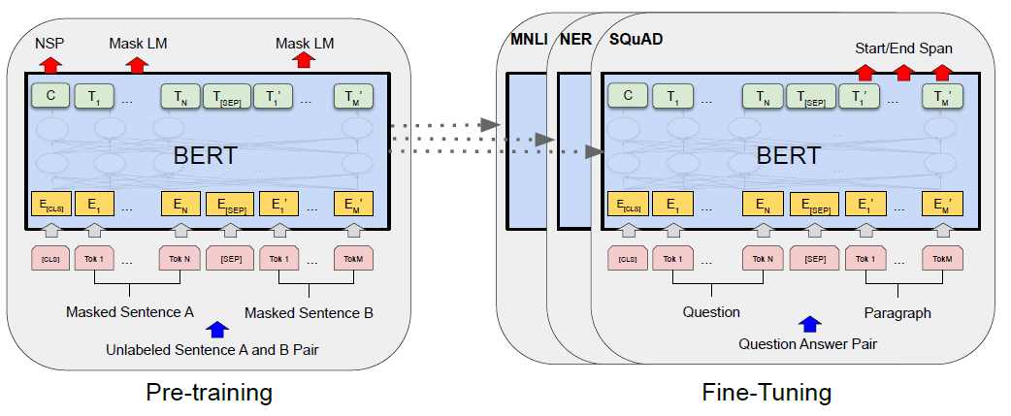
BERT (Bidirectional Encoder Representation from Transformers)
Using only Transformer encoder
Masked Language Model pretraining
Next Sentence Prediction for training CLS embedding
Fine-tuning for downstream tasks

Slide 5
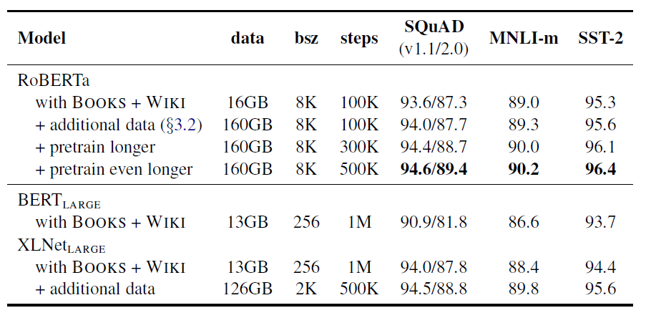
RoBERTa

Slide 6

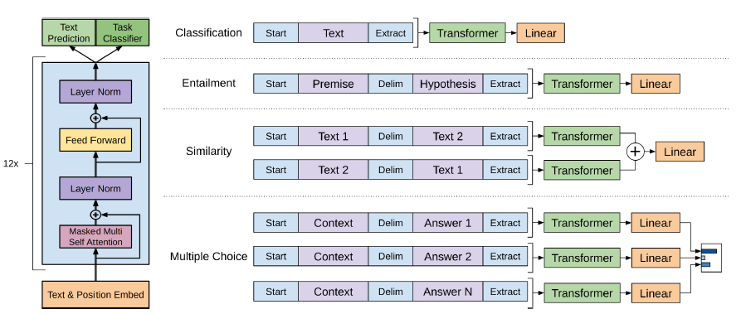
GPT-1 (Generative Pretraining from Transformers)
Using only Transformer decoder (without cross-attention parts)
Unsupervised pretraining using next token prediction
Fine-tuning for supervised tasks
Observation: fine-tuning requires only few epochs

Slide 7
GPT-like vs. BERT-like models
BERT-like models are better for token embeddings, since they look at both left and right context
GPT-like models are better for prompt answering, since they are trained in next-token-prediction fashion

Slide 8
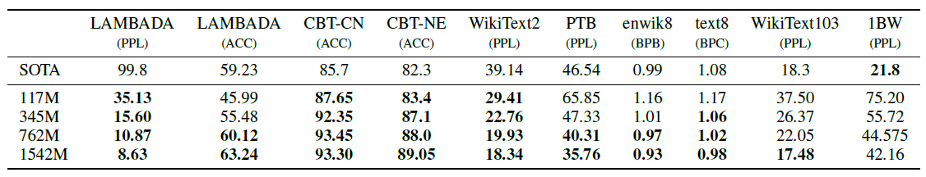
GPT-2
Increased sizes of model and dataset
Fully unsupervised training
Shows not that bad zero-shot performance

Slide 9
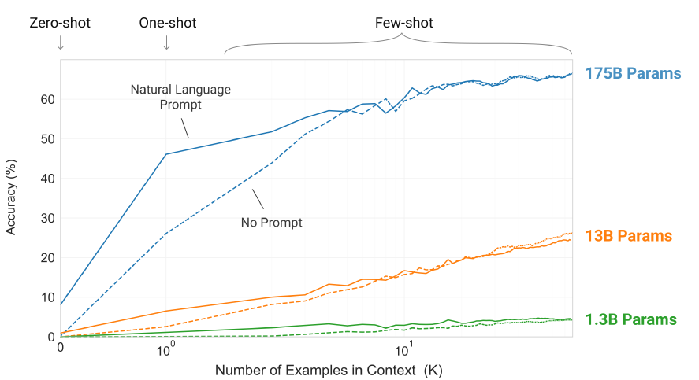
GPT-3
Significantly increased sizes of model and dataset
Fully unsupervised training
Shows much better zero-shot performance

Slide 10
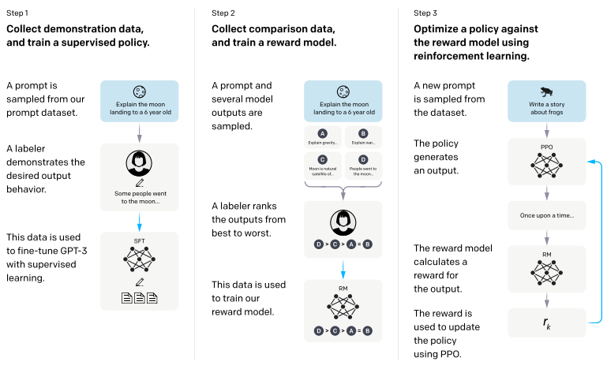
InstructGPT
Finetuning of GPT-3 with assessors help

Slide 11
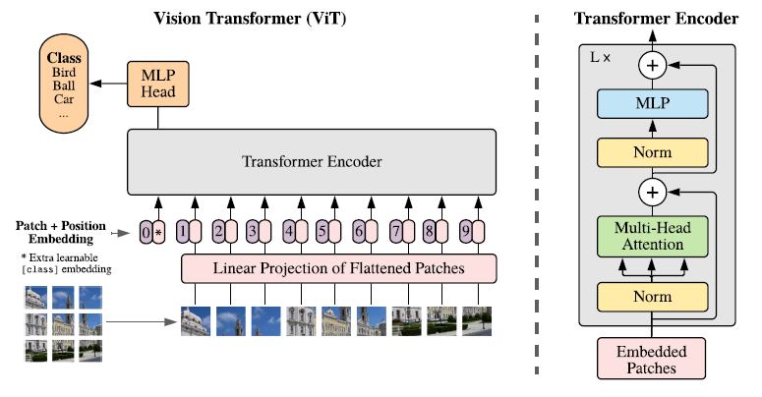
Vision Transformer
Using similar unsupervised masked pretraining mechanism for images

Slide 12
BERT/GPT models for images
Vision Transformer – an analogue of BERT/RoBERTa models, allows finding good image representation and is used as alternative to convolutional encoders
ImageGPT – an analogue of InstructGPT/ChatGPT models of image pixels, can be used for image generation, but in practice diffusion-based models like DALL-E, Stable Diffusion are usually used

