Slide 1
Bias-Variance Decomposition Compositions of ML algorithms: Random Forest and Gradient Boosting

Slide 2
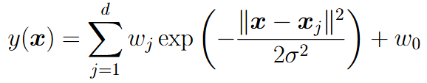
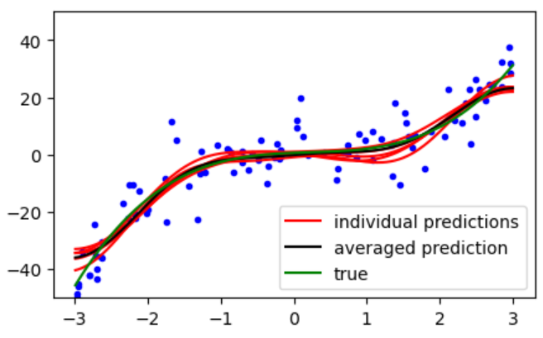
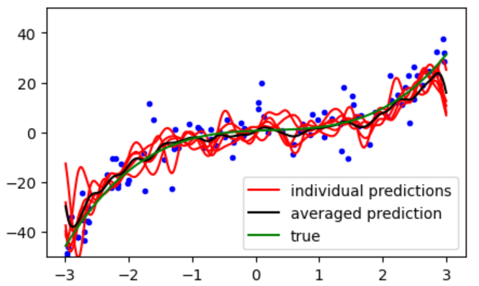
Bias-Variance Decomposition (BVD)
BVD is a theoretical concept describing generalization ability of a given ML algorithm in terms of sensitivity of its performance w.r.t. different training datasets
Linear regression with RBF features:
sigma=1
sigma=0.1

Slide 3




General performance of ML model for regression
Joint probability distribution:
Dataset = set of independent samples from the joint distribution:
Fixed ML model:
Risk = performance of ML model on general population sample (infinite testing set):

Slide 4


Optimal ML model for regression

Slide 5



Bias-Variance Decomposition (BVD)
- randomly chosen dataset (e.g. random subsample from fixed training set)
- ML training procedure applied for given dataset Z
ML model:
Risk:

Slide 6

Bias-Variance Decomposition (BVD)
Risk:
Noise = performance of optimal model (non-reducing error)
Bias = how mean ML model differs from the optimal model (complexity of ML family of models)
Variance = sensitivity of ML model to the chosen training set
Good ML model should have low risk value = both low bias and low variance

Slide 7
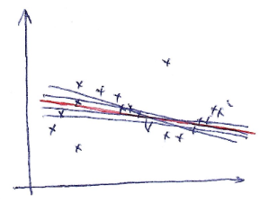
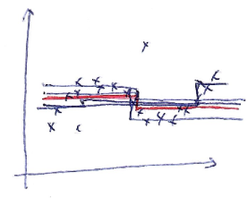
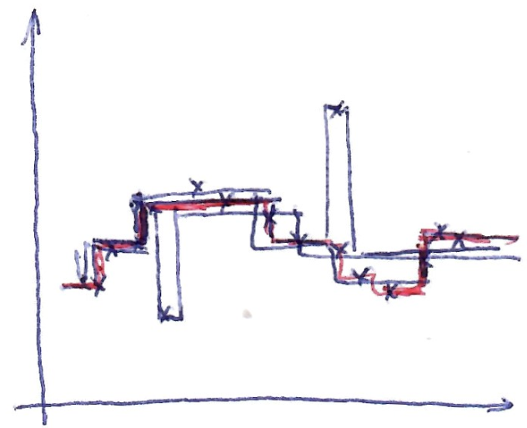
Examples
Linear models
Low variance
High bias
DT with one split
Low variance
High bias
DT with many splits
High variance
Low bias

Slide 8
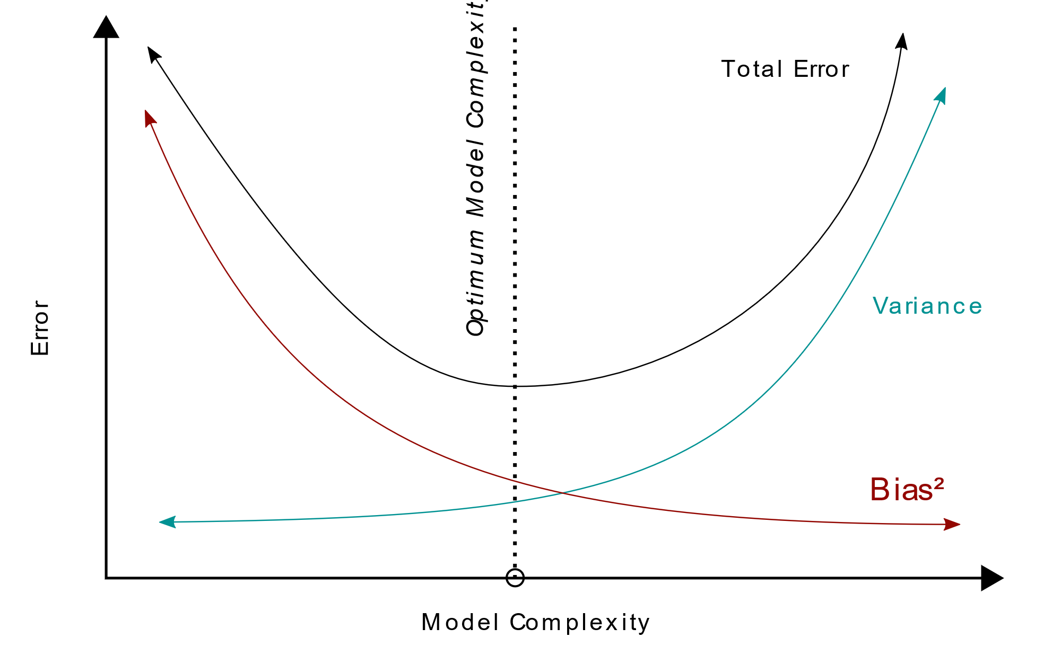
BVD

Slide 9
Random Forest

Slide 10





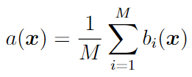
Composition of ML algorithms
Let’s consider regression problem
Dataset:
ML learning method for given dataset:
Let’s consider different datasets constructed from the original one (for example, by random subsampling)
ML models trained on different datasets:
Composition of ML models:

Slide 11
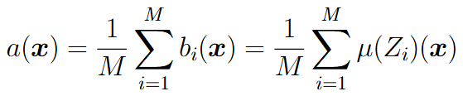
BVD for Composition ML model
Composition ML model:
Bias for composition = Bias for one base model, hence it is beneficial to take in composition base model with low bias (e.g. DT with big depth)
Variance for composition:
Variance of composition can be M times lower (!) comparing to variance of base model in case of good uncorrelated base models

Slide 12




Bagging (Bootstrap AGGregatING)
Original dataset:
Bootstrapped dataset = random resample from original dataset with repetitions:
For
Base model = ML model trained on bootstrapped dataset
Final ML model = averaging of base models

Slide 13


Random Forest
Random Forest main ideas:
1) use bagging over deep decision trees
2) during finding best splitting predicate in each node use random subsample of features (not the same as taking random subset of features for the whole decision tree!)
Recommendation for number of random features m:
For classification:
For regression:

Slide 14


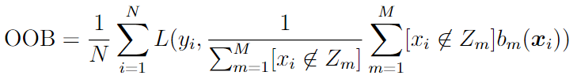
Out-of-bag (OOB) performance estimation
- dataset for training m-th base model
We can use OOB instead of costly to compute cross-validation

Slide 15
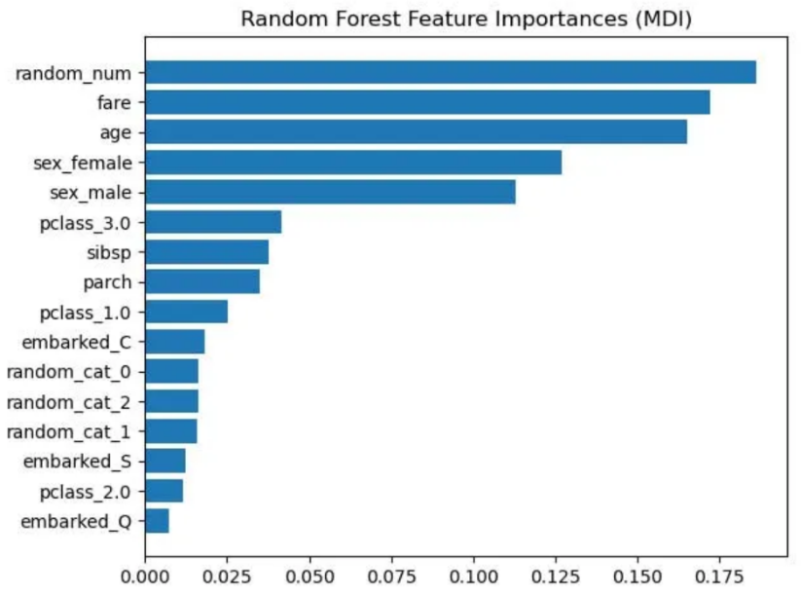
Feature Importance in Random Forest
MDI (Mean Decrease Impurity measure)
For each node of each tree in the forest, compute the impurity decrease of the node on a specific feature.
Compute the weighted sum of the impurity decreases with weights proportional to number of objects in that node.
Average the weighted impurity decrease over all trees in the forest.
MDI can favor numerical features and categorical features with many values. Also, MDI is computed on the training set.
Alternative: Permutation Feature Importance.

Slide 16


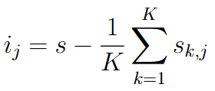
Permutation Feature Importance
Compute model’s performance s on control dataset D
For each feature j:
For each repetition k in 1,...,K:
Randomly shuffle column j of dataset D to generate a corrupted version of the data
Compute model’s performance on corrupted data
Compute feature importance:

Slide 17
Random Forest
Advantages:
Usually good ML performance
Do not have hyperparameters
Out-of-bag (OOB) performance estimation and MDI feature importances
Disadvantage:
Maybe slow to train
Do not account for non-MSE loss function in composition training

Slide 18
Gradient Boosting

Slide 19
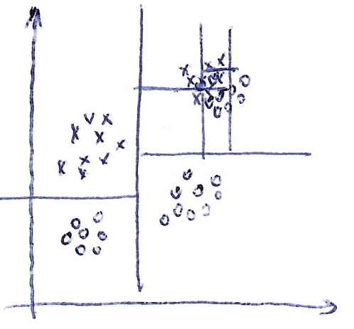
Random Forest
In Random Forest each base model is trained from scratch independently of each other. May be too slow to train the composition.
There may be simple and complicated regions in feature space. In RF each tree learns all regions by its own

Slide 20
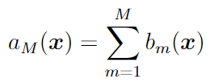

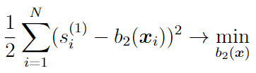

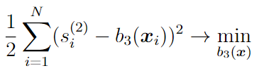

Boosting for regression
Main idea: next base ML model is trained w.r.t. performance of current composition
Composition is a sum of base models:
Train the first model:
Compute residuals:
Compute residuals of the current composition:
The process continues until all M base models are trained

Slide 21
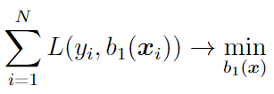
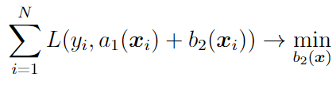


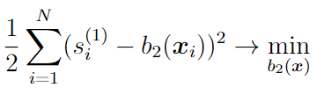
Gradient Boosting for general loss function
Train first model:
Let’s make one gradient descent step from 0:
Compute pseudo-residual:
Fit the next model to this residual:

Slide 22


Gradient Boosting for general loss function
Equivalent formulation:
- learning rate
With adding base algorithms error rate of training set usually decreases. So training procedure continues until error rate on control dataset is start increasing

Slide 23
Gradient Boosting
Every next base model tries to correct mistakes of current composition. Without proper regularization this procedure may lead to overfitted solution.
Regularization ideas:
Choose smaller learning rate
Train each base model on random subsample from the original dataset

Slide 24

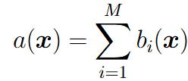





Gradient Boosting for classification
Pseudo-residuals:
Train regression model as next base model:

Slide 25
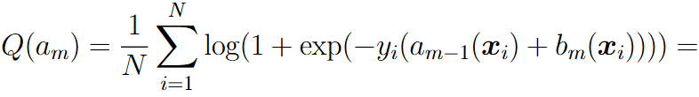
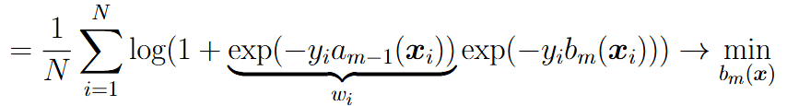
Object weights in gradient boosting
Objects with big positive margins have almost zero weights in training the next base model
Objects with big negative margins have the biggest weights in training the next base model

Slide 26


Object weights in gradient boosting
Objects with big negative margins have pseudo-residuals close to class label
Objects with big positive margins have pseudo-residuals close to zero

Slide 27
Bias-Variance for Gradient Boosting
Composition model:
Here compact formulas for bias and variance can not be derived due to dependence between base models
During training (adding new base models) bias is decreasing, while variance may increase
In Gradient Boosting usually simple base models are used (e.g. decision trees with few leaves). They do not overfit (have low variance) and bias of total composition is decreased by boosting procedure

Slide 28



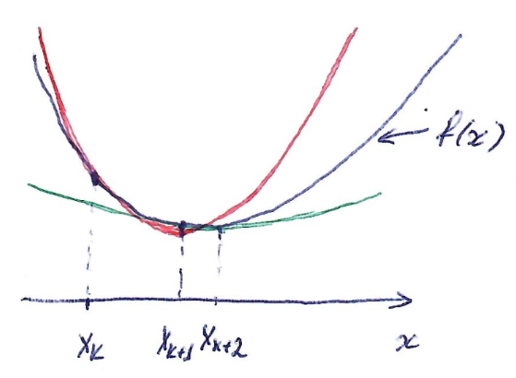
Newton optimization method

Slide 29

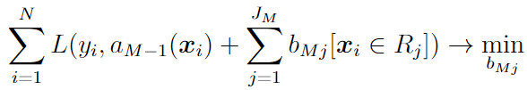

Gradient Boosting for Decision Trees
Train DT on pseudo-residuals and fix found predicates
Fine-tune prediction in each region by solving 1d optimization problem using one-step Newton procedure:

Slide 30
Gradient boosting parameters
Learning rate
Maximal number of trees (base ML models)
Maximal tree depth (e.g. 3) or number of leaves (e.g. 8)
Minimal number of objects per leaf
Object subsampling rate (e.g. 70%)
Feature subsample rate (e.g. 50%)

Slide 31
Random Forest vs. GB
RF:
No hyperparameters
Do not overfit
Costly to train
Do not account for loss function
GB:
Many hyperparameters
May overfit
Faster to train comparing to RF
Accounts for loss function
OOB performance measure and MDI feature importance can be used in both approaches

