Slide 1
Decision Trees for Regression and Classification

Slide 2
Decision Trees Motivation
Gives interpretable solution from human point of view
Directly deals with categorical features and missing feature values
A building block in composition algorithms like Random Forest and Gradient Boosting

Slide 3
Introduction to Decision Trees
Example: job interview for Data Scientist position
Logistic Regression?
no
yes
Overfitting effect in ML and how to cope with it?
Dual optimization problem?
no
yes
no
yes
Reject
Further first-step interview
Further interview for Data Engineer
Can be recommended to Research Department

Slide 4




Decision Trees
Decision tree is a binary tree, where
In all internal nodes there are some logical predicates
In all leaf nodes there is some prediction
For regression:
For K-class classification:

Slide 5


Decision Tree for prediction
Predict(v, x):
If v is a leaf, then return
If :
return Predict(left(v), x)
Else:
return Predict(right(v), x)
Call Predict(v=root, x)

Slide 6



Types of predicates
Comparison of some feature value with some threshold:
Linear predicate:
Distance to given object:
In practice usually the simplest variant 1 is used, because it already allows building a universal approximator

Slide 7
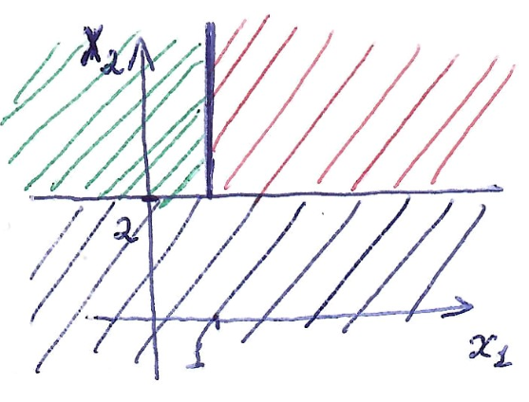


Decision Trees for simple predicates
DT builds piecewise constant prediction in feature space.
yes
no
blue region
yes
no
green region
red region

Slide 8
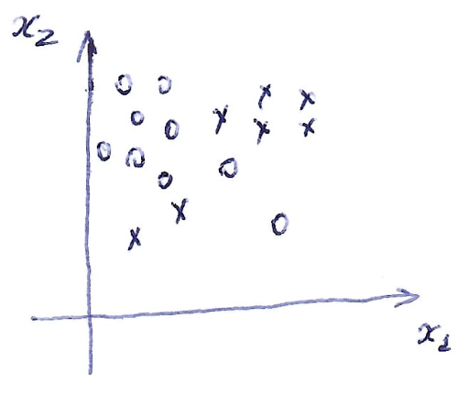
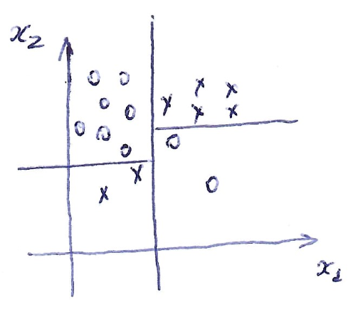
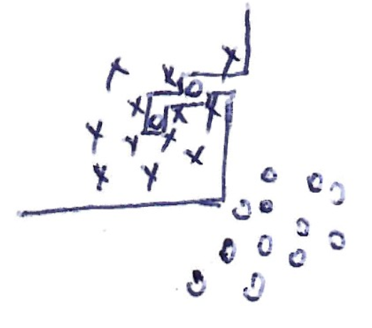
Decision Trees for simple predicates
With enough splitting steps DT with threshold predicates is able to overfit to arbitrary dataset!

Slide 9







Training Decision Trees
Procedure
If stopping criteria is satisfied:
find prediction
m = leaf
exit

Slide 10
Training Decision Trees
Choose stopping criteria
Choose constant prediction in leaves
Choose splitting criteria
Choose pruning method
Choose the way to work with missing values and categorical features
These exist many DT implementations: ID3, C4.5, CART, etc.

Slide 11

Stopping criteria
If all objects belong to one class (quality of constant prediction is below some threshold)
If maximal tree depth is reached
If
If maximal number of leaves is reached
If a splitting criteria in current node is below some threshold

Slide 12





How to find prediction in leaf?
Regression:
MSE
MAE
Classification:
Most frequent class
Class probabilities (the same as to use logistic loss in minimization)

Slide 13


How to find good predicate?
Let’s introduce some Impurity criteria
Impurity is higher if diversity of target values is higher
Criteria for finding good predicate = big reduction of impurity:

Slide 14




Impurity for regression

Slide 15
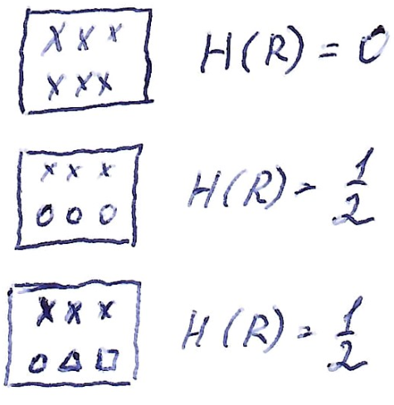
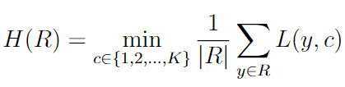

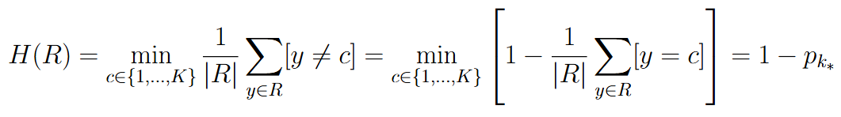
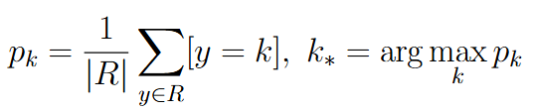
Impurity for classification

Slide 16


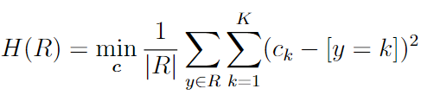



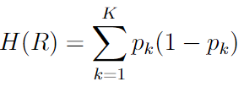
Impurity for classification: Gini index
From Logistic Regression discussion we have two loss functions that allow to learn probabilities: quadratic loss and logistic loss. Let’s try both of them.

Slide 17
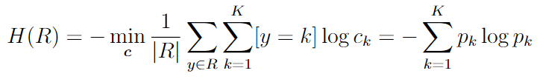
Impurity for classification: Entropy criterion
Gini index and entropy criterion show in practice similar performance

Slide 18
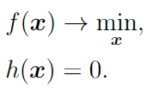



Recap: constrained minimization
Let’s consider optimization problem with some equality constraint:
Lagrange function:
If is a local constrained minimum then

Slide 19
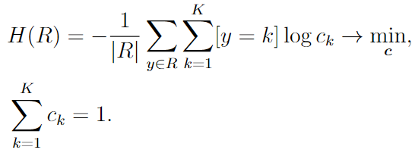
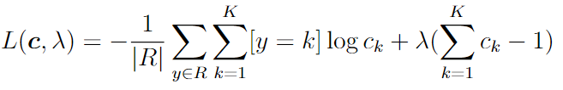
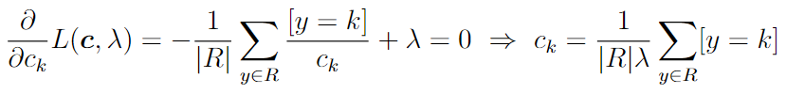
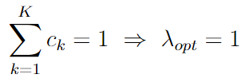

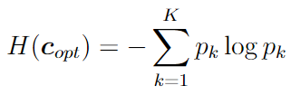
Minimizing Entropy criterion

Slide 20
Pruning for decision trees
In order to control overfitting in decision trees Pre-pruning and Post-pruning methods are used
Pre-pruning: find hyperparameters like maximal tree depth, minimal number of samples in each leaf, minimal number of samples in internal node using cross-validation
Post-pruning: first construct full tree and then simplify it by pruning some of its subtrees

Slide 21



Cost Complexity Pruning
Solves the problem of balancing DT quality and simplicity:
- sum of loss function values for all leaf nodes
- number of leaf nodes
- hyperparameter that is tuned using cross-validation
In composition algorithms with decision trees pruning is not used

Slide 22
Working with missing/unknown values in general
Many ML models like Linear and Logistic Regression, SVM, neural networks and others are able to train only for numerical features
Strategy 1: discard all objects or features with missing values from the dataset (very simple and rude, but can work sometimes)
Strategy 2: imputation with some constant value (e.g. mean or median of known feature values, most frequent value for categorical feature)

Slide 23
Working with missing/unknown values in general
Strategy 3: iterative imputation
For each feature let’s solve a regression problem where this feature is target variable and all others are inputs. On training use only objects with known target feature value.
Iterate this procedure several times (use imputed features from previous iteration for training regressors on the next iterate)

Slide 24
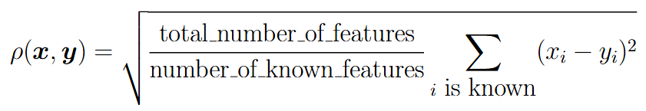
Working with missing/unknown values in general
Strategy 4: k nearest neighbor imputation
Each missing feature is imputed by taking k nearest neighbour objects with known target feature, where Euclidean distance w.r.t. other features is used:

Slide 25





Working with missing/unknown values in decision trees
Training: is a set of objects with unknown values of j-th feature in the current set of objects
Objects from are sent to both left and right subtrees with weights and
(requires weighted loss function minimization in impurity criterion)
Alternative: send objects randomly to left or right subtree
Testing: send objects with unknown values both to left and right subtrees and return prediction:

Slide 26
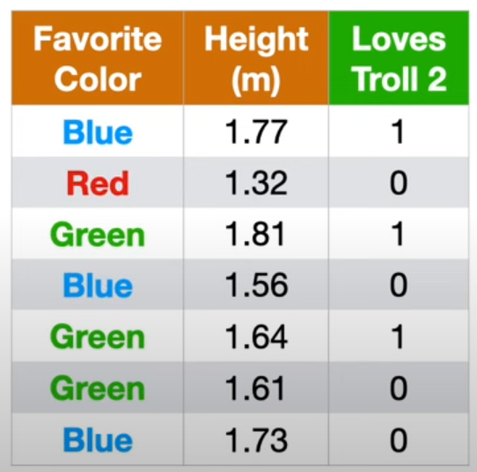
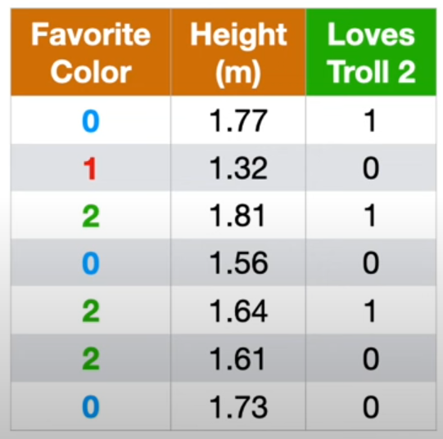
Working with categorical features in general
Ordinal (Label) Encoding: encode each category with some number using e.g. lexicographical sorting of category names
The problem: some artificial ordering is introduced 0 < 1 < 2
Examples are taken from Josh Starmer’s video

Slide 27
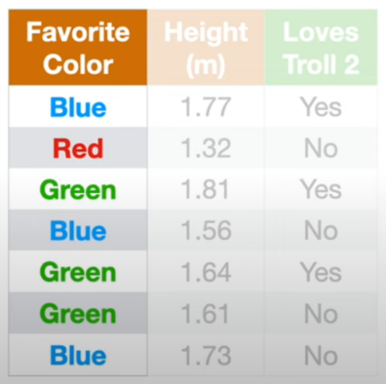
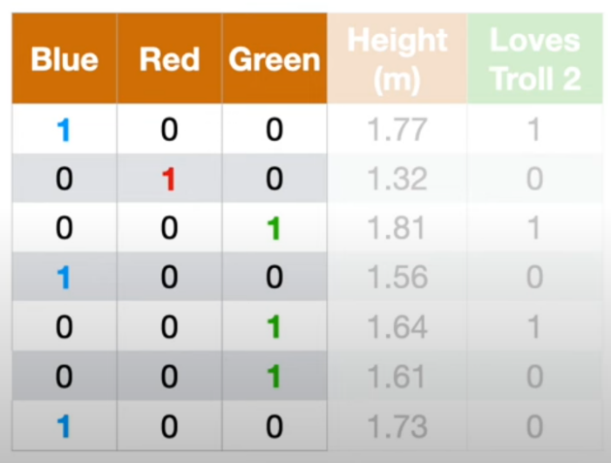
Working with categorical features in general
One-Hot Encoding: introduce K new binary features where K is a number of possible categories
Efficiently solves the problem of artificial ordering, but may require too many new features.
Examples are taken from Josh Starmer’s video

Slide 28
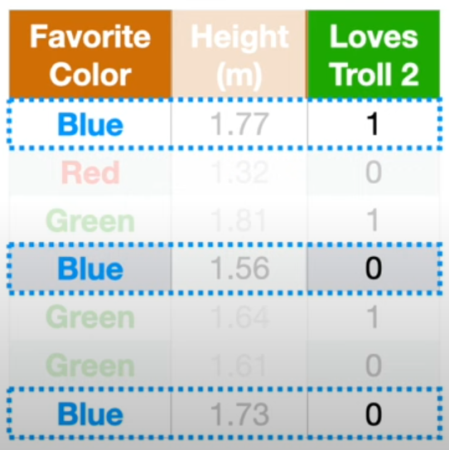
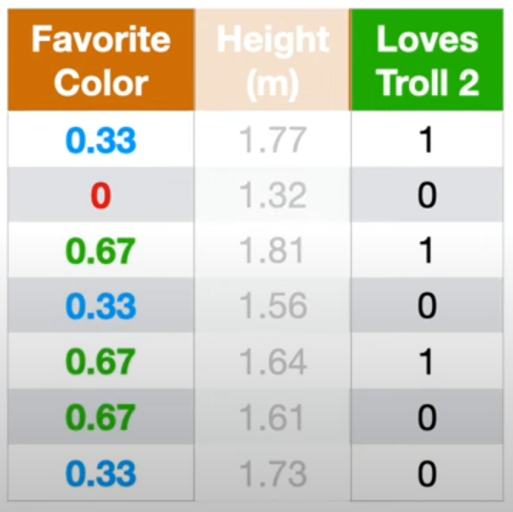
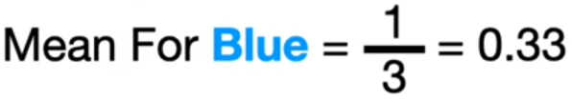
Working with categorical features in general
Target Encoding: average target values for all objects with the given category
The problem: target averaging for low-representative categories may be misleading (red category in the example)
Examples are taken from Josh Starmer’s video

Slide 29
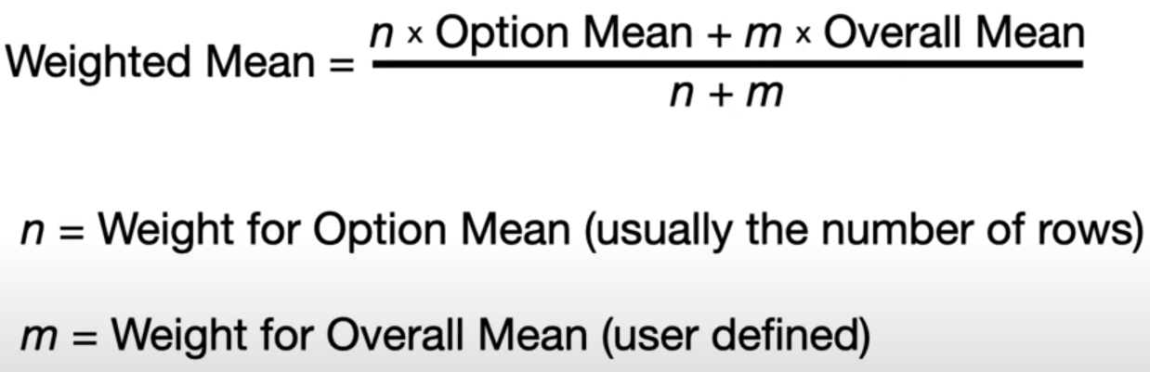
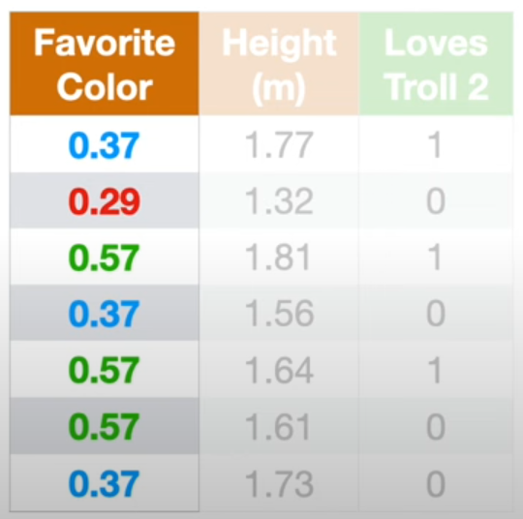
Working with categorical features in general
Bayesian Mean Encoding: use in target encoding weighted average of target values
Can be interpreted from Bayesian estimation viewpoint: overall mean – prior distribution, weighted mean – posterior distribution
Examples are taken from Josh Starmer’s video

Slide 30
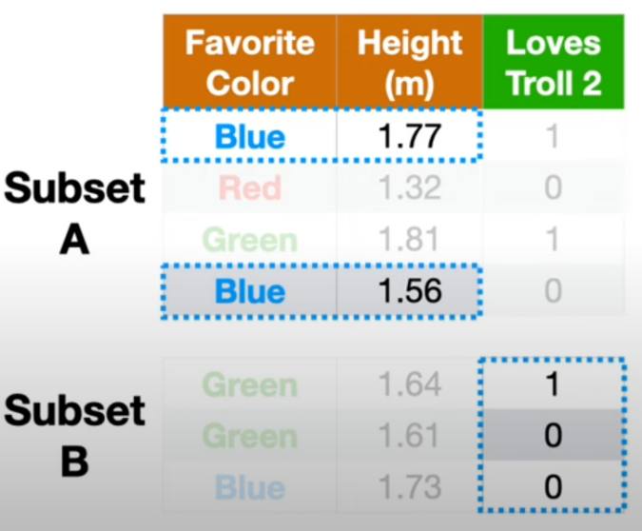
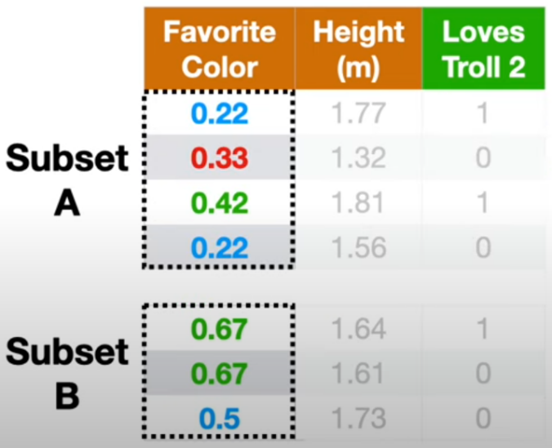
Working with categorical features in general
K-Fold Target Encoding: average target values from other subset in data split
Solves the problem of target variable leakage in Target Encoding
Examples are taken from Josh Starmer’s video

Slide 31




Working with categorical features in decision trees
Strategy 1: Number of children = number of categories
Strategy 2: Split all categories into two subsets
Direct implementation requires here number of splits

Slide 32




Working with categorical features in decision trees
- objects from the current set with category u
Let’s sort all categories w.r.t. target variable
Classification:
Regression:
Transform categorical feature into numerical one and compute Gini index or entropy criteria

Slide 33


Decision Tree as a linear classifier
DT can be interpreted as constructing a linear classifier on top of learnable features

