Slide 1
Learning to Rank

Slide 2



Applications of Ranking
Web search engines:
Video service recommender systems:
Online shopping recommender systems:

Slide 3



Scoring model for ranking
Object = a pair of query and document
Scoring model:
Inference: for given query and collection of documents output a list of top-ranked documents w.r.t. their scores
Query/documents examples
Web search: query = user + search query, documents = web pages
Online shopping: query = user + current order, documents = goods
Video service: query = user + recent video history, documents = videos

Slide 4



Supervision in Ranking
1. Relevant/non-relevant objects (users click data):
2. Ranking for pairs of documents (given by assessors):
3. Graded relevance: 0(bad), 1(fair), 2(good), 3(excellent), 4(perfect) (given by assessors)
In real search engines usually a combination of different supervision is used with more weight for assessor’s data

Slide 5
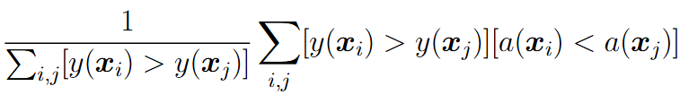
Ranking Evaluation Metrics
Ranking error rate:
This metrics doesn’t account for top K relevance

Slide 6



Ranking Evaluation Metrics
Binary relevance:
Let’s sort all objects w.r.t. their relevance scores and take top-K elements
Their corresponding relevancies:
This metric doesn’t consider the ordering, e.g. for [0,0,0,1,1] and [1,1,0,0,0] it has the same value

Slide 7
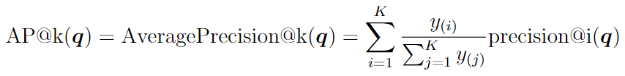



Ranking Evaluation Metrics
For the case y=[0, 0, 0, 1, 1]
For the case y=[1, 1, 0, 0, 0]

Slide 8

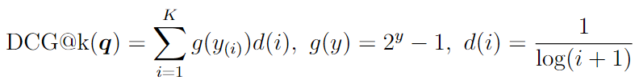


Ranking Evaluation Metrics
Graded relevance:
Discounted Cumulative Gain (g – gain, d – discount):
Normalized DCG:
Here maximum is attained for descending order of relevance y
Final metric:

Slide 9
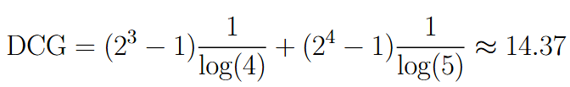


Ranking Evaluation Metrics
DCG and nDCG example
For the case y = [0, 0, 3, 4, 0]

Slide 10
Features for ranking
Query features:
Text query embedding (computed by some neural network like BERT)
Query popularity
Query category (geographical place, particular product, definition from Wikipedia, etc.)
User profile features like age, sex, etc.
User embedding

Slide 11
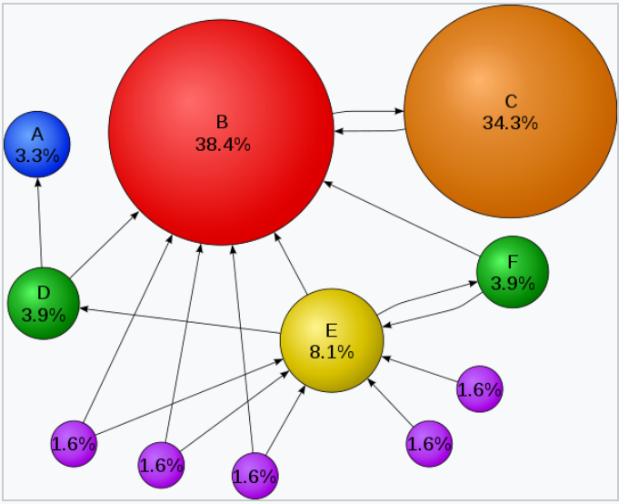



Features for ranking
Document features:
Document embedding
Document popularity
Document category
PageRank
- list of pages that link to p_i
- number of outbound links from p_j
PageRank can be manipulated

Slide 12
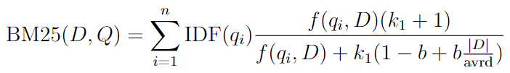



Features for ranking
Joint query-document features:
Scalar product of query and document embeddings
BM25 (“best-match 25”)
Query = collections of words/terms q_1, … q_n
- frequency of word/term q_i in the document D
- inverse document frequency
Avrd – average document length in collection

Slide 13
Ranking Methods
Pointwise methods: the loss is computed using individual objects (query-document pairs)
Pairwise methods: the loss is computed using pairs of objects
Listwise methods: the loss is computed for a list of objects

Slide 14

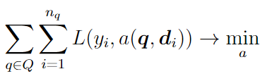
Pointwise method
Binary relevance:
Learn two-class classifier:
Usually, pointwise methods do not show good performance

Slide 15




RankNet (pairwise method)
Pairwise relevance:
or any other differentiable score function w.r.t. w
Training procedure using SGD and linear a(x):

Slide 16


Mismatch between ranking error rate and ranking metrics
In training we minimize loss function that corresponds to minimization of ranking error rate, but in practice we’re interested in high values of MAP, nDCG, etc.
Example: only one relevant document
Moving relevant document from 3-rd to 2-nd position: error rate changes by 1, AP increases by
Moving relevant document from 10-th to 9-th position: error rate changes by 1, AP increases by
Simple heuristic for RankNet: measure MAP/nDCG on validation set at the end of every epoch and output the solution with the highest value

Slide 17
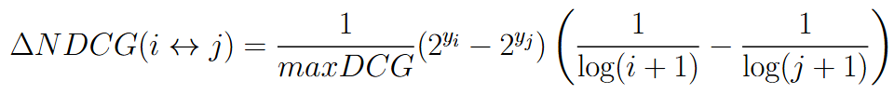
LambdaRank
It is hard to invent a smooth loss function that would approximate MAP, nDCG, etc.
Instead, we can modify gradients:
- change in NDCG value in case of swapping i-th and j-th documents in output and leave all the other documents unchanged
Similarly change in MAP value can be used

Slide 18
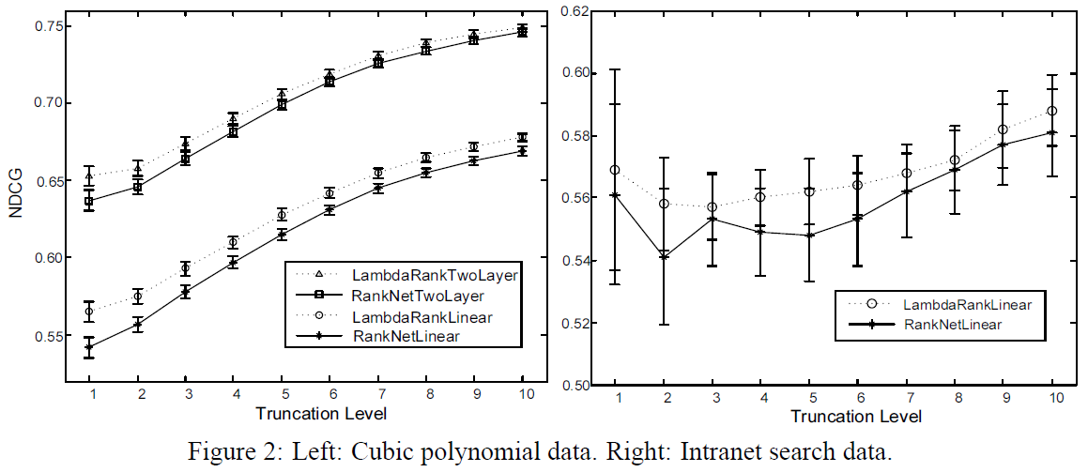
LambdaRank
LambdaRank usually better optimizes target ranking metrics compared to RankNet

Slide 19
LambdaRank
LambdaRank is a mixed pairwise/listwise method: for updates we need to sample only pair of documents, but need the value maxDCG from the full list

Slide 20
LambdaMART
MART (Multiple Additive Decision Tree) – a classic version of gradient boosting on top of decision trees. Boosting uses loss gradients as pseudo-targets for training next decision tree.
LambdaRank chooses gradients for training rank algorithm by adding nDCG/MAP absolute change
LambdaMART = MART, where pseudo-targets are computed using loss gradients + nDCG/MAP absolute change

Slide 21
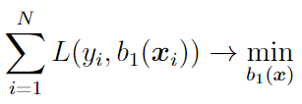



Recall on gradient boosting for two-class classification
Train first model:
Pseudo-residuals:
Train MSE decision tree regression model as next base model:

Slide 22

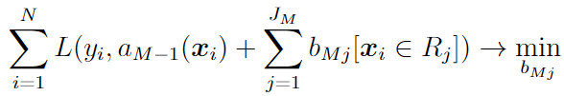

Recall on gradient boosting for two-class classification
Train DT on pseudo-residuals and fix found predicates
Fine-tune prediction in each region by solving 1d optimization problem using one-step Newton procedure:

Slide 23
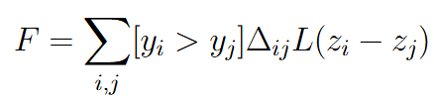


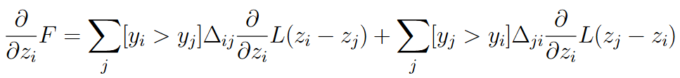

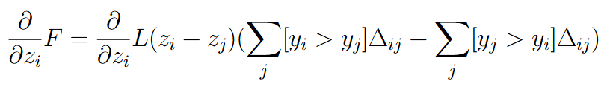
Pseudo-targets in LambdaMART
Weighted RankNet loss:

Slide 24
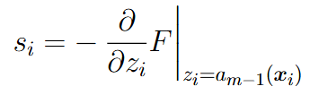
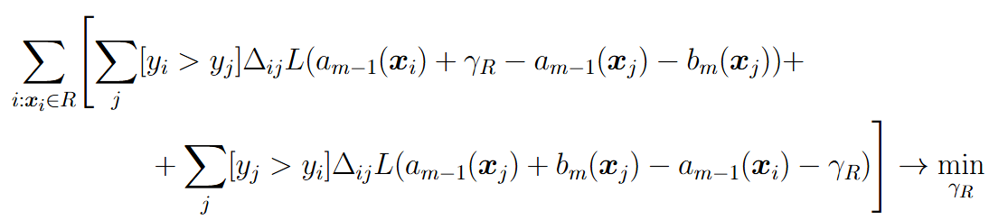
Pseudo-targets in LambdaMART
Pseudo-residuals:
Train next DT base model (find all regions):
Fine-tune prediction in each region by solving 1d optimization problem using one-step Newton procedure:

Slide 25

Listwise Method
For given query and relevant documents let’s compute their scores
For optimization we need to define a differentiable loss function measuring the distance between graded ordering and given set of scores

Slide 26
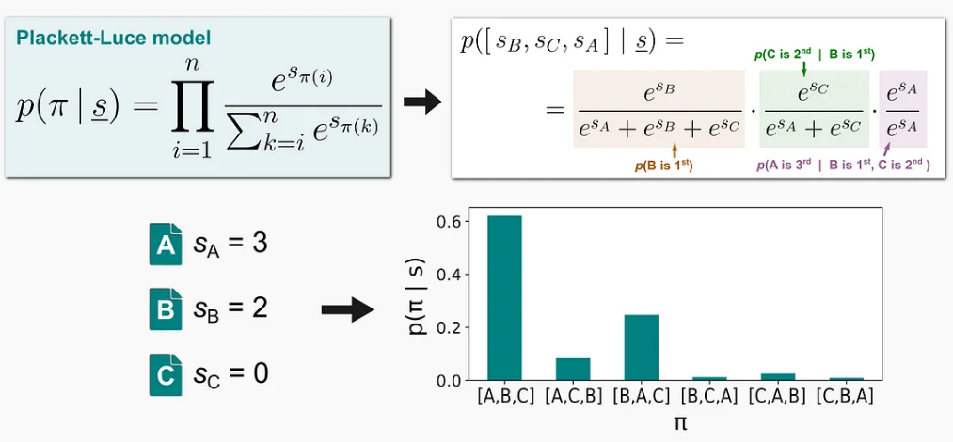

Listwise Method
Let’s introduce probability distribution on a set of permutations:
Loss function:
This loss is hard to deal with directly due to too many terms (= number of possible permutations)

Slide 27

ListNet
Probability that the given element is stated on the first position under Plackett-Luce probability model:
Loss function:

