Slide 1
Machine Learning
Instructor: Dmitry Kropotov
TAs: Maksim Nakhodnov, Ivan Shchekotov

Slide 2
Communication
Course page: https://github.com/dkropotov/cub_ml_spring25
Telegram chat: https://t.me/+izhIIZ9W5Fs1NDM6
Home assignments: Teams space

Slide 3
Assessment
Assessment Type: Written examination, Duration: 120 min, Weight: 100%
Completion: To pass this module, the examination has to be passed with at least 45%.

Slide 4
Home Assignments
Assignments:
programming assignments in jupyter notebooks
theoretical written assignments
Home assignments are fully optional
65% and higher -> 10% bonus on the final exam
30-65% -> 5% bonus on the final exam
Bonus is given only if 45% threshold on the final exam is passed

Slide 5
Mid-term exam
Mid-term written exam is planned in the middle of the semester
Participation in the mid-term is optional
70% and higher -> 10% bonus on the final exam
45-70% -> 5% bonus on the final exam
Bonus is summed with bonus for home assignments but can’t exceed 10% in total. The bonus is given only if 45% threshold on the final exam is passed

Slide 6
Introduction to Machine Learning

Slide 7
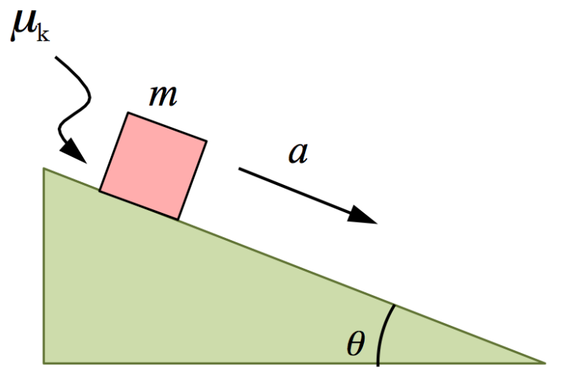
Prediction in natural sciences
Experiments with nature
Formulation of universal laws
Prediction for new situations using these laws

Slide 8
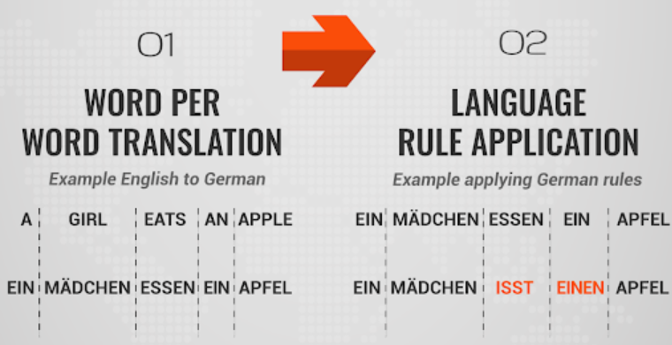
Machine translation: rule-based

Slide 9
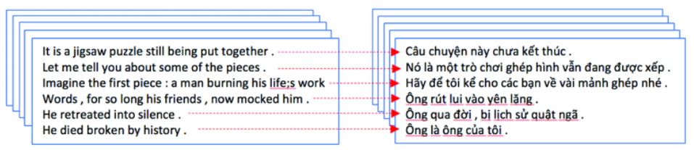
Machine translation: data-driven
1. Collect parallel text corpus
2. Introduce a family of functions
f(text in input language; parameters) = text in output language
3. Introduce quality criterion function
Q(given translation, true translation)
4. Learn parameters on collected corpus by maximizing quality function (minimizing loss function)

Slide 10
Example of machine learning problems
Bank loan approval
E-mail spam filter
Price recommendation in sales services for autos, real estate, etc.
Internet search engine
Recommendation system for goods, videos, songs, etc.
Speech recognition
Learning computer playing chess or computer games
And many others….

Slide 11


Basic terms in ML
Example: recommendation system for songs
Object : for what we make prediction
For rec. system object = (user, song)
Target variable : what we predict
For rec. system target = real scalar in [0,1] =
percentage of total duration of some song that was listened by user

Slide 12

Basic terms in ML
Each object is described by a set of its numerical characteristics = features
For rec. system features are:
user features: gender, age, favorite genres, etc.
song features: year, author, genres, spectrogram characteristics, etc.
joint features: song genre is among user's favorite genres, total listening duration for song’s author, etc.
Training dataset = collection of feature vectors and targets for all objects

Slide 13




Feature types
1. Binary features
For rec. system: user gender
2. Numerical features
For rec. system: user age, song year
3. Categorical/nominal features
- unordered set
For rec. system: song genre
For rec. system:
song type (single, album, anthology)
4. Ordinal features
- ordered set
5. Set-valued features = arbitrary subset from basic elements
For rec. system: user’s favorite genres
6. Features with complicated structure for images, texts, audio, video, etc.

Slide 14
ML problem types
Supervised learning
Requires supervision (= value of target variable) for each object in the training dataset
Unsupervised learning
No target variable
Semi-supervised learning
Target variable is given only for some subset of the training dataset

Slide 15




ML problem types
For rec. system predict song’s ratio listened by user
1. Regression problem
2. Classification problem
For rec. system predict song’s genre
- Binary / two-class classification problem
For bank loan -> approve/reject
- Multi-label classification problem
For rec. system predict all song’s genres
These are supervised learning problems, because they require object-feature matrix with target variables

Slide 16

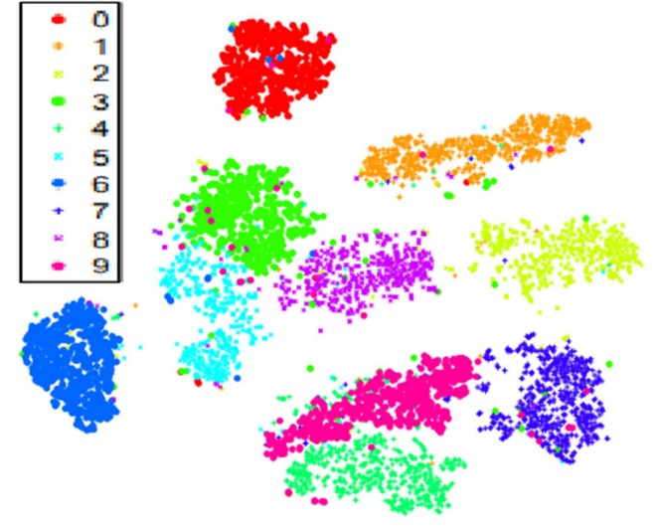
ML problem types
1. Clusterization problem = split objects into groups of similar elements
Split students from given university into groups by similarity
2. Dimension reduction problem = transform each object features to low-dimensional vector
Accelerate data processing
Do data visualization
These are unsupervised learning problems, because they require only object-feature matrix and no target variables

Slide 17
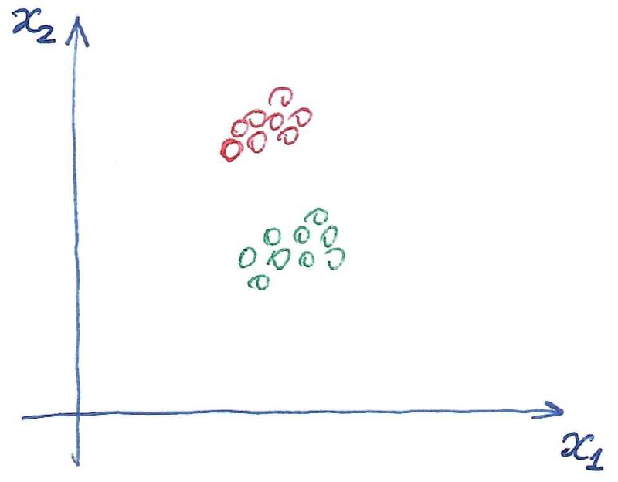


ML problem types
Semi-supervised learning
and
Dataset of bank clients and information about some subsets of clients from marketing department. Goal: mark out all the remaining clients

Slide 18
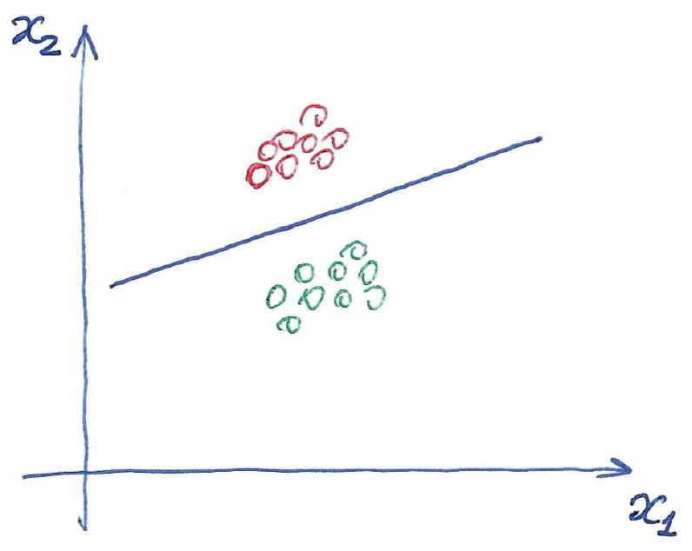
ML problem types
Semi-supervised learning
and
Dataset of bank clients and information about some subsets of clients from marketing department. Goal: mark out all the remaining clients

Slide 19
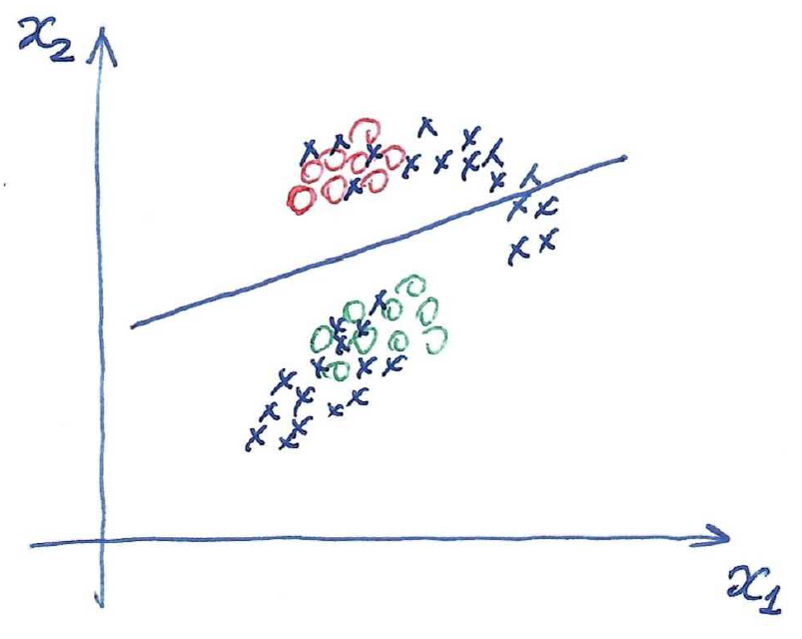
ML problem types
Semi-supervised learning
and
Dataset of bank clients and information about some subsets of clients from marketing department. Goal: mark out all the remaining clients

Slide 20
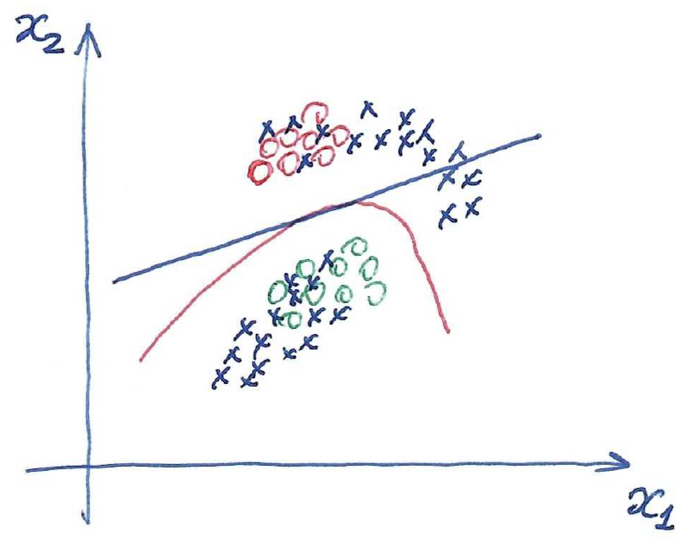
ML problem types
Semi-supervised learning
and
Dataset of bank clients and information about some subsets of clients from marketing department. Goal: mark out all the remaining clients

Slide 21


ML algorithm / model
ML model / algorithm
Family of ML models
Example: family of linear ML models
Other ML families:
Decision trees
Metric algorithms
Kernel-based models
Neural networks
And others….

Slide 22




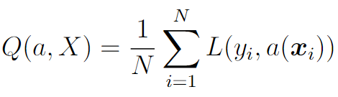

Loss functions and ML model training
Loss function
for regression
for classification
Training dataset
Quality criterion function
Training problem

Slide 23
Solving ML problem
Collect dataset
Choose good discriminative features
Choose loss function and family of ML algorithms relevant for the problem being solved
Solve optimization problem for training ML model
Estimate quality of the obtained model

Slide 24
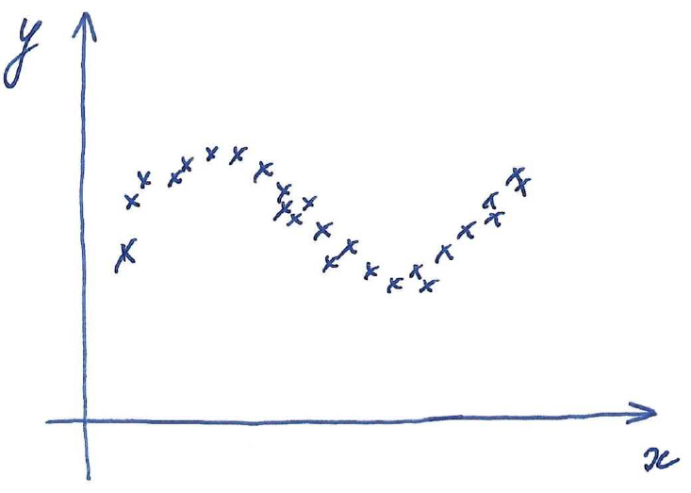
Underfitting and overfitting

Slide 25
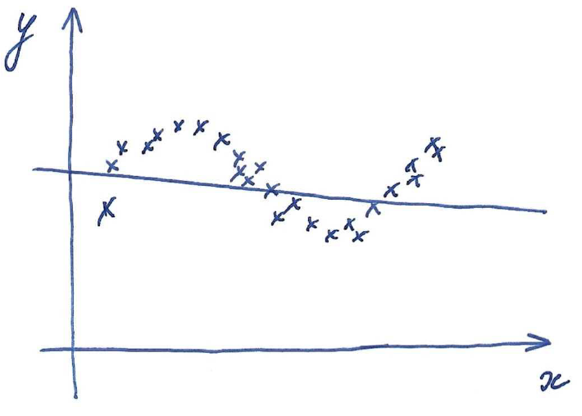

Underfitting and overfitting

Slide 26
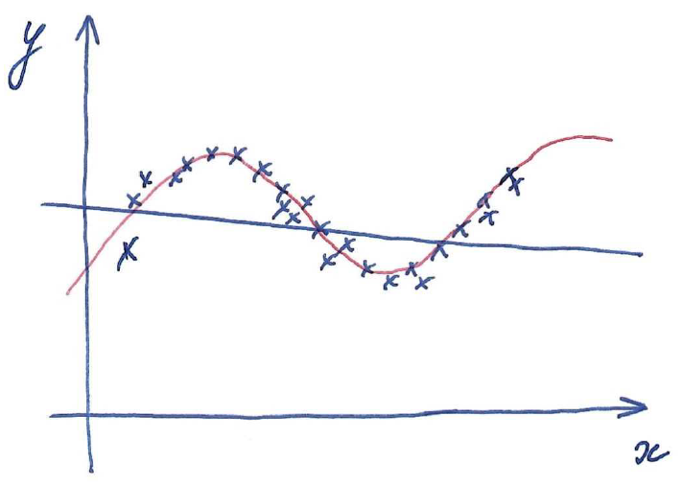
Underfitting and overfitting

Slide 27
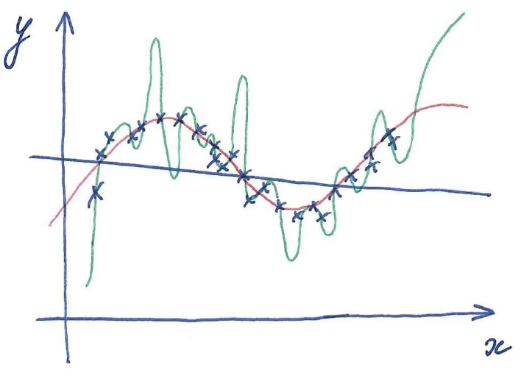

Underfitting and overfitting
Blue model is too simple and underfitted, green model is too complicated and overfitted, red model has good generalization ability

Slide 28
Overfitting detection
Let’s split initial training dataset into two parts: training part X_train and testing part X_test
Train ML model on X_train
Measure performance of the trained model on training set Q(a(X_train), X_train) and test set Q(a(X_train), X_test)
If performance on test set is noticeably worse than on train set, then we face with overfitting and ML model should be retrained under new setting

Slide 29

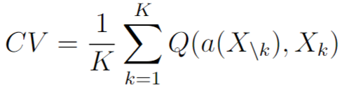

K-fold Cross Validation and Leave-One-Out
Quality measurement based on just one train-test split may be unstable
Let’s split initial dataset into K subsets
Here is all subsets except for k-th part
If K=N then this procedure is called Leave-One-Out
With increasing of K stability in quality measurement increases but for the price of larger computation

