Slide 1
Linear Regression

Slide 2





Linear model for regression
Regression problem
ML model
Family of ML models
- parameters/weights of linear model
- bias
In total D+1 parameters. Linear models require small memory, are fast in inference and interpretable.

Slide 3
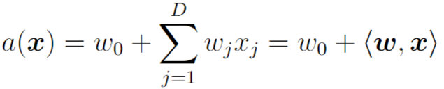


Linear model for regression
ML model
Sometimes it is convenient to augment feature vectors with constant feature =1

Slide 4
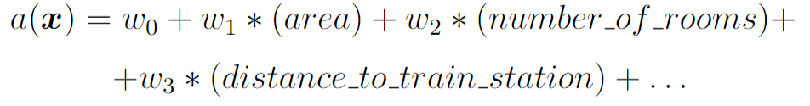
Example: apartment cost prediction
x – apartment, y – its cost
Important property of linear models: each feature influences independently on prediction result
Sometimes it is reasonable to consider different combinations of initial features and feature transformations

Slide 5

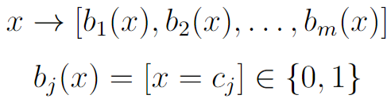
OHE for nominal features
Linear models can work only with numerical features
Let’s consider nominal feature “apartment district”
One-hot-encoding

Slide 6
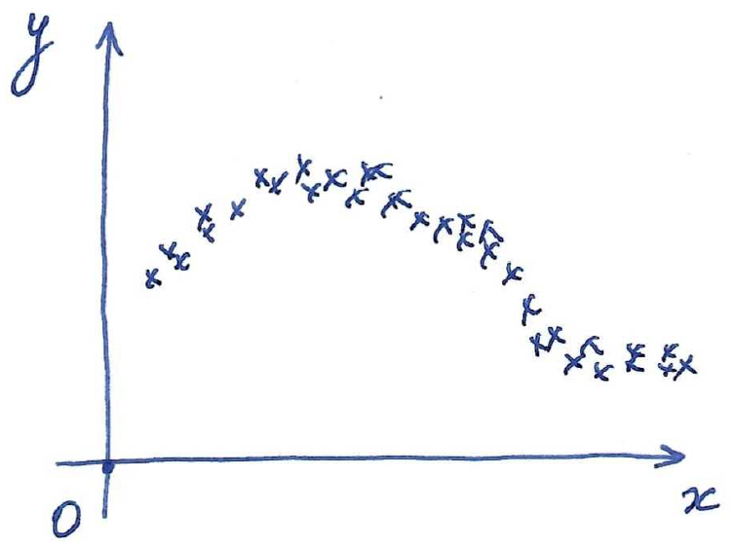
Binarization of numerical features

Slide 7
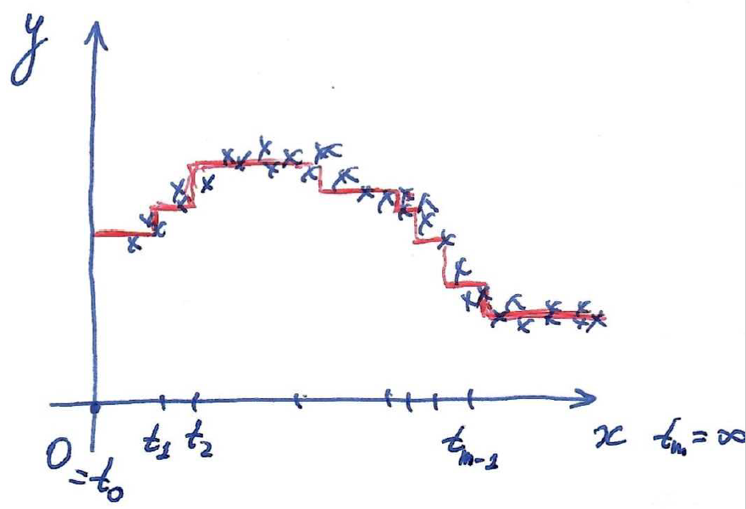
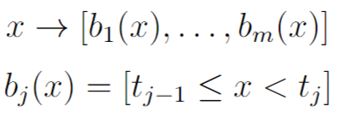
Binarization of numerical features
For linear models it is important to prepare a reasonable set of features from original ones!

Slide 8

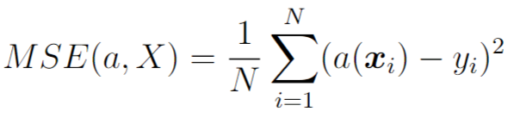
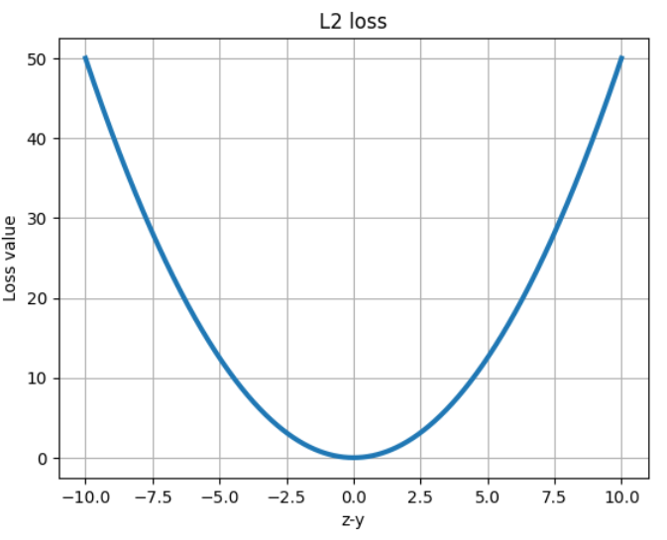
Loss functions for regression
Squared error loss / Quadratic loss / L2 loss
Mean squared error

Slide 9

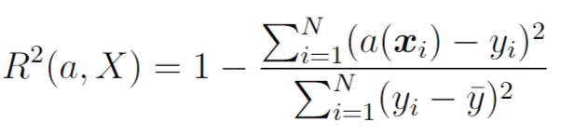
Loss functions for regression
Squared error loss / Quadratic loss / L2 loss
Mean squared error
Root mean squared error
Coefficient of determination
For ideal a(x) R2=1, for constant a(x) R2=0

Slide 10
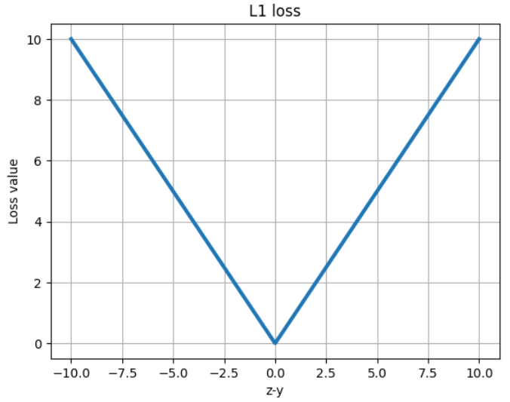

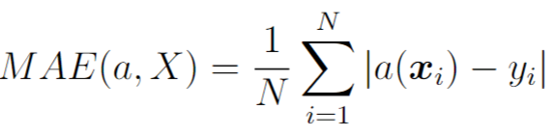
Mean Absolute Error loss
L1 loss
MAE is non-differentiable
MAE is more robust to outliers

Slide 11
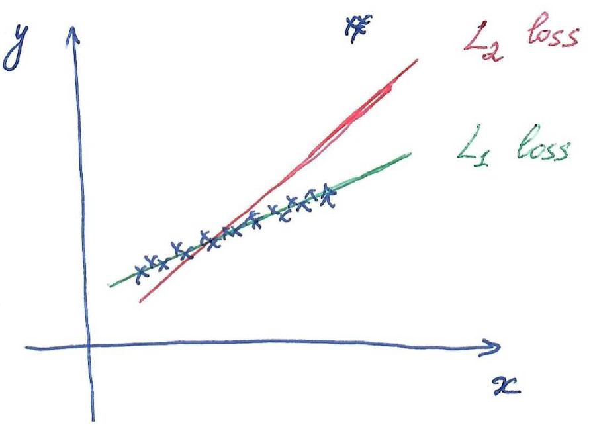
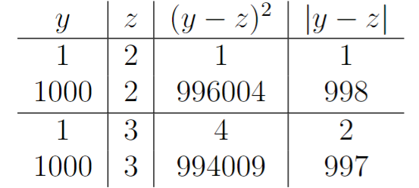
Mean Absolute Error loss
L1 loss

Slide 12
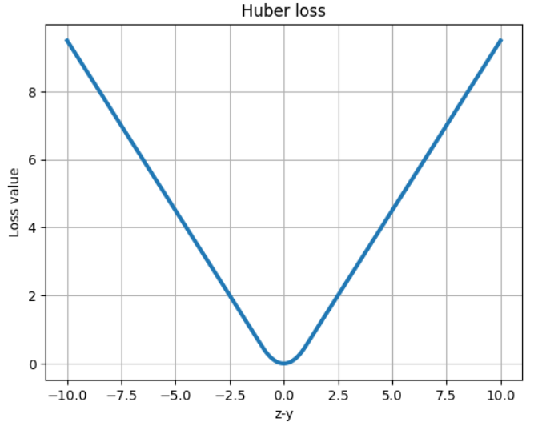
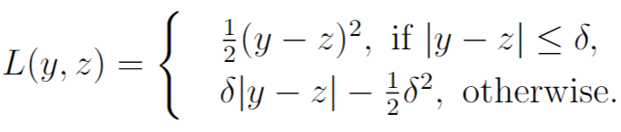
Huber loss
Huber loss is continuously differentiable everywhere

Slide 13
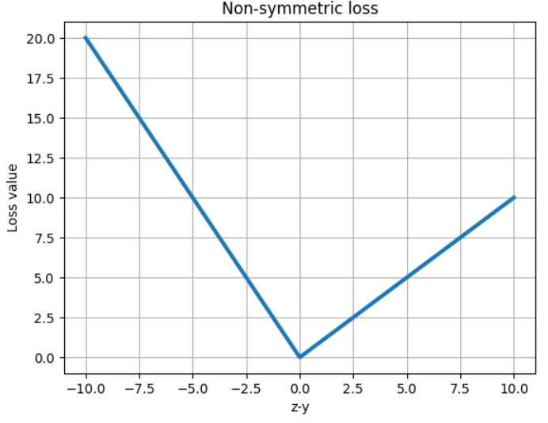
Non-symmetric loss
Loss function should be chosen according to business requirements

Slide 14

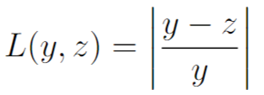
Other losses
Mean Squared Logarithmic Error (MSLE)
Mean Absolute Percentage Error (MAPE)
And many others…

Slide 15
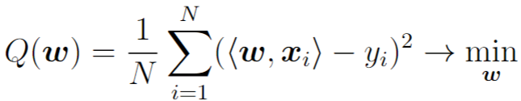
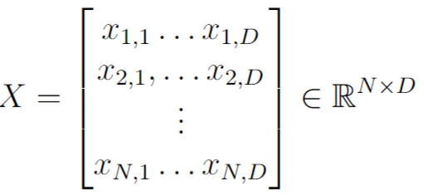
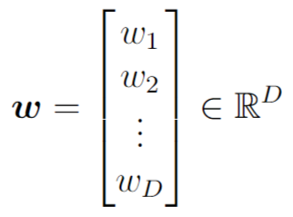
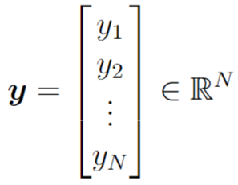

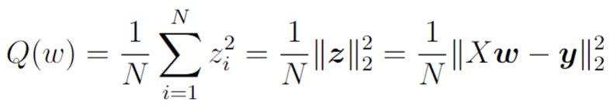

Linear regression training

Slide 16
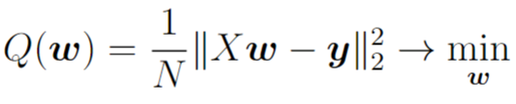




Linear regression training
Properties of the matrix :
Quadratic and symmetric:
Non-negatively defined:
Recall: matrix is non-negatively definite, if
Equivalently: all eigenvalues are non-negative.

Slide 17


Linear regression training
For analytical solution the matrix should be non-singular.
So the matrix is singular if N < D or there are duplicating features
Computational complexity of analytical solution:
for computing
for linear system solving

Slide 18
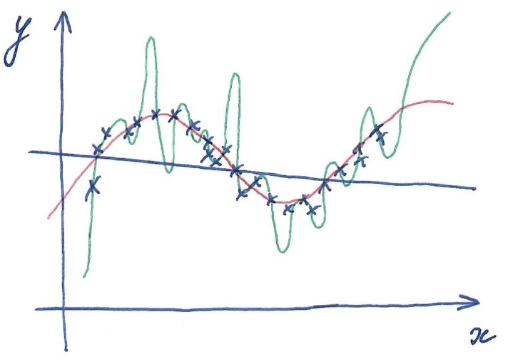


Underfitting and overfitting
Blue model is too simple and underfitted, green model is too complicated and overfitted, red model has good generalization ability

Slide 19


Regularization
Overfitted model usually has oscillating effect – small change of inputs may lead to large change of outputs
For linear models oscillating happens with high absolute values of some weights
Idea: let’s additionally require during training that our ML model should have weights with low absolute values

Slide 20

Regularization
This is known as L2 regularization, weight decay, ridge regularization
This minimization problem can be solved analytically

Slide 21


Regularization
Non-regularized solution
This solution can’ t be computed if N<D or there are duplicating features
Regularized solution
This solution can always be computed because the matrix
is strictly positively definite
Important: bias parameter is usually not regularized!

Slide 22







Eigenvalue Decomposition
Let’s consider arbitrary symmetric matrix
and all its eigenvalues and eigenvectors
Eigenvalue decomposition in matrix form:

Slide 23
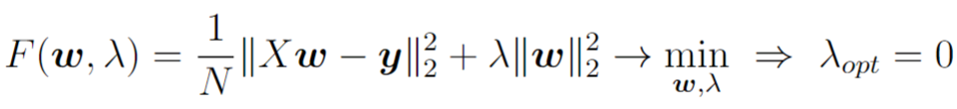
Choosing regularization coefficient
Regularization coefficient can’t be optimized on the training set. Parameters with this property are called hyperparameters.
Hyperparameter can be chosen by brute force – estimating cross-validation (CV) value of ML model for some set of values
(1/N) coefficient in loss function helps making optimal value of regularization parameter less sensitive to the training set size N.

Slide 24
Underfitting and overfitting
In case of overfitting increase regularization coefficient
In case of underfitting decrease regularization coefficient or increase ML model complexity

Slide 25
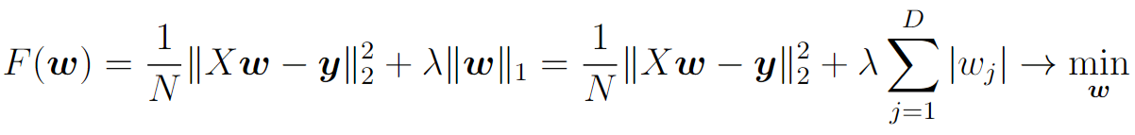
L1 regularization / Lasso regression
L1 norm penalizes high absolute values of weights and thus prevents overfitting.
L1 norm allows to find sparse solution when some of weights w_j exactly equal zero. In such a way we may find relevant/irrelevant features.

Slide 26

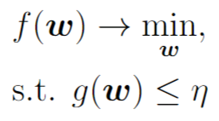
L1 regularization / Lasso regression
From optimization theory it is known that the optimization problem
is equivalent to the following constrained optimization problem:

Slide 27

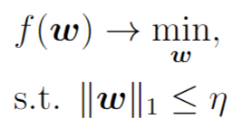
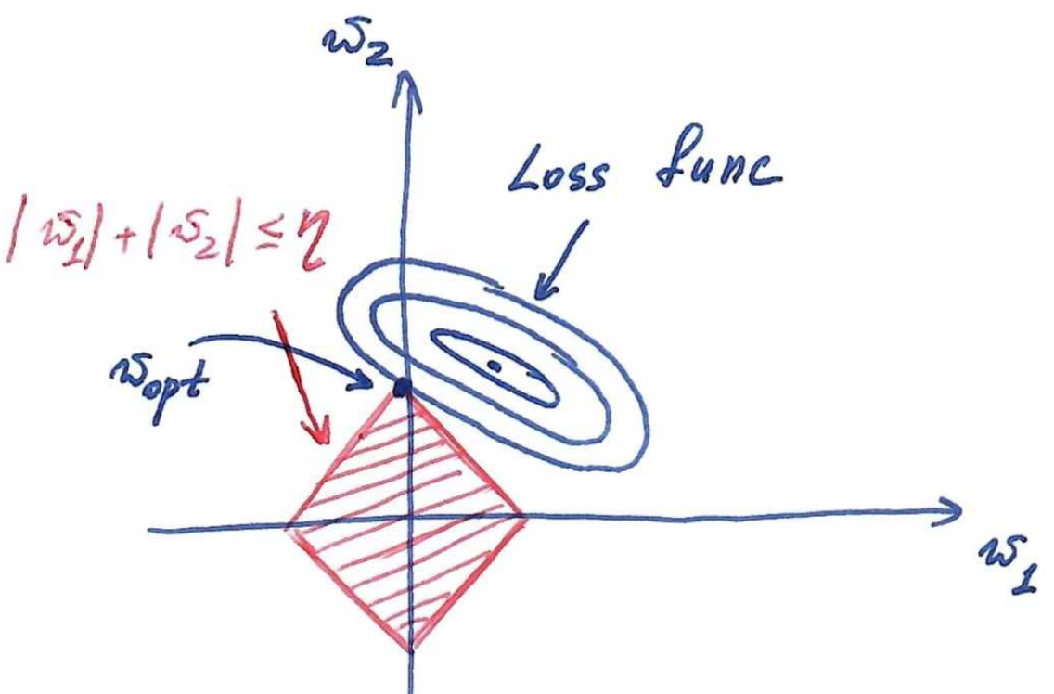
L1 regularization / Lasso regression

Slide 28

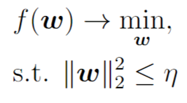
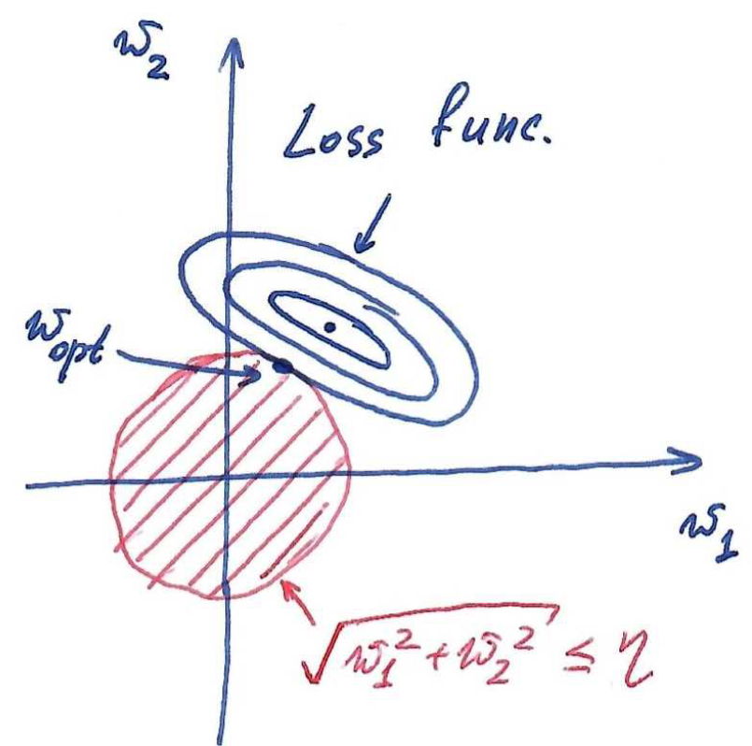
L2 regularization / Ridge regression

Slide 29
Elastic Net regularization

Slide 30
Matrix/vector differentiation

Slide 31
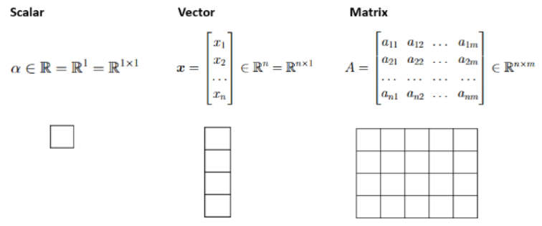
Vector expressions
In mathematical expressions a column-wise vector notation is convenient

Slide 32
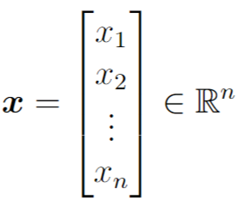
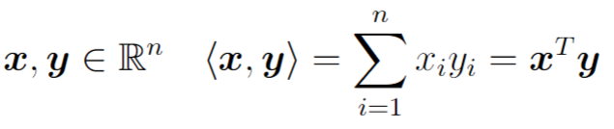

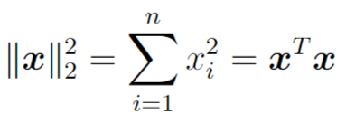
Vector expressions

Slide 33
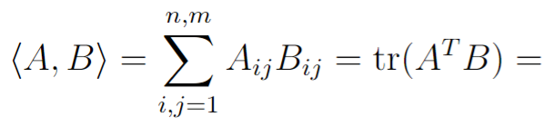

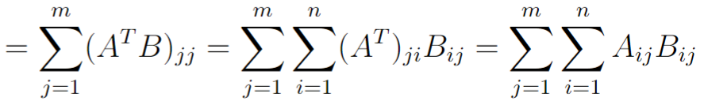
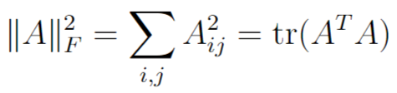


Matrix expressions
Properties of transposition:

Slide 34


Summation and product
Summation of two vector/matrix objects
is valid only if two objects have the same size
Product of two objects
is valid only if the last dimension of the first object coincides with the first dimension of the second object.
Exception: multiplication by scalar is allowed.
In general, the order of arguments in product is important because

Slide 35

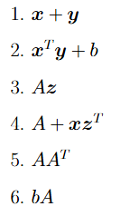
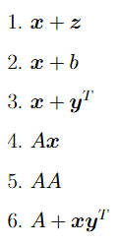
Summation and product
Correct examples:
Incorrect examples:

Slide 36




Inversion (division)
It is possible to multiply both parts of equation either by
inversed scalar or by inversed matrix ,, where
is quadratic and non-degenerate matrix.
Division by vector is not possible!
Correct examples:
Incorrect examples:

Slide 37

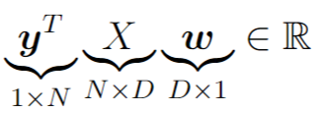
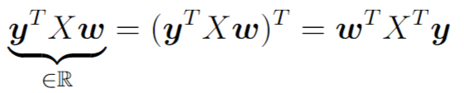
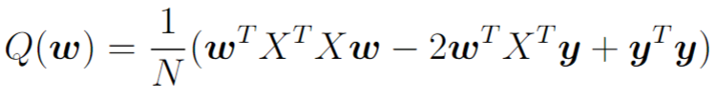
Manipulating with vector expression
Check yourself by dimensionality!

Slide 38

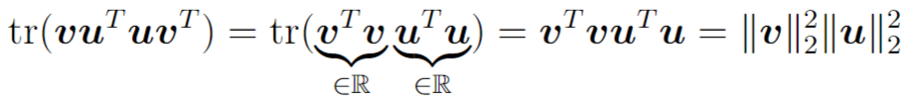
Manipulating with vector expression
Circular property of trace operation:

Slide 39
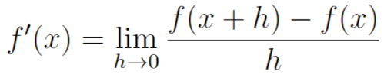

Differential calculus in scalar case
Table of standard derivatives:
Differentiation rules:

Slide 40
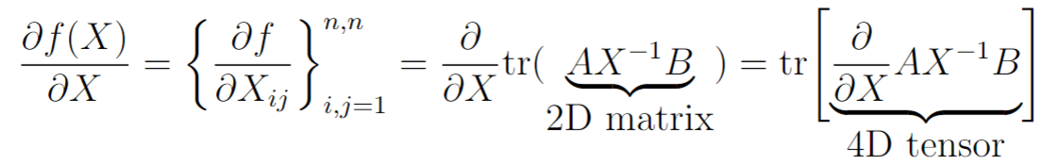
Differential calculus in vector/matrix case
Goal: Make differentiation without dealing with higher dimensional tensors in intermediate computations

Slide 41









Differential calculus in vector/matrix case
- set of scalars, vectors, matrices
Def. Function is called differentiable at point if
- differential
For fixed x
For scalar functions differential is just a product of derivative and increment
For functions differential is

Slide 42
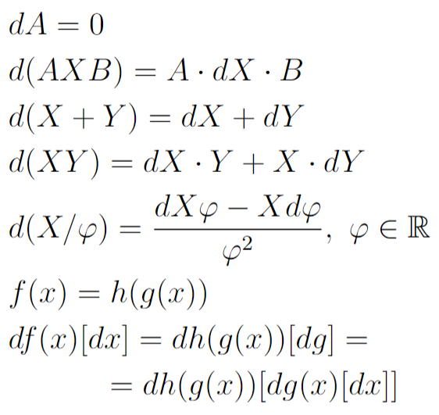
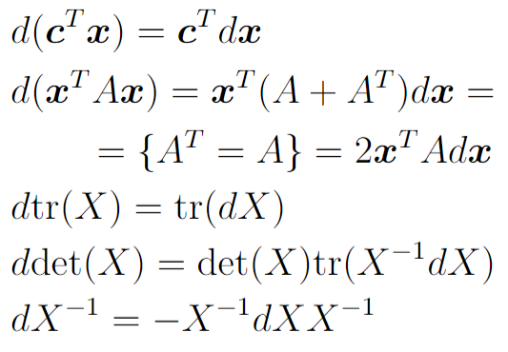
Differential calculus in vector/matrix case
Differentials of standard functions:
Differentiation rules:

Slide 43
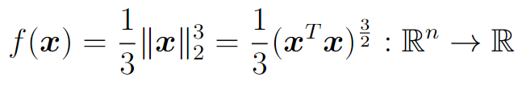



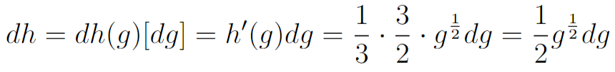

Differential calculus in vector/matrix case

Slide 44



Differential calculus in vector/matrix case
Connection between differential and gradient:

Slide 45
Differential calculus in vector/matrix case
General scheme:
Compute differential of your function using table of standard differentials and differentiation rules
Transform expression for differential into canonical form
Extract gradient value

Slide 46




Differential calculus for linear regression

Slide 47



Differential calculus for linear regression

Slide 48





Differential calculus for linear regression

Slide 49

Matrix differential example

