Slide 1
Conditional Optimization Support Vector Machine (SVM)

Slide 2



Unconstrained optimization
Analytical solution:
Numerical solution, e.g. GD:

Slide 3
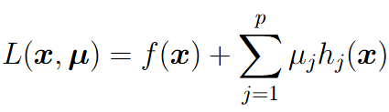
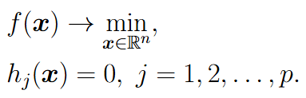




Equality constraints
Lagrange function:
- Lagrange variables
If is constrained local minima, then
Here in total n+p unknowns and n+p equations

Slide 4
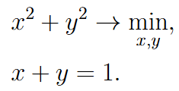
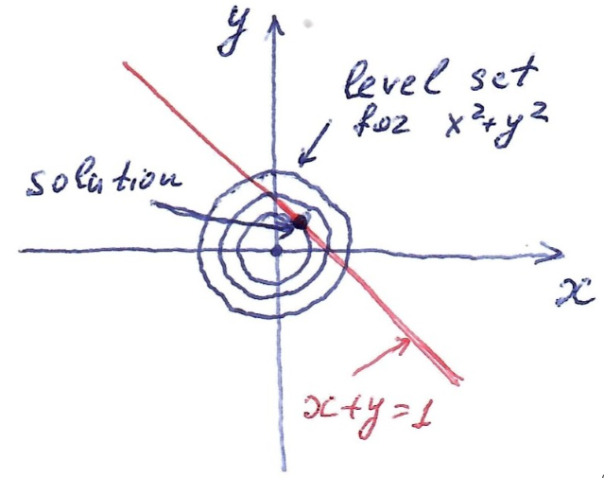

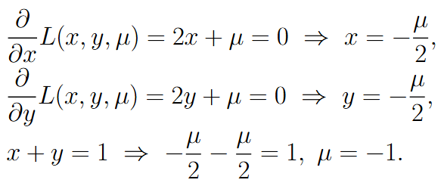

Equality constraints
Solution:

Slide 5
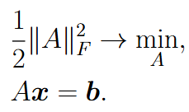




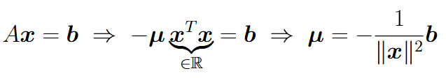

Equality constraints
Solution:

Slide 6
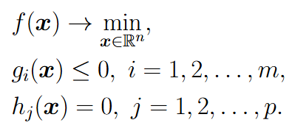
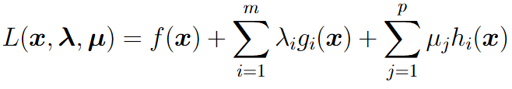

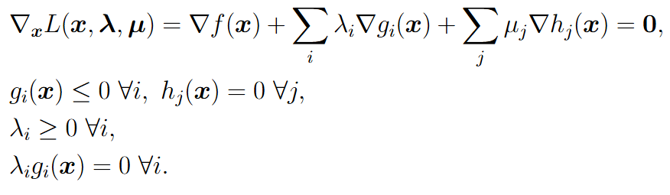
Equality and inequality constraints
For particular examples m or p can be zero
Lagrange function:
KKT theorem: If is constrained local minima, then
Here in total n+m+p unknowns, n+m+p equations and
2m inequalities

Slide 7
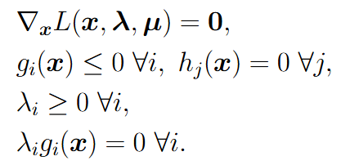

Equality and inequality constraints
KKT conditions:
Complementary slackness:
Interpretation:
either inequality constraint can be dropped without changing the solution or
the constraint at the solution becomes equality (becomes active)

Slide 8

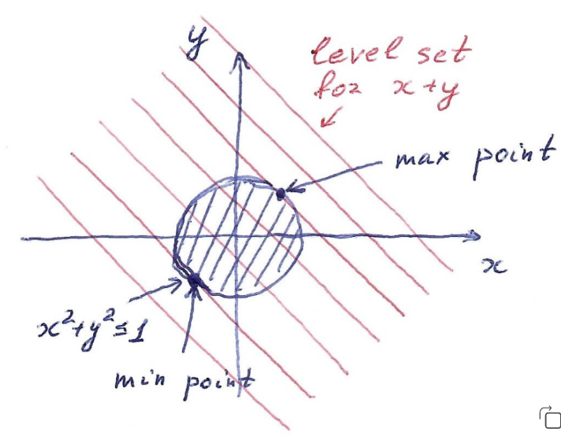
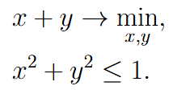
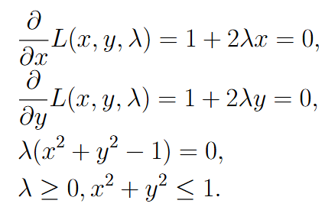







Equality and inequality constraints
KKT:
Case 1:
Contradiction
Case 2:
- loc.max.
- loc.min.

Slide 9
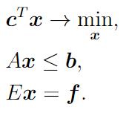
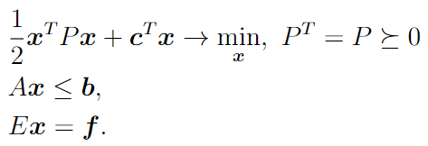
Numerical constrained minimization
Solving general constrained minimization problem is usually inefficient. That is why special classes of constrained minimization are considered. Examples include linear and quadratic programming.
Linear Programming (LP)
Quadratic Programming (QP)

Slide 10
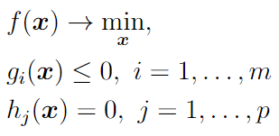
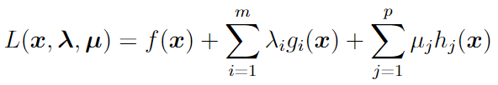



Dual optimization problems
Primal optimization problem:
Lagrange function:
Dual function:
Properties of dual function:
is concave function
2. Lower bound to any feasible solution:

Slide 11
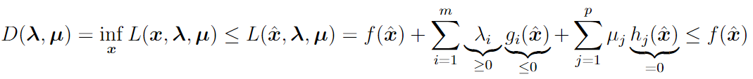

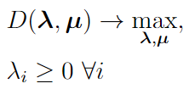
Dual optimization problems
Proof:
Dual optimization problem:

Slide 12



Dual optimization problems
Primal optimization problem:
Dual optimization problem:
Properties of dual problem:
1. Dual problem is always convex
2. Duality gap
Finding solution of primal problem if we know solution of dual problem:
For convex primal problem duality gap is zero:

Slide 13
Dual optimization problems
Dual problem is a way to find alternative formulation to initial primal problem
In general case dual problem is not simpler that the primal one
In particular cases dual problems may be considerably simpler or have some specific interesting properties

Slide 14
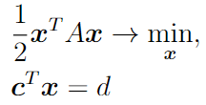








Dual optimization problems
Let’s consider the following optimization problem:
Lagrange function
Dual function
Dual problem:

Slide 15
Support Vector Machine (SVM)

Slide 16
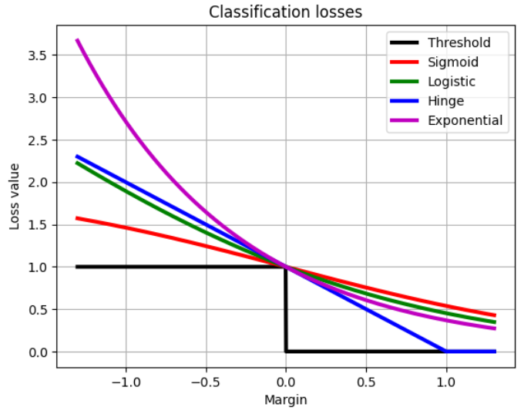





Recap on linear classification
Let’s consider two-class classification problem
Logistic Regression
Support Vector Machine (SVM)

Slide 17
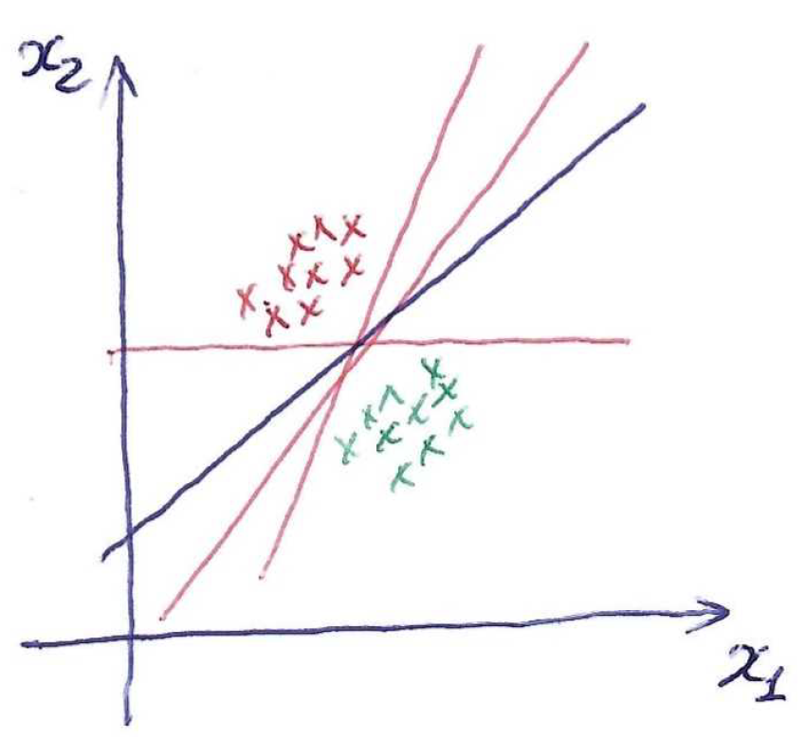
SVM: linearly separable case
Decision rule:
Idea: find separating hyperplane with the largest gap (margin) to dataset

Slide 18

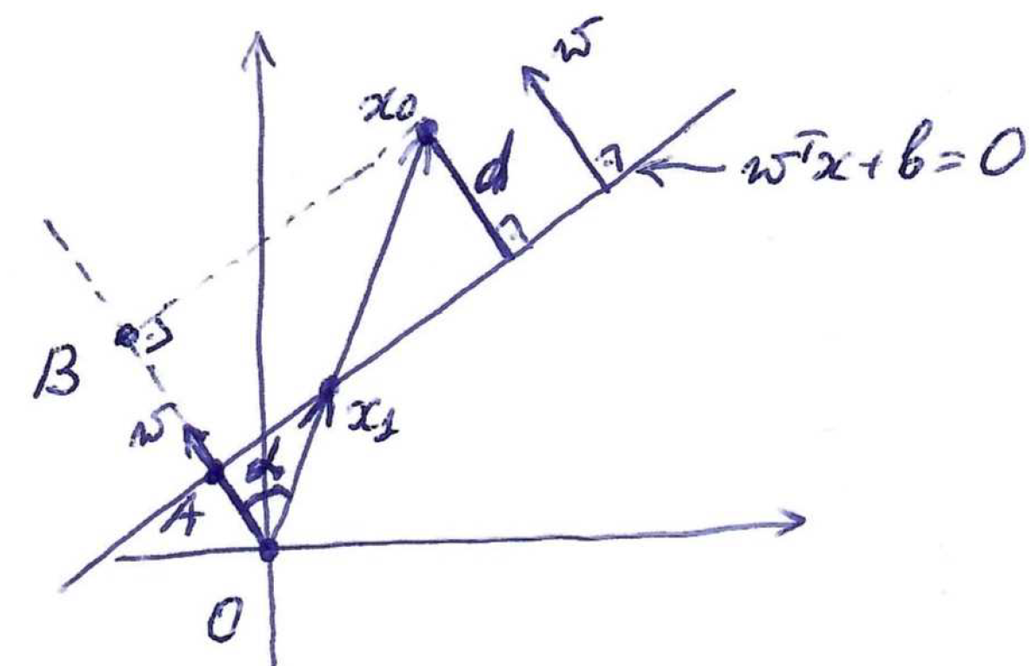
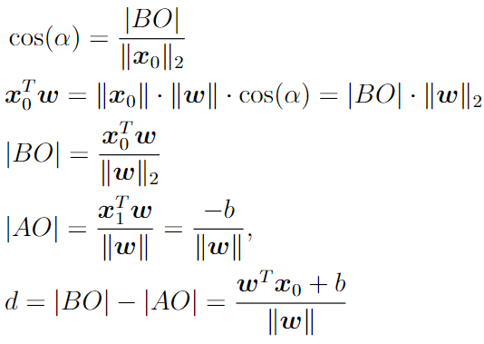
Distance to separating hyperplane
The separating hyperplane is determined up to arbitrary norm of weights

Slide 19


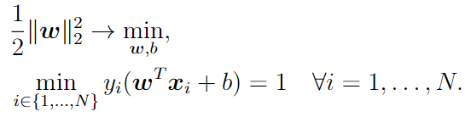
Finding hyperplane with the largest margin
To break ambiguity in hyperplane parameterization we may fix either nominator or denominator. Let’s fix nominator.
Training dataset:
Distance from the dataset to a hyperplane:
Equivalent formulation:

Slide 20
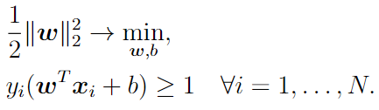
Finding hyperplane with the largest margin
Equivalent formulation:
This is QP (quadratic programming) problem, for which some numerical optimization routine is used

Slide 21
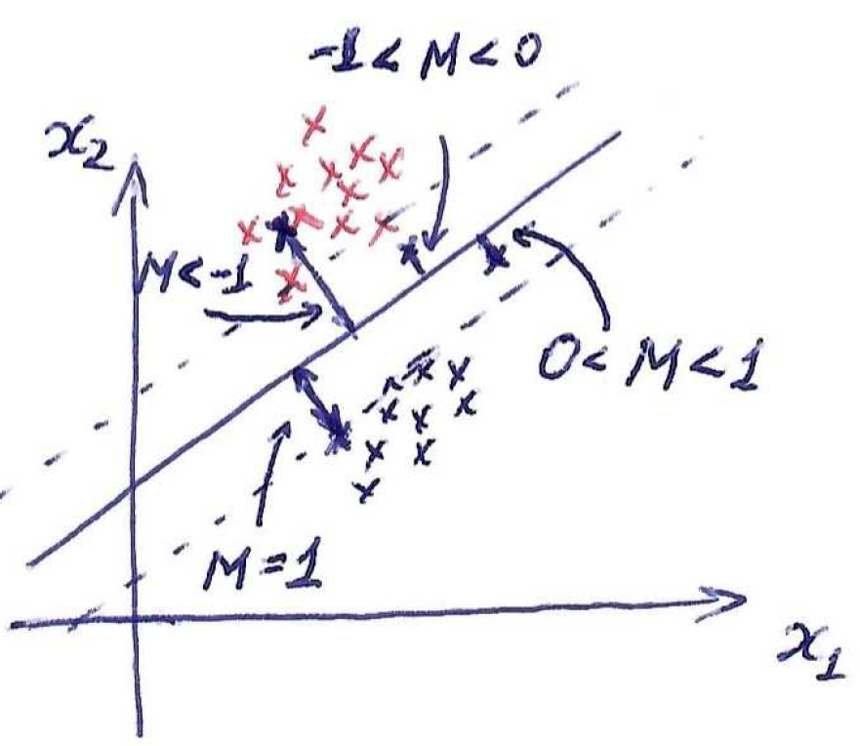
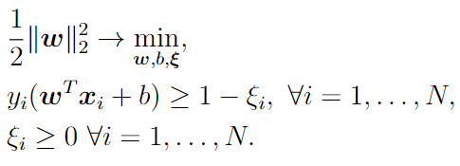


SVM: non-separable case
Let’s allow linear classifier to make errors on some objects:
- slack variables
This optimization problem doesn’t have a proper solution:

Slide 22
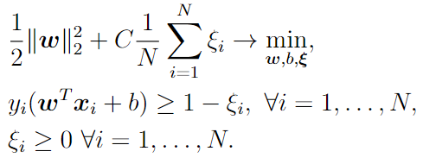

SVM: non-separable case
Let’s introduce some penalty for making errors:
- hyperparameter (similar to regularization coefficient)
This is QP problem

Slide 23
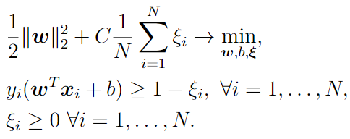




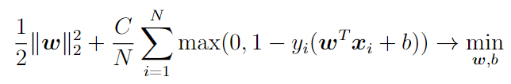
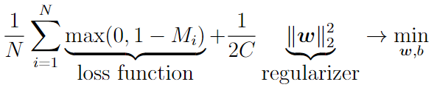

SVM: unconstrained formulation
Equivalent unconstrained formulation:
Here we can apply stochastic optimization

Slide 24
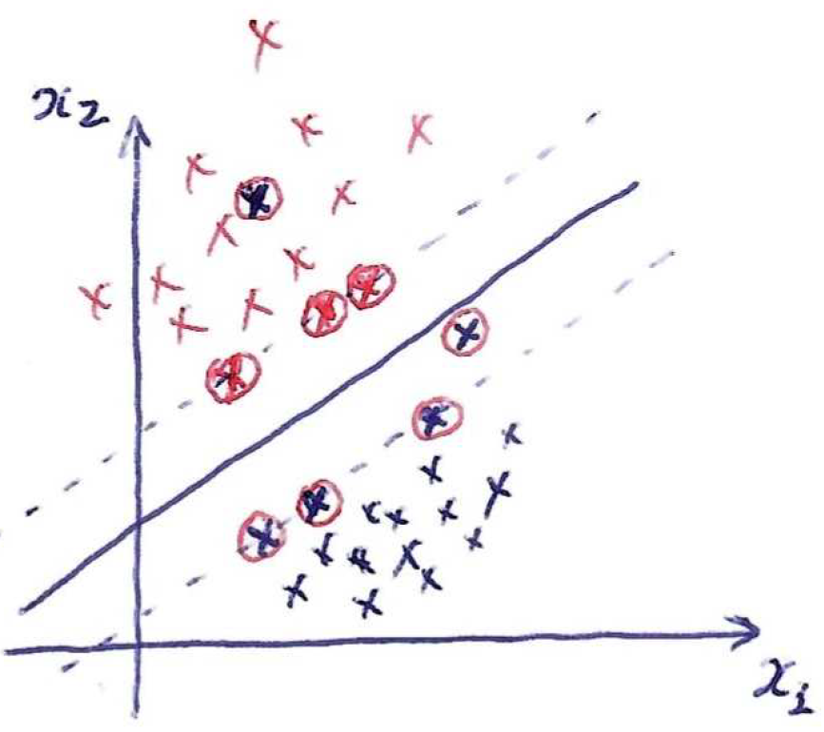
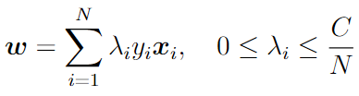

Support vectors
It is possible to show that optimal weights are determined as
Only objects with have impact on weights. They are called support vectors.

Slide 25
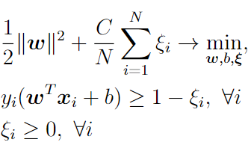
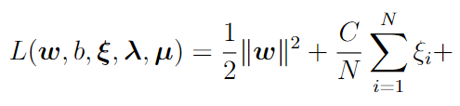
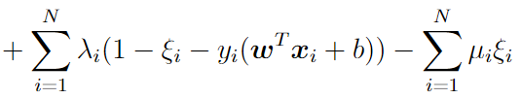
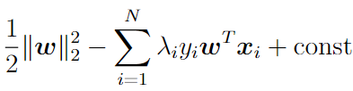
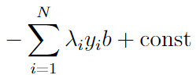

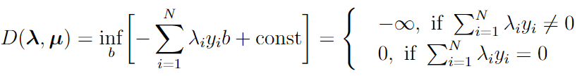
Dual problem for SVM
Primal problem:
Lagrange function:
Lagrange function as a function of w:
Lagrange function as a function of b:

Slide 26

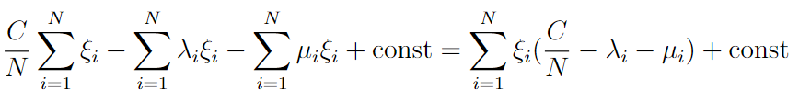
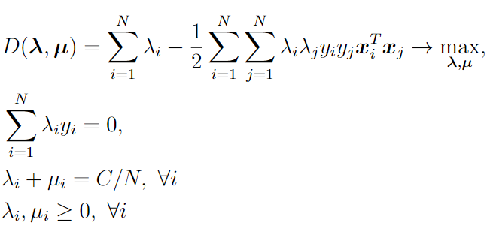

Dual problem for SVM
Lagrange function as a function of

Slide 27
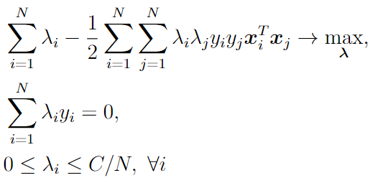



Dual problem for SVM
Final dual formulation:
Finding primal solution using dual solution:
This is QP problem
The main advantage: dual problem and prediction depends on input features only in terms of their inner product

Slide 28





Dual problem for SVM
Complementary slackness from KKT:
From dual solution let’s take some object with positive and

Slide 29
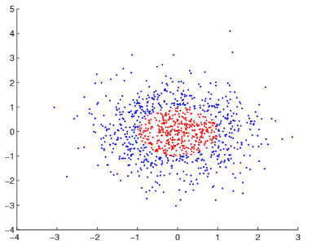
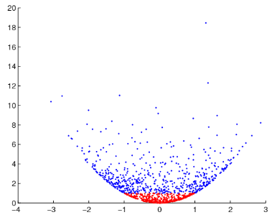

Kernel trick
Usually, data are not linearly separable
Adding a new feature would give perfect linear separation

Slide 30



Kernel trick
In general case it is not clear how to find good transformation of initial features
Let’s consider polynomial features: together with initial features a add all products of pairs , all products of three elements and so on
Number of such features grows exponentially fast!

Slide 31

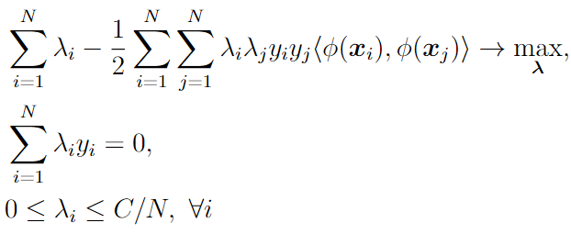

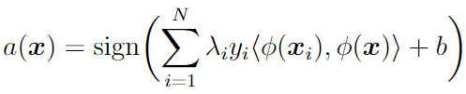
Kernel trick
Let’s consider arbitrary non-linear transformation of initial features
Dual problem in SVM:
Let’s introduce kernel function:
Then the whole training process depends only on kernel function and does not require explicit introduction of non-linear transformation!
Prediction in SVM:

Slide 32


Kernel trick
Let’s consider all quadratic features:
Instead of working with exponentially many features we may interact only with fast to compute kernel function

Slide 33
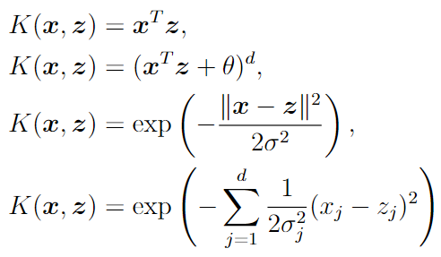
Some popular kernel function
Linear
Polynomial
RBF (Radial Basis Function)
RBF with weights

Slide 34
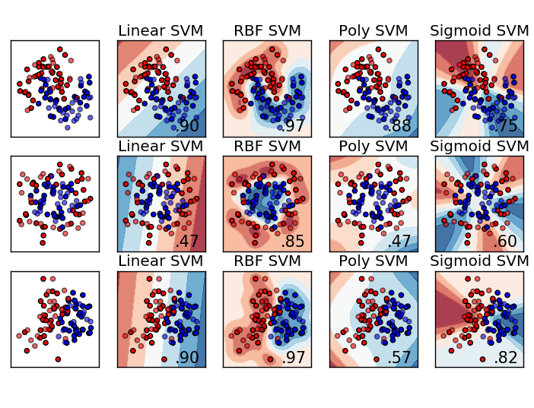
Kernel trick

Slide 35
SVM: three views
Primal QP formulation:
Dual QP formulation:
Unconstrained formulation:
Kernel functions can be applied only for dual QP formulation. Question: is it possible to do similar kernel trick for other formulations?

Slide 36


Kernel features
Decision rule from dual formulation:
It looks like a linear decision rule on top of new “kernel” features:
The same idea can be applied also for linear regression. In this case it is called Kernel Regression.

Slide 37



Kernel features
Linear SVM with RBF features:
Kernel regression with RBF features:
Training set
SVM prediction

Slide 38



Kernel features
In order to reduce the number of kernel features (less then training set size) we may first cluster the data and then take features
Here is cluster center (centroid)
Number of clusters are usually chosen as square root of the training set size

