Slide 1
Unsupervised learning: clustering, dimension reduction, data visualization

Slide 2



Supervised vs. unsupervised learning
Supervised learning:
Goal: prediction algorithm
Unsupervised learning:
Goal: undefined. Usually used in exploratory data analysis and for finding good data representation.

Slide 3


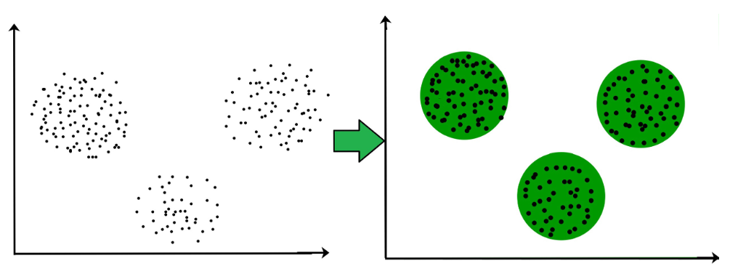
Clustering
Dataset:
Goal: split dataset into K groups (clusters)

Slide 4
Clustering applications
News aggregator: cluster all news and show to users only one item from each group (unique news)
Advertisement pre-moderation: cluster all advertisements into groups and do moderation only for one element in each group
Market segmentation: cluster all customers of some business into groups and use targeted advertisement
Market Basket analysis: analyze sales in supermarkets and find which items are usually bought together

Slide 5




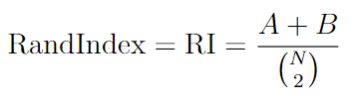
Clustering metrics: Rand Index
Suppose we have a ground truth clustering and want to compare it with another clustering
RandIndex (RI) takes values between 0 and 1, but its value is influenced by random factors (if we fix all clusters sizes in both partitions and make random clustering, then RI would be non-zero)

Slide 6




Clustering metrics: Adjusted Rand Index
Let’s fix the sizes of all clusters in both partitions: and
- Mean value of RI under random permutation
ARI takes values between -0.5 and 1: the value 1 corresponds to perfect matching, the value 0 – to random clusterings

Slide 7
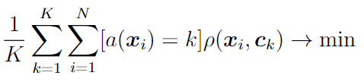

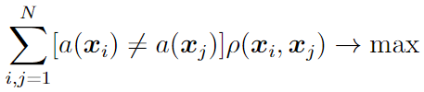



Clustering metrics: intra-cluster and inter-cluster distance
Intra-cluster (inside cluster) distance:
- centers of clusters
Inter-cluster (between cluster) distance:
- inter-cluster distance
Dunn Index:
- intra-cluster distance
No single metric usually can characterize the clustering quality. In practice here a combination of metrics and tests should be used

Slide 8


K-means
Parameters:
centers of clusters
assignment of objects to clusters
Initialization: randomly choose cluster centers
Step a: for fixed cluster centers find new object assignments
Step b: for fixed object assignments find new cluster centers
Repeat step a and b until convergence

Slide 9


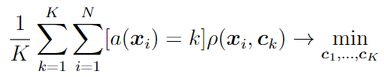


K-means
Step a: for fixed cluster centers find new object assignments
Step b: for fixed object assignments find new cluster centers

Slide 10
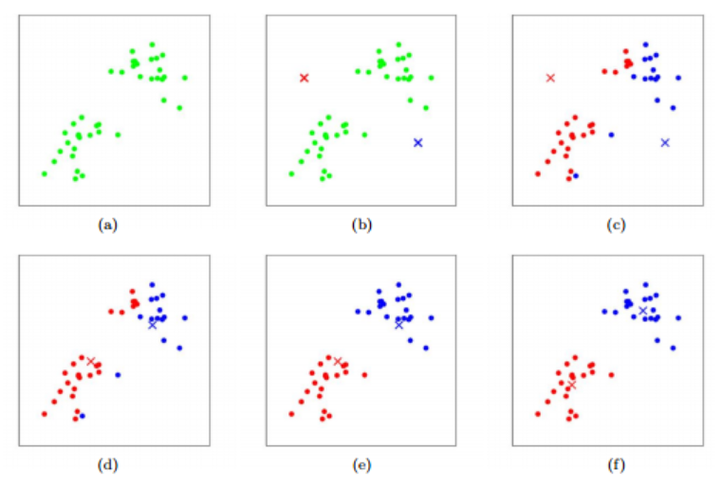
K-means Illustration

Slide 11
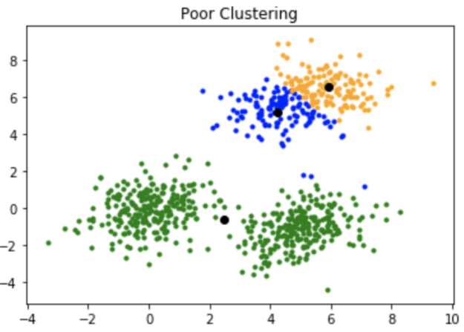
K-means ++
Problem in K-means: the result may heavily depend on initialization of centers

Slide 12


K-means ++
K-means ++: a special initialization procedure for K-means
Choose one random point as first center
For each datapoint compute its distance to the nearest center
Choose new datapoint as a new center with probabilities proportional to
Repeat steps 2 and 3 until K centers are found

Slide 13
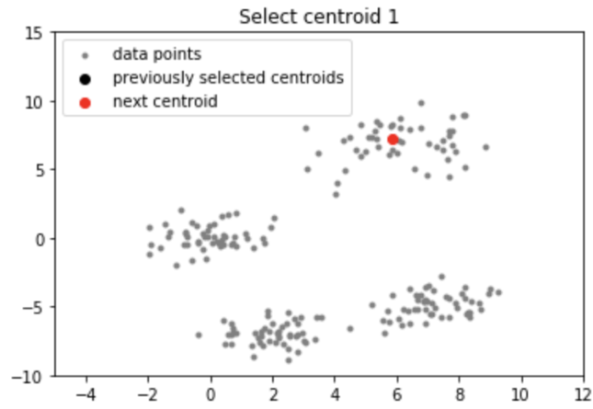
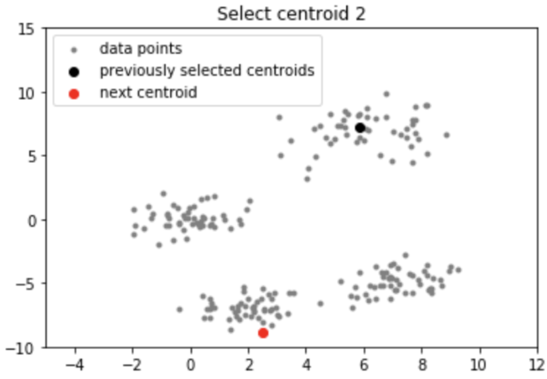
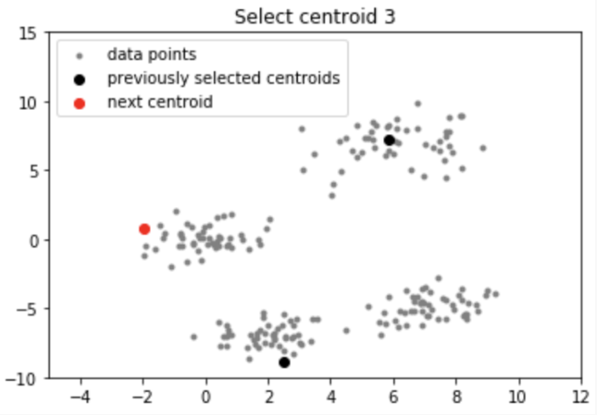
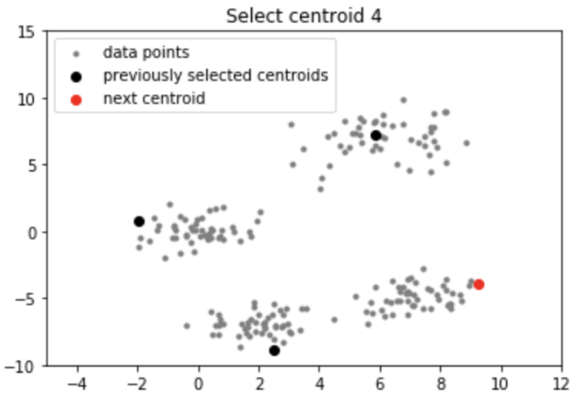
K-means ++

Slide 14
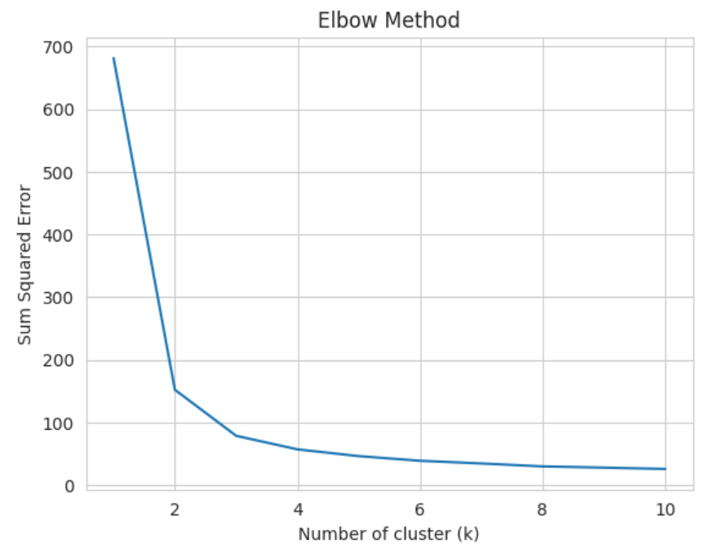
Elbow heuristics
Number of clusters K is a hyperparameter, that should be provided by user. The larger K, the lower the sum of squared errors. Choose K that correspond to “elbow”: K=3 in the example.

Slide 15
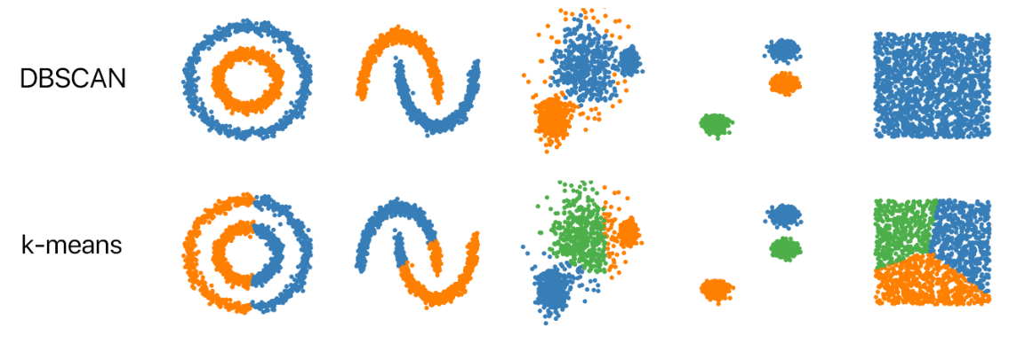
DBSCAN
General problem in K-means: it is able to find only spherical clusters

Slide 16

DBSCAN (Density-based spatial clustering of applications with noise)
General Idea: each cluster is a region of typical density that is considerably higher than outside of the cluster
Two parameters:
MinPts – minimum number of points clustered together for a region to be considered dense
Eps – a distance to locate points in vicinity of other points

Slide 17
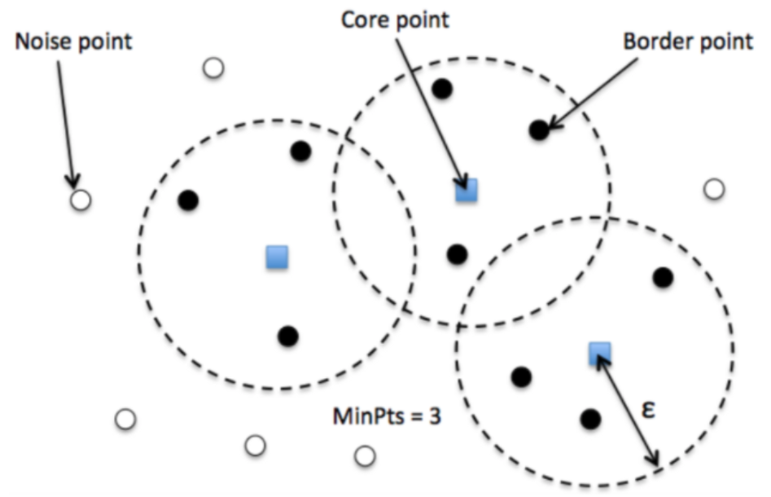
DBSCAN
Core point: there are at least MinPts points with distance Eps
Border point: there is a least one core point with distance Eps
Noise point: neither Core nor Border point

Slide 18
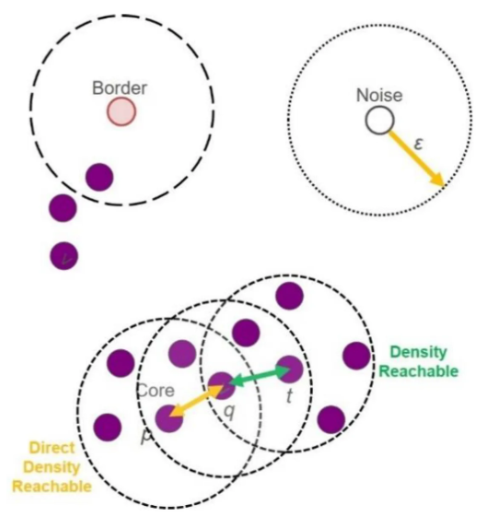
DBSCAN
Choose arbitrary point from dataset
If there are at least MinPts points with Eps distance to the current point than all these points belong to the same cluster
Clusters are then expanded by recursively finding neighborhood for each neighboring points
DBScan demo

Slide 19
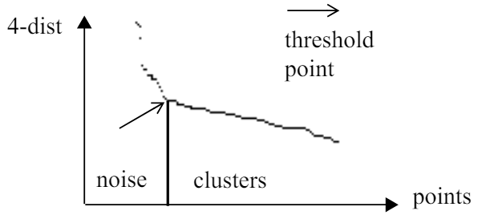
Choosing parameters in DBSCAN
Recommendations:
MinPts = 2*dimensionality
Eps: compute MinPts-neighbor distance for all points, sort them and apply elbow heuristics

Slide 20
DBSCAN vs. K-means
DBSCAN:
is able to find non-spherical clusters
automatically find the number of clusters
is able to find noise datapoints

Slide 21
PCA: Principal component analysis

Slide 22


PCA
Dataset:
Goal: find lower-dimensional data representation, that preserves the properties of the original dataset

Slide 23
PCA
Idea: let’s consider a projection of data to lower-dimensional linear subspace, that minimizes the total projection length
Equivalent formulation: find a projection of data with the largest variance
In the example D=2, d=1

Slide 24


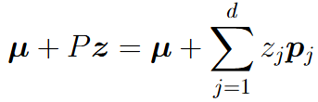





PCA
A set of basis vectors for linear subspace:
Any point on a d-dimensional hyperplane can be represented as follows:
Finding projection of given datapoint to the hyperplane:
Using the result from linear regression:
Assuming orthogonal basis , we get

Slide 25




PCA
Total projection length:

Slide 26



PCA

Slide 27





PCA
For simplicity let’s consider the special case
Sample covariance matrix:

Slide 28



PCA
Lagrange function:
Hence direction p is eigenvector of the matrix S

Slide 29

PCA
General case:
Here are eigenvectors of the sample covariance matrix, that correspond to the its largest eigenvalues

Slide 30

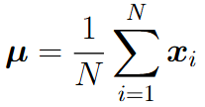
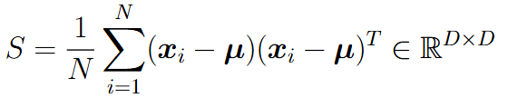
PCA
Dataset:
1. Compute sample mean and sample covariance:
2. Find all eigenvalues and eigenvectors of the matrix S
3. P – the matrix, that is constructed from d eigenvectors corresponding to the largest d eigenvalues
4. Make projection:

Slide 31
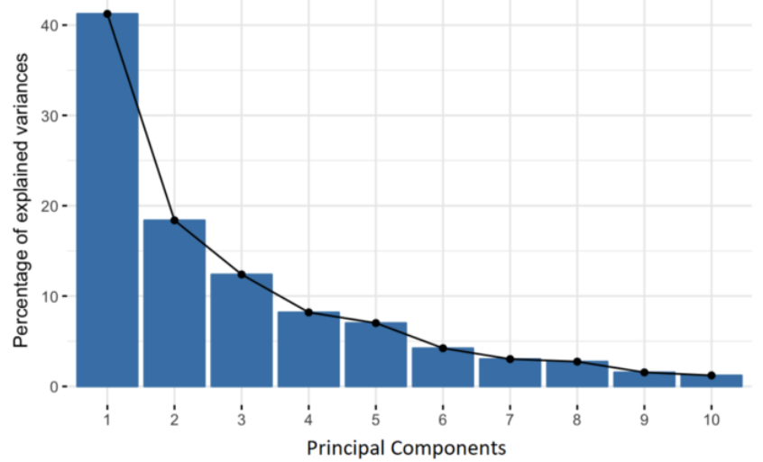
PCA
Choose the dimension d by elbow heuristics

Slide 32
T-SNE: non-linear data visualization

Slide 33

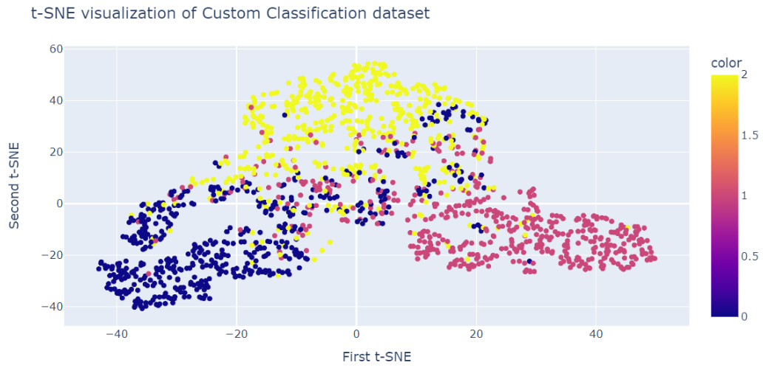
Data Visualization
Dataset:
Distribution of distances in y space is similar to distribution of distances in initial D dimensional space
Goal:

Slide 34


T-SNE (t-distributed Stochastic Neighbor Embedding)
Distribution of distances for initial points:
Distribution of distances for low-dimensional points:

Slide 35





KL-divergence
Two probability distributions: and
Kullback-Leibler divergence:
KL properties:
non-negative:
non-symmetric:

Slide 36


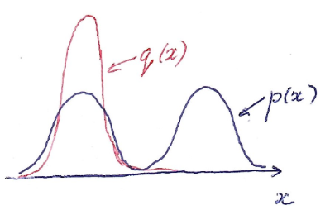
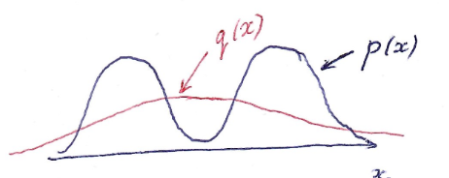
KL asymmetry

Slide 37




KL from information theory
Stream of symbols for transmission:
Need lossless compression into stream of bits:
Good compression scheme: use shorter bit codes for symbols with higher probabilities
- true probabilities of symbols
- estimated probabilities of symbols
- Difference of expected encoded message length between encoding with q(x) and optimal encoding with p(x)

Slide 38
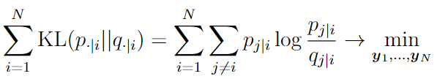
T-SNE
Optimization criterion:
Solve optimization problem using stochastic gradient descent

Slide 39


Choosing parameters
In different regions of feature space it could be different density of data points hence different sigmas should be chosen
For too big sigma we have a uniform distribution, for too small sigma we have a degenerate distribution
Perplexity can be interpreted as a smooth measure of effective number of neighbors. Sigma is chosen in a way to have a given value of perplexity

