Slide 1
Linear Regression: Bayesian View Logistic Regression Multi-Class Classification

Slide 2

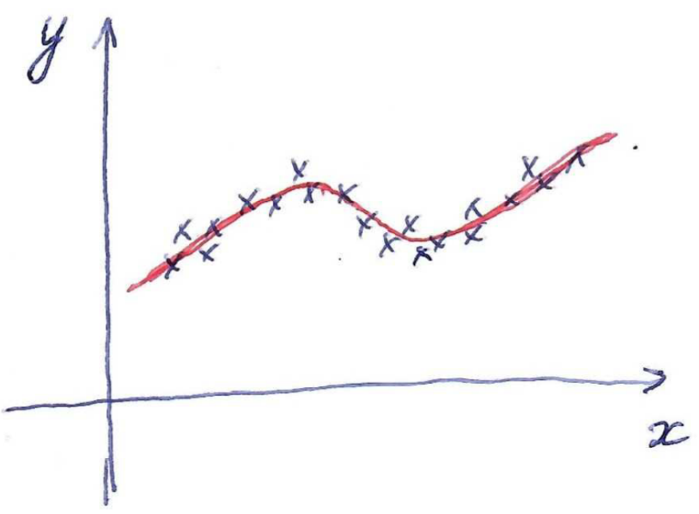





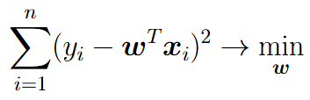
Linear regression: probabilistic view
Equivalently:
Let’s find ML estimate for parameters
Dataset:
This optimization problem is equivalent to MSE loss minimization:
Question: Can we find probabilistic analogue for L2-regularized MSE loss min.?

Slide 3







Bayesian Inference
Let’s encode our uncertain knowledge about some variable value in terms of probability distribution (prior distribution):
Make some measurement x that is indirectly connected with y:
Bayes formula:
Reestimate our uncertain knowledge about y after measurement x by finding posterior distribution:
Continue this process: make some new measurement z from , assume new prior and find new posterior
This is the same as making two measurements x, z, assume prior
and find posterior

Slide 4
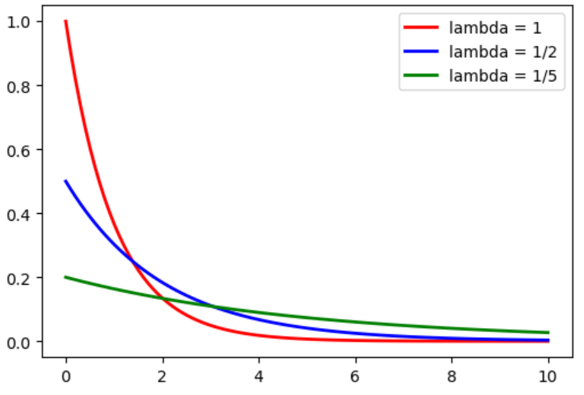





Example: train delay estimation
Train delay in minutes:
Let’s assume Exponential probabilistic model:
Goal: estimate (delay model) using observations
Let’s take only one measurement x = 5. Then = 1/5 and we come to barely realistic green model of delays.
Common problem for ML estimates: they are weak for small sample size

Slide 5
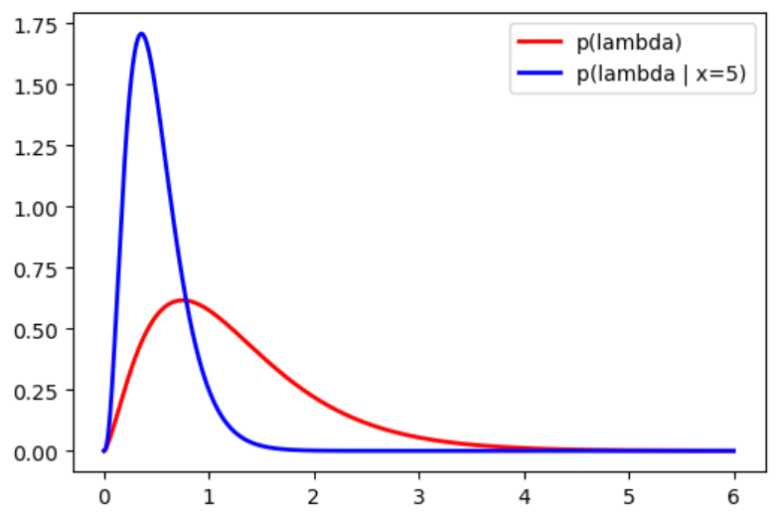




Example: train delay estimation
Let’s apply Bayesian inference
Let’s assume some prior:
Observation model:
Bayesian inference:
Bayesian estimate:
Alternative:

Slide 6
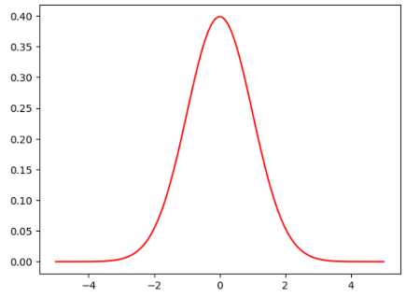

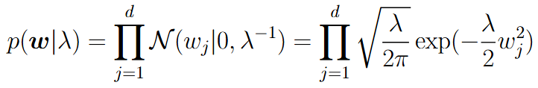

Linear Regression: Bayesian view
Goal: estimate weights
Observation model:
Prior distribution:

Slide 7


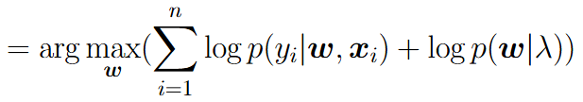
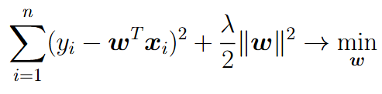
Linear Regression: Bayesian view
The last optimization problem is equivalent to:

Slide 8
Logistic Regression

Slide 9
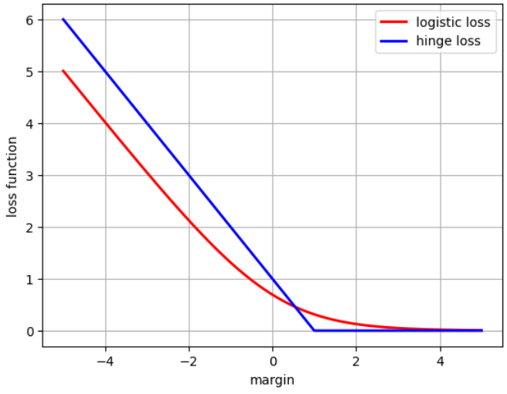



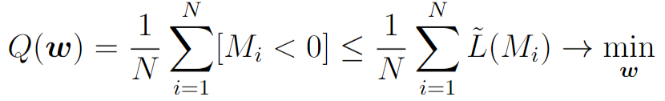


Linear classification
Let’s consider two-class classification problem
Logistic Regression
SVM

Slide 10

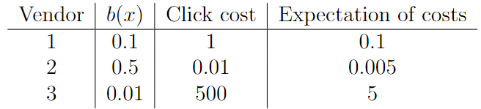
Probability prediction
Suppose we want together with class label also predict the probability / confidence of our prediction
Example: Internet advertisement sales

Slide 11


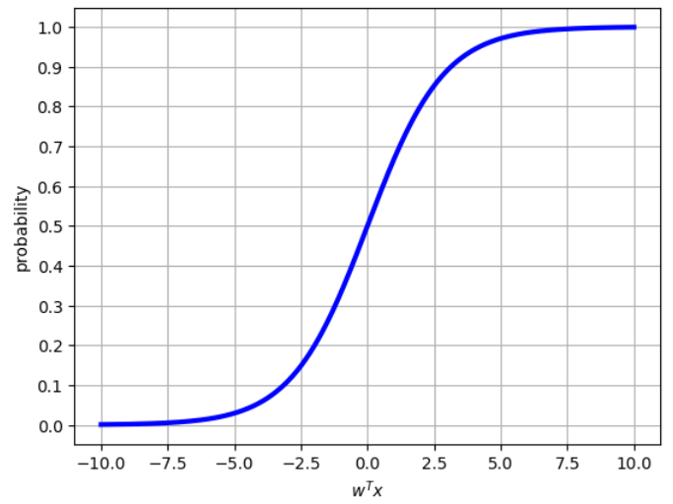
Probability prediction
To predict probability with linear models we need to define a monotonic transformation from linear score to probabilities

Slide 12

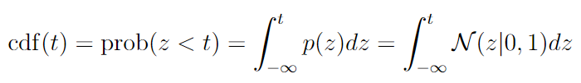

Probability prediction (Probit Regression)
Possible choice of transformation function:
cumulative density function (cdf) of a standard normal variable
Drawback: hard to deal with integral

Slide 13

Probability prediction (Logistic Regression)
Alternative: sigmoid (logistic) function

Slide 14

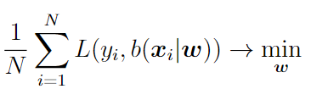
Probability prediction: Loss function view
Probability prediction:
Training procedure:
Problem: how to introduce a proper loss function that would correspond to learning correct probabilities?

Slide 15




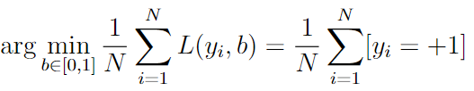
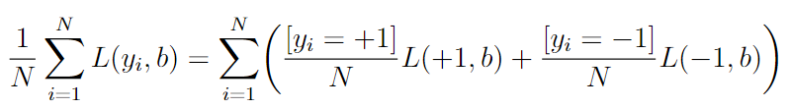


Learning probabilities
General idea: correctly estimates probabilities if for all objects with predicted positive class probability their real positive class frequency is also
Let’s consider the simplified case when all training objects are the same:

Slide 16




Example: quadratic loss
Desired property:
Result: quadratic loss correctly estimates probabilities

Slide 17


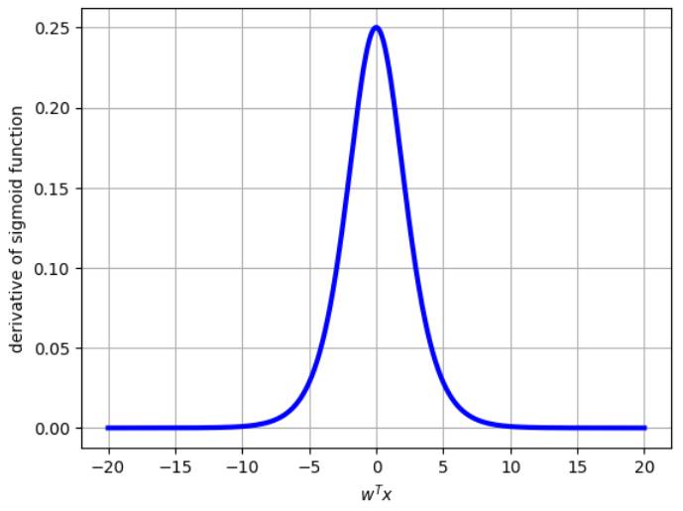
Example: quadratic loss
Sigmoid function
Training:
Derivative of sigmoid function
Here we may deal with vanishing gradient problem

Slide 18



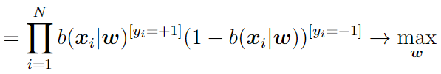
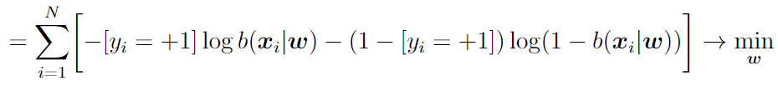
Probability prediction: probabilistic view
Dataset:
Probabilistic model:
Likelihood function:
Logistic loss (log loss):

Slide 19



Learning probabilities with logistic loss
Desired property:
Result: logistic loss correctly estimates probabilities

Slide 20




Logistic regression
Probability prediction:
Logistic loss for training:

Slide 21
Logistic Regression vs. SVM
SVM loss doesn’t penalize any margins greater than 1. This usually leads to better performance in terms of accuracy, F-measure, ROC-AUC, etc.
Logistic loss is minimized for margins tending to infinity. This usually leads to better probability calibration.
For linearly separable datasets logistic regression can’t be trained without regularizer

Slide 22


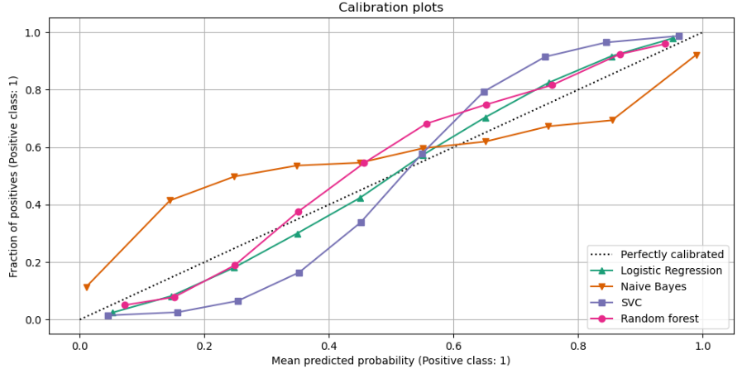

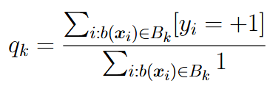
Probability calibration
Let’s take some classifier that output probabilities
For SVM we may take:
Let’s split [0,1] interval into a set of non-intersecting bins:
Compute for each bin ratio of positive class:

Slide 23
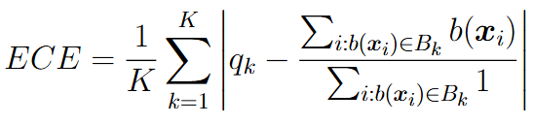
Probability calibration: estimation
For estimation of probability calibration we may use ECE criterion (Expected Calibration Error):
Here other metrics (not only sum of absolute differences) may be used

Slide 24

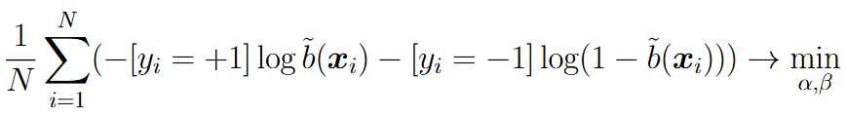
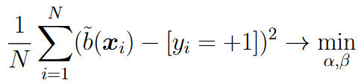
Probability calibration: Platt scaling
Let’s consider additional transformation on top of estimated probability from classifier:
Train transformation parameters using appropriate loss function:
Alternatively:
Important: calibration is made on validation set, otherwise we may have target leak

Slide 25
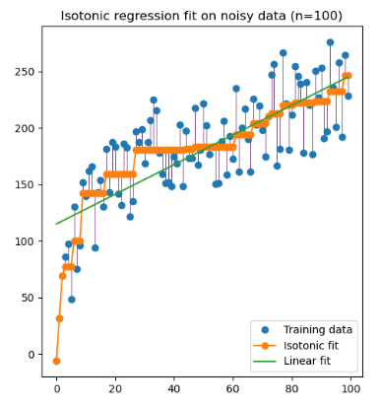
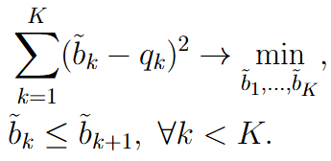
Probability calibration: Isotonic Regression
Train monotonic piecewise linear transformation from input probabilities to output probabilities:
This is QP problem of special type: for solution efficient pool-adjacent-violators algorithm (PAVA) can be used

Slide 26
Multi-Class Classification

Slide 27


Multi-class Classification
Two options:
Build multi-class classifier using several two-class classifiers
Directly extend two-class classification model to the general case

Slide 28
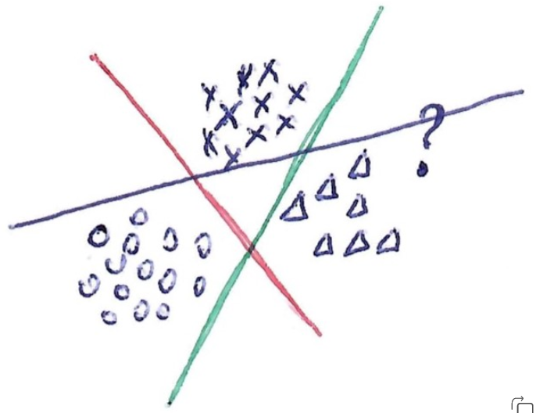



One-vs-All (One-vs-Rest)
Let’s introduce K separate two-class linear classifiers:
Each classifier is trained to separate one class from all the rest:
Final prediction:
Main drawback: each classifier is trained without any knowledge of others

Slide 29




All-vs-All (AvA)
Let’s introduce linear classifiers:
Each classifier separates one class from another one:
Final prediction:
AvA:
usually shows better performance comparing to OvA
does not depend on particular score values of separate classifiers
requires training of many classifiers and has many parameters
may be sensitive to lowly-representative classes

Slide 30




Logistic Regression for multi-class case
Logistic regression should produce probabilities for all classes:
Let’s introduce K linear scores:

Slide 31

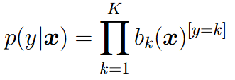

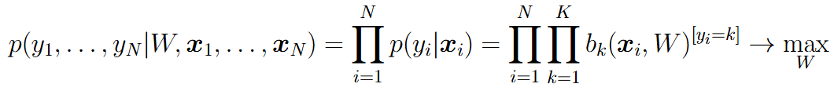
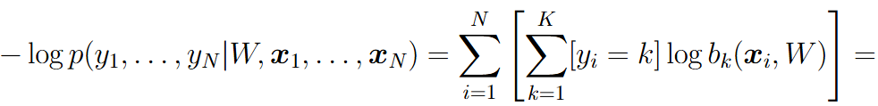
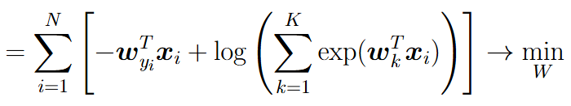

Logistic Regression for multi-class case
Probabilistic model:
Prediction:

Slide 32





SVM for two-class case
Constraint from primal view:
Score for positive class:
Score for negative class:

Slide 33
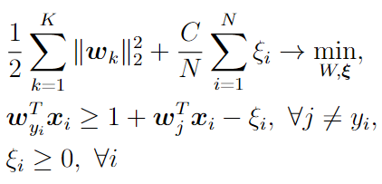
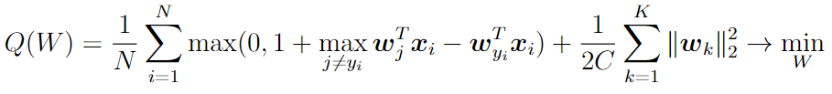
SVM for multi-class case
Training in primal view:
Prediction:
Training in unconstrained view:

Slide 34
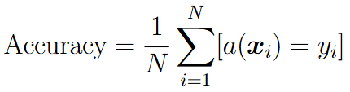

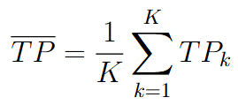
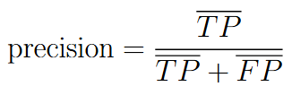

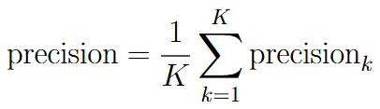
Measuring quality for multi-class classification
For each class k let’s compute , where positive class is k-th class and negative class are all the rest.
Micro-averaging:
Macro-averaging:
Macro-averaging is better for unbalanced classes, but can be understated by one poorly predicted class.

