Slide 1
Mid-Term Exam Discussion

Slide 2
Nominal feature: it takes values from discrete set of incomparable categories
Correct examples:
1) color: “red”, “green”, “black”, …
2) country name: “Germany”, “Vietnam”, “USA”, …
3) car brand: “BMW”, “Audi”, “Tesla”, …
Incorrect example:
gender: “male”, “female” (this is binary feature, that can be perfectly encoded with 0 and 1)

Slide 3
Ordinal feature: it takes values from discrete set of comparable categories, but the values are not numerical
Correct examples:
1) Education level: High School Certificate, BSc degree, MSc degree, PhD degree
2) Temperature: cold, warm, hot
3) Accommodation: WG, apartment, several-floor apartment, own house, …
Incorrect examples:
1) Height, weight, age (these all are numerical features)
2) Ranking in video game MMR: 5000, MMR: 3469
3) List of tags in video description (this is a set-valued feature)

Slide 4
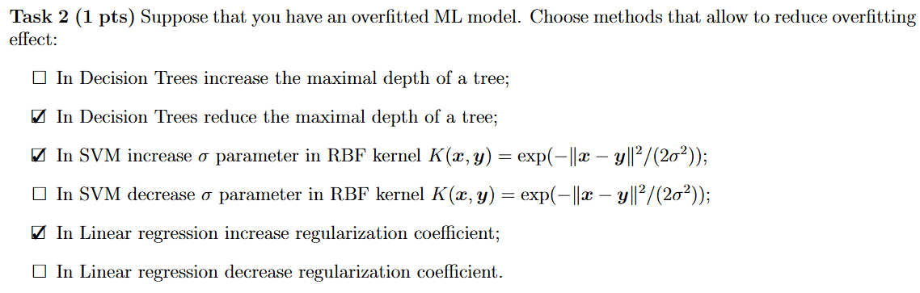

Slide 5
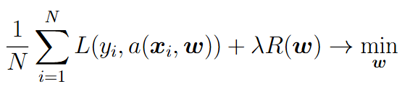
ML model training = minimization of loss function + regularization term:
The lower the loss function, the better approximation of answers on the training set
The lower the regularization term, the simpler the approximation model
With higher regularization coefficient the regularization term has higher impact on solution. Hence higher regularization coefficient corresponds to less overfitted model (with the prize of poorer quality on the training set).

Slide 6
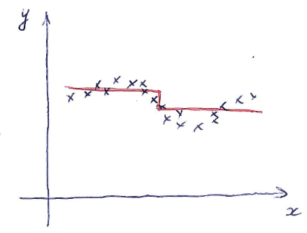
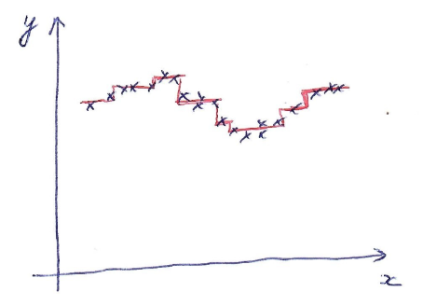
DT with one split
DT with many splits
With bigger depth a decision tree is able to better fit the given data. Hence with smaller depth we have less risk of overfitting.

Slide 7
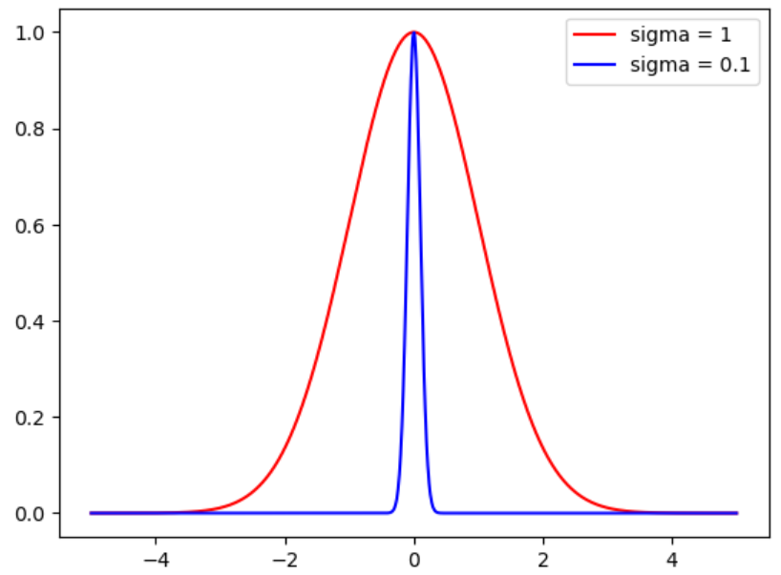
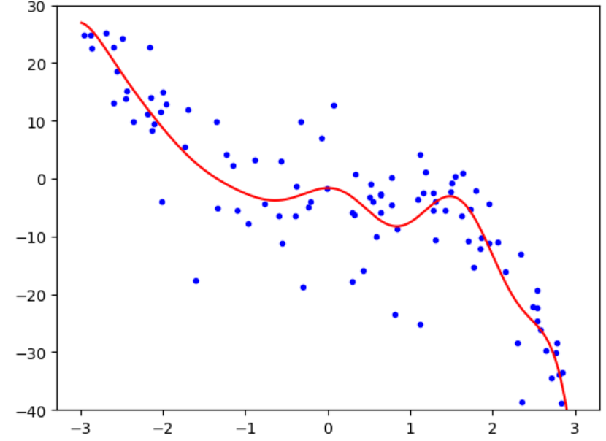
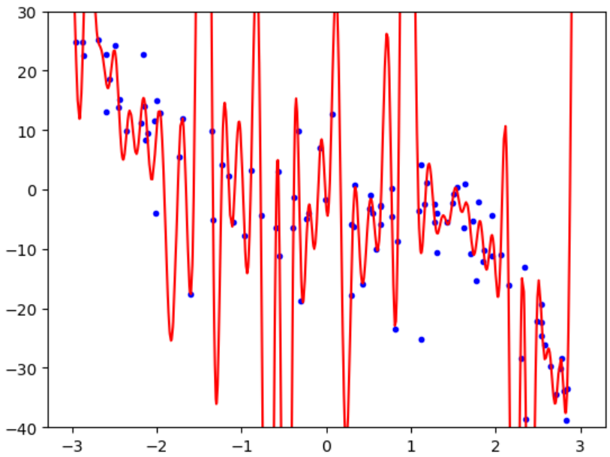
Decision rule in SVM with RBF kernel function:
RBF linear regression with sigma=1
RBF linear regression with sigma=0.1
Kernel function
With smaller sigma SVM can better fit training data and hence has higher risk of overfitting

Slide 8
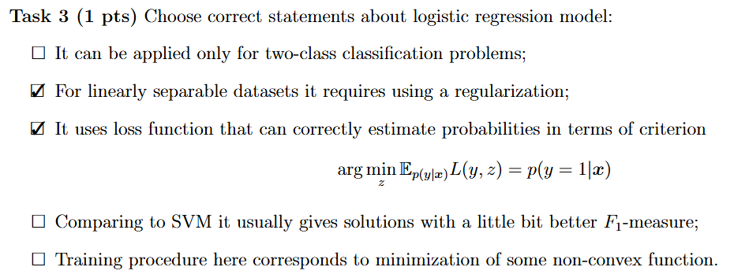

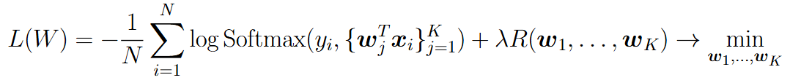
Logistic regression for K-class case:

Slide 9
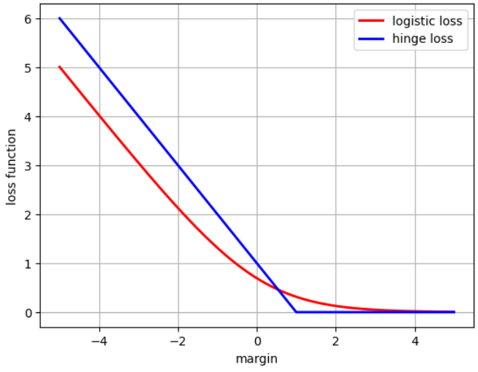
Separating hyperplane is determined by direction of vector w, but not its norm
Loss function in logistic regression is monotonically decreasing
Hence for linearly-separable dataset the logistic regression tends vector w to infinity norm
SVM loss is the same for all margins >= 1

Slide 10






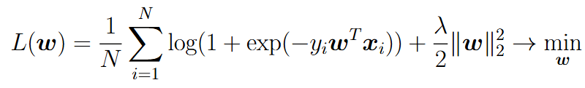


General results about convexity:
If is convex, then the function is also convex
The function is convex, if all functions are convex and all
Any norm is a convex function
Loss function in logistic regression:
The function is convex, because

Slide 11
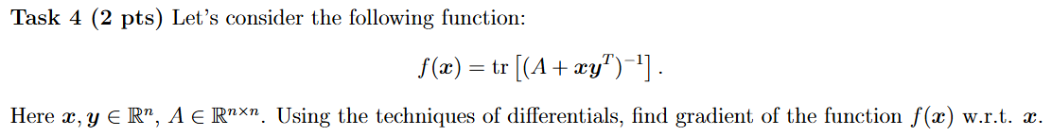




Common mistake:

Slide 12
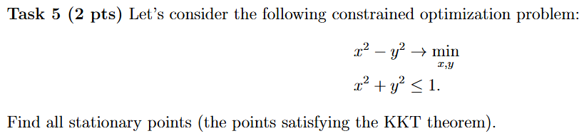

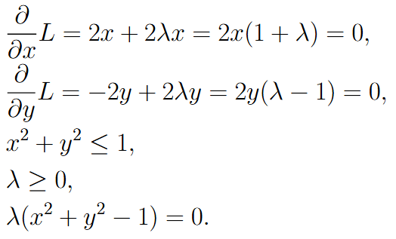
Lagrange function:
KKT conditions:
1) Lagrange function stationarity
2) Primal feasibility
3) Dual feasibility
4) Complementary slackness

Slide 13





Let’s consider all variants from complementary slackness
Three stationary points:
(saddle point)
(loc.min. point)
(loc.min. point)
Common mistake:
(lambda should be non-negative)

Slide 14
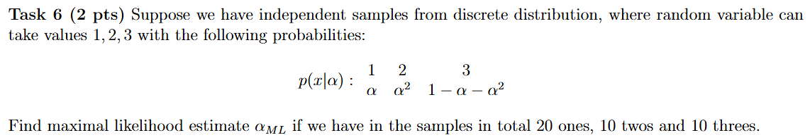
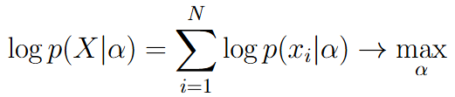



Log-likelihood maximization:
Answer:

Slide 15
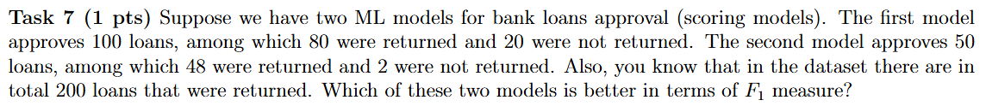
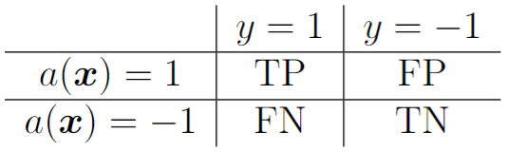




100 for model 1 and 50 for model 2
200
Model 1:
Model 2:

Slide 16



2500
2500
In physical world all values TP, FP, FN, TN must be integer. Non-integer numbers here are due to mistake in task formulation.

Slide 17
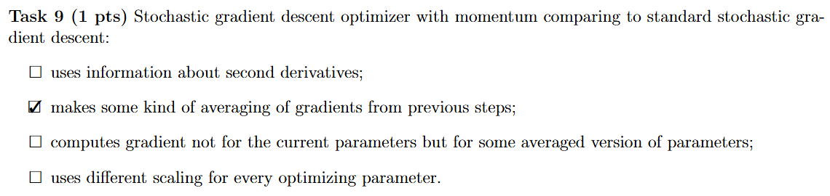
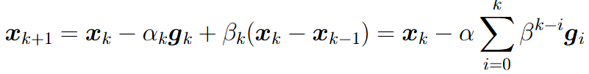

SGD + momentum:
Second derivatives are used in Newton method
Component-wise scaling is used in ADAM, RMSprop and Adagrad
Computing gradient in some extrapolation point from previous iterations is realized in Nesterov Accelerated Gradient optimization

Slide 18
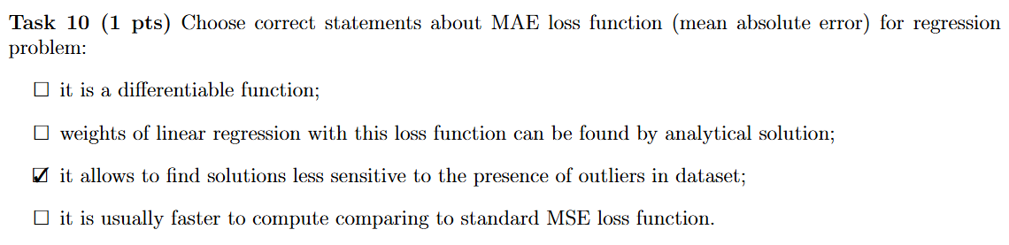

Slide 19
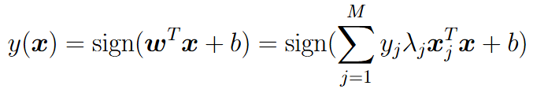


SVM decision rule:
If w is stored in memory, then computational complexity is
If summation over support vectors is used, then computational complexity is

Slide 20
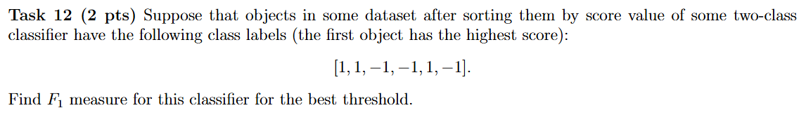
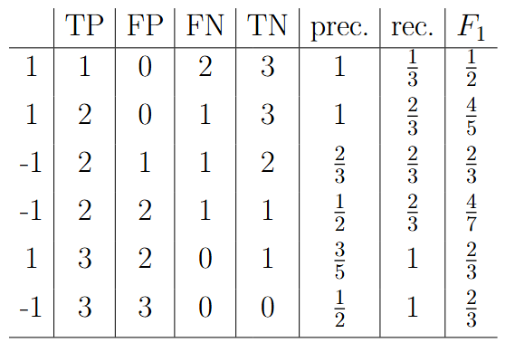
In the table the values are computed for the case that the current object and above belong to positive class
The best F1 is 4/5, when the first two objects are assigned to positive class and all the rest – to negative
In case all objects are assigned to negative class: TP=0, FP=0, FN=3, TN=3, prec.=1, rec.=0, F1=0

Slide 21




One SGD step:

Slide 22
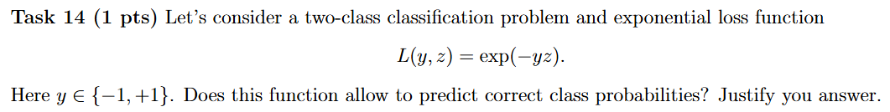




Need to check the following condition:
Hence, the function does not correctly predict probabilities
Common misunderstanding: the value of z should be in [0,1], and not the loss function itself

Slide 23
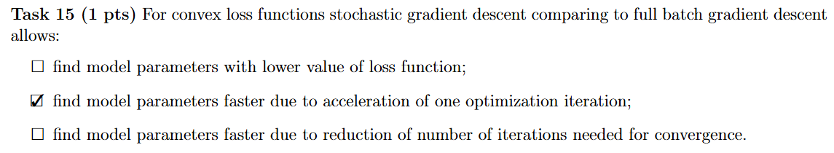

Slide 24
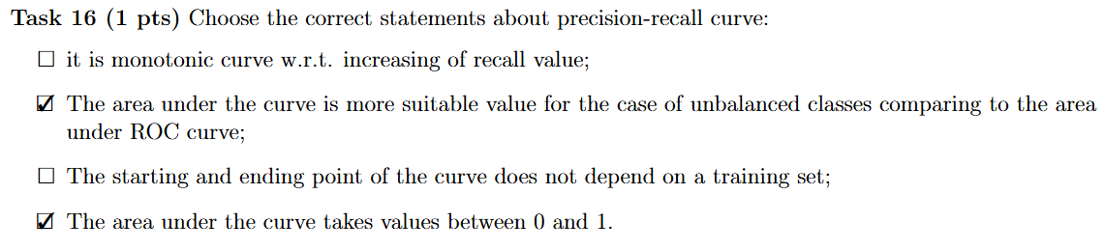
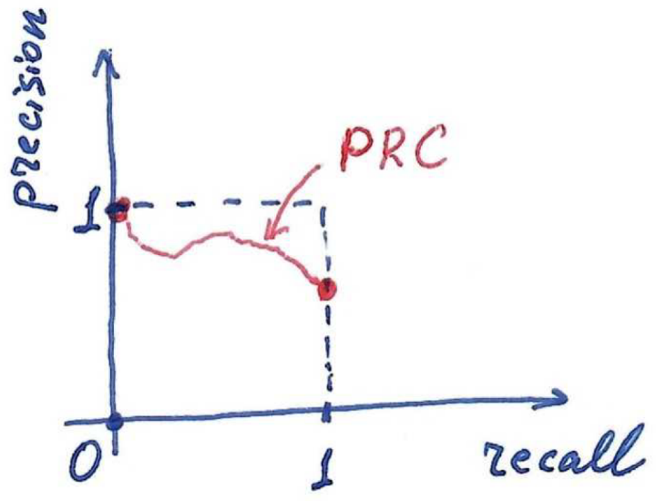
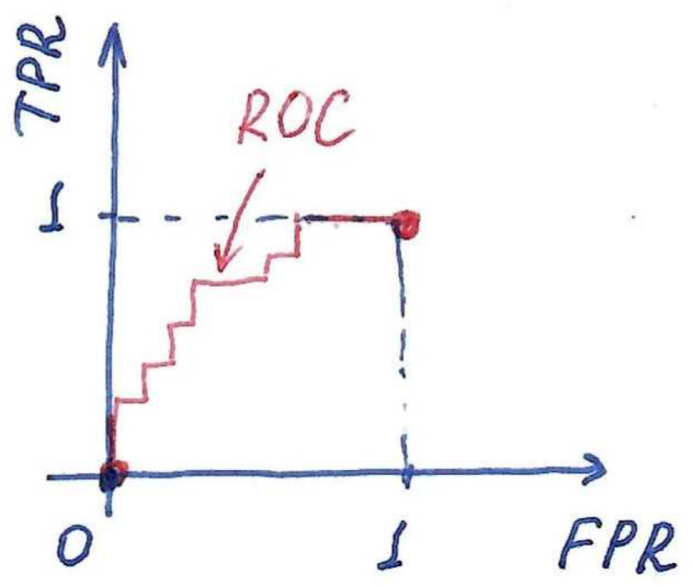
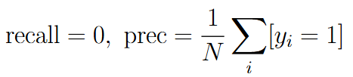

Slide 25



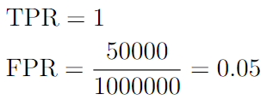




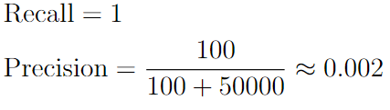

Value of AUC-PRC is less sensitive to the case of unbalanced classes

Slide 26
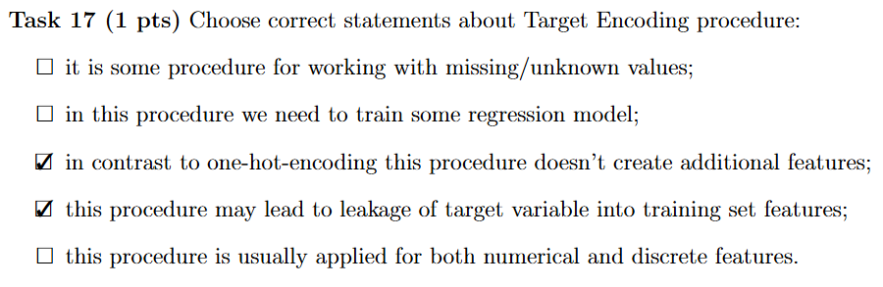
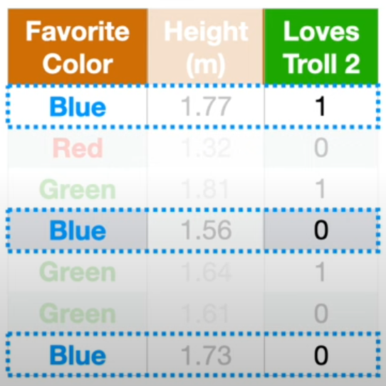
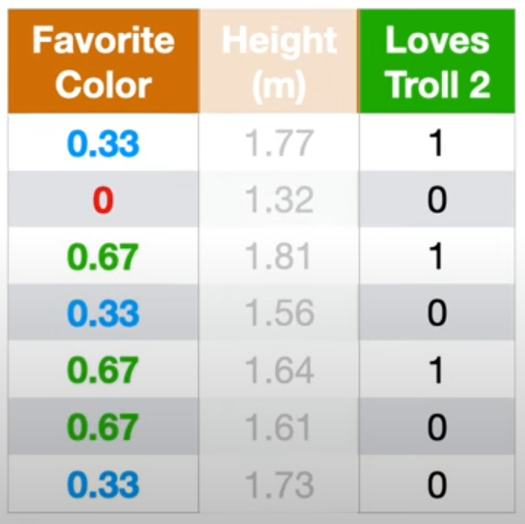
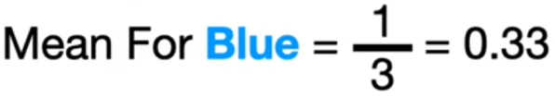

Slide 27
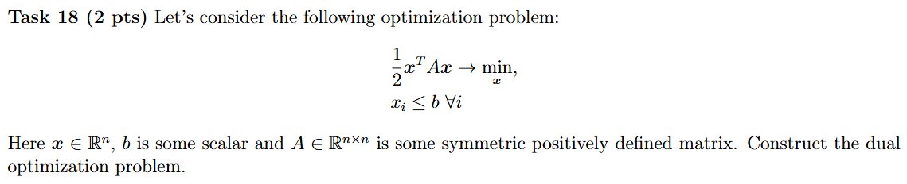
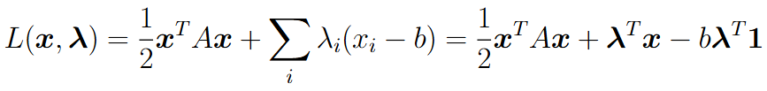




Dual optimization problem:
Common mistakes: 1) no conditions in dual opt. problem and 2) division by matrix:

Slide 28
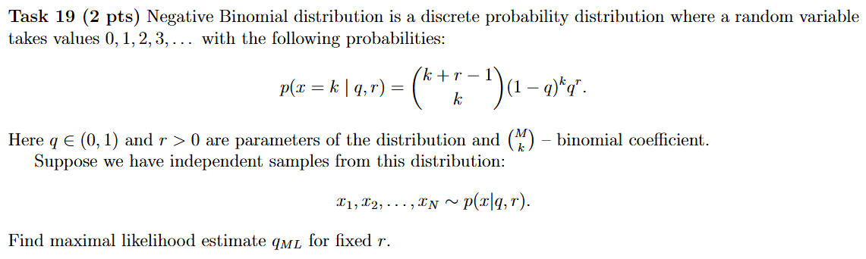
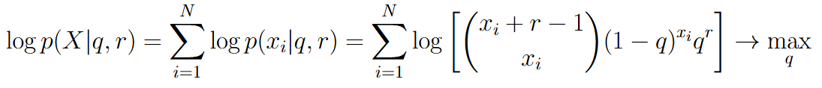
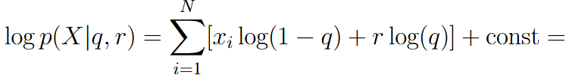




Slide 29
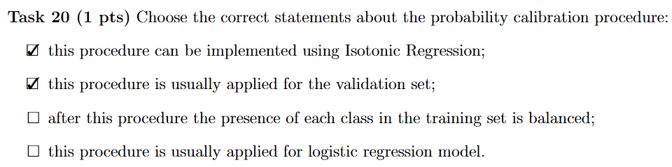
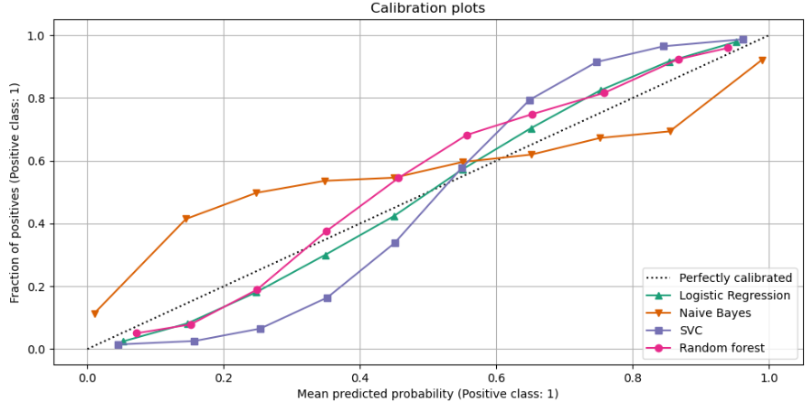

Slide 30
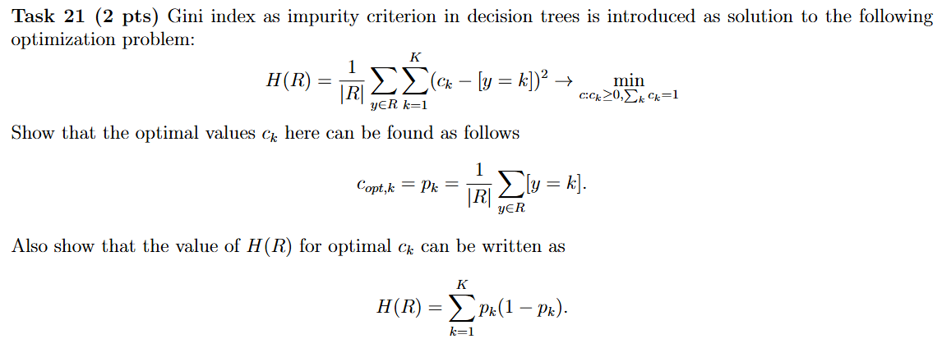
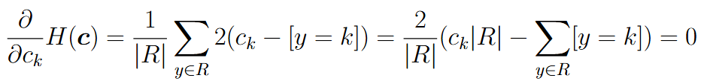
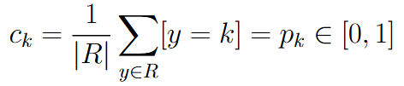
ck automatically satisfies all the constraints, hence introducing Lagrange function here is not necessary

Slide 31
