Slide 1
Gradient Boosting Implementation: XGBoost, LightGBM Blending, Stacking

Slide 2
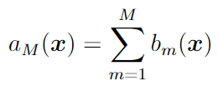
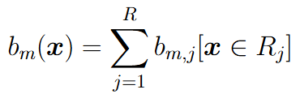

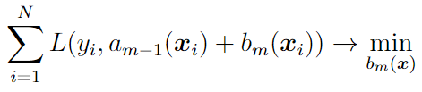
Gradient Boosting on Decision Trees
Composition of base models:
Base model = regression decision tree:
- number of leaves
The base models are trained sequentially, e.g. the next tree corrects the errors of the current composition:
Each tree is supposed to be simple (has few nodes/leaves)

Slide 3








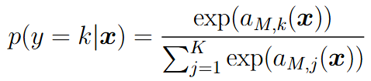
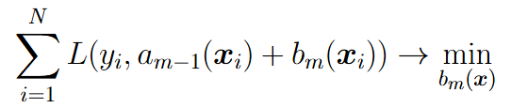
Gradient Boosting on Decision Trees
Important: the composition is happening on score values, not on targets
Regression
Prediction rule:
Probabilistic model:
Two-class classification
Prediction rule:
Probabilistic model:
K-class classification
Prediction rule:
Probabilistic model:

Slide 4




Gradient Boosting on Decision Trees
Gradient Boosting: 1) make opt. step in the space of DT outputs (e.g. with gradient descent) and 2) fit DT to the obtained step
Pseudo-residuals:
Training of the next base model:
Use shrinkage:
- step size

Slide 5
Popular GB implementations
XGBoost (eXtreme Gradient Boosting, paper)
LightGBM (Light Gradient Boosting Machine, paper)
CatBoost (Categorical Boosting, paper)

Slide 6
XGBoost (Extreme Gradient Boosting)
Main ideas:
Using Newton optimization for loss function
Using regularization for each decision tree
Impurity criterion for splitting in decision trees depends on loss function
Using shrinkage and feature subsampling
Efficient procedure for finding splits in each tree
Working with missing/sparse values
Using parallel implementation and efficient memory handling

Slide 7

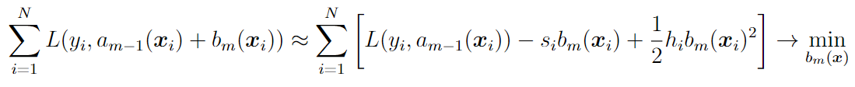

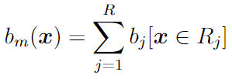



Newton optimization for loss function
Newton optimizer idea:
Base algorithm is decision tree:
Regularizations:
Number of leaves with reg. coef.
L2-regularization for values in leaves with reg. coef.

Slide 8
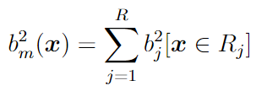
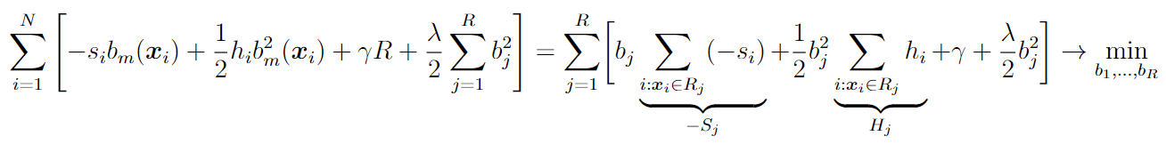
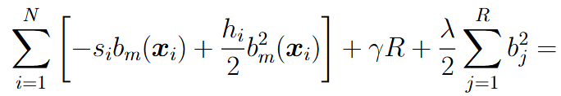



Newton optimization for loss function

Slide 9
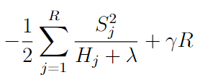

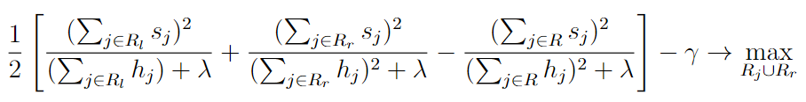
New impurity criterion for DT splits
Decision Tree quality after tuning all values in leaves:
We can use this criterion for finding the best splits in Decision Tree
Stopping criterion for splitting: the criterion above should be positive

Slide 10
Shrinkage and feature subsampling
Shrinkage:
- step size
Use feature subsampling like in Random Forest (sample random subset of features for finding each split, the subset is different for different nodes in one tree)

Slide 11

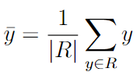
Exact Naïve Algorithm for Splits
Suppose in current node there are N objects with D features and variance is used as impurity criterion
For each feature 1..D:
Sort all objects w.r.t. current feature O(N log N)
For each threshold 1..N:
Compute mean target for left and right subtree O(N)
Compute variance for left and right subtree O(N)
Total computational cost: O(D*N*N)

Slide 12


Acceleration of Naïve Algorithm
For each feature 1..D:
Sort all objects w.r.t. current feature O(N log N)
For each threshold 1..N:
Recompute mean target when moving one object y from right to left subtree O(1)
Recompute variance for left and right subtree O(1)
Total computational cost: O(D*N*log N)

Slide 13
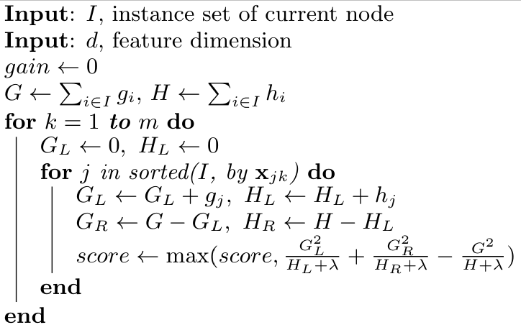
Exact algorithm for splits in XGBoost

Slide 14
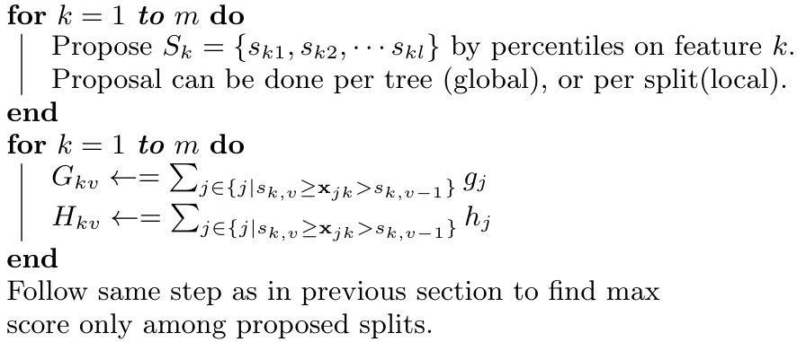
Approximate algorithms for splits
Computational cost: O(D * number of proposals)

Slide 15
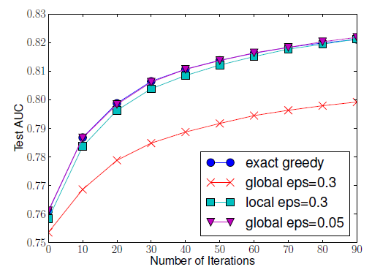
Approximate algorithms for splits
Global proposals: require more refined number of bins, but can be done only once per tree
Local proposals: we can use few bins, but need to compute them for every node a new
Result: both approaches show similar performance

Slide 16

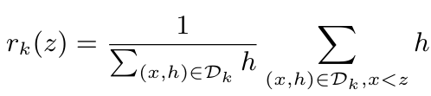
Finding good proposals
- object weight
Ranking function:
Optimal splits:

Slide 17
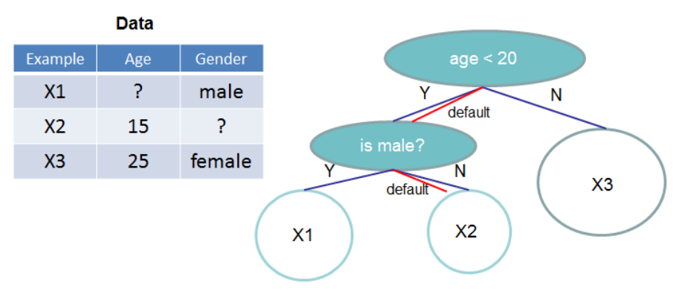
Working with missing/sparse values
Idea: introduce default subtree for missing/zero feature value

Slide 18
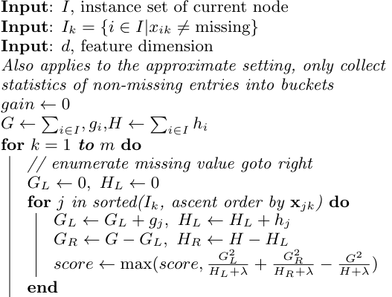
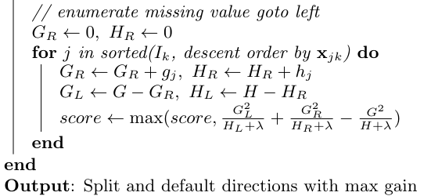
Finding default subtree
Idea: compute score value twice – 1) all missing values go to the right subtree and 2) all missing values go to the left subtree

Slide 19
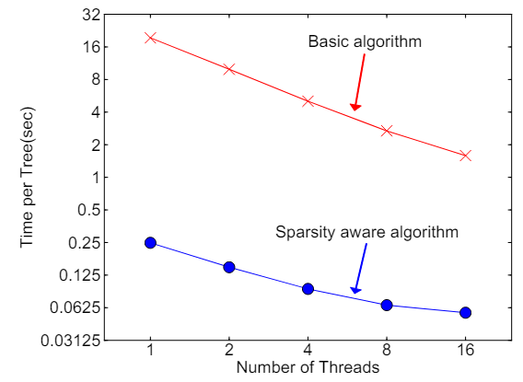
Acceleration for sparse training

Slide 20
LightGBM
Main ideas:
Using loss gradient pseudo-targets like in classic GB scheme
Using object subsampling with sufficient object reduction for construction of each tree
Using clusters of features (groups of features) with sufficient groups number reduction for construction of each tree

Slide 21

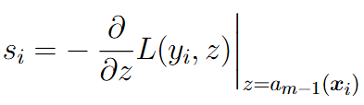
Efficient object subsampling
Object importance = absolute value of loss gradient (for objects with almost zero gradient the base model doesn’t need to learn anything)
GOSS (Gradient-based One-Side Sampling):
Sort all objects w.r.t. their absolute grad. values in descending order
Take the top a% objects (the objects with the highest grad. values)
Among the rest randomly sample b% of objects
Weights for dataset: =1 for objects from step 2, =(1-a)/b for objects from step 3

Slide 22


Efficient object subsampling
Considering object weights in prediction and impurity criterion:

Slide 23
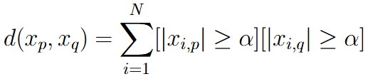

Clusters of features
Two features are called mutually exclusive, if they rarely take non-zero values simultaneously (e.g. features after one-hot encoding)
Distance between two features
Distance between feature and group of features
Clustering algorithm:
For each feature:
For each group:
if dist(feature, group) < threshold, then add the feature into the group
else make new group consisting of this feature

Slide 24



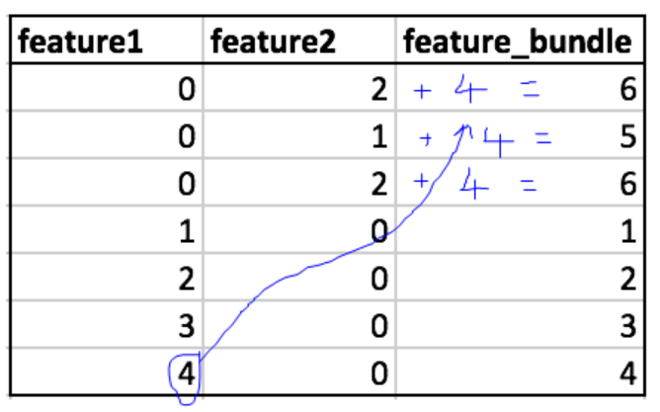
Uniting features in one group
Suppose some group consists of two features and . The first takes values between [0, 10), the second takes values between [0, 20). Transform the second feature values to [10, 30) and create a new united feature as . Define threshold splits for this newly created feature.

Slide 25



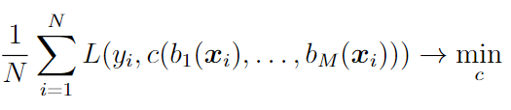
Introduction to Blending and Stacking
Random forest and GB: base models are chosen by composition procedure
Stacking: composition over arbitrary base models
Composition:
Meta-model:
Meta-model training:
Important: meta-model and base models should be trained on different datasets!

Slide 26

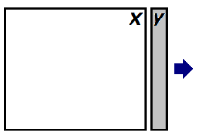
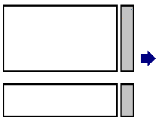
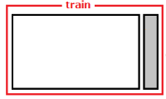


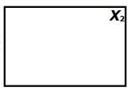
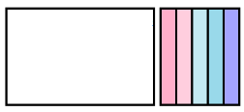
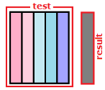
Blending
Split dataset into two parts:
Training set for base models
Train all base models
Training set
Train meta model
Training set for meta model
Answers of base models
Test set
Meta model prediction
Answers of base models for test set

Slide 27


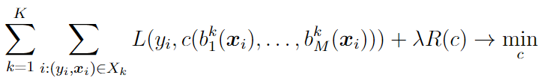

Stacking
Training:
- base model trained on all parts except of k-th part
In total MK base models
Inference:
Train all base models on full training set
Averaging of base models
Stacking on many different algorithms is a usual winner in ML competitions

