Slide 1
RESUME FINDER
Contributors
DURGA KROVI
ALOK KUMAR
SID RATHI
JATIN SAXENA

Slide 2
PROJECT GOAL
Limitation of current keyword based search used by many online websites might not be entirely accurate, as the correlation between the skills and the experience is often missing.
‘Spark’, instead of just searching for the keyword ‘Spark’ in the resume, we want to know (for scoring purpose) - if the employee worked in Spark for X number of years, - did he have experience on Spark, in multiple organizations.
Build a resume parser that will create a score for each profile/resume based on the skill set mentioned in the query and rank them in order of score (highest to lowest).

Slide 3
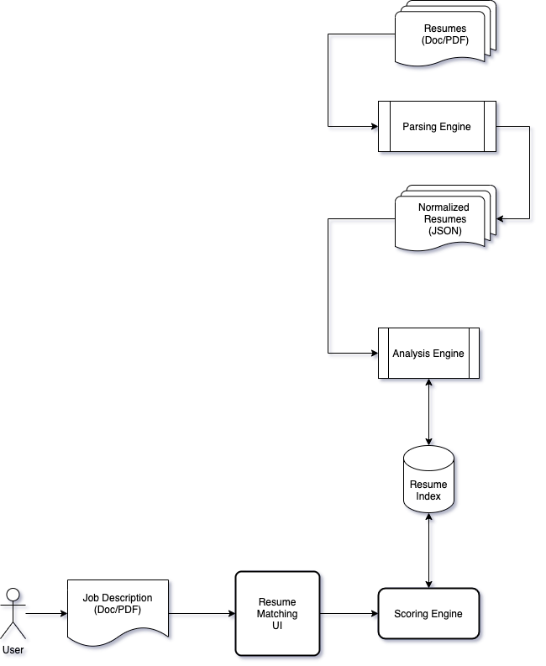
PROJECT – ARCHITECTURE DIAGRAM

Slide 4
PARSING ENGINE
Uses Stanford NLP for text retrieval
Unigram & Bigram model
Uses background model to filter out the common words
Uses a skill dataset master list which is used for keyword search
Input a list of resume
Currently supports PDF and MS Word Resume formats
Outputs a normalized json with a list of skills. One json file per resume

Slide 5
SAMPLE JSON OUTPUT
{ "location": "/Resume_FullStack.json", "skills": [ { "skill": "Angular", "duration": 40 }, { "skill":"JavaScript", "duration": 10 }, { "skill": "ETL", "duration": 2 } ] }

Slide 6
SCORING ENGINE
Uses Lucerne index for text retrieval
Creates an inverted index of the resumes
Stores skills with experience as a field in Apache Lucene document
Builds search functionality used by the UI
Uses Range query to filter result based on minimum experience
Boost query for mandatory skills so that resume with those are skills scored high
Search and return location of resume from json file in descending order of score

Slide 7
UI
Interactive UI in which the user can input following options
Up to 3 skills
Minimum experience in number of years
Whether the skills are mandatory or optional

Slide 8
VIDEO DEMO
https://mediaspace.illinois.edu/media/t/1_tuxjijvb

