Slide 1
Computers and computing
Damir Krstinić
damir.krstinic@fesb.hr

Slide 2

About...
Computing
Computation
Computers
Computer science

Slide 3
What is a computing?

Slide 4

Computing
Computing is a fundamental mental process
Computing can be carried out by a person or some tool (machine)

Slide 5
Computing
Computing is a fundamental mental process
Computing can be carried out by a person or some tool (machine)
The same computation can be carried out using a number of different technologies:

Slide 6

Computing
Computing is a fundamental mental process
Computing can be carried out by a person or some tool (machine)
The same computation can be carried out using a number of different technologies:

Slide 7
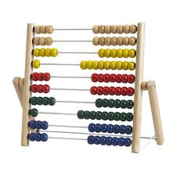
Computing
Computing is a fundamental mental process
Computing can be carried out by a person or some tool (machine)
The same computation can be carried out using a number of different technologies:

Slide 8
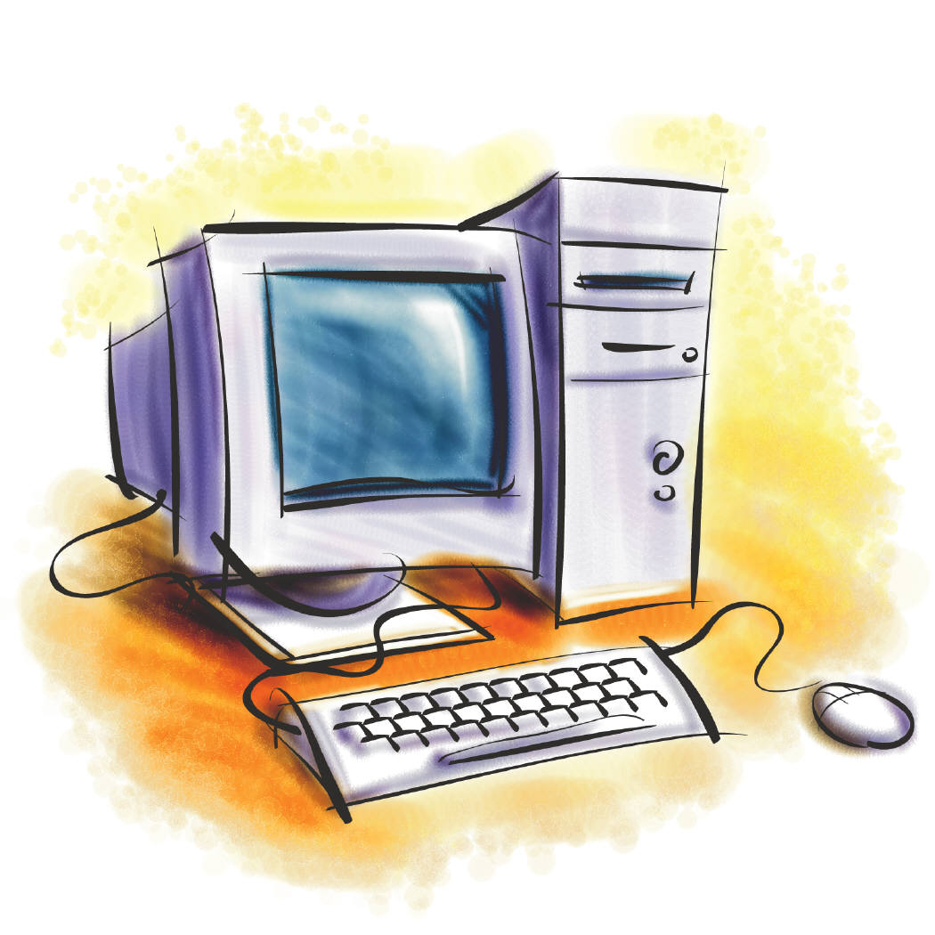
Computing
Computing is a fundamental mental process
Computing can be carried out by a person or some tool (machine)
The same computation can be carried out using a number of different technologies:

Slide 9
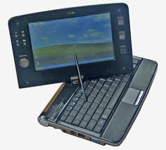
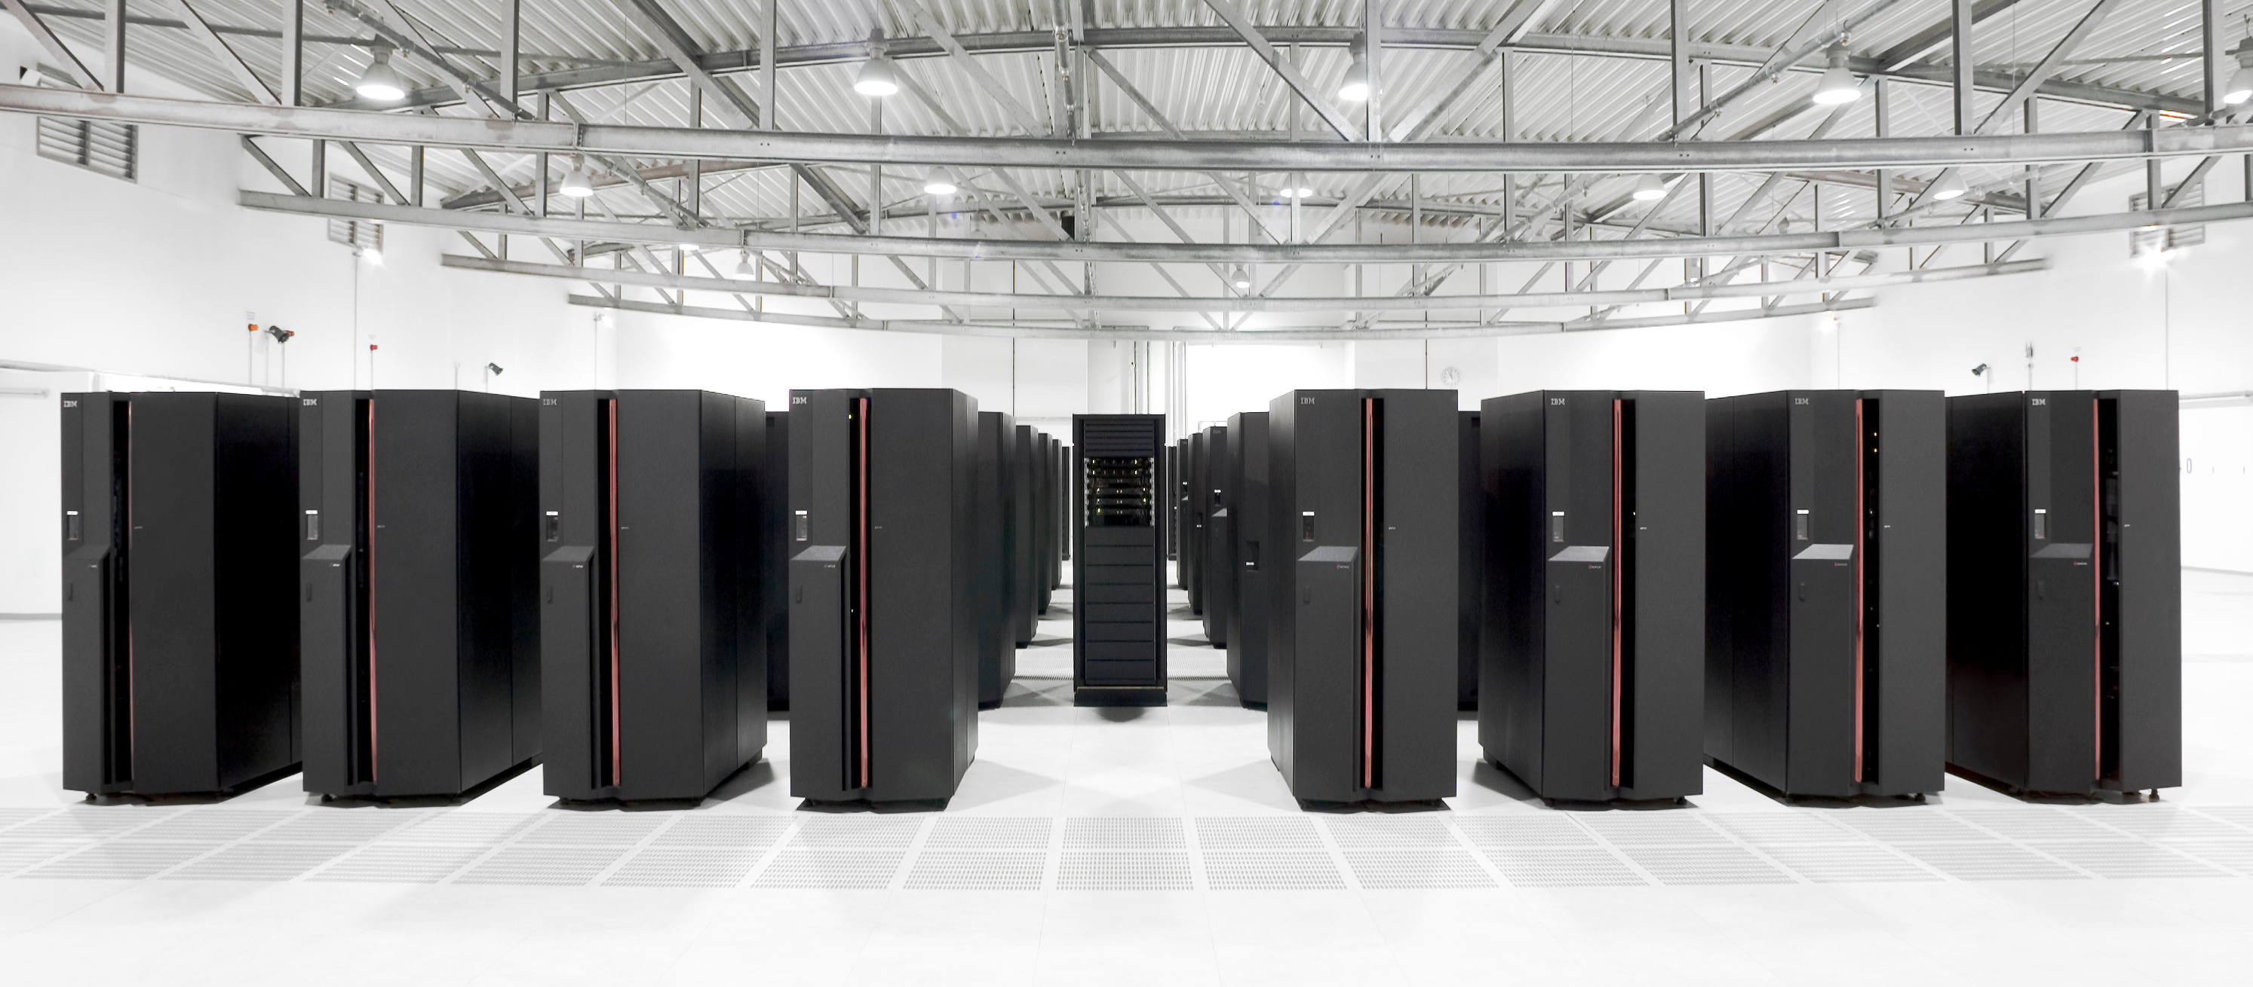
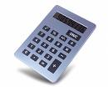
Computing
Computing is a fundamental mental process
Computing can be carried out by a person or some tool (machine)
The same computation can be carried out using a number of different technologies:

Slide 10
Computing
Computing is a fundamental mental process
Computing can be carried out by a person or some tool (machine)
The same computation can be carried out using a number of different technologies:
Any computational tool basicaly only assist the mind!

Slide 11

Computing
Computing is a fundamental mental process
Computing can be carried out by a person or some tool (machine)
The same computation can be carried out using a number of different technologies:
Any computational tool basicaly only assist the mind!

Slide 12
What is a computation?

Slide 13

Computation
A computation (calculation) is a sequence of well-defined operations that uses some data as input (starting point) and produces a desired (and expected!) outcome
The idea that problem can be solved by following a detailed set of instructions is very old
  Acient Greek, Persian and Chinese philosophers all developed computational aproaches for solving arithmetic problems

Slide 14
What is a computer?

Slide 15
What is a computer?
Until the 1940s the word “computer” was a job title
Computers were people trained to follow a precise set of instructions required to create mathematical tables used for navigation, astronomy etc.

Slide 16

Computer
(Modern) computer is an electronic machine that accepts data as an input, processes the input data (perform a computation), and produces output information
The computer is able to process input data to produce the desired output because there are instructions in its memory precisely describing the desired computation
The usefulness of the modern computer is in the abbility to process (and store) large amounts of data

Slide 17

The Brief History of Computers
2500 BC, Mesopotamia: Abacus
  A table of succesive columns which delimited the succesive orders of magnitude
100 BC, Antikythera mechanism
  DIscovered in 1901. in the ship wrech near the Greek islan of Antikythera, it is belived to be the earliest known mechanical analog computer designed to calculate astronimic positions
Mediavel Islamic world: number of mechanical devices that can be programmed to perform a specific task (Astrolab)

Slide 18
The Brief History of Computers
1642. Blaise Pascal designed a computer that added numbers entered with dials
  The first signs of technofobia: mathematicians fearing the loss of their jobs!
1837. Charles Babbage describes the Analytical Engine which is accepted as the first design for a modern computer (it was newer built)
  Expandable memory, arithmetic unit, logic processing capabilities, able to interpret set of instructions with loops and conditional branching.
  Touring complete!

Slide 19
The Brief History of Computers
1703. Binary logic developed by Gottfried Wilhem Leibnitz
  Formal numerical system base on ones and zeroes which also represent true or false and on or off state
1854. George Boole published Boolean Algebra
  Complete system that allowed computational processes to be mathematically modeled.
1936. Alan Turing and Alonzo Church introduced the formalization of an algorithm
  Turing introduced Turing Machine, capable of simulating any computer algorithm!

Slide 20
The Brief History of Computers
1936. Z1 Computer built by Konrad Zuse, electrically driven mechanical calculator
1942. EINAC (Electrical Numerical Integrator and Calculator)
  18000 vacume tubes, capable of multiply two numbers at a rate of 300 per second
1946. John von Neumann architecture
  Provided uniformity in subsequent computer designs
...

Slide 21
Computers and Computing
Computing: a process
Computation: the sequence of steps to achieve the desired result
Computer: the tool (slightly more advance than pencile and paper)

Slide 22
Computers and Computing
Computing is much more fundamental than computers
Computing may be done without a computer
Computer cannot do much besides computing

Slide 23
What is a Computer science?

Slide 24
What is a Computer science?
Science about computers?

Slide 25
What is a Computer science?
Science about computers?
"Computer science is no more about computers than astronomy is about telescopes."
Edsger Wybe Dijkstra

Slide 26
Computer science
Computer science is the scientific and practical approach to computation and its applications.
  It is systematic study of the feasibility, structure, expression and mechanization of the methodical processes (algorithms) that underlie the aquisition, representation, processing, storage, communication and access to information, whether such information is encoded in bits in a computer memory or in protein structures in a human cell.

