Slide 1
Algorithms
Damir Krstinić
damir.krstinic@fesb.hr

Slide 2

About...
Knowledge
Problem solving
Computing tools
Algorithm
Turing machine
Complexity

Slide 3
What is a knowledge?

Slide 4

Declarative knowledge
Familiarity, awareness or understanding about someone or something gained through expirience or study.
The sum of all that has been perceived, discovered or learned.

Slide 5

Declarative knowledge
Familiarity, awareness or understanding about someone or something gained through expirience or study.
The sum of all that has been perceived, discovered or learned:
“Apple is delightful”

Slide 6
Declarative knowledge
Familiarity, awareness or understanding about someone or something gained through expirience or study.
The sum of all that has been perceived, discovered or learned:
“Apple is delightful”
“y is the square root of x only if y*y = x”

Slide 7
Declarative knowledge
Familiarity, awareness or understanding about someone or something gained through expirience or study.
The sum of all that has been perceived, discovered or learned:
“Apple is delightful”
“y is the square root of x only if y*y = x”
“A good helth care plan improves the quality of medical care while saving money”

Slide 8

Imperative knowledge
Imperative (procedural, implicit) knowledge is the knowledge excersised in the accomplishment of a task
It is about how to accomplish something (a recipe)
It can be directly applied to a task
Unlike the declarative knowledge, imperative knowledge cannot be easily articulated by the individual
  Most of the imperative knowledge is adopted without even being aware of the learning

Slide 9
Knowledge
Knowledge is a familiarity with someone or something, which can include facts, information, descriptions, or skills acquired through experience or education.
It can refer to the theoretical or practical understanding of a subject.
It can be implicit (as with practical skill or expertise) or explicit (as with the theoretical understanding of a subject)

Slide 10
Problem solving
Considered the most complex of all intelectuall functions, higher-order cognitive process that requires the modulation and control of more routine or fundamental skils
Mathematical and personal problem solving
Given some initial condition (input data), taking a set of steps to achieve desired final condition (output information)
  It is about how to accomplish something (a recipe) – an algorithm

Slide 11
Mathematical problem solving
Can be assited by using computing tools
Does usage of more advance tool make problem solving easier or more complex?

Slide 12
Mathematical problem solving
Can be assited by using computing tools
Does usage of more advance tool make problem solving simpler or more complex?
EXAMPLE: transfer from one place to another:
  By foot
  By car
  By plane

Slide 13
Mathematical problem solving
Can be assited by using computing tools
Does usage of more advance tool make problem solving easier or more complex?
EXAMPLE: transfer from one place to another:
  By foot - hard way
  By car - easier and faster
  By plane - fastest

Slide 14
Mathematical problem solving
Can be assited by using computing tools
Does usage of more advance tool make problem solving easier or more complex?
EXAMPLE: transfer from one place to another:
  By foot - hard way, requires minimal knowledge
  By car - easier and faster, requires advance skils
  By plane - fastest, requires most advance and rare skill of flaying the plane!

Slide 15
Computing tools
Sticks and stones

Slide 16
Computing tools
Sticks and stones
Paper and pencil

Slide 17
Computing tools
Sticks and stones
Paper and pencil
Abacus

Slide 18

Computing tools
Sticks and stones
Paper and pencil
Abacus
Slide rules

Slide 19
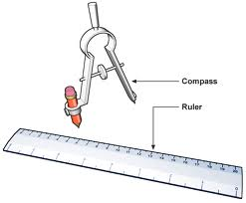
Computing tools
Sticks and stones
Paper and pencil
Abacus
Slide rules
Ruler and compass

Slide 20
Computing tools
Sticks and stones
Paper and pencil
Abacus
Slide rules
Ruler and compass
...
Digital computer

Slide 21
Computing tools
Each tool has set of capabilities called primitive operations or primitives
The primitives may be combined in various ways to perform a computation
EXAMPLE: Ruler and compass
  Ruler: can draw lines and specify lengths
  Compass: can define arcs and circles

Slide 22
TASK 1:
Divide nuber by 2 using ruller and compass

Slide 23

TASK 1: Divide nuber by 2 using ruller and compass
STEP 1: draw a line of a specific length

Slide 24

TASK 1: Divide nuber by 2 using ruller and compass
STEP 2: set compass to more than
a half of a length
and less than a full length

Slide 25

TASK 1: Divide nuber by 2 using ruller and compass
STEP 3: draw arcs from both
Ends of the line

Slide 26
TASK 1: Divide nuber by 2 using ruller and compass
STEP 4: draw a vertical line
using ruler and measure half of
a length

Slide 27
Algorithm
Given a problem to be solved and a tool with its set of primitive operations, the goal is to evolve a combination of primitives of the tool in a certain order to solve the problem.
The algorithm is a finite specification of the solution of the problem given as an explicit combination of the primitives of the given tool in the specific order.

Slide 28

Algorithm
FINITE: the number of steps in the computation is finite!
DEFINITE: precisely specified set of a input and output values
UNAMBIGOUS: distinct set and order of operations (given in the language understandable by the tool!)
COMPLEXITY: measure of the requirements for the algorithm execution (memory, time, ...)

Slide 29
Turing machine
Hypothetical device that mechanically manipulates symbols on tape according to a table of rules
  Operation (computation) is fully determined by a finite set of elementary instructions such as:
“In state 9, if the symbol on tape is 3, write symbol 10 on tape and change to state 42”

Slide 30
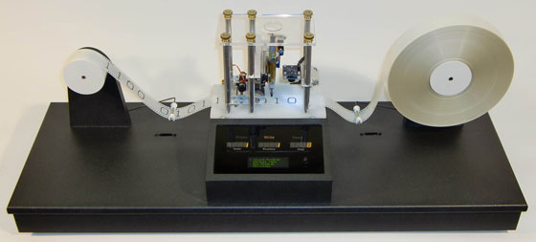
Turing machine

Slide 31
Turing machine - model
TS = (Q, S, δ, q0, h)
Q = {q0, q1, ..., qn, h} Finite set of internal states
S = {s1, s2, ..., sm, B} Alfabet, B (Blank): empty symbol
δ Transition function (table)
q0 ∈ Q Initial state
h ∈ Q Halting state

Slide 32
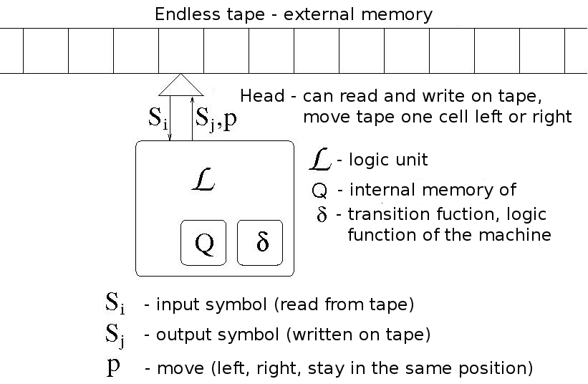
Turing machine - model

Slide 33

Turing machine
Reads input information A (written as a sequence of symbols on the tape)
Each step:
The machine reads symbol below the head
Based on symbol and internal state, logical unit generates output symbol, new state and move command
If halting state is reached, machine stops
Output information B is written as a sequence of symbold on the tape

Slide 34
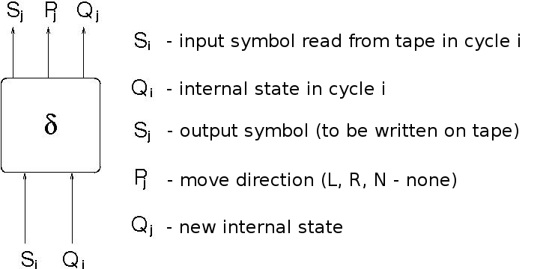
Turing machine
Logic function:

Slide 35
Turing machine
Logic function:
Mapping combination of the internal state and the symbol read from tape to a new internal state, move and symbol to be written on tape
(Sj, Pj, Qj)= δ(Si, Qi)
If new state Qj = h (HALT) machine stops

Slide 36
Turing machine – logic function
Logic function δ defines mapping
δ:(Si, Qi) (Sj, P, Qj)
Logc function can be shown in the form of the transition table

Slide 37
Turing machine - limitations
What are the limitations of the Touring machine?
  What set of problems could be solved with the Touring machine and is there any problem that cannot be solved with it?

Slide 38
Turing machine - limitations
What are the limitations of the Touring machine?
  Every algorithm could be represented in the form of mapping input values to output values (regardless of the type of data and input method)
EXAMPLE: add two nublers
U
a, b
f
c = a + b
I
c

Slide 39
Turing machine - limitations
What are the limitations of the Touring machine?
  Every algorithm could be represented in the form of mapping input values to output values (regardless of the type of data and input method)
Church – Turing thesis:
Function is algorithmically computable if and only if it is computable by a Turing machine.

Slide 40
Turing machine - limitations
What are the limitations of the Touring machine?
  What set of problems could be solved with the Touring machine and is there any problem that cannot be solved with it?
Despite its simplicity, a Touring machine can be adapted to simulate the logic of any computer algorithm!

Slide 41
Turing machine and digital computers
There is no problem that can be solved with the most advance modern computer that cannot be solved with the Touring machine!

Slide 42
Algorithm
The algorithm is a finite specification of the solution of the problem given as an explicit combination of the primitives of the given tool in the specific order.
  What is the algorithm of the Turing machine?

Slide 43
Algorithm
The algorithm is a finite specification of the solution of the problem given as an explicit combination of the primitives of the given tool in the specific order.
  What is the algorithm of the Turing machine?

Slide 44
Definitivness of an algorithm
Is there a set of problems that cannot be solved with Turing machine
  Is there a set of problems that cannot be solved with a digital computer?
DEFINITION:
Let us assume that we can connect all the computers in the world in one single supercomputer and let that computer work on a single problem. If that computer eventualy finds a solution to the problem in the unlimited time (until the end of the universe), we still consider that problem “solvable”.

Slide 45
Definitivness of an algorithm
DEFINITION:
Let us assume that we can connect all the computers in the world in one single supercomputer and let that computer work on a single problem. If that computer eventualy finds a solution to the problem in the unlimited time (until the end of the universe), we still consider that problem “solvable”.
Even according to the above definition, it can be shown that there is a whole set of problems that cannot be solved niether with the Turing machine nor with the modern digital computer!

Slide 46
Definitivness and Turing machine
Turing machine maps input information A to the output information B
CASE 1:
    After finite number of steps, machine reaches the halting state h and stops
CASE 2:
    Machine never reaches halting state
      Turing machine is not applicable to the input information A

Slide 47
Algorithm complexity
The analysis of algorithm complexity is the determination of the amount of resources necessary to execute the algorithm.
  Time complexity: quantifies the amount of time taken by an algorithm to run as a function of the size of the input data set
  Space complexity: quantifies the amount of memory space required for the algorithm as a function of the size of the input data set

Slide 48
Time complexity
How can we access the time complexity of an algorithm?
  By measuring time needed for the algorithm to execute with a particular data set?
QUESTIONS:
What execution time can we expect with the different data set?
What execution time can we expect on a different computer?

Slide 49
Time complexity
How can we access the time complexity of an algorithm?
  By measuring time needed for the algorithm to execute with a particular data set?
QUESTIONS:
What execution time can we expect with the different data set?
What execution time can we expect on a different computer?

Slide 50
TASK 2:
Sort numbers:
3, 9, 8, 1, 15, 7, 10, 11, 6 in ascending order

Slide 51
TASK 3:
Write down precise steps you took to sort the aforetime sequence of numbers

Slide 52
TASK 4:
Write down precise steps necessary to sort a sequence of arbitrary length (length is known at the begining of the execution)

Slide 53
TASK 5:
Evaluate successful algorithms and select the best one

Slide 54
Bubble sort
function A=bubbleSort (A)
n = length(A); % Length of a sequence
for i = n:-1:1 % From last to first number
for j=1:i-1 % From first to (i-1)th
if A(j) > A(j+1) % If next one is smaller
tmp = A(j); % swap consequtive numbers
A(j) = A(j+1);
A(j+1) = tmp;
end
end
end % Sequence is sorted

Slide 55

function A=bubbleSort (A)
n = length(A); % Length of a sequence
for i = n:-1:1 % From last to first number
for j=1:i-1 % From first to (i-1)th
if A(j) > A(j+1) % If next one is smaller
tmp = A(j); % swap consequtive numbers
A(j) = A(j+1);
A(j+1) = tmp;
end
end
end % Sequence is sorted

Slide 56
Bubble sort
If execution time of the sorting algorithm on the sequence of 100 numbers is 5 seconds, how long should it take to sort a sequence of 200 numbers?

Slide 57
Bubble sort
function A=bubbleSort (A)
n = length(A); % Number of operations:
for i = n:-1:1 % n
for j=1:i-1 % (n-1)+(n-2)+...+1=n(n-1)/2
if A(j) > A(j+1)
tmp = A(j); % number of swap operations
A(j) = A(i); % depends on criterion
A(i) = tmp; % A(j)>A(j+1)
end
End % Overall num. of operations
end % is proportional to n²

Slide 58
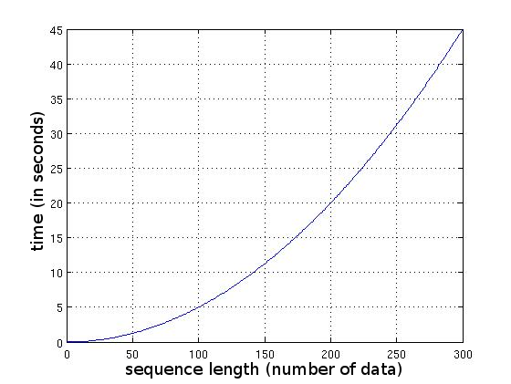
Time complexity of Bubble sort
Estimated execution time, assuming that sorting of 100 numbers takes 5 sec.
  Estimated time for sorting 200 numbers is 20 sec, (4 times longer)
  Estimated time for sorting 300 numbers is 45 seconds (9 times longer)!

Slide 59
Time complexity
Time complexity of an algorithm is defined as number of primitives (arithmetic, logic, memmory access operations, ...) as a function of the size of the input data set
  Assessment of the time complexity is basically counting the number of operations.
  This approach gives estimate of the algorithm efficiency regardless of the implementation details and the available hardware.
O(f(n))
n – number of input data
f(x) - complexity function

Slide 60
Classes of Complexity
Constant time: O(1)
Logarithmic complexity: O(log(n))
Linear complexity: O(n)
Polynomial time: O(n^{k})
  quadratic time O(n²), cubic time O(n³) , ...
Factorial time: O(n!)
...

Slide 61
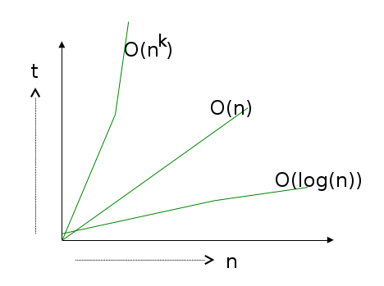
Classes of Complexity
Efficiency of an algorithm is given with its complexity class:
Algorithms with complexities O(n) and O(3n) belong to the same complexity class
Efficiency of an algorithm with polynomial complexity is defined by exponent k (quadratic complexity, cubic complexity, ...)

Slide 62
NP complexity
NP refers to “nondeterministic polynomial time”
One of the most fundamental complexity classes!
“Any given solution to NP complex problem can be verified quickly, however there is no known efficient way to find a solution”
The time required to solve an NP problem using any currently known algorithm increases very quickly as the sizen of the problem grows

