Slide 1
Control Constructs in C++, Lua, and Ruby
Daniel Kruze
November 5th, 2022

Slide 2
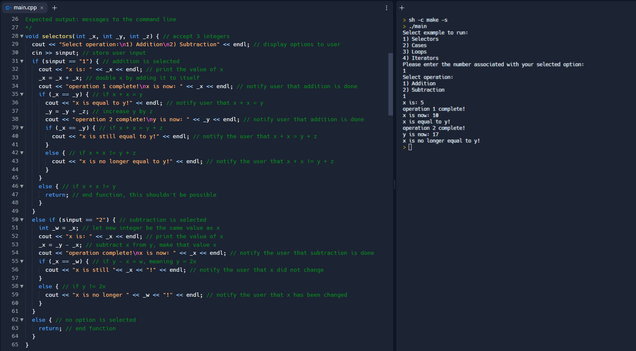
Selectors (if..else) in C++

Slide 3
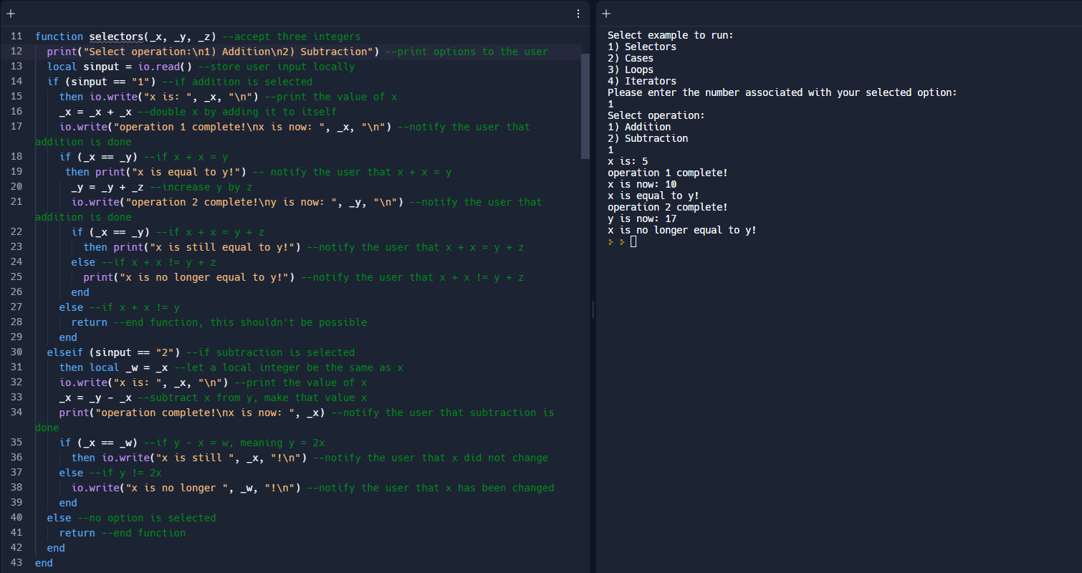
Selectors (if..else) in Lua

Slide 4
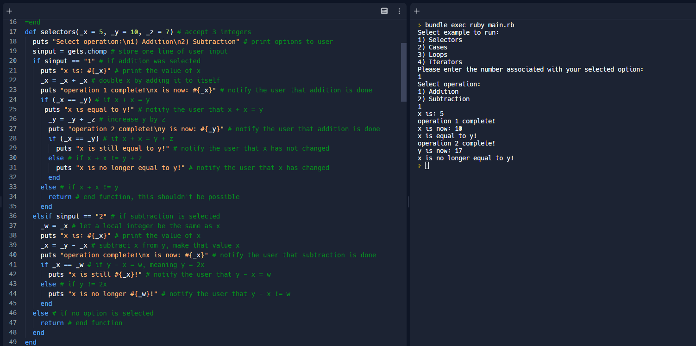
Selectors (if..else) in Ruby

Slide 5
Comparing the three…
C++
Lua
Ruby
Lightweight, no need for “then” keyword
Brackets are optional for single-line execution
Complicated printing operation
Straightforward “else if” keyword
Strong typing, helpful for Boolean operations
Clunky inclusion of “then” keyword
No brackets at all for execution
“end” statements for every if..else block can be confusing
Straightforward “elseif” keyword like C++
Weak typing makes Boolean operations hard to debug
Super lightweight, very few keywords, no “then” like C++
No brackets or even parentheses at all
“end statements” for every block like Lua
The loathsome “elsif” keyword
Weak typing makes Boolean operations hard to debug like Lua

Slide 6
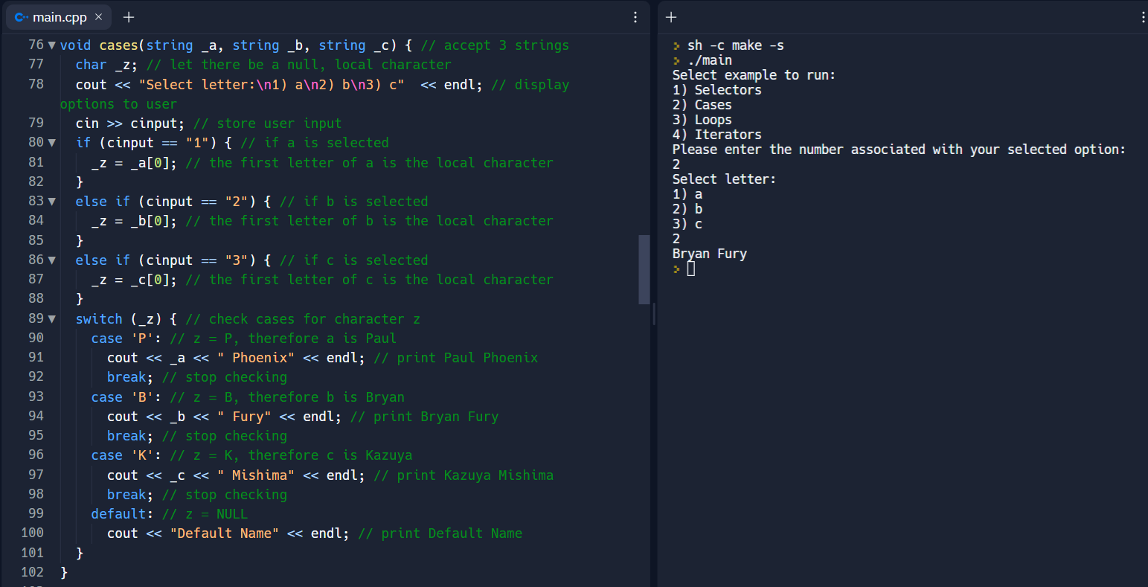
Multiple-Selectors (switch) in C++

Slide 7
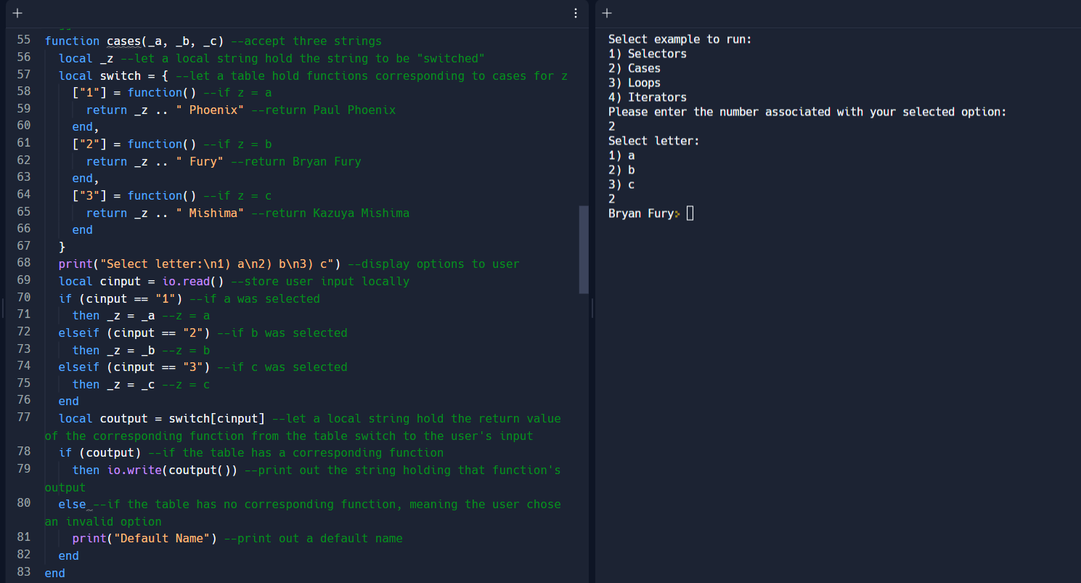
Multiple-Selectors (switch) in Lua

Slide 8
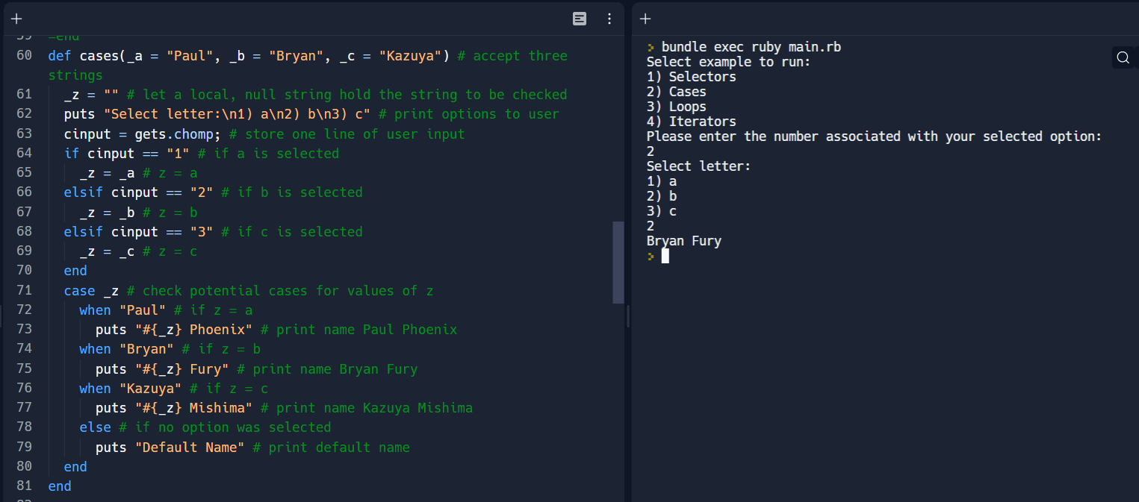
Multiple-Selectors (switch) in Ruby

Slide 9
Comparing the three…
C++
Lua
Ruby
C-Style “switch” statement
Cannot switch with strings, must convert or split them
Default operation built-in
Only primitive data types; means not only no strings but also no data structures
Verbose, requiring many keywords including “break”
No switch statement or equivalent, requires table manipulation
Can operate on strings
No default operation
All data types, but requires making many anonymous functions to process them
Confusing workaround to learn
C-Style “switch” statement like C++, even lighter
Can operate on strings like Lua
Default operation built-in like C++
All data types, no strings attached
Very few keywords involved, by far the easiest and most lightweight of the three

Slide 10
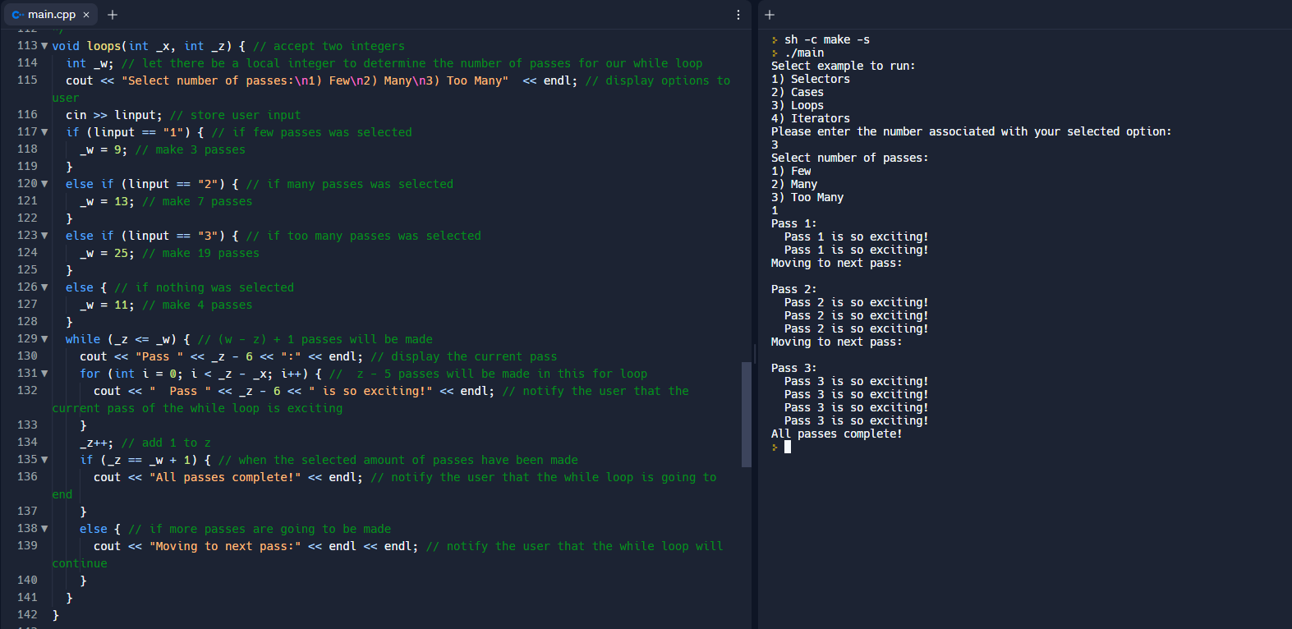
Loops in C++

Slide 11
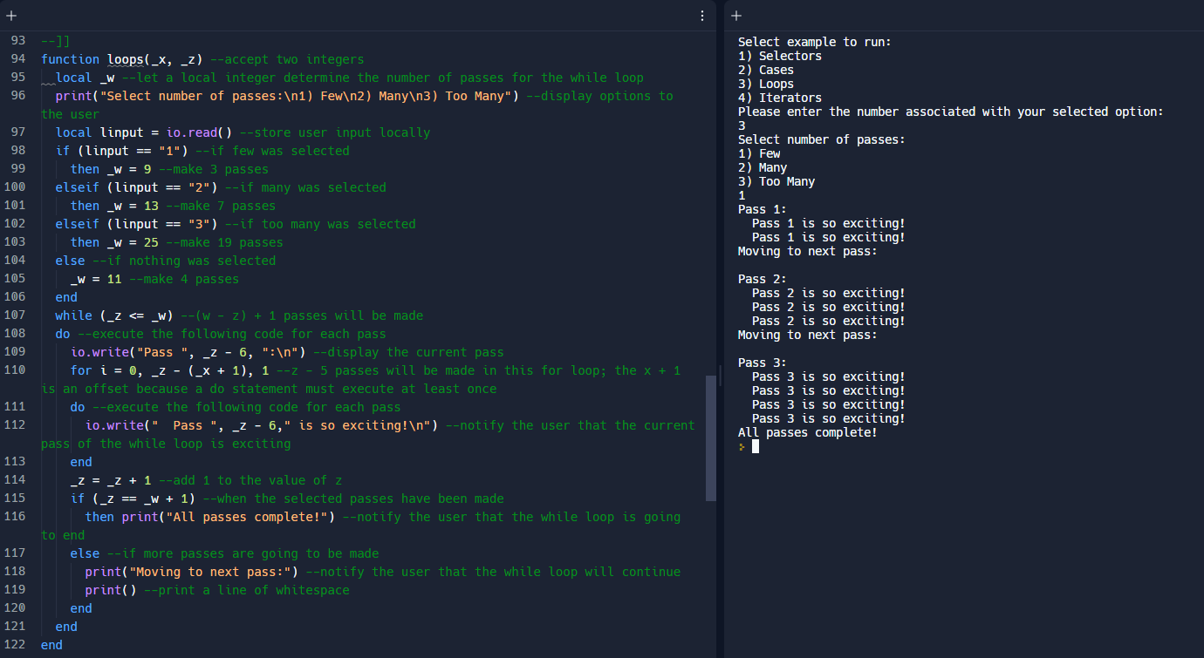
Loops in Lua

Slide 12
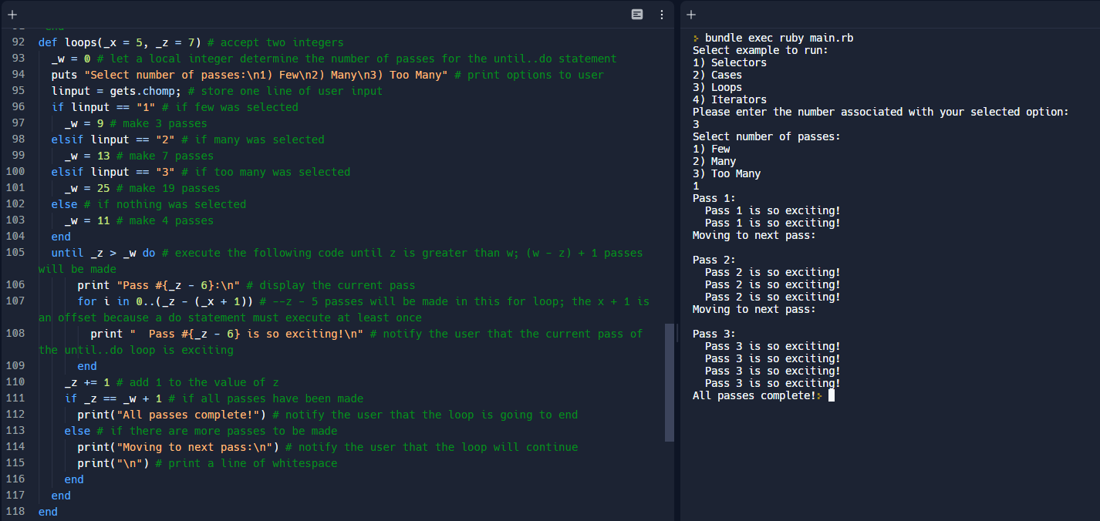
Loops in Ruby

Slide 13
Comparing the three…
C++
Lua
Ruby
Very efficient, light on memory
Highly descriptive conditions, at the cost of readability
Support for nesting, local variables can be declared inside loops
Not many keywords, simply parentheses and brackets
Support for incremental operators (++, --)
Inefficient, “for” loop required to operate at least once
Confusing and unhelpful conditions
Support for nesting just like C++
Laced with “do” and “end” keywords, but no brackets or parentheses
No incremental operators
“for” loop required to operate at least once like Lua
Descriptive but limiting conditions, can’t loop backwards
Support for nesting just like C++
Similar to Lua but “do” keywords aren’t always used, “until” keyword can make while loops more concise
No incremental operators like Lua

Slide 14
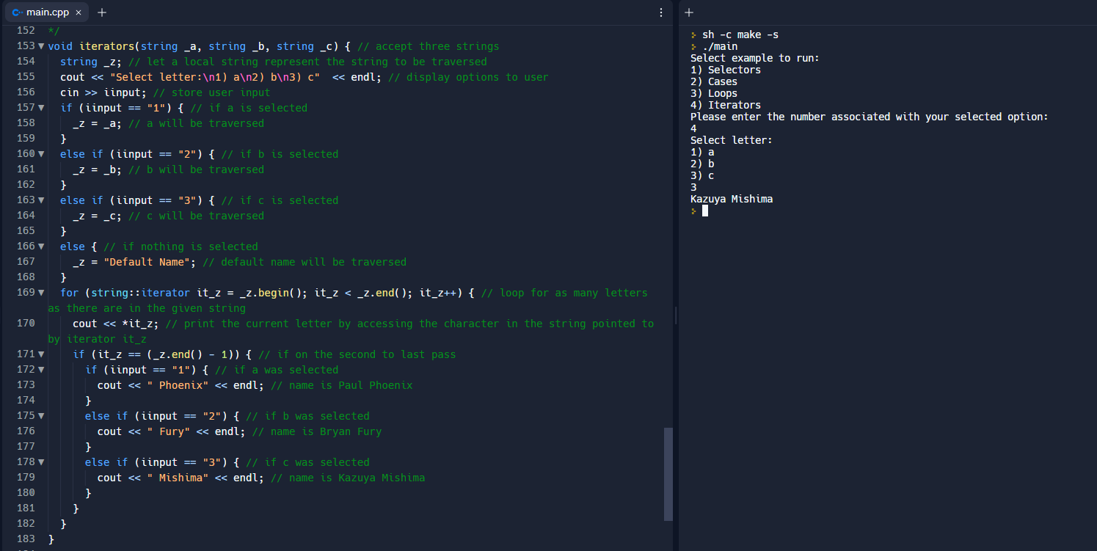
Iterators in C++

Slide 15
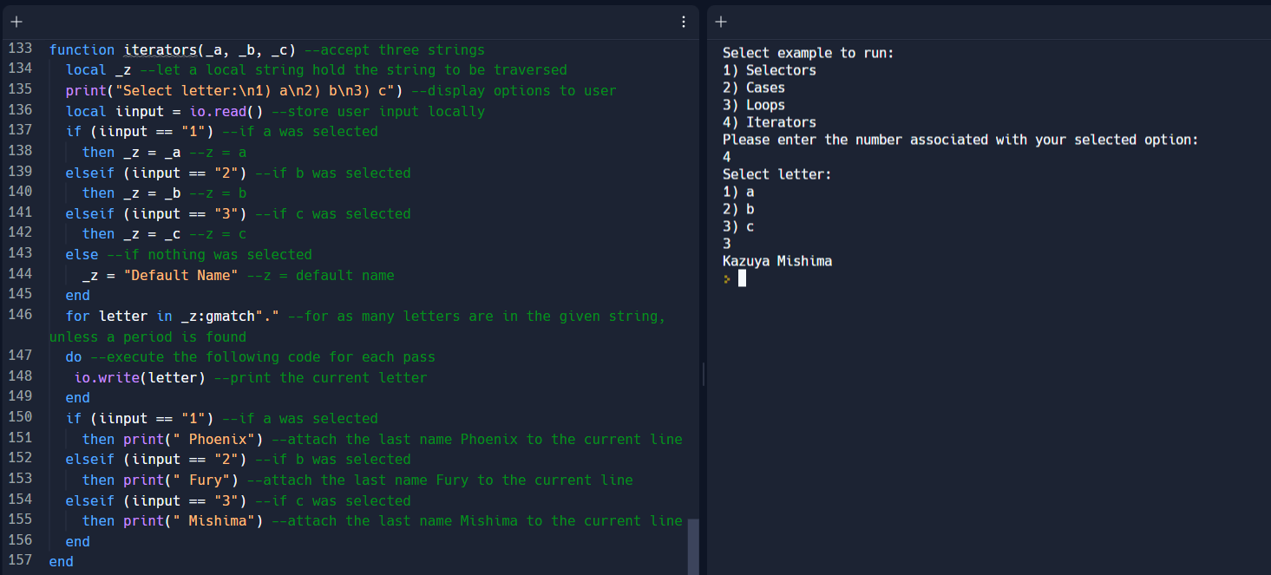
Iterators in Lua

Slide 16
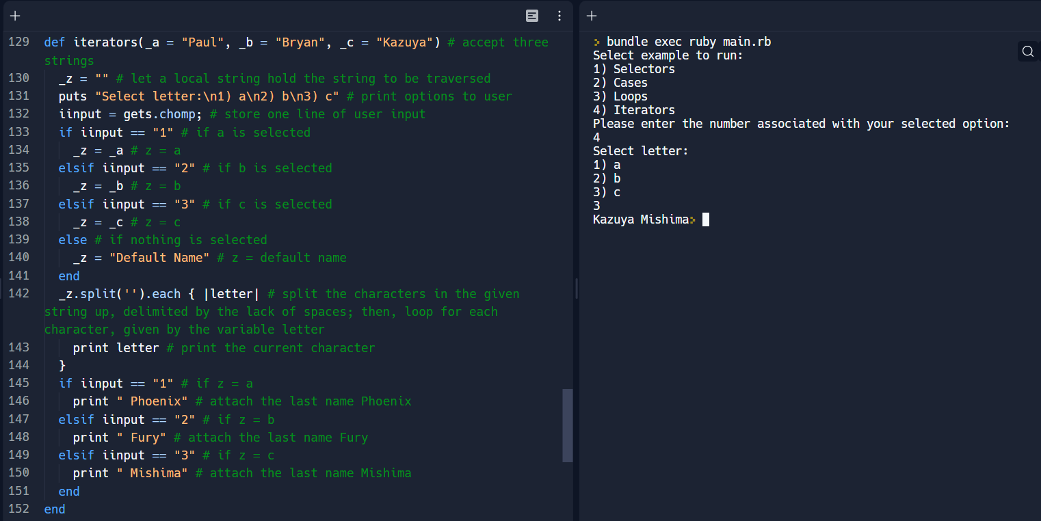
Iterators in Ruby

Slide 17
Comparing the three…
C++
Lua
Ruby
Requires a library to create
Can operate on any kind of collection
Requires some external methods to use on certain structures
Works in tandem with a for loop
Accessed as a pointer to a piece of data in a structure
Easily accessed from built-in method
Can operate on any kind of collection like C++
Built-in methods for everything
Works in tandem with a for loop like C++
Hides pointers from user, simply accessed as a variable
Accessed from built-in method like Lua
Can operate on any kind of collection like C++
Built-in methods for everything like Lua
Can be used in many situations, even chained with other methods
Hides pointers from user like Lua

Slide 18
Conclusions
Lua and Ruby are more similar to each other than either one is to C++, but they both diverge from the C-style in their own ways. Ruby seeks to make things as lightweight as possible by stripping out keywords and punctuation, which puts more impetus on indentation as well as the interpreter. Lua, however, is more focused on being more like a scripting language, so it lacks some important features but includes some very helpful ones for string operations and printing. Ruby seems to be the most efficient and easy to use, not to mention its enormous focus on object-oriented programming, but it has some rather confusing syntactical decisions and missing details that will make refugees from C++ scratch their heads. Lua has significant drawbacks as well, being hard to debug (much like Ruby) as well as devoid of some very basic features expected of any language. C++ is not innocent of this either, though, as its truly neanderthal approach to strings and parsing is almost unacceptable by today’s standards.

