Slide 1
Report on Suicides in India 2001-2012
Presented By :
Sakhil Taneja (43)
Dushyant Kumar Singh(23)
Anurag Yadav(9)
Sachin Gupta(41)
Ankit Sorathi(7)

Slide 2
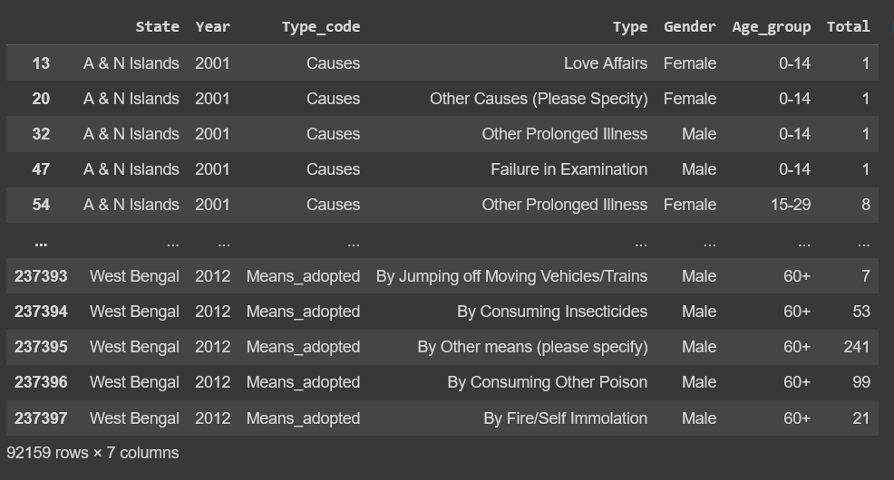
About the Dataset
This data set contains yearly suicide detail of all the states/u.t of India by various parameters from 2001 to 2012.
Parameters:
Suicide causes
Education status
By means adopted
Professional profile
Social status

Slide 3
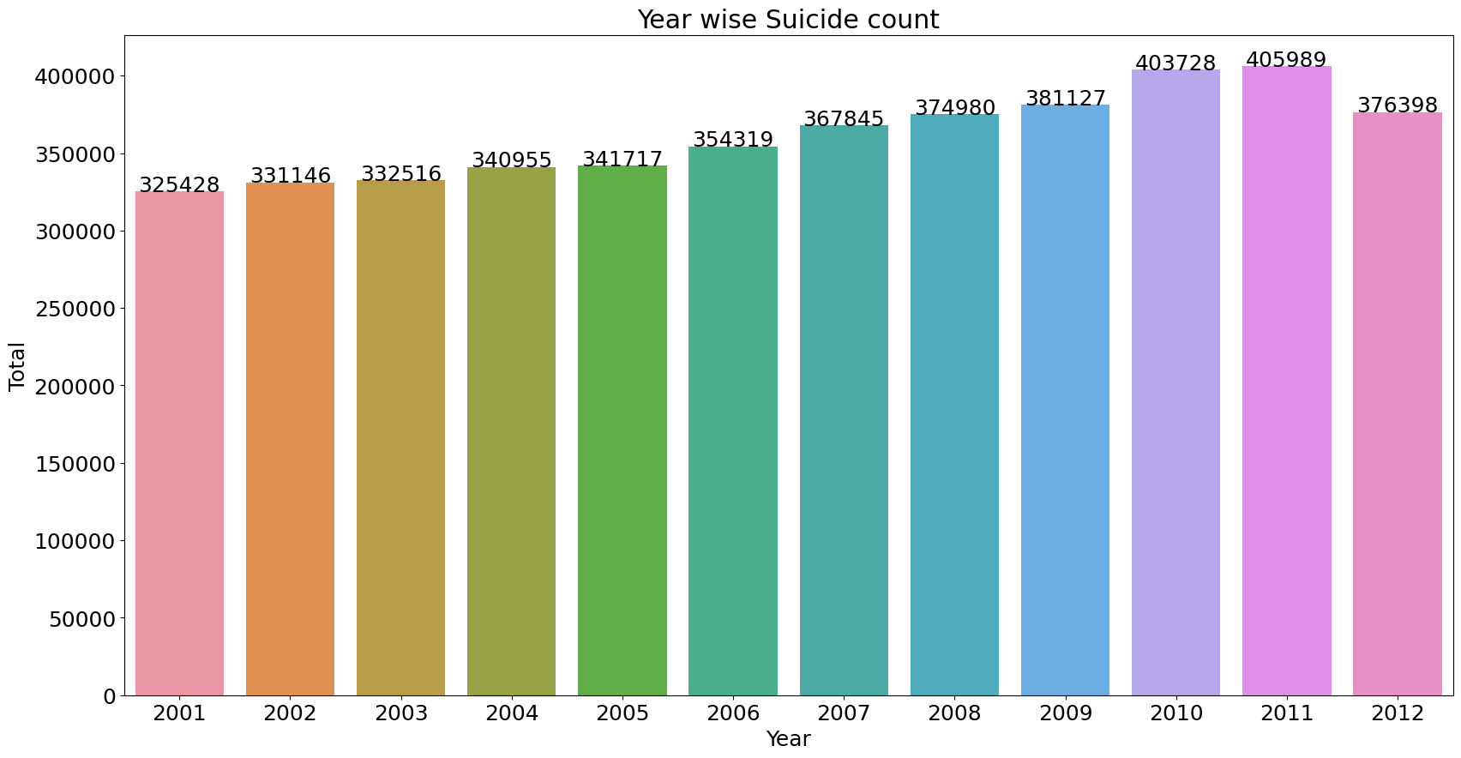
Year Wise Suicide Count
Year 2011 recorded the highest suicide rates (405989)
Yearly Suicide Rate has increased by:
15.66% from Year 2001 – 12
24.76% from Year 2001-11

Slide 4
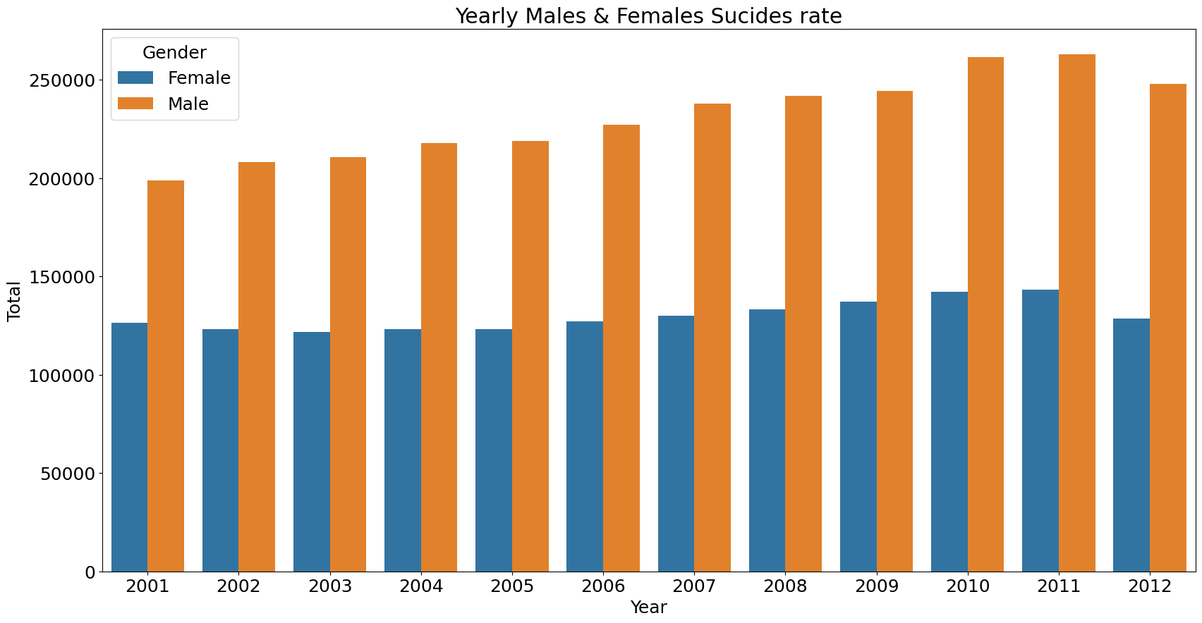
Year wise Male and Female Suicide Count
Men appears to be more vulnerable to suicides

Slide 5
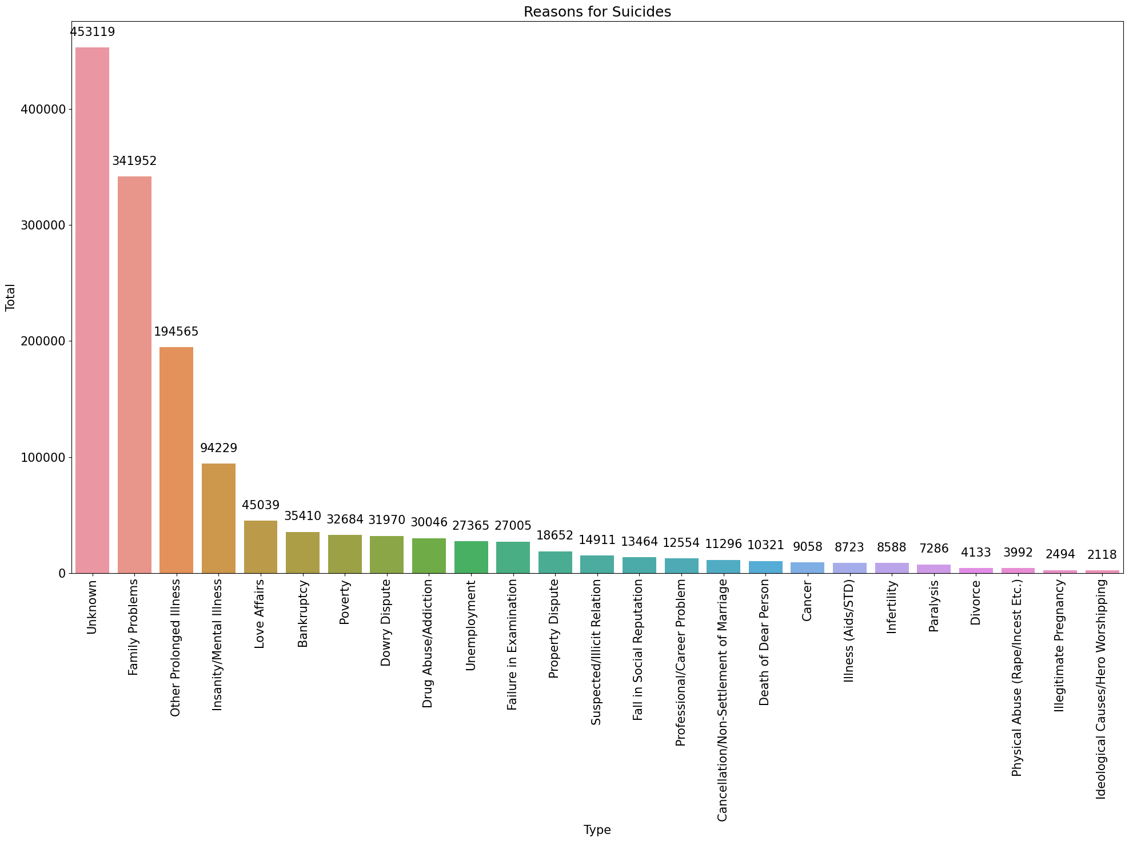
Reasons for Suicide
Family Problems, Illness(Both Physical and Mental) and Love Affairs are on top of the list

Slide 6
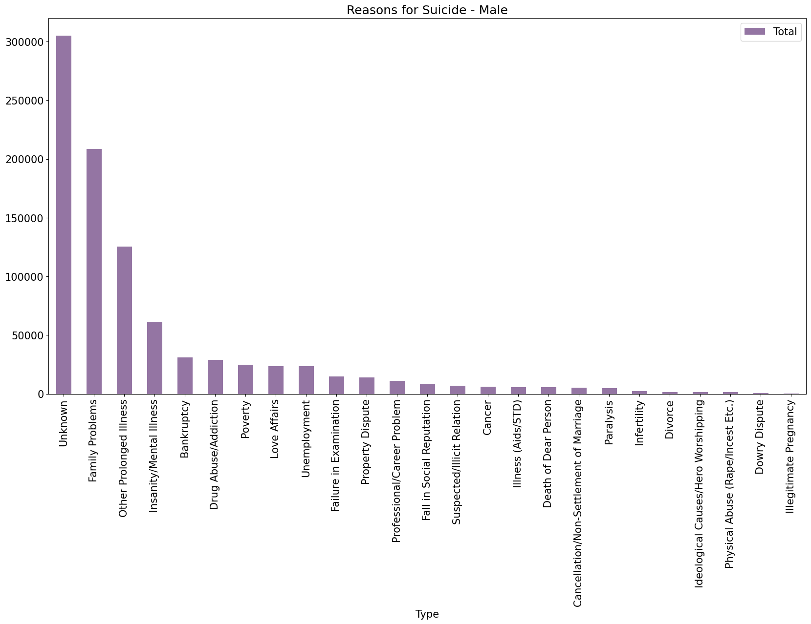
Reasons for Male Suicide
Family Problems, Illness(Both Physical and Mental) are on top of the list

Slide 7
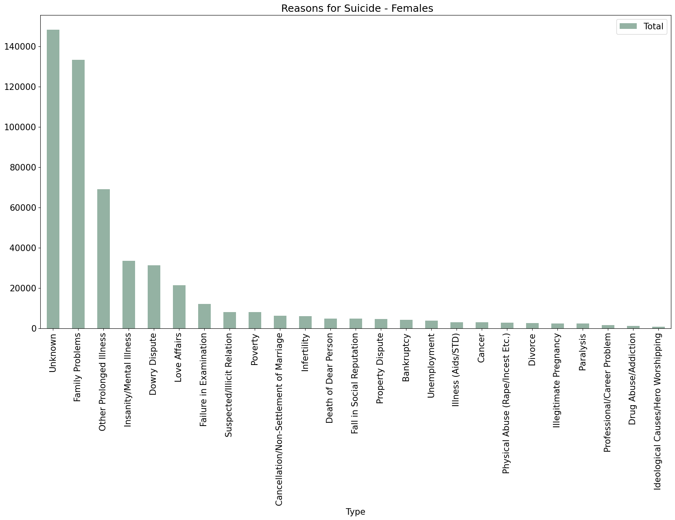
Reasons for Female Suicide
Family Problems, Illness(Both Physical and Mental) and Dowry Disputes are on top of the list

Slide 8
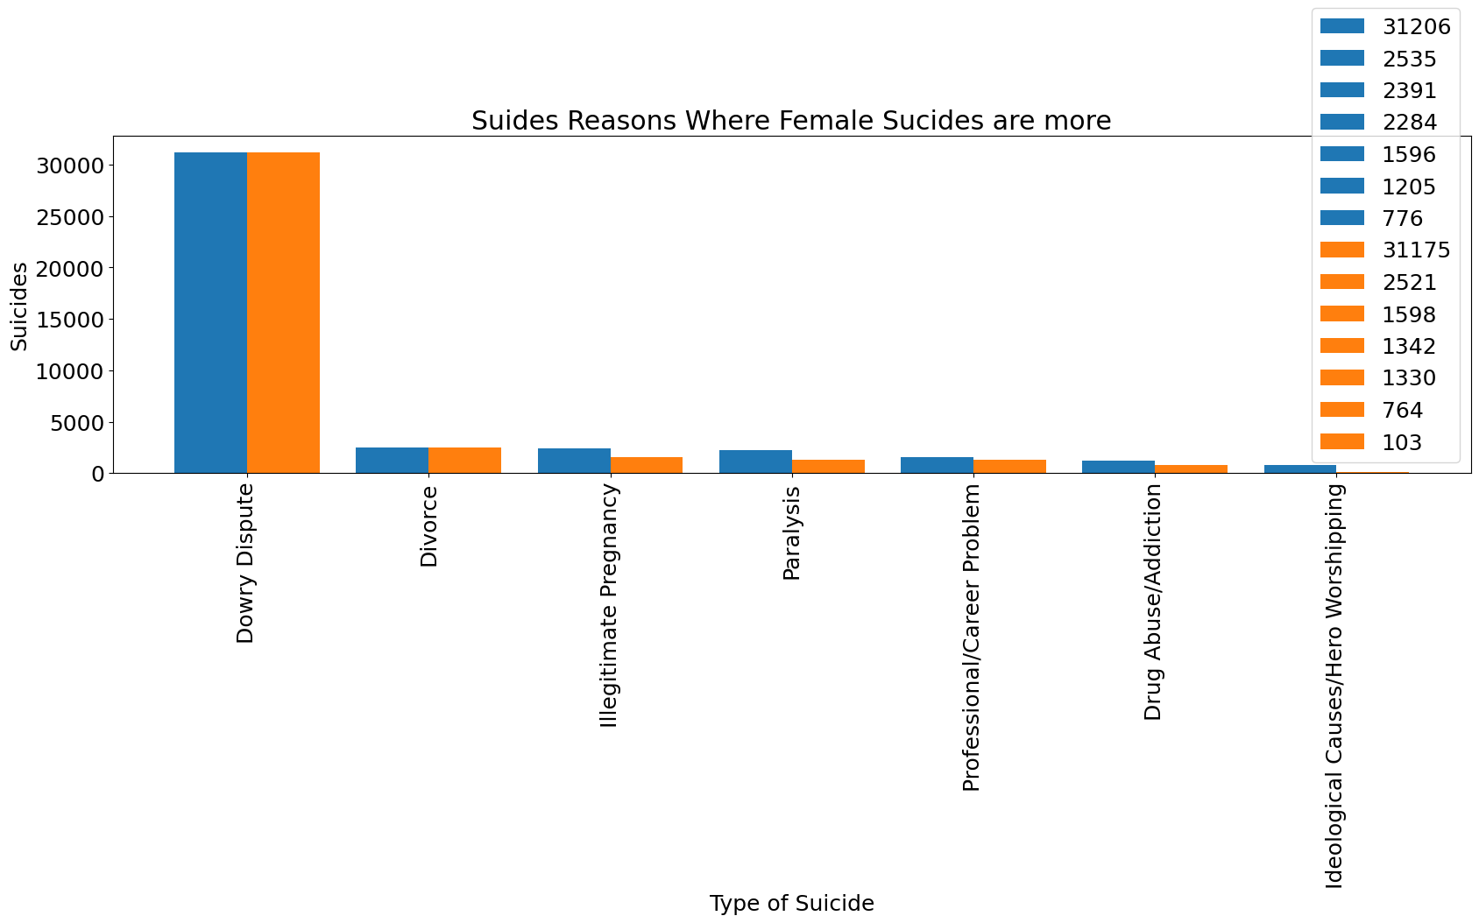
Suicide Reasons where Female Suicides are more
Paralysis is the reason with the highest difference b/w male and female suicides (942)
Dowry Dispute results in equally high no of deaths for both Male and Female

Slide 9
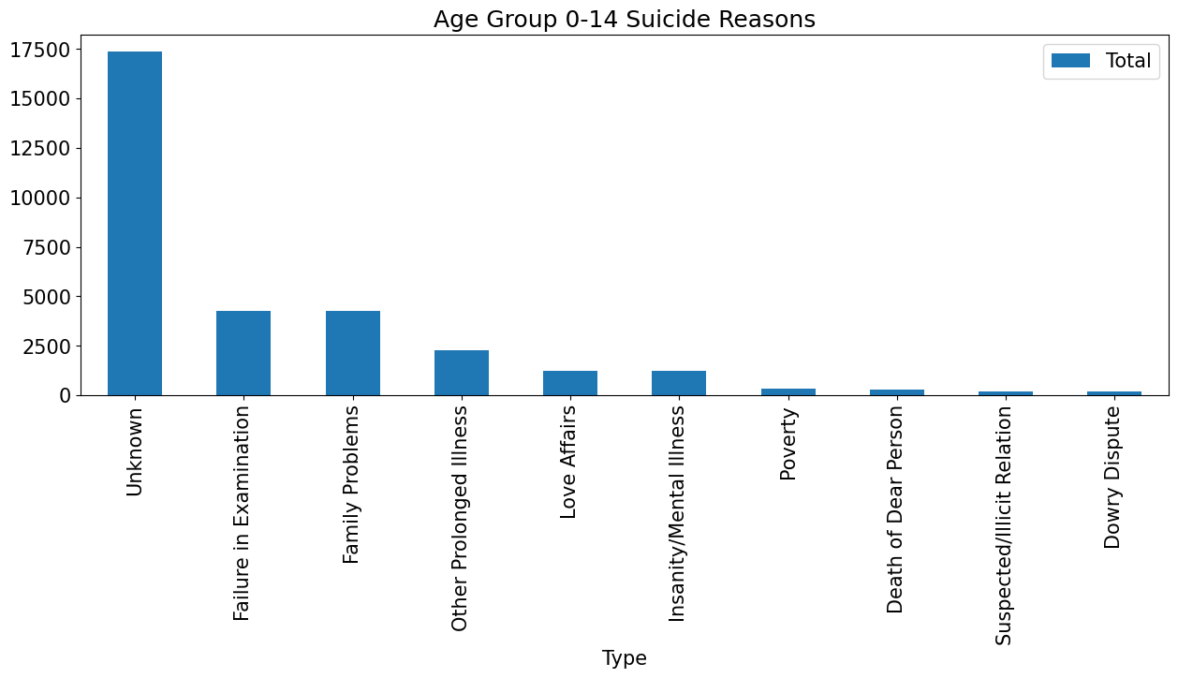
Age Group Based Suicide Reasons

Slide 10
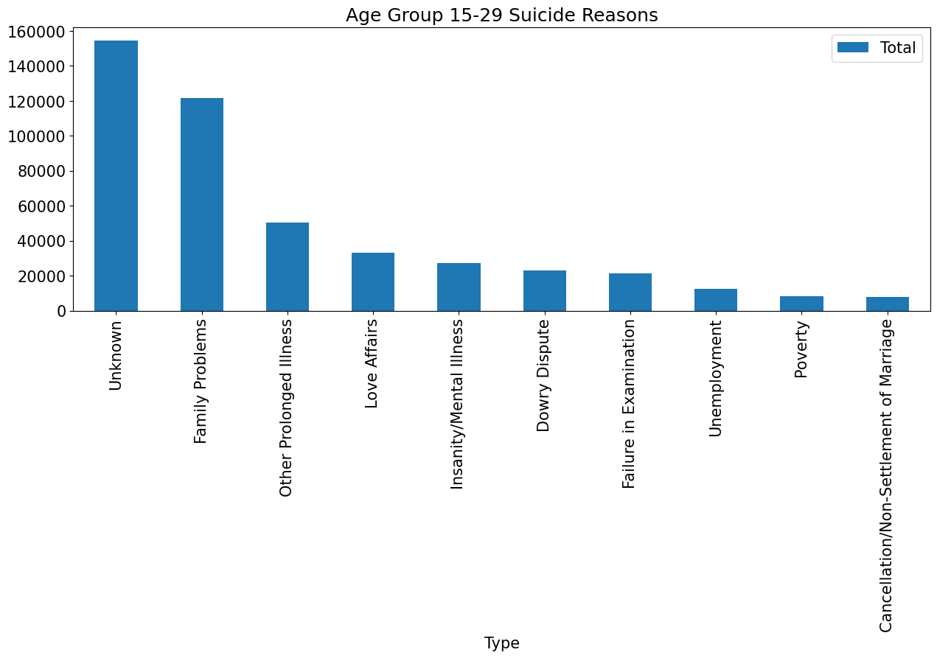
Age Group Based Suicide Reasons (Contd.)

Slide 11
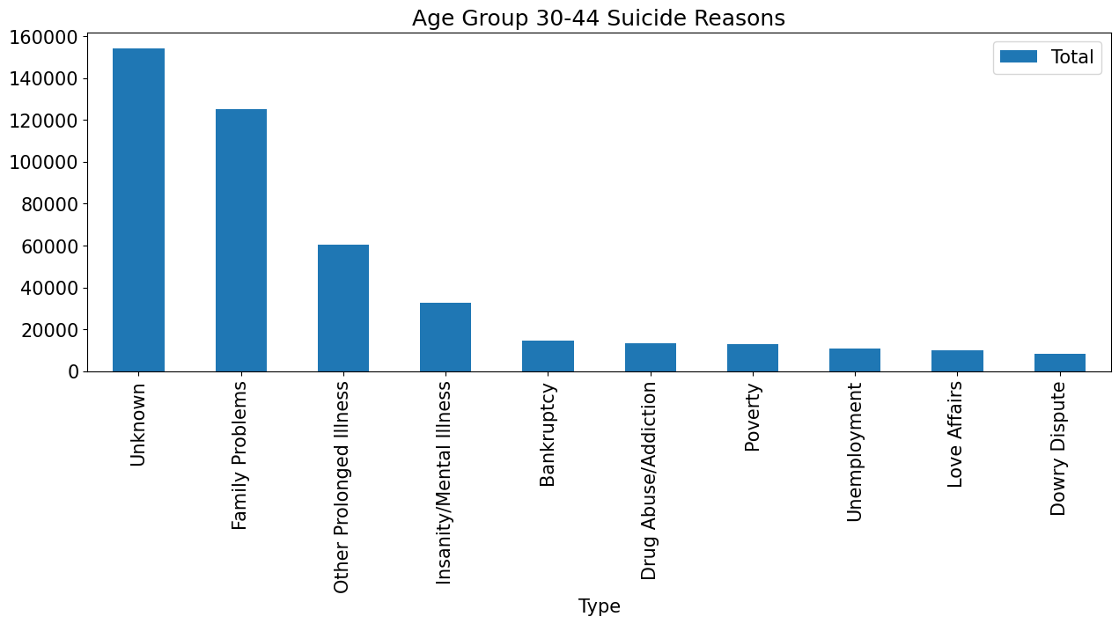
Age Group Based Suicide Reasons (Contd.)

Slide 12
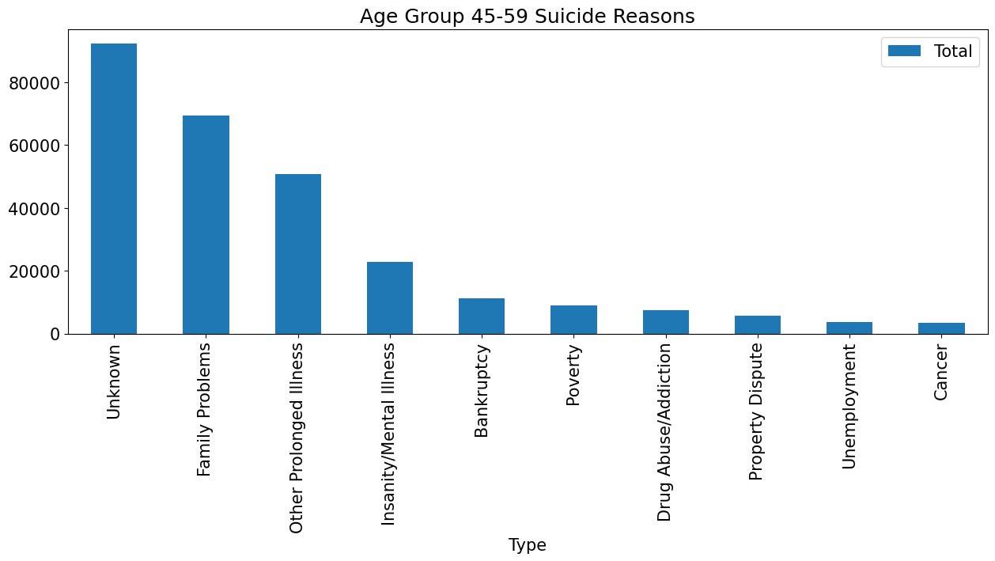
Age Group Based Suicide Reasons (Contd.)

Slide 13
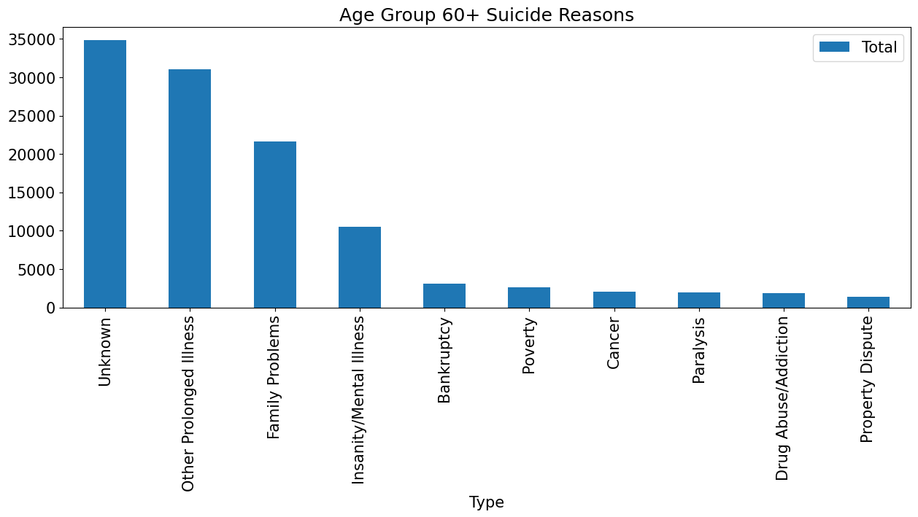
Age Group Based Suicide Reasons (Contd.)

Slide 14
Age Group Based Suicide Reasons (Observations)
Age group 0-14, 15-29 Love affairs is one of the top ten reasons
Age group 0-14 --Failure in Examination is the second Strong reason
Family Problems is the strongest reason in all the age groups
Prolonged illness is the strongest reason for age group Age 60+
In general illness is appearing as the strongest reason irrespective of age group and gender

Slide 15
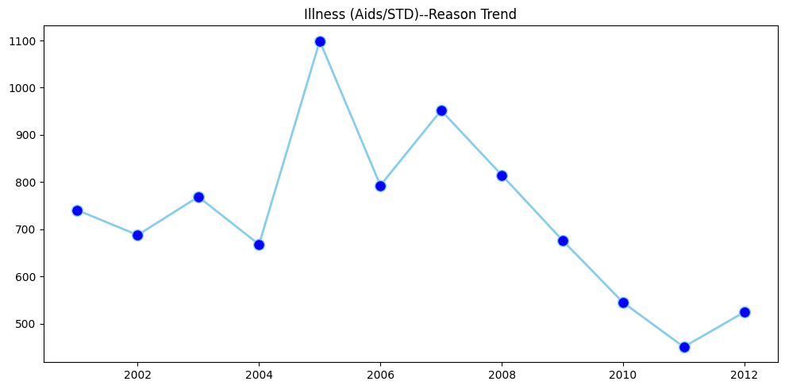
Yearly Suicide based on Type of Cause

Slide 16
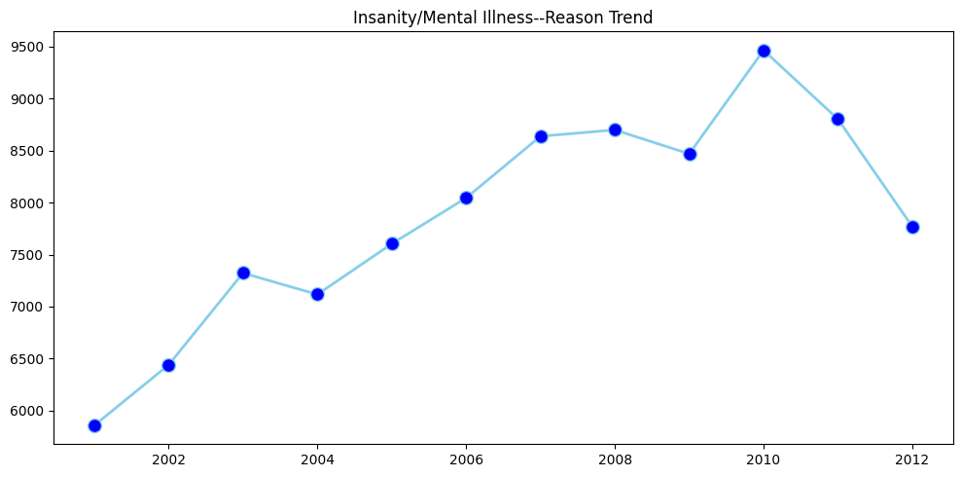
Yearly Suicide based on Type of Cause(Contd.)

Slide 17
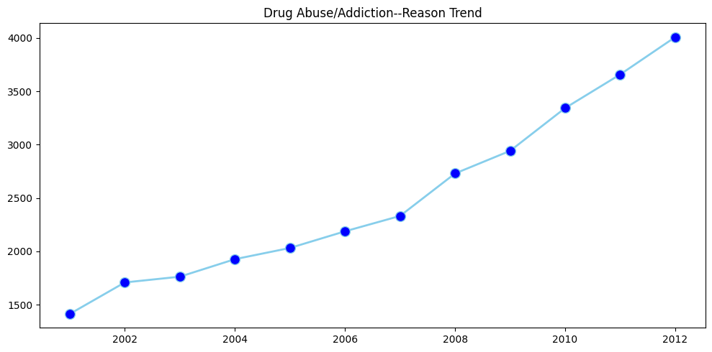
Yearly Suicide based on Type of Cause(Contd.)

Slide 18
Yearly Suicide based on Type of Cause(Observation)
Aids as we can observe from the line plot that deaths from it is decreasing it is due to the fact that over the year the disease has become treatable due to more advances in medical sciences.
Deaths due to drug abuse has been over the rise in the following years, following a general trend over the years, due to various reasons like increase in population and increase in general income of the population.
Deaths due to insanity and mental illness have shown uneven growth over the years ,
https://www.ft.com/content/da86bb36-acf8-11dd-971e-000077b07658
But in some trigger events live 2008 to 2010 financial crisis there has been a spike rise in suicides in india.

Slide 19
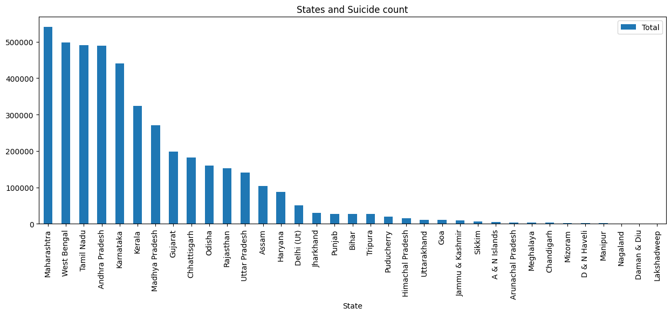
Overall Suicide Count of each State

Slide 20
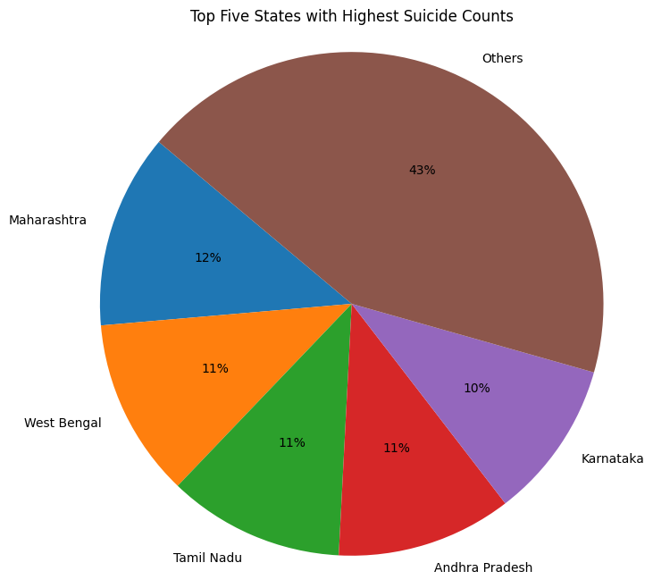
Top 5 States with Highest Suicide Count
Maharashtra - 541167
West Bengal - 497962
Tamil Nadu - 491065
Andhra Pradesh - 488419
Karnataka - 440895

