Slide 1
Sample plugins
Notes:
Show off two XD plugins

Slide 2
PART0 Set-up

Slide 3
http://adobe.ly/xdapi
http://adobe.ly/xdapifeedback
Notes:
Make the links work

Slide 4



Get your text editor ready

Slide 5
Create a new folder
Plugins > Development > Show Develop Folder > Create new folder

Slide 6
Create main.js and manifest.json
Cerate these two files in your favorite text editor
my-first-plugin ├── main.js └── manifest.json
Notes:
Make sure everyone is on the same page

Slide 7
Populate manifest.json
{
"id": "your-unique-id",
"name": "Labs Starter Plugin",
"host": {
"app": "XD",
"minVersion": "21.0"
},
"version": "0.0.1",
"uiEntryPoints": [
{
"type": "menu",
"commandId": "myPluginCommand"
}
]
}
Notes:
Remove label and update the min version to 21.0

Slide 8
Populate main.js
const { Rectangle, Color } = require("scenegraph");
function myPluginCommand(selection) { // Your code goes here }
module.exports = {
commands: {
myPluginCommand
}
};

Slide 9
PART1 Getting started

Slide 10
Create a Rectangle Instance
const shape = new Rectangle();
shape.width = 100;
shape.height = 100;

Slide 11
Color the Rectangle
shape.fill = new Color("#f00");

Slide 12
Place the Rectangle in the Artboard
selection.insertionParent.addChild(shape);

Slide 13
Move the Rectangle
shape.moveInParentCoordinates(100, 100);

Slide 14
PART2 Creating a "button padding” plugin

Slide 15
Place a button around a text
???
OK!
OK!

Slide 16
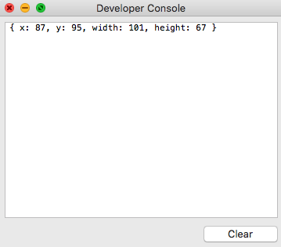
Style the text and get the textBounds
const textNode = selection.items[0];
textNode.textTransform = "uppercase";
const textBounds = textNode.boundsInParent;
Y
X
ok!
height
width
Notes:
Change the quotes

Slide 17
create a Rectangle and set padding ¸
const padding = 30;
const shape = new Rectangle();
shape.width = textBounds.width + 2*padding;
shape.height = textBounds.height + 2*padding;
shape.stroke = new Color("blue");
Padding

Slide 18
Place the Rectangle in the Artboard
selection.insertionParent.addChild(shape);

Slide 19
Place the rectangle on top of the text
shape.placeInParentCoordinates({x: 0, y: 0},
{x: textBounds.x - padding, y: textBounds.y - padding});
Y - padding
X - padding
OK!
Padding

Slide 20
Provide us feedback!
http://adobe.ly/xdapifeedback
Notes:
Put extra samples link to the readme

Slide 21
PART3 Creating a dialog UI

Slide 22
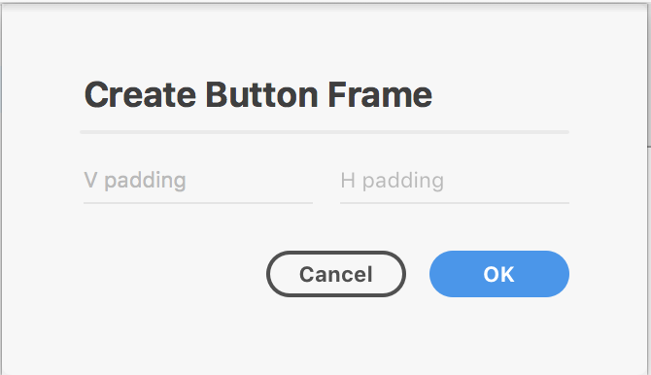
Place a button around a text (UI)
???
OK!
OK!

Slide 23
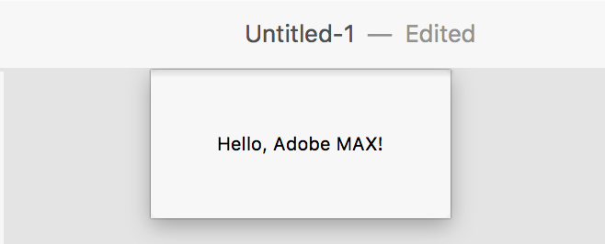
Create a simple dialog
let dialog = document.createElement("dialog");
dialog.innerHTML = "Hello, Adobe MAX!";
document.appendChild(dialog);
return dialog.showModal()

Slide 24
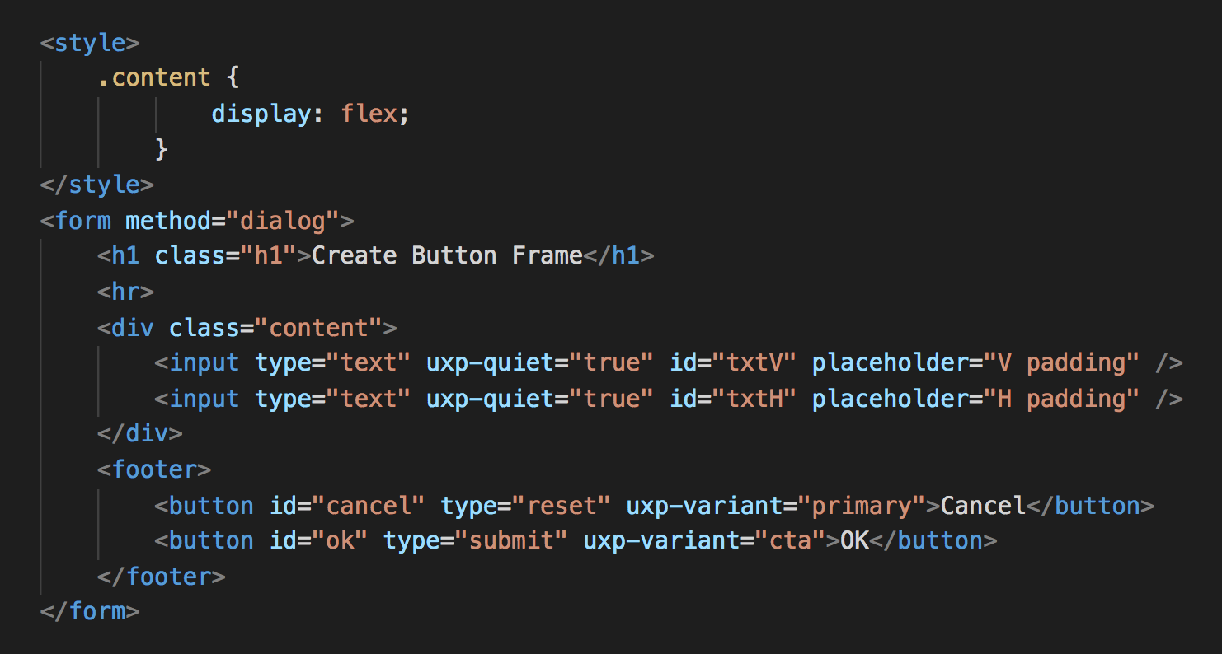
Insert your HTML
let dialog = document.createElement("dialog");
dialog.innerHTML = ”YOUR_HTML_CODE";
document.appendChild(dialog);
return dialog.showModal()

Slide 25
PART4 Putting it all together

Slide 26
PART5 Panel Plugin
https://adobexdplatform.com/plugin-docs/tutorials/quick-start-panel/

Slide 27
Provide us feedback!
Notes:
Put extra samples link to the readme

