Slide 1
AADL, AGREE, and Safety Annex Introduction
Danielle Stewart

Slide 2
Architecture Analysis and Design Language (AADL)
AADL = SAE AS5506 standard
Target: Embedded, real-time, distributed systems
Describes both hardware and software
Extensible syntax
Open source tools, supported by SEI
AADL Goal
Model software and hardware architectures for real-time embedded systems

Slide 3
AADL Model : hierarchy/tree of components
AADL Component : models a software or hardware entity
Can be organized into packages
Has a type/interface and one or more implementations
May have subcomponents
May extend other components
Component Interactions :
Modeled by component connections

Slide 4
AADL Components
Component Type
High level specification of a component : Interface
Has a category to denote :
Software (threads, data, etc.)
Hardware (processor, bus, etc.)
Component Implementation
Internal structure (subcomponents)
Additional or refined properties
Connections

Slide 5

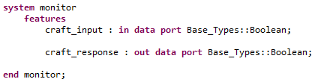
Component Type

Slide 6
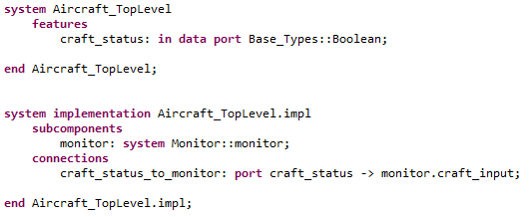
Component Implementation

Slide 7

AGREE: Compositional Reasoning for AADL Models

Slide 8
Monolithic Reasoning
S
Problem: Verification of high level properties on monolithic models does not scale.

Slide 9
Monolithic Reasoning
S
Problem: Verification of high level properties on monolithic models does not scale.

Slide 10

Compositional Reasoning
S
Solution: Prove localized properties at different levels of the hierarchy in order to prove high level properties.
A
$$P_{A}∧P_{B}⇒P_{S}$$
B

Slide 11


Compositional Reasoning
S
Solution: Prove localized properties at different levels of the hierarchy in order to prove high level properties.
A
C
D
$$P_{C}∧P_{D}⇒P_{A}$$
$$P_{E}∧P_{F}⇒P_{B}$$
B
E
F

Slide 12
Assume Guarantee Reasoning
Each component has a contract consisting of assumptions and guarantees
Assumptions: Constraints over what a component expects to see from its environment
Guarantees: Constraints over how a component behaves in response to its environment
The contract of a component abstracts the behavior of its implementation
What to solve?
Check that system assumptions imply component assumptions
Check that component guarantees imply system guarantees
How to solve?
Use a model checker (JKind/Kind)

Slide 13
AGREE Language
Expressions consist of constraints over booleans, integers, and reals
AADL types are interpreted as one of the three.
Constraints can reason about past states of expressions

Slide 14
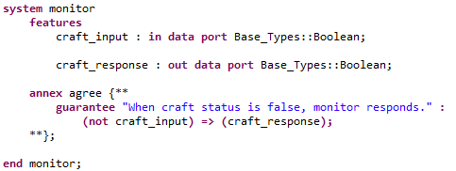
AADL Annex
AGREE syntax is incorporated as an annex of AADL

Slide 15
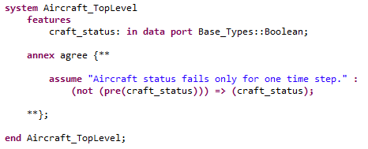
AGREE Language
Top level system: Add assumptions about the inputs from environment

Slide 16
AGREE Language
Mid or lowest level components: Add assumptions about the inputs and guarantees on the outputs

Slide 17
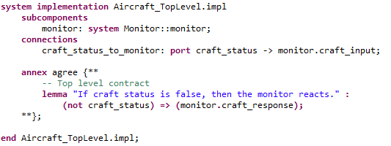
AGREE Language
Top level requirements: Add lemmas that are proven using the lower level guarantees

Slide 18
AGREE Features
Most features provided by Xtext
Syntax highlighting
Code refactoring features
Variable linking
Type Checking
Counterexample Views
Export to spreadsheet
Linking from results to implementation
Counterexample generalization (blame)

Slide 19
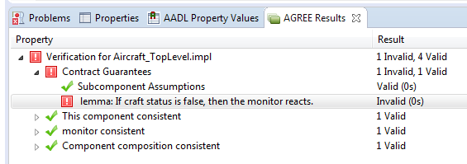
Verification View

Slide 20
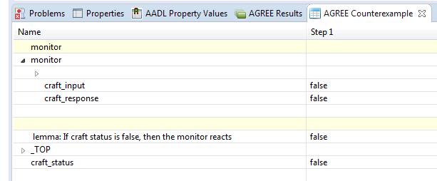
Counterexample View

Slide 21
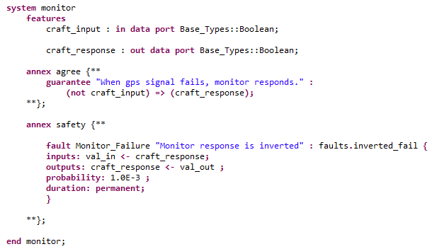
Safety Annex
Safety syntax is incorporated as an annex of AADL

Slide 22
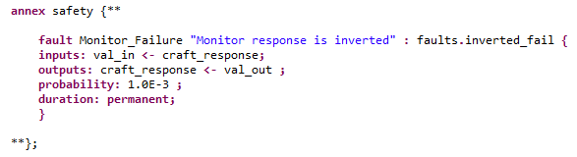
Safety Annex

Slide 23
Safety Annex

Slide 24
Safety Annex

Slide 25
Safety Annex

Slide 26
Safety Annex

Slide 27
Safety Annex

Slide 28
Safety Annex
Nominal system model : AADL + AGREE
Extended system model : AADL + AGREE + Safety Annex

