Slide 1

Architectural Modeling and Analysis for Safety Engineering (AMASE)
Model-based safety analysis of critical systems
Danielle Stewart

Slide 2


Notes:
Safety engineers do most of the analysis activities like fault tree creation manually, based on a lot of informal requirements and design documents. These analyses seem to be quite subjective and highly dependent on the skill and experience of the safety engineers. Thus, it is not surprising that different safety engineers will quite often produce fault trees, which may differ in substantial ways. It is only through a rigorous review process that a concensus will be built on the correct fault tree, which captures the right fault behavior. We think that the review process implicitly consolidates existing information from various documents and then completes it with unspecified details architectural and fault behaviors. It would be great if all these activities would be based off a comprehensive system architecture.
We also observe that due to the complexity of the systems involved, it is possible that the fault trees may not capture involved fault scenarios that may occur due to complex interactions between components.

Slide 3
Master in Mathematik : 2015
Doktorarbeit in Informatik : Universität von Minnesota
Notes:
Safety engineers do most of the analysis activities like fault tree creation manually, based on a lot of informal requirements and design documents. These analyses seem to be quite subjective and highly dependent on the skill and experience of the safety engineers. Thus, it is not surprising that different safety engineers will quite often produce fault trees, which may differ in substantial ways. It is only through a rigorous review process that a concensus will be built on the correct fault tree, which captures the right fault behavior. We think that the review process implicitly consolidates existing information from various documents and then completes it with unspecified details architectural and fault behaviors. It would be great if all these activities would be based off a comprehensive system architecture.
We also observe that due to the complexity of the systems involved, it is possible that the fault trees may not capture involved fault scenarios that may occur due to complex interactions between components.

Slide 4

Motivation
Requirements and
Design Documents
Safety
Analyst A
Safety
Analyst B
System Safety Analysis is
- Based on Informal Specifications
- Highly Dependent on Skill of the Analyst
Notes:
Safety engineers do most of the analysis activities like fault tree creation manually, based on a lot of informal requirements and design documents. These analyses seem to be quite subjective and highly dependent on the skill and experience of the safety engineers. Thus, it is not surprising that different safety engineers will quite often produce fault trees, which may differ in substantial ways. It is only through a rigorous review process that a concensus will be built on the correct fault tree, which captures the right fault behavior. We think that the review process implicitly consolidates existing information from various documents and then completes it with unspecified details architectural and fault behaviors. It would be great if all these activities would be based off a comprehensive system architecture.
We also observe that due to the complexity of the systems involved, it is possible that the fault trees may not capture involved fault scenarios that may occur due to complex interactions between components.

Slide 5
Model-Based Development
Why Not the
Safety Analysis?
We Base the Entire
Development Cycle
Around the Model

Slide 6
Model-Based Safety Analysis
Wheel Braking System
AIR6110
CONTIGUOUS AIRCRAFT/SYSTEM DEVELOPMENT PROCESS EXAMPLE
Green Pump
Blue Pump
Isolation Valve
Isolation Valve
Power A
Pedal 1
System
A
Selector Valve
Shut
Plant
Normal
N
A
Accumulator
Feed back
System
O
L
Valve
R
T
M
E
Accumulator
Pedal 2
System
B
A
R
Pump
Power B
L
N
AntiSkid
A
Meter
Command
T
Valve
Mechanical
Braking
+
Meter
E
Pedal
Fault Tolerant
AntiSkid
Valve
Meter
Braking System
Command
Valve
Control Unit
Plant
( BSCU )
Model
Model the Digital Controller Architecture
and the Physical System
Add Fault Model for Physical System
and Digital Controller Architecture
Integrates System and Safety Engineering About a Common Model
Automation Enables “What-If” Consideration of System Designs
Notes:
Steve’s slide

Slide 7
Nominal Model
Notes:
Maybe remove, check on other agree slides

Slide 8
Creation of Nominal System Model
Model of the Digital System
Power A
Verify safety properties of the nominal digital system
Pedal 1
System
A
Plant
Feed back
Pedal 2
System
B
Green Pump
Blue Pump
Power B
Isolation Valve
Isolation Valve
Fault Tolerant
Power A
Braking System
Control Unit
Pedal 1
Selector Valve
( BSCU )
Shut
Plant
Normal
N
A
Accumulator
Feed back
System
O
L
Valve
Verify safety properties of the nominal mechanical system
R
T
M
E
Accumulator
Pedal 2
System
B
A
R
Pump
Power B
L
N
AntiSkid
A
Meter
Command
T
Valve
Mechanical
Braking
E
Pedal
Fault Tolerant
+
Meter
Meter
Braking System
AntiSkid
Valve
Valve
Control Unit
Command
Plant
( BSCU )
Model
Model of the Digital System +
Model of the Mechanical System

Slide 9
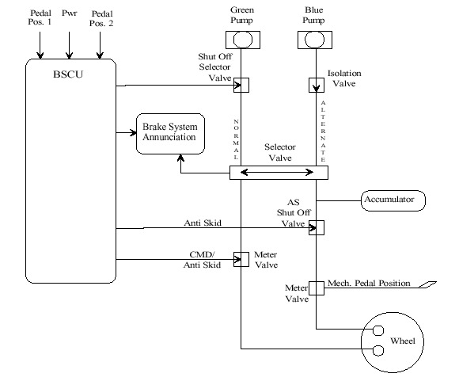
Wheel Brake System

Slide 10
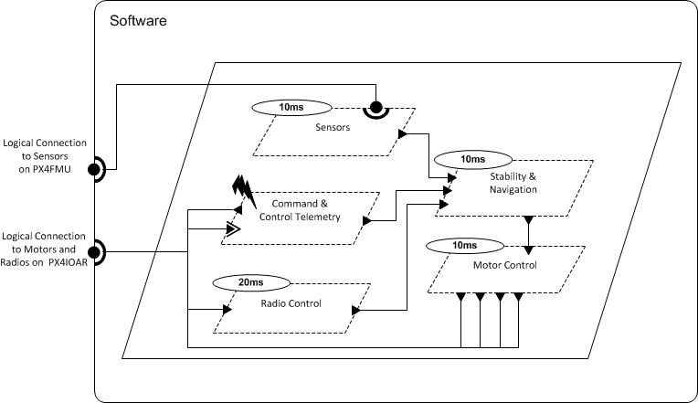
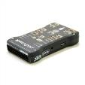

Architecture Analysis and Design Language (AADL)
AADL = SAE AS5506 standard
Target: Embedded, real-time, distributed systems
Describes both hardware and software
Extensible syntax (annex)
Open source tools, supported by SEI

Slide 11
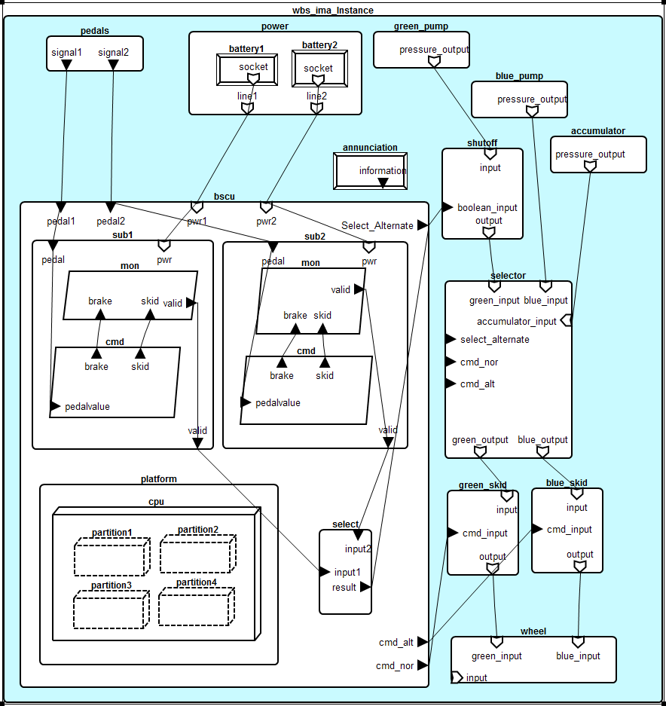
WBS AADL Model

Slide 12
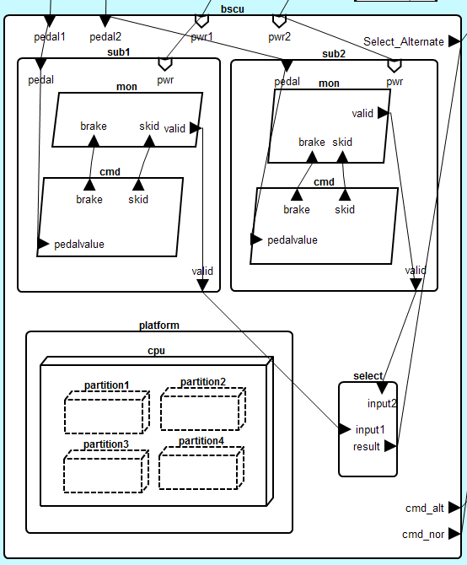

Slide 13
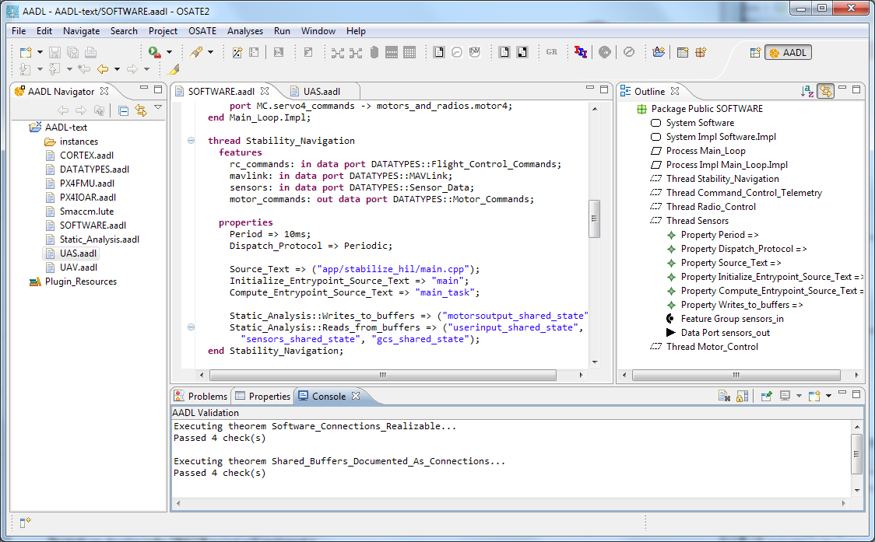


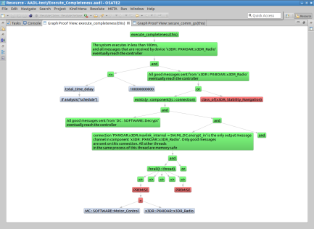
Architecture Modeling and Analysis Tools
Resolute
OSATE
AGREE
Trusted
Build
SIM
TCG
Architecture Models
Architecture Translation
Architecture Analysis
A
C
Assumption: Input < 20
Guarantee: Output < 2*Input
Assumption: none
Guarantee: Output = Input1 + Input2
B
seL4
Assumption: Input < 20
Guarantee: Output < Input + 15
Assumption: Input < 10
Guarantee: Output < 50
eChronos
VxWorks
Kind/JKind
Model Checker
Notes:
START AGREE HERE

Slide 14
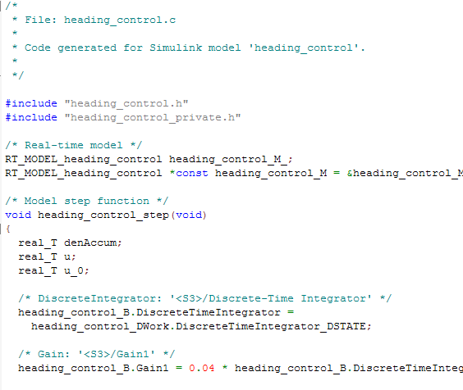
AGREE: Assume Guarantee Reasoning Environment
contract
contract
contract
Each component has a contract consisting of assumptions and guarantees
Assumptions: Constraints over what a component expects from its environment
Guarantees: Constraints over how a component behaves in response to its environment (requirements)
The contract of a component abstracts the behavior of its implementation
AGREE analysis
contract
contract
contract
contract
Component
Implementation

Slide 15



Compositional Verification of Critical Systems
Compositional verification tool for analysis of AADL system models
AGREE: Assume-Guarantee Reasoning Environment
Focus on system safety properties
Compositional approach scales model checking to larger systems
Example system: Quad-redundant flight control system provided by NASA
FCC
FCC
A
C
FCC
FCC
Assumption: Input < 20
Guarantee: Output < 2*Input
Assumption: none
Guarantee: Output = Input1 + Input2
AFDX or
TTE
Switch
AFDX or
TTE
Switch
B
Assumption: Input < 20
Guarantee: Output < Input + 15
Assumption: Input < 10
Guarantee: Output < 50
DaC
DaC
DaC
DaC

Slide 16
Compositional Verification of Critical Systems
Compositional verification tool for analysis of AADL system models
AGREE: Assume-Guarantee Reasoning Environment
Focus on system safety properties
Compositional approach scales model checking to larger systems
Example system: Quad-redundant flight control system provided by NASA
FCC
FCC
A
C
FCC
FCC
Assumption: Input < 20
Guarantee: Output < 2*Input
Assumption: none
Guarantee: Output = Input1 + Input2
AFDX or
TTE
Switch
AFDX or
TTE
Switch
B
Assumption: Input < 20
Guarantee: Output < Input + 15
Assumption: Input < 10
Guarantee: Output < 50
DaC
DaC
DaC
DaC

Slide 17
Compositional Verification of Critical Systems
Compositional verification tool for analysis of AADL system models
AGREE: Assume-Guarantee Reasoning Environment
Focus on system safety properties
Compositional approach scales model checking to larger systems
Example system: Quad-redundant flight control system provided by NASA
FCC
FCC
A
C
FCC
FCC
Assumption: Input < 20
Guarantee: Output < 2*Input
Assumption: none
Guarantee: Output = Input1 + Input2
AFDX or
TTE
Switch
AFDX or
TTE
Switch
B
Assumption: Input < 20
Guarantee: Output < Input + 15
Assumption: Input < 10
Guarantee: Output < 50
DaC
DaC
DaC
DaC

Slide 18
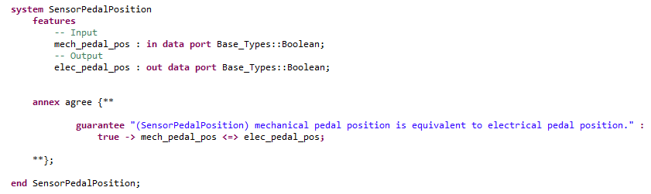
Notes:
Maybe remove, check on other agree slides

Slide 19
Fault Model
Notes:
Maybe remove, check on other agree slides

Slide 20
Wrap nominal component in fault
Watch behavior of system through AGREE contracts

Slide 21
Component A
Component B
Out
In
Nominal Behavior:
Component A
Component B
Out
Fault
In
Fault Behavior:

Slide 22
WBS : No inadvertent braking
Normal Operating Mode:
Mechanical pedal pressed (brakes commanded)
Sensor on pedal converts to electrical signal
Signal sent to BSCU to command brakes

Slide 23
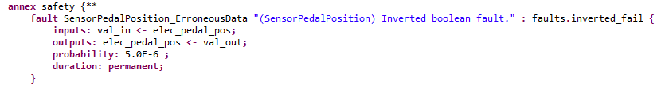
A Fault on the Pedal Sensor Component

Slide 24
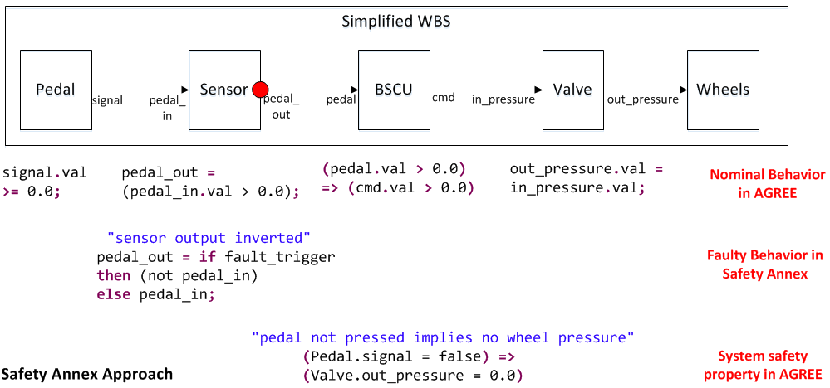
Behavioral Fault Propagation

Slide 25
Active Sensor Fault
Mechanical pedal is not pressed
Inverted Boolean failure on sensor activated
Electrical signal is true and braking is commanded through BSCU
Top level lemma fails (Unintentional braking occurs)

Slide 26
Current Support
Maximum number of faults
Probabilistic analysis
Hardware and software faults

Slide 27
Future Work
Fault Tree Generation
Transient Faults

