Slide 1


The Safety Annex for AADL and the Safety Assessment Process
Model-based safety analysis of highly complex safety critical systems
University of Minnesota
Danielle Stewart

Slide 2
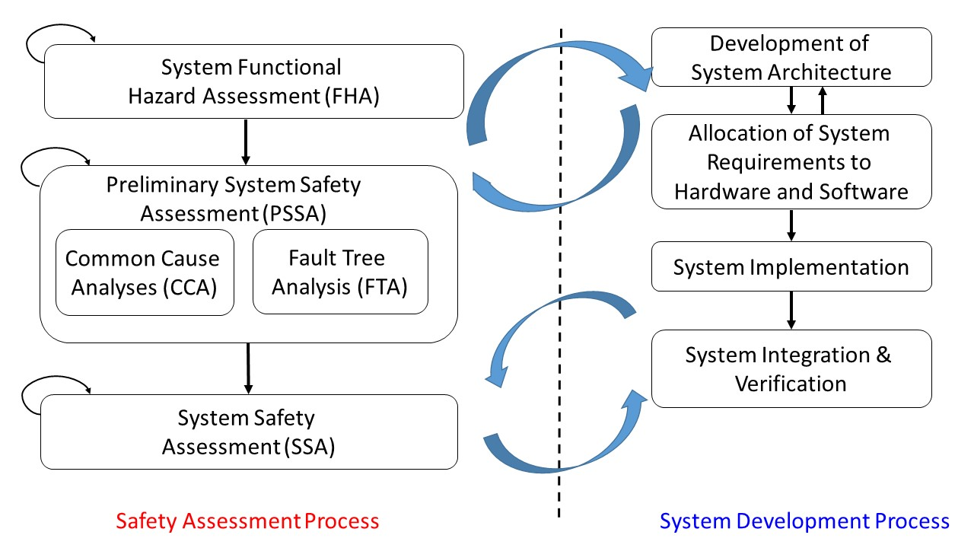

Traditional Safety Assessment Process
System engineers develop architecture and related documentation (signal flow diagrams, etc.)
Safety Analysts use this information to develop hazard (FHA) and safety assessments (PSSA)
Given safety assessment findings, changes to the architecture are proposed.
Notes:
This figure presents our proposed use of this shared system design and safety analysis
model in the context of the ARP4754A Safety Assessment Process Model (derived from
Figure 7 of ARP4754A). The shared model is one of the system development artifacts
from the “Development of System Architecture” and “Allocation of System Requirements
to Item” activities in the System Development Process, which interacts with the
PSSAs and SSAs activities in the Safety Assessment Process. The shared model can
serve as an interface to capture the information from the system design and implementation
that is relevant for the safety analysis.

Slide 3
Traditional Safety Assessment Process
Problems with the traditional approach:
Architectural details about the system behavior gathered from multiple sources
Investigation typically stops at system level, software function details largely unexplored
Lack of precise models of the system architecture and its failure modes
Changes can be made in the system architecture that are not reflected in the safety assessment
Notes:
This figure presents our proposed use of this shared system design and safety analysis
model in the context of the ARP4754A Safety Assessment Process Model (derived from
Figure 7 of ARP4754A). The shared model is one of the system development artifacts
from the “Development of System Architecture” and “Allocation of System Requirements
to Item” activities in the System Development Process, which interacts with the
PSSAs and SSAs activities in the Safety Assessment Process. The shared model can
serve as an interface to capture the information from the system design and implementation
that is relevant for the safety analysis.

Slide 4
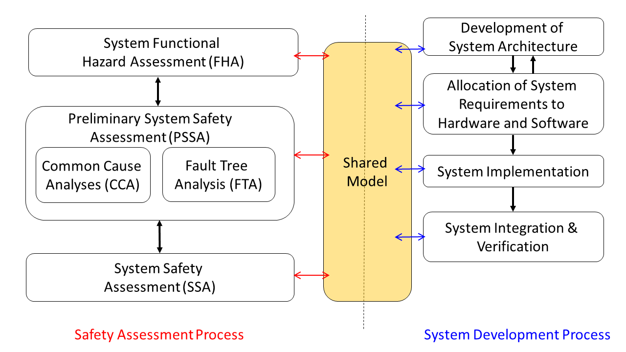
Model Based Safety Assessment Process
Use single unified model to support both system design and safety analysis
Notes:
This figure presents our proposed use of this shared system design and safety analysis
model in the context of the ARP4754A Safety Assessment Process Model (derived from
Figure 7 of ARP4754A). The shared model is one of the system development artifacts
from the “Development of System Architecture” and “Allocation of System Requirements
to Item” activities in the System Development Process, which interacts with the
PSSAs and SSAs activities in the Safety Assessment Process. The shared model can
serve as an interface to capture the information from the system design and implementation
that is relevant for the safety analysis.

Slide 5
Model Based Safety Assessment Process Steps
Safety Engineers
System Engineers
Check that safety requirements are satisfied by the nominal design model with the backend model checker
Capture Design Information in a shared AADL/AGREE model (architecture, nominal behavior, system level safety requirements)
Augment the nominal model with the component failure modes
Specify the fault hypothesis for the analysis
Analyze if the safety requirements are satisfied by the design in the presence of faults with the backend model checker, using counterexamples and minimal cut sets produced for diagnosis
Examine the results to assess the validity of the fault combinations and the fault tolerance level of the system design
Drive for design change
Notes:
This figure presents our proposed use of this shared system design and safety analysis
model in the context of the ARP4754A Safety Assessment Process Model (derived from
Figure 7 of ARP4754A). The shared model is one of the system development artifacts
from the “Development of System Architecture” and “Allocation of System Requirements
to Item” activities in the System Development Process, which interacts with the
PSSAs and SSAs activities in the Safety Assessment Process. The shared model can
serve as an interface to capture the information from the system design and implementation
that is relevant for the safety analysis.

Slide 6
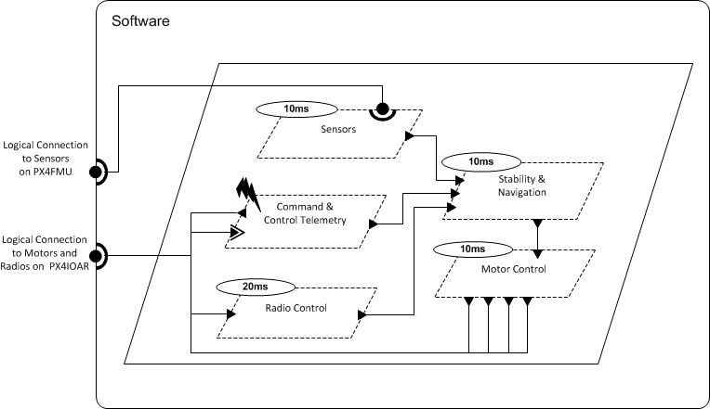
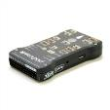

Architecture Analysis and Design Language (AADL)
AADL = SAE AS5506 standard
Target: Embedded, real-time, distributed systems
Describes both hardware and software
Extensible syntax (annex)
Open source tools, supported by SEI

Slide 7
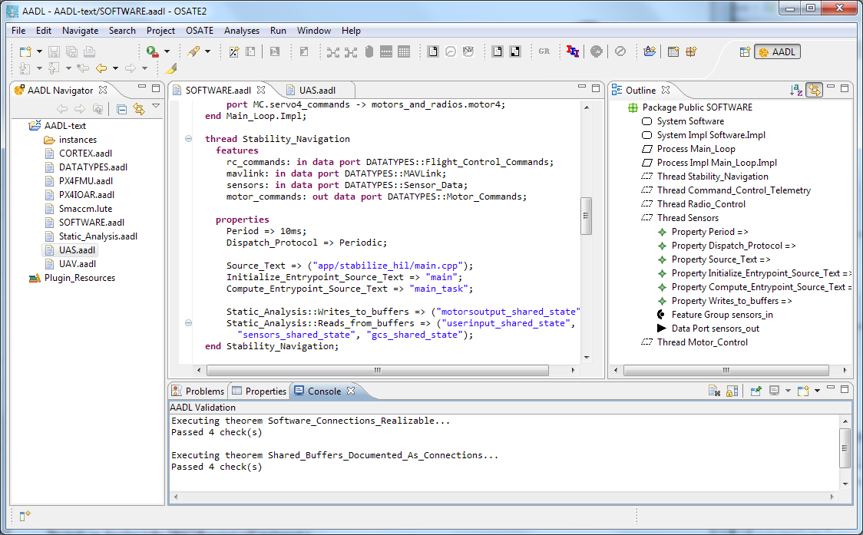


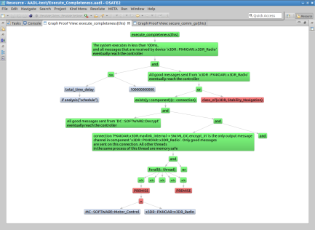
Architecture Modeling and Analysis Tools
Resolute
OSATE
AGREE
Trusted
Build
SIM
TCG
Architecture Models
Architecture Translation
Architecture Analysis
A
C
Assumption: Input < 20
Guarantee: Output < 2*Input
Assumption: none
Guarantee: Output = Input1 + Input2
B
seL4
Assumption: Input < 20
Guarantee: Output < Input + 15
Assumption: Input < 10
Guarantee: Output < 50
eChronos
VxWorks
Kind/JKind
Model Checker
Notes:
START AGREE HERE

Slide 8



Compositional Verification of Critical Systems
Compositional verification tool for analysis of AADL system models
AGREE: Assume-Guarantee Reasoning Environment
Focus on system safety properties
Compositional approach scales model checking to larger systems
Example system: Quad-redundant flight control system provided by NASA
FCC
FCC
A
C
FCC
FCC
Assumption: Input < 20
Guarantee: Output < 2*Input
Assumption: none
Guarantee: Output = Input1 + Input2
AFDX or
TTE
Switch
AFDX or
TTE
Switch
B
Assumption: Input < 20
Guarantee: Output < Input + 15
Assumption: Input < 10
Guarantee: Output < 50
DaC
DaC
DaC
DaC

Slide 9
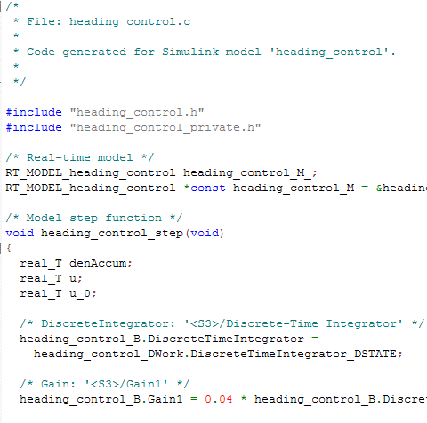
AGREE: Assume Guarantee Reasoning Environment
contract
contract
contract
Each component has a contract consisting of assumptions and guarantees
Assumptions: Constraints over what a component expects from its environment
Guarantees: Constraints over how a component behaves in response to its environment (requirements)
AGREE analysis
contract
contract
contract
contract
Component
Implementation

Slide 10
Safety Annex for AADL
Define faults on component output
Behavioral propagation through AGREE contracts
Independence or dependence between faults can be captured
Generates output such as:
Counterexamples showing active faults and how they propagate
Probabilistic analysis using a probability threshold
Minimal Cut Sets in terms of cardinality or probability
Notes:
This figure presents our proposed use of this shared system design and safety analysis
model in the context of the ARP4754A Safety Assessment Process Model (derived from
Figure 7 of ARP4754A). The shared model is one of the system development artifacts
from the “Development of System Architecture” and “Allocation of System Requirements
to Item” activities in the System Development Process, which interacts with the
PSSAs and SSAs activities in the Safety Assessment Process. The shared model can
serve as an interface to capture the information from the system design and implementation
that is relevant for the safety analysis.

Slide 11
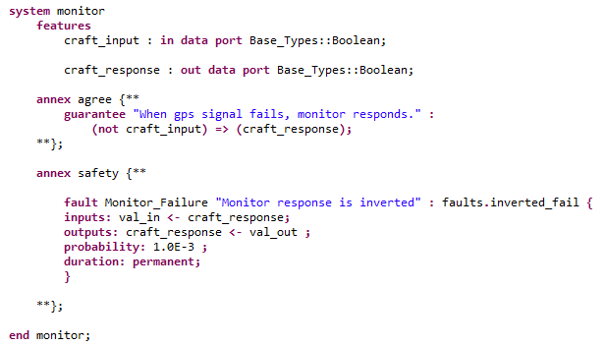
Safety Annex
Safety syntax is incorporated as an annex of AADL

Slide 12
Behavioral Failure Propagation
Wrap nominal component output in fault
Watch behavior of system through AGREE contracts when fault is activated
Component A
Component B
Out
In
Nominal Behavior:
Component A
Component B
Out
Fault
In
Fault Behavior:

Slide 13

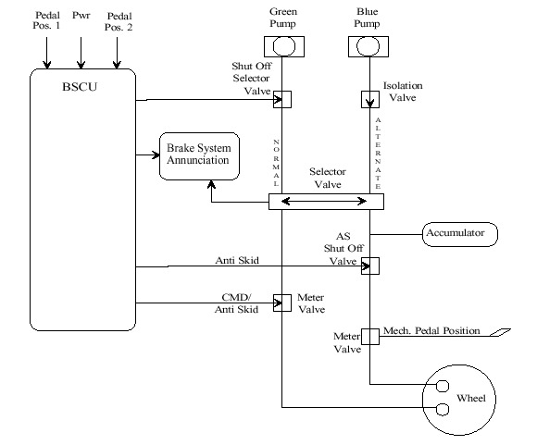
Wheel Brake System : Preliminary System Diagram

Slide 14
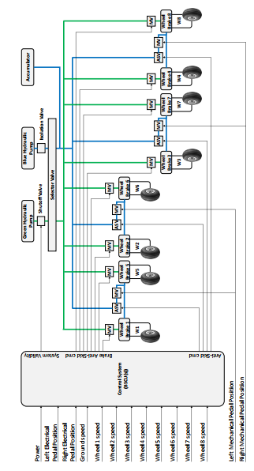
Wheel Brake System AIR6110
FBK: AIR6110 Case Study
Notes:
The large WBS example.

Slide 15
MBSA Steps: WBS and AADL/AGREE/Safety Annex
Safety Engineers
System Engineers
Check that safety requirements are satisfied by the nominal design model with the backend model checker
Capture Design Information in a shared AADL/AGREE model (architecture, nominal behavior, system level safety requirements)
Augment the nominal model with the component failure modes
Specify the fault hypothesis for the analysis
Analyze if the safety requirements are satisfied by the design in the presence of faults with the backend model checker, using counterexamples and minimal cut sets produced for diagnosis
Examine the results to assess the validity of the fault combinations and the fault tolerance level of the system design
Drive for design change
Notes:
This figure presents our proposed use of this shared system design and safety analysis
model in the context of the ARP4754A Safety Assessment Process Model (derived from
Figure 7 of ARP4754A). The shared model is one of the system development artifacts
from the “Development of System Architecture” and “Allocation of System Requirements
to Item” activities in the System Development Process, which interacts with the
PSSAs and SSAs activities in the Safety Assessment Process. The shared model can
serve as an interface to capture the information from the system design and implementation
that is relevant for the safety analysis.

Slide 16
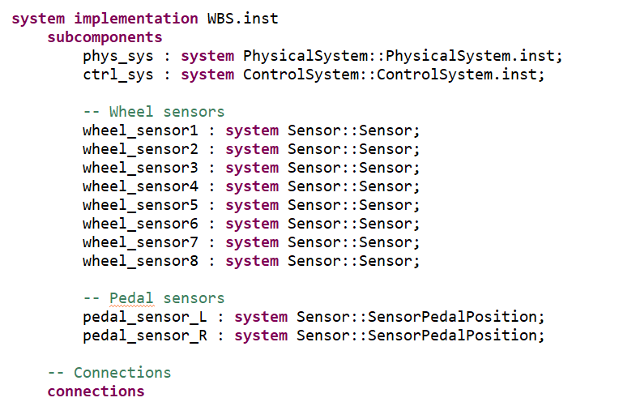
System Architecture in AADL

Slide 17
WBS Architecture
30 different types of components
169 component instances

Slide 18
MBSA Steps: WBS and AADL/AGREE/Safety Annex
Safety Engineers
System Engineers
Check that safety requirements are satisfied by the nominal design model with the backend model checker
Capture Design Information in a shared AADL/AGREE model (architecture, nominal behavior, system level safety requirements)
Augment the nominal model with the component failure modes
Specify the fault hypothesis for the analysis
Analyze if the safety requirements are satisfied by the design in the presence of faults with the backend model checker, using counterexamples and minimal cut sets produced for diagnosis
Examine the results to assess the validity of the fault combinations and the fault tolerance level of the system design
Drive for design change
Notes:
This figure presents our proposed use of this shared system design and safety analysis
model in the context of the ARP4754A Safety Assessment Process Model (derived from
Figure 7 of ARP4754A). The shared model is one of the system development artifacts
from the “Development of System Architecture” and “Allocation of System Requirements
to Item” activities in the System Development Process, which interacts with the
PSSAs and SSAs activities in the Safety Assessment Process. The shared model can
serve as an interface to capture the information from the system design and implementation
that is relevant for the safety analysis.

Slide 19
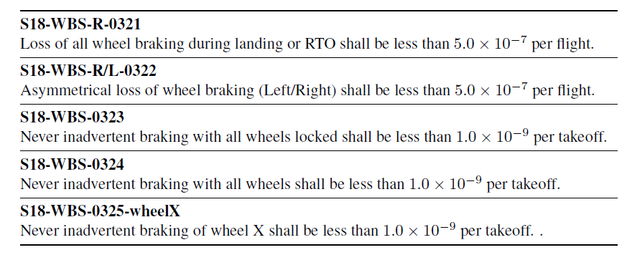
Top Level Safety Properties

Slide 20
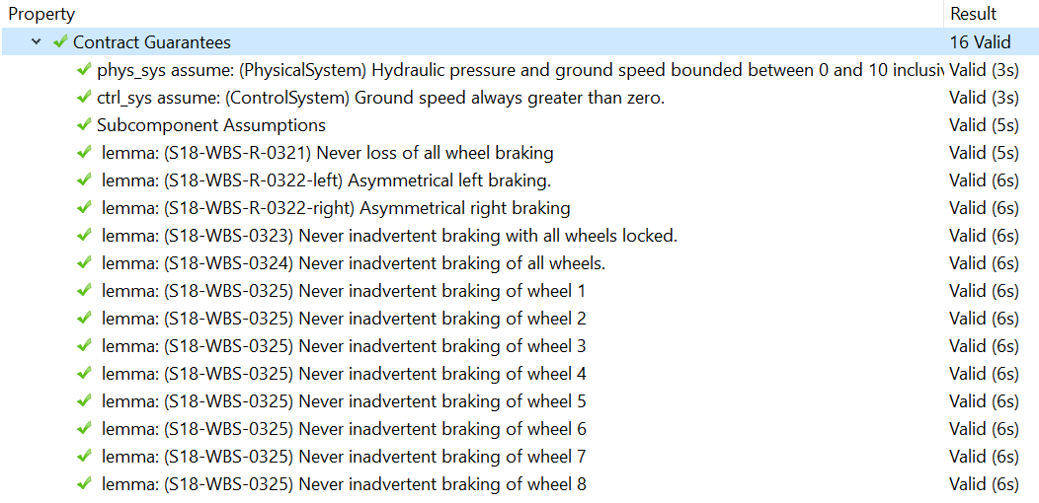
Nominal Model Analysis Output

Slide 21
MBSA Steps: WBS and AADL/AGREE/Safety Annex
Safety Engineers
System Engineers
Check that safety requirements are satisfied by the nominal design model with the backend model checker
Capture Design Information in a shared AADL/AGREE model (architecture, nominal behavior, system level safety requirements)
Augment the nominal model with the component failure modes
Specify the fault hypothesis for the analysis
Analyze if the safety requirements are satisfied by the design in the presence of faults with the backend model checker, using counterexamples and minimal cut sets produced for diagnosis
Examine the results to assess the validity of the fault combinations and the fault tolerance level of the system design
Drive for design change
Notes:
This figure presents our proposed use of this shared system design and safety analysis
model in the context of the ARP4754A Safety Assessment Process Model (derived from
Figure 7 of ARP4754A). The shared model is one of the system development artifacts
from the “Development of System Architecture” and “Allocation of System Requirements
to Item” activities in the System Development Process, which interacts with the
PSSAs and SSAs activities in the Safety Assessment Process. The shared model can
serve as an interface to capture the information from the system design and implementation
that is relevant for the safety analysis.

Slide 22
Defining Faults on Component Outputs
Valves
Stuck open
Stuck closed
Stuck nondeterministically
Sensors
Output inverted
Pumps
Output zero
Calculating components and Gates
Erroneous data

Slide 23
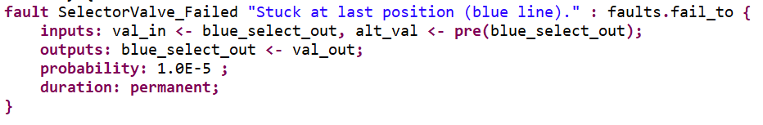
A Fault Definition
Blue line out
(blue_select_out)
Blue pump in
Selector Valve
Green pump in
Green line out

Slide 24
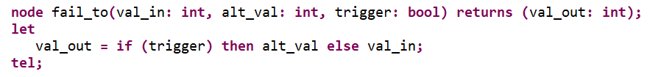
Fault Node Definition
Fault node defines behavior of fault when activated
Commonly used fault nodes held in library
Users can define nodes specific to a domain

Slide 25
MBSA Steps: WBS and AADL/AGREE/Safety Annex
Safety Engineers
System Engineers
Check that safety requirements are satisfied by the nominal design model with the backend model checker
Capture Design Information in a shared AADL/AGREE model (architecture, nominal behavior, system level safety requirements)
Augment the nominal model with the component failure modes
Specify the fault hypothesis for the analysis
Analyze if the safety requirements are satisfied by the design in the presence of faults with the backend model checker, using counterexamples and minimal cut sets produced for diagnosis
Examine the results to assess the validity of the fault combinations and the fault tolerance level of the system design
Drive for design change
Notes:
This figure presents our proposed use of this shared system design and safety analysis
model in the context of the ARP4754A Safety Assessment Process Model (derived from
Figure 7 of ARP4754A). The shared model is one of the system development artifacts
from the “Development of System Architecture” and “Allocation of System Requirements
to Item” activities in the System Development Process, which interacts with the
PSSAs and SSAs activities in the Safety Assessment Process. The shared model can
serve as an interface to capture the information from the system design and implementation
that is relevant for the safety analysis.

Slide 26


Specify Fault Hypothesis Statement
Located in system implementation
Max N Fault Analysis
Probabilistic Analysis
Notes:
This figure presents our proposed use of this shared system design and safety analysis
model in the context of the ARP4754A Safety Assessment Process Model (derived from
Figure 7 of ARP4754A). The shared model is one of the system development artifacts
from the “Development of System Architecture” and “Allocation of System Requirements
to Item” activities in the System Development Process, which interacts with the
PSSAs and SSAs activities in the Safety Assessment Process. The shared model can
serve as an interface to capture the information from the system design and implementation
that is relevant for the safety analysis.

Slide 27
MBSA Steps: WBS and AADL/AGREE/Safety Annex
Safety Engineers
System Engineers
Check that safety requirements are satisfied by the nominal design model with the backend model checker
Capture Design Information in a shared AADL/AGREE model (architecture, nominal behavior, system level safety requirements)
Augment the nominal model with the component failure modes
Specify the fault hypothesis for the analysis
Analyze if the safety requirements are satisfied by the design in the presence of faults with the backend model checker, using counterexamples and minimal cut sets produced for diagnosis
Examine the results to assess the validity of the fault combinations and the fault tolerance level of the system design
Drive for design change
Notes:
This figure presents our proposed use of this shared system design and safety analysis
model in the context of the ARP4754A Safety Assessment Process Model (derived from
Figure 7 of ARP4754A). The shared model is one of the system development artifacts
from the “Development of System Architecture” and “Allocation of System Requirements
to Item” activities in the System Development Process, which interacts with the
PSSAs and SSAs activities in the Safety Assessment Process. The shared model can
serve as an interface to capture the information from the system design and implementation
that is relevant for the safety analysis.

Slide 28
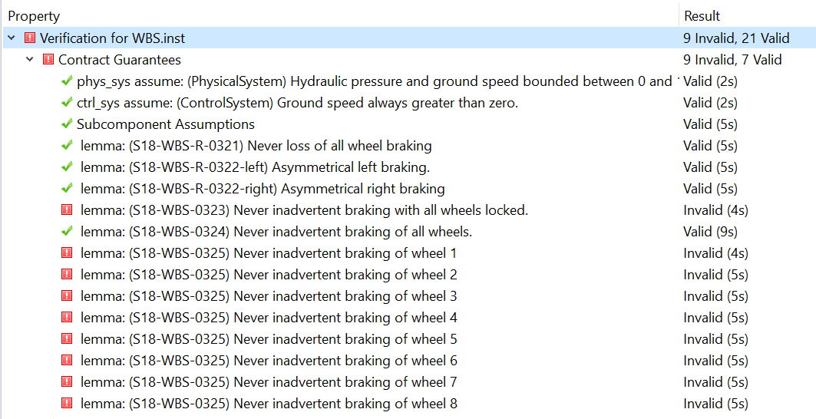
Analysis Results
Max 1 Fault Analysis:
Notes:
This figure presents our proposed use of this shared system design and safety analysis
model in the context of the ARP4754A Safety Assessment Process Model (derived from
Figure 7 of ARP4754A). The shared model is one of the system development artifacts
from the “Development of System Architecture” and “Allocation of System Requirements
to Item” activities in the System Development Process, which interacts with the
PSSAs and SSAs activities in the Safety Assessment Process. The shared model can
serve as an interface to capture the information from the system design and implementation
that is relevant for the safety analysis.

Slide 29
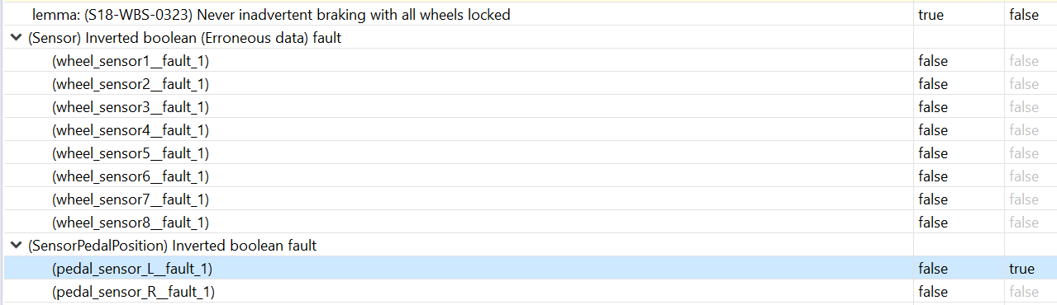
Counterexample View

Slide 30
MBSA Steps: WBS and AADL/AGREE/Safety Annex
Safety Engineers
System Engineers
Check that safety requirements are satisfied by the nominal design model with the backend model checker
Capture Design Information in a shared AADL/AGREE model (architecture, nominal behavior, system level safety requirements)
Augment the nominal model with the component failure modes
Specify the fault hypothesis for the analysis
Analyze if the safety requirements are satisfied by the design in the presence of faults with the backend model checker, using counterexamples and minimal cut sets produced for diagnosis
Examine the results to assess the validity of the fault combinations and the fault tolerance level of the system design
Drive for design change
Notes:
This figure presents our proposed use of this shared system design and safety analysis
model in the context of the ARP4754A Safety Assessment Process Model (derived from
Figure 7 of ARP4754A). The shared model is one of the system development artifacts
from the “Development of System Architecture” and “Allocation of System Requirements
to Item” activities in the System Development Process, which interacts with the
PSSAs and SSAs activities in the Safety Assessment Process. The shared model can
serve as an interface to capture the information from the system design and implementation
that is relevant for the safety analysis.

Slide 31
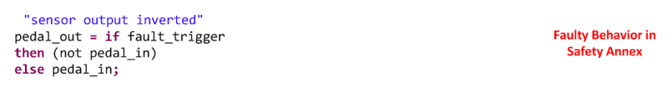

Safety Annex Approach

Slide 32
MBSA Steps: WBS and AADL/AGREE/Safety Annex
Safety Engineers
System Engineers
Check that safety requirements are satisfied by the nominal design model with the backend model checker
Capture Design Information in a shared AADL/AGREE model (architecture, nominal behavior, system level safety requirements)
Augment the nominal model with the component failure modes
Specify the fault hypothesis for the analysis
Analyze if the safety requirements are satisfied by the design in the presence of faults with the backend model checker, using counterexamples and minimal cut sets produced for diagnosis
Examine the results to assess the validity of the fault combinations and the fault tolerance level of the system design
Drive for design change
Notes:
This figure presents our proposed use of this shared system design and safety analysis
model in the context of the ARP4754A Safety Assessment Process Model (derived from
Figure 7 of ARP4754A). The shared model is one of the system development artifacts
from the “Development of System Architecture” and “Allocation of System Requirements
to Item” activities in the System Development Process, which interacts with the
PSSAs and SSAs activities in the Safety Assessment Process. The shared model can
serve as an interface to capture the information from the system design and implementation
that is relevant for the safety analysis.

Slide 33
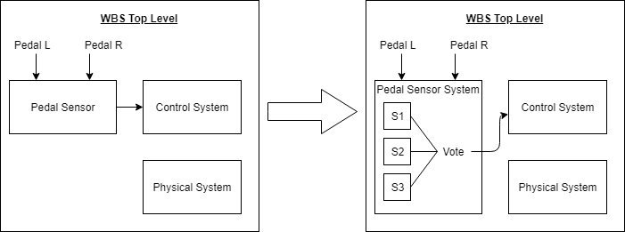
Design Change Option
Redundancy in the Pedal Sensor
Notes:
This figure presents our proposed use of this shared system design and safety analysis
model in the context of the ARP4754A Safety Assessment Process Model (derived from
Figure 7 of ARP4754A). The shared model is one of the system development artifacts
from the “Development of System Architecture” and “Allocation of System Requirements
to Item” activities in the System Development Process, which interacts with the
PSSAs and SSAs activities in the Safety Assessment Process. The shared model can
serve as an interface to capture the information from the system design and implementation
that is relevant for the safety analysis.

Slide 34
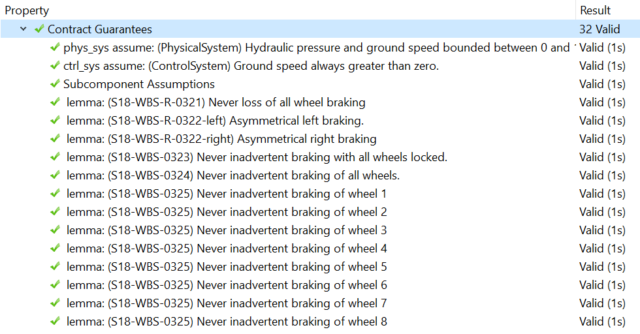
Results of Design Change
Now resilient against this fault
Notes:
This figure presents our proposed use of this shared system design and safety analysis
model in the context of the ARP4754A Safety Assessment Process Model (derived from
Figure 7 of ARP4754A). The shared model is one of the system development artifacts
from the “Development of System Architecture” and “Allocation of System Requirements
to Item” activities in the System Development Process, which interacts with the
PSSAs and SSAs activities in the Safety Assessment Process. The shared model can
serve as an interface to capture the information from the system design and implementation
that is relevant for the safety analysis.

Slide 35
Minimal Cut Set Analysis
The minimal sets of fault combinations that cause violation of the safety property.
Used in Fault Tree Analysis for PSSA/SSA.
Gives insight into problematic subcomponents of the system, single points of failure, etc.
Results from Safety Annex comes in 3 forms:
Tally of how many cut sets with certain cardinality
Text file giving description of each cut set, what component they effect, and which faults are in the sets
SOTERIA input file used to generate graphical fault trees

Slide 36
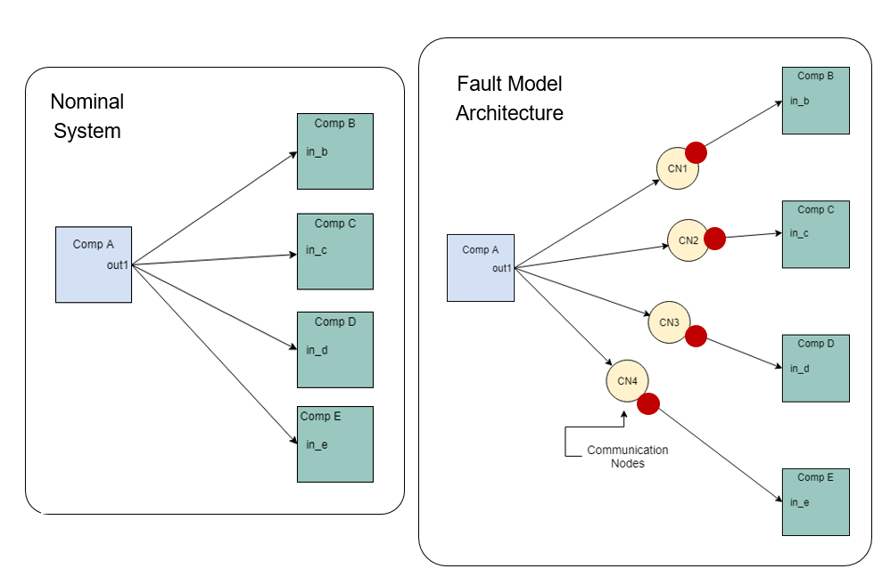
Byzantine Fault Modeling

Slide 37
Future Work
Use the information gleaned from the compositional collection of minimal cut sets for interesting things:
Use fault probabilities to calculate the system threshold
Plans for use in a large scale aircraft system in 2020

Slide 38

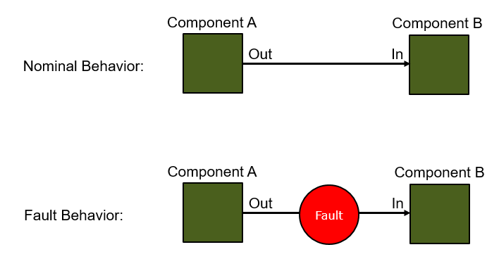
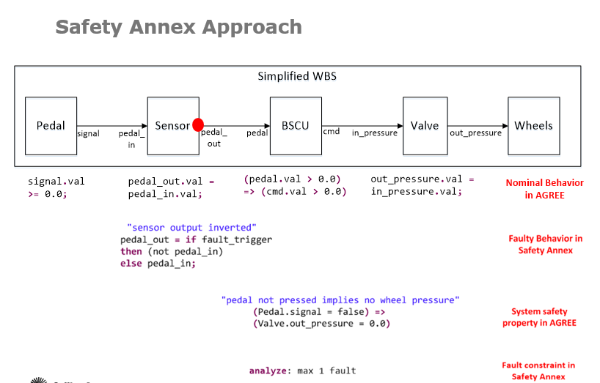
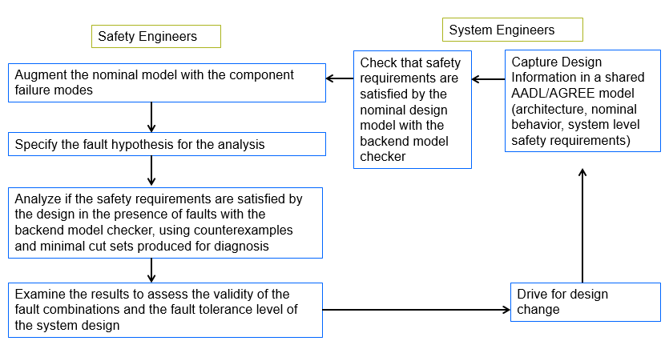
Questions?
MBSA Approach
Fault Modeling
Safety Assessment Process

