Slide 1

Architectural Modeling and Analysis for Safety Engineering (AMASE)
Research Opportunities in Aeronautics (NRA ROA-2015)
Model-based safety analysis of highly complex safety critical systems
Year-end Review
4 Oct 2018

Slide 2

Motivation
Requirements and
Design Documents
Safety
Analyst A
Safety
Analyst B
System Safety Analysis is
- Based on Informal Specifications
- Highly Dependent on Skill of the Analyst
Notes:
Safety engineers do most of the analysis activities like fault tree creation manually, based on a lot of informal requirements and design documents. These analyses seem to be quite subjective and highly dependent on the skill and experience of the safety engineers. Thus, it is not surprising that different safety engineers will quite often produce fault trees, which may differ in substantial ways. It is only through a rigorous review process that a concensus will be built on the correct fault tree, which captures the right fault behavior. We think that the review process implicitly consolidates existing information from various documents and then completes it with unspecified details architectural and fault behaviors. It would be great if all these activities would be based off a comprehensive system architecture.
We also observe that due to the complexity of the systems involved, it is possible that the fault trees may not capture involved fault scenarios that may occur due to complex interactions between components.

Slide 3
Model-Based Development
Why Not the
Safety Analysis?
We Base the Entire
Development Cycle
Around the Model

Slide 4
Model-Based Safety Analysis
Wheel Braking System
AIR6110
CONTIGUOUS AIRCRAFT/SYSTEM DEVELOPMENT PROCESS EXAMPLE
Green Pump
Blue Pump
Isolation Valve
Isolation Valve
Power A
Pedal 1
System
A
Selector Valve
Shut
Plant
Normal
N
A
Accumulator
Feed back
System
O
L
Valve
R
T
M
E
Accumulator
Pedal 2
System
B
A
R
Pump
Power B
L
N
AntiSkid
A
Meter
Command
T
Valve
Mechanical
Braking
+
Meter
E
Pedal
Fault Tolerant
AntiSkid
Valve
Meter
Braking System
Command
Valve
Control Unit
Plant
( BSCU )
Model
Model the Digital Controller Architecture
and the Physical System
Add Fault Model for Physical System
and Digital Controller Architecture
Integrates System and Safety Engineering About a Common Model
Automation Enables “What-If” Consideration of System Designs
Notes:
Steve’s slide

Slide 5
Nominal Model
Notes:
Maybe remove, check on other agree slides

Slide 6
Creation of Nominal System Model
Model of the Digital System
Power A
Verify safety properties of the nominal digital system
Pedal 1
System
A
Plant
Feed back
Pedal 2
System
B
Green Pump
Blue Pump
Power B
Isolation Valve
Isolation Valve
Fault Tolerant
Power A
Braking System
Control Unit
Pedal 1
Selector Valve
( BSCU )
Shut
Plant
Normal
N
A
Accumulator
Feed back
System
O
L
Valve
Verify safety properties of the nominal mechanical system
R
T
M
E
Accumulator
Pedal 2
System
B
A
R
Pump
Power B
L
N
AntiSkid
A
Meter
Command
T
Valve
Mechanical
Braking
E
Pedal
Fault Tolerant
+
Meter
Meter
Braking System
AntiSkid
Valve
Valve
Control Unit
Command
Plant
( BSCU )
Model
Model of the Digital System +
Model of the Mechanical System

Slide 7
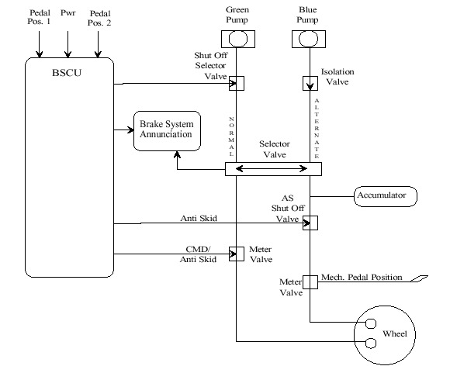
Wheel Brake System

Slide 8
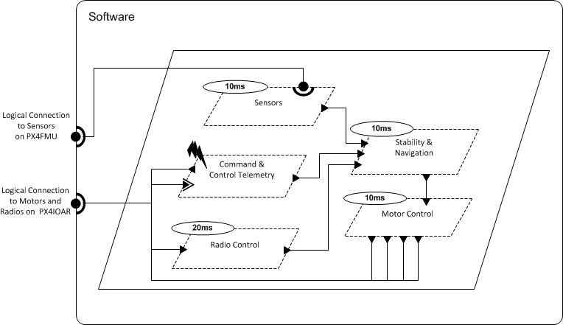
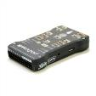

Architecture Analysis and Design Language (AADL)
AADL = SAE AS5506 standard
Target: Embedded, real-time, distributed systems
Describes both hardware and software
Extensible syntax (annex)
Open source tools, supported by SEI

Slide 9
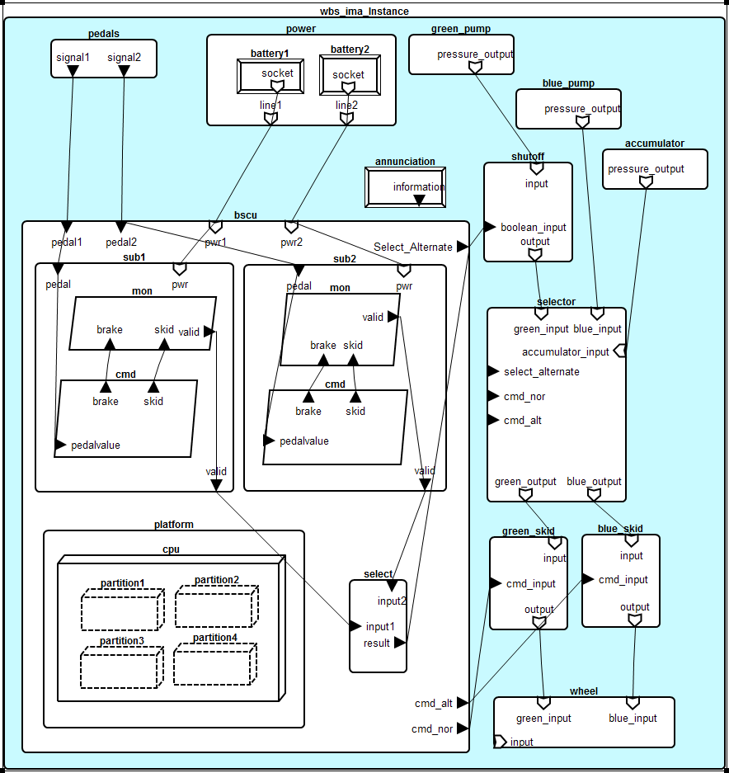
WBS AADL Model

Slide 10
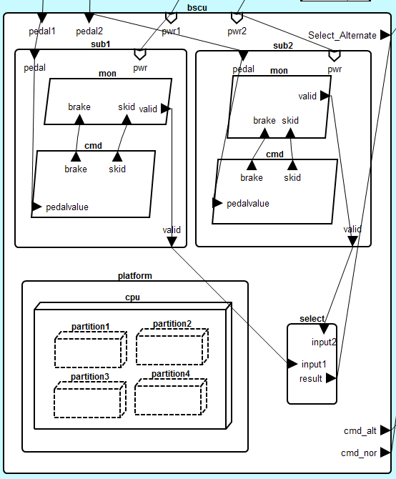

Slide 11
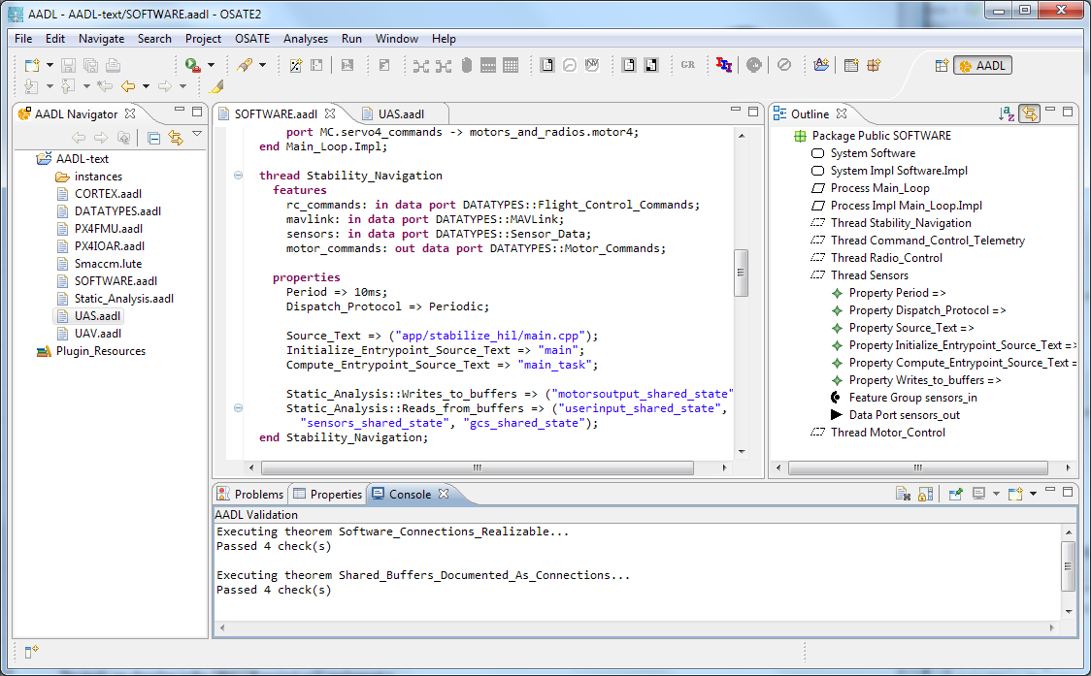


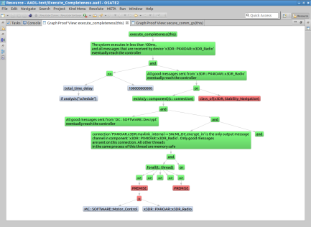
Architecture Modeling and Analysis Tools
Resolute
OSATE
AGREE
Trusted
Build
SIM
TCG
Architecture Models
Architecture Translation
Architecture Analysis
A
C
Assumption: Input < 20
Guarantee: Output < 2*Input
Assumption: none
Guarantee: Output = Input1 + Input2
B
seL4
Assumption: Input < 20
Guarantee: Output < Input + 15
Assumption: Input < 10
Guarantee: Output < 50
eChronos
VxWorks
Kind/JKind
Model Checker
Notes:
START AGREE HERE

Slide 12
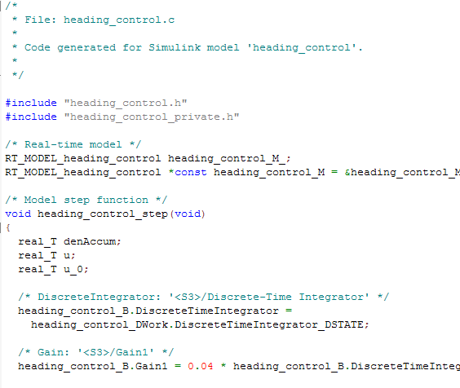
AGREE: Assume Guarantee Reasoning Environment
contract
contract
contract
Each component has a contract consisting of assumptions and guarantees
Assumptions: Constraints over what a component expects from its environment
Guarantees: Constraints over how a component behaves in response to its environment (requirements)
The contract of a component abstracts the behavior of its implementation
AGREE analysis
contract
contract
contract
contract
Component
Implementation

Slide 13



Compositional Verification of Critical Systems
Compositional verification tool for analysis of AADL system models
AGREE: Assume-Guarantee Reasoning Environment
Focus on system safety properties
Compositional approach scales model checking to larger systems
Example system: Quad-redundant flight control system provided by NASA
FCC
FCC
A
C
FCC
FCC
Assumption: Input < 20
Guarantee: Output < 2*Input
Assumption: none
Guarantee: Output = Input1 + Input2
AFDX or
TTE
Switch
AFDX or
TTE
Switch
B
Assumption: Input < 20
Guarantee: Output < Input + 15
Assumption: Input < 10
Guarantee: Output < 50
DaC
DaC
DaC
DaC

Slide 14
Compositional Verification of Critical Systems
Compositional verification tool for analysis of AADL system models
AGREE: Assume-Guarantee Reasoning Environment
Focus on system safety properties
Compositional approach scales model checking to larger systems
Example system: Quad-redundant flight control system provided by NASA
FCC
FCC
A
C
FCC
FCC
Assumption: Input < 20
Guarantee: Output < 2*Input
Assumption: none
Guarantee: Output = Input1 + Input2
AFDX or
TTE
Switch
AFDX or
TTE
Switch
B
Assumption: Input < 20
Guarantee: Output < Input + 15
Assumption: Input < 10
Guarantee: Output < 50
DaC
DaC
DaC
DaC

Slide 15
Compositional Verification of Critical Systems
Compositional verification tool for analysis of AADL system models
AGREE: Assume-Guarantee Reasoning Environment
Focus on system safety properties
Compositional approach scales model checking to larger systems
Example system: Quad-redundant flight control system provided by NASA
FCC
FCC
A
C
FCC
FCC
Assumption: Input < 20
Guarantee: Output < 2*Input
Assumption: none
Guarantee: Output = Input1 + Input2
AFDX or
TTE
Switch
AFDX or
TTE
Switch
B
Assumption: Input < 20
Guarantee: Output < Input + 15
Assumption: Input < 10
Guarantee: Output < 50
DaC
DaC
DaC
DaC

Slide 16
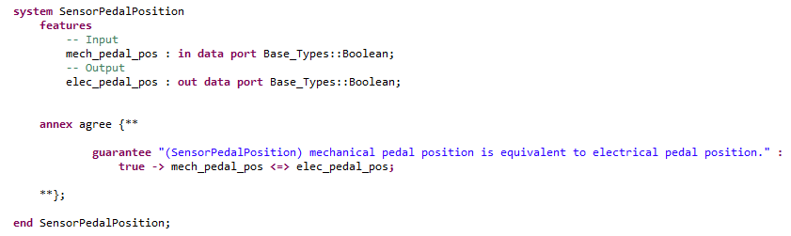
Notes:
Maybe remove, check on other agree slides

Slide 17
Fault Model
Notes:
Maybe remove, check on other agree slides

Slide 18
Wrap nominal component in fault
Watch behavior of system through AGREE contracts

Slide 19
Component A
Component B
Out
In
Nominal Behavior:
Component A
Component B
Out
Fault
In
Fault Behavior:

Slide 20
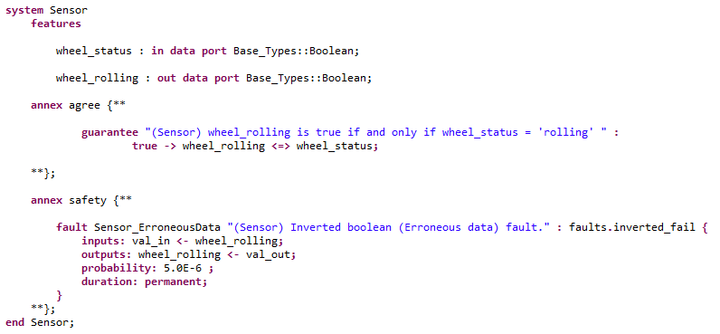
Safety Annex
Safety syntax is incorporated as an annex of AADL

Slide 21
WBS : No inadvertent braking
Normal Operating Mode:
Mechanical pedal pressed (brakes commanded)
Sensor on pedal converts to electrical signal
Signal sent to BSCU to command brakes

Slide 22
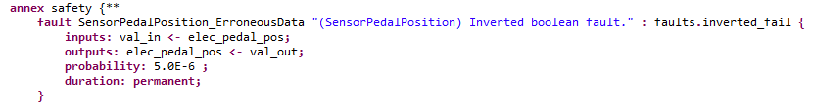
A Fault on the Pedal Sensor Component

Slide 23
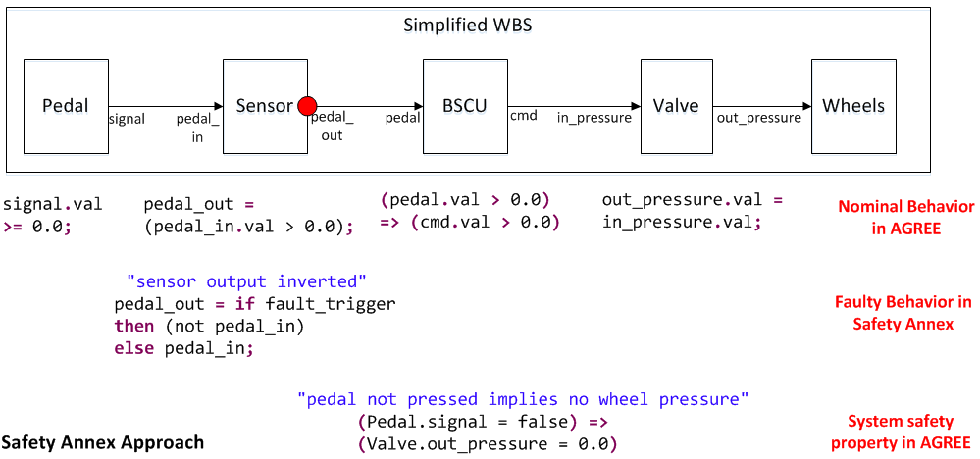
Behavioral Fault Propagation

Slide 24
Active Sensor Fault
Mechanical pedal is not pressed
Inverted Boolean failure on sensor activated
Electrical signal is true and braking is commanded through BSCU
Top level lemma fails (Unintentional braking occurs)

Slide 25

Maximum Number of Faults (Compositional)

Slide 26

Probabilistic Analysis (Monolithic)

Slide 27
Hardware Dependent Faults
Fault in HW triggers faults in connected components

Slide 28
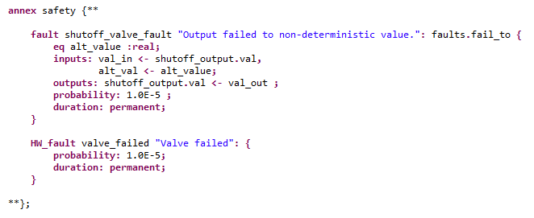
Hardware Dependent Faults
HW fault definition in the Fault Statement of the component type

Slide 29
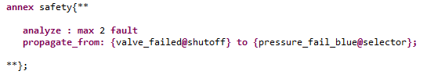
Hardware Dependent Faults
HW propagation in the Safety Annex of the component implementation

Slide 30
Byzantine Faults Simulation: Flight Control Computer
Created multiple connections to observers
Introduced disagreement through fault injection

Slide 31
Cut Set Generation
Standards (APR4761, AIR6110, etc) describe techniques involving cut sets
Required for FTA and FMEA
Currently, these are the needs of Safety Engineers in a Safety Analysis tool

Slide 32
Inductive Validity Cores

Slide 33
Inductive Validity Cores
Safety Property

Slide 34
Inductive Validity Cores
Safety Property
a
b
c
d
e
f
Model Elements

Slide 35
Inductive Validity Cores
Safety Property
a
b
c
d
e
f
Model Elements: {a,b,c,d,e,f}

Slide 36
Inductive Validity Cores
Safety Property
a
b
c
d
e
f
IVC : A minimum set of elements
needed to prove the
Safety Property
{a, c, d}

Slide 37
Inductive Validity Cores
Safety Property
a
b
c
d
e
f
All IVCs : All minimal sets of elements
needed to prove the
Safety Property
{ {a,c,d}, {b,e}, {f} }

Slide 38






Inductive Validity Cores with Faults
Safety Property
$${!f}_{1}$$
$${!f}_{2}$$
$${!f}_{3}$$
$$g_{1}$$
$$g_{2}$$
$$g_{3}$$
Model Elements : {Faults = FALSE, Guarantees}

Slide 39
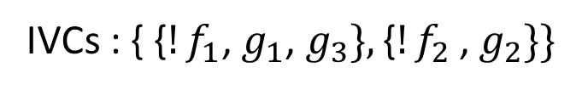






Cut Set Generation: Inductive Validity Cores with Faults
Safety Property
$${!f}_{1}$$
$${!f}_{2}$$
$${!f}_{3}$$
$$g_{1}$$
$$g_{2}$$
$$g_{3}$$
IVCs : { {${!f}_{1}$, $g_{1}$, $g_{3}\},\text{\{}{!f}_{2}\text{, }g_{2}\}\}$

Slide 40
Cut Set Generation: Inductive Validity Cores
Safety Property
Model Elements

