Slide 1
Architecture Modeling and Analysis for Safety Engineering
Danielle Stewart
Michael Whalen
Darren Cofer
Mats Heimdahl
University of Minnesota, Rockwell Collins

Slide 2

Motivation
Requirements and
Design Documents
Safety
Analyst A
Safety
Analyst B
System Safety Analysis is
- Based on Informal Specifications
- Highly Dependent on Skill of the Analyst
Notes:
Safety engineers do most of the analysis activities like fault tree creation manually, based on a lot of informal requirements and design documents. These analyses seem to be quite subjective and highly dependent on the skill and experience of the safety engineers. Thus, it is not surprising that different safety engineers will quite often produce fault trees, which may differ in substantial ways. It is only through a rigorous review process that a concensus will be built on the correct fault tree, which captures the right fault behavior. We think that the review process implicitly consolidates existing information from various documents and then completes it with unspecified details architectural and fault behaviors. It would be great if all these activities would be based off a comprehensive system architecture.
We also observe that due to the complexity of the systems involved, it is possible that the fault trees may not capture involved fault scenarios that may occur due to complex interactions between components.

Slide 3
Model-Based Development
Why Not the
Safety Analysis?
We Base the Entire
Development Cycle
Around the Model

Slide 4
Model-Based Safety Analysis
Wheel Braking System
AIR6110
CONTIGUOUS AIRCRAFT/SYSTEM DEVELOPMENT PROCESS EXAMPLE
Green Pump
Blue Pump
Isolation Valve
Isolation Valve
Power A
Pedal 1
System
A
Selector Valve
Shut
Plant
Normal
N
A
Accumulator
Feed back
System
O
L
Valve
R
T
M
E
Accumulator
Pedal 2
System
B
A
R
Pump
Power B
L
N
AntiSkid
A
Meter
Command
T
Valve
Mechanical
Braking
+
Meter
E
Pedal
Fault Tolerant
AntiSkid
Valve
Meter
Braking System
Command
Valve
Control Unit
Plant
( BSCU )
Model
Model the Digital Controller Architecture
and the Physical System
Add Fault Model for Physical System
and Digital Controller Architecture
Integrates System and Safety Engineering About a Common Model
Automation Enables “What-If” Consideration of System Designs
Notes:
Steve’s slide

Slide 5
Creation of Nominal System Model
Model of the Digital System
Library of Faults
Power A
Verify safety properties of the nominal digital system
Pedal 1
System
A
Plant
Feed back
Pedal 2
System
B
Green Pump
Blue Pump
Power B
Isolation Valve
Isolation Valve
Fault Tolerant
Power A
Braking System
Selector Valve
Control Unit
Pedal 1
( BSCU )
Shut
Plant
Normal
N
A
Accumulator
Feed back
System
O
L
Valve
R
T
M
E
Accumulator
Verify safety properties of the nominal mechanical system
Pedal 2
System
B
A
R
Pump
Power B
L
N
AntiSkid
A
Meter
Command
T
Valve
Mechanical
Braking
E
Pedal
Fault Tolerant
+
Meter
Meter
Braking System
AntiSkid
Valve
Valve
Control Unit
Command
Plant
( BSCU )
Model
Model of the Digital System +
Model of the Mechanical System

Slide 6
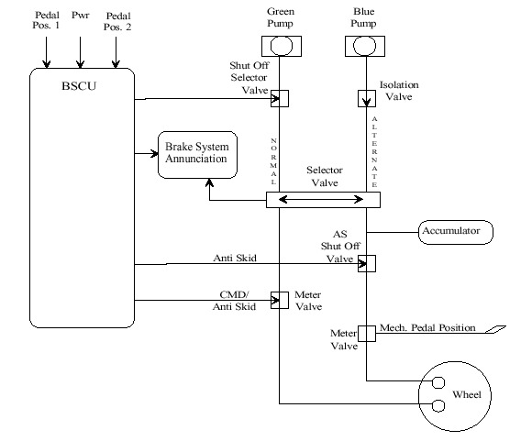
Wheel Brake System

Slide 7
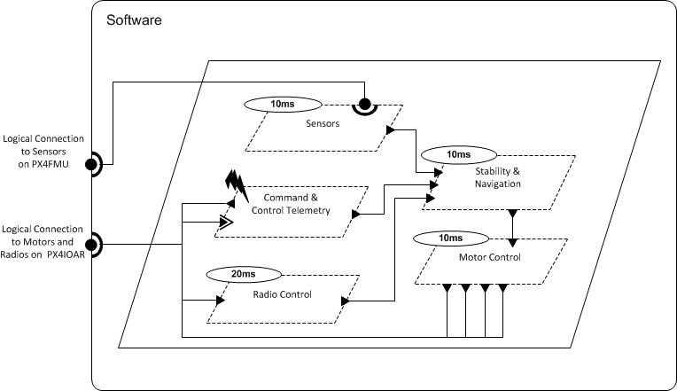
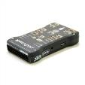

Architecture Analysis and Design Language (AADL)
AADL = SAE AS5506 standard
Target: Embedded, real-time, distributed systems
Describes both hardware and software
Extensible syntax (annex)
Open source tools, supported by SEI

Slide 8
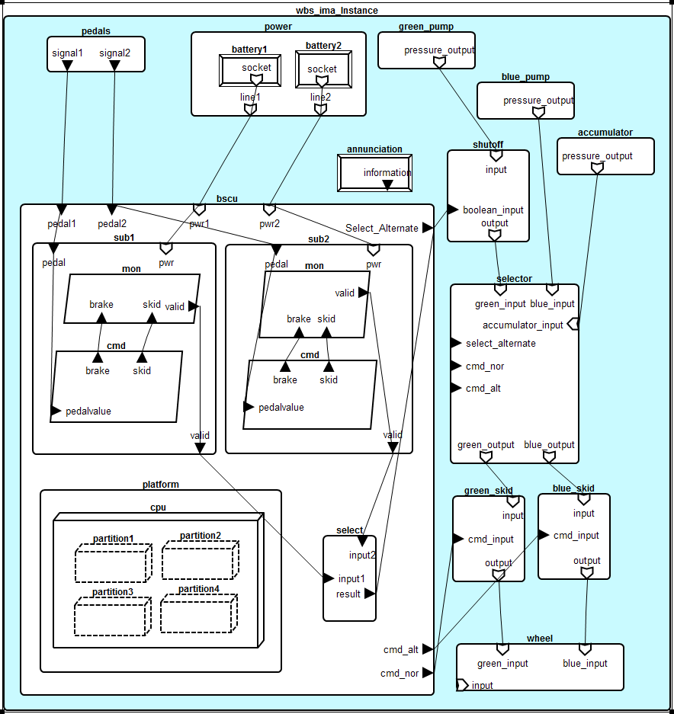
WBS AADL Model

Slide 9
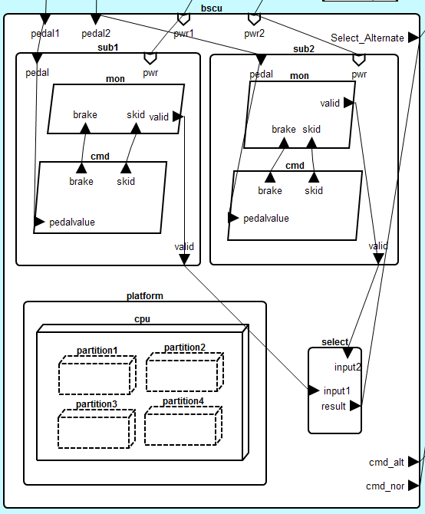

Slide 10
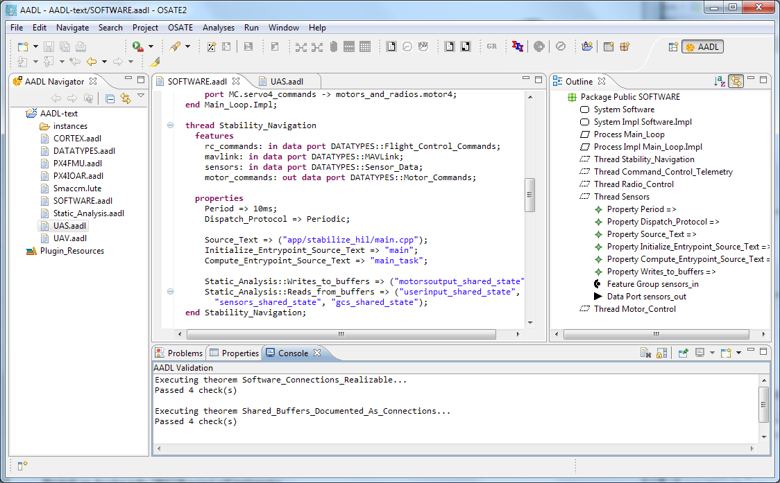


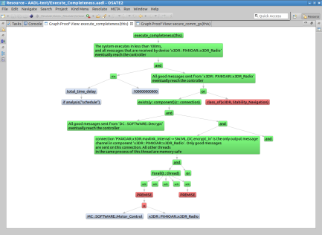
Architecture Modeling and Analysis Tools
Resolute
OSATE
AGREE
Trusted
Build
SIM
TCG
Architecture Models
Architecture Translation
Architecture Analysis
A
C
Assumption: Input < 20
Guarantee: Output < 2*Input
Assumption: none
Guarantee: Output = Input1 + Input2
B
seL4
Assumption: Input < 20
Guarantee: Output < Input + 15
Assumption: Input < 10
Guarantee: Output < 50
eChronos
VxWorks
Kind/JKind
Model Checker
Notes:
START AGREE HERE

Slide 11



Compositional Verification of Critical Systems
Compositional verification tool for analysis of AADL system models
AGREE: Assume-Guarantee Reasoning Environment
Focus on system safety properties
Compositional approach scales model checking to larger systems
Example system: Quad-redundant flight control system provided by NASA
FCC
FCC
A
C
FCC
FCC
Assumption: Input < 20
Guarantee: Output < 2*Input
Assumption: none
Guarantee: Output = Input1 + Input2
AFDX or
TTE
Switch
AFDX or
TTE
Switch
B
Assumption: Input < 20
Guarantee: Output < Input + 15
Assumption: Input < 10
Guarantee: Output < 50
DaC
DaC
DaC
DaC

Slide 12
Compositional Verification of Critical Systems
Compositional verification tool for analysis of AADL system models
AGREE: Assume-Guarantee Reasoning Environment
Focus on system safety properties
Compositional approach scales model checking to larger systems
Example system: Quad-redundant flight control system provided by NASA
FCC
FCC
A
C
FCC
FCC
Assumption: Input < 20
Guarantee: Output < 2*Input
Assumption: none
Guarantee: Output = Input1 + Input2
AFDX or
TTE
Switch
AFDX or
TTE
Switch
B
Assumption: Input < 20
Guarantee: Output < Input + 15
Assumption: Input < 10
Guarantee: Output < 50
DaC
DaC
DaC
DaC

Slide 13
Compositional Verification of Critical Systems
Compositional verification tool for analysis of AADL system models
AGREE: Assume-Guarantee Reasoning Environment
Focus on system safety properties
Compositional approach scales model checking to larger systems
Example system: Quad-redundant flight control system provided by NASA
FCC
FCC
A
C
FCC
FCC
Assumption: Input < 20
Guarantee: Output < 2*Input
Assumption: none
Guarantee: Output = Input1 + Input2
AFDX or
TTE
Switch
AFDX or
TTE
Switch
B
Assumption: Input < 20
Guarantee: Output < Input + 15
Assumption: Input < 10
Guarantee: Output < 50
DaC
DaC
DaC
DaC

Slide 14
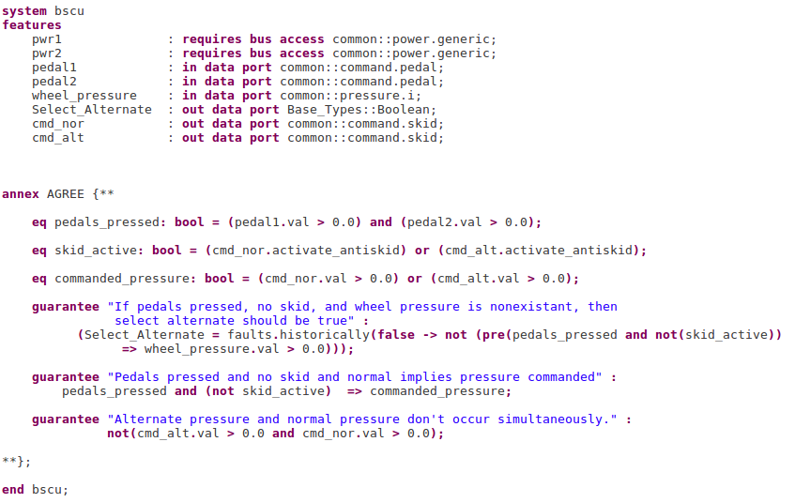
Notes:
Maybe remove, check on other agree slides

Slide 16
Wrap nominal component in fault
Watch behavior of system through AGREE contracts

Slide 17
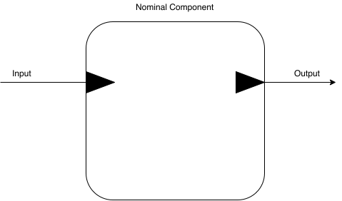

Slide 18
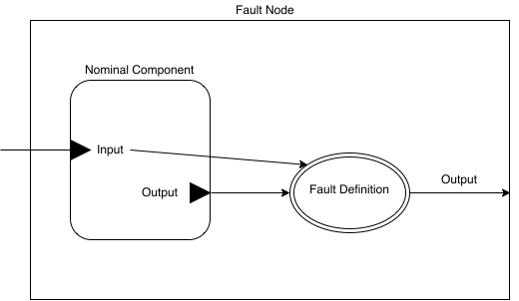

Slide 19


Slide 20
Summary of Nominal Model Changes
Feedback from the wheel component to the BSCU component
Weaken top level contract to account for feedback
Selector component cannot control normal, alternate, and emergency modes

Slide 21
WBS AADL Model

Slide 22
Summary of Nominal Model Changes
Feedback from the wheel component to the BSCU component
Weaken top level contract to account for feedback
Selector component cannot control normal, alternate, and emergency modes

Slide 23
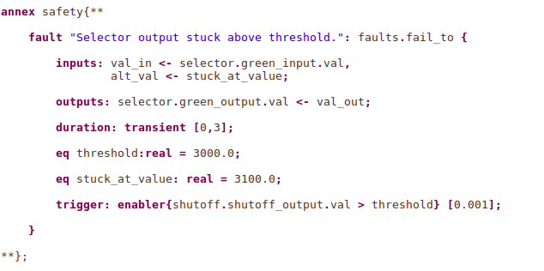

Slide 29
Formal Design and Safety Analysis of AIR6110 Wheel Brake System : Bozzano, Cimatti, et. al.

Slide 30
Failure Effect Modeling vs. Failure Logic Modeling

Slide 31
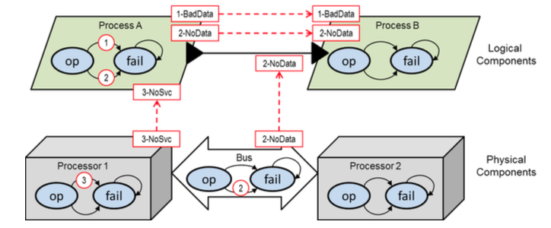
AADL Error Annex: FLM

Slide 32
Trade Space Exploration
Tool | Abs. Level | Causal or Non-causal | SA-Only Models? | Compo-sitional? | Rich Types? | Propagation Model
AltaRica 3.0 | High | Non-causal | Yes | No | No | FEM/FLM
HiP-HOPS | High | Causal | No | No | No | FLM
Joshi | Low-High | Causal | Yes | No | No | FEM/FLM
AADL Error Annex | Low-High | Non-causal | No | No | No | FLM
AGREE w/ Extensions | Low-High | Causal | No | Yes | Yes | FEM/FLM
smartIflow | Medium High | Non-causal | No | No | No | FEM/FLM
xSAP | Low-high | Causal | Yes | Yes | Yes | FEM/FLM

Slide 33
Future Work
Scalability
Probabilistic Analysis
Real time

Slide 34
Questions?

Slide 35
Issues with Previous Work
Component-Level, rather than Architecture-Level Descriptions
Previous work in Simulink / SCADE
Designed for talking about component behavior rather than architecture
Architecture description language is better location for analysis
Scale
Previous analyses were built on BDD-based tools with much less scalability than current model checkers (JKind, NuXmv)
Even with new tools, functional models rapidly become too complex to analyze monolithically
Integration
Not integrated with existing analyses for fault tolerance
Visualization of results

