Slide 1

Architectural Modeling and Analysis for Safety Engineering (AMASE)
Research Opportunities in Aeronautics (NRA ROA-2015)
Model-based safety analysis of highly complex safety critical systems
Year-end Review
20 Sept 2017

Slide 2

Motivation
Requirements and
Design Documents
Safety
Analyst A
Safety
Analyst B
System Safety Analysis is
- Based on Informal Specifications
- Highly Dependent on Skill of the Analyst
Notes:
Safety engineers do most of the analysis activities like fault tree creation manually, based on a lot of informal requirements and design documents. These analyses seem to be quite subjective and highly dependent on the skill and experience of the safety engineers. Thus, it is not surprising that different safety engineers will quite often produce fault trees, which may differ in substantial ways. It is only through a rigorous review process that a concensus will be built on the correct fault tree, which captures the right fault behavior. We think that the review process implicitly consolidates existing information from various documents and then completes it with unspecified details architectural and fault behaviors. It would be great if all these activities would be based off a comprehensive system architecture.
We also observe that due to the complexity of the systems involved, it is possible that the fault trees may not capture involved fault scenarios that may occur due to complex interactions between components.

Slide 3
Model-Based Development
Why Not the
Safety Analysis?
We Base the Entire
Development Cycle
Around the Model

Slide 4
Model-Based Safety Analysis
Wheel Braking System
AIR6110
CONTIGUOUS AIRCRAFT/SYSTEM DEVELOPMENT PROCESS EXAMPLE
Green Pump
Blue Pump
Isolation Valve
Isolation Valve
Power A
Pedal 1
System
A
Selector Valve
Shut
Plant
Normal
N
A
Accumulator
Feed back
System
O
L
Valve
R
T
M
E
Accumulator
Pedal 2
System
B
A
R
Pump
Power B
L
N
AntiSkid
A
Meter
Command
T
Valve
Mechanical
Braking
+
Meter
E
Pedal
Fault Tolerant
AntiSkid
Valve
Meter
Braking System
Command
Valve
Control Unit
Plant
( BSCU )
Model
Model the Digital Controller Architecture
and the Physical System
Add Fault Model for Physical System
and Digital Controller Architecture
Integrates System and Safety Engineering About a Common Model
Automation Enables “What-If” Consideration of System Designs
Notes:
Steve’s slide

Slide 5
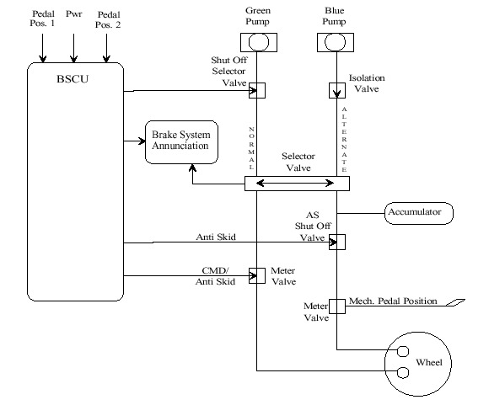
Wheel Brake System

Slide 6
Wheel Brake System

Slide 7
Wheel Brake System

Slide 8
Wheel Brake System

Slide 9
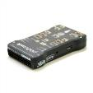

Architecture Analysis and Design Language (AADL)
AADL = SAE AS5506 standard
Target: Embedded, real-time, distributed systems
Describes both hardware and software
Extensible syntax (annex)
Open source tools, supported by SEI

Slide 10
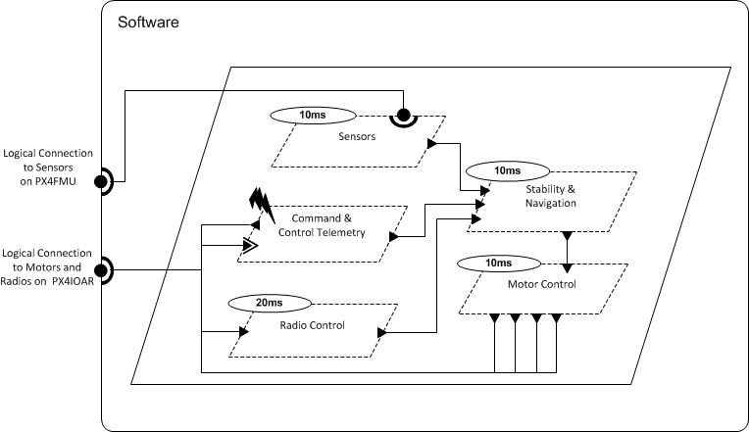
Architecture Analysis and Design Language (AADL)
AADL = SAE AS5506 standard
Target: Embedded, real-time, distributed systems
Describes both hardware and software
Extensible syntax (annex)
Open source tools, supported by SEI

Slide 11
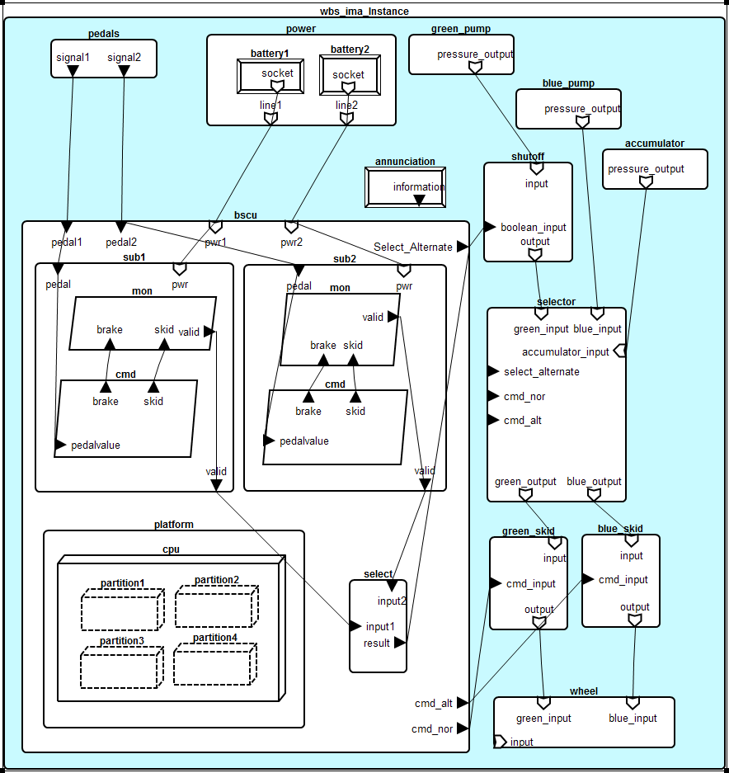
WBS AADL Model

Slide 12
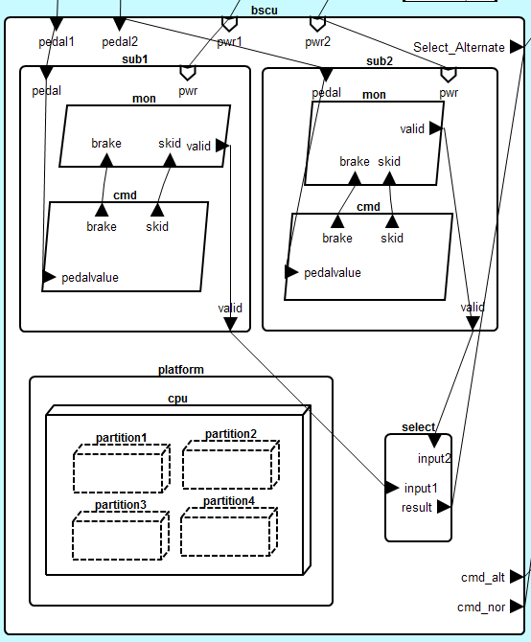

Slide 13
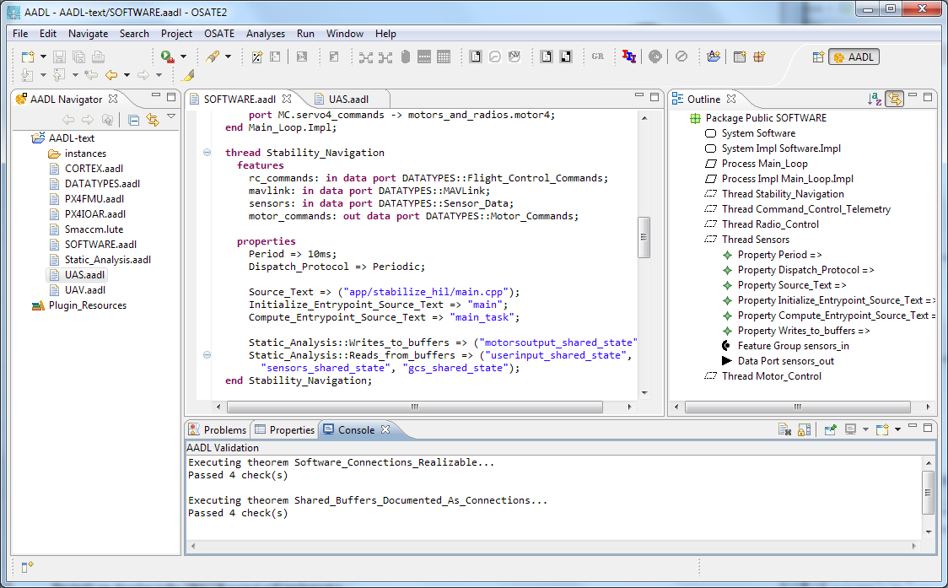


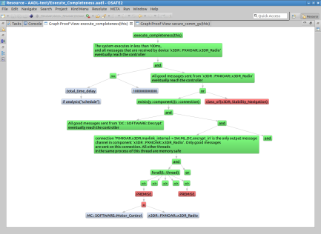
Architecture Modeling and Analysis Tools
Resolute
OSATE
AGREE
Trusted
Build
SIM
TCG
Architecture Models
Architecture Translation
Architecture Analysis
A
C
Assumption: Input < 20
Guarantee: Output < 2*Input
Assumption: none
Guarantee: Output = Input1 + Input2
B
seL4
Assumption: Input < 20
Guarantee: Output < Input + 15
Assumption: Input < 10
Guarantee: Output < 50
eChronos
VxWorks
Kind/JKind
Model Checker
Notes:
START AGREE HERE

Slide 14
Architecture Modeling and Analysis Tools
Resolute
OSATE
AGREE
Trusted
Build
SIM
TCG
Architecture Models
Architecture Translation
Architecture Analysis
A
C
Assumption: Input < 20
Guarantee: Output < 2*Input
Assumption: none
Guarantee: Output = Input1 + Input2
B
seL4
Assumption: Input < 20
Guarantee: Output < Input + 15
Assumption: Input < 10
Guarantee: Output < 50
eChronos
VxWorks
Kind/JKind
Model Checker
Notes:
START AGREE HERE

Slide 15



Compositional Verification of Critical Systems
Compositional verification tool for analysis of AADL system models
AGREE: Assume-Guarantee Reasoning Environment
Focus on system safety properties
Compositional approach scales model checking to larger systems
Example system: Quad-redundant flight control system provided by NASA
FCC
FCC
A
C
FCC
FCC
Assumption: Input < 20
Guarantee: Output < 2*Input
Assumption: none
Guarantee: Output = Input1 + Input2
AFDX or
TTE
Switch
AFDX or
TTE
Switch
B
Assumption: Input < 20
Guarantee: Output < Input + 15
Assumption: Input < 10
Guarantee: Output < 50
DaC
DaC
DaC
DaC

Slide 16
Compositional Verification of Critical Systems
Compositional verification tool for analysis of AADL system models
AGREE: Assume-Guarantee Reasoning Environment
Focus on system safety properties
Compositional approach scales model checking to larger systems
Example system: Quad-redundant flight control system provided by NASA
FCC
FCC
A
C
FCC
FCC
Assumption: Input < 20
Guarantee: Output < 2*Input
Assumption: none
Guarantee: Output = Input1 + Input2
AFDX or
TTE
Switch
AFDX or
TTE
Switch
B
Assumption: Input < 20
Guarantee: Output < Input + 15
Assumption: Input < 10
Guarantee: Output < 50
DaC
DaC
DaC
DaC

Slide 17
Compositional Verification of Critical Systems
Compositional verification tool for analysis of AADL system models
AGREE: Assume-Guarantee Reasoning Environment
Focus on system safety properties
Compositional approach scales model checking to larger systems
Example system: Quad-redundant flight control system provided by NASA
FCC
FCC
A
C
FCC
FCC
Assumption: Input < 20
Guarantee: Output < 2*Input
Assumption: none
Guarantee: Output = Input1 + Input2
AFDX or
TTE
Switch
AFDX or
TTE
Switch
B
Assumption: Input < 20
Guarantee: Output < Input + 15
Assumption: Input < 10
Guarantee: Output < 50
DaC
DaC
DaC
DaC

Slide 18
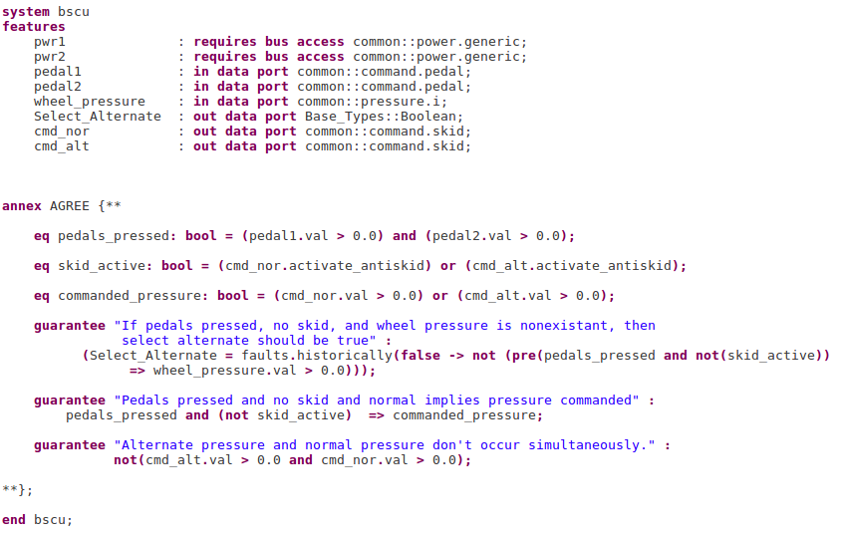
Notes:
Maybe remove, check on other agree slides

Slide 19
Notes:
Maybe remove, check on other agree slides

Slide 20
Notes:
Maybe remove, check on other agree slides

Slide 22
Wrap nominal component in fault
Watch behavior of system through AGREE contracts

Slide 23
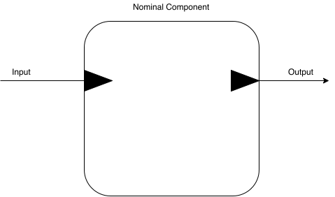

Slide 24
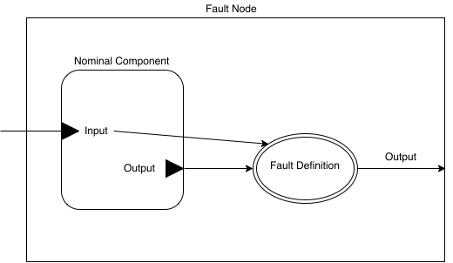

Slide 25

WBS Top Level Contract

Slide 26
Manual Fault Injection

Slide 27
Manual Fault Injection

Slide 28
Summary of Nominal Model Changes
Feedback from the wheel component to the BSCU component

Slide 29
WBS AADL Model

Slide 30
Summary of Nominal Model Changes
Feedback from the wheel component to the BSCU component
Weaken top level contract to account for feedback

Slide 31

New Top Level Contract

Slide 32
Summary of Nominal Model Changes
Feedback from the wheel component to the BSCU component
Weaken top level contract to account for feedback
Selector component cannot control normal, alternate, and emergency modes

Slide 33
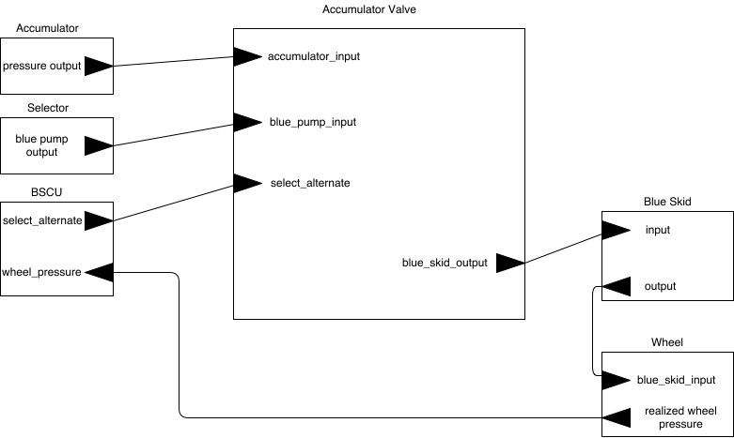
Accumulator Valve

Slide 34
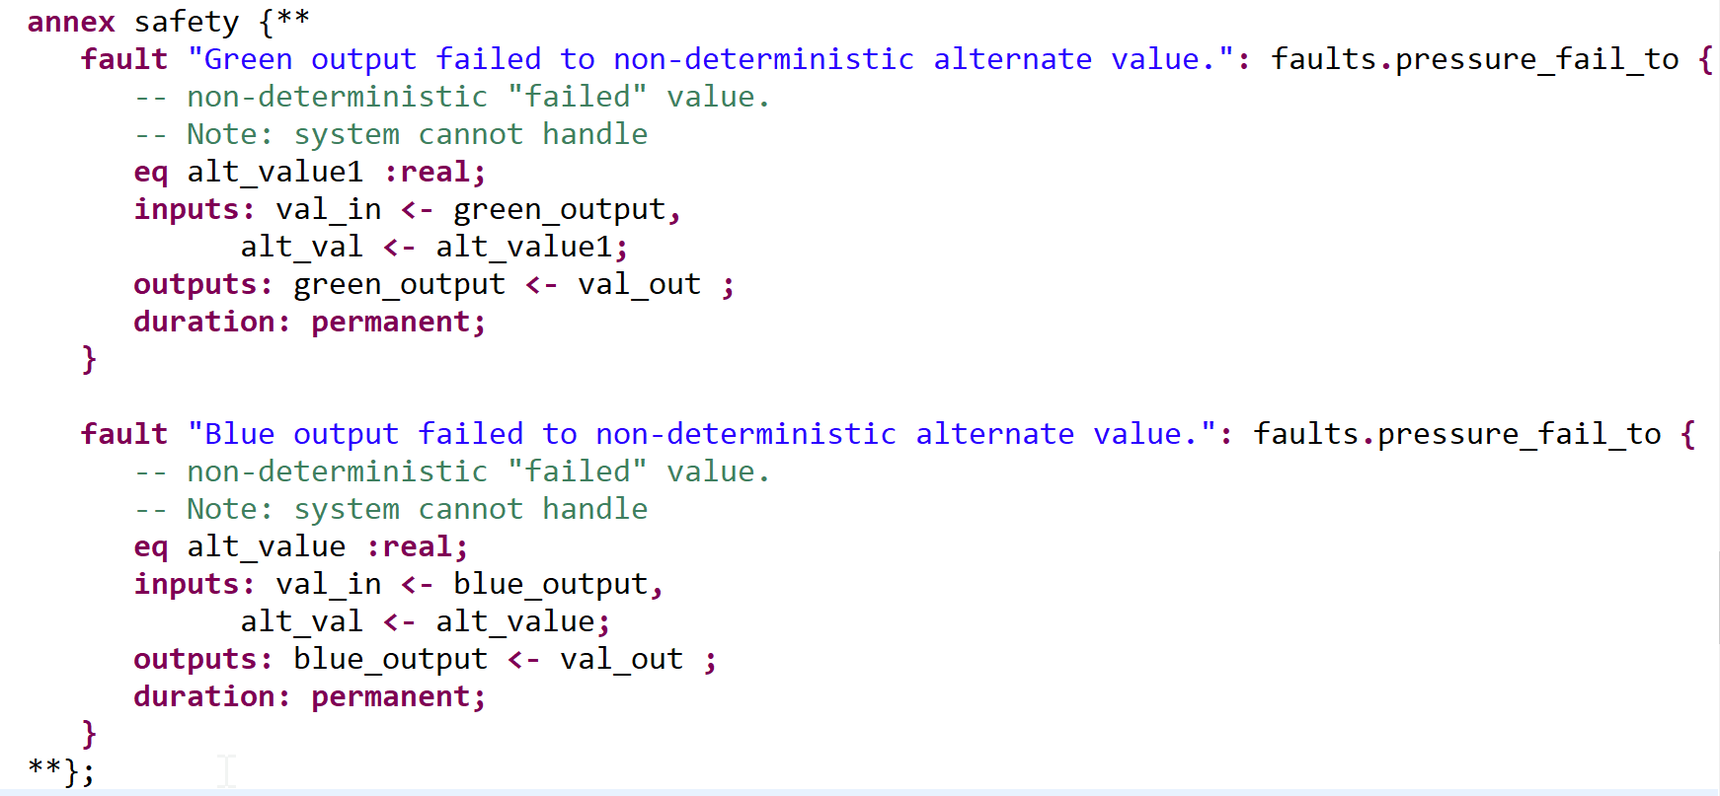

Slide 35
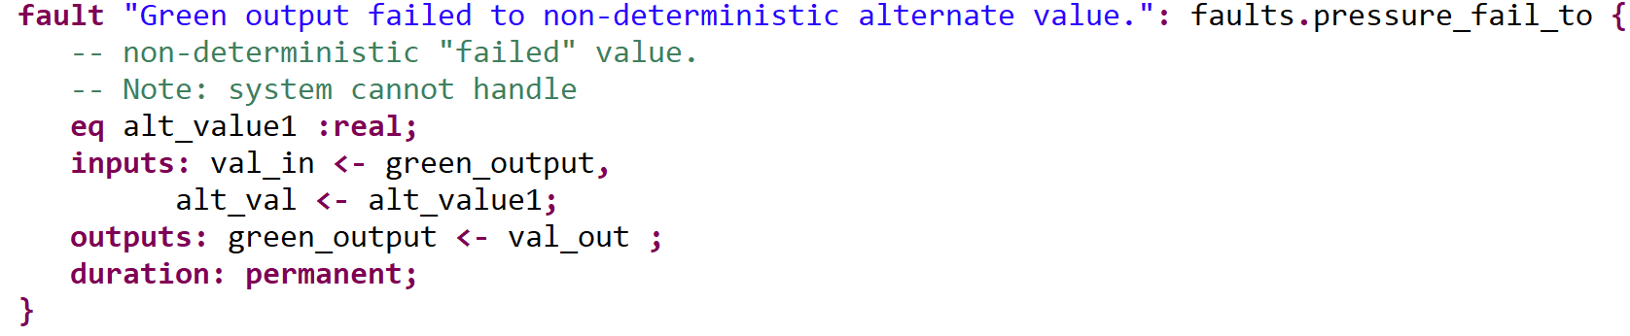

Slide 40
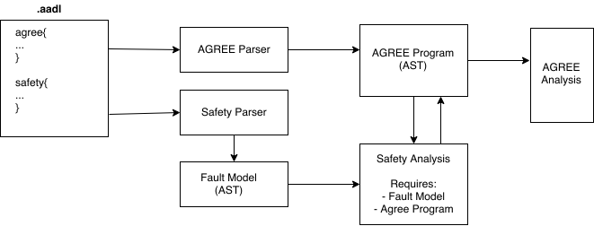
AGREE Extension Point Implementation

Slide 41
Transformation of AGREE AST
Locate references to inputs and outputs in AGREE program

Slide 42

Transformation of AGREE AST
Locate references to inputs and outputs in AGREE program

Slide 43
Transformation of AGREE AST
Locate references to inputs and outputs in AGREE program

Slide 44
Transformation of AGREE AST
Locate references to inputs and outputs in AGREE program
Replace output with nominal fault variable

Slide 45
Transformation of AGREE AST
Locate references to inputs and outputs in AGREE program
Replace output with nominal fault variable
selector.green_output
fault_nominal_green_output

Slide 46
Transformation of AGREE AST
Locate references to inputs and outputs in AGREE program
Replace output with nominal fault variable
Link nominal fault variable to nominal output

Slide 47
Transformation of AGREE AST
Locate references to inputs and outputs in AGREE program
Replace output with nominal fault variable
Link nominal fault variable to nominal output
assert: selector_fault_#_node_val_out = green_output

Slide 48
Transformation of AGREE AST
Locate references to inputs and outputs in AGREE program
Replace output with nominal fault variable
Link nominal fault variable to nominal output
Replace references to nominal variables with nominal fault variables

Slide 49
Transformation of AGREE AST
Locate references to inputs and outputs in AGREE program
Replace output with nominal fault variable
Link nominal fault variable to nominal output
Replace references to nominal variables with nominal fault variables
guarantee: green_output.val <= green_input.val;
guarantee: nominal_fault_green_output.val <= green_input.val;

