Slide 1

Architectural Modeling and Analysis for Safety Engineering
Thesis Proposal, Dec 5th 2019
University of Minnesota
Danielle Stewart

Slide 2
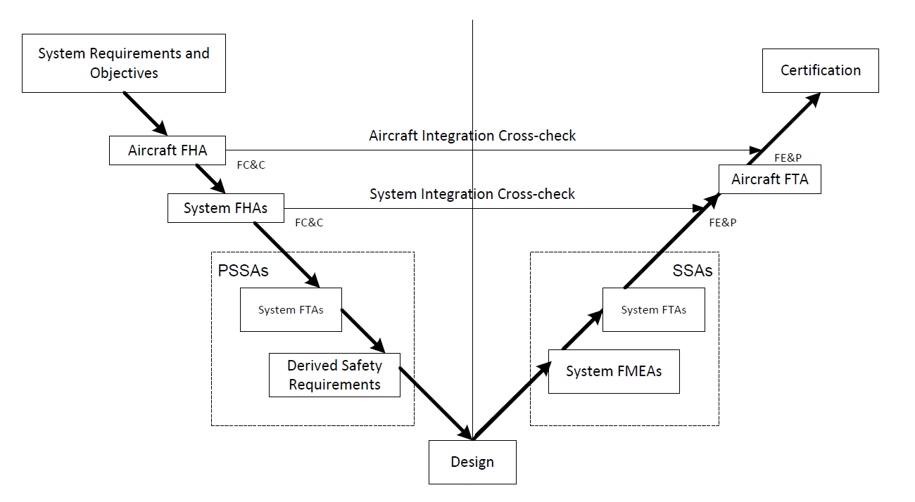
System Development and Safety Assessment
System Development
Safety Analysis

Slide 3
Model Based Safety Analysis
Why Not the
Safety Analysis?
We Base the Entire
Development Cycle
Around the Model

Slide 4
System Dev Model
Fault Model
One approach:
System Dev Model
Add fault model
information
Very complex Model
Another approach:
System Dev Model
Fault Model
Our approach:
Shared Model

Slide 5
Safety Assessment Process
System Development Process
Shared
Model
Development of
System Architecture
System Functional
Hazard Assessment (FHA)
Allocation of System
Requirements to
Hardware and Software
Preliminary System Safety Assessment (PSSA)
Common Cause
Analyses (CCA)
Fault Tree
Analysis (FTA)
System Implementation
System Integration &
Verification
System Safety
Assessment (SSA)

Slide 6
Objective of the Proposal
Formal Verification in Safety Analysis
Define and prove relationships between verification artifacts and safety artifacts
Implementation
Implement algorithms that utilize formal verification relationships

Slide 7
Aims of the Proposal
Define and implement a Safety Annex to enable fault modeling in a modeling language
Define compositional verification capabilities in the face of component failures
Define compositional computation of minimal cut sets
Determine accurate compositional probabilistic computations for top-level events
Evaluate the results using representative models

Slide 8
Aims of the Proposal
Define and implement a Safety Annex to enable fault modeling in a modeling language
Define compositional verification capabilities in the face of component failures
Define compositional computation of minimal cut sets
Determine accurate compositional probabilistic computations for top-level events
Evaluate the results using representative models

Slide 9



Architecture Analysis and Design Language (AADL)
AADL = SAE AS5506 standard
Target: Embedded, real-time, distributed systems
Describes both hardware and software
Extensible syntax (annex)
Open source tools

Slide 10
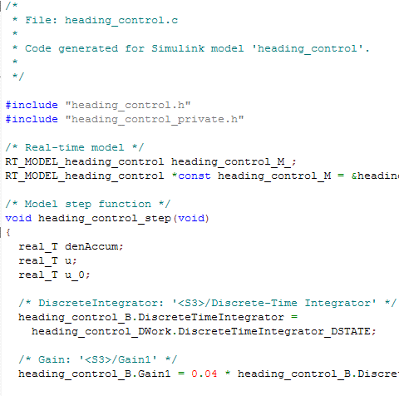
Assume-Guarantee Reasoning Environment (AGREE)
Component Implementation
A system with subcomponents
contract
contract
contract
AGREE
Each component has a contract consisting of assumptions and guarantees
Allows for compositional or monolithic verification
Assumptions (input)
Guarantees (output)

Slide 11
JKind Model Checker
Structured as parallel engines that coordinate to prove properties and perform other verification tasks
AADL System Model
(.aadl)
Abstract Syntax Tree
(.java)
System and Behavioral Model
(.lus)
AADL type and
Implementation
annex agree{**
contracts
**};
AGREE Parser
AGREE Program
JKind Program
(Lustre)
JKind

Slide 12
Implementation of the Safety Annex
AADL System Model
(.aadl)
Abstract Syntax Tree
(.java)
System and Behavioral Model
(.lus)
AADL type and
Implementation
annex agree{**
contracts
**};
annex safety{**
faults
**};
AGREE Parser
AGREE Program
JKind Program
(Lustre)
AGREE Plugin
Extension
Point
AGREE AST with
fault
information
JKind
Safety Parser
Fault Model
Abstract Syntax Tree
(.java)
Safety Plugin

Slide 13
Aims of the Proposal
Define and implement a Safety Annex to enable fault modeling in AADL modeling language
Define verification capabilities in the face of component failures
Define compositional computation of minimal cut sets
Determine accurate compositional probabilistic computations for top-level events
Evaluate the results using representative models in AADL

Slide 14


Verification in the Face of Component Failures
Maximum no. of faults analysis threshold
Are contracts violated in the presence of n active faults?
Probabilistic analysis threshold
Are contracts violated with a probability greater than x?

Slide 15
Flexible Fault Modeling
Behavioral Propagation
The effects of an active fault propagate through the system naturally
Explicit Propagation (dependencies)
Analyst explicitly states dependencies and propagations

Slide 16
Published Papers
Stewart, D., Whalen, M., Cofer, D., Heimdahl, M.P. “Architecture modeling and analysis for safety engineering.” IMBSA, (2017)
Stewart, D., Liu, J., Whalen, M., Cofer, D., Heimdahl, M.P., Cofer, D., Whalen, M.W., Peterson, M. “The safety annex for architecture analysis and design language.” To appear ERTS, (2020)
Stewart, D., Liu, J., Heimdahl, M., Whalen, M.W., Cofer, D., Peterson, M. “Architectural modeling and analysis for safety engineering (AMASE), NASA Final Report, (2019).

Slide 17
Aims of the Proposal
Define and implement a Safety Annex to enable fault modeling in AADL modeling language
Define compositional verification capabilities in the face of component failures
Define compositional computation of minimal cut sets
Determine accurate compositional probabilistic computations for top-level events
Evaluate the results using representative models in AADL

Slide 18
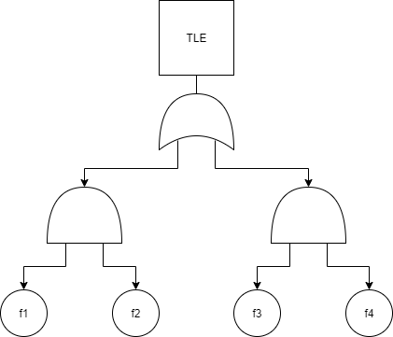
Minimal Cut Sets
  Minimal Cut Sets : Minimal set of faults that cause top level event
  Currently computed monolithically

Slide 19

Constraint System
$$Constraint System:Ordered set of constraints$$
$$over variables$$
$C=\{¬a, a→b,b\}$ : Satisfiable
$C=\{a, ¬a,¬a∨b,¬b\}$: Unsatisfiable

Slide 20


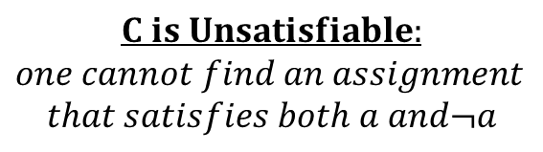
Minimal Unsatisfiable Subsets
$$Constraint System:$$
$$C=\{a, ¬a,¬a∨b,¬b\}$$
$$What are the minimal reasons$$
$$for unsatisfiability?$$
$$These are the MUSs:$$
$$MUS 1 :\left\{a,¬a\right\}$$
$$MUS 2:\{a,¬a ∨b,¬b\}$$
$$C is Unsatisfiable:$$
$$one cannot find an assignment$$
$$that satisfies both a and¬a$$
$$Minimal Unsatisfiable Subset: M is a subset of C such that M is UNSAT$$
$$and ∀c∈M, M\backslash \{c\} is SAT$$

Slide 21


Inductive Validity Cores
  Given a constraint system, MIVC algorithm returns the minimal set of elements necessary to find proof of property P.
$$Minimal Unsatisfiable Subsets$$
$$\left(Minimal Inductive Validity Cores\right)$$
$$All counterexamples for the$$
$$unsatisfiable constraint$$
$$system.$$
Ghassabani, E., Whalen, M.W., and Gacek, A. “Efficient generation of all minimal inductive validity cores” FMCAD, (2017)
Model Checker

Slide 22

Minimal Inductive Validity Cores
  A requirement of the MIVC algorithm is that the safety property P proves given constraints, $c_{1},c_{2},…,c_{n}$.
  The constraint system for the MIVC algorithm is: $\{c_{1},c_{2},…,c_{n},¬P\}$
  Given the assumption above, this constraint system is UNSAT
  MIVC algorithm finds the minimal UNSAT cores for the unsatisfiable constraint system.

Slide 23


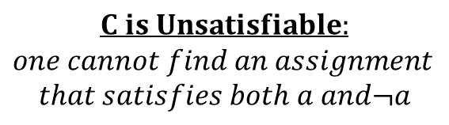
Minimal Correction Sets
$$Constraint System$$
$$C=\{a, ¬a,¬a∨b,¬b\}$$
$$What are the minimal corrections that$$
$$can be made to make C SAT?$$
$$These are the MCSs:$$
$$MCS 1 :\left\{a\right\}$$
$$MCS 2:\left\{¬a,¬b\right\}$$
$$MCS 3:\{¬a,¬a ∨b\}$$
$$C is Unsatisfiable:$$
$$one cannot find an assignment$$
$$that satisfies both a and¬a$$
$$Minimal Correction Set: M is a subset of C such that C\backslash M is SAT$$
$$and ∀S⊂M, C\backslash S is UNSAT$$

Slide 24

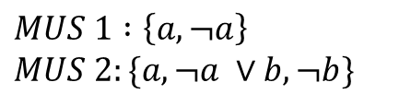

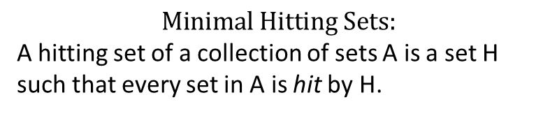


Duality of MUS and MCS:
Minimal Hitting Sets
$$MUS 1 :\left\{a,¬a\right\}$$
$$MUS 2:\{a,¬a ∨b,¬b\}$$
$$MCS 1 :\left\{a\right\}$$
$$MCS 2:\left\{¬a,¬b\right\}$$
$$MCS 3:\{¬a,¬a ∨b\}$$
$$Minimal Hitting Sets:$$
A hitting set of a collection of sets A is a set H such that every set in A is hit by H.
$A=\left\{MUS1, MUS2\right\}=\{\left\{a,¬a\right\}$, {$a,¬a ∨b,¬b\}\};$
$$H1=\{a\}$$
$$H2=\{¬a,¬a ∨b\}$$
$$H3=\{¬a,¬b\}$$

Slide 25
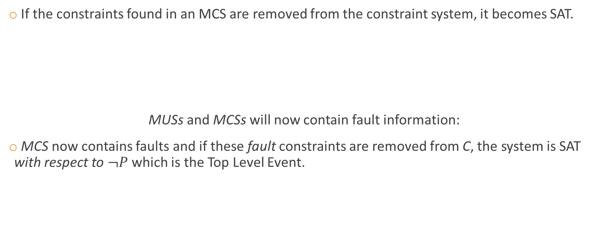
What do MCSs have to do with safety?
If the constraints found in an MCS are removed from the constraint system, it becomes SAT.
MUSs and MCSs will now contain fault information:
MCS now contains faults and if these fault constraints are removed from C, the system is SAT with respect to $¬P$ which is the Top Level Event.
$$C=\{¬f_{1},…,¬f_{n}\text{,}c_{1},…,c_{m},¬P\}$$

Slide 26


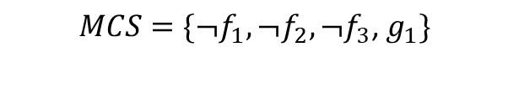
MCS to MinCutSet
$$MCS=\left\{¬f_{1},¬f_{2},¬f_{3}\right\}$$
$$MinCutSet=\{f_{1},f_{2},f_{3}\}$$
Case 1:
MCS only contains fault literals
  → Remove constraints on faults
Case 2:
MCS contains faults and contracts
  → Replace contracts with faults that cause
  their violation
  → Remove constraints on faults
$$MCS=\{¬f_{1},¬f_{2},¬f_{3}\text{,}{ g}_{1}\}$$
$$MinCutSet(g_{1})=\{f_{4}\}$$
$$MinCutSet=\{f_{1},f_{2},f_{3}{,f}_{4}\}$$

Slide 27
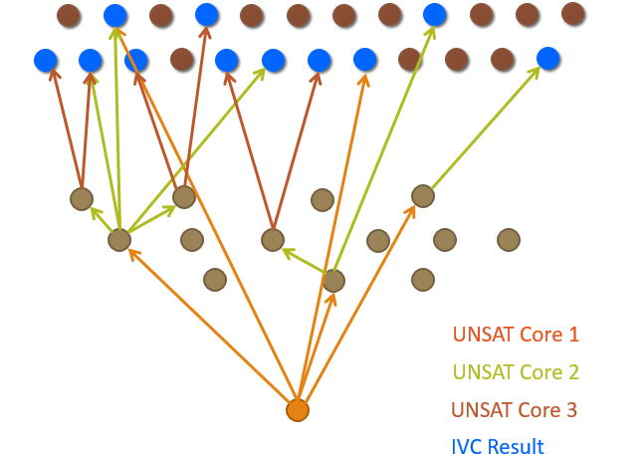




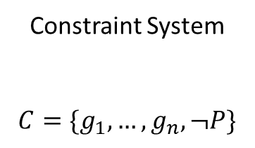



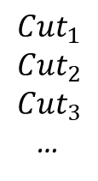




The Main Idea
1. Add constrained faults
to constraint system
2. Get all MUSs from
All-MIVC algorithm
Constraint System
$$C=\{g_{1},…,g_{n},¬P\}$$
$${MCS}_{1}$$
All MUSs
$${Cut}_{1}$$
$${Cut}_{2}$$
$${Cut}_{3}$$
…
$${MCS}_{1}$$
$${MCS}_{3}$$
$${MCS}_{5}$$
$${¬f}_{1}$$
$${MCS}_{2}$$
$${MCS}_{4}$$
$$¬f_{2}$$
$${¬f}_{3}$$
3. Get all MCSs from
Hitting Set Algorithm
4. Transform MCSs
Into MinCutSets
$${¬f}_{4}$$
$$¬ f_{5}$$

Slide 28
Aims of the Proposal
Define and implement a Safety Annex to enable fault modeling in AADL modeling language
Define compositional verification capabilities in the face of component failures
Define compositional computation of minimal cut sets
Determine accurate compositional probabilistic computations for top-level events
Evaluate the results using representative models in AADL

Slide 29
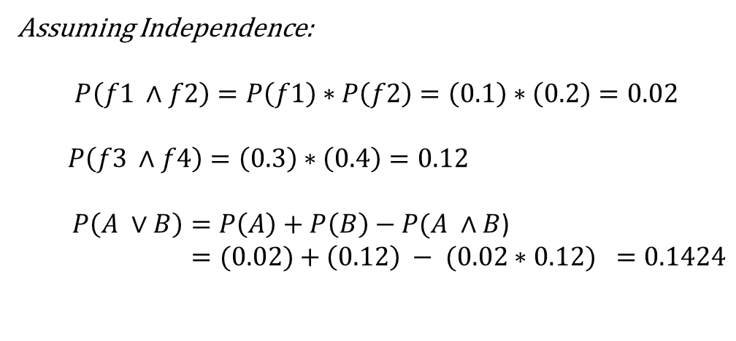
Probabilistic Computations over FTs
0.1424
Assuming Independence:
$$P\left(f1 ∧f2\right)=P\left(f1\right)∗P\left(f2\right)=\left(0.1\right)∗\left(0.2\right)=0.02$$
$P\left(f3 ∧f4\right)=\left(0.3\right)∗\left(0.4\right)=0.12$
$P\left(A ∨B\right)=P\left(A\right)+P\left(B\right)−P(A ∧B$)
$$=(0.02)+\left(0.12\right) − (0.02∗0.12) =0.1424$$
0.02
0.12
P(f1) = 0.1
P(f2) = 0.2
P(f3) = 0.3
P(f4) = 0.4

Slide 30
Problem with this approach
One must have all MinCutSets to make the computation
→ In large scale systems, this is computationally difficult.
Problem often addressed by setting thresholds on cardinality of MinCutSets
→ Assume it is too unlikely for many faults to occur at once.
→ Approximate error by a few orders of magnitude.

Slide 31

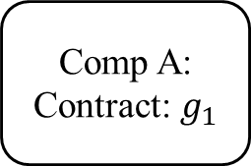
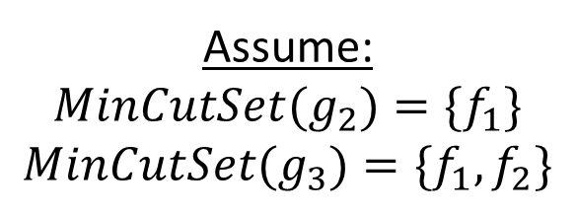


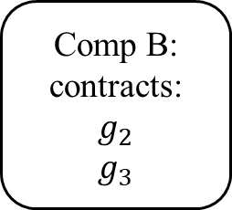
Naïve Approach to Computation Roll-up
Comp A: Contract: $g_{1}$
Assume:
$${MinCutSet(g}_{2})={\{f}_{1}\}$$
$${MinCutSet(g}_{3})={\{f}_{1},f_{2}\}$$
…
Assume:
For $g_{1}$ to be violated,
both $g_{2}$ and $g_{3}$
must also be violated.
$${MinCutSet(g}_{1})={\{f}_{1},f_{2}\}$$
$${P (¬g}_{1})={P(f}_{1})∗P(f_{2})$$
Comp B: contracts:
$$g_{2}$$
$$g_{3}$$
…
$$f_{1}$$
$$f_{2}$$

Slide 32
Naïve Approach to Computation Roll-up
Comp A: Contract: $g_{1}$
Replace guarantees with probabilities of their MinCutSets
Roll computations from bottom up
…
Comp B: contracts:
$$g_{2}$$
$$g_{3}$$
→ Solves scalability problem of
dealing with set replacements and
instead only deals with numbers.
…
$$f_{1}$$
$$f_{2}$$

Slide 33
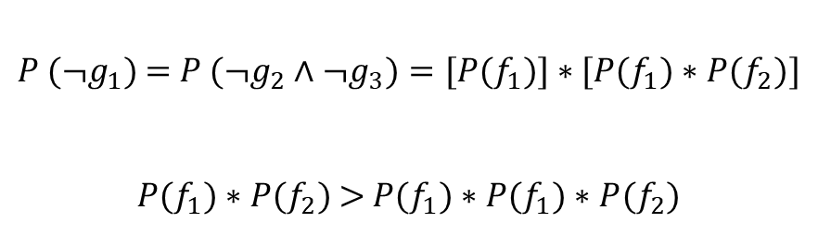
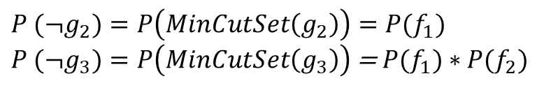
Naïve Approach to Computation Roll-up
Comp A: Contract: $g_{1}$
$${P (¬g}_{2})={P\left(MinCutSet\left(g_{2}\right)\right)=P(f}_{1})$$
${P (¬g}_{3})=P\left(MinCutSet\left(g_{3}\right)\right)$ = ${P(f}_{1})∗$ ${P(f}_{2})$
${P (¬g}_{1})$ = ${{P (¬g}_{2}{∧¬g}_{3})=[P(f}_{1})]∗{[P(f}_{1})∗$ ${P(f}_{2})]$
${P(f}_{1})∗$ ${P(f}_{2})$ >${ P(f}_{1}){∗P(f}_{1})∗$ ${P(f}_{2})$
…
Comp B: contracts:
$$g_{2}$$
$$g_{3}$$
…
Unsafe approximation: we report lower probability than the actual.
$$f_{1}$$
$$f_{2}$$

Slide 34
Probabilistic Computation Solutions
If all MinCutSets can be easily found, give full computation results.
If not:
  Use cardinality threshold as under approximation and estimate error term.
  Give under approximation using naïve approach and over approximation using (?)

Slide 35
Aims of the Proposal
Define and implement a Safety Annex to enable fault modeling in AADL modeling language
Define compositional verification capabilities in the face of component failures
Define compositional computation of minimal cut sets
Determine accurate compositional probabilistic computations for top-level events
Evaluate the results using representative models in AADL

Slide 36
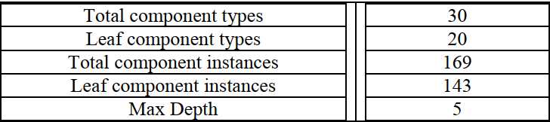
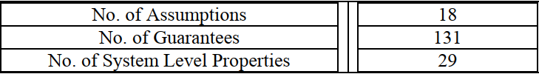
Evaluation using Representative AADL Models
WBS: Large scale wheel brake system for aircraft

Slide 37
Evaluation using Representative AADL Models
WBS: Large scale wheel brake system for aircraft
  Scalability: The size of the model will give an idea for how useful the tool and algorithms are for industrial sized systems
  MBSA: The artifacts generated should give valuable information to analysts for system development
  Behavioral analysis: The analysis should show additional information about the behavior of components in the face of failure
  Certification: The artifacts generated should be usable in the certification process
Smaller models
  MBSA
  Examples of rich fault modeling

Slide 38
Proposed Timeline
Dec 2019 - Feb 2020: Outline and prove probabilistic methods and algorithms for compositional computations.
Dec 2019 - Feb 2020: Complete the implementation of both minimal cut set generation and probabilistic computations.
Feb - March 2020: Complete the implementation of the graphical representation of hierarchical fault trees.
Dec 2019 - April 2020: Write the dissertation.
May 2020: Complete any requested edits on dissertation.
June 2020: Defend dissertation and complete final changes.

Slide 39
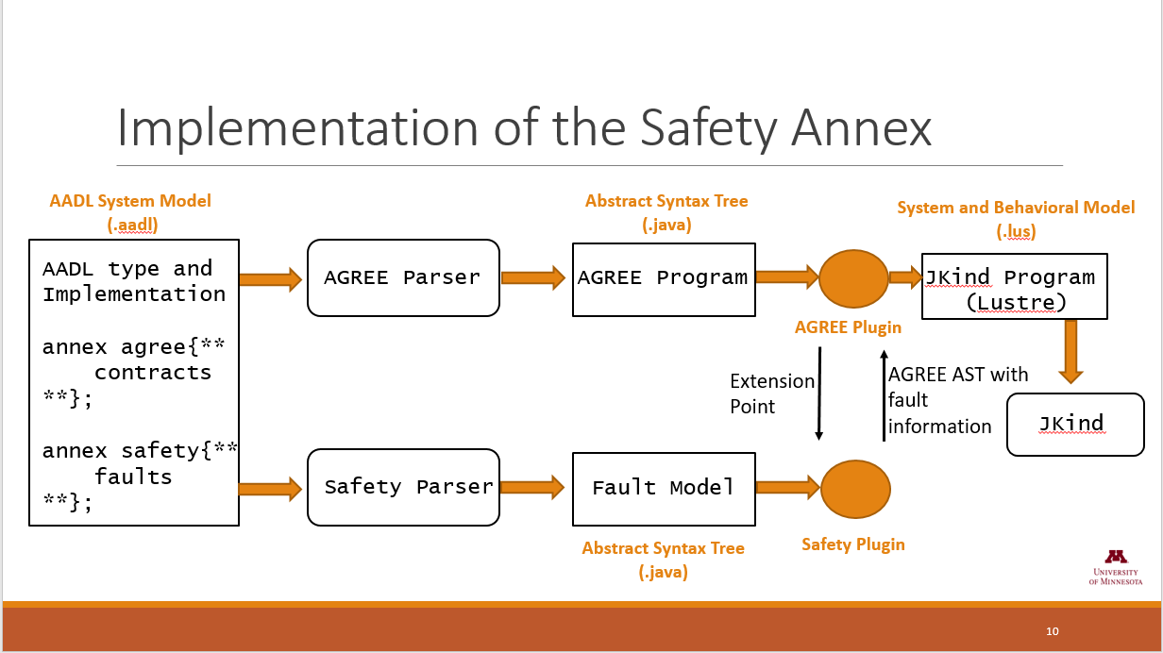
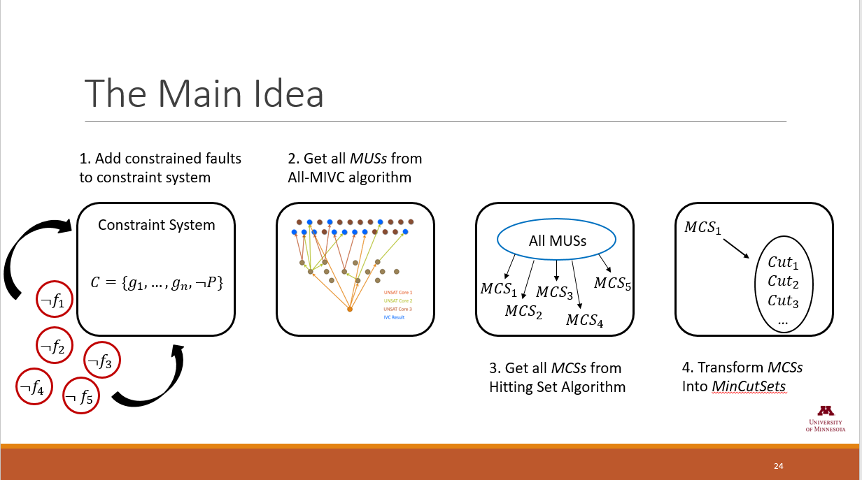
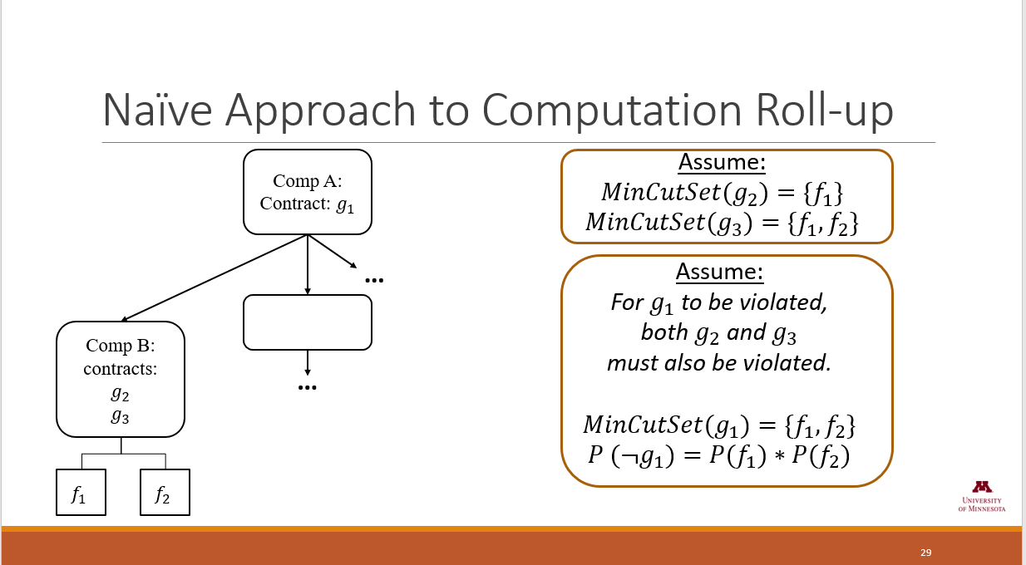
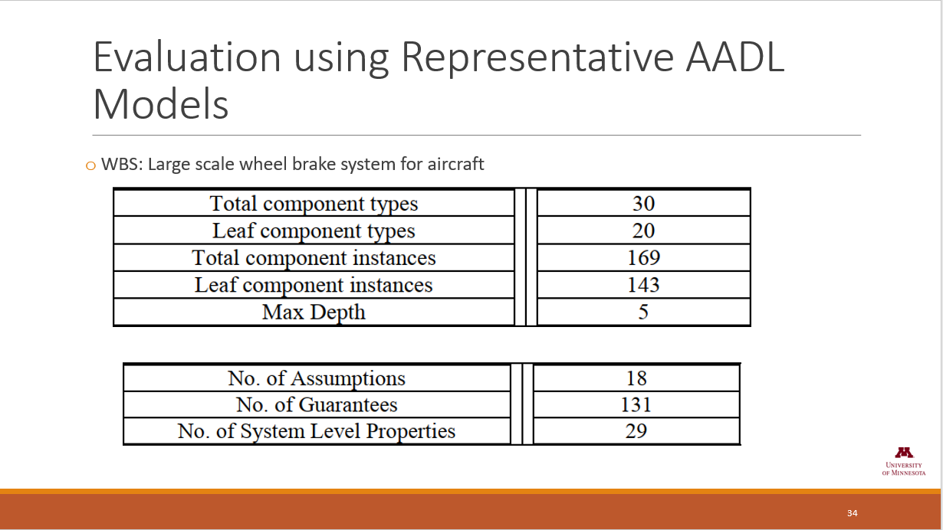
Questions?

