Slide 1

Formal Methods and Safety Analysis
  Development of highly complex safety critical systems
University of Minnesota
Danielle Stewart
dkstewar@umn.edu

Slide 2

Formal Methods in Model-based Engineering
Develop reliable complex systems… how?
  User requirements
  Decompose user requirements into lower level functional requirements
  Build system architecture
  Test that the system works as intended
What about formal methods?
  An additional method used to verify that the system behavior meets the specified requirements
  Using formal models allows some verification objectives to be satisfied by use of formal analysis

Slide 3
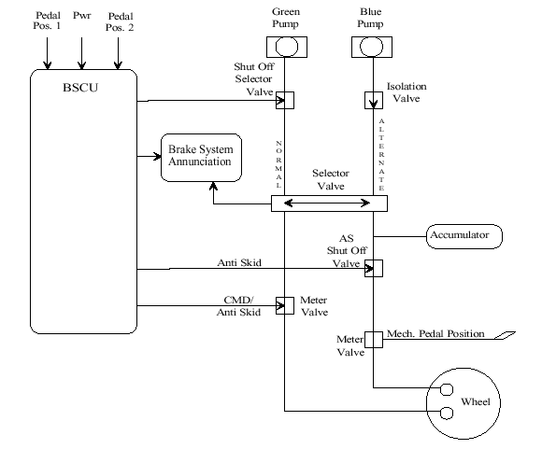
Wheel Brake System : Preliminary System Diagram

Slide 4
Modeling the System
We Base the Entire
Development Cycle
Around the Model

Slide 5
A Simple Model of the System
Wheel Brake System: Top Level
Control/Digital System
Mechanical System

Slide 6

Considerations for Formal Methods
Given a verification objective:
All notations must be precise and unambiguous
The soundness method should be justified
All assumptions should be described and justified

Slide 7
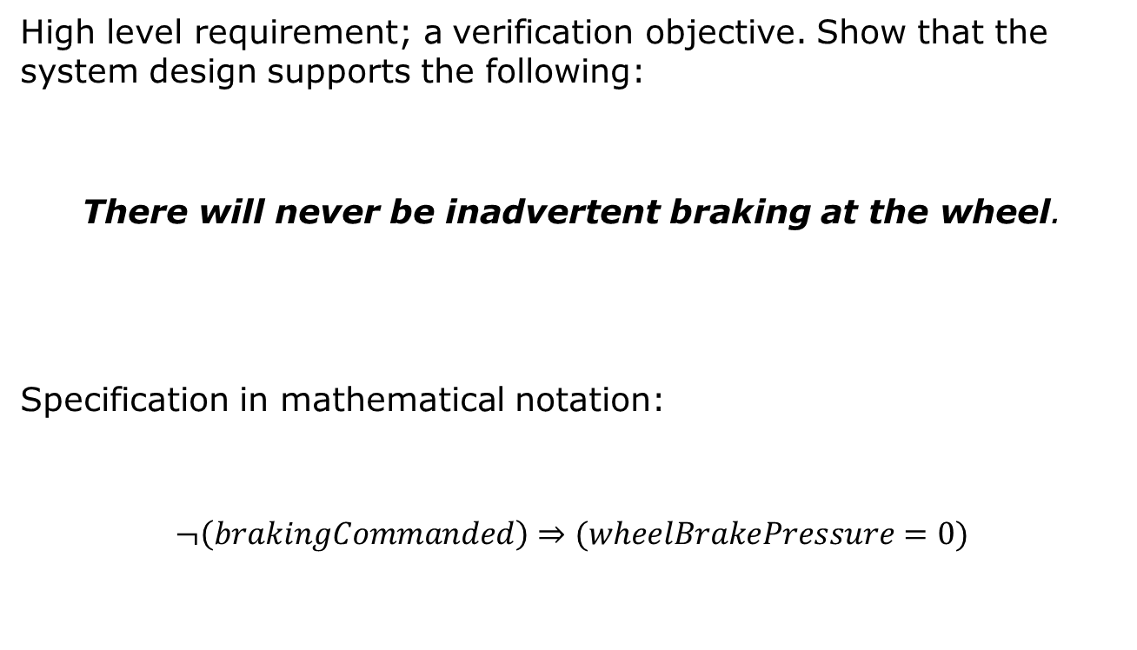
Requirement Specification
High level requirement; a verification objective. Show that the system design supports the following:
There will never be inadvertent braking at the wheel.
Specification in mathematical notation:
$$¬\left(brakingCommanded\right)⇒(wheelBrakePressure=0)$$

Slide 8
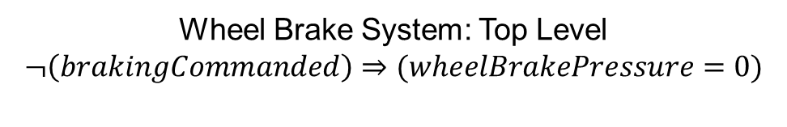
A Simple Model of the System
Wheel Brake System: Top Level
$$¬\left(brakingCommanded\right)⇒(wheelBrakePressure=0)$$
Control/Digital System
Mechanical System
Subcomponent requirements must support verification objective.

Slide 9
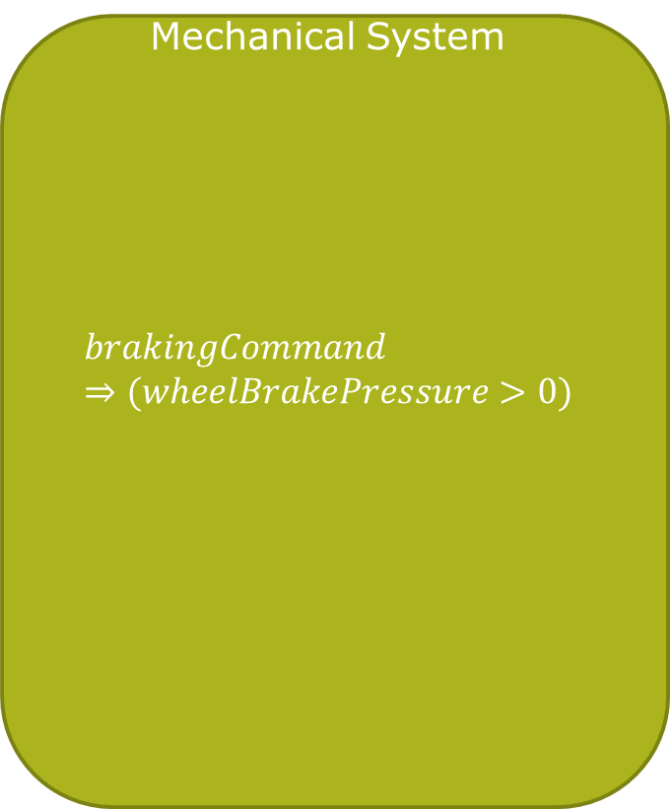
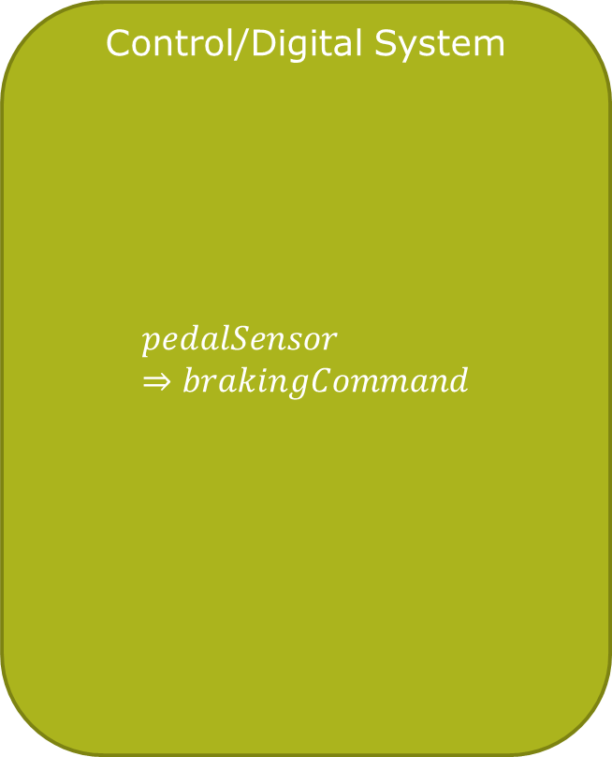
A Simple Model of the System
Control/Digital System
$$pedalSensor⇒brakingCommand$$
Mechanical System
$$brakingCommand⇒(wheelBrakePressure>0)$$
Pedal Sensor Input
Braking Command Input
Command Braking Output
Wheel Brake Pressure Output

Slide 10

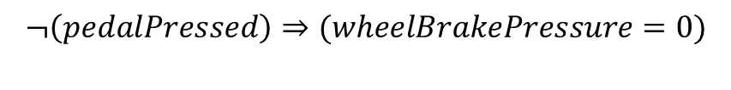
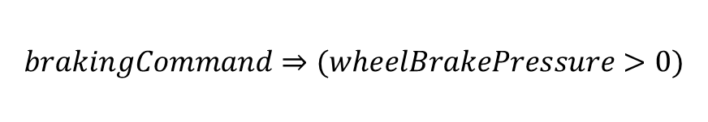
Lower level component contracts with assumptions on environment used to prove the verification objective:
$$¬\left(pedalPressed\right)⇒(wheelBrakePressure=0)$$
$$pedalSensor⇒brakingCommand$$
$$brakingCommand⇒(wheelBrakePressure>0)$$

Slide 11
Considerations for Formal Methods
Given a verification objective:
All notations must be precise and unambiguous
The soundness method should be justified
All assumptions should be described and justified

Slide 12



Are the results sound?
Know your tools and verification engines.
Enter “obvious” properties into the model to test your specifications.
$$¬\left(pedalPressed\right)$$
FALSE
$$\left(wheelBrakePressure=0\right)$$
$$¬\left(brakingCommanded\right)$$

Slide 13
Considerations for Formal Methods
Given a verification objective:
All notations must be precise and unambiguous
The soundness method should be justified
All assumptions should be described and justified

Slide 14



Assumptions: Constrain the Environment
Assumptions are used as axioms in the proof. A stronger assumption makes things easier to prove… but is the assumption valid?
Make sure assumptions are reasonable.
$$assume (speed≥ 0)$$
$$assume (0≤ speed<100)$$
?

Slide 15
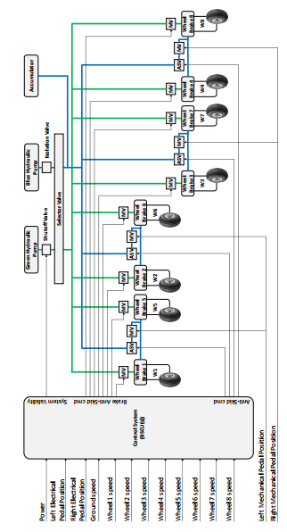
Iterations of the Process Throughout Development
FBK: AIR6110 Case Study
Notes:
The large WBS example.

Slide 16
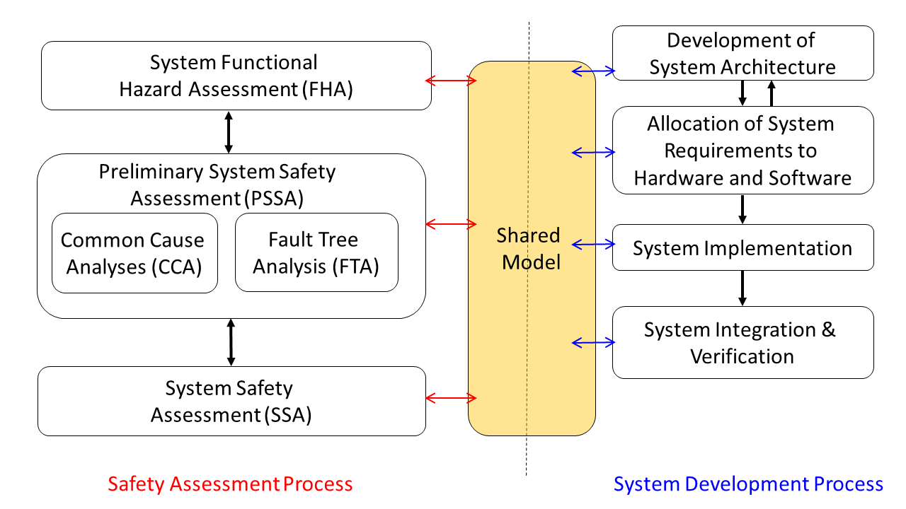
Model-based Safety Assessment Process
Use single unified model to support both system design and safety analysis
Notes:
This figure presents our proposed use of this shared system design and safety analysis
model in the context of the ARP4754A Safety Assessment Process Model (derived from
Figure 7 of ARP4754A). The shared model is one of the system development artifacts
from the “Development of System Architecture” and “Allocation of System Requirements
to Item” activities in the System Development Process, which interacts with the
PSSAs and SSAs activities in the Safety Assessment Process. The shared model can
serve as an interface to capture the information from the system design and implementation
that is relevant for the safety analysis.

Slide 17
Safety Engineers
System Engineers
Starts
Check that safety requirements are satisfied by the nominal design model with formal verification
Capture Design Information in a shared model (architecture, nominal behavior, system level safety requirements)
Augment the nominal model with the component failure modes
Specify the fault hypothesis for the analysis
Analyze if the safety requirements are satisfied by the design in the presence of faults through formal verification, using system traces and minimal cut sets produced for diagnosis
Ends
Examine the results to assess the validity of the fault combinations and the fault tolerance level of the system design
Drive for design change
Notes:
This figure presents our proposed use of this shared system design and safety analysis
model in the context of the ARP4754A Safety Assessment Process Model (derived from
Figure 7 of ARP4754A). The shared model is one of the system development artifacts
from the “Development of System Architecture” and “Allocation of System Requirements
to Item” activities in the System Development Process, which interacts with the
PSSAs and SSAs activities in the Safety Assessment Process. The shared model can
serve as an interface to capture the information from the system design and implementation
that is relevant for the safety analysis.

Slide 18



Architecture Analysis and Design Language (AADL)
AADL = SAE AS5506 standard
Target: Embedded, real-time, distributed systems
Describes both hardware and software
Extensible syntax (annex)
Open source tools, supported by SEI

Slide 19
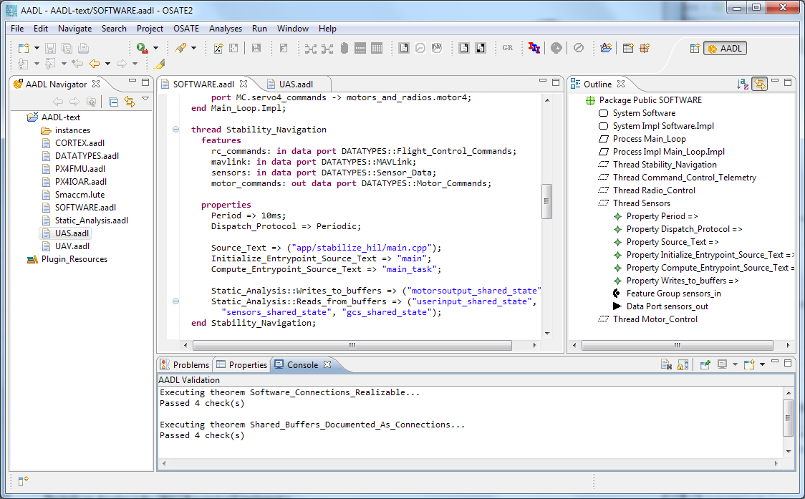


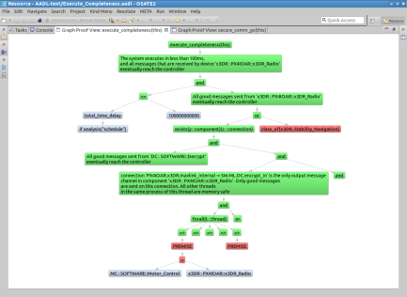
Architecture Modeling and Analysis Tools
Resolute
OSATE
AGREE
Trusted
Build
SIM
TCG
Architecture Models
Architecture Translation
Architecture Analysis
A
C
Assumption: Input < 20
Guarantee: Output < 2*Input
Assumption: none
Guarantee: Output = Input1 + Input2
B
seL4
Assumption: Input < 20
Guarantee: Output < Input + 15
Assumption: Input < 10
Guarantee: Output < 50
eChronos
VxWorks
Kind/JKind
Model Checker
Notes:
START AGREE HERE

Slide 20
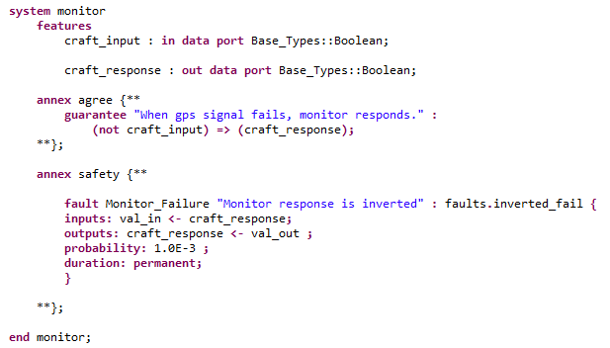
AGREE:
Assume Guarantee
Reasoning Environment
Each component has a contract consisting of assumptions and guarantees
  Assumptions: Constraints over what a component expects from its environment
  Guarantees: Constraints over how a component behaves in response to its environment (requirements)

Slide 21
Safety Annex for AADL
Define faults on component output
Behavioral propagation through AGREE contracts
Independence or dependence between faults can be captured
Generates output such as:
  Counterexamples showing active faults and how they propagate
  Probabilistic analysis using a probability threshold
  Minimal Cut Sets in terms of cardinality or probability
Notes:
This figure presents our proposed use of this shared system design and safety analysis
model in the context of the ARP4754A Safety Assessment Process Model (derived from
Figure 7 of ARP4754A). The shared model is one of the system development artifacts
from the “Development of System Architecture” and “Allocation of System Requirements
to Item” activities in the System Development Process, which interacts with the
PSSAs and SSAs activities in the Safety Assessment Process. The shared model can
serve as an interface to capture the information from the system design and implementation
that is relevant for the safety analysis.

Slide 22
Safety Annex
Safety syntax is incorporated as an annex of AADL

Slide 23
Behavioral Failure Propagation
Wrap nominal component output in fault
Watch behavior of system through AGREE contracts when fault is activated
Component A
Component B
Out
In
Nominal Behavior:
Component A
Component B
Out
Fault
In
Fault Behavior:

Slide 24
MBSA Steps: WBS and AADL/AGREE/Safety Annex
Safety Engineers
System Engineers
Check that safety requirements are satisfied by the nominal design model with the backend model checker
Capture Design Information in a shared AADL/AGREE model (architecture, nominal behavior, system level safety requirements)
Augment the nominal model with the component failure modes
Specify the fault hypothesis for the analysis
Analyze if the safety requirements are satisfied by the design in the presence of faults with the backend model checker, using counterexamples and minimal cut sets produced for diagnosis
Examine the results to assess the validity of the fault combinations and the fault tolerance level of the system design
Drive for design change
Notes:
This figure presents our proposed use of this shared system design and safety analysis
model in the context of the ARP4754A Safety Assessment Process Model (derived from
Figure 7 of ARP4754A). The shared model is one of the system development artifacts
from the “Development of System Architecture” and “Allocation of System Requirements
to Item” activities in the System Development Process, which interacts with the
PSSAs and SSAs activities in the Safety Assessment Process. The shared model can
serve as an interface to capture the information from the system design and implementation
that is relevant for the safety analysis.

Slide 25
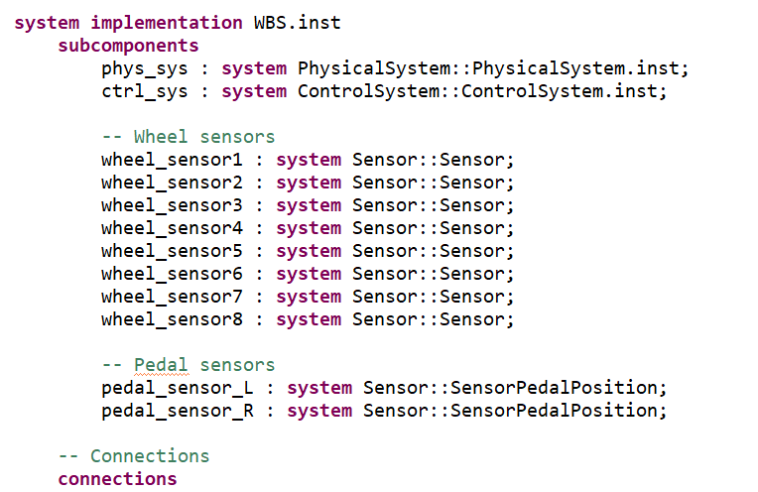
System Architecture in AADL

Slide 26
MBSA Steps: WBS and AADL/AGREE/Safety Annex
Safety Engineers
System Engineers
Check that safety requirements are satisfied by the nominal design model with the backend model checker
Capture Design Information in a shared AADL/AGREE model (architecture, nominal behavior, system level safety requirements)
Augment the nominal model with the component failure modes
Specify the fault hypothesis for the analysis
Analyze if the safety requirements are satisfied by the design in the presence of faults with the backend model checker, using counterexamples and minimal cut sets produced for diagnosis
Examine the results to assess the validity of the fault combinations and the fault tolerance level of the system design
Drive for design change
Notes:
This figure presents our proposed use of this shared system design and safety analysis
model in the context of the ARP4754A Safety Assessment Process Model (derived from
Figure 7 of ARP4754A). The shared model is one of the system development artifacts
from the “Development of System Architecture” and “Allocation of System Requirements
to Item” activities in the System Development Process, which interacts with the
PSSAs and SSAs activities in the Safety Assessment Process. The shared model can
serve as an interface to capture the information from the system design and implementation
that is relevant for the safety analysis.

Slide 27
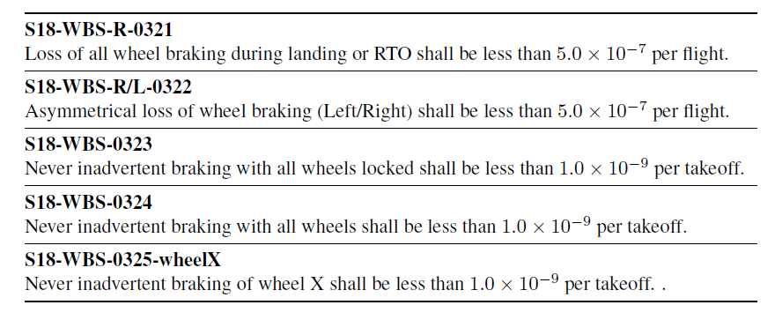
Top Level Safety Properties

Slide 28
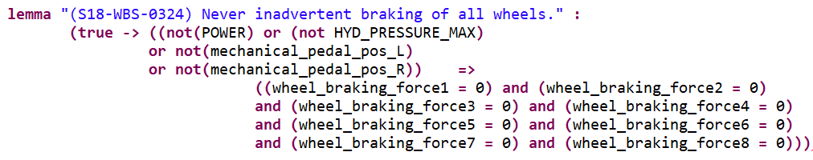
Top Level Safety Properties

Slide 29
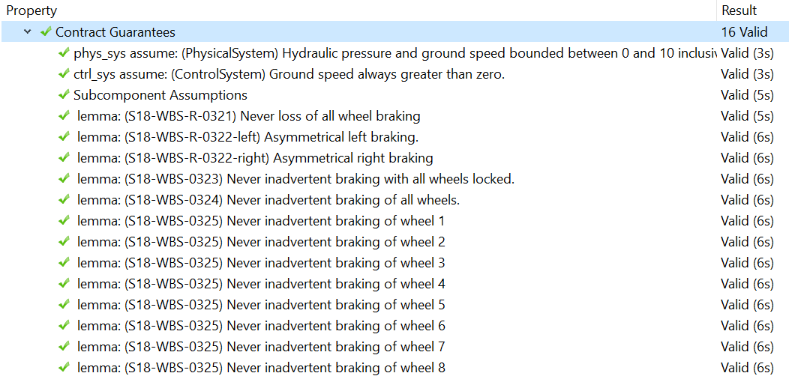
Nominal Model Analysis Output

Slide 30
MBSA Steps: WBS and AADL/AGREE/Safety Annex
Safety Engineers
System Engineers
Check that safety requirements are satisfied by the nominal design model with the backend model checker
Capture Design Information in a shared AADL/AGREE model (architecture, nominal behavior, system level safety requirements)
Augment the nominal model with the component failure modes
Specify the fault hypothesis for the analysis
Analyze if the safety requirements are satisfied by the design in the presence of faults with the backend model checker, using counterexamples and minimal cut sets produced for diagnosis
Examine the results to assess the validity of the fault combinations and the fault tolerance level of the system design
Drive for design change
Notes:
This figure presents our proposed use of this shared system design and safety analysis
model in the context of the ARP4754A Safety Assessment Process Model (derived from
Figure 7 of ARP4754A). The shared model is one of the system development artifacts
from the “Development of System Architecture” and “Allocation of System Requirements
to Item” activities in the System Development Process, which interacts with the
PSSAs and SSAs activities in the Safety Assessment Process. The shared model can
serve as an interface to capture the information from the system design and implementation
that is relevant for the safety analysis.

Slide 31
Defining Faults on Component Outputs
Valves
  Stuck open
  Stuck closed
  Stuck nondeterministically
Sensors
  Output inverted
Pumps
  Output zero
Calculating components and Gates
  Erroneous data

Slide 32
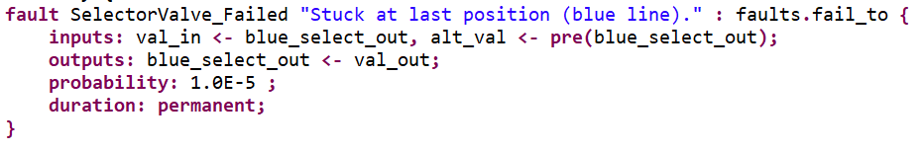
A Fault Definition
Blue line out
(blue_select_out)
Blue pump in
Selector Valve
Green pump in
Green line out

Slide 33
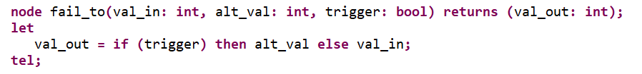
Fault Node Definition
Fault node defines behavior of fault when activated
Commonly used fault nodes held in library
Users can define nodes specific to a domain

Slide 34
MBSA Steps: WBS and AADL/AGREE/Safety Annex
Safety Engineers
System Engineers
Check that safety requirements are satisfied by the nominal design model with the backend model checker
Capture Design Information in a shared AADL/AGREE model (architecture, nominal behavior, system level safety requirements)
Augment the nominal model with the component failure modes
Specify the fault hypothesis for the analysis
Analyze if the safety requirements are satisfied by the design in the presence of faults with the backend model checker, using counterexamples and minimal cut sets produced for diagnosis
Examine the results to assess the validity of the fault combinations and the fault tolerance level of the system design
Drive for design change
Notes:
This figure presents our proposed use of this shared system design and safety analysis
model in the context of the ARP4754A Safety Assessment Process Model (derived from
Figure 7 of ARP4754A). The shared model is one of the system development artifacts
from the “Development of System Architecture” and “Allocation of System Requirements
to Item” activities in the System Development Process, which interacts with the
PSSAs and SSAs activities in the Safety Assessment Process. The shared model can
serve as an interface to capture the information from the system design and implementation
that is relevant for the safety analysis.

Slide 35


Specify Fault Hypothesis Statement
Located in system implementation
Max N Fault Analysis
Probabilistic Analysis
Notes:
This figure presents our proposed use of this shared system design and safety analysis
model in the context of the ARP4754A Safety Assessment Process Model (derived from
Figure 7 of ARP4754A). The shared model is one of the system development artifacts
from the “Development of System Architecture” and “Allocation of System Requirements
to Item” activities in the System Development Process, which interacts with the
PSSAs and SSAs activities in the Safety Assessment Process. The shared model can
serve as an interface to capture the information from the system design and implementation
that is relevant for the safety analysis.

Slide 36
MBSA Steps: WBS and AADL/AGREE/Safety Annex
Safety Engineers
System Engineers
Check that safety requirements are satisfied by the nominal design model with the backend model checker
Capture Design Information in a shared AADL/AGREE model (architecture, nominal behavior, system level safety requirements)
Augment the nominal model with the component failure modes
Specify the fault hypothesis for the analysis
Analyze if the safety requirements are satisfied by the design in the presence of faults with the backend model checker, using counterexamples and minimal cut sets produced for diagnosis
Examine the results to assess the validity of the fault combinations and the fault tolerance level of the system design
Drive for design change
Notes:
This figure presents our proposed use of this shared system design and safety analysis
model in the context of the ARP4754A Safety Assessment Process Model (derived from
Figure 7 of ARP4754A). The shared model is one of the system development artifacts
from the “Development of System Architecture” and “Allocation of System Requirements
to Item” activities in the System Development Process, which interacts with the
PSSAs and SSAs activities in the Safety Assessment Process. The shared model can
serve as an interface to capture the information from the system design and implementation
that is relevant for the safety analysis.

Slide 37
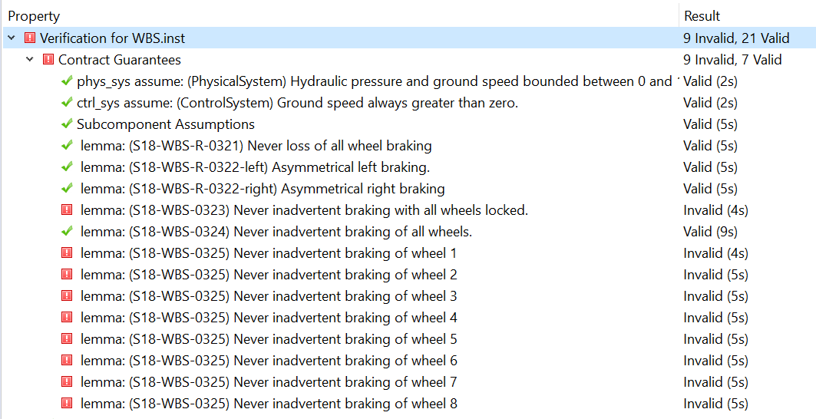
Analysis Results
Max 1 Fault Analysis:
Notes:
This figure presents our proposed use of this shared system design and safety analysis
model in the context of the ARP4754A Safety Assessment Process Model (derived from
Figure 7 of ARP4754A). The shared model is one of the system development artifacts
from the “Development of System Architecture” and “Allocation of System Requirements
to Item” activities in the System Development Process, which interacts with the
PSSAs and SSAs activities in the Safety Assessment Process. The shared model can
serve as an interface to capture the information from the system design and implementation
that is relevant for the safety analysis.

Slide 38
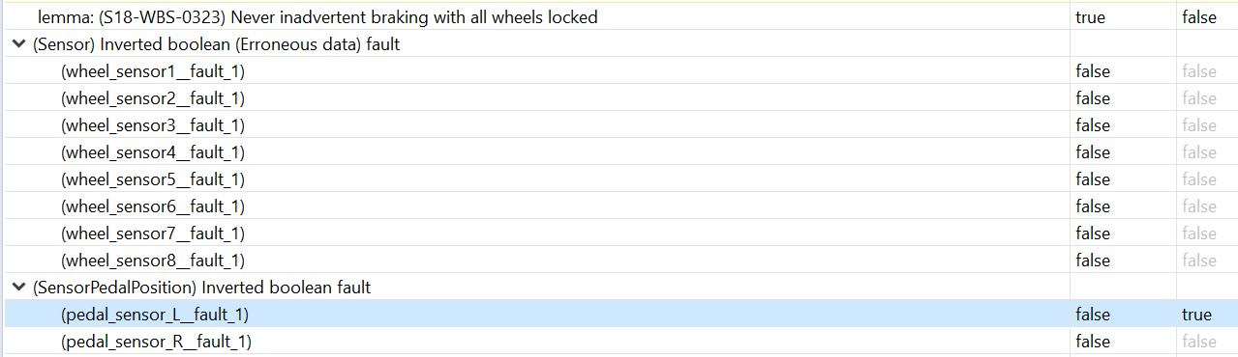
Counterexample View

Slide 39
MBSA Steps: WBS and AADL/AGREE/Safety Annex
Safety Engineers
System Engineers
Check that safety requirements are satisfied by the nominal design model with the backend model checker
Capture Design Information in a shared AADL/AGREE model (architecture, nominal behavior, system level safety requirements)
Augment the nominal model with the component failure modes
Specify the fault hypothesis for the analysis
Analyze if the safety requirements are satisfied by the design in the presence of faults with the backend model checker, using counterexamples and minimal cut sets produced for diagnosis
Examine the results to assess the validity of the fault combinations and the fault tolerance level of the system design
Drive for design change
Notes:
This figure presents our proposed use of this shared system design and safety analysis
model in the context of the ARP4754A Safety Assessment Process Model (derived from
Figure 7 of ARP4754A). The shared model is one of the system development artifacts
from the “Development of System Architecture” and “Allocation of System Requirements
to Item” activities in the System Development Process, which interacts with the
PSSAs and SSAs activities in the Safety Assessment Process. The shared model can
serve as an interface to capture the information from the system design and implementation
that is relevant for the safety analysis.

Slide 40
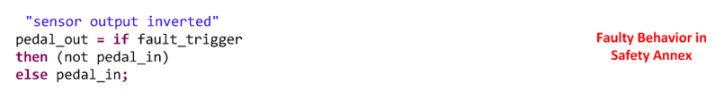

Safety Annex Approach

Slide 41
MBSA Steps: WBS and AADL/AGREE/Safety Annex
Safety Engineers
System Engineers
Check that safety requirements are satisfied by the nominal design model with the backend model checker
Capture Design Information in a shared AADL/AGREE model (architecture, nominal behavior, system level safety requirements)
Augment the nominal model with the component failure modes
Specify the fault hypothesis for the analysis
Analyze if the safety requirements are satisfied by the design in the presence of faults with the backend model checker, using counterexamples and minimal cut sets produced for diagnosis
Examine the results to assess the validity of the fault combinations and the fault tolerance level of the system design
Drive for design change
Notes:
This figure presents our proposed use of this shared system design and safety analysis
model in the context of the ARP4754A Safety Assessment Process Model (derived from
Figure 7 of ARP4754A). The shared model is one of the system development artifacts
from the “Development of System Architecture” and “Allocation of System Requirements
to Item” activities in the System Development Process, which interacts with the
PSSAs and SSAs activities in the Safety Assessment Process. The shared model can
serve as an interface to capture the information from the system design and implementation
that is relevant for the safety analysis.

Slide 42
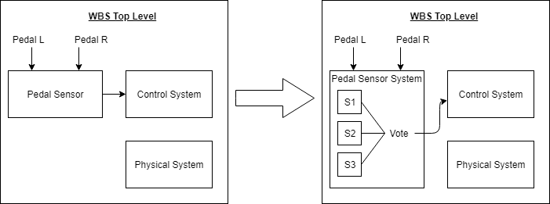
Design Change Option
Redundancy in the Pedal Sensor
Notes:
This figure presents our proposed use of this shared system design and safety analysis
model in the context of the ARP4754A Safety Assessment Process Model (derived from
Figure 7 of ARP4754A). The shared model is one of the system development artifacts
from the “Development of System Architecture” and “Allocation of System Requirements
to Item” activities in the System Development Process, which interacts with the
PSSAs and SSAs activities in the Safety Assessment Process. The shared model can
serve as an interface to capture the information from the system design and implementation
that is relevant for the safety analysis.

Slide 43
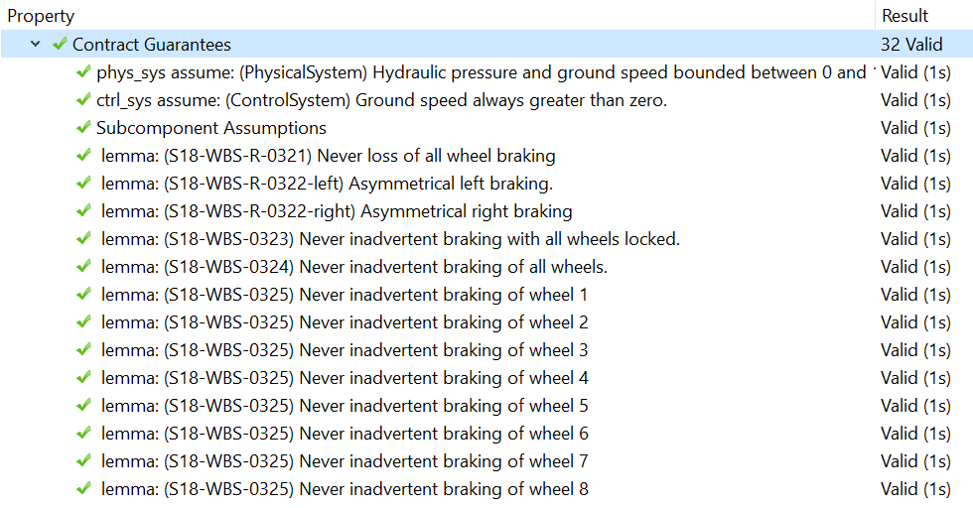
Results of Design Change
Now resilient against this fault
Notes:
This figure presents our proposed use of this shared system design and safety analysis
model in the context of the ARP4754A Safety Assessment Process Model (derived from
Figure 7 of ARP4754A). The shared model is one of the system development artifacts
from the “Development of System Architecture” and “Allocation of System Requirements
to Item” activities in the System Development Process, which interacts with the
PSSAs and SSAs activities in the Safety Assessment Process. The shared model can
serve as an interface to capture the information from the system design and implementation
that is relevant for the safety analysis.

Slide 44
Summary
Formal methods is an additional way to add confidence to the development of a complex critical system.
Model-based safety assessment can take advantage of the formal methods used to provide more information on faulty behavior.

Slide 45

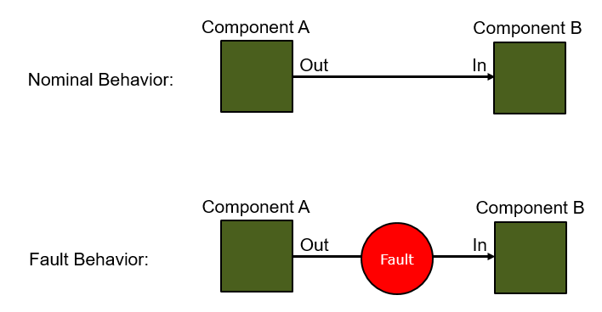
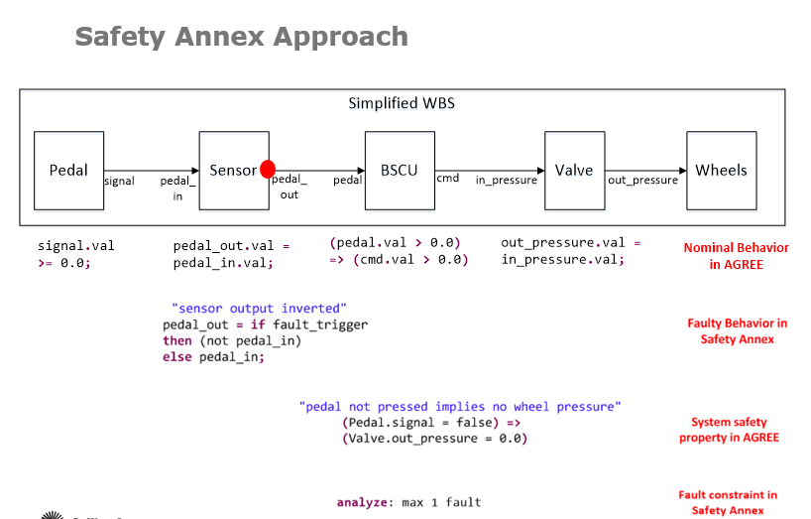
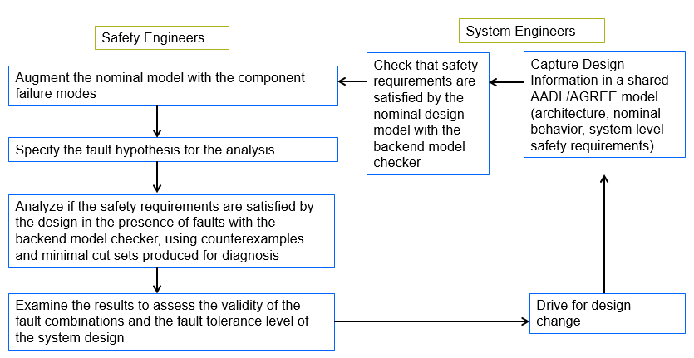
Questions?
MBSA Approach
Fault Modeling
Safety Assessment Process

