Slide 1

Architectural Modeling and Analysis for Safety Engineering (AMASE)
Research Opportunities in Aeronautics (NRA ROA-2015)
  Model-based safety analysis of highly complex safety critical systems
Year-end Review: Progress
Danielle Stewart
4 Oct 2018

Slide 2
Year Two Overview
Byzantine Faults
Hardware Faults
Probabilistic Threshold Analysis
Fault Tree Generation

Slide 3
Year Two Overview
Example system: Quad-redundant flight control system provided by NASA
FCC
FCC
FCC
FCC
Byzantine Faults
Hardware Faults
Probabilistic Threshold Analysis
Fault Tree Generation
AFDX or
TTE
Switch
AFDX or
TTE
Switch
DaC
DaC
DaC
DaC

Slide 4
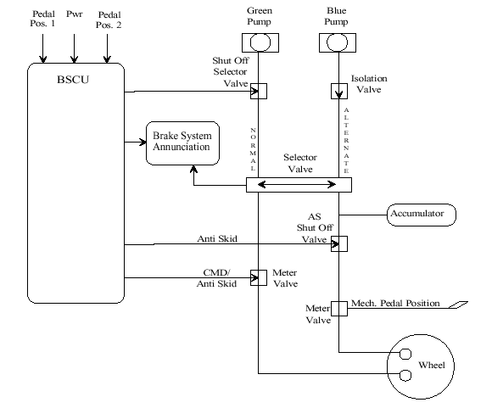
Year Two Overview
Byzantine Faults
Hardware Faults
Probabilistic Threshold Analysis
Fault Tree Generation
Example system: Wheel Brake System from AIR6110

Slide 5
Wheel Brake System

Slide 6
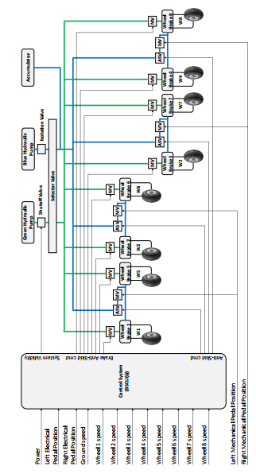

Slide 7
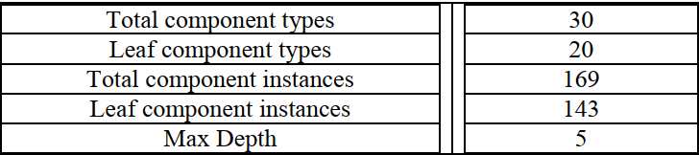
WBS Architecture Details

Slide 8
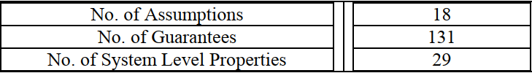
WBS AGREE Contract Details

Slide 9
Example of Behavioral Fault Propagation
Wrap nominal component in fault
Watch behavior of system through AGREE contracts

Slide 10
Example of Behavioral Fault Propagation
Component A
Component B
Out
In
Nominal Behavior:
Component A
Component B
Out
Fault
In
Fault Behavior:

Slide 11
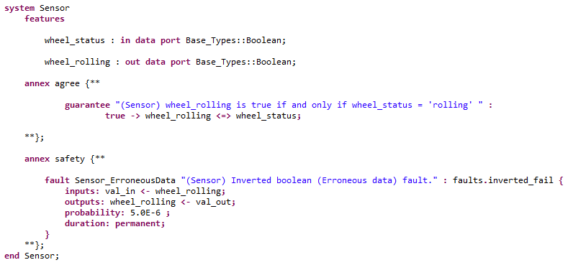
Safety Annex

Slide 12
WBS : No inadvertent braking
Normal Operating Mode:
Mechanical pedal pressed (brakes commanded)
Sensor on pedal converts to electrical signal
Signal sent to BSCU to command brakes

Slide 13
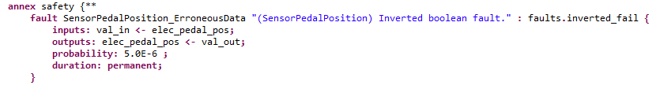
A Fault on the Pedal Sensor Component

Slide 14
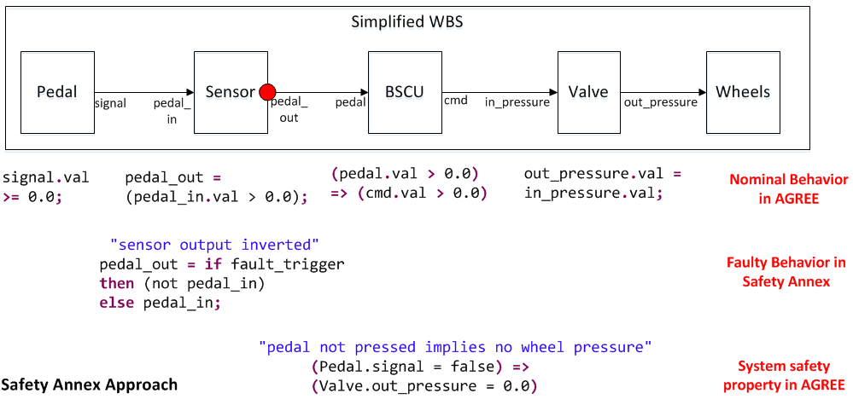
Behavioral Fault Propagation

Slide 15
Active Sensor Fault
Mechanical pedal is not pressed
Inverted Boolean failure on sensor activated
Electrical signal is true and braking is commanded through BSCU
Top level lemma fails (Unintentional braking occurs)

Slide 16
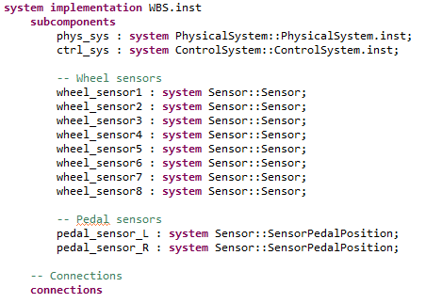
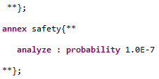
Maximum Fault vs. Probabilistic
. . .
. . .

Slide 17
Maximum Fault vs. Probabilistic
. . .
. . .

Slide 18
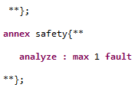
Maximum Fault vs. Probabilistic
. . .
. . .

Slide 19
Maximum Fault vs. Probabilistic
. . .
. . .

Slide 20
WBS Fault Model Details

Slide 21
Cut Set Generation
Standards (APR4761, AIR6110, etc) describe techniques involving cut sets
Required for FTA and FMEA
Currently, these are the needs of Safety Engineers in a Safety Analysis tool

Slide 22
Inductive Validity Cores
Safety Property

Slide 23
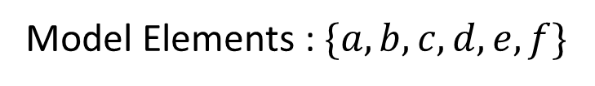






Inductive Validity Cores
Safety Property
$$a$$
$$b$$
$$c$$
$$d$$
$$e$$
$$f$$
Model Elements : $\{a, b, c, d, e, f\}$

Slide 24
Inductive Validity Cores
Safety Property
$$a$$
$$b$$
$$c$$
$$d$$
$$e$$
$$f$$
Model Elements : $\{a, b, c, d, e, f\}$

Slide 25




Inductive Validity Cores
Safety Property
$$a$$
$$b$$
$$c$$
$$d$$
$$e$$
$$f$$
IVC : A minimum set of elements
needed to prove the
Safety Property
$$\{a, c, d\}$$

Slide 26




Inductive Validity Cores
Safety Property
$$a$$
$$b$$
$$c$$
$$d$$
$$e$$
$$f$$
All IVCs : All minimal sets of elements
needed to prove the
Safety Property
$\{\left\{a, c, d\right\},${$b, e, f$}}

Slide 27






Inductive Validity Cores with Faults
Safety Property
$${!f}_{1}$$
$${!f}_{2}$$
$${!f}_{3}$$
$$g_{1}$$
$$g_{2}$$
$$g_{3}$$
Model Elements : $\{Faults=FALSE, Guarantees\}$

Slide 28




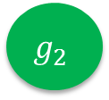


Inductive Validity Cores with Faults
Safety Property
$${!f}_{1}$$
$${!f}_{2}$$
$${!f}_{3}$$
$$g_{1}$$
$$g_{2}$$
$$g_{3}$$
All IVCs : All minimal sets of elements
needed to prove the
Safety Property
$\{\{!f_{1}$, !$f_{3}$, $g_{1}\}$, {$!f_{2}$, $g_{2}$, $g_{3}\}\}$

Slide 29
Compositionality
Top Level Safety Pröperty
Layer 2
Layer 3
Layer 4
Leaf Level
Leaf Level
Contracts
Leaf level faults

Slide 30
Compositionality
Top Level Safety Pröperty
Layer 2
Layer 3
Layer 4
Layer 4
Contracts
The inactive faults
from Leaf Level
needed to prove
Layer 4
contracts.
Leaf Level
Leaf Level
Contracts
Leaf level faults

Slide 31
Compositionality
Top Level Safety Pröperty
Layer 2
Layer 3
Layer 3
Contracts
The inactive faults
and contracts from
Layer 4 needed
to prove contracts
of Layer 3.
Layer 4
Layer 4
Contracts
Layer 4 faults

Slide 32
Compositionality
Top Level Safety Pröperty
Layer 2
Layer 2
Contracts
The inactive faults
and contracts from
Layer 3 needed
to prove contracts
of Layer 2 .
Layer 3
Layer 3
Contracts
Layer 3 faults

Slide 33
Quad-redundant Flight Control System
Built for NASA’s Transport Class Model (TCM) aircraft simulation
Developed in AADL/AGREE and includes:
  Control Laws
  Sensors
  Actuators
  Dynamics
Includes a hierarchy of English language requirements
Initial AADL model developed as part of CVFCS project

Slide 34
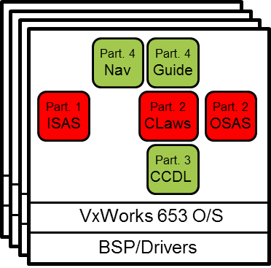
QFCS Architecture
The flight control system consists of four flight control computers (FCC).
Each FCC includes:
  Navigation (NAV)
  Guidance (GUIDE)
  Control Laws (Claws)
  Input Signal Analysis and Selection (ISAS)
  Output Signal Analysis and Selection (OSAS)
  Cross Channel Data Link (CCDL)

Slide 35
QFCS Architecture
Input:
INS/GPS
Air-data
AOA, AOS
Control inputs
Switch inputs
Actuator data
Engine data
Gear data
FCC 1
Output:
Throttle cmds
Surface cmds
Display data
System cmds
FCC 2
FCC 3
FCC 4

Slide 36
QFCS Architecture
FCS
AGREE contract
FCC
EGI
CLAW
ISAS
OSAS
AOA
FCC
ADS
CLAW
ISAS
OSAS
FCC
Actuator Comm.
CLAW
ISAS
OSAS
Actuator Return
FCC
AGREE contract
Actuator Sense
CLAW
ISAS
OSAS
AGREE contracts

Slide 37
Byzantine Faults Simulation:
Flight Control Computer
Created multiple connections to observers
Introduced disagreement through fault injection

