Slide 1


Architectural Modeling and Analysis for Safety Engineering (AMASE)
  Model-based safety analysis of critical systems
Danielle Stewart
Oral Preliminary Exam
January 2019

Slide 2


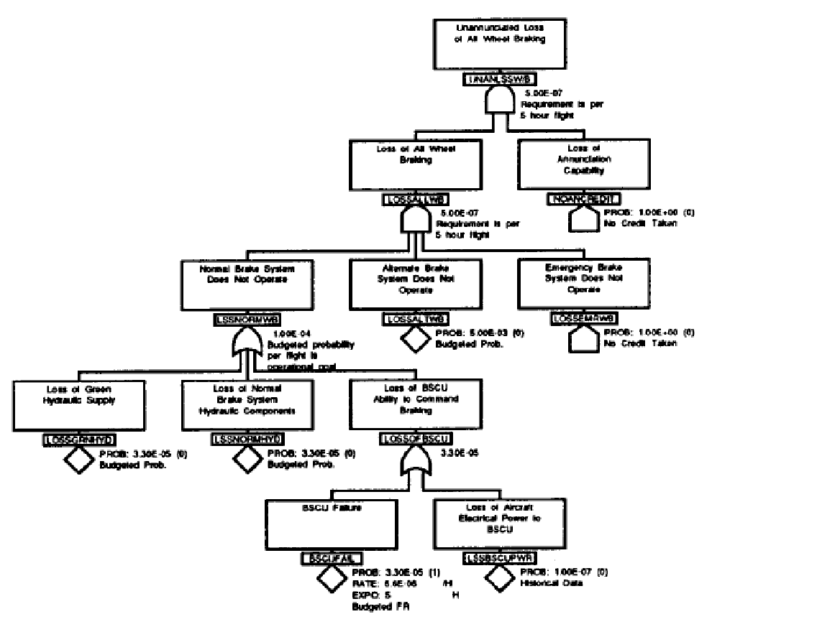

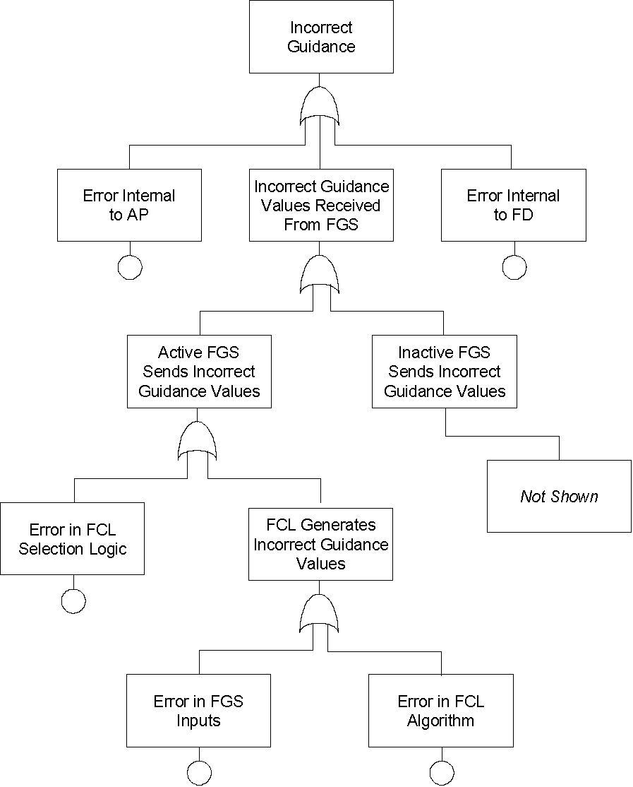
Motivation
Requirements and
Design Documents
Safety
Analyst A
Safety
Analyst B
System Safety Analysis is
- Based on Informal Specifications
- Highly Dependent on Skill of the Analyst
Adapted from Stephen Miller
Notes:
Safety engineers do most of the analysis activities like fault tree creation manually, based on a lot of informal requirements and design documents. These analyses seem to be quite subjective and highly dependent on the skill and experience of the safety engineers. Thus, it is not surprising that different safety engineers will quite often produce fault trees, which may differ in substantial ways. It is only through a rigorous review process that a concensus will be built on the correct fault tree, which captures the right fault behavior. We think that the review process implicitly consolidates existing information from various documents and then completes it with unspecified details architectural and fault behaviors. It would be great if all these activities would be based off a comprehensive system architecture.
We also observe that due to the complexity of the systems involved, it is possible that the fault trees may not capture involved fault scenarios that may occur due to complex interactions between components.

Slide 3
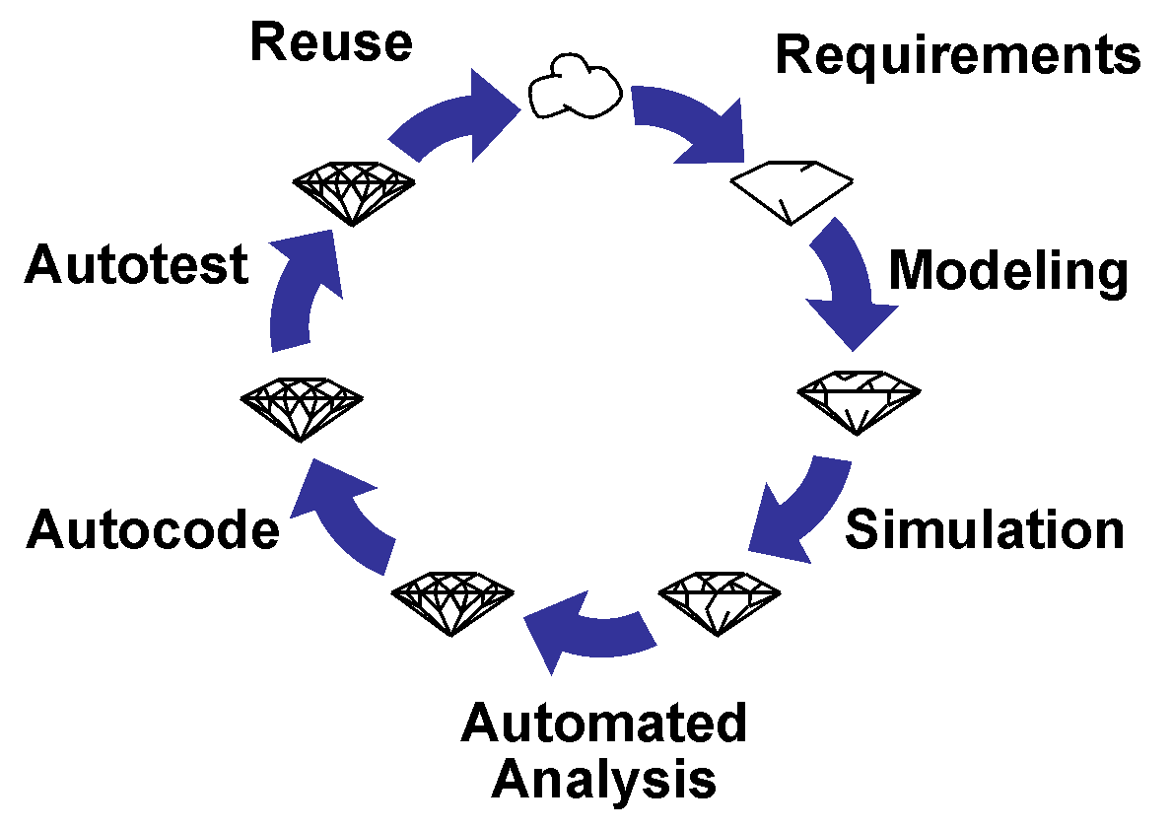
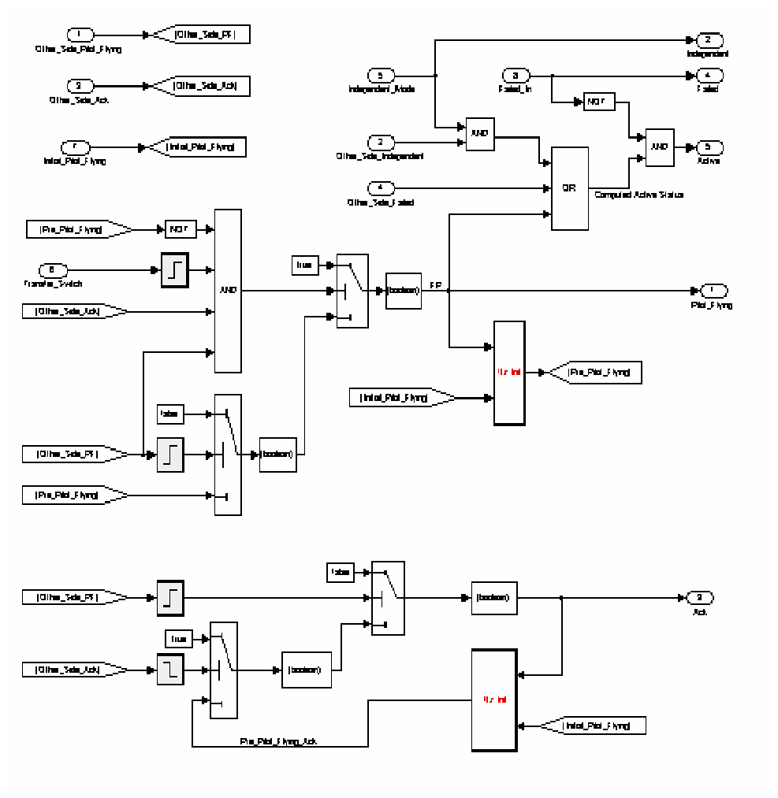
Model-Based Development
Why Not the
Safety Analysis?
We Base the Entire
Development Cycle
Around the Model
Adapted from Stephen Miller

Slide 4
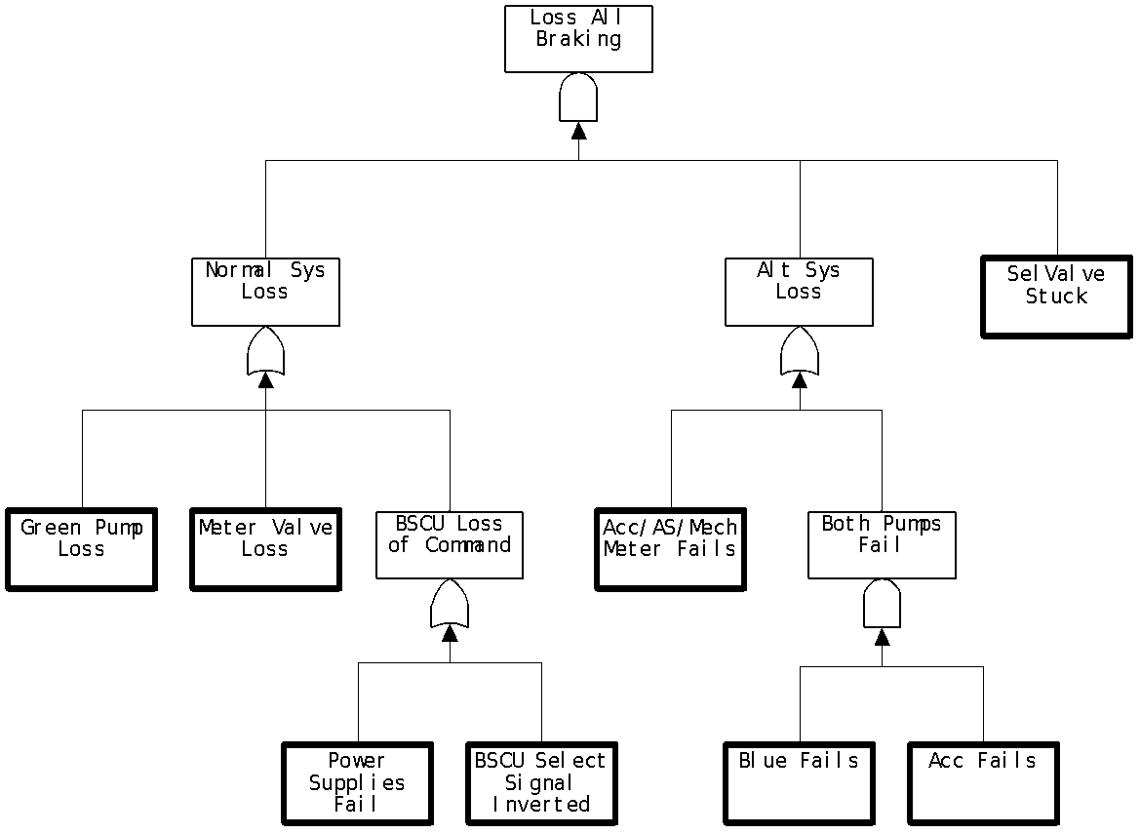

Model-Based Safety Analysis
Wheel Braking System
AIR6110
CONTIGUOUS AIRCRAFT/SYSTEM DEVELOPMENT PROCESS EXAMPLE
Green Pump
Blue Pump
Isolation Valve
Isolation Valve
Power A
Pedal 1
System
A
Selector Valve
Shut
Plant
Normal
N
A
Accumulator
Feed back
System
O
L
Valve
R
T
M
E
Accumulator
Pedal 2
System
B
A
R
Pump
Power B
L
N
AntiSkid
A
Meter
Command
T
Valve
Mechanical
Braking
+
Meter
E
Pedal
Fault Tolerant
AntiSkid
Valve
Meter
Braking System
Command
Valve
Control Unit
Plant
( BSCU )
Model
Model the Digital Controller Architecture
and the Physical System
Add Fault Model for Physical System
and Digital Controller Architecture
Integrates System and Safety Engineering About a Common Model
Automation Enables “What-If” Consideration of System Designs
Adapted from Stephen Miller
Notes:
Steve’s slide

Slide 5
Fault and Failure Definitions
Fault: something can go wrong. When that happens, we have a
Failure: The corrupted state of the component is observable.
A failure may only be observable on a component level. It may or may not lead to a top level system failure.
This failure state can be propagated from the component to other components and may propagate to the top level of the system.

Slide 6
Conceptions of MBSA
Failure propagations:
Failure Logic Modeling (FLM)
Failure Effect Modeling (FEM)
Directional vs Bidirectional flows
Purpose Built Fault Model vs Extension of System Model
Compositional Analysis or Monolithic Analysis

Slide 7
Existing Tools and Methods
 | FLM | FEM : Directional | FEM: Bidirectional | M | C | PB | ESM
EMV2 | ✓ |  |  |  |  |  | AADL
Compass | ✓ |  |  |  | ✓ |  | SLIM
SmartIFlow |  |  | ✓ | ✓ |  | ✓
SAML |  | ✓ |  | ✓ |  | ✓
AltaRica |  |  | ✓ | ✓ |  | ✓
HipHops | ✓ |  |  |  |  |  | East-ADL

Slide 8
Where does the our research fit?
Extend System Model
Compositional and Monolithic Analysis
Implicit and Explicit Failure Propagation (FEM and FLM)

Slide 9
Existing Tools and Methods
 | FLM | FEM : Directional | FEM: Bidirectional | M | C | PB | ESM
EMV2 | ✓ |  |  |  |  |  | AADL
Compass | ✓ | ✓ |  |  | ✓ |  | SLIM
SmartIFlow |  |  | ✓ | ✓ |  | ✓
SAML |  | ✓ |  | ✓ |  | ✓
AltaRica |  |  | ✓ | ✓ |  | ✓
HipHops | ✓ |  |  |  |  |  | East-ADL
Our Research | ✓ | ✓ |  | ✓ | ✓ |  | AADL

Slide 10
Creation of Nominal System Model
Model of the Digital System
Power A
Verify safety properties of the nominal digital system
Pedal 1
System
A
Plant
Feed back
Pedal 2
System
B
Green Pump
Blue Pump
Power B
Isolation Valve
Isolation Valve
Fault Tolerant
Power A
Braking System
Control Unit
Pedal 1
Selector Valve
( BSCU )
Shut
Plant
Normal
N
A
Accumulator
Feed back
System
O
L
Valve
Verify safety properties of the nominal mechanical system
R
T
M
E
Accumulator
Pedal 2
System
B
A
R
Pump
Power B
L
N
AntiSkid
A
Meter
Command
T
Valve
Mechanical
Braking
E
Pedal
Fault Tolerant
+
Meter
Meter
Braking System
AntiSkid
Valve
Valve
Control Unit
Command
Plant
( BSCU )
Model
Model of the Digital System +
Model of the Mechanical System
Adapted from Stephen Miller

Slide 11
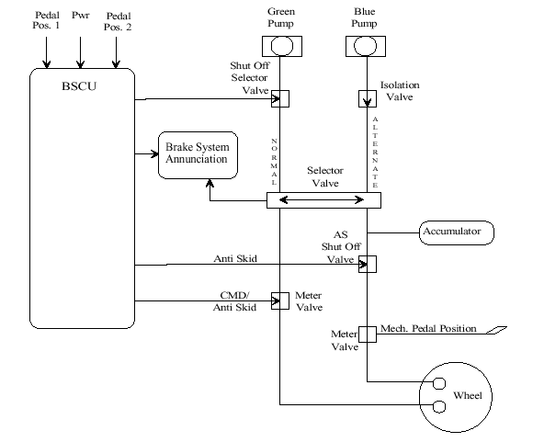
Wheel Brake System

Slide 12

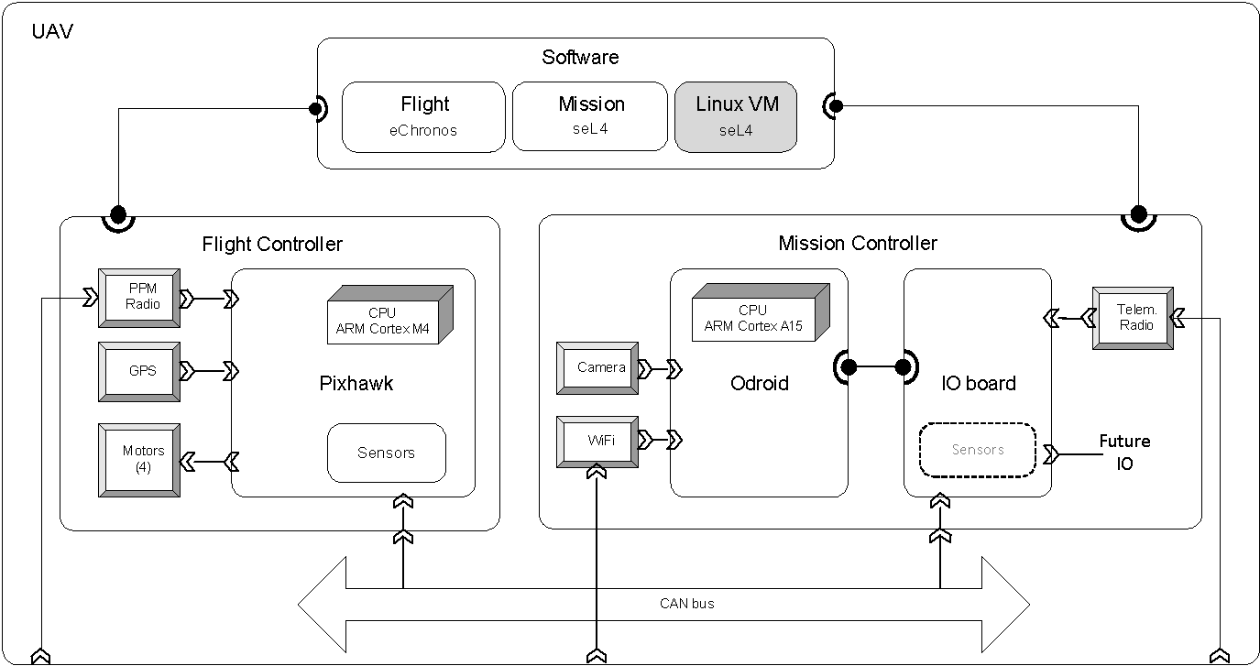


Architecture Analysis and Design Language (AADL)
AADL = SAE AS5506 standard
Target: Embedded, real-time, distributed systems
Describes both hardware and software
Extensible syntax (annex)
Open source tools, supported by SEI
Slide from Collins Aerospace

Slide 13
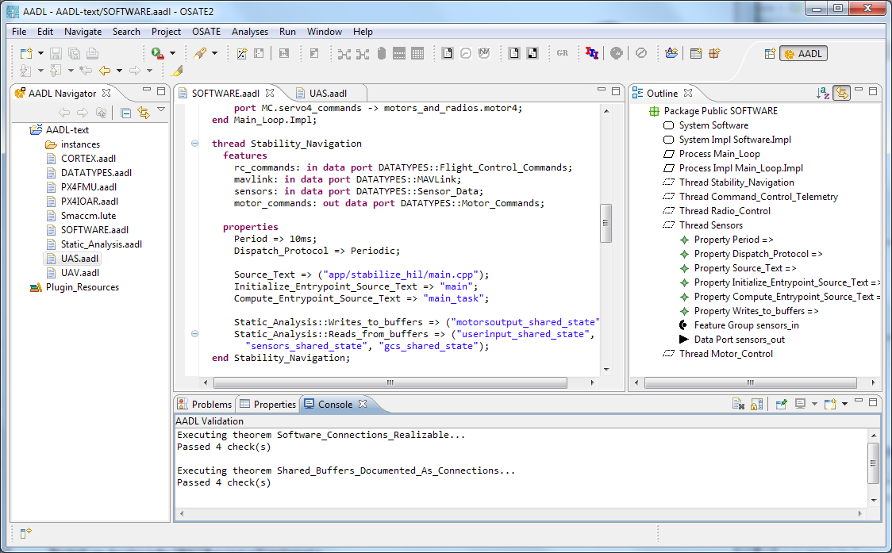



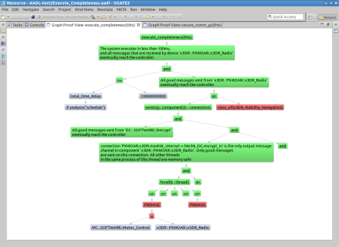
Architecture Modeling and Analysis Tools
Resolute
OSATE
AGREE
Trusted
Build
SIM
TCG
Architecture Models
Architecture Translation
Architecture Analysis
A
C
Assumption: Input < 20
Guarantee: Output < 2*Input
Assumption: none
Guarantee: Output = Input1 + Input2
B
seL4
Assumption: Input < 20
Guarantee: Output < Input + 15
Assumption: Input < 10
Guarantee: Output < 50
eChronos
VxWorks
Kind/JKind
Model Checker
Adapted from Collins Aerospace
Notes:
START AGREE HERE

Slide 14
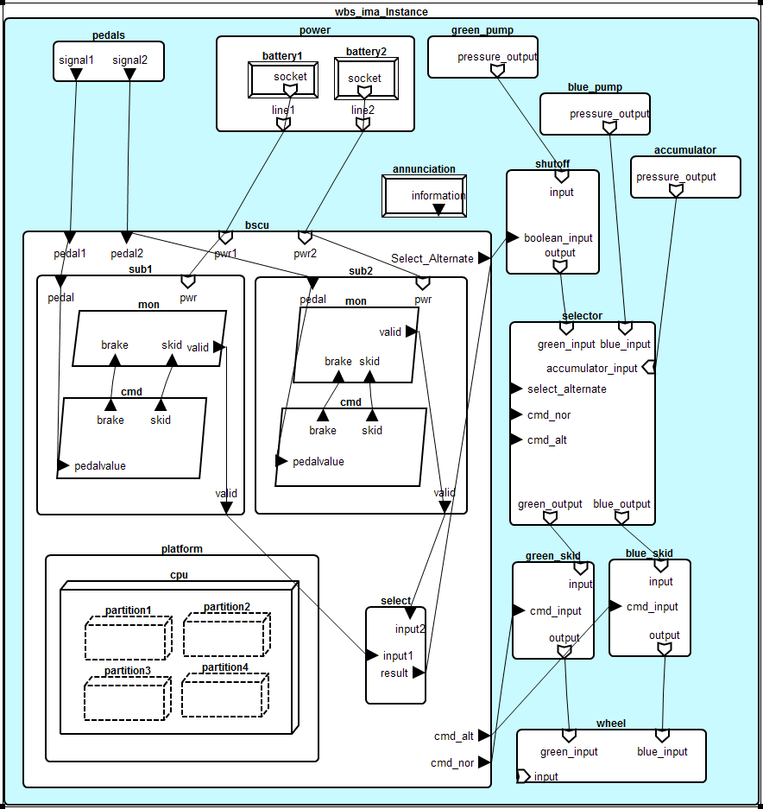
WBS AADL Model

Slide 15
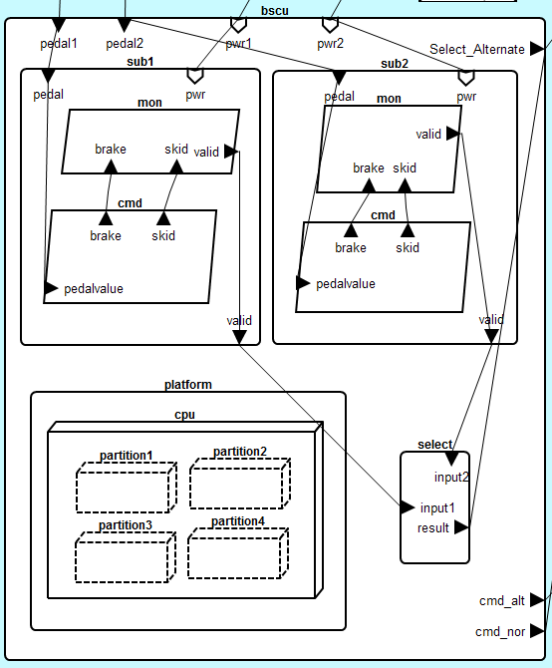

Slide 16
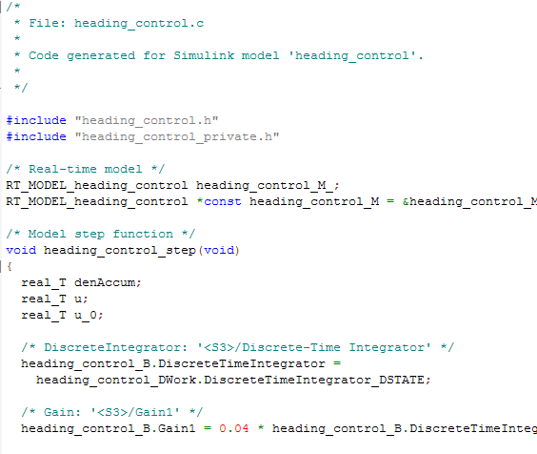
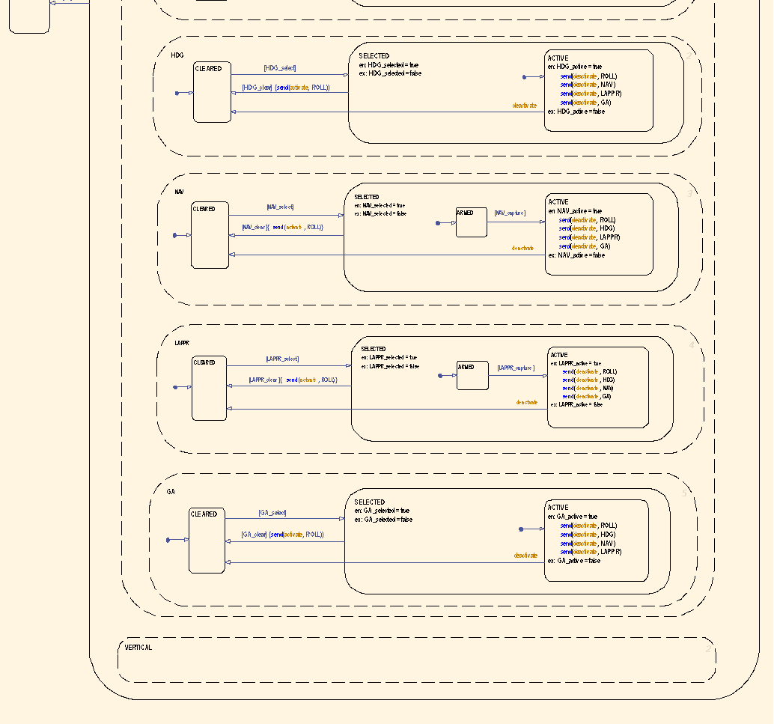
AGREE:
Assume Guarantee
Reasoning Environment
contract
contract
contract
Each component has a contract consisting of assumptions and guarantees
  Assumptions: Constraints over what a component expects from its environment
  Guarantees: Constraints over how a component behaves in response to its environment (requirements)
The contract of a component abstracts the behavior of its implementation
AGREE analysis
contract
contract
contract
contract
Component
Implementation
Slide from Collins Aerospace

Slide 17



Compositional Verification of Critical Systems
Compositional verification tool for analysis of AADL system models
AGREE: Assume-Guarantee Reasoning Environment
Focus on system safety properties
Compositional approach scales model checking to larger systems
Example system: Quad-redundant flight control system provided by NASA
FCC
FCC
A
C
FCC
FCC
Assumption: Input < 20
Guarantee: Output < 2*Input
Assumption: none
Guarantee: Output = Input1 + Input2
AFDX or
TTE
Switch
AFDX or
TTE
Switch
B
Assumption: Input < 20
Guarantee: Output < Input + 15
Assumption: Input < 10
Guarantee: Output < 50
DaC
DaC
DaC
DaC
Slide from Collins Aerospace

Slide 18
Compositional Verification of Critical Systems
Compositional verification tool for analysis of AADL system models
AGREE: Assume-Guarantee Reasoning Environment
Focus on system safety properties
Compositional approach scales model checking to larger systems
Example system: Quad-redundant flight control system provided by NASA
FCC
FCC
A
C
FCC
FCC
Assumption: Input < 20
Guarantee: Output < 2*Input
Assumption: none
Guarantee: Output = Input1 + Input2
AFDX or
TTE
Switch
AFDX or
TTE
Switch
B
Assumption: Input < 20
Guarantee: Output < Input + 15
Assumption: Input < 10
Guarantee: Output < 50
DaC
DaC
DaC
DaC
Adapted from Collins Aerospace

Slide 19
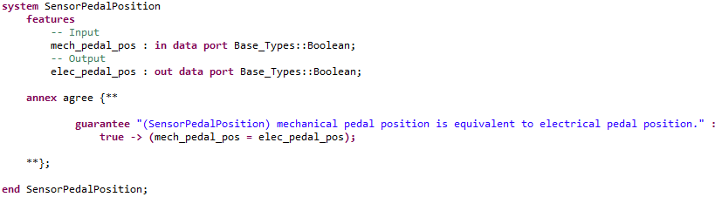
Nominal Model Component in AADL and AGREE
Notes:
Maybe remove, check on other agree slides

Slide 20
Creation of the Fault Model
Wrap nominal component in fault
Watch behavior of system through AGREE contracts

Slide 21
Component A
Component B
Out
In
Nominal Behavior:
Component A
Component B
Out
Fault
In
Fault Behavior:

Slide 22
WBS Top Level Property : No inadvertent braking
Nominal Behavior:
Mechanical pedal pressed (brakes commanded)
Sensor on pedal converts to electrical signal
Signal sent to BSCU to command brakes

Slide 23
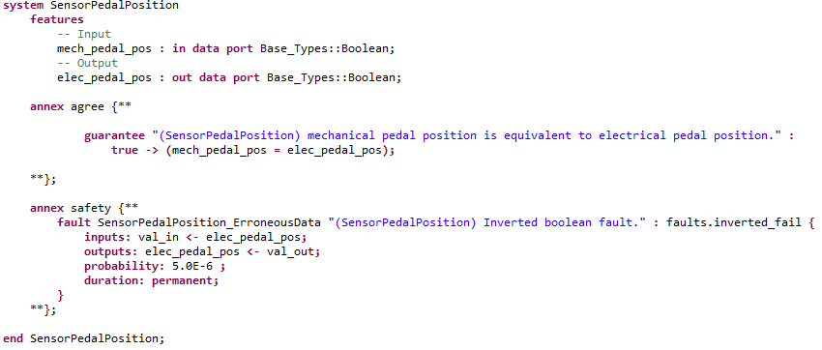
A Fault on the Pedal Sensor Component

Slide 24
Active Sensor Fault
Mechanical pedal is not pressed
Inverted Boolean failure on sensor activated
Electrical signal is true and braking is commanded through BSCU
Top level lemma fails (Unintentional braking occurs)

Slide 25
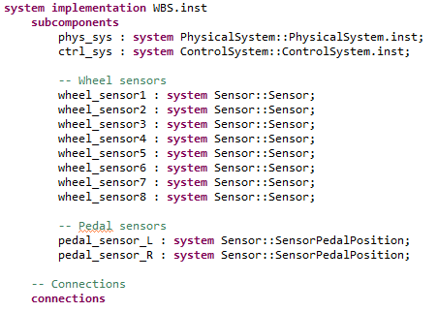
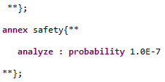
Probabilistic Analysis and Maximum Faults
. . .
. . .

Slide 26
Probabilistic Analysis and Maximum Faults
. . .
. . .

Slide 27
Probabilistic Analysis and Maximum Faults
. . .
. . .

Slide 28
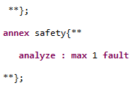
Probabilistic Analysis and Maximum Faults
. . .
. . .

Slide 29
Current Support
Maximum number of faults in a given layer of the architecture
Probabilistic analysis
Hardware and software faults

Slide 30
Future Work
Compositional Fault Tree Generation and Probabilistic Analysis
Allow for more flexible modeling:
  Byzantine Fault Modeling
  Transient Faults Analysis

Slide 31
Motivation for Compositional Fault Analysis
Currently: Given top level threshold, do the fault combinations exceed it?
Desire: Given faults and probabilities, what is the threshold of the system?
Currently: Fault tree analysis done monolithically.
Desire: Generate informative Fault Trees containing both fault model information and nominal model architecture.

Slide 32
Challenges and Lessons Learned
Theorizing an idea
The correct implementation of the theory
The correct order of theorizing and then implementing
The challenge of working with pre-existing tools and extending a language correctly
Staying up-to-date on new research in the field

Slide 33
A special thank you to...
Darren Cofer, Janet Liu, and Mike Peterson from Collins Aerospace
Kurt Woodham from NASA
Mike Whalen from UMN/Amazon

