Slide 1

The Safety Annex for Architecture Analysis and Design Language
January 2020
AADL Standards Meeting
Danielle Stewart, Jing (Janet) Liu, Darren Cofer,
Mats Heimdahl, Michael Whalen, Michael Peterson

Slide 2
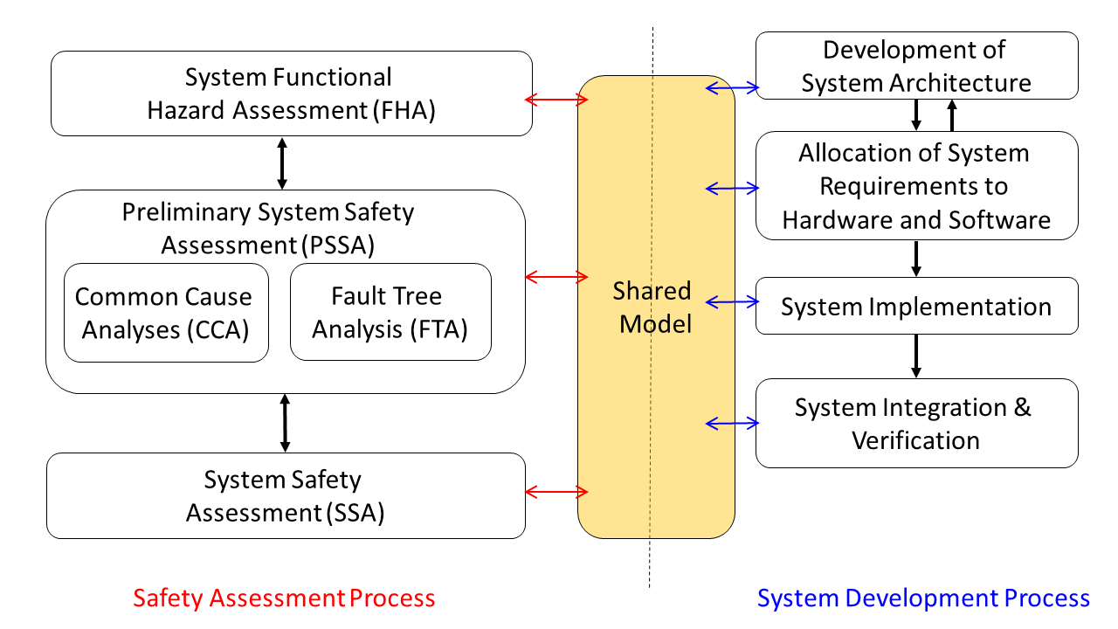
MBSA process in safety assessment
Have system developers and safety engineers use the same system models created during a model-based development process
Extend system model to add capabilities for reasoning about faulty behaviors

Slide 3
size and complexity of industrial models
What is the overall behavior of the system when faults are present?
It is difficult to know all complex interactions between HW and SW components. How to determine fault propagation through the system?
  Can we leverage model checking capabilities to provide answers?
  Many types of model checking techniques suffer from scalability.
Numerous types of components require flexible fault modeling capabilities.

Slide 4
MBSA process Steps
Safety Engineers
System Engineers
Starts
Augment the nominal model with the component failure modes
Check that safety requirements are satisfied by the nominal design model with the backend model checker
Capture Design Information in a shared model (architecture, nominal behavior, system level safety requirements)
Specify the fault hypothesis for the analysis
Analyze if the safety requirements are satisfied by the design in the presence of faults with the backend model checker, using counterexamples and fault trees produced for diagnosis
Ends
Examine the results to assess the validity of the fault combinations and the fault tolerance level of the system design
Drive for design change

Slide 5
What will help safety analysts do this?
Shared model
  Modeling language expressive enough to capture HW/SW, standard language
Flexible error propagations
  Behavioral AND explicit propagations
Flexible fault modeling
  Symmetric, asymmetric, dependent, independent
Backend model checker
  Used to assess design with or without active faults
Ability to generate assessment artifacts
  System traces, counterexamples, minimal cut sets, fault trees, etc.

Slide 6
Closely Related work
EMV2:
  Model based, generates artifacts, captures propagations explicitly
COMPASS:
  Model based, generates artifacts, captures behavioral and explicit propagations, is not an SAE standard language: not as descriptive as AADL for real-time embedded systems

Slide 7



AADL
AADL = SAE AS5506 standard
Target: Embedded, real-time, distributed systems
Describes both hardware and software
Extensible syntax (annex)
Open source tools, supported by SEI

Slide 8
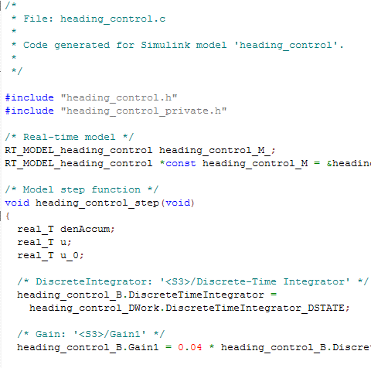
Assume-Guarantee Reasoning Environment (AGREE)
Component Implementation
A system with subcomponents
contract
contract
contract
AGREE
Each component has a contract consisting of assumptions and guarantees
  Assumptions: Constraints over what a component expects from its environment
  Guarantees: Constraints over how a component behaves in response to its environment (requirements)
Assumptions (input)
Guarantees (output)

Slide 9
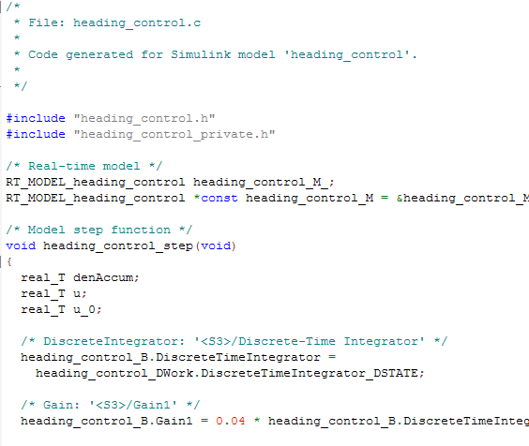
Compositional Reasoning
contract
contract
Each component has a contract consisting of assumptions and guarantees
The contract of a component abstracts the behavior of its implementation
Contracts at each layer must be satisfied by contracts of its components
Leaf component contracts must be satisfied by implementation
Compositional analysis provides scalability in verification
contract
AGREE analysis
contract
contract
contract
contract
Component
Implementation

Slide 10
JKind Model Checker
Structured as parallel engines that coordinate to prove properties and perform other verification tasks
AADL System Model
(.aadl)
Abstract Syntax Tree
(.java)
System and Behavioral Model
(.lus)
AADL type and
Implementation
annex agree{**
contracts
**};
AGREE Parser
AGREE Program
JKind Program
(Lustre)
JKind

Slide 11
Implementation of the safety annex
AADL System Model
(.aadl)
Abstract Syntax Tree
(.java)
System and Behavioral Model
(.lus)
AADL type and
Implementation
annex agree{**
contracts
**};
annex safety{**
faults
**};
AGREE Parser
AGREE Program
JKind Program
(Lustre)
AGREE Plugin
Extension
Point
AGREE AST with
fault
information
JKind
Safety Parser
Fault Model
Abstract Syntax Tree
(.java)
Safety Plugin

Slide 12
Behavioral error propagation
Nominal Behavior:
Allows faults to be injected into the AGREE program and then verified by the model checker.
Wrap nominal component output in fault
Watch behavior of system through AGREE contracts when fault is activated
Component A
Component B
Out
In
Fault Behavior:
Component A
Component B
Out
Fault
In

Slide 13
Transform proof cores into Minimal cut sets
JKind can compositionally find minimal sets of model elements required to prove safety property
These can be transformed into minimal cut sets:
  The minimal sets of faults required to violate the safety property
Compositional generation of minimal cut sets promises to be more scalable than alternatives.

Slide 14
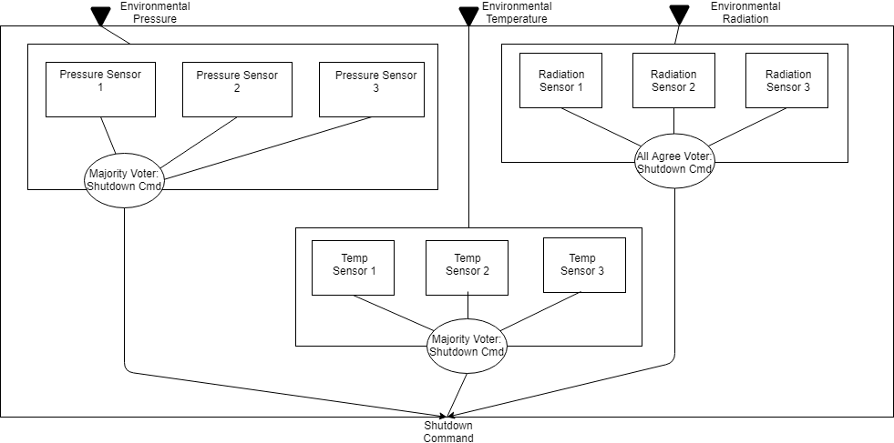
Sensor example

Slide 15
Voting mechanisms in agree
Temperature and pressure sensors have majority voter.
Radiation sensor : All three must agree to send shutdown command.

Slide 16
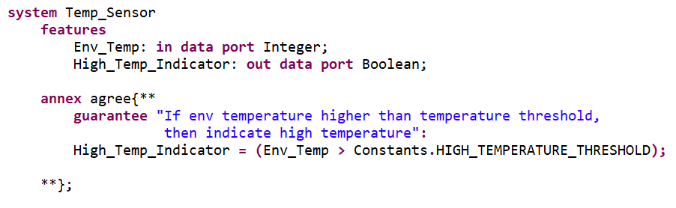
Temperature sensor in aadl and agree

Slide 17
Sensor Example: Faults
Notes:
Goal is to prove the top level safety property of system.

Slide 18
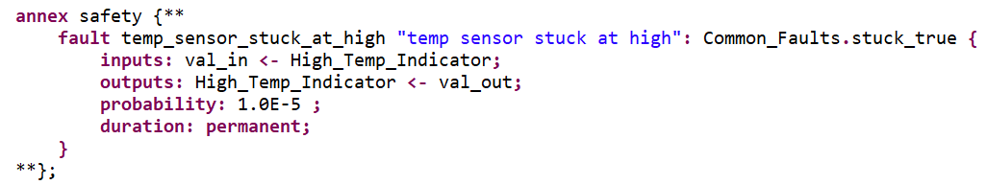
Fault definition in safety annex
Two faults on each sensor: Fail high and fail low
Notes:
Goal is to prove the top level safety property of system.

Slide 19
Fault definition in safety annex
Common_Faults: an .aadl file with commonly used fault nodes
stuck_true: an AGREE node definition that determines fault behavior
Notes:
Goal is to prove the top level safety property of system.

Slide 20
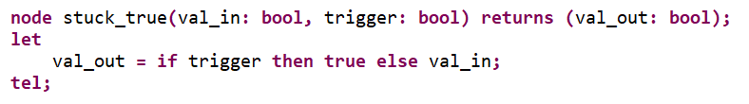
Fault node in safety annex
The AGREE node definition that determines fault behavior
Notes:
Goal is to prove the top level safety property of system.

Slide 21
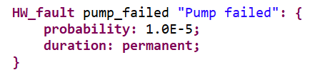
Explicit vs implicit propagation
The default propagation is implicit, but not all interactions can be captured in this way.
  e.g., co-located components
Dependencies defined through a source hw fault and a propagation statement
Hardware Fault Definition:
Propagation Statement:
Notes:
Goal is to prove the top level safety property of system.

Slide 22
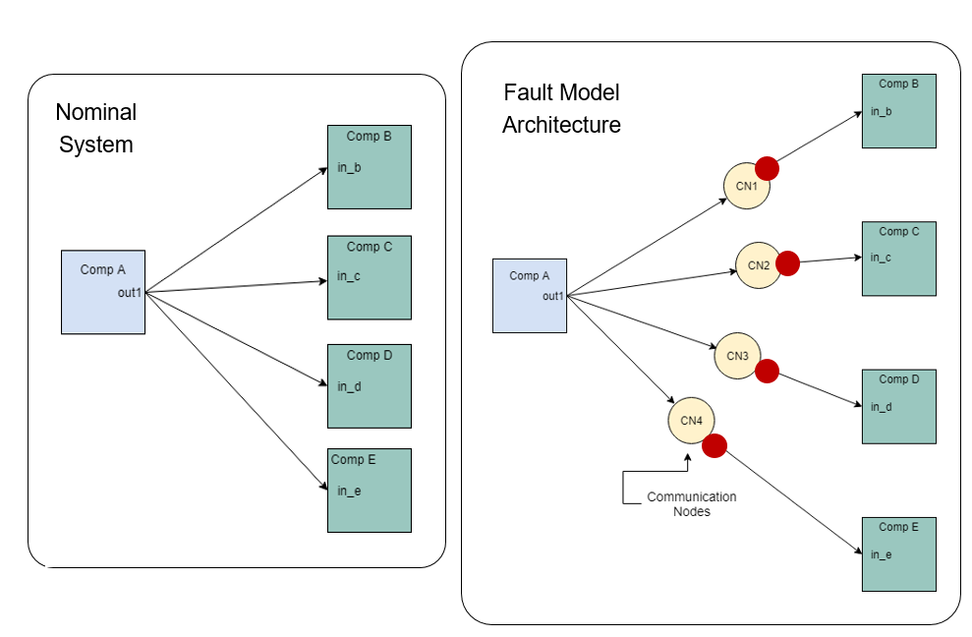
Symmetric vs asymmetric faults
The default fault type is symmetric: output is one-to-one
Support for asymmetric faults: output is one-to-many
Asymmetric fault causes output to reflect different values for different observers.
Notes:
Goal is to prove the top level safety property of system.

Slide 23


Fault analysis statements
Two types of analysis are available
Max N Fault Analysis
Probabilistic Analysis
Notes:
This figure presents our proposed use of this shared system design and safety analysis
model in the context of the ARP4754A Safety Assessment Process Model (derived from
Figure 7 of ARP4754A). The shared model is one of the system development artifacts
from the “Development of System Architecture” and “Allocation of System Requirements
to Item” activities in the System Development Process, which interacts with the
PSSAs and SSAs activities in the Safety Assessment Process. The shared model can
serve as an interface to capture the information from the system design and implementation
that is relevant for the safety analysis.

Slide 24
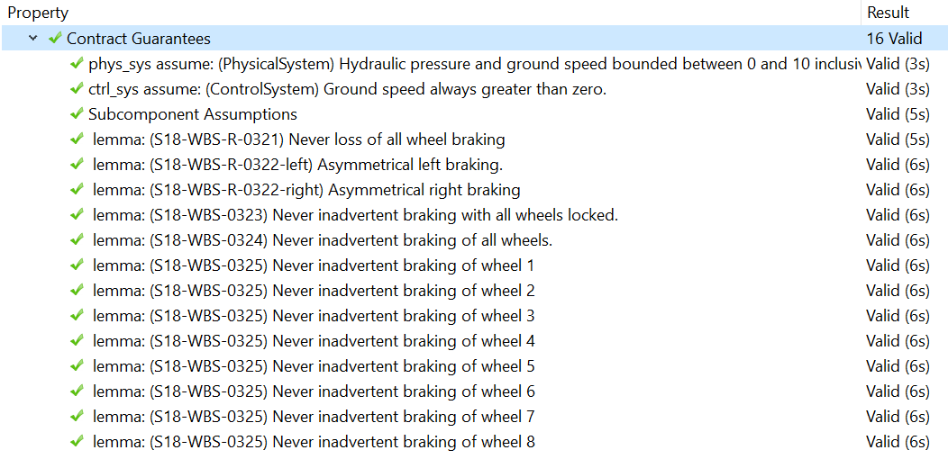
Nominal model analysis output

Slide 25
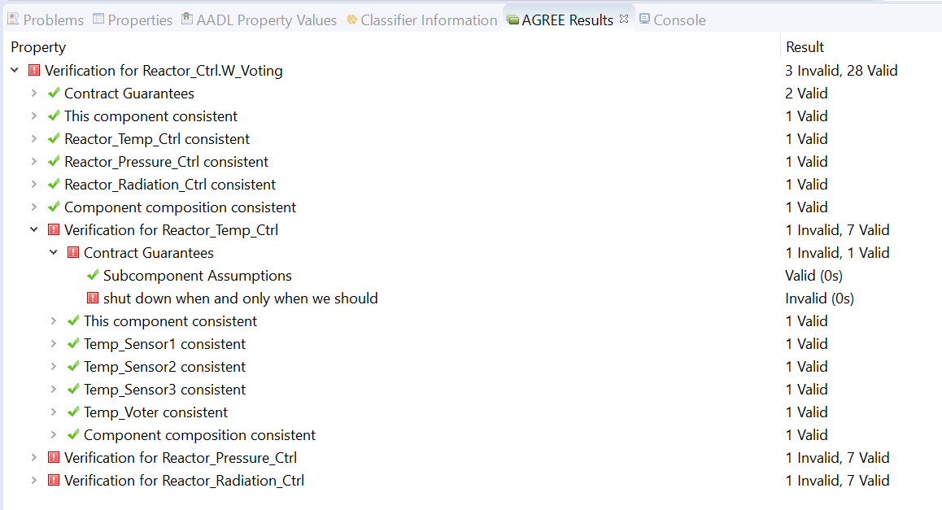
Fault Analysis results
Max 3 Fault Analysis for Sensor Example

Slide 26
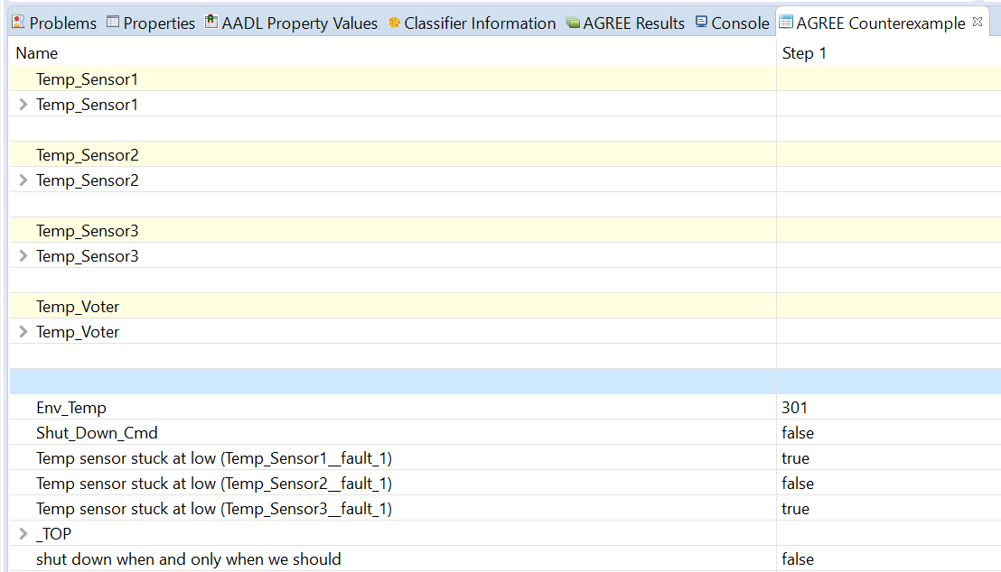
Counterexamples: traces of the system
Provides information on the propagation of the error
Shows the state of the system when faults are active

Slide 27
Minimal Cut Set Analysis
The minimal sets of fault combinations that cause violation of the safety property.
Used in Fault Tree Analysis for PSSA/SSA.
Gives insight into problematic subcomponents of the system, single points of failure, etc.
Results from Safety Annex comes in 3 forms:
Tally of how many cut sets with certain cardinality
Text file giving description of each cut set, what component they effect, and which faults are in the sets
SOTERIA input file used to generate graphical fault trees

Slide 28
Future work
Maturation of the tool
Evaluate the tool and approach on real avionics systems

Slide 29
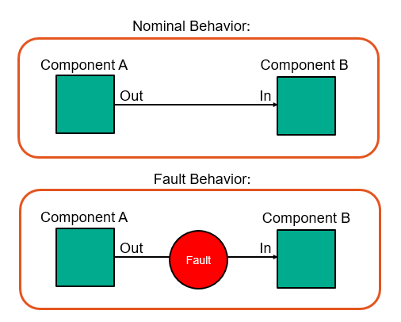
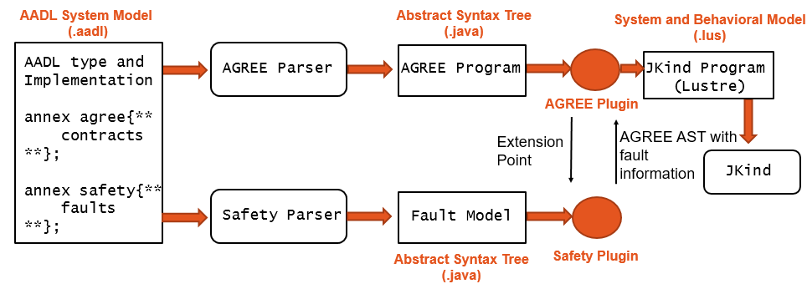
questions

Slide 30
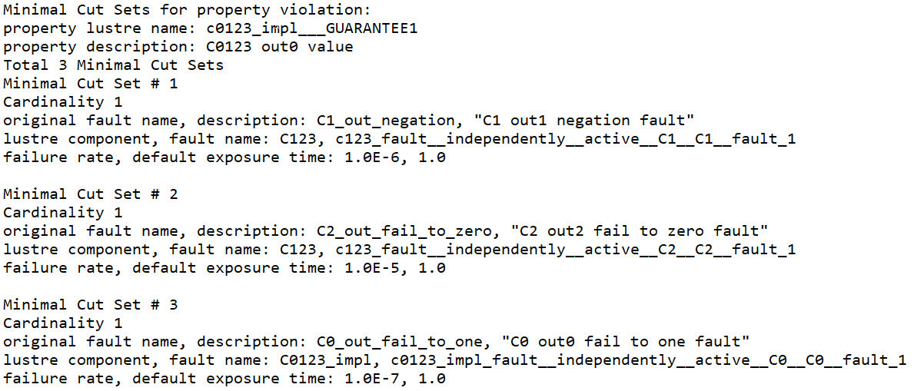
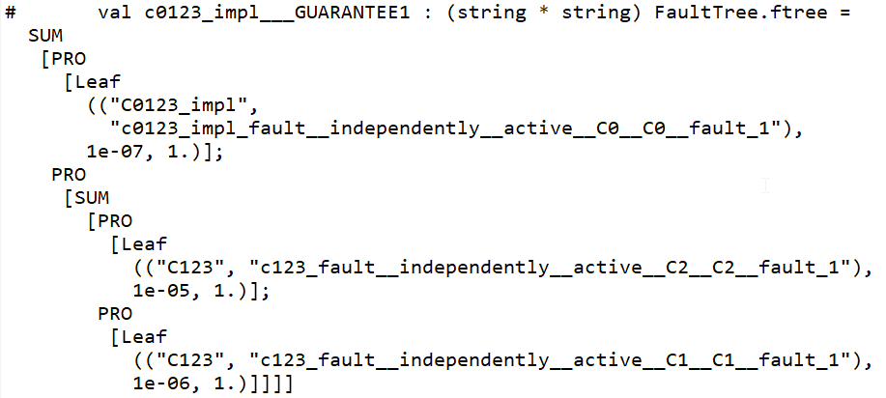
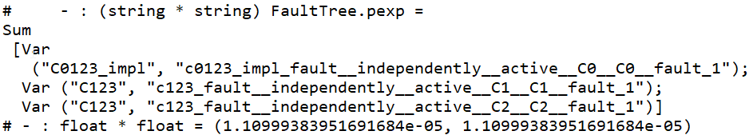
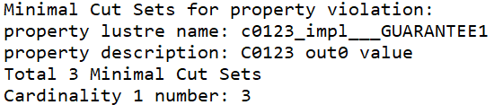
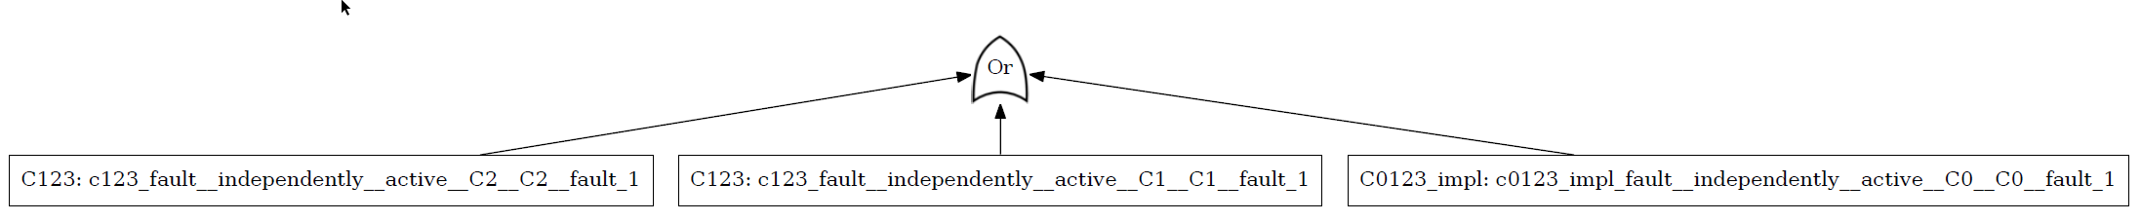
Example Safety Artifacts Generated
Minimal Cut Sets
Fault Trees
List
Text
Probabilities
Tally
Graph

