Slide 1


Architectural Modeling and Analysis for Safety Engineering (AMASE)
  Model-based safety analysis of critical systems
Danielle Stewart
Oral Preliminary Exam
September 2018

Slide 2

Motivation
Requirements and
Design Documents
Safety
Analyst A
Safety
Analyst B
System Safety Analysis is
- Based on Informal Specifications
- Highly Dependent on Skill of the Analyst
Notes:
Safety engineers do most of the analysis activities like fault tree creation manually, based on a lot of informal requirements and design documents. These analyses seem to be quite subjective and highly dependent on the skill and experience of the safety engineers. Thus, it is not surprising that different safety engineers will quite often produce fault trees, which may differ in substantial ways. It is only through a rigorous review process that a concensus will be built on the correct fault tree, which captures the right fault behavior. We think that the review process implicitly consolidates existing information from various documents and then completes it with unspecified details architectural and fault behaviors. It would be great if all these activities would be based off a comprehensive system architecture.
We also observe that due to the complexity of the systems involved, it is possible that the fault trees may not capture involved fault scenarios that may occur due to complex interactions between components.

Slide 3
Model-Based Development
Why Not the
Safety Analysis?
We Base the Entire
Development Cycle
Around the Model

Slide 4
Model-Based Safety Analysis
Wheel Braking System
AIR6110
CONTIGUOUS AIRCRAFT/SYSTEM DEVELOPMENT PROCESS EXAMPLE
Green Pump
Blue Pump
Isolation Valve
Isolation Valve
Power A
Pedal 1
System
A
Selector Valve
Shut
Plant
Normal
N
A
Accumulator
Feed back
System
O
L
Valve
R
T
M
E
Accumulator
Pedal 2
System
B
A
R
Pump
Power B
L
N
AntiSkid
A
Meter
Command
T
Valve
Mechanical
Braking
+
Meter
E
Pedal
Fault Tolerant
AntiSkid
Valve
Meter
Braking System
Command
Valve
Control Unit
Plant
( BSCU )
Model
Model the Digital Controller Architecture
and the Physical System
Add Fault Model for Physical System
and Digital Controller Architecture
Integrates System and Safety Engineering About a Common Model
Automation Enables “What-If” Consideration of System Designs
Notes:
Steve’s slide

Slide 5
Conceptions of MBSA
Failure propagations:
Failure Logic Modeling (FLM)
Failure Effect Modeling (FEM)

Slide 6
Conceptions of MBSA
Failure propagations:
Failure Logic Modeling (FLM)
Failure Effect Modeling (FEM)
Directional vs Bidirectional flows

Slide 7
Conceptions of MBSA
Failure propagations:
Failure Logic Modeling (FLM)
Failure Effect Modeling (FEM)
Directional vs Bidirectional flows
Purpose Built Fault Model vs Extension of System Model

Slide 8
Conceptions of MBSA
Failure propagations:
Failure Logic Modeling (FLM)
Failure Effect Modeling (FEM)
Directional vs Bidirectional flows
Purpose Built Fault Model vs Extension of System Model
Compositional Analysis or Monolithic Analysis

Slide 9
Existing Tools and Methods
 | FLM | FEM : Directional | FEM: Bidirectional | M | C | PB | ESM
EMV2 | ✓ |  |  |  |  |  | AADL
Compass | ✓ | ✓ |  |  | ✓ |  | SLIM
SmartIFlow |  |  | ✓ | ✓ |  | ✓
SAML |  | ✓ |  | ✓ |  | ✓
AltaRica |  |  | ✓ | ✓ |  | ✓
HipHops | ✓ |  |  |  |  |  | East-ADL

Slide 10
Creation of Nominal System Model
Model of the Digital System
Power A
Verify safety properties of the nominal digital system
Pedal 1
System
A
Plant
Feed back
Pedal 2
System
B
Green Pump
Blue Pump
Power B
Isolation Valve
Isolation Valve
Fault Tolerant
Power A
Braking System
Control Unit
Pedal 1
Selector Valve
( BSCU )
Shut
Plant
Normal
N
A
Accumulator
Feed back
System
O
L
Valve
Verify safety properties of the nominal mechanical system
R
T
M
E
Accumulator
Pedal 2
System
B
A
R
Pump
Power B
L
N
AntiSkid
A
Meter
Command
T
Valve
Mechanical
Braking
E
Pedal
Fault Tolerant
+
Meter
Meter
Braking System
AntiSkid
Valve
Valve
Control Unit
Command
Plant
( BSCU )
Model
Model of the Digital System +
Model of the Mechanical System

Slide 11
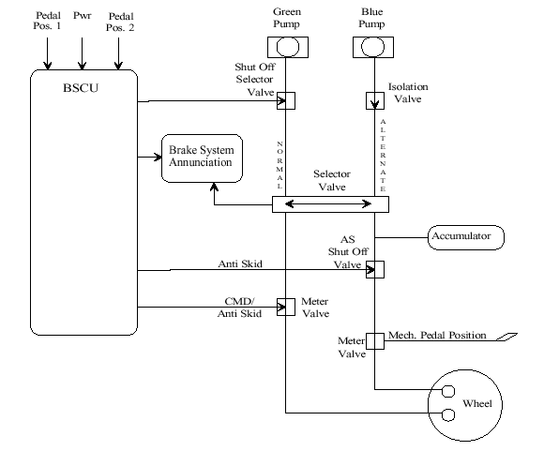
Wheel Brake System

Slide 12



Architecture Analysis and Design Language (AADL)
AADL = SAE AS5506 standard
Target: Embedded, real-time, distributed systems
Describes both hardware and software
Extensible syntax (annex)
Open source tools, supported by SEI

Slide 13
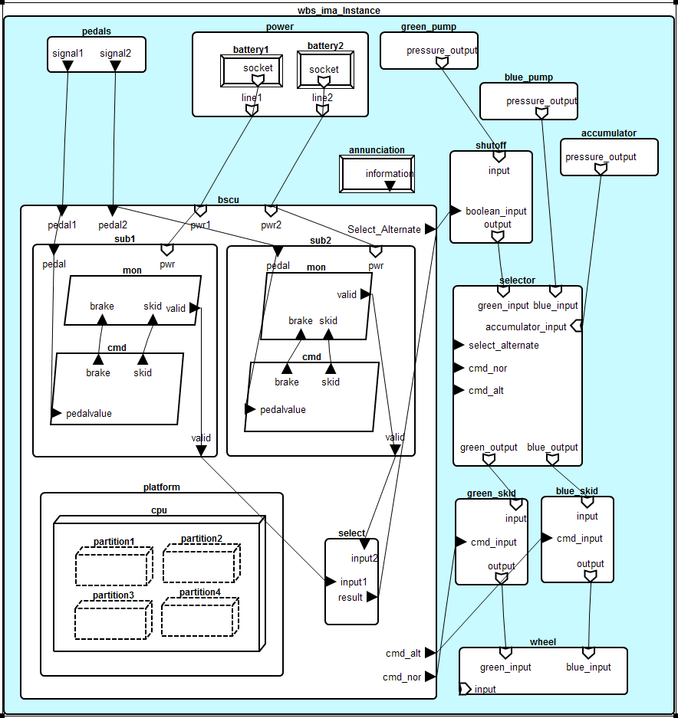
WBS AADL Model

Slide 14
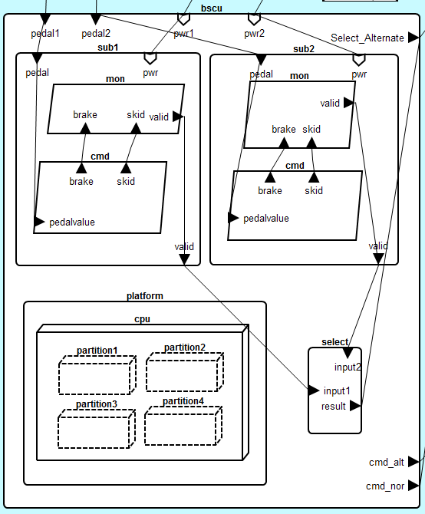

Slide 15
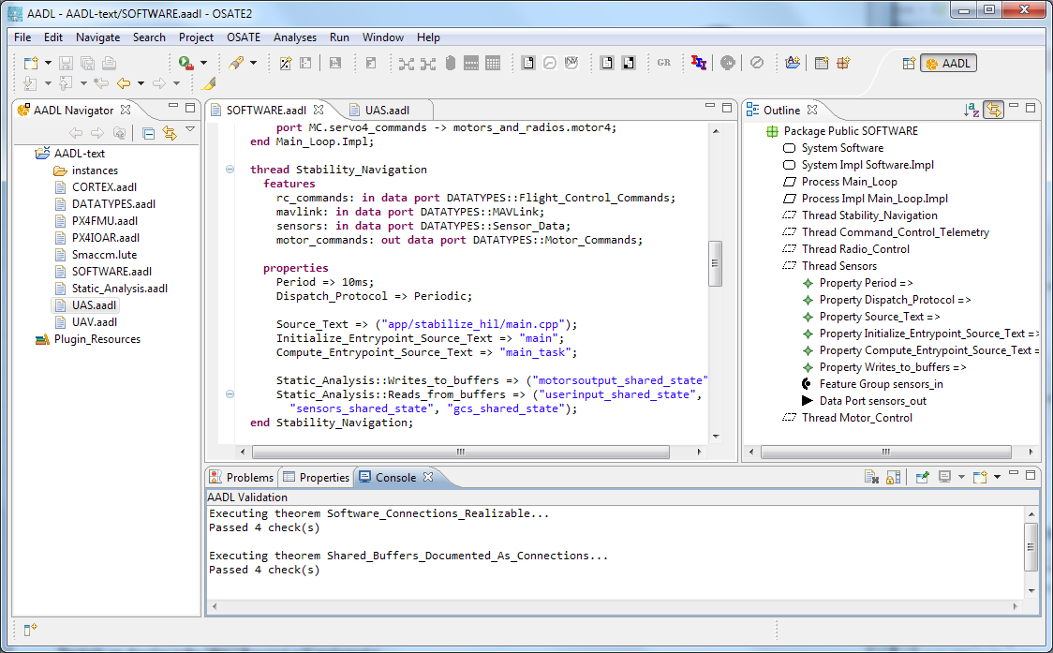


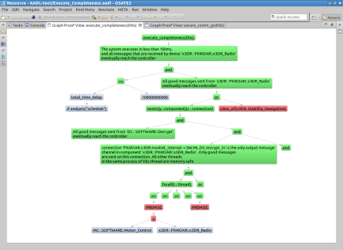
Architecture Modeling and Analysis Tools
Resolute
OSATE
AGREE
Trusted
Build
SIM
TCG
Architecture Models
Architecture Translation
Architecture Analysis
A
C
Assumption: Input < 20
Guarantee: Output < 2*Input
Assumption: none
Guarantee: Output = Input1 + Input2
B
seL4
Assumption: Input < 20
Guarantee: Output < Input + 15
Assumption: Input < 10
Guarantee: Output < 50
eChronos
VxWorks
Kind/JKind
Model Checker
Notes:
START AGREE HERE

Slide 16
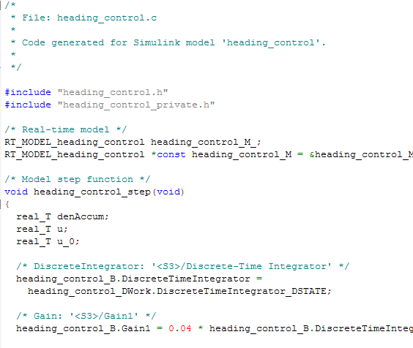
AGREE:
Assume Guarantee
Reasoning Environment
contract
contract
contract
Each component has a contract consisting of assumptions and guarantees
  Assumptions: Constraints over what a component expects from its environment
  Guarantees: Constraints over how a component behaves in response to its environment (requirements)
The contract of a component abstracts the behavior of its implementation
AGREE analysis
contract
contract
contract
contract
Component
Implementation

Slide 17



Compositional Verification of Critical Systems
Compositional verification tool for analysis of AADL system models
AGREE: Assume-Guarantee Reasoning Environment
Focus on system safety properties
Compositional approach scales model checking to larger systems
Example system: Quad-redundant flight control system provided by NASA
FCC
FCC
A
C
FCC
FCC
Assumption: Input < 20
Guarantee: Output < 2*Input
Assumption: none
Guarantee: Output = Input1 + Input2
AFDX or
TTE
Switch
AFDX or
TTE
Switch
B
Assumption: Input < 20
Guarantee: Output < Input + 15
Assumption: Input < 10
Guarantee: Output < 50
DaC
DaC
DaC
DaC

Slide 18
Compositional Verification of Critical Systems
Compositional verification tool for analysis of AADL system models
AGREE: Assume-Guarantee Reasoning Environment
Focus on system safety properties
Compositional approach scales model checking to larger systems
Example system: Quad-redundant flight control system provided by NASA
FCC
FCC
A
C
FCC
FCC
Assumption: Input < 20
Guarantee: Output < 2*Input
Assumption: none
Guarantee: Output = Input1 + Input2
AFDX or
TTE
Switch
AFDX or
TTE
Switch
B
Assumption: Input < 20
Guarantee: Output < Input + 15
Assumption: Input < 10
Guarantee: Output < 50
DaC
DaC
DaC
DaC

Slide 19
Compositional Verification of Critical Systems
Compositional verification tool for analysis of AADL system models
AGREE: Assume-Guarantee Reasoning Environment
Focus on system safety properties
Compositional approach scales model checking to larger systems
Example system: Quad-redundant flight control system provided by NASA
FCC
FCC
A
C
FCC
FCC
Assumption: Input < 20
Guarantee: Output < 2*Input
Assumption: none
Guarantee: Output = Input1 + Input2
AFDX or
TTE
Switch
AFDX or
TTE
Switch
B
Assumption: Input < 20
Guarantee: Output < Input + 15
Assumption: Input < 10
Guarantee: Output < 50
DaC
DaC
DaC
DaC

Slide 20
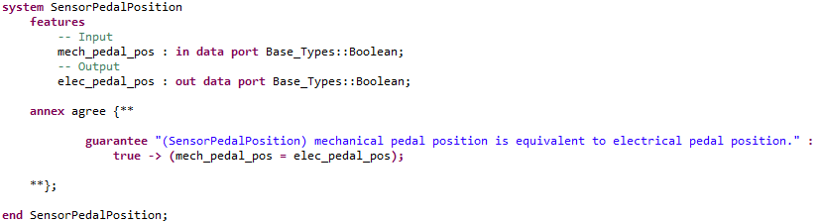
Nominal Model Component in AADL and AGREE
Notes:
Maybe remove, check on other agree slides

Slide 21
Creation of the Fault Model
Wrap nominal component in fault
Watch behavior of system through AGREE contracts

Slide 22
Wrap output in fault
Component A
Component B
Out
In
Nominal Behavior:
Component A
Component B
Out
Fault
In
Fault Behavior:

Slide 23
WBS Top Level Property : No inadvertent braking
Normal Operating Mode:
Mechanical pedal pressed (brakes commanded)
Sensor on pedal converts to electrical signal
Signal sent to BSCU to command brakes

Slide 24
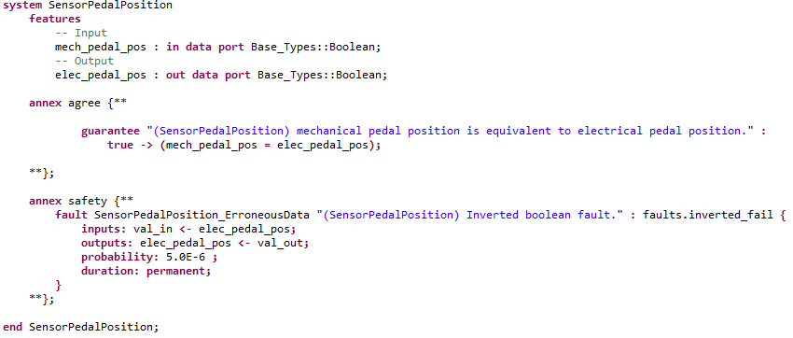
A Fault on the Pedal Sensor Component

Slide 25
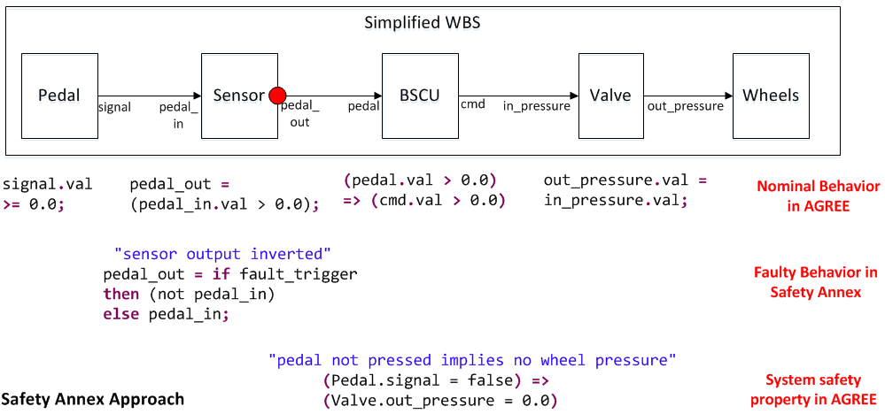
Behavioral Fault Propagation

Slide 26
Active Sensor Fault
Mechanical pedal is not pressed
Inverted Boolean failure on sensor activated
Electrical signal is true and braking is commanded through BSCU
Top level lemma fails (Unintentional braking occurs)

Slide 27
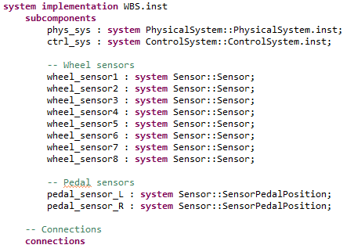
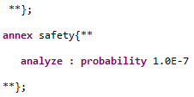
Maximum Fault vs Probabilistic Analysis
. . .
. . .

Slide 28
Maximum Fault vs Probabilistic Analysis
. . .
. . .

Slide 29
Maximum Fault vs Probabilistic Analysis
. . .
. . .

Slide 30
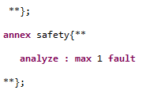
Maximum Fault vs Probabilistic Analysis
. . .
. . .

Slide 31
Current Support
Maximum number of faults
Probabilistic analysis
Hardware and software faults

Slide 32
Where does the Safety Annex fit?
Extend System Model
Compositional Analysis
Implicit Failure Propagation (FEM)

Slide 33
Existing Tools and Methods
 | FLM | FEM : Directional | FEM: Bidirectional | M | C | PB | ESM
EMV2 | ✓ |  |  |  |  |  | AADL
Compass | ✓ | ✓ |  |  | ✓ |  | SLIM
SmartIFlow |  |  | ✓ | ✓ |  | ✓
SAML |  | ✓ |  | ✓ |  | ✓
AltaRica |  |  | ✓ | ✓ |  | ✓
HipHops | ✓ |  |  |  |  |  | East-ADL
Safety Annex | ✓ | ✓ |  |  | ✓ |  | AADL

Slide 34
Future Work
Compositional Fault Tree Generation
Byzantine Faults
Transient Faults Analysis

Slide 35
Top Level Safety Property
Monolithic
Contracts and Faults
from Leaf Level
are used to find Minimal Cut Sets.
Layer 2
Layer 3
Layer 4
Leaf Level
Leaf Level
Contracts
Leaf level faults

Slide 36
Top Level Safety Property
Compositional
Contracts and Faults
from Leaf Level
are used to find Minimal Cut Sets for the next highest layer.
Layer 2
Layer 3
Layer 4
Leaf Level
Leaf Level
Contracts
Leaf level faults

Slide 37
Compositionality
Top Level Safety Property
Compositional
Contracts and Faults
from Leaf Level
are used to find Minimal Cut Sets for the next highest layer.
Layer 2
Layer 3
Layer 4
Layer 4
Contracts
Leaf Level
Leaf Level
Contracts
Leaf level faults

Slide 38
Compositionality
Top Level Safety Property
Compositional
Contracts and Faults
from Leaf Level
are used to find Minimal Cut Sets for the next highest layer.
Layer 2
Layer 3
Layer 3
Contracts
Layer 4
Layer 4
Contracts
Layer 4 faults

Slide 39
Compositionality
Top Level Safety Property
Compositional
Contracts and Faults
from Leaf Level
are used to find Minimal Cut Sets for the next highest layer.
Layer 2
Layer 2
Contracts
Layer 3
Layer 3
Contracts
Layer 3 faults

