Slide 1
Architectural Modeling and Analysis for Safety Engineering (AMASE)
Research Opportunities in Aeronautics (NRA ROA-2015)
  Model-based safety analysis of highly complex safety critical systems
Year 2 Review Meeting
NASA Langley Research Center
4 October 2018

Slide 2
Agenda
Project overview
  Status
  Technical approach
  Accomplishments
  Plans
AGREE and Safety Analysis Annex
Tool demo
Next steps (discussion…)
  Byzantine Fault
  Transient Fault
  Scalability & Usability
    ARP4754A/4761 objectives
    Assessment on the draft ARP4761 appendix on MBSA
    Complete the assessment of compositional probabilistic fault analysis on the extended WBS example
    Another large aerospace example

Slide 3

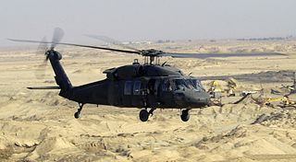

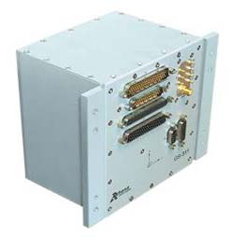
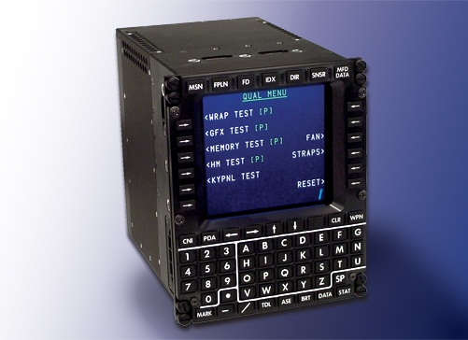
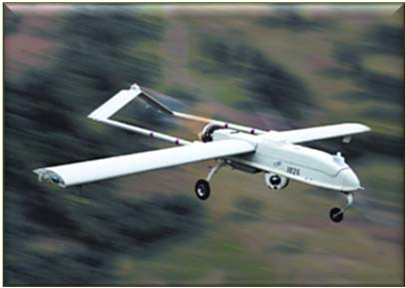
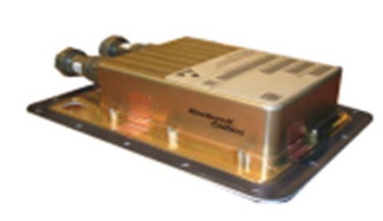
Advanced Technology Center
RC Minneapolis
& Univ. of MN
Trusted Systems Group
Formal methods for verification
Model-based development
Practical and effective tools
Certification (DO-178C)
Rockwell Collins Products
Avionics systems
Commercial and military
Manned and unmanned
Safety and security

Slide 4
Project Overview
NASA ARMD
  RESEARCH OPPORTUNITIES IN AERONAUTICS (ROA-2015)
  NASA RESEARCH ANNOUNCEMENT (NRA): NNH15ZEA001N
Airspace Operations and Safety Program (AOSP)
  SMART-NAS Test Bed for Safe, Trajectory-Based Operations Project
  Systems Assurance Technologies sub-project
  Safe Avionics and ATM Future Evolution (SAAFE) technical challenge
  Subtopic 2.5: Model-Based Safety Analysis (MBSA) of Highly-Complex, Safety Critical Systems
Our project: Architectural Modeling and Analysis for Safety Engineering (AMASE)
  Three year project (base + two option years)
  Rockwell Collins (prime) + University of Minnesota (sub)
Fully funded!

Slide 5
Team
Rockwell Collins
  Darren Cofer (Fellow, PI)
  Janet Liu (Sr. Software Engineer)
  Matt Wilding (Eng. Manager, Trusted Systems)
  Rick Spring (PM)
University of Minnesota
  Mats Heimdahl (Dept Head, CS & Eng, Co-I)
  Danielle Stewart (PhD Student)

Slide 6
Model-Based Safety Analysis
Problem
  Traditional system safety analysis is subjective and dependent on the skill of the practitioner
  Based on informal (or non-existent) system models that are incomplete, imprecise, possibly inconsistent
Insight
  Have system developers and safety engineers use the same system models created during a model-based development process
Approach
  Extend AADL-based system modeling and analysis tools to add appropriate syntax and analysis capabilities for reasoning about faulty system behaviors

Slide 7
But what about the AADL Error Model Annex?
EMA was developed before AADL had any support for modeling component behaviors
EMA therefore requires fault propagation to be explicitly modeled, apart from actual system behavior
Fault representations available in EMA are limited/incomplete
Current EMA analysis tools are limited in effectiveness
Meanwhile…
We implemented AGREE annex and analysis tool to add assume-guarantee contracts and compositional reasoning to AADL
This allows us to take a different (better) approach to safety analysis for AADL models

Slide 8
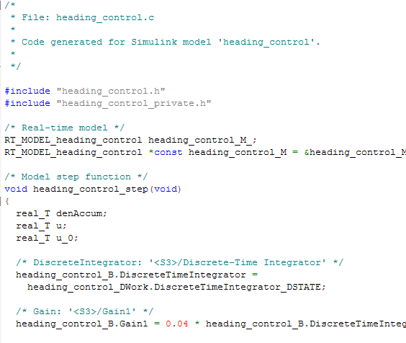
AGREE:
Assume Guarantee
Reasoning Environment
contract
contract
contract
Each component has a contract consisting of assumptions and guarantees
  Assumptions: Constraints over what a component expects from its environment
  Guarantees: Constraints over how a component behaves in response to its environment (requirements)
The contract of a component abstracts the behavior of its implementation
AGREE analysis
contract
contract
contract
contract
Component
Implementation

Slide 9

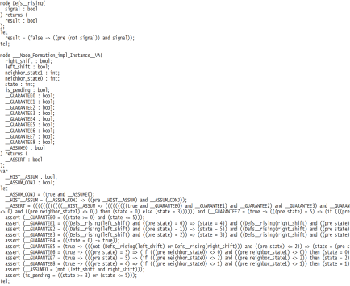
AGREE Translation
Translates AADL models with AGREE annotations into Lustre for analysis by k-induction model checkers
  Kind 2 (University of Iowa)
  JKind (Rockwell Collins)
AGREE
Kind 2
or
JKind
AADL
Lustre
Your favorite SMT solver
Z3
CMC4
Yikes
SMTInterpol

Slide 10
FLM vs. FEM
Terminology from: O. Lisagor, T. Kelly, and R. Niu. Model-based safety assessment: Review of the discipline and its challenges. In The Proceedings of 2011 9th International Conference on Reliability, Maintainability and Safety
Failure Logic Modeling (FLM): Failure propagation is explicit
  Component failure information is propagated to “downstream” components
  Analysis proceeds by determining whether failure reaches system boundary
Failure Effect Modeling (FEM): Failure propagation is implicit
  System dynamics are present in a nominal behavioral model
  Component Failures are described by their affect on variables in component dynamics
  Propagation occurs via continued effect on dynamics of “downstream” components
  Analysis proceeds by determining whether system dynamics are still acceptable in the presence of component failures.

Slide 11
AMASE Technical Approach
HACMS example for year-3 still applicable?
Update previous NASA-sponsored work on MBSA using current generation of MBSE tools and recent research
Extend our AADL system architecture modeling and analysis tools to implement new safety analysis capabilities based on FEM approach to fault modeling/propagation
Develop example systems based on
  Wheel Braking System in SAE AIR6110
  NASA quad-redundant flight control system (QFCS)
  HACMS unmanned aircraft (or comparable systems)
Link to system safety objectives in ARP4754A/4761 to demonstrate effectiveness in certification

Slide 12
Year 2 Statement of Work
3.2.1 Apply the MBSA process and tools developed in Phase 1 to a system representative in complexity/size of fielded systems in the National Airspace (NAS) – for example, NASA Quad-redundant Flight Control System (QFCS). Evaluate and address scalability issues identified by extending the analysis framework from the Phase 1 (feasibility) model to the MBSA I system model and conduct demonstrations.
3.2.2 Document the MBSA approach/process including data definitions and analysis steps, illustrated with the methodology used to define and assess MBSA I models. The Contractor shall document results of scalability analysis conducted under 3.2.1. Document any refinements to the analysis framework necessary to transition to analysis of the MBSA I system in 3.2.1.
3.2.3 Conference paper.

Slide 13
Year 2 Schedule
OCT
NOV
DEC
JAN
FEB
MAR
APR
MAY
JUN
JUL
AUG
SEP
Application of MBSA I
Documentation of MBSA
approach and process I
Models and Demonstrations
Year 1 Review
(20 Sep @LaRC)
Mid-year review
Year 2 Review (@LaRC)
Year 2 report
Monthly reports
1st month
6 months
9 months
12 months
13
Notes:
13

Slide 14
Year 2 Deliverables
4.1 Monthly Progress Reports Monthly
4.2 Kickoff Meeting & Presentation 20 Sept 2017
4.3 Midterm Review & Presentation 19 Mar 2018
4.4 Reserved
4.5.A Feasibility Demonstrations 19 Mar 2018
4.5.B Feasibility Demonstrations 11 Jun 2018
4.5.C Feasibility Demonstrations Today
4.6 Phase 2 Report 22 Sept 2018
4.7 Phase 2 Review & Presentation Today

Slide 15
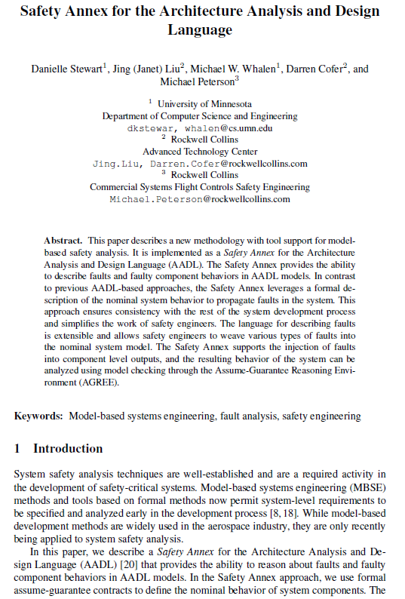
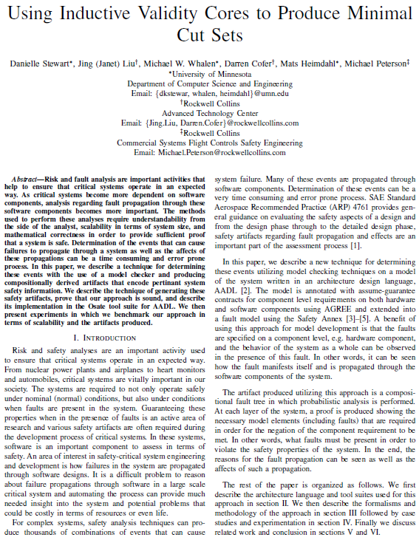
Technical Write-ups of the Work in Progress

Slide 16
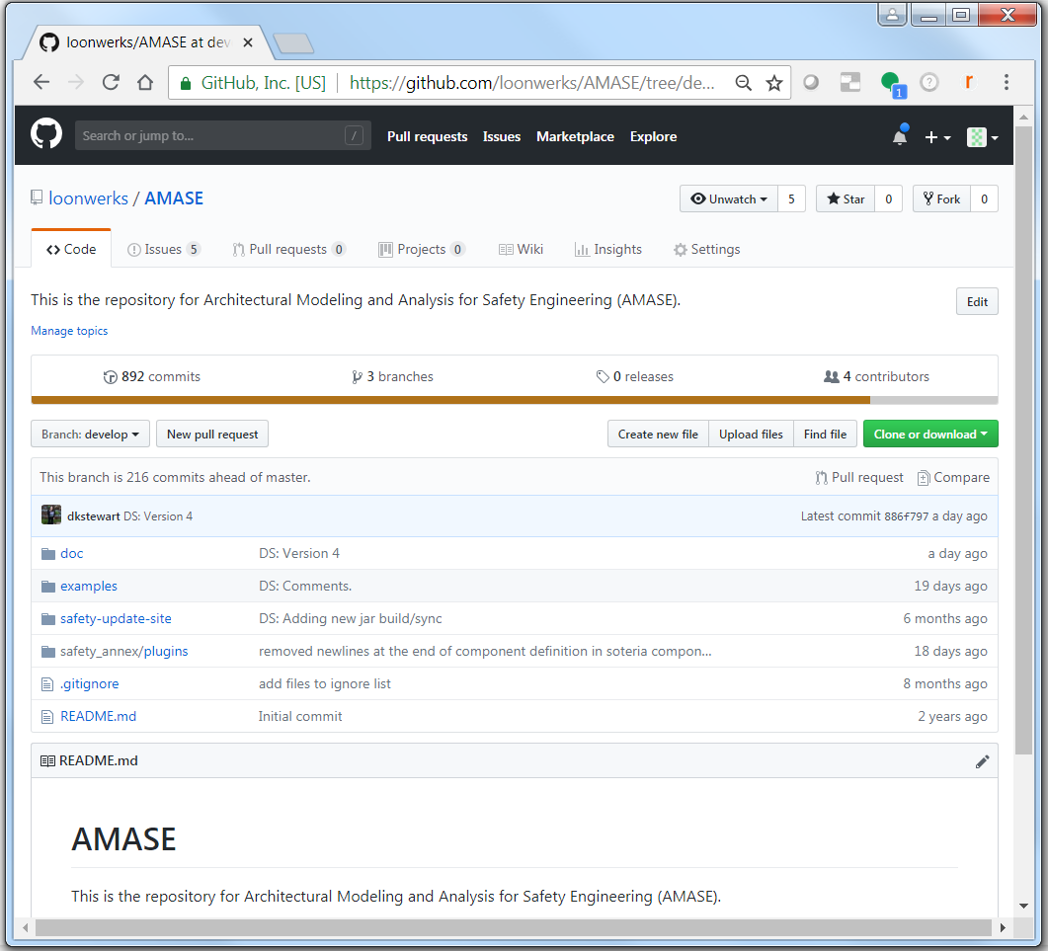
Models and tools on github

Slide 17

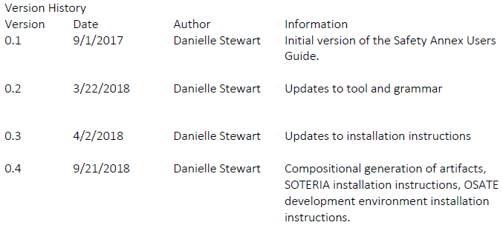
Updated Users Guide

Slide 18
Year 3 Statement of Work
Refine Framework and Application MBSA II
3.2.1 Apply the MBSA process and tools developed in Phase 2 to a reasonable distinct system from that addressed in Phase 2, and of complexity/size representative of fielded systems in the National Airspace (NAS). Evaluate and address scalability and practicality issues identified by extending the analysis framework from the Phase 2 (scalability) model to the MBSA II system model and conduct demonstrations.
3.2.2 Document the MBSA approach including data definitions and analysis steps, illustrated with the methodology used to define and assess MBSA II models. The Contractor shall document results of scalability analysis conducted under 3.2.1. Document any refinements to the analysis framework necessary to transition to analysis of the MBSA II system in 3.2.1.
3.2.3 Conference paper.

Slide 19
Year 3 Schedule
OCT
NOV
DEC
JAN
FEB
MAR
APR
MAY
JUN
JUL
AUG
SEP
Application of MBSA II
Documentation of MBSA
approach and process II
Models and Demonstrations
Year 2 Review
(4 Oct @LaRC)
Mid-year review
Year 3 Review (@LaRC)
Year 3 report
Monthly reports
1st month
6 months
9 months
12 months
19
Notes:
19

Slide 20
Progress To Date

Slide 21
Background

Slide 22

Motivation
Keep?
Requirements and
Design Documents
Safety
Analyst A
Safety
Analyst B
System Safety Analysis is
- Based on Informal Specifications
- Highly Dependent on Skill of the Analyst
Notes:
Safety engineers do most of the analysis activities like fault tree creation manually, based on a lot of informal requirements and design documents. These analyses seem to be quite subjective and highly dependent on the skill and experience of the safety engineers. Thus, it is not surprising that different safety engineers will quite often produce fault trees, which may differ in substantial ways. It is only through a rigorous review process that a concensus will be built on the correct fault tree, which captures the right fault behavior. We think that the review process implicitly consolidates existing information from various documents and then completes it with unspecified details architectural and fault behaviors. It would be great if all these activities would be based off a comprehensive system architecture.
We also observe that due to the complexity of the systems involved, it is possible that the fault trees may not capture involved fault scenarios that may occur due to complex interactions between components.

Slide 23
Model-Based Development
Keep?
Why Not the
Safety Analysis?
We Base the Entire
Development Cycle
Around the Model

Slide 24
Model-Based Safety Analysis
Keep?
Wheel Braking System
AIR6110
CONTIGUOUS AIRCRAFT/SYSTEM DEVELOPMENT PROCESS EXAMPLE
Green Pump
Blue Pump
Isolation Valve
Isolation Valve
Power A
Pedal 1
System
A
Selector Valve
Shut
Plant
Normal
N
A
Accumulator
Feed back
System
O
L
Valve
R
T
M
E
Accumulator
Pedal 2
System
B
A
R
Pump
Power B
L
N
AntiSkid
A
Meter
Command
T
Valve
Mechanical
Braking
+
Meter
E
Pedal
Fault Tolerant
AntiSkid
Valve
Meter
Braking System
Command
Valve
Control Unit
Plant
( BSCU )
Model
Model the Digital Controller Architecture
and the Physical System
Add Fault Model for Physical System
and Digital Controller Architecture
Integrates System and Safety Engineering About a Common Model
Automation Enables “What-If” Consideration of System Designs
Notes:
Steve’s slide

Slide 25
Nominal Model

Slide 26
Nominal System Model
Model of the Digital System
Power A
Verify safety properties of the nominal digital system
Pedal 1
System
A
Plant
Feed back
Pedal 2
System
B
Green Pump
Blue Pump
Power B
Isolation Valve
Isolation Valve
Fault Tolerant
Power A
Braking System
Control Unit
Pedal 1
Selector Valve
( BSCU )
Shut
Plant
Normal
N
A
Accumulator
Feed back
System
O
L
Valve
Verify safety properties of the nominal mechanical system
R
T
M
E
Accumulator
Pedal 2
System
B
A
R
Pump
Power B
L
N
AntiSkid
A
Meter
Command
T
Valve
Mechanical
Braking
E
Pedal
Fault Tolerant
+
Meter
Meter
Braking System
AntiSkid
Valve
Valve
Control Unit
Command
Plant
( BSCU )
Model
Model of the Digital System +
Model of the Mechanical System

Slide 27
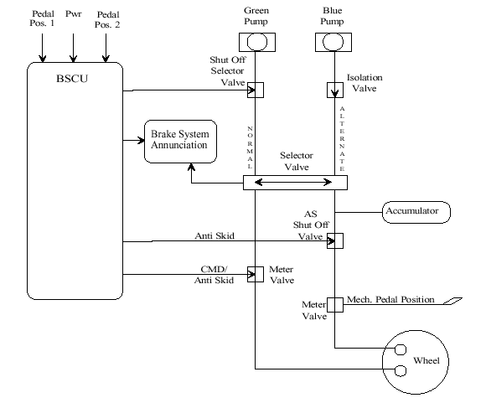
Wheel Brake System
Notes:
A brief description of a simplified wheel brake system originally described in AIR6110.

Slide 28



Architecture Analysis and Design Language (AADL)
AADL = SAE AS5506 standard
Target: Embedded, real-time, distributed systems
Describes both hardware and software
Extensible syntax (annex)
Open source tools, supported by SEI
Notes:
SAE standard modeling language we focus on is AADL.

Slide 29
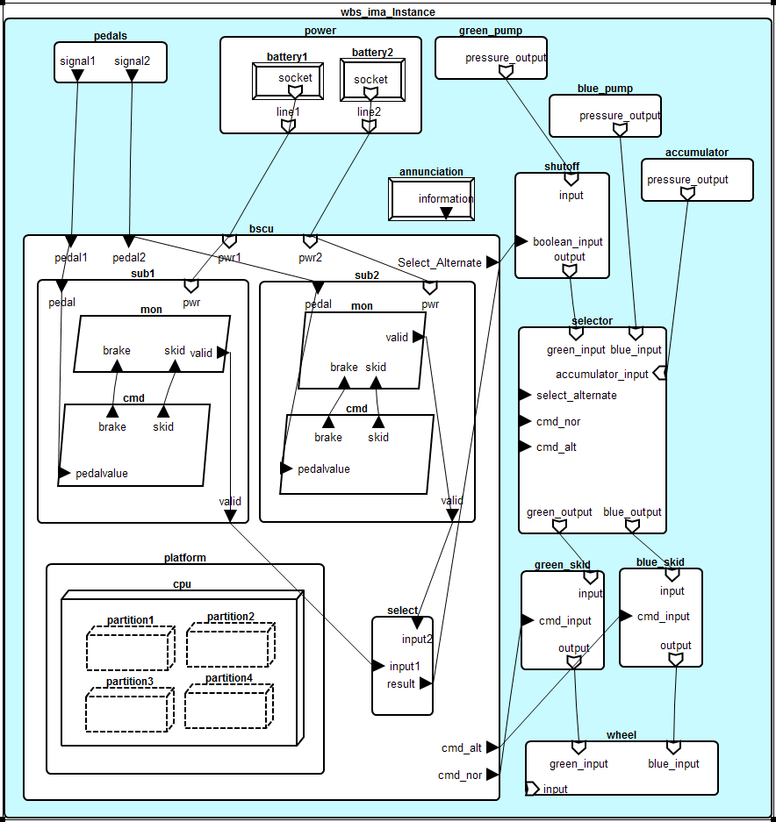
WBS AADL Model (Overview)
Notes:
The simplified WBS model in AADL.

Slide 30
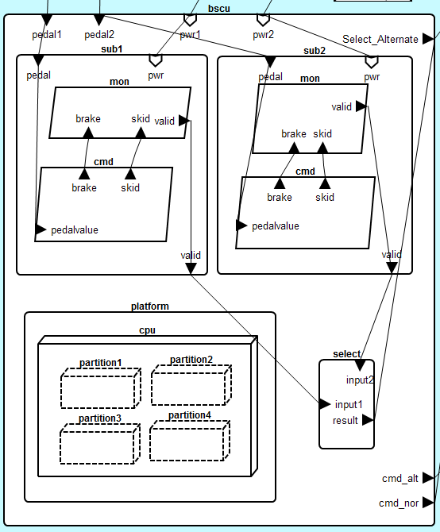
WBS AADL Model
(BSCU)

Slide 31
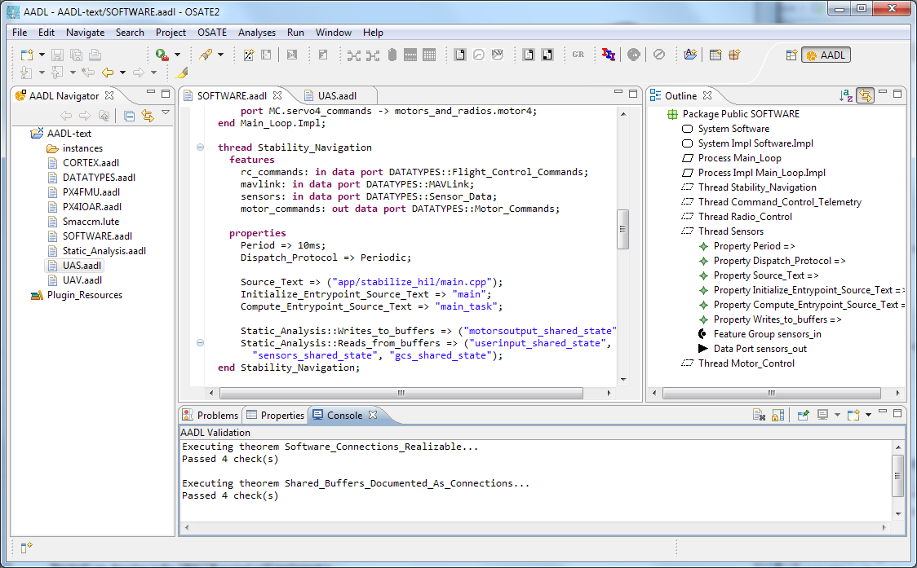


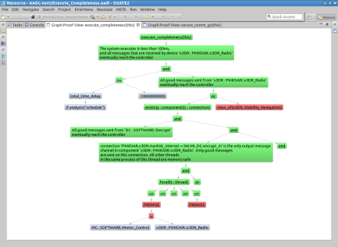
Architecture Analysis Tools
Resolute
OSATE
AGREE
Trusted
Build
SIM
TCG
Architecture Models
Architecture Translation
Architecture Analysis
A
C
Assumption: Input < 20
Guarantee: Output < 2*Input
Assumption: none
Guarantee: Output = Input1 + Input2
B
seL4
Assumption: Input < 20
Guarantee: Output < Input + 15
Assumption: Input < 10
Guarantee: Output < 50
eChronos
VxWorks
Kind/JKind
Model Checker
Notes:
START AGREE HERE

Slide 32
AGREE:
Assume Guarantee
Reasoning Environment
contract
contract
contract
Each component has a contract consisting of assumptions and guarantees
  Assumptions: Constraints over what a component expects from its environment
  Guarantees: Constraints over how a component behaves in response to its environment (requirements)
The contract of a component abstracts the behavior of its implementation
AGREE analysis
contract
contract
contract
contract
Component
Implementation

Slide 33



Compositional Verification of Critical Systems
Compositional verification tool for analysis of AADL system models
AGREE: Assume-Guarantee Reasoning Environment
Focus on system safety properties
Compositional approach scales model checking to larger systems
Example system: Quad-redundant flight control system provided by NASA
FCC
FCC
A
C
FCC
FCC
Assumption: Input < 20
Guarantee: Output < 2*Input
Assumption: none
Guarantee: Output = Input1 + Input2
AFDX or
TTE
Switch
AFDX or
TTE
Switch
B
Assumption: Input < 20
Guarantee: Output < Input + 15
Assumption: Input < 10
Guarantee: Output < 50
DaC
DaC
DaC
DaC

Slide 34
Compositional Verification of Critical Systems
Compositional verification tool for analysis of AADL system models
AGREE: Assume-Guarantee Reasoning Environment
Focus on system safety properties
Compositional approach scales model checking to larger systems
Example system: Quad-redundant flight control system provided by NASA
FCC
FCC
A
C
FCC
FCC
Assumption: Input < 20
Guarantee: Output < 2*Input
Assumption: none
Guarantee: Output = Input1 + Input2
AFDX or
TTE
Switch
AFDX or
TTE
Switch
B
Assumption: Input < 20
Guarantee: Output < Input + 15
Assumption: Input < 10
Guarantee: Output < 50
DaC
DaC
DaC
DaC

Slide 35
Compositional Verification of Critical Systems
Compositional verification tool for analysis of AADL system models
AGREE: Assume-Guarantee Reasoning Environment
Focus on system safety properties
Compositional approach scales model checking to larger systems
Example system: Quad-redundant flight control system provided by NASA
FCC
FCC
A
C
FCC
FCC
Assumption: Input < 20
Guarantee: Output < 2*Input
Assumption: none
Guarantee: Output = Input1 + Input2
AFDX or
TTE
Switch
AFDX or
TTE
Switch
B
Assumption: Input < 20
Guarantee: Output < Input + 15
Assumption: Input < 10
Guarantee: Output < 50
DaC
DaC
DaC
DaC

Slide 36
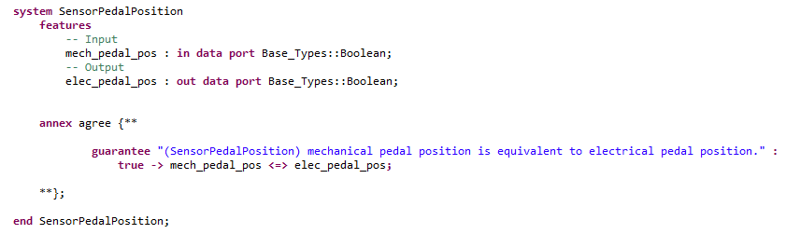
Notes:
An example of a simple component in AADL with AGREE contracts.

Slide 37
Wheel Brake System (Simple Version)

Slide 38
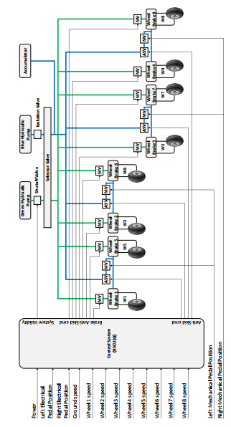
Wheel Brake System (Complex Version)
Notes:
The large WBS example.

Slide 39
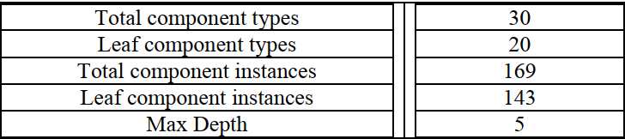
Scalability: WBS Architecture Details

Slide 40
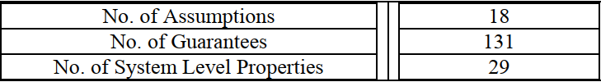
Scalability: WBS AGREE Contract Details

Slide 41
Fault Model

Slide 42
Behavioral Failure Propagation
Wrap nominal component in fault
Watch behavior of system through AGREE contracts

Slide 43
Behavioral Failure Propagation
Component A
Component B
Out
In
Nominal Behavior:
Component A
Component B
Out
Fault
In
Fault Behavior:

Slide 44
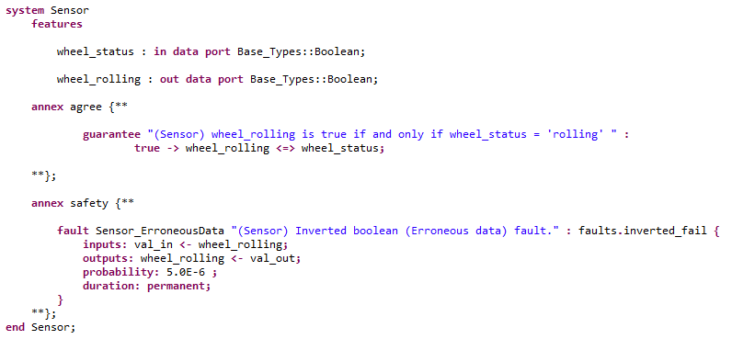
Safety Annex
Notes:
An example of the simple AADL/AGREE system component with the Safety Annex added in.

Slide 45
Sensor Nominal Model
Normal Operating Mode:
Mechanical pedal pressed (brakes commanded)
Sensor on pedal converts to electrical signal
Signal sent to BSCU to command brakes
Notes:
A running example of the Sensor component to illustrate how the Safety Annex can provide insight into behavioral fault propagation.

Slide 46
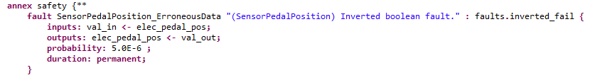
Sensor Fault Model

Slide 47
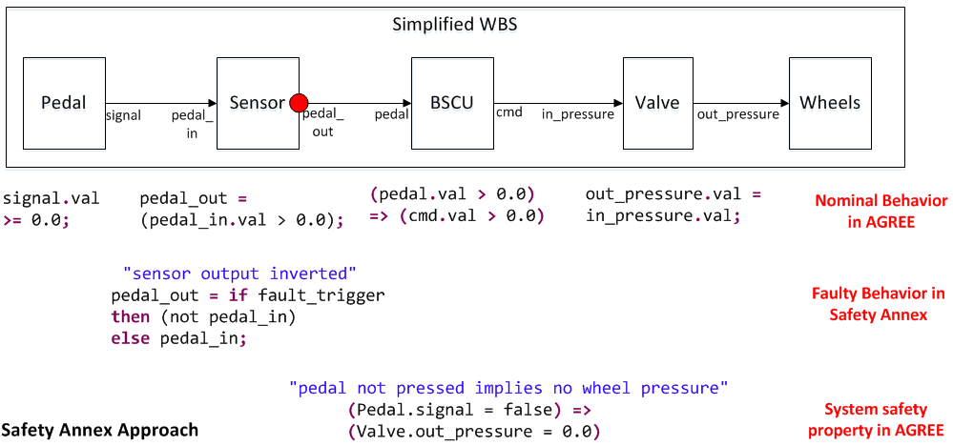
Behavioral Fault Propagation
Notes:
A behavioral flow diagram showing fault propagation.
Active Sensor Fault:
Mechanical pedal is not pressed
Inverted Boolean failure on sensor activated
Electrical signal is true and braking is commanded through BSCU
Top level lemma fails (Unintentional braking occurs)

Slide 48
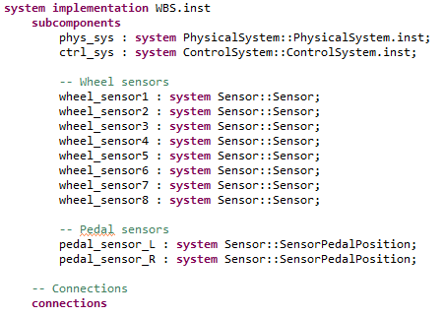
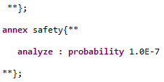
Fault Hypothesis in System Implementation
. . .
. . .
Notes:
Top level system component with AGREE contracts and the Safety Annex analysis statements.

Slide 49
Nominal Behavior in AGREE Annex
. . .
. . .
Notes:
Top level system component with AGREE contracts and the Safety Annex analysis statements.

Slide 50
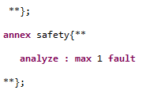
Maximum No. of Faults Fault Hypothesis
. . .
. . .
Notes:
Top level system component with AGREE contracts and the Safety Annex analysis statements.

Slide 51
Probabilistic Fault Hypothesis
. . .
. . .
Notes:
Top level system component with AGREE contracts and the Safety Annex analysis statements.

Slide 52
WBS Fault Model Details

Slide 53
Demo WBS

Slide 54
Compositional
Probablistic
Fault Analysis

Slide 55
Motivation for Compositional Fault Analysis
Currently: Given top level threshold, do the fault combinations exceed it?
Desire: Given faults and probabilities, what is the threshold of the system?
Currently: FT analysis done monolithically.
Desire: Generate informative FTs containing both fault model information and nominal model architecture.

Slide 56
Inductive Validity Cores
Safety Property
Notes:
Goal is to prove the top level safety property of system.

Slide 57



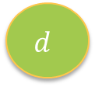


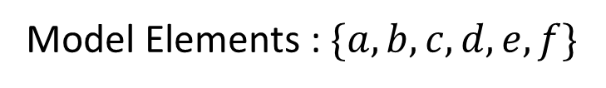
Inductive Validity Cores
Safety Property
$$a$$
$$b$$
$$c$$
$$d$$
$$e$$
$$f$$
Model Elements : $\{a, b, c, d, e, f\}$
Notes:
We feed in the model elements to the model checker as well as the safety property.

Slide 58
Inductive Validity Cores
Safety Property
$$a$$
$$b$$
$$c$$
$$d$$
$$e$$
$$f$$
Model Elements : $\{a, b, c, d, e, f\}$

Slide 59




Inductive Validity Cores
Safety Property
$$a$$
$$b$$
$$c$$
$$d$$
$$e$$
$$f$$
IVC : A minimal set of elements
needed to prove the
Safety Property
$$\{a, c, d\}$$
Notes:
The model checker can return a minimal set of elements required in order to perform the proof.

Slide 60




Inductive Validity Cores
Safety Property
$$a$$
$$b$$
$$c$$
$$d$$
$$e$$
$$f$$
All IVCs : All minimal sets of elements
needed to prove the
Safety Property
$\{\left\{a, c, d\right\},${$b, e, f$}}
Notes:
Or we can request all IVCs.

Slide 61


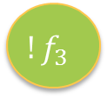
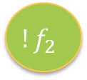


Inductive Validity Cores with Faults
Safety Property
$${!f}_{1}$$
$${!f}_{2}$$
$${!f}_{3}$$
$$g_{1}$$
$$g_{2}$$
$$g_{3}$$
Model Elements : $\{Faults=FALSE, Guarantees\}$
Notes:
Instead of feeding in only the model elements, we feed in the negation of faults as well.

Slide 62





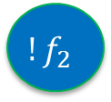

Inductive Validity Cores with Faults
Safety Property
$${!f}_{1}$$
$${!f}_{2}$$
$${!f}_{3}$$
$$g_{1}$$
$$g_{2}$$
$$g_{3}$$
All IVCs : All minimal sets of elements
needed to prove the
Safety Property
$\{\{!f_{1}$, !$f_{3}$, $g_{1}\}$, {$!f_{2}$, $g_{2}$, $g_{3}\}\}$
Notes:
The IVCs then include the faults that must not occur in order to prove the safety property.

Slide 63
Proof Tree
$$\left(!f1 ∧!f2\right) ∨\left(!f1∧!f3\right) ⊢SP$$
Notes:
Here is the proof tree provided after performing the IVC analysis.

Slide 64
Negation of the Proof Tree
$$\left(f1 ∨ f2\right)∧\left(f1∨ f3\right) ⊢! SP=TLE$$
Notes:
This is the form of the tree given after negating the results from the IVC analysis.

Slide 65

Perform Analysis
Using Boolean logic, this equation can be rearranged to find Minimal Cut Sets and calculate top level probability threshold.
$$\left(f1 ∨ f2\right)∧\left(f3 ∨ f1\right) ⊢! SP=TLE$$
$$= f1∨(f2∧f3)$$

Slide 66
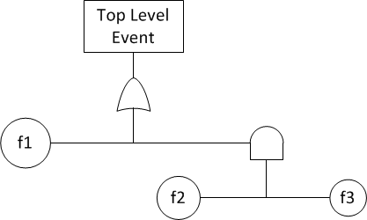

Perform Analysis
Using Boolean logic, this equation can be rearranged to find Minimal Cut Sets and calculate top level probability threshold.
$$\left(f1 ∨ f2\right)∧\left(f3 ∨ f1\right) ⊢! SP=TLE$$
$$= f1∨(f2∧f3)$$
Fault Tree Analysis
Probabilistic Analysis
$$P\left(TLE\right)=P\left(f1\right)+P\left(f2\right)P(f3)$$

Slide 67

Perform Analysis
Automatically generate SOTERIA model
OCaml

Slide 68
Perform Analysis
Automatically generate SOTERIA model
Feed model into SOTERIA tool
OCaml
SOTERIA

Slide 69


Perform Analysis
Automatically generate SOTERIA model
Feed model into SOTERIA tool
SOTERIA performs boolean algebra and probabilistic calculations
Output includes behavior propagation, fault trees, probabilities, etc.
OCaml
SOTERIA
$$P\left(TLE\right)=P\left(f1\right)+P\left(f2\right)P(f3)$$

Slide 70
Demo Compositional Probablistic
Fault Analysis
Notes:
Notes for Janet:
Goal
Conduct verification in the presence of faults
Approach overview
We provide a framework for users to explore/verify in the modeling domain more than before, e.g.,
User our model to turn on different fault classes, and see how that affect the safety property and probability
Verify if the architecture is fault tolerant, and if the fault mitigation design is effective
Safety Annex Progress
Probabilistic fault analysis
Specify probabilities for faults
Monolithic analysis: specify probability threshold (previously we supported max num of faults)
Compositional analysis: turn MIVC results into failure propagation model to compute the top-level probability
Using MIVCs
Use the SOTERIA tool to calculate cutsets and top-level probabilities and output fault trees and fault propagation models
Failure propagations
Specify hardware faults and propagations
The extended WBS example
The functionally and structurally equivalent AADL version of the most complex WBS xSAP model (arch4wbs)
Demo of exploration/verification in the modeling domain
Max num of faults analysis
No fault activated, property holds
One fault activated, if property fails – single point of failure
Prohibit the above fault from happening, see if property holds
Probabilistic fault analysis
All fail scenarios: 1 failure, 2 failures, 3 failures
Adjust probability threshold to see different results (e.g., only 2 simultaneous faults instead of 3 are considered)
Use our approach to check if the architecture is resilient to single point of failure
To clarify:
1. Two ways to turn faults on/off (based on max num of faults or probability threshold)
2. Our approach can do the following:
- verify if a safety property holds
- verify if the property holds given the threshold which faults can activate simultaneously
- compute probabilities

Slide 71
Hardware Dependent Faults

Slide 72
HW Failures
Failures in hardware (HW) components can
  Trigger behavioral faults in the software (SW) or system (SYS) components that depend on them
    e.g., processor failure triggers faulty behavior in the process bound to it
  Trigger faults/failures at another HW component located nearby
    e.g., cascading failure caused by a fire or water damage
There may be no concrete behaviors associated with HW components
  Existing fault propagation in AGREE through nominal behavior requires modeling using data ports and AGREE behaviors, which may not be readily available for HW components
Notes:
Definitions from ARP4761:
Failure: A loss of function or a malfunction of a system or a part thereof.
Fault: An undesired anomaly in an item or system.
Error: (1) An occurrence arising as a result of an incorrect action or decision by personnel operating or maintaining a system. (2) A mistake in specification, design, or implementation.

Slide 73
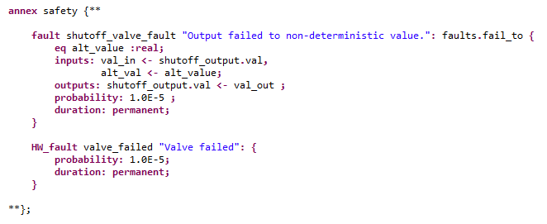
HW Failures (Continued)
    Added fault model element for HW components
      A triggering event stemming from the HW component
      No behavioral effects or data ports
Notes:
Definitions from ARP4761:
Failure: A loss of function or a malfunction of a system or a part thereof.
Fault: An undesired anomaly in an item or system.
Error: (1) An occurrence arising as a result of an incorrect action or decision by personnel operating or maintaining a system. (2) A mistake in specification, design, or implementation.

Slide 74

Fault Propagations from HW Failures
Fault propagations from HW failures are typically tied to the way components are connected or bound together
  This information may not be available at the HW components where the faults are being specified
Allow users to specify fault dependencies in system implementation where the dependencies are clear
  Specifies which behavioral faults are triggered by the HW failure
  The tool auto propagates the fault once the HW failure is activated

Slide 75
Demo Hardware Dependent Faults

Slide 76
Support to System and Safety Engineering

Slide 77
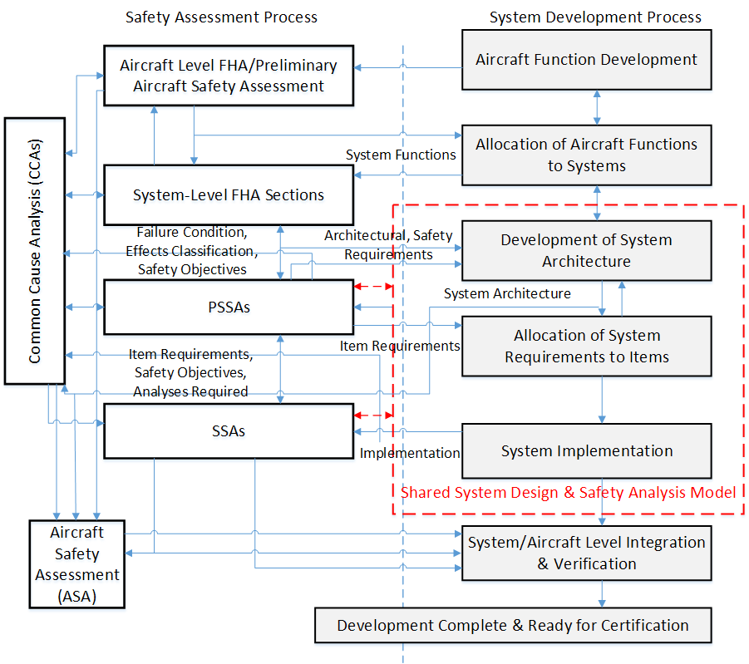
Integration to the ARP4754A Safety Assessment Process
Safety Assessment Process -> Shared model: info to guide the creation of the fault models
Shared model -> Safety Assessment Process: info on how the system works and fails
Notes:
This figure presents our proposed use of this shared system design and safety analysis
model in the context of the ARP4754A Safety Assessment Process Model (derived from
Figure 7 of ARP4754A). The shared model is one of the system development artifacts
from the “Development of System Architecture” and “Allocation of System Requirements
to Item” activities in the System Development Process, which interacts with the
PSSAs and SSAs activities in the Safety Assessment Process. The shared model can
serve as an interface to capture the information from the system design and implementation
that is relevant for the safety analysis.

Slide 78
Support of ARP4754A Safety Assessment Process Objectives
Objective 3.1 The aircraft/system functional hazard assessment is performed
  Not supported.
Objective 3.2 The preliminary aircraft safety assessment is performed
Objective 3.3 The preliminary system safety assessment is performed
  Partially supported.
  Formally determine how failures could cause failure conditions identified by the Functional Hazard Assessment (FHA) in a behavioral modeling setting.
  Formally validate that the proposed architecture and allocated behavioral requirements can reasonably meet safety requirements in the presence of faults.
Notes:
3.1 The aircraft/system functional hazard assessment is performed
Perform the functional hazard assessment by identifying the failure condition, effects of failure condition, classification of each failure condition, and outlining considerations and assumptions for each failure condition. Re-evaluation should occur after implementation of systems and after integration of systems.
3.2 The preliminary aircraft safety assessment is performed
Perform the preliminary aircraft safety assessment by conducting a systematic examination of proposed architecture to determine how failures could cause Failure Conditions identified by the FHA, and create safety requirements and validate that the proposed architecture can reasonably meet safety requirements.
3.3 The preliminary system safety assessment is performed
Perform the preliminary system safety assessment by conducting a systematic examination of proposed architecture to determine how failures could cause Failure Conditions identified by the FHA, and create safety requirements and validate that the proposed architecture can reasonably meet safety requirements.
3.4 The common cause analyses are performed
Perform the particular risk assessment, common mode analysis, and zonal safety analysis per ARP4761, Appendix I, J, K.
3.5 The aircraft safety assessment is performed
Use verification methods to verify implemented design meets safety requirements.
3.6 The system safety assessment is performed
Use verification methods to verify implemented design meets safety requirements.
3.7 Independence requirements in functions, systems and items are captured
Capture independence requirements

Slide 79
Support of ARP4754A Safety Assessment Process Objectives (Continued)
  Objective 3.4 The common cause analyses are performed
  Not supported.
Objective 3.5 The aircraft safety assessment is performed
Objective 3.6 The system safety assessment is performed
  Partially supported. Formally verify that the implemented design meets safety requirements in a behavioral modeling setting.
Objective 3.7 Independence requirements in functions, systems and items are captured
  Partially supported. Behavioral Independence requirements can be formally verified, and violations discovered.
Notes:
3.1 The aircraft/system functional hazard assessment is performed
Perform the functional hazard assessment by identifying the failure condition, effects of failure condition, classification of each failure condition, and outlining considerations and assumptions for each failure condition. Re-evaluation should occur after implementation of systems and after integration of systems.
3.2 The preliminary aircraft safety assessment is performed
Perform the preliminary aircraft safety assessment by conducting a systematic examination of proposed architecture to determine how failures could cause Failure Conditions identified by the FHA, and create safety requirements and validate that the proposed architecture can reasonably meet safety requirements.
3.3 The preliminary system safety assessment is performed
Perform the preliminary system safety assessment by conducting a systematic examination of proposed architecture to determine how failures could cause Failure Conditions identified by the FHA, and create safety requirements and validate that the proposed architecture can reasonably meet safety requirements.
3.4 The common cause analyses are performed
Perform the particular risk assessment, common mode analysis, and zonal safety analysis per ARP4761, Appendix I, J, K.
3.5 The aircraft safety assessment is performed
Use verification methods to verify implemented design meets safety requirements.
3.6 The system safety assessment is performed
Use verification methods to verify implemented design meets safety requirements.
3.7 Independence requirements in functions, systems and items are captured
Capture independence requirements

Slide 80
Benefits from Safety Engineer’s View
Tackles the most time consuming steps in the safety assessment process
Helps with safety reviews
Fosters early communications between safety and system engineers
Notes:
The model and generated signal flow diagram tackles the most time consuming steps in the safety assessment
process which is to understand how the software is intended to work. Other steps are not as time consuming, e.g., two days to understand how the software in a Stall Warning System was intended to work, and a few hours to get the fault tree.
2. There are not only one way to do fault tree. There are nuances to tell what's valid and what's not valid. We can have our approach to help standardize how fault tree looks to help with safety reviews. This way, safety engineers can tell what's valid and what's not valid based on the generated signal flow. This helps with the interaction cycle with safety review process as well.
3. It forces the intermix/communication early on between safety and system engineers that can help reduce problems later on.

Slide 81
Future Work

Slide 82
Asymmetric/Byzantine Faults
Byzantine Faults
  “A fault presenting different symptoms to different observers” ^{[1]}
  Many fault-tolerant system designs are still vulnerable to Byzantine faults without designers’ full awareness
Current AGREE and Safety Annex can simulate Byzantine Faults with some workarounds
  Creating one-to-one connection from the source to multiple observers
  Introducing disagreements by injecting faults on individual outputs
[1] K. Driscoll, H. Sivencrona, and P. Zumsteg. Byzantine Fault Tolerance, from Theory to Reality. In SAFECOMP, vol. 2788 of LNCS, pp. 235-248, 2003.

Slide 83
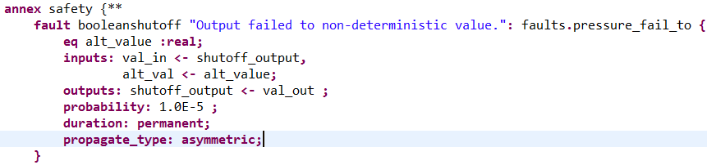
Asymmetric/Byzantine Faults (Continued)
Proposed syntax and usage for Byzantine Faults modeling
  Specify “asymmetric” for propagate_type
  For non HW fault, the tool will inject the faults on a subset of the connections from the output specified
  Hardware failures may only trigger the faulty behaviors on a subset of system outputs

Slide 84
Representation of Time
  Currently the model-checking approach is implicit of time scale
    We look at behavior over an infinite trace
  Probabilities of fault/failure are associated with a time bound
    actual fault probabilities are calculated from failure rate multiply by exposure time
    e.g., 10⁻⁵ chance of failure per flight hour
    Time rates are currently implicit in safety annex model
  Faults can occur at any time within infinite trace
    Usually cluster of independent faults lead to failures.
  Fault hypotheses have probabilities but not time rate
    So, unintended braking property: only problematic during V1 time interval. If this interval is short (say, 5 seconds), risk may be acceptably low.

Slide 85
Representation of Time (Continued)
For permanent faults, we overapproximate probability of failure
  We assume faults could happen any time in an infinite trace rather than a finite time window.
  Since faults are permanent, they can’t re-occur
For transient faults, it depends on how they are modeled.
  These can re-occur.

Slide 86
Explore Transient Faults in More Depth
  Transient fault is time dependent and may have very different computations, e.g.,
  Should transient faults be allowed to occur more than once in one trace?
  Is the probability of two occurrences equal to the independent probabilities of any other event?
  Is there a time component to this probability: e.g., can a transient fault occur twice in a row?
  The fault activation boolean variables can be constraint in various ways, e.g., with time steps
  With modeling of transient faults added, our approach can be used to figure out if an architecture is resilient to transient fault

Slide 87
Scalability
Continue to use compositional approach to handle scalability
  The compositional approach scales
    works for max number of faults
    For probabilistic analysis, the compositional approach generated the MIVCs, but the calculation of cut sets and probabilities is currently monolithic and we ran into scalability challenge there when feeding into the SOTERIA tool (combinatorial issues)
  In the future, consider:
    Put threshold of probabilities to control the number of possible cut sets being considered
    Prune the cut sets and calculate the probabilities ourselves

Slide 88
Usability & Certification Aspects
Address usability to help incorporate into certification artifacts
  Manipulate the IVC results to be more understandable (e.g., disjunctive normal form to be more intuitive)
  Add probability and descriptions to the nodes to be more readable/usable
  Possible looking at porting the results into other commercial FTA tools (e.g., CAFTA) to incorporate to an artifact used by safety engineers today
Assessment on the draft ARP4761 appendix on MBSA

Slide 89
Applications
To discuss
Complete the assessment of compositional probabilistic fault analysis on the extended WBS example
Possible another large aerospace example

Slide 90
Other Engineering Improvements
  Incorporate to the latest User Version of OSATE
  Update master branches of AGREE, JKind to incorporate the new features (e.g., All-IVCs)
  GUI update
  Safety analysis specific preference settings (e.g., All-IVC timeout value)
  Informational/Reminder messages to the users (e.g., remind users to make sure all properties pass in AGREE verify all layers before conducting compositional probabilistic fault analysis)

Slide 91
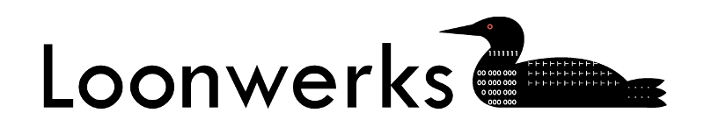

More information, code, and papers available at:
Loonwerks.com

