Slide 1

Using Inductive Validity Cores to Generate Minimal Cut Sets
University of Minnesota
Danielle Stewart

Slide 2
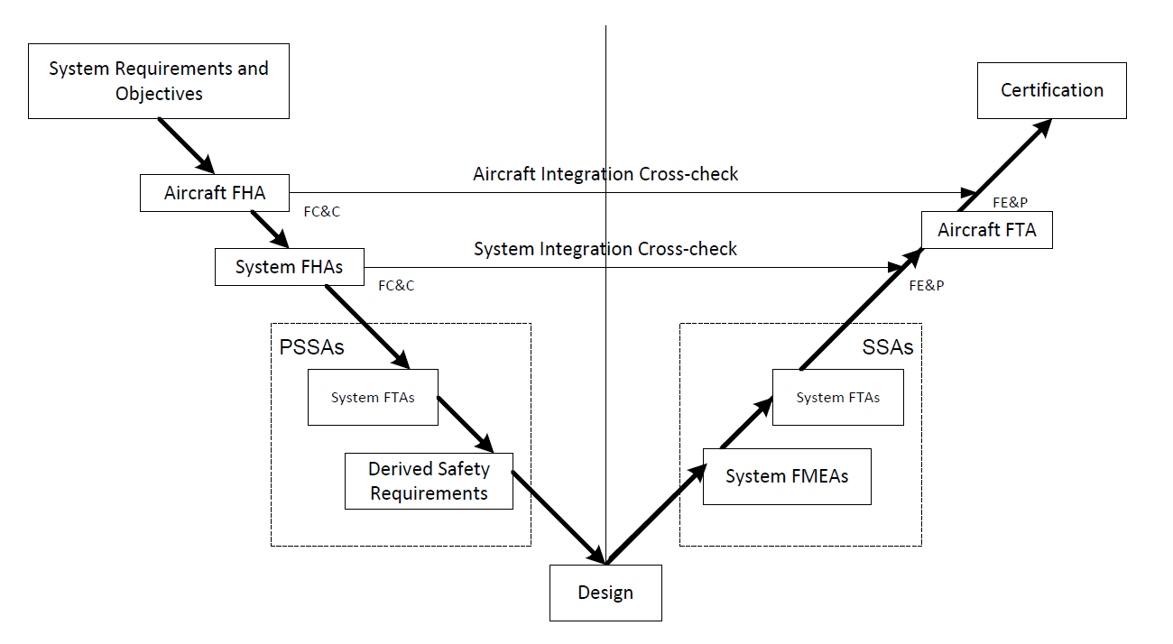
Critical System Development
System Development
Safety Analysis

Slide 3
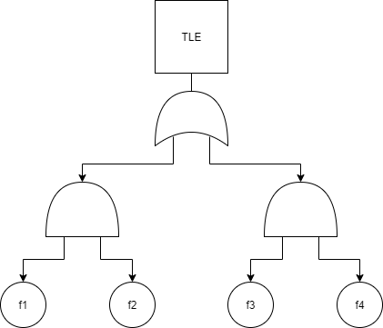
Common Artifacts of the Safety Assessment Process
Fault Trees:
  The relationship between active faults and the hazard they cause.
  Usually reflects signal flows within the system.
Minimal cut sets:
  The minimal sets of faults that lead to a given hazard.
  The faults in the AND nodes of the fault tree.
Top Level Event

Slide 4
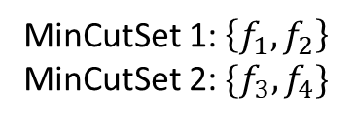
Minimal Cut Sets
  Minimal sets of faults that violate safety property
  Commonly used as safety analysis artifact
  Gives information on critical faults in a system
  Often performed manually
  Automatic generation hindered by scalability issues
MinCutSet 1: $\left\{f_{1},f_{2}\right\}$
MinCutSet 2: $\{f_{3},f_{4}\}$
Top Level Event
The main idea:
Automatic generation of minimal cut sets via proof information provided by model checker

Slide 5
MinCutSet Generation Issues
  Often generated manually
  Scalability issues with cyber-physical systems
  Can we automate the process?
  Can we provide a more scalable approach?

Slide 6
Model Based Safety Analysis
Why Not the
Safety Analysis?
We Base the Entire
Development Cycle
Around the Model

Slide 7
Safety Assessment Process
System Development Process
Shared
Model
Development of
System Architecture
System Functional
Hazard Assessment (FHA)
Allocation of System
Requirements to
Hardware and Software
Preliminary System Safety Assessment (PSSA)
Common Cause
Analyses (CCA)
Fault Tree
Analysis (FTA)
System Implementation
System Integration &
Verification
System Safety
Assessment (SSA)

Slide 8
AADL and AGREE
AADL = SAE AS5506 standard
Target: Embedded, real-time, distributed systems
Describes both hardware and software
Extensible syntax (annex)
Open source tools
AGREE: Assume Guarantee Reasoning Environment
Behavioral model defining requirements for each system component.
Each component has a contract consisting of assumptions and guarantees
Allows for compositional or monolithic verification
Uses JKind model checker over AADL/AGREE model

Slide 9
The Safety Annex for AADL
Define faults for components in a system
Use model checker to verify behavior of system in the presence of faults
See effects of active faults in the behavior of components through verification of AGREE contracts.
If the violated guarantee is used in the proof of the system safety property, it is seen in the fault analysis.
If fault is active, it could violate guarantees of A and assumptions of B.
If fault is inactive, the output of A remains unchanged.
Component A
Component B
Guarantees on output
Out
In
Assumptions on input
F

Slide 10
Scalability:
Monolithic vs. Compositional Verification
S
Monolithic: Use all contracts of the system to prove the top level property.
Compositional: Perform the analysis one layer at a time, from the top down.

Slide 11
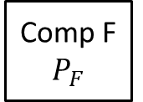
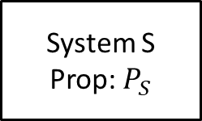
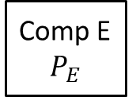
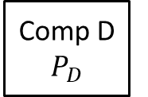
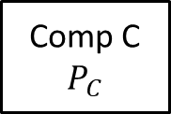
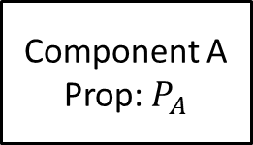
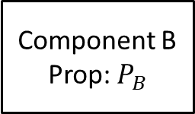
Hierarchical Layers of a System
S
S
A
System S
Prop: $P_{S}$
C
D
Component A
Prop: $P_{A}$
Component B
Prop: $P_{B}$
B
Comp C $P_{C}$
Comp D $P_{D}$
Comp E $P_{E}$
Comp F $P_{F}$
E
F

Slide 12

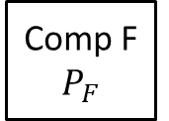

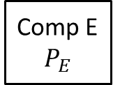
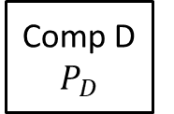


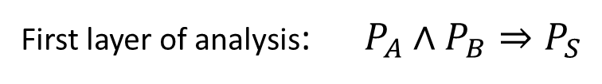


Compositional Verification
S
System S
Prop: $P_{S}$
First layer of analysis: $P_{A}∧P_{B}⇒P_{S}$
Component A
Prop: $P_{A}$
Component B
Prop: $P_{B}$
Second layer of analysis: $P_{C}∧P_{D}⇒P_{A}$
Comp C $P_{C}$
Comp D $P_{D}$
Comp E $P_{E}$
Comp F $P_{F}$
$$P_{E}∧P_{F}⇒P_{B}$$

Slide 13
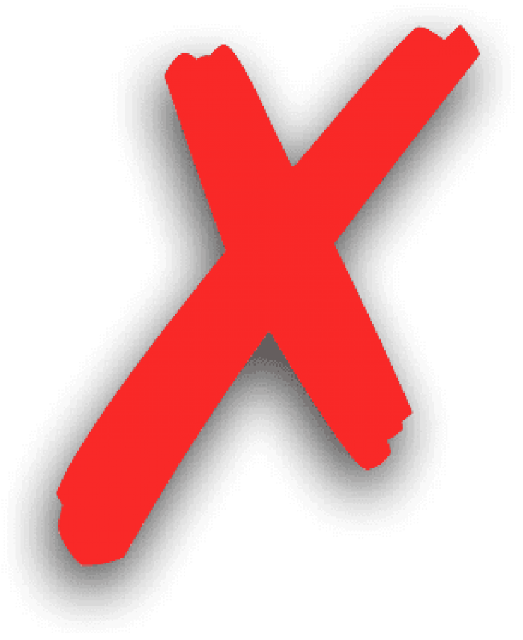
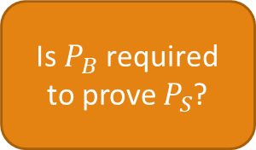
Problem with MinCutSets and Compositional Verification
S
System S
Prop: $P_{S}$
First layer of analysis: $P_{A}∧P_{B}⇒P_{S}$
Is $P_{B}$ required to prove $P_{S}$?
Component A
Prop: $P_{A}$
Component B
Prop: $P_{B}$
Second layer of analysis: $P_{C}∧P_{D}⇒P_{A}$
Comp C $P_{C}$
Comp D $P_{D}$
Comp E $P_{E}$
Comp F $P_{F}$
$$P_{E}∧P_{F}⇒P_{B}$$

Slide 14

JKind Analysis and Constraint Systems
$$Constraint System:Ordered set of constraints$$
$$over variables$$
$C=\{¬a, a→b,b\}$ : Satisfiable
$C=\{a, ¬a,¬a∨b,¬b\}$: Unsatisfiable

Slide 15


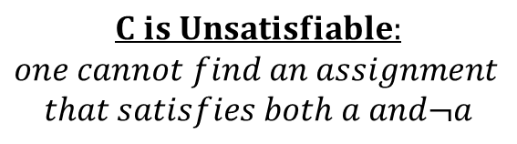
Minimal Unsatisfiable Subsets (MUSs)
$$Constraint System:$$
$$C=\{a, ¬a,¬a∨b,¬b\}$$
$$C is Unsatisfiable:$$
$$one cannot find an assignment$$
$$that satisfies both a and¬a$$
$$What are the minimal reasons$$
$$for unsatisfiability?$$
$$These are the MUSs:$$
$$MUS 1 :\left\{a,¬a\right\}$$
$$MUS 2:\{a,¬a ∨b,¬b\}$$
$$Minimal Unsatisfiable Subset: M is a subset of C such that M is UNSAT$$
$$and ∀c∈M, M\backslash \{c\} is SAT$$

Slide 16


Minimal Inductive Validity Cores (MIVCs)
  Given a constraint system, JKind‘s MIVC algorithm returns the minimal set of elements necessary to find proof of property P.
$$Minimal Unsatisfiable Subsets$$
$$\left(Minimal Inductive Validity Cores\right)$$
$$All counterexamples for the$$
$$unsatisfiable constraint$$
$$system.$$
Ghassabani, E., Whalen, M.W., and Gacek, A. “Efficient generation of all minimal inductive validity cores” FMCAD, (2017)
Model Checker

Slide 17
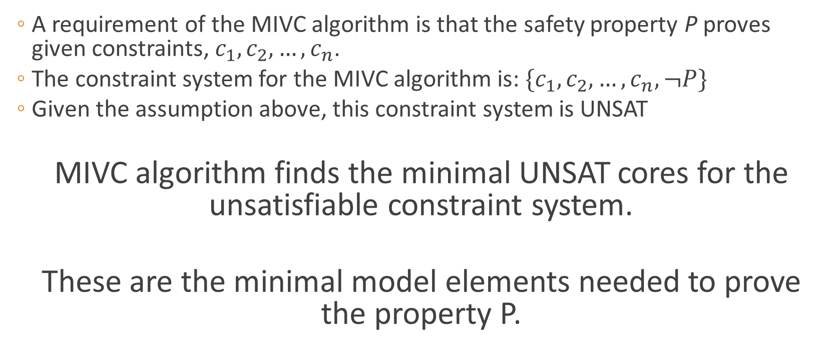
Minimal Inductive Validity Cores
  A requirement of the MIVC algorithm is that the safety property P proves given constraints, $c_{1},c_{2},…,c_{n}$.
  The constraint system for the MIVC algorithm is: $\{c_{1},c_{2},…,c_{n},¬P\}$
  Given the assumption above, this constraint system is UNSAT
  MIVC algorithm finds the minimal UNSAT cores for the unsatisfiable constraint system.
  These are the minimal model elements needed to prove the property P.

Slide 18


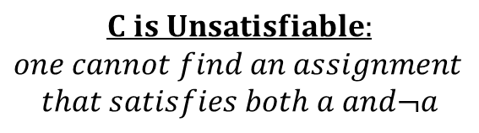
Minimal Correction Sets (MCSs)
$$Constraint System$$
$$C=\{a, ¬a,¬a∨b,¬b\}$$
$$C is Unsatisfiable:$$
$$one cannot find an assignment$$
$$that satisfies both a and¬a$$
$$What are the minimal corrections that$$
$$can be made to make system SAT?$$
$$These are the MCSs:$$
$$MCS 1 :\left\{a\right\}$$
$$MCS 2:\left\{¬a,¬b\right\}$$
$$MCS 3:\{¬a,¬a ∨b\}$$
$$Minimal Correction Set: M is a subset of C such that C\backslash M is SAT$$
$$and ∀S⊂M, C\backslash S is UNSAT$$

Slide 19

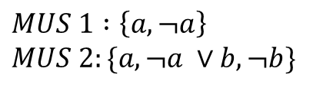

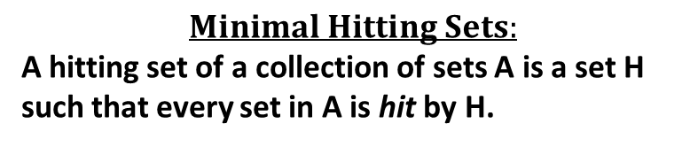


Duality of MUS and MCS:
Minimal Hitting Sets
One can find all MCSs by finding the Minimal Hitting Sets of all MUSs.
$$MUS 1 :\left\{a,¬a\right\}$$
$$MUS 2:\{a,¬a ∨b,¬b\}$$
$$MCS 1 :\left\{a\right\}$$
$$MCS 2:\left\{¬a,¬b\right\}$$
$$MCS 3:\{¬a,¬a ∨b\}$$
$$Minimal Hitting Sets:$$
A hitting set of a collection of sets A is a set H such that every set in A is hit by H.
$A=\left\{MUS1, MUS2\right\}=\{\left\{a,¬a\right\}$, {$a,¬a ∨b,¬b\}\};$
$$H1=\{a\}$$
$$H2=\{¬a,¬a ∨b\}$$
$$H3=\{¬a,¬b\}$$

Slide 20
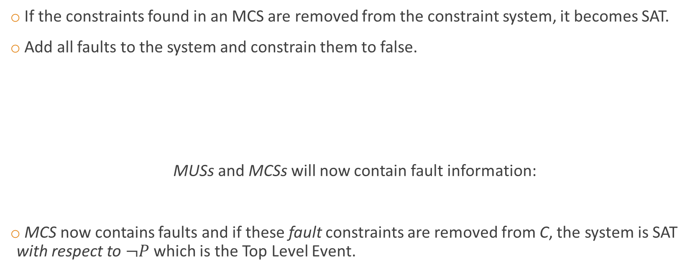
What do MCSs have to do with safety?
If the constraints found in an MCS are removed from the constraint system, it becomes SAT.
Add all faults to the system and constrain them to false.
MUSs and MCSs will now contain fault information:
MCS now contains faults and if these fault constraints are removed from C, the system is SAT with respect to $¬P$ which is the Top Level Event.
$$C=\{¬f_{1},…,¬f_{n}\text{,}c_{1},…,c_{m},¬P\}$$

Slide 21

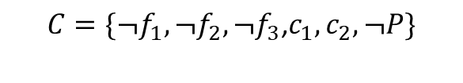

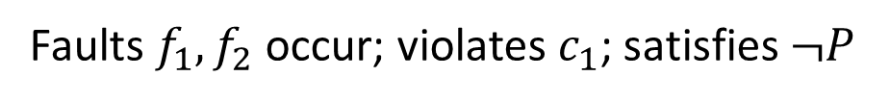

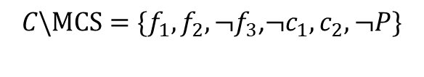




Example
System S
Prop: $P$
$$C=\{¬f_{1},¬f_{2},¬f_{3}\text{,}c_{1},c_{2},¬P\}$$
$$MCS=\{¬f_{1},¬f_{2},c_{1}\}$$
Component A
Prop: $c_{1}$
Component B
Prop: $c_{2}$
Remove constraints from C found in MCS:
$$f_{1}$$
$$f_{2}$$
$$f_{3}$$
$$C\backslash MCS=\{f_{1},f_{2},¬f_{3}\text{,}¬c_{1},c_{2},¬P\}$$
Faults $f_{1}, f_{2}$ occur; violates $c_{1}$; satisfies $¬P$

Slide 22


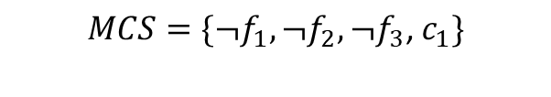
MCS to MinCutSet
$$MCS=\left\{¬f_{1},¬f_{2},¬f_{3}\right\}$$
$$MinCutSet=\{f_{1},f_{2},f_{3}\}$$
Case 1:
MCS only contains fault literals
  → Remove constraints on faults
Case 2:
MCS contains faults and contracts
  → Replace contracts with faults that cause
  their violation
  → Remove constraints on faults
$$MCS=\{¬f_{1},¬f_{2},¬f_{3}\text{,}{ c}_{1}\}$$
$$MinCutSet(c_{1})=\{f_{4}\}$$
$$MinCutSet=\{f_{1},f_{2},f_{3}{,f}_{4}\}$$

Slide 23
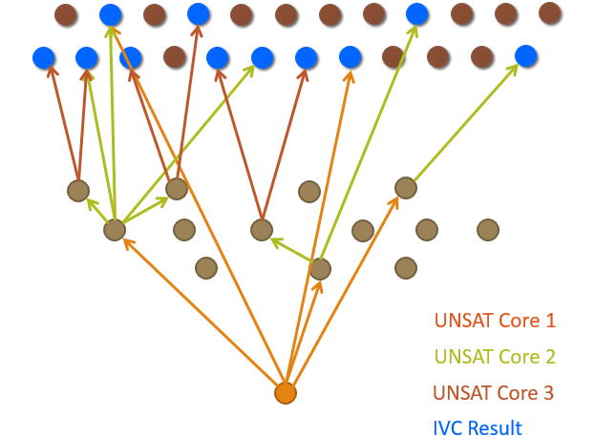




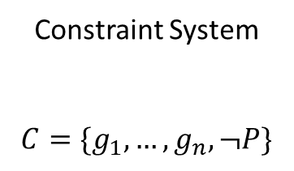



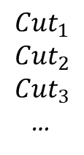




The Main Idea
1. Add constrained faults
to constraint system
2. Get all MUSs from
All-MIVC algorithm
Constraint System
$$C=\{g_{1},…,g_{n},¬P\}$$
$${MCS}_{1}$$
All MUSs
$${Cut}_{1}$$
$${Cut}_{2}$$
$${Cut}_{3}$$
…
$${MCS}_{1}$$
$${MCS}_{3}$$
$${MCS}_{5}$$
$${¬f}_{1}$$
$${MCS}_{2}$$
$${MCS}_{4}$$
$$¬f_{2}$$
$${¬f}_{3}$$
3. Get all MCSs from
Hitting Set Algorithm
4. Transform MCSs
Into MinCutSets
$${¬f}_{4}$$
$$¬ f_{5}$$

Slide 24
Future Work
  Ongoing conversations with safety analysts to provide tools they need (and will use)
  Further integration of formal methods into both the system development and safety assessment processes
  Encouragement in industry to adopt a model based approach
  Look into further ways the proof information can be used to shed light on other aspects of system/safety (i.e., assurance cases, critical component detection, etc.)

Slide 25
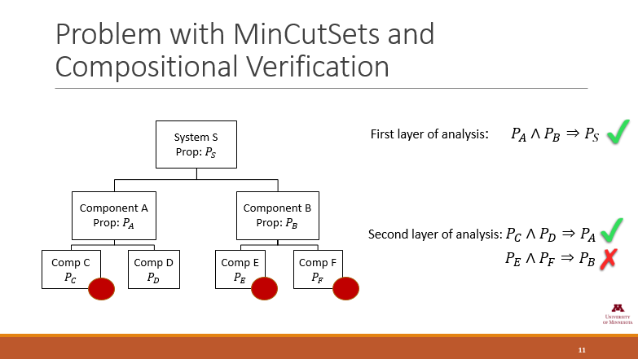
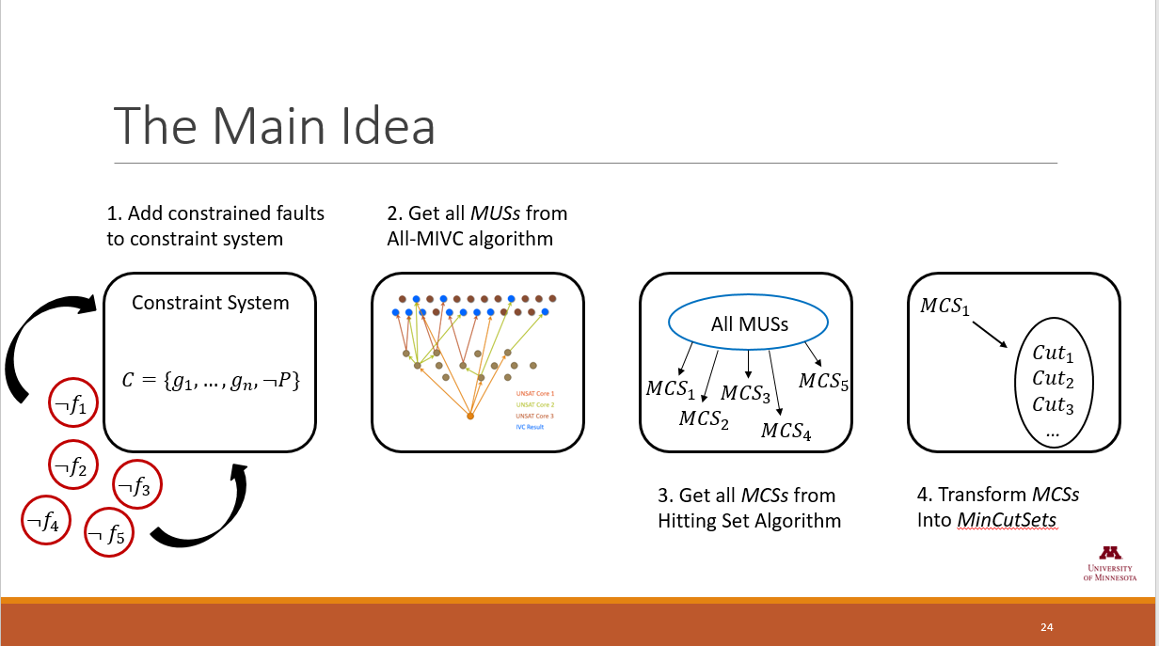
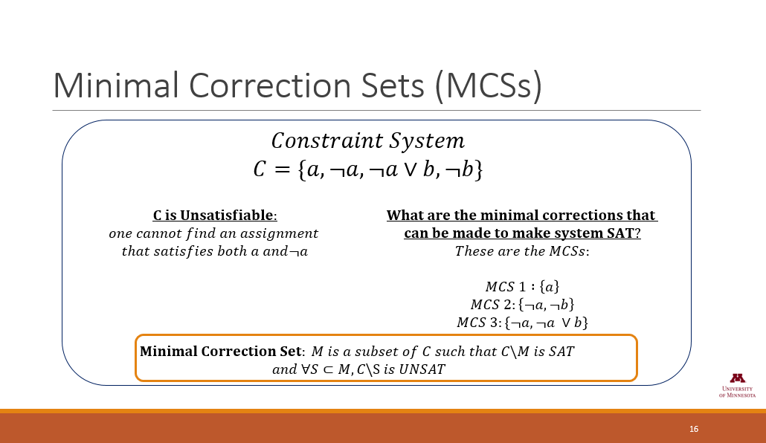
Questions
?

Slide 26


Verification in the Face of Component Failures
Maximum no. of faults analysis threshold
Are contracts violated in the presence of n active faults?
Probabilistic analysis threshold
Are contracts violated with a probability greater than x?

Slide 27
Flexible Fault Modeling
Behavioral Propagation
The effects of an active fault propagate through the system naturally
Explicit Propagation (dependencies)
Analyst explicitly states dependencies and propagations

Slide 28
JKind Model Checker
Structured as parallel engines that coordinate to prove properties and perform other verification tasks
AADL System Model
(.aadl)
Abstract Syntax Tree
(.java)
System and Behavioral Model
(.lus)
AADL type and
Implementation
annex agree{**
contracts
**};
AGREE Parser
AGREE Program
JKind Program
(Lustre)
JKind

Slide 29
Implementation of the Safety Annex
AADL System Model
(.aadl)
Abstract Syntax Tree
(.java)
System and Behavioral Model
(.lus)
AADL type and
Implementation
annex agree{**
contracts
**};
annex safety{**
faults
**};
AGREE Parser
AGREE Program
JKind Program
(Lustre)
AGREE Plugin
Extension
Point
AGREE AST with
fault
information
JKind
Safety Parser
Fault Model
Abstract Syntax Tree
(.java)
Safety Plugin

Slide 30
Implementation
  Automatically insert defined faults into AGREE program as IVC elements for consideration. Set these equal to false.
  Run analysis on the model and request All-MIVCs from JKind.
    The analysis results are a tree reflecting at each layer the MIVCs pertaining to properties.
  Use Minimal Hitting Set Algorithm to find all Minimal Correction Sets per property.
  Transform the MCSs into MinCutSets.

