Slide 1

The Safety Annex for The Architecture Analysis and Design Language
Embedded Real Time Systems
January 2020
Danielle Stewart, Jing (Janet) Liu, Darren Cofer,
Mats Heimdahl, Michael Whalen, Michael Peterson

Slide 2
Traditional safety assessment process Guidelines
ARP4754A provides guidance on applying development assurance at each hierarchical level throughout the development life cycle of highly-integrated/complex aircraft systems to establish the assurance process.
The safety assessment process is used to show compliance with certification requirements and for meeting a company’s internal safety standards.
ARP4761 identifies a systematic means to show compliance, including:
  Preliminary System Safety Assessment (PSSA) that evaluates the proposed system design and defines safety requirements
  System Safety Assessment (SSA) that evaluates the implemented system to show that safety requirements defined in the PSSA and certification regulation documentation are in fact satisfied.
ARP4754A: Guidelines for Development of Civil Aircraft and Systems
Provides Safety Guidelines and Methods
ARP4761: Guidelines and Methods for Conducting the Safety Assessment Process on Civil Airborne Systems and Equipment

Slide 3
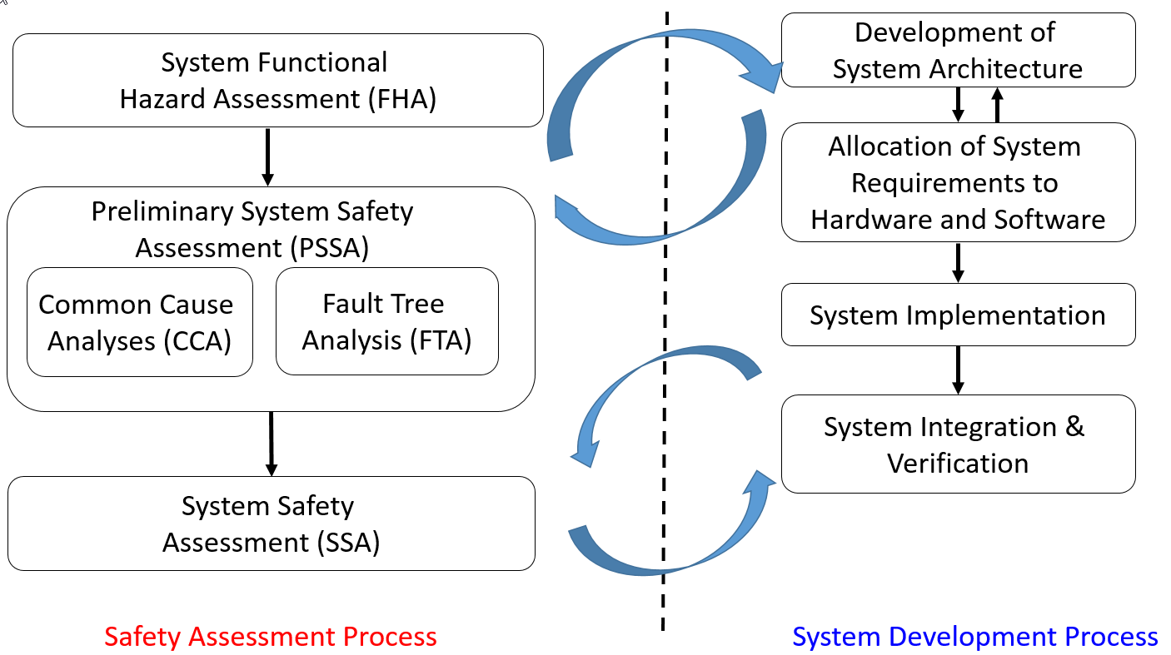
Traditional safety assessment process
Completeness of the traditional system safety analysis artifacts is subjective and dependent on the skill of the practitioner
Based on informal (or non-existent) system models that are incomplete, imprecise, possibly inconsistent
Architectural details about the system behavior gathered from multiple sources
Developing adequate understanding especially for software components is a difficult and time consuming endeavor

Slide 4
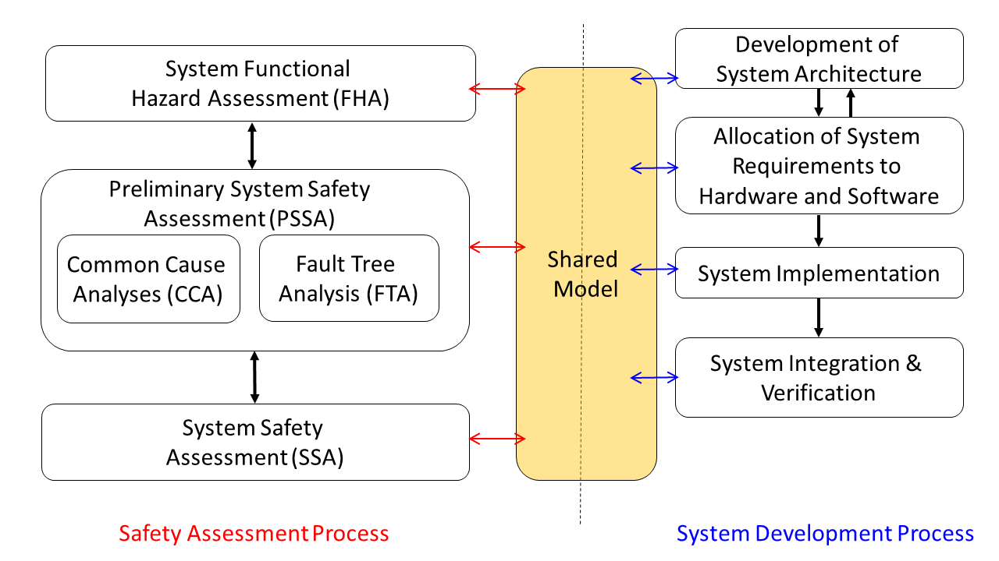
MBSA process
Have system developers and safety engineers use the same system models created during a model-based development process
Extend system model to add capabilities for reasoning about faulty behaviors

Slide 5
MBSA process Steps
Safety Engineers
System Engineers
Starts
Augment the nominal model with the component failure modes
Check that safety requirements are satisfied by the nominal design model with the backend model checker
Capture Design Information in a shared model (architecture, nominal behavior, system level safety requirements)
Specify the fault hypothesis for the analysis
Analyze if the safety requirements are satisfied by the design in the presence of faults with the backend model checker, using counterexamples and fault trees produced for diagnosis
Ends
Examine the results to assess the validity of the fault combinations and the fault tolerance level of the system design
Drive for design change

Slide 6
What will help safety analysts do this?
Shared model
  Modeling language expressive enough to capture HW/SW, standard language
Flexible error propagations
  Behavioral AND explicit propagations
Flexible fault modeling
  Symmetric, asymmetric, dependent, independent
Backend model checker
  Used to assess design with or without active faults
Ability to generate assessment artifacts
  System traces, counterexamples, minimal cut sets, fault trees, etc.

Slide 7
Closely Related work
EMV2:
  Model based, generates artifacts, captures propagations explicitly
COMPASS:
  Model based, generates artifacts, captures behavioral and explicit propagations, is not an SAE standard language: not as descriptive as AADL for real-time embedded systems

Slide 8
MBSA process Steps
Safety Engineers
System Engineers
Augment the nominal model with the component failure modes
Check that safety requirements are satisfied by the nominal design model with the backend model checker
Capture Design Information in a shared model (architecture, nominal behavior, system level safety requirements)
Specify the fault hypothesis for the analysis
Analyze if the safety requirements are satisfied by the design in the presence of faults with the backend model checker, using counterexamples and fault trees produced for diagnosis
Examine the results to assess the validity of the fault combinations and the fault tolerance level of the system design
Drive for design change

Slide 9



AADL
AADL = SAE AS5506 standard
Target: Embedded, real-time, distributed systems
Describes both hardware and software
Extensible syntax (annex)
Open source tools, supported by SEI

Slide 10
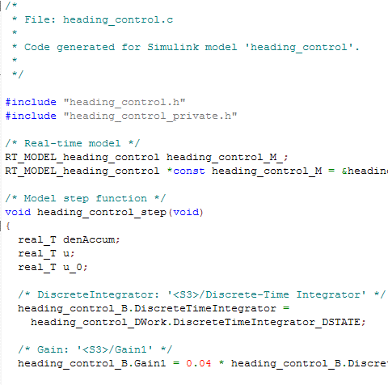
Assume-Guarantee Reasoning Environment (AGREE)
Component Implementation
A system with subcomponents
contract
contract
contract
AGREE
Each component has a contract consisting of assumptions and guarantees
  Assumptions: Constraints over what a component expects from its environment
  Guarantees: Constraints over how a component behaves in response to its environment (requirements)
Assumptions (input)
Guarantees (output)

Slide 11
MBSA process Steps
Safety Engineers
System Engineers
Augment the nominal model with the component failure modes
Check that safety requirements are satisfied by the nominal design model with the backend model checker
Capture Design Information in a shared AADL/AGREE model (architecture, nominal behavior, system level safety requirements)
Specify the fault hypothesis for the analysis
Analyze if the safety requirements are satisfied by the design in the presence of faults with the backend model checker, using counterexamples and fault trees produced for diagnosis
Examine the results to assess the validity of the fault combinations and the fault tolerance level of the system design
Drive for design change

Slide 12
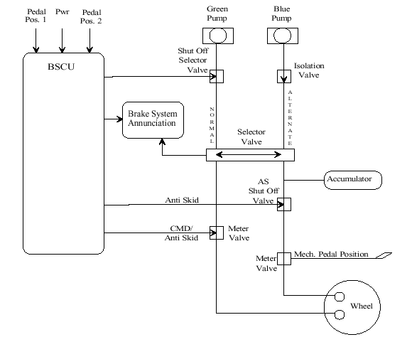
Wheel brake system (WBS)

Slide 13
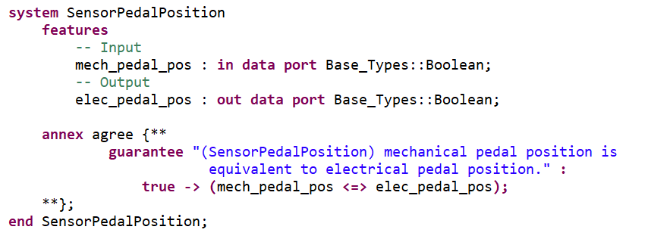
AADL and Agree
AGREE is incorporated as an annex of AADL

Slide 14
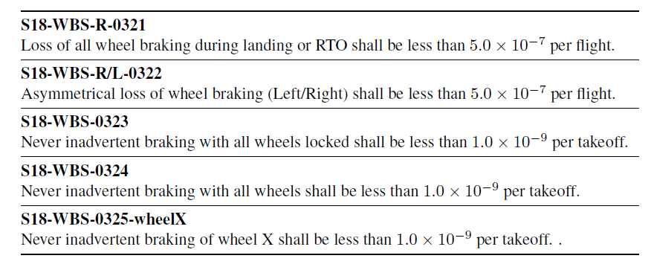
Safety requirements for WBS

Slide 15
MBSA process Steps
Safety Engineers
System Engineers
Augment the nominal model with the component failure modes
Check that safety requirements are satisfied by the nominal design model with the backend model checker
Capture Design Information in a shared AADL/AGREE model (architecture, nominal behavior, system level safety requirements)
Specify the fault hypothesis for the analysis
Analyze if the safety requirements are satisfied by the design in the presence of faults with the backend model checker, using counterexamples and fault trees produced for diagnosis
Examine the results to assess the validity of the fault combinations and the fault tolerance level of the system design
Drive for design change

Slide 16
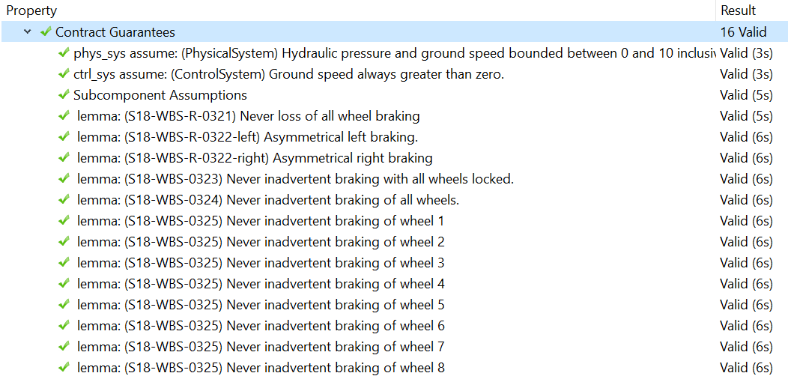
Nominal model analysis output

Slide 17
MBSA process Steps
Safety Engineers
System Engineers
Augment the nominal model with the component failure modes
Check that safety requirements are satisfied by the nominal design model with the backend model checker
Capture Design Information in a shared AADL/AGREE model (architecture, nominal behavior, system level safety requirements)
Specify the fault hypothesis for the analysis
Analyze if the safety requirements are satisfied by the design in the presence of faults with the backend model checker, using counterexamples and fault trees produced for diagnosis
Examine the results to assess the validity of the fault combinations and the fault tolerance level of the system design
Drive for design change

Slide 18
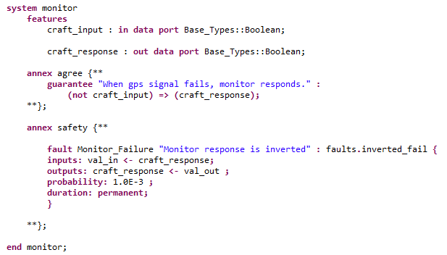
Nominal model analysis output
Safety syntax is incorporated as an annex of AADL

Slide 19
Defining faults on component outputs
Valves
  Stuck open
  Stuck closed
  Stuck non-deterministically
Sensors
  Output inverted
Pumps
  Output zero
Calculating components and Gates
  Erroneous data

Slide 20
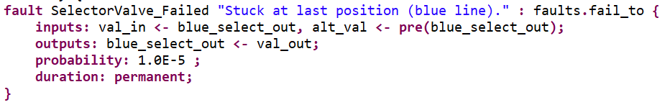
A fault definition
Selector Valve
Blue line out
(blue_select_out)
Blue pump in
Green pump in
Green line out

Slide 21
Behavioral error propagation
Wrap nominal component output in fault
Watch behavior of system through AGREE contracts when fault is activated
Component A
Component B
Out
In
Nominal Behavior:
Component A
Component B
Out
Fault
In
Fault Behavior:

Slide 22
MBSA process Steps
Safety Engineers
System Engineers
Augment the nominal model with the component failure modes
Check that safety requirements are satisfied by the nominal design model with the backend model checker
Capture Design Information in a shared AADL/AGREE model (architecture, nominal behavior, system level safety requirements)
Specify the fault hypothesis for the analysis
Analyze if the safety requirements are satisfied by the design in the presence of faults with the backend model checker, using counterexamples and fault trees produced for diagnosis
Examine the results to assess the validity of the fault combinations and the fault tolerance level of the system design
Drive for design change

Slide 23


Specify fault hypothesis statement
Specifies type of analysis to perform
Max N Analysis
Probabilistic Analysis

Slide 24
MBSA process Steps
Safety Engineers
System Engineers
Augment the nominal model with the component failure modes
Check that safety requirements are satisfied by the nominal design model with the backend model checker
Capture Design Information in a shared AADL/AGREE model (architecture, nominal behavior, system level safety requirements)
Specify the fault hypothesis for the analysis
Analyze if the safety requirements are satisfied by the design in the presence of faults with the backend model checker, using counterexamples and fault trees produced for diagnosis
Examine the results to assess the validity of the fault combinations and the fault tolerance level of the system design
Drive for design change

Slide 25
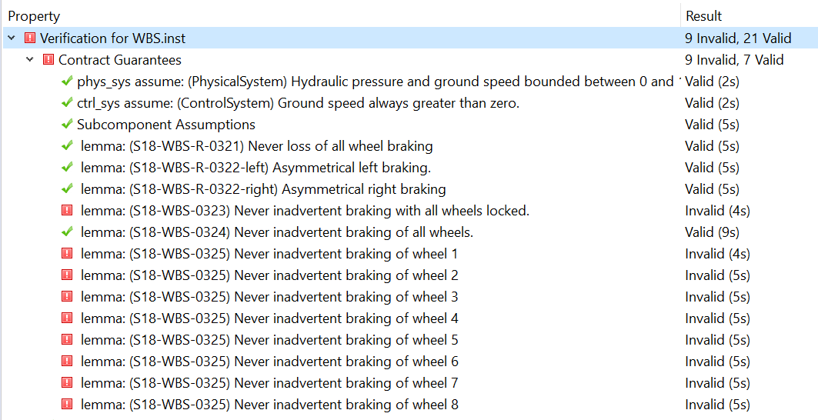
Fault Analysis results
Max 1 Fault Analysis for WBS

Slide 26
Other Generated artifacts
Counterexamples showing trace of the system
Minimal cut sets
  Tally format
  Textual format
Fault Trees (with or without probabilistic information)
  Text format
  Graph format

Slide 27
MBSA process Steps
Safety Engineers
System Engineers
Augment the nominal model with the component failure modes
Check that safety requirements are satisfied by the nominal design model with the backend model checker
Capture Design Information in a shared AADL/AGREE model (architecture, nominal behavior, system level safety requirements)
Specify the fault hypothesis for the analysis
Analyze if the safety requirements are satisfied by the design in the presence of faults with the backend model checker, using counterexamples and fault trees produced for diagnosis
Examine the results to assess the validity of the fault combinations and the fault tolerance level of the system design
Drive for design change

Slide 28
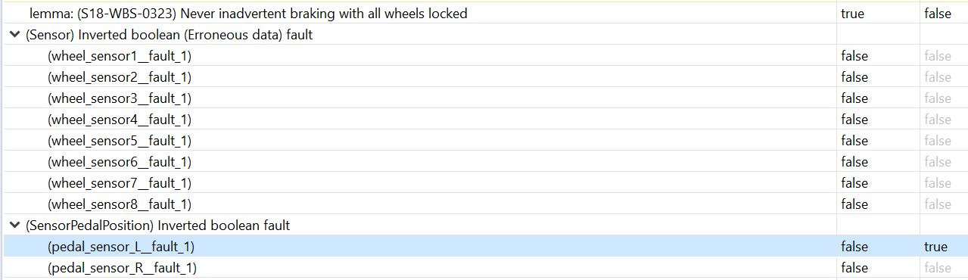
Counterexample view
Max 1 Fault Analysis for WBS

Slide 29
Assess behavior with faults
Pedal not pressed
Sensor reports that it was pressed
BSCU commands braking

Slide 30
MBSA process Steps
Safety Engineers
System Engineers
Augment the nominal model with the component failure modes
Check that safety requirements are satisfied by the nominal design model with the backend model checker
Capture Design Information in a shared AADL/AGREE model (architecture, nominal behavior, system level safety requirements)
Specify the fault hypothesis for the analysis
Analyze if the safety requirements are satisfied by the design in the presence of faults with the backend model checker, using counterexamples and fault trees produced for diagnosis
Examine the results to assess the validity of the fault combinations and the fault tolerance level of the system design
Drive for design change

Slide 31
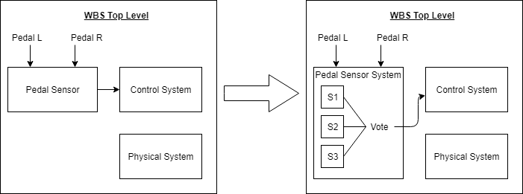
Assess behavior with faults
Redundancy in the Pedal Sensor

Slide 32
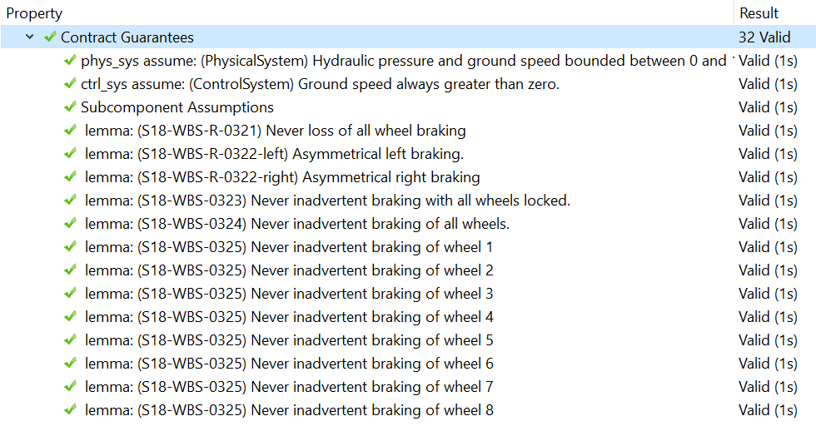
Results of Design Change
Now resilient to this single fault

Slide 33
Future work
Use the information gleaned from the collection of minimal cut sets for interesting things:
  Use fault probabilities to calculate the system threshold
  Integrate into hierarchy of system to show more meaningful fault trees
Plans for use in a large scale aircraft system in 2020

Slide 34
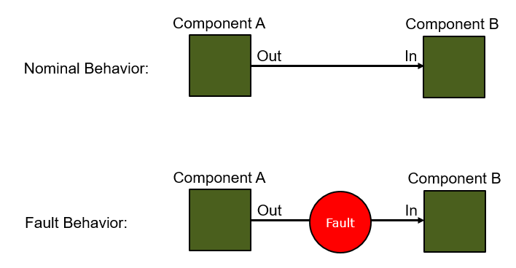

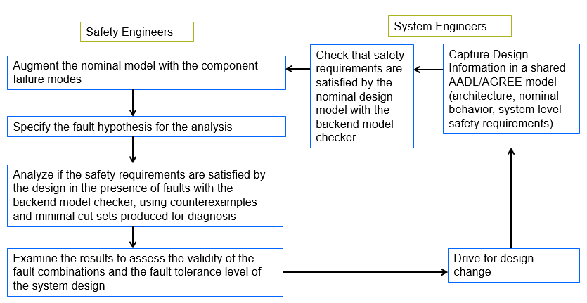
questions

Slide 35
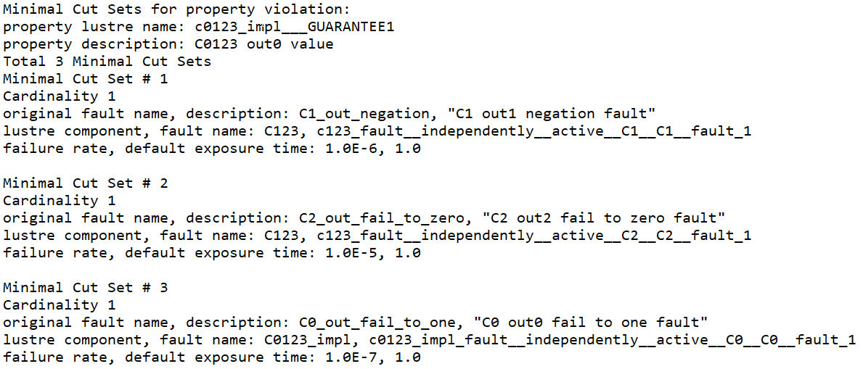
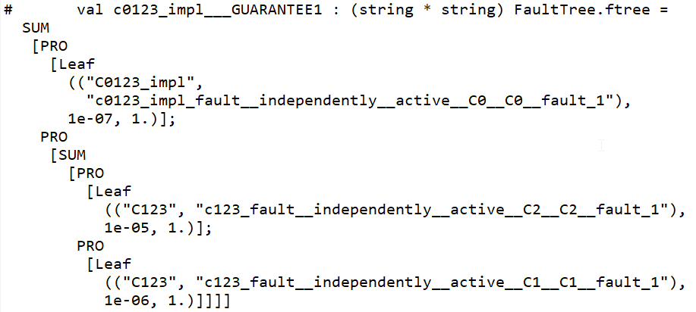
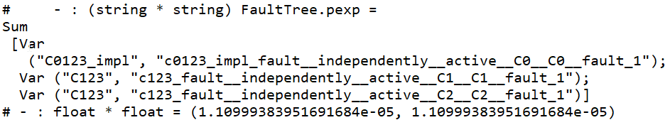
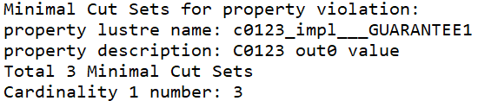
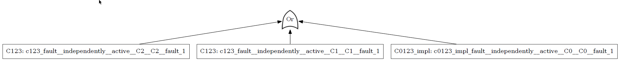
Example Safety Artifacts Generated
Panagiotis Manolios, Kit Siu, Michael Noorman and Hongwei Liao. A Model-Based Framework for Analyzing the Safety of System Architectures. RAMS, the 65th Annual Reliability and Maintainability Symposium, 2019. http://www.ccs.neu.edu/home/pete/research/rams-2019.html
Minimal Cut Sets
Fault Trees
List
Text
Probabilities
Tally
Graph

