Slide 1
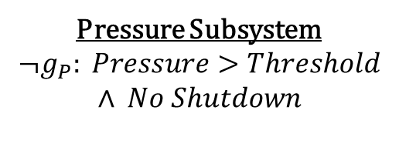
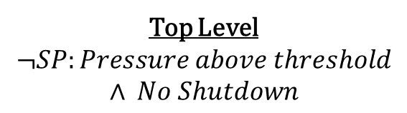
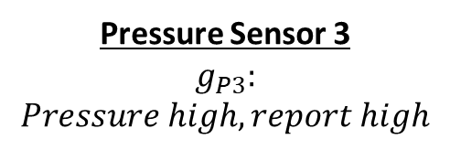


Top Level
$$¬SP:Pressure above threshold$$
$$∧ No Shutdown$$
Pressure Subsystem
$$¬g_{P}: Pressure>Threshold$$
$$∧ No Shutdown$$
Pressure Sensor 1
$${¬g}_{P1}:$$
$$Pressure high, fail low$$
Pressure Sensor 2
$${¬g}_{P2}:$$
$$Pressure high, fail low$$
Pressure Sensor 3
$$g_{P3}:$$
$$Pressure high, report high$$

