Slide 1
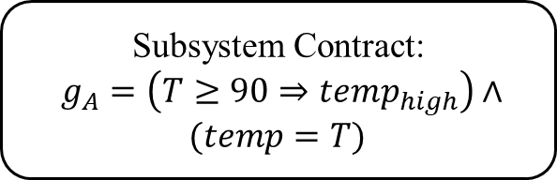
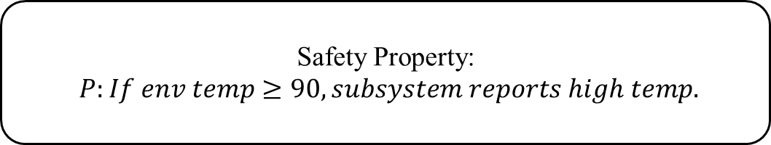


Safety Property:
$P:If env temp≥90, subsystem reports high temp.$
Subsystem Contract:
$g_{A}=\left(T≥90⇒temp_{high}\right)∧(temp=T)$
…
$$f_{1}$$
$$f_{2}$$
…

Slide 2



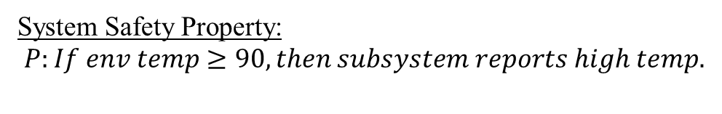


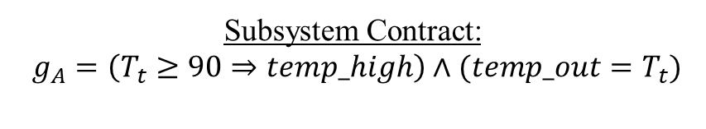
System Safety Property:
$P:If env temp≥90, then subsystem reports high temp.$
Subsystem Contract:
$g_{A}=\left(T_{t}≥90⇒temp_high\right)∧(temp_out=T_{t})$
Sensor Contract:
$g_{a1}=\left(T_{t}≥90⇒temp_high\right)$
$$g_{a2}=(temp_out=T_{t})$$
$$temp_high$$
$$env_temp_in$$
f1
$$temp_in$$
f2
$$temp_out$$

Slide 3
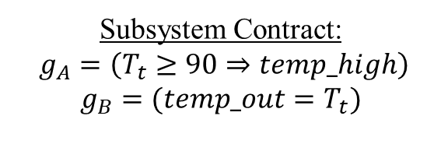
System Safety Property:
$P:If env temp≥90, then subsystem reports high temp.$
Subsystem Contract:
$g_{A}=\left(T_{t}≥90⇒temp_high\right)$
$$g_{B}=(temp_out=T_{t})$$
Sensor Contract:
$g_{a1}=\left(T_{t}≥90⇒temp_high\right)$
$$g_{a2}=(temp_out=T_{t})$$
$$temp_high$$
$$env_temp_in$$
f1
$$temp_in$$
f2
$$temp_out$$

Slide 4
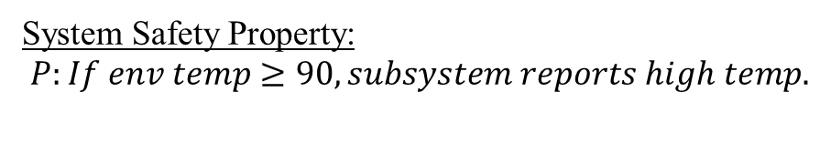


System Safety Property:
$P:If env temp≥90, subsystem reports high temp.$
Subsystem Contracts:
$g_{A}=\left(T≥90⇒temp_high\right)$
$$g_{B}= (temp_out=T)$$
$$temp_high$$
f1
$$env_temp_in$$
$$temp_in$$
$$temp_out$$
f2

Slide 5
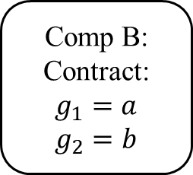
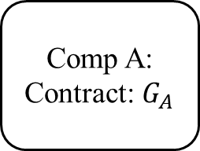


…
Comp A: Contract: $G_{A}$
Comp B: Contract: $g_{1}=a$
$$g_{2}=b$$
…
…
$$f_{1}$$
$$f_{2}$$

Slide 6
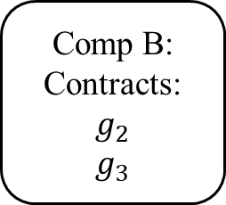
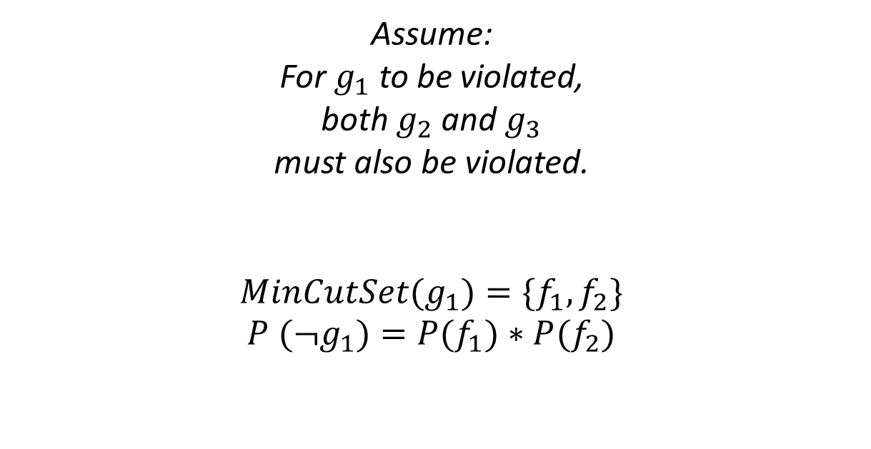
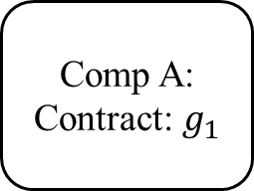
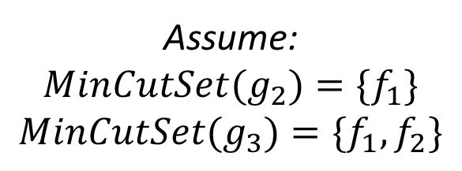


…
Assume:
$${MinCutSet(g}_{2})={\{f}_{1}\}$$
$${MinCutSet(g}_{3})={\{f}_{1},f_{2}\}$$
Comp A: Contract: $g_{1}$
Assume:
For $g_{1}$ to be violated,
both $g_{2}$ and $g_{3}$
must also be violated.
$${MinCutSet(g}_{1})={\{f}_{1},f_{2}\}$$
$${P (¬g}_{1})={P(f}_{1})∗P(f_{2})$$
Comp B: Contracts: $g_{2}$
$$g_{3}$$
…
…
$$f_{1}$$
$$f_{2}$$

Slide 7
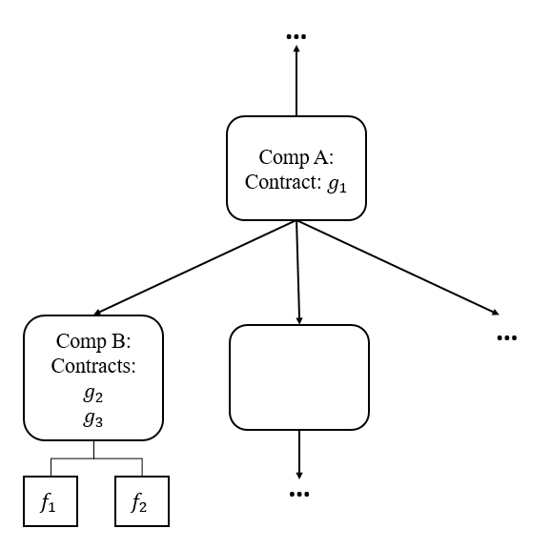
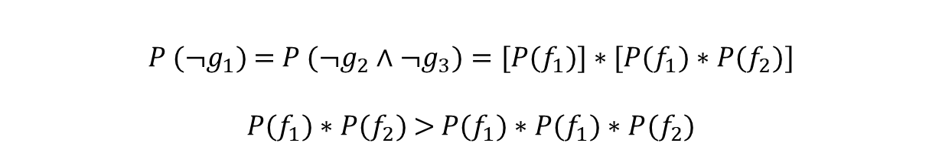
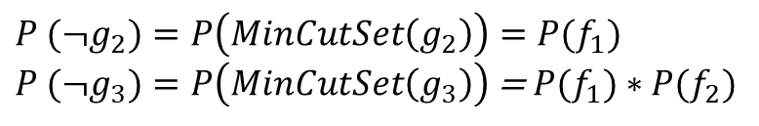
$${P (¬g}_{2})={P\left(MinCutSet\left(g_{2}\right)\right)=P(f}_{1})$$
${P (¬g}_{3})=P\left(MinCutSet\left(g_{3}\right)\right)$ = ${P(f}_{1})∗$ ${P(f}_{2})$
A naïve probability replacement:
Replace guarantees with probability of their MinCutSets
Roll computations from bottom up.
${P (¬g}_{1})$ = ${{P (¬g}_{2}{∧¬g}_{3})=[P(f}_{1})]∗{[P(f}_{1})∗$ ${P(f}_{2})]$
${P(f}_{1})∗$ ${P(f}_{2})$ >${ P(f}_{1}){∗P(f}_{1})∗$ ${P(f}_{2})$
Unsafe approximation: we report
lower probability than actual.

